Slide 1
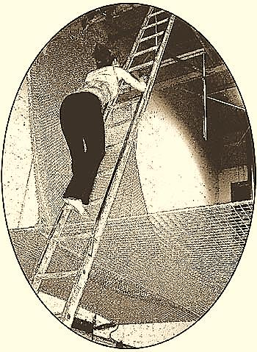
“How shall we escape, if we neglect so great salvation?”
Heb. 2:3

Slide 2



Note: Any videos in this presentation will only play online. After you download the slideshow, you will need to also download the videos from YouTube & add them back into your PowerPoint.
We present these messages at Bee Creek Park in College Station, TX.
If you would like to watch the video of the service with this message, click here:
http://campaignkerusso.org/videos
We would love to know more about the people who download our lessons & sermons. We invite you to email us & let us know where & how you use them.
info@ckbrazos.org

Slide 3
Following, is a famous tragic incident in America…
They died of cruel neglect!
Next Slide - Video:
The Triangle Shirtwaist Factory Fire →
Download Here: http://www.youtube.com/watch?v=XxycBCfMt_I

Slide 4
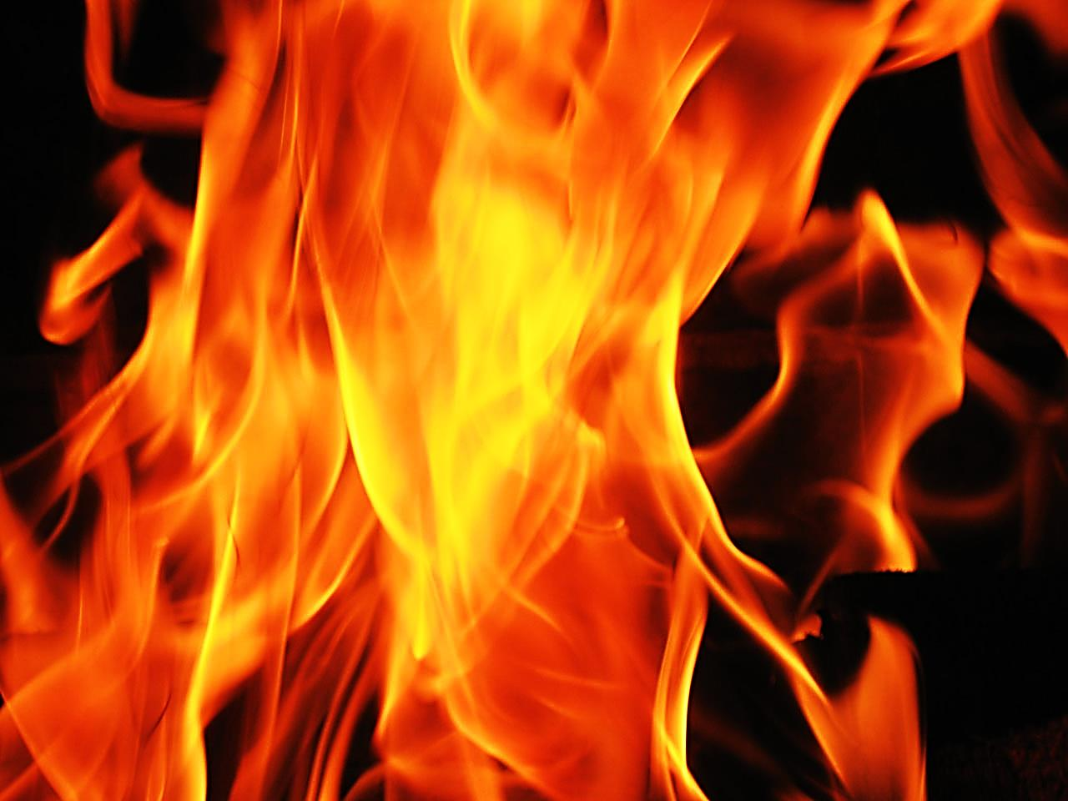
John’s Vision of the Fire to Come
“Those who emerge victorious will inherit these things. I will be their God, and they will be my sons and daughters.”
“But for the cowardly, the faithless, the vile, the murderers, those who commit sexual immorality, those who use drugs and cast spells, the idolaters and all liars—their share will be in the lake that burns with fire and sulfur. This is the second death.” Rev. 21:7,8

Slide 5
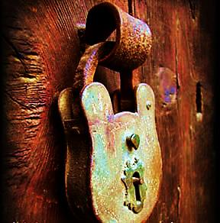
Man’s Plans Failed to Save at the Triangle Shirtwaist Factory Fire
The door was locked

Slide 6
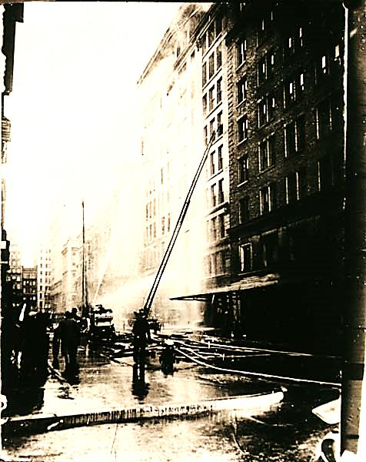
Man’s Plans Failed →
The ladders didn’t reach

Slide 7
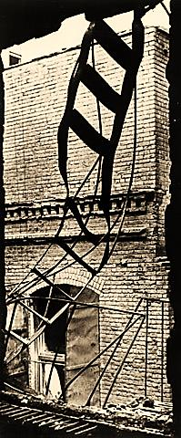
Man’s Plans Failed →
The fire escapes were too weak

Slide 8

Man’s Plans Failed …
The Net Broke!

Slide 9
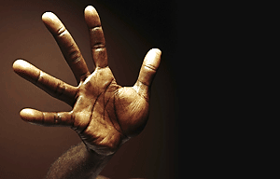
Man’s Plans Still Fail → Come Short
Other people (no matter how well meaning) cannot save us. Their reach is just too short.
No TV “Guru”
No Educator or Advisor
No Loved One

Slide 10
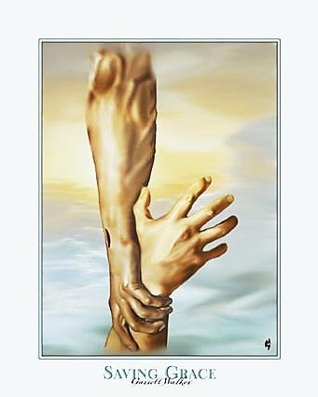
God’s Plan Saves → Long Reach
“Surely the arm of the LORD is not too short to save…”
Isa. 59:1
Only He can reach from Heaven to Earth.
Only He can reach deep into our hearts.

Slide 11
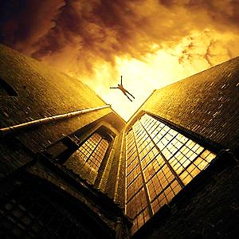
Man’s Plans Fail → Too Weak
We cannot save ourselves. Our “fire escapes” are too weak.
Good deeds & charity won’t save
New Year’s resolutions fail
Last minute conversions may not be possible

Slide 12
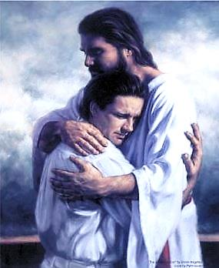
God’s Plan Saves →
His Love is Strong
“No power in the sky above or in the earth below--indeed, nothing in all creation will ever be able to separate us from the love of God that is revealed in Christ Jesus our Lord.” Rom. 8:39
No, not our sins, our past, our failures – nothing can separate us from God’s love.

Slide 13
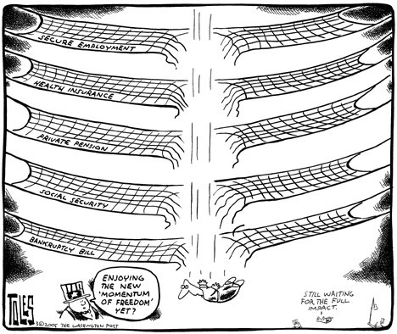
Man’s Plans Will Break
Human nets can’t save!
At best we can attempt to protect ourselves from financial ruin. But, no net of man’s making can save us from eternal hell fire.

Slide 14
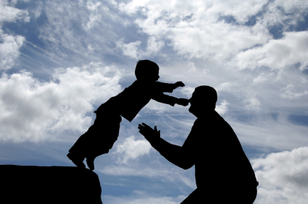
God’s Plan Saves
His net holds - We can jump into His strong hands and be saved.

Slide 15
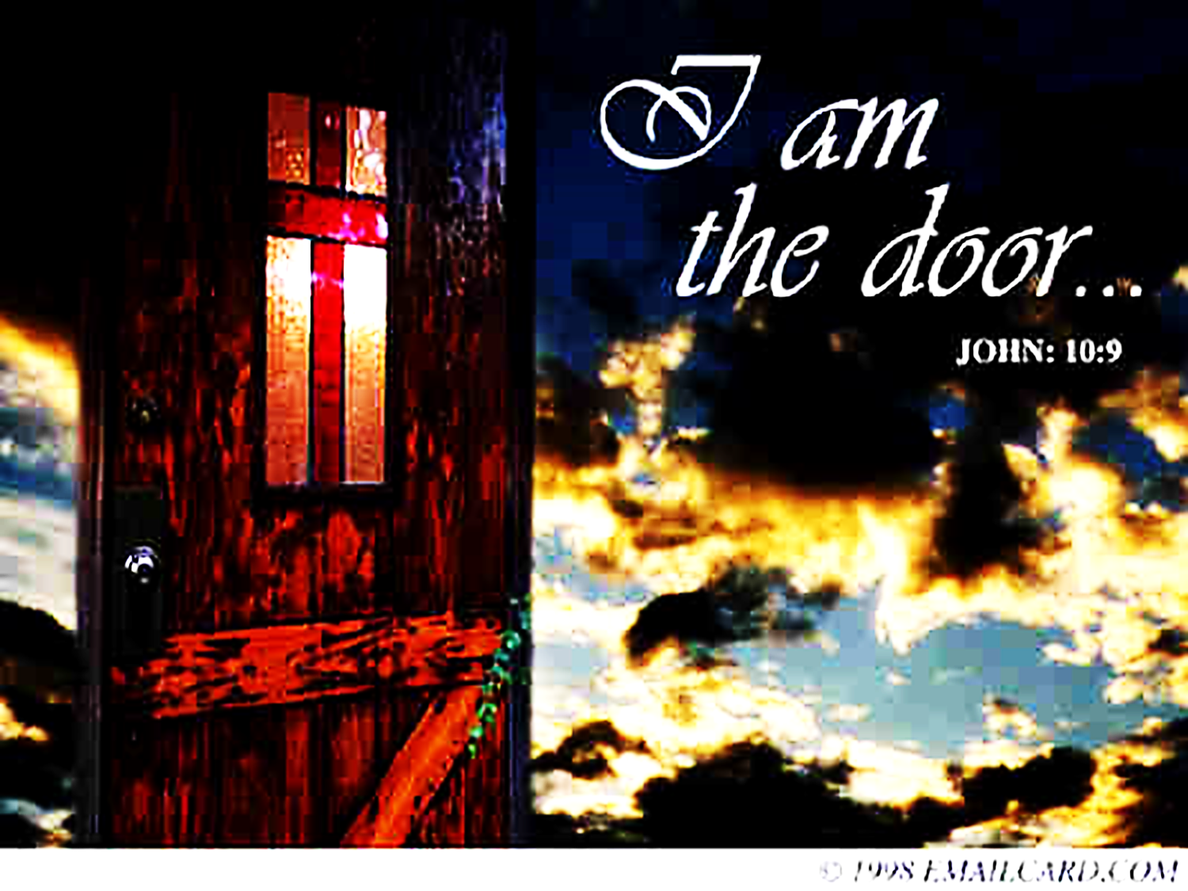

Slide 16
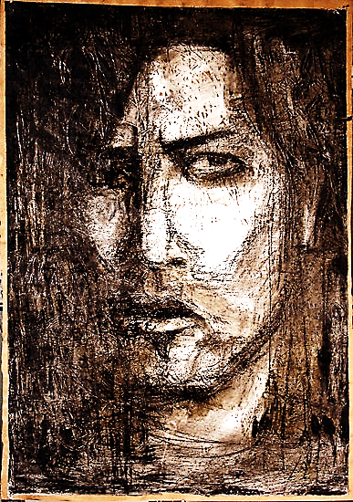
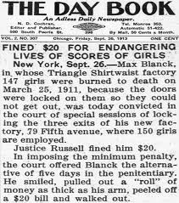
A Cruel Man Locked the Critical Door
The Door to Heaven is Locked by Cruel Unbelief

Slide 17
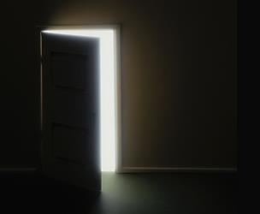
Only Jesus Saves
"I am the door; if anyone enters through Me, he will be saved…”
John 10:9

Slide 18
Soon, we will all face judgment…
Those who believe and enter through the DOOR (Jesus) will be saved.
Other people can’t save us – they can’t even save themselves
Many famous people live & die unhappily
Money can’t save – severe depression is highest in the richest countries
Our real enemy is unbelief. It locks the only Door. The Door we need to escape! Our Great Salvation!

Slide 19
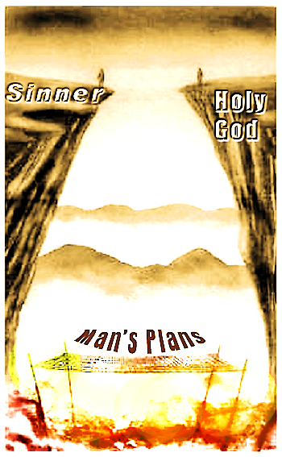
Man has NO safety-net strong enough to save him from the eternal ‘Lake of Fire.’

Slide 20
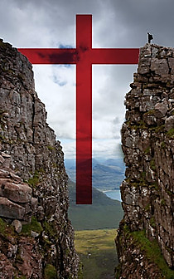
Jesus Alone is our Salvation
“How shall we escape, if we neglect so great salvation?”
Heb. 2:3

Slide 21

What is the Sinner‘s Prayer?
This is a prayer we can pray when we are ready to admit we are sinners and need Christ’s forgiveness.
It must be prayed with faith in our hearts and a readiness to have a life-changing encounter with Jesus Christ.

Slide 22
You Should Pray this Prayer If :
If you never have before
You have in the past, but you think you would mean it more today
You have been walking afar off and you want to come back
You want to set an example and show others how it is done
You just like to give your heart to Jesus again & again

Slide 23
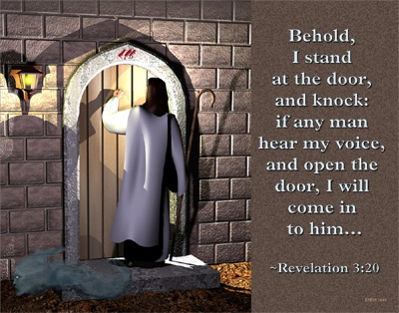

Slide 24

Dear Jesus,
I know I am a sinner & need your forgiveness.
I believe you died for my sins.
I now turn from sin.
Come into my heart I pray.
Do you want to meet Jesus as your savior right now?
Do you believe He died to save you from your sins & that He rose from the dead?
Do you believe that He is waiting to save you right now?

Slide 25


“But to all who believed him and accepted him, he gave the right to become children of God.” John 1:12

Slide 26



Slide 27


“If you declare with your mouth that Jesus is
Lord, and believe in your heart that God raised him from the dead, you
will be
saved.” Rom. 10:9
What did you learn today?
How does this lesson apply to our lives today?
What do you want to say about Jesus today?

Slide 28

“Draw near to God, and He will draw near to you…
…Cleanse your hands, you sinners, and make your hearts pure, you who are half-hearted towards God.” James 4:8 WNT

Slide 29
Note: Any videos in this presentation will only play online. After you download the slideshow, you will need to also download the videos from YouTube & add them back into your PowerPoint.
We present these messages at Bee Creek Park in College Station, TX.
If you would like to watch the video of the service with this message, click here:
http://campaignkerusso.org/videos
We would love to know more about the people who download our lessons & sermons. We invite you to email us & let us know where & how you use them.
info@ckbrazos.org

Slide 30
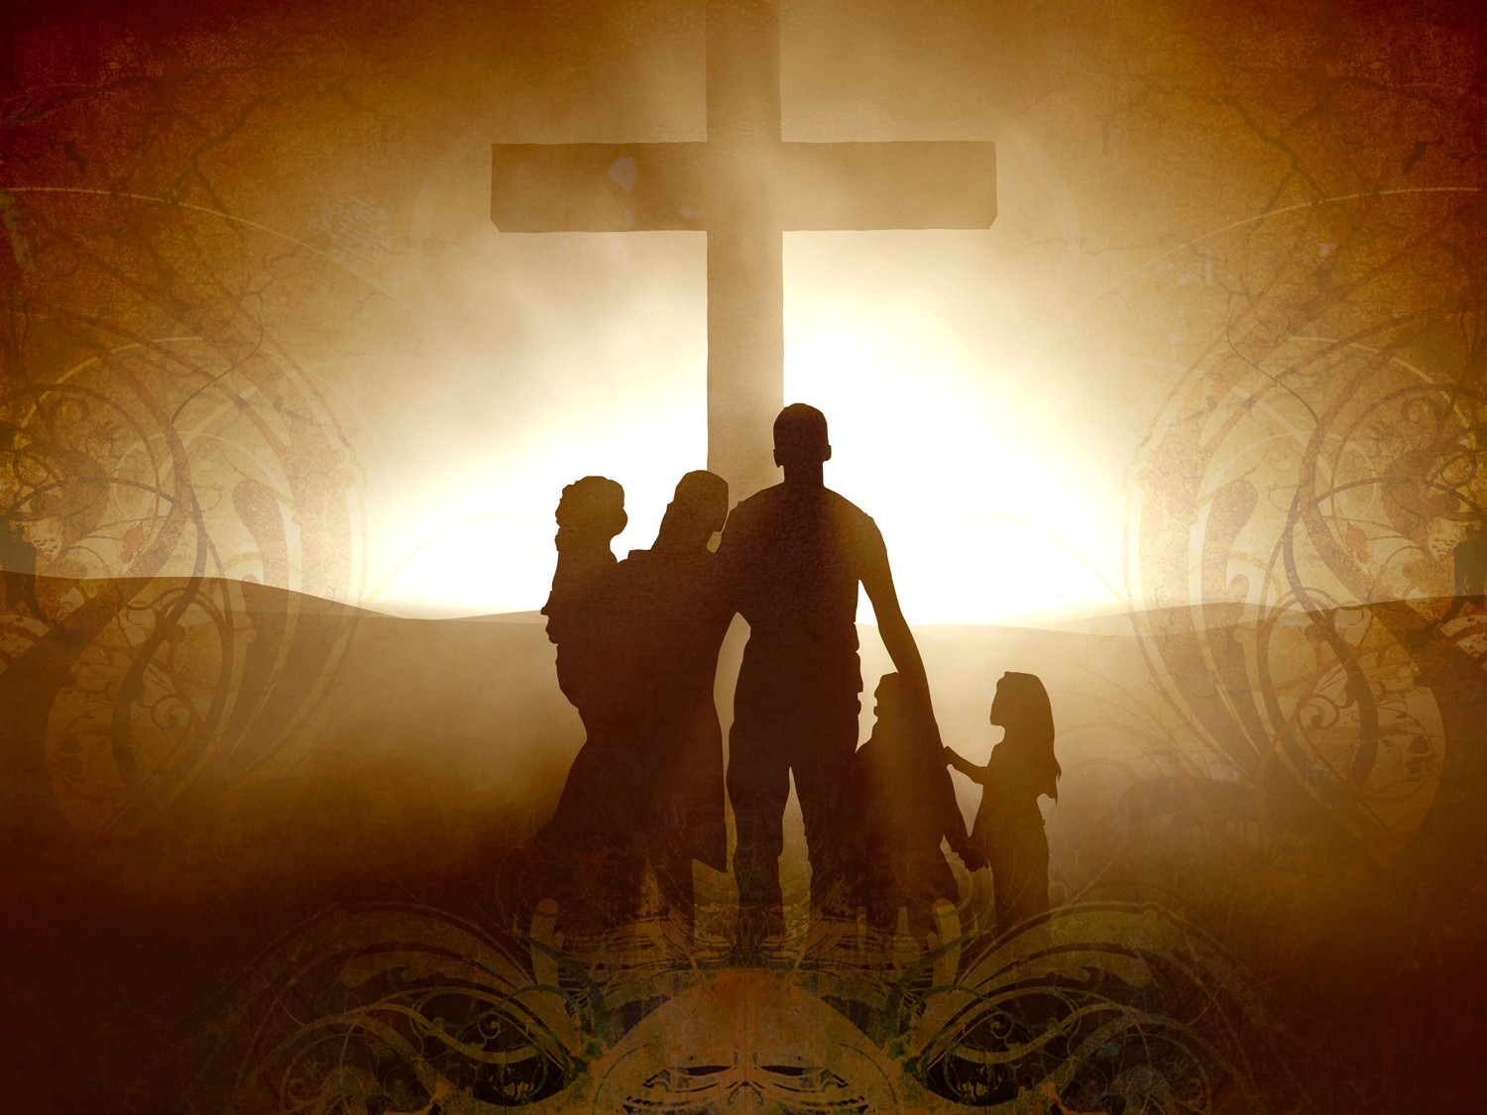
Welcome to Aggieland Faith
Family Style Worship

Slide 31

CURRENT SCHEDULE:
See www.Aggielandfaith.org
SATURDAY —
At Bee Creek Park
2:00-4:00pm: Through the bible with felt-board stories – plus hot-dogs & drinks
SUNDAY —
At Bee Creek Park
2:00-4pm: Free snacks, drinks, kids crafts, prizes, singing & bible preaching

Slide 32


Would You Like Prayer or Bible Study at Your House?
Personal Prayer:
We can come to your home & pray with you, or you can email us when you need prayer.
Home Bible Study:
We will come to your home & hold
a bible study for you & your friends.
Bible Party:
We will hold a Kid’s Bible Party:
You provide the food & kids - we
will do the bible fun & stories.

Slide 33

Would You Like Visitation?
We will visit a friend, loved one in the hospital or in prison to pray for them & share Christ with them.
Contact: info@aggielandfaith.org

Slide 34

www.aggielandfaith.org
Go here to see pictures & videos
Go here to subscribe to e-mails about changes & cancellations

Slide 35
Note: Any videos in this presentation will only play online. After you download the slideshow, you will need to also download the videos from YouTube & add them back into your PowerPoint.
We present these messages at Bee Creek Park in College Station, TX.
If you would like to watch the video of the service with this message, click here:
http://campaignkerusso.org/videos
We would love to know more about the people who download our lessons & sermons. We invite you to email us & let us know where & how you use them.
info@ckbrazos.org

