Slide 1
The Trinity

Slide 2
Note: Any videos in this presentation will only play online. After you download the slideshow, you will need to also download the videos from YouTube & add them back into your PowerPoint.
We present these messages at Bee Creek Park in College Station, TX. If you would like to watch the video of the service with this message, click here:
http://campaignkerusso.org/?p=6647
We would love to know more about the people who download our lessons & sermons. We invite you to email us & let us know where & how you use them.
info@ckbrazos.org

Slide 3
What is water?

Slide 4
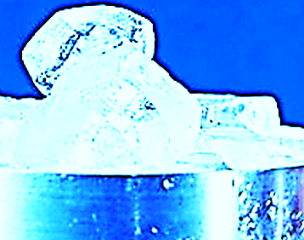
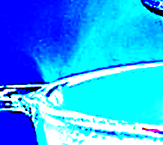
Which one is Water?
Water, the “Ice”
Water, the “Liquid”
Water, the “Steam”

Slide 5
THEY ARE ALL WATER!

Slide 6
What is an egg?

Slide 7
Which one is Egg?
Egg, the “Shell”
Egg, the “Yolk”
Egg, the “White”

Slide 8
They are all egg!

Slide 9
Who is God?

Slide 10
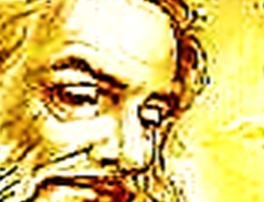
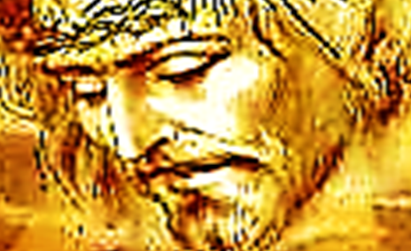
Which one is God?
God, the “Father”
God, the “Son”
God, the “Holy Spirit”

Slide 11
THEY ARE ALL GOD!

Slide 12
God is Three in One

Slide 13
Next Slide - Video: What is the Trinity? → Download Here: http://www.youtube.com/watch?v=n-1AdUwbWLw

Slide 14
Craft

Slide 15
What is the Sinner‘s Prayer?
This is a prayer we can pray when we are ready to admit we are sinners and need Christ’s forgiveness.
It must be prayed with faith in our hearts and a readiness to have a life-changing encounter with Jesus Christ.

Slide 16
You Should Pray this Prayer If :
If you never have before
You have in the past, but you think you would mean it more today
You have been walking afar off and you want to come back
You want to set an example and show others how it is done
You just like to give your heart to Jesus again & again

Slide 18
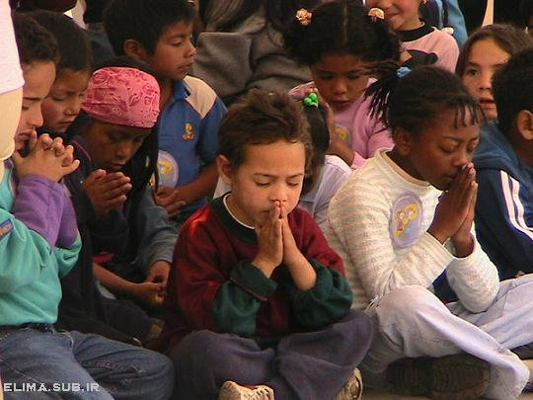
Dear Jesus,
I know I am a sinner & need your forgiveness.
I believe you died for my sins.
I now turn from sin.
Come into my heart I pray.
Do you want to meet Jesus as your savior right now?
Do you believe He died to save you from your sins & that He rose from the dead?
Do you believe that He is waiting to save you right now?

Slide 19
“But to all who believed him and accepted him, he gave the right to become children of God.” John 1:12

Slide 21
“If you declare with your mouth that Jesus is
Lord, and believe in your heart that God raised him from the dead, you
will be
saved.” Rom. 10:9
What did you learn today?
How does this lesson apply to our lives today?
What do you want to say about Jesus today?

Slide 22
“Draw near to God, and He will draw near to you…
…Cleanse your hands, you sinners, and make your hearts pure, you who are half-hearted towards God.” James 4:8 WNT

Slide 23
Note: Any videos in this presentation will only play online. After you download the slideshow, you will need to also download the videos from YouTube & add them back into your PowerPoint.
We present these messages at Bee Creek Park in College Station, TX. If you would like to watch the video of the service with this message, click here:
http://campaignkerusso.org/?p=6647
We would love to know more about the people who download our lessons & sermons. We invite you to email us & let us know where & how you use them.
info@ckbrazos.org

Slide 24
Welcome to Aggieland Faith Family Style Worship

Slide 25
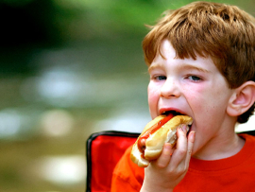
CURRENT SCHEDULE: See www.Aggielandfaith.org
SATURDAY —
At Bee Creek Park
2:00-4:00pm: Through the bible with felt-board stories – plus hot-dogs & drinks
SUNDAY —
At Bee Creek Park
2:00-4pm: Free snacks, drinks, kids crafts, prizes, singing & bible preaching

Slide 26
Would You Like Prayer or Bible Study at Your House?
Personal Prayer: We can come to your home & pray with you, or you can email us when you need prayer.
Home Bible Study: We will come to your home & hold a bible study for you & your friends.
Bible Party: We will hold a Kid’s Bible Party: You provide the food & kids - we will do the bible fun & stories.

Slide 27
Would You Like Visitation?
We will visit a friend, loved one in the hospital or in prison to pray for them & share Christ with them.
Contact: info@aggielandfaith.org

Slide 28
www.aggielandfaith.org
Go here to see pictures & videos
Go here to subscribe to e-mails about changes & cancellations

Slide 29
Note: Any videos in this presentation will only play online. After you download the slideshow, you will need to also download the videos from YouTube & add them back into your PowerPoint.
We present these messages at Bee Creek Park in College Station, TX. If you would like to watch the video of the service with this message, click here:
http://campaignkerusso.org/?p=6647
We would love to know more about the people who download our lessons & sermons. We invite you to email us & let us know where & how you use them.
info@ckbrazos.org

