Slide 1

Are Believers

Slide 2

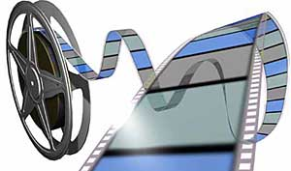

Note: Any videos in this presentation will only play online. After you download the slideshow, you will need to also download the videos from YouTube & add them back into your PowerPoint.
We present these messages at Bee Creek Park in College Station, TX.
If you would like to watch the video with this message, click here:
http://campaignkerusso.org/?p=7555
We would love to know more about the people who download our lessons & sermons. We invite you to email us & let us know where & how you use them.
info@ckbrazos.org

Slide 3
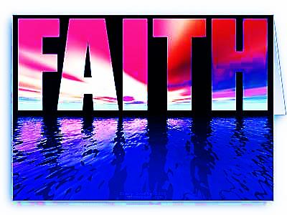
Believers Aren’t Really Bonkers
They Just Believe God & Obey

Slide 4
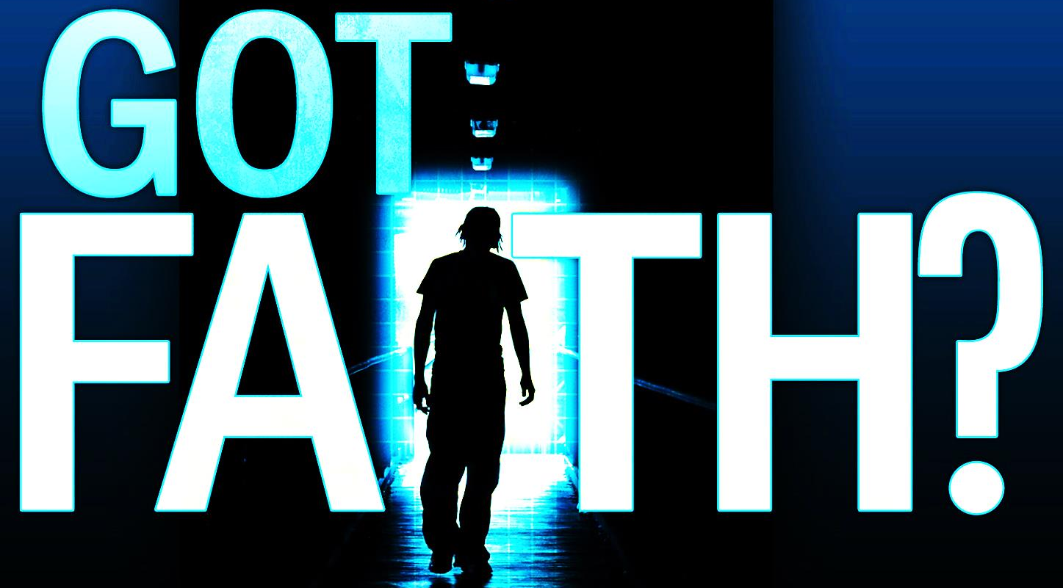
“To have faith is to be sure of the things we hope for, to be certain of the things we cannot see.” Hebrews 11:1

Slide 5
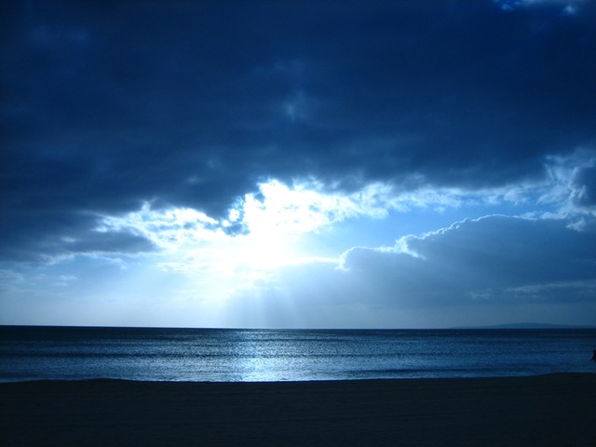

Faith embraces the unseen promises of God as being more real than anything else.

Slide 6
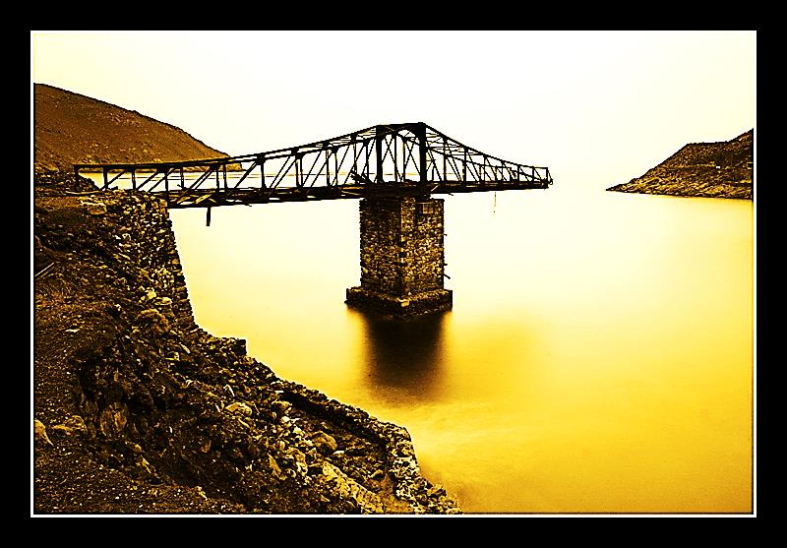
Believers seem bonkers because they begin things they can’t possibly finish.
Human Wisdom Says: “Never begin something you can’t finish.”

Slide 7
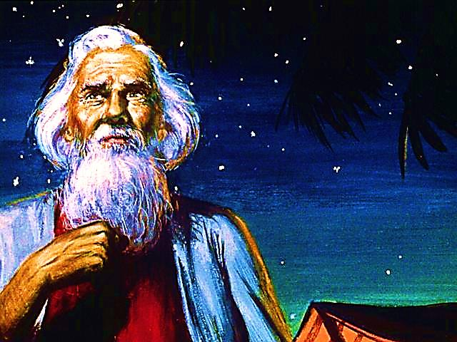
Abraham Started Something He Couldn’t Possibly Finish
“It was faith that made Abraham obey when God called him to go out to a country which God had promised to give him.
He left his own country without knowing where he was going…
He lived in tents, as did Isaac and Jacob, who received the same promise from God.
For Abraham was waiting for the city which God has designed and built…” Heb.11:8-10

Slide 8
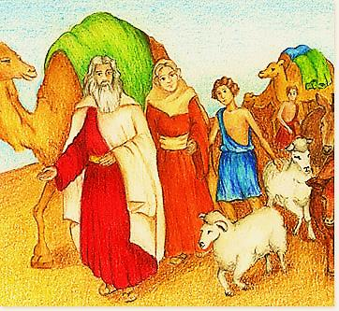
“It was in faith that all these persons died. They did not receive the things God had promised, but from a long way off they saw them and welcomed them, and admitted openly that they were foreigners and refugees on earth.” Heb. 11:13,14

Slide 9
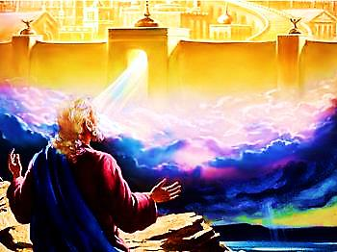
“Those who say such things make it clear that they are looking for a country…
…it was a better country they longed for, the heavenly country.
And so God is not ashamed
for them to call him their God, because he has prepared a city for them.” Heb. 11
Abraham teaches us how to walk in faith.
Yes, he “arrived” → to a place of faith!!!

Slide 10
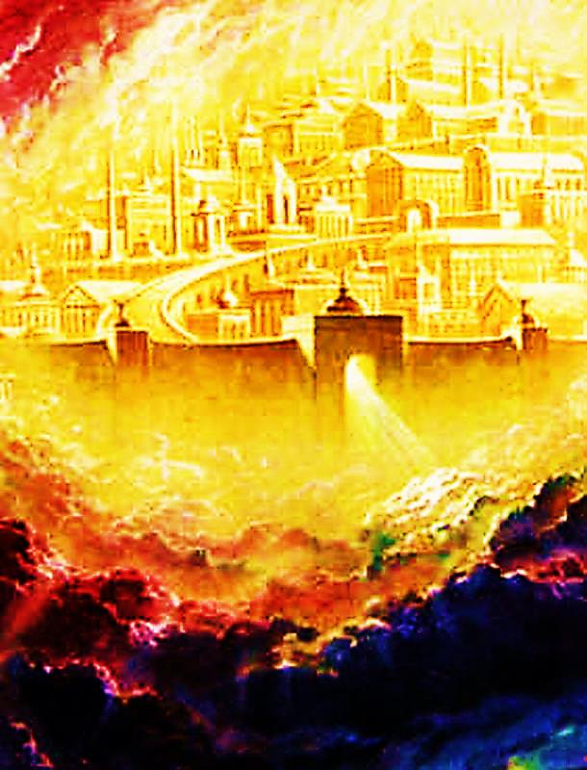
“And I saw a new heaven and a new earth…
And I heard a great voice out of heaven saying, Behold, the tabernacle of God is with men, and he will dwell with them, and they shall be his people, and God himself shall be with them, and be their God.” Rev. 21:1&3

Slide 11
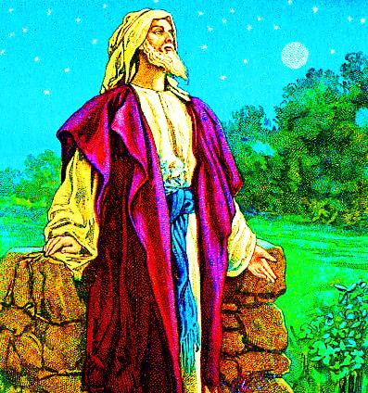
Abraham, Isaac and Jacob seemed bonkers because they were looking for a city that only God could build and only God knew the way.
All they did was believe and obey God.
They started a journey that only God could finish.

Slide 12
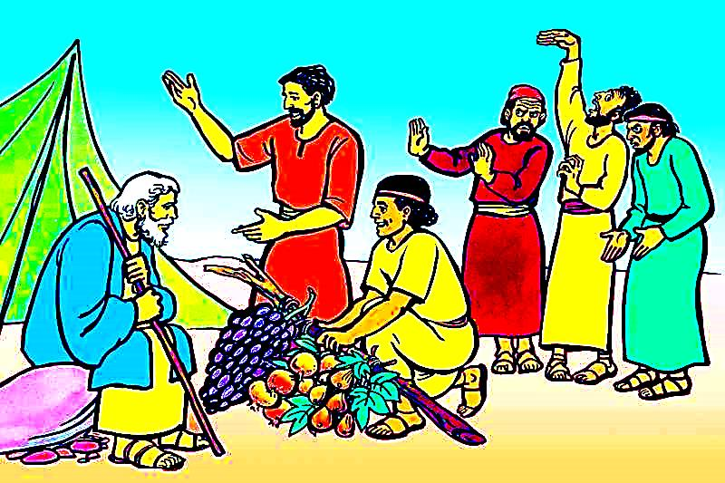
Believers seem bonkers because they battle enemies they can’t possibly defeat.
Human Wisdom Says: “Pick your battles.”

Slide 13
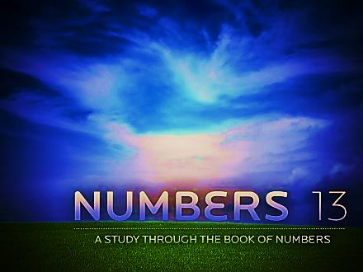
“… “We went to the land where you sent us. It is a land filled with many good things… But the people living there are very powerful…
…Then Caleb said, “We should go up and take that land for ourselves. We can easily take that land.”
But the men that had gone with him said, “We can’t fight those people! They are much stronger than we are… They looked at us like we were little grasshoppers…” Numbers 13:27-31

Slide 14
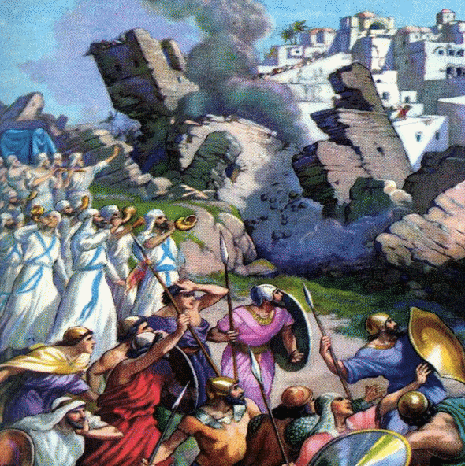
“It was faith that made the walls of Jericho fall down after the Israelites had marched around them for seven days.”
Heb. 11:30

Slide 15
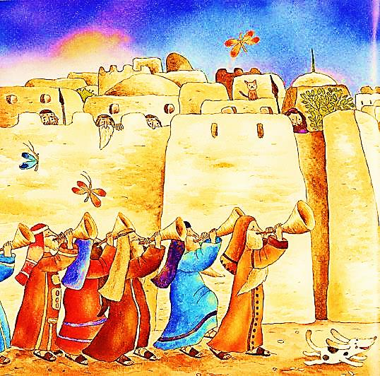
The Israelites seemed to be bonkers because they believed God and fought a battle they KNEW they could not win.
All they did was believe and obey God.
They fought a battle that only God could win.

Slide 16
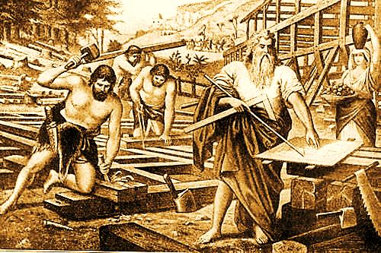
Believers may seem bonkers because they believe in blessings they can’t see.
Human Wisdom Says: “Seeing is believing.”

Slide 17
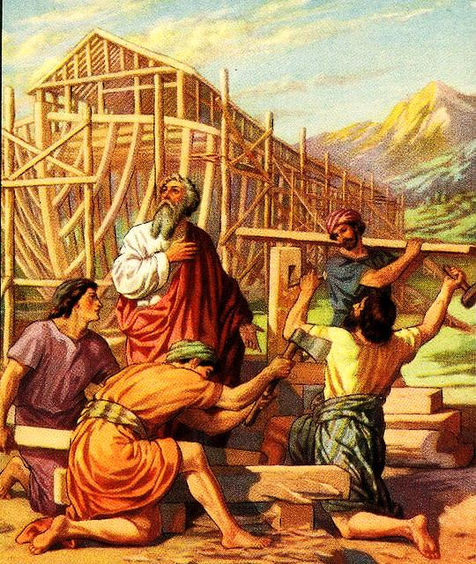
“It was faith that made Noah hear God's warnings about things in the future that he could not see. He obeyed God and built a boat in which he and his family were saved.”
Hebrews 11:7

Slide 18
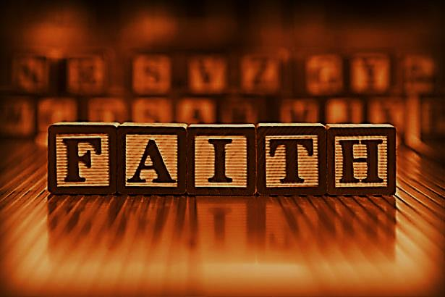
Believers trust they have blessings they may never see or fully understand in this life.
They may not understand how God is using them or why He has them doing what they are doing.
Noah believed for a blessing that only God fully understood.
Noah just obeyed.

Slide 19
Video: Thank You for Giving → See Next Slide
Download this video here: http://www.youtube.com/watch?v=UFrdJ2V3r7Y&feature=player_embedded

Slide 20
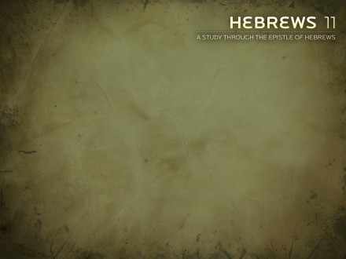
We are not able, in our own strength, to finish what God asks us to do for Him; nor can we fight His battles without His help.
We may not even understand what He is doing or why He has us doing what we are doing. But, if we believe and obey, we will one day, understand how our part fits into His overall plan.

Slide 21
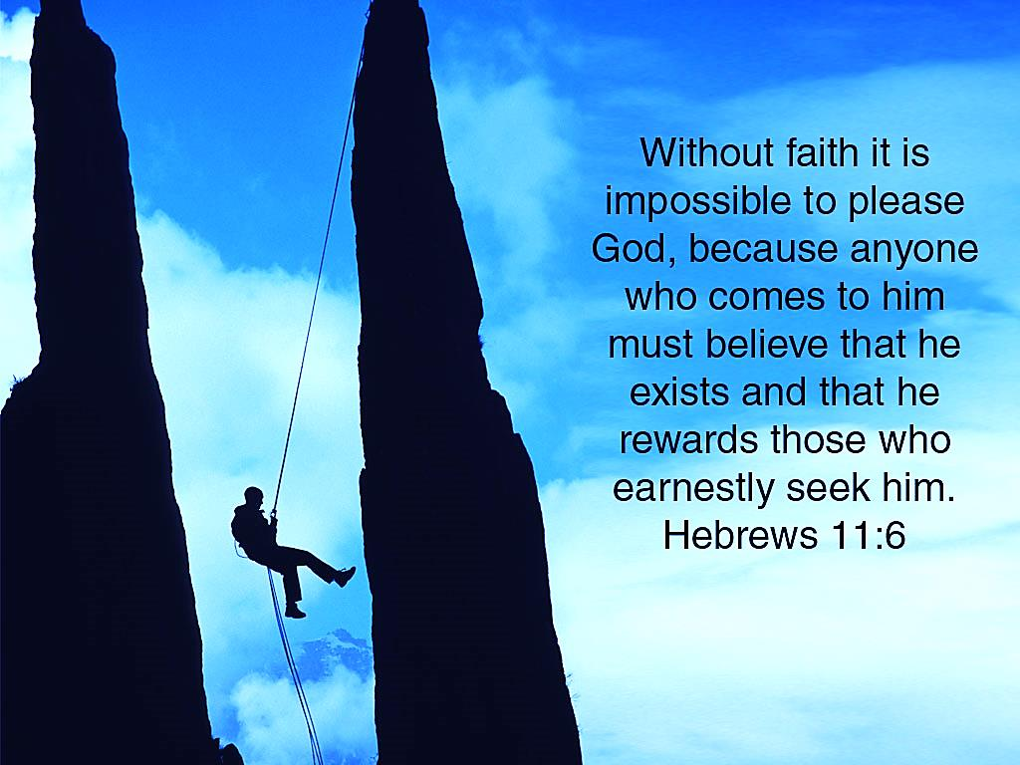
If Believers are bonkers,
then God likes bonkers!

Slide 22

What is the Sinner‘s Prayer?
This is a prayer we can pray when we are ready to admit we are sinners and need Christ’s forgiveness.
It must be prayed with faith in our hearts and a readiness to have a life-changing encounter with Jesus Christ.
You Should Pray this Prayer If :
If you never have before
You have in the past, but you think you would mean it more today
You have been walking afar off and you want to get closer
You want to set an example and show others how it is done
You just like to give your heart to Jesus again & again

Slide 23

Dear Jesus,
I know I am a sinner & need your forgiveness.
I believe you died for my sins.
I now turn from sin & ask you into my heart.
Do you want to meet Jesus & know Him as your personal savior?
Do you believe Jesus died to save you from your sins & that He rose from the dead?
Do you believe that He is waiting to save you right now?

Slide 24


“But to all who believed him and accepted him, he gave the right to become children of God.” John 1:12

Slide 25



Slide 26


“If you declare with your mouth that Jesus is
Lord, and believe in your heart that God raised him from the dead, you
will be
saved.”
Rom. 10:9
What did you learn today?
How does this lesson apply to us today?
What do you want to say about Jesus today?

Slide 27

“Draw near to God, and He will draw near to you…
…Cleanse your hands, you sinners, and make your hearts pure, you who are half-hearted towards God.” James 4:8 WNT

Slide 28
Note: Any videos in this presentation will only play online. After you download the slideshow, you will need to also download the videos from YouTube & add them back into your PowerPoint.
We present these messages at Bee Creek Park in College Station, TX.
If you would like to watch the video with this message, click here: http://campaignkerusso.org/?p=7555
We would love to know more about the people who download our lessons & sermons. We invite you to email us & let us know where & how you use them.
info@ckbrazos.org

Slide 29
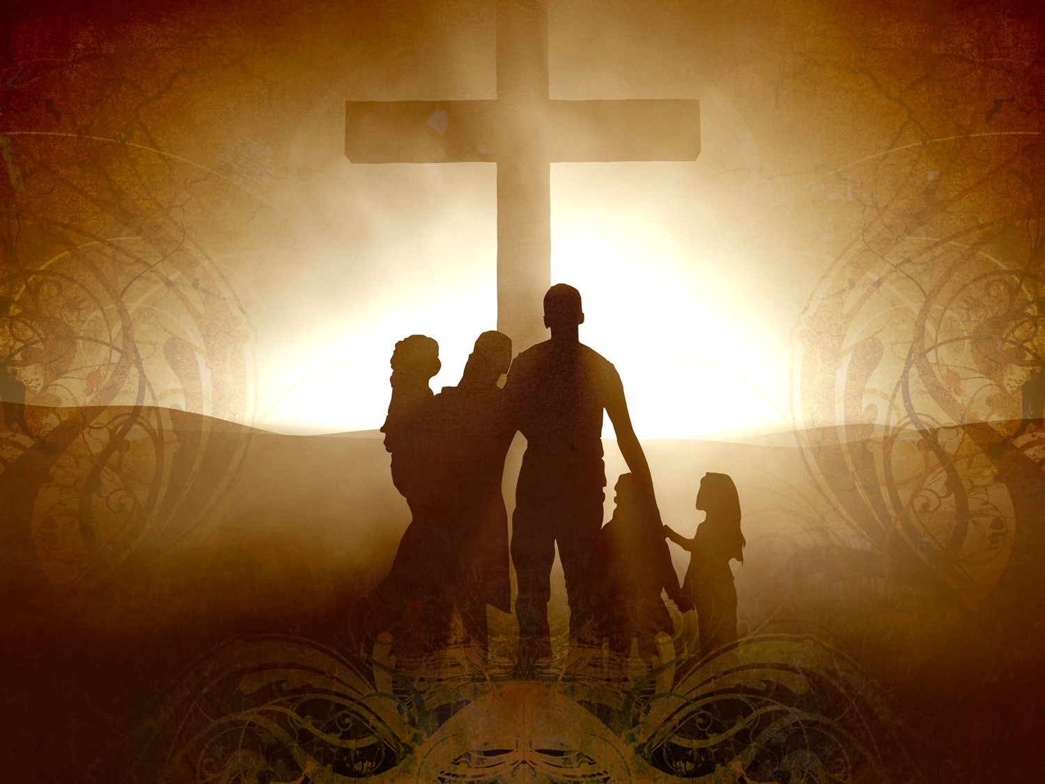
Welcome to Aggieland Faith
Family Style Worship

Slide 30

CURRENT SCHEDULE:
See www.Aggielandfaith.org
SATURDAY —
At Bee Creek Park
2:00-4:00pm: Through the bible with felt-board stories – plus hot-dogs & drinks
SUNDAY —
At Bee Creek Park
2:00-4pm: Free snacks, drinks, kids crafts, prizes, singing & bible preaching

Slide 31


Would You Like Prayer or Bible Study at Your House?
Personal Prayer:
We can come to your home & pray with you, or you can email us when you need prayer.
Home Bible Study:
We will come to your home & hold
a bible study for you & your friends.
Bible Party:
We will hold a Kid’s Bible Party:
You provide the food & kids - we
will do the bible fun & stories.

Slide 32

Would You Like Visitation?
We will visit a friend, loved one in the hospital or in prison to pray for them & share Christ with them.
Contact: info@aggielandfaith.org

Slide 33
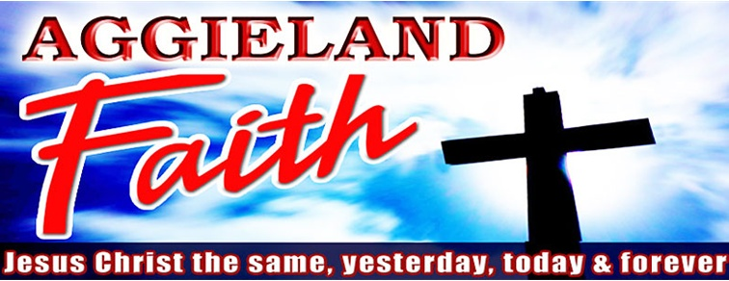
www.aggielandfaith.org
Go here to see pictures & videos
Go here to subscribe to e-mails about changes & cancellations

Slide 34
Note: Any videos in this presentation will only play online. After you download the slideshow, you will need to also download the videos from YouTube & add them back into your PowerPoint.
We present these messages at Bee Creek Park in College Station, TX.
If you would like to watch the video with this message, click here: http://campaignkerusso.org/?p=7555
We would love to know more about the people who download our lessons & sermons. We invite you to email us & let us know where & how you use them.
info@ckbrazos.org

