Slide 1
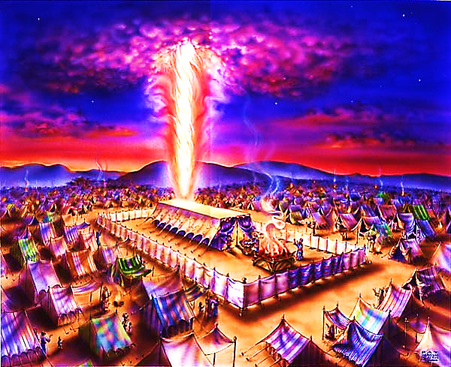
The Tabernacle in the Wilderness pt. 1

Slide 2



Note: Any videos in this presentation will only play online. After you download the slideshow, you will need to also download the videos from YouTube & add them back into your PowerPoint.
We present these messages at Bee Creek Park in College Station, TX.
If you would like to watch the video with this message, click here: http://campaignkerusso.org/?p=7587
We would love to know more about the people who download our lessons & sermons. We invite you to email us & let us know where & how you use them.
info@ckbrazos.org

Slide 3
Why a
Tabernacle?
To temporally dwell with His people and illustrate how He planned to make it a permanent living situation.

Slide 4
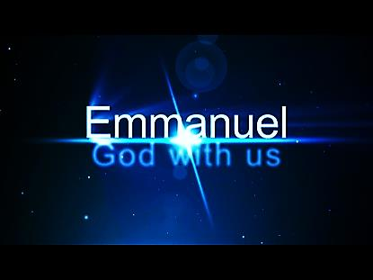
This is all God
Cares About!

Slide 5
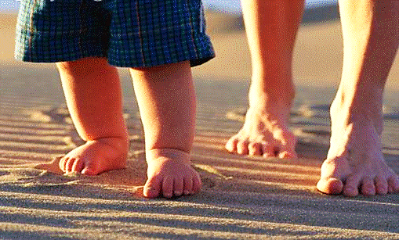
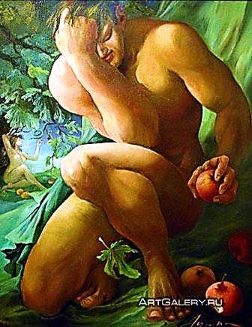
Sin destroyed our relationship with God…
God wants it back!

Slide 6
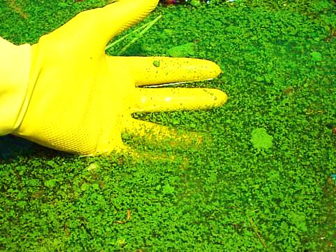
Sin Cannot Dwell in the Presence of God
God’ dwelling is not like a scum pond…
full of germs and waste…
SIN!

Slide 7
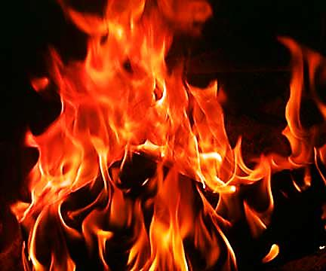
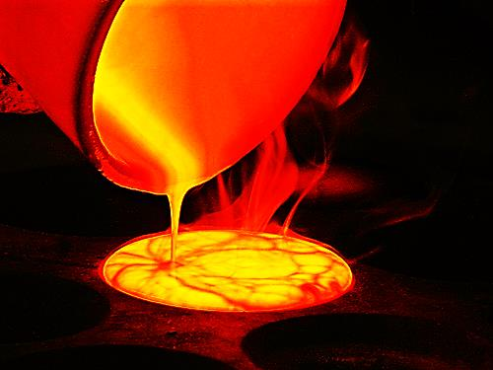
He is Like a Refining Fire

Slide 8
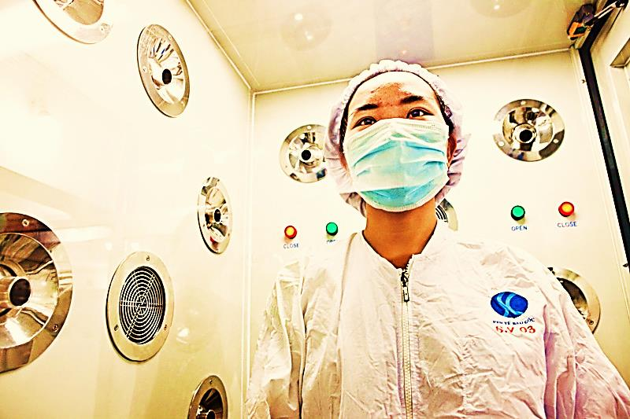
Or a Sci-fi Sanitation Room

Slide 9
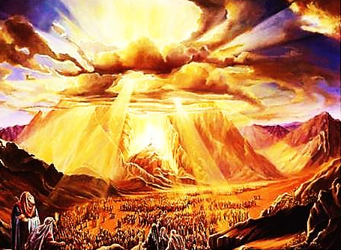
“When the people saw the thunder and lightning… and saw the mountain in smoke, they trembled with fear. They stayed at a distance and said to Moses, ‘Speak to us yourself and we will listen. But do not have God speak to us or we will die.’”
Ex. 20: 18, 19

Slide 10
God’s temporal solution was The Tabernacle… His ultimate solution was the Gospel of Jesus Christ.

Slide 11
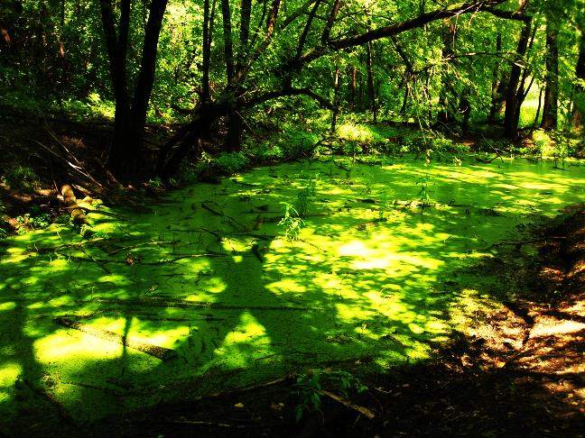
The Cross is God’s
Final Sanitation Plan

Slide 12
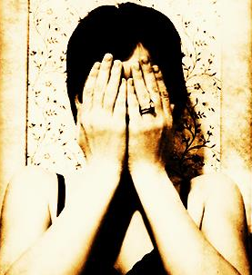
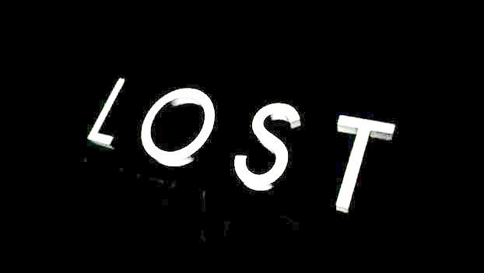
We hid from God…
He asked: “Where are you?”
He pursues…
He draws…
He calls…
He searches out

Slide 13
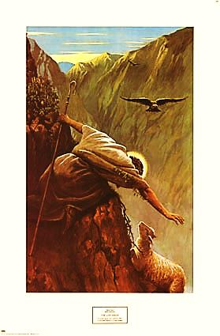
God’s pursuit of us!
He expresses it as having lost something – a sheep – a coin – a son

Slide 14
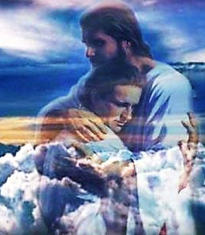
Tell the Lord ‘where you are’ right now…
Just do that much!
That is how you begin with God

Slide 15
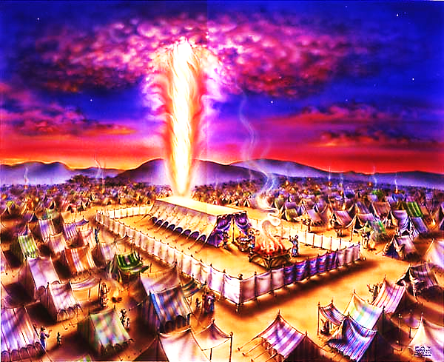
The Beauty of God’s Consistency
The bible is one story… It is the story of God trying to make a place where He can dwell with men.
From Exodus to Revelation

Slide 16
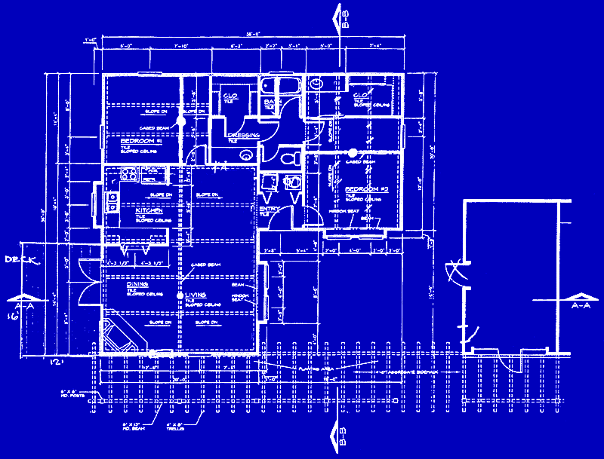
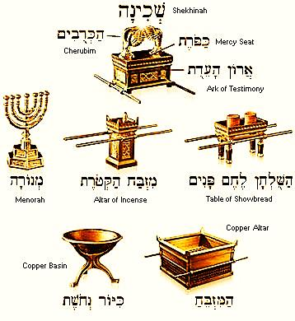
The Tabernacle is actually God’s blueprint of His gospel plan.

Slide 17
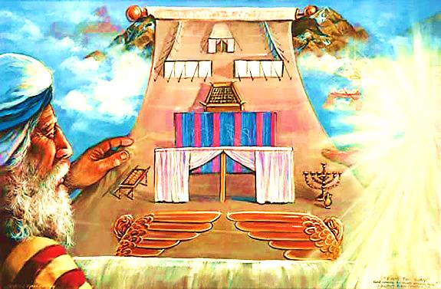
The original tabernacle exists in Heaven.
A copy (shadow) was built by Moses.
The original tabernacle existed before time and will continue after time.

Slide 18
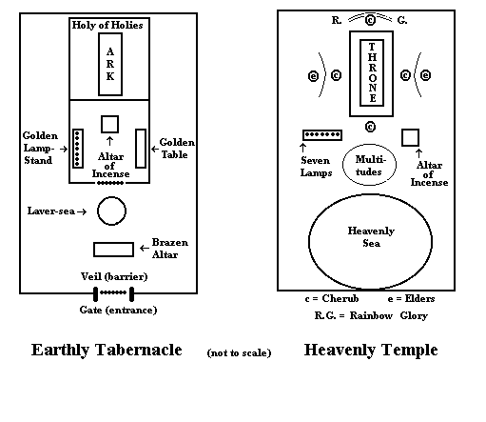

Slide 19
The perfect universe looks like this: God dwells with man!
Sin destroys this… God repairs it.
That’s the whole bible story… that’s the Gospel.
God wants us to come home and dwell with Him.

Slide 20

The Key to the Bible:
The Glory of God’s Son
“All the scriptures concerning Himself.”
The whole bible is about Jesus and the cross and the plan of salvation
n

Slide 21

What is the Sinner‘s Prayer?
This is a prayer we can pray when we are ready to admit we are sinners and need Christ’s forgiveness.
It must be prayed with faith in our hearts and a readiness to have a life-changing encounter with Jesus Christ.
You Should Pray this Prayer If :
If you never have before
You have in the past, but you think you would mean it more today
You have been walking afar off and you want to get closer
You want to set an example and show others how it is done
You just like to give your heart to Jesus again & again

Slide 22

Dear Jesus,
I know I am a sinner & need your forgiveness.
I believe you died for my sins.
I now turn from sin & ask you into my heart.
Do you want to meet Jesus & know Him as your personal savior?
Do you believe Jesus died to save you from your sins & that He rose from the dead?
Do you believe that He is waiting to save you right now?

Slide 23


“If you declare with your mouth that Jesus is
Lord, and believe in your heart that God raised him from the dead, you
will be
saved.”
Rom. 10:9
What did you learn today?
How does this lesson apply to us today?
What do you want to say about Jesus today?

Slide 24
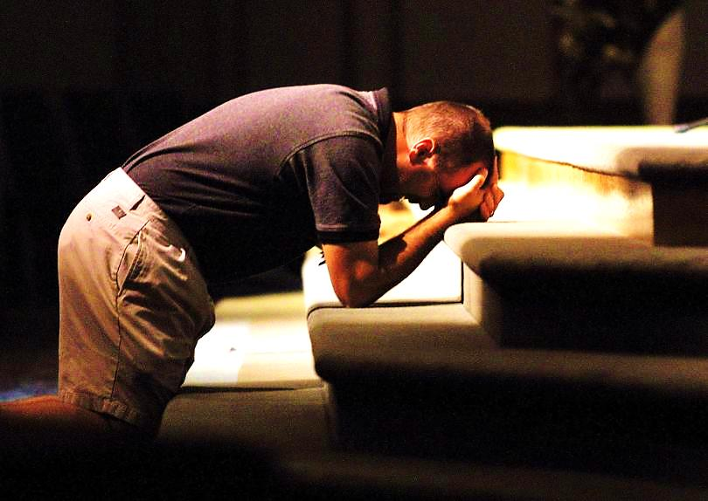
“Draw near to God, and He will draw near to you…
…Cleanse your hands, you sinners, and make your hearts pure, you who are half-hearted towards God.” James 4:8 WNT

Slide 25
Note: Any videos in this presentation will only play online. After you download the slideshow, you will need to also download the videos from YouTube & add them back into your PowerPoint.
We present these messages at Bee Creek Park in College Station, TX.
If you would like to watch the video with this message, click here: http://campaignkerusso.org/?p=7587
We would love to know more about the people who download our lessons & sermons. We invite you to email us & let us know where & how you use them.
info@ckbrazos.org

Slide 26
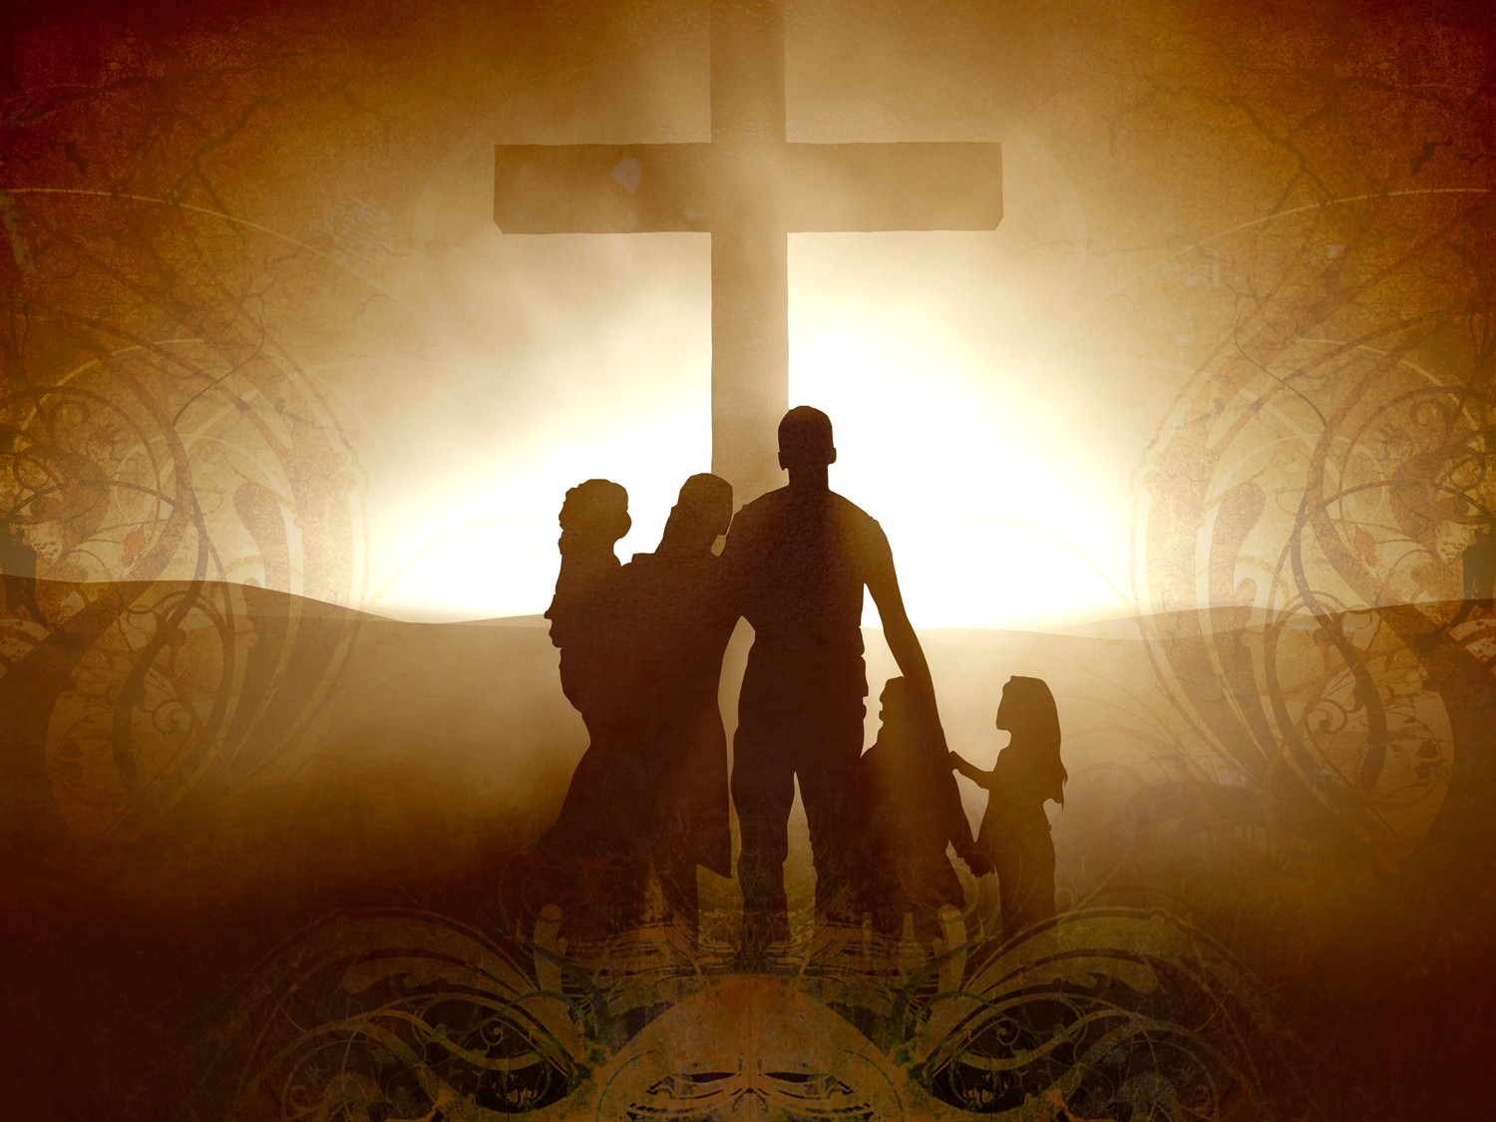
Welcome to Aggieland Faith
Family Style Worship

Slide 27

CURRENT SCHEDULE:
See www.Aggielandfaith.org
SATURDAY —
At Bee Creek Park
2:00-4:00pm: Through the bible with felt-board stories – plus hot-dogs & drinks
SUNDAY —
At Bee Creek Park
2:00-4pm: Free snacks, drinks, kids crafts, prizes, singing & bible preaching

Slide 28


Would You Like Prayer or Bible Study at Your House?
Personal Prayer:
We can come to your home & pray with you, or you can email us when you need prayer.
Home Bible Study:
We will come to your home & hold
a bible study for you & your friends.
Bible Party:
We will hold a Kid’s Bible Party:
You provide the food & kids - we
will do the bible fun & stories.

Slide 29

Would You Like Visitation?
We will visit a friend, loved one in the hospital or in prison to pray for them & share Christ with them.
Contact: info@aggielandfaith.org

Slide 30

www.aggielandfaith.org
Go here to see pictures & videos
Go here to subscribe to e-mails about changes & cancellations

Slide 31
Note: Any videos in this presentation will only play online. After you download the slideshow, you will need to also download the videos from YouTube & add them back into your PowerPoint.
We present these messages at Bee Creek Park in College Station, TX.
If you would like to watch the video with this message, click here: http://campaignkerusso.org/?p=7587
We would love to know more about the people who download our lessons & sermons. We invite you to email us & let us know where & how you use them.
info@ckbrazos.org

