Slide 1
Prayer is Knocking on God’s Door
vv

Slide 2
Note: Any videos in this presentation will only play online. After you download the slideshow, you will need to also download the videos from YouTube & add them back into your PowerPoint.
We present these messages at Bee Creek Park in College Station, TX. Watch the video with this message here:
http://campaignkerusso.org/?p=7719
We would love to know more about the people who download our lessons & sermons. We invite you to email us & let us know where & how you use them.
info@ckbrazos.org

Slide 3
Prayer is Knocking on God’s Door We Must Ask With a Pure Heart

Slide 4
Ask God for Good Things
“We are sure that if we ask anything that He wants us to have, He will hear us.” 1 John 5:14

Slide 5
“Or if you do ask, you do not receive because your reasons for asking are wrong. You want these things only to please yourselves.” James 4:3

Slide 6
We Must Ask With a Pure Heart
Not a Selfish Heart (blind to the needs of others)

Slide 7
Prayer is Knocking on God’s Door We Must Ask With Believing Heart

Slide 8
Ask With Faith
“All things you ask for in prayer, you will receive if you have faith.” Matthew 21:22

Slide 9
We Must Ask With a Faith-Filled Heart
Not a Doubt – Filled Heart

Slide 10
Prayer is Knocking on God’s Door We Must Ask and Never Quit

Slide 11
Keep Asking and Don’t Give Up

Slide 12
“Then Jesus said to them, ‘Suppose someone has a friend. He goes to him at midnight. He says, 'Friend, lend me three loaves of bread.
A friend of mine on a journey has come to stay with me. I have nothing for him to eat.'

Slide 13
"Then the one inside answers, 'Don't bother me. The door is already locked. My children are with me in bed. I can't get up and give you anything.'
"I tell you, that person will not get up. And he won't give the man bread just because he is his friend. But because the man keeps on asking, he will get up. He will give him as much as he needs.

Slide 14
Ask and it will be given to you Seek and you will find Knock and the door will be opened to you

Slide 15
Video: A Friend at Midnight See Next Slide → Download Here: http://www.youtube.com/watch?v=1fnElIVTOrs

Slide 16
Video: A Midnight Snack See Next Slide → Download Here: http://www.youtube.com/watch?v=yIeQVvFfeug

Slide 17
Video: The Persistent Friend See Next Slide → Download Here: http://www.youtube.com/watch?v=QDY7SrwbDh8

Slide 18
We Must Ask With Persistent Heart
Not a Quitter’s Heart

Slide 19
Prayer is Knocking on God’s Door Ask Friends to Join You

Slide 20
Ask Your Friends to Join You in Prayer
“Where two or three people meet together in my name, I am there with them." Matthew 18:20

Slide 21
Ask Friends to Join You in Prayer

Slide 22
Prayer is Knocking on God’s Door Pray With Your Whole Heart

Slide 23
Pray With Your Whole Heart
…The earnest (heartfelt, continued) prayer of a righteous man makes tremendous power available… James 5:16

Slide 24
We Must Ask With a Whole Heart
Not Half-Hearted

Slide 25
What is the Sinner‘s Prayer?
This is a prayer we can pray when we are ready to admit we are sinners and need Christ’s forgiveness.
It must be prayed with faith in our hearts and a readiness to have a life-changing encounter with Jesus Christ.

Slide 27
John Wesley’s Testimony
“…the preacher was describing the change which God works in the heart through faith in Christ and I felt my heart strangely warmed.”
Disciple’s Testimony
“They said to each other, ‘Did not our hearts burn within us while he talked to us on the road, while he opened to us the Scriptures?’”

Slide 28
A prayer of faith → Pray this prayer if :
If you never have before
You have in the past, but you think it would mean more today
You have been walking afar off and you want to come back
You want to set an example & show others how it is done
You just like to give your heart to Jesus again & again
Faith

Slide 29
We Declare Our Faith Publicly Because Jesus Declared His LOVE Publicly
“If you stand before others and are willing to say you believe in me, then I will tell my Father in heaven that you belong to me.” Mat 10:32

Slide 30
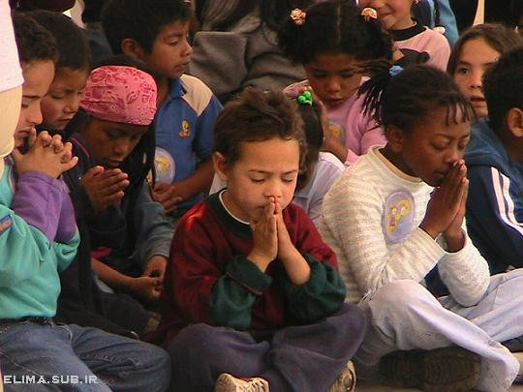
Dear Jesus,
I know I am a sinner & need your forgiveness.
I believe you died for my sins.
I now turn from sin.
Come into my heart I pray.
Do you want to meet Jesus as your savior right now?
Do you believe He died to save you from your sins & that He rose from the dead?
Do you believe that He is waiting to save you right now?

Slide 31
“But some people did accept him. They believed in him, and he gave them the right to become children of God.” John 1:12

Slide 33
“If you openly say, ‘Jesus is Lord’ and believe in your heart that God raised him from death, you will be saved.”
Rom. 10:9
What did you learn today?
What is the meaning of the name-tag?
What have you neen thinking about God lately?
What do you want to tell the world about Jesus?

Slide 34
“Draw near to God, and He will draw near to you…
…Cleanse your hands, you sinners, and make your hearts pure, you who are half-hearted towards God.” James 4:8 WNT

Slide 35
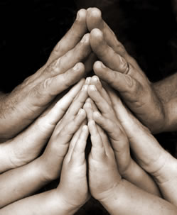
Close in Prayer

Slide 36
Note: Any videos in this presentation will only play online. After you download the slideshow, you will need to also download the videos from YouTube & add them back into your PowerPoint.
We present these messages at Bee Creek Park in College Station, TX. If you would like to watch the video of the service with this message, click here:
http://campaignkerusso.org/?p=7719
We would love to know more about the people who download our lessons & sermons. We invite you to email us & let us know where & how you use them.
info@ckbrazos.org

Slide 37
Welcome to Aggieland Faith Family Style Worship

Slide 38
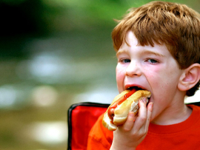
CURRENT SCHEDULE: See www.Aggielandfaith.org
SATURDAY —
At Bee Creek Park
2:00-4:00pm: Through the bible with felt-board stories – plus hot-dogs & drinks
SUNDAY —
At Bee Creek Park
2:00-4pm: Free snacks, drinks, kids crafts, prizes, singing & bible preaching

Slide 39
Would You Like Prayer or Bible Study at Your House?
Personal Prayer: We can come to your home & pray with you, or you can email us when you need prayer.
Home Bible Study: We will come to your home & hold a bible study for you & your friends.
Bible Party: We will hold a Kid’s Bible Party: You provide the food & kids - we will do the bible fun & stories.

Slide 40
Would You Like Visitation?
We will visit a friend, loved one in the hospital or in prison to pray for them & share Christ with them.
Contact: info@aggielandfaith.org

Slide 41
www.aggielandfaith.org
Go here to see pictures & videos
Go here to subscribe to e-mails about changes & cancellations

Slide 42
Note: Any videos in this presentation will only play online. After you download the slideshow, you will need to also download the videos from YouTube & add them back into your PowerPoint.
We present these messages at Bee Creek Park in College Station, TX. If you would like to watch the video of the service with this message, click here:
http://campaignkerusso.org/?p=7719
We would love to know more about the people who download our lessons & sermons. We invite you to email us & let us know where & how you use them.
info@ckbrazos.org

