Slide 1
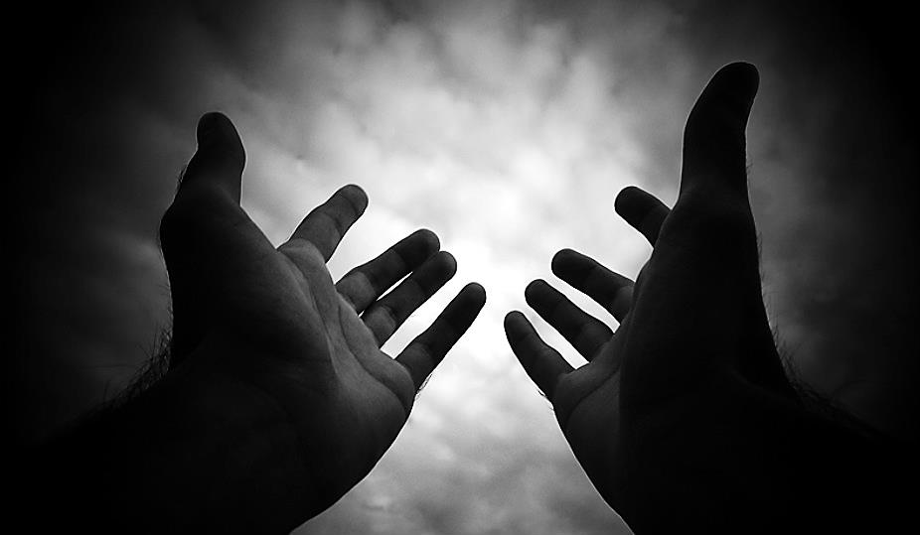
Birthing & Launching Ministries & Movements (Part 1)
Part 1

Slide 2
Note: Any videos in this presentation will only play online. After you download the slideshow, you will need to also download the videos from YouTube & add them back into your PowerPoint.
We present these messages at Bee Creek Park in College Station, TX. If you would like to watch the video of the service with this message, click here:
http://campaignkerusso.org/?p=10532
We would love to know more about the people who download our lessons & sermons. We invite you to email us & let us know where & how you use them.
info@ckbrazos.org

Slide 3
Next Slide → Song: God Has a Plan For Me Download Here: http://youtu.be/78jXwLQ9QWI

Slide 4
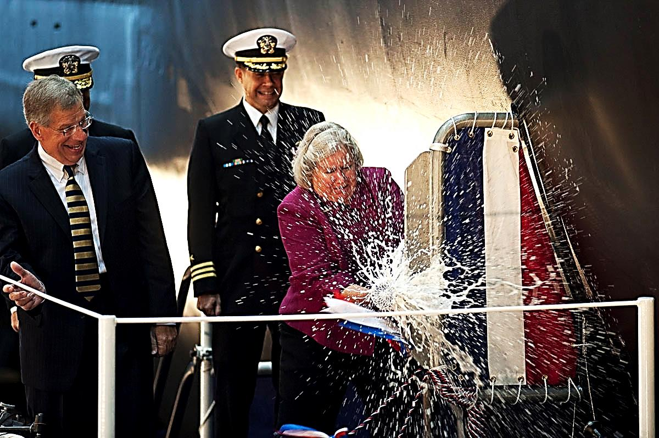
A ship is launched when it is ready.

Slide 5
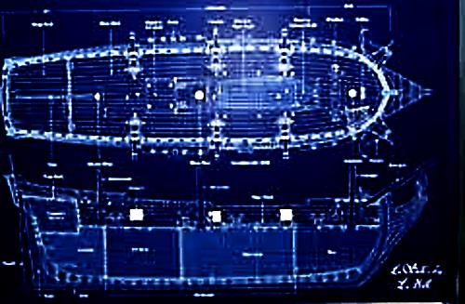
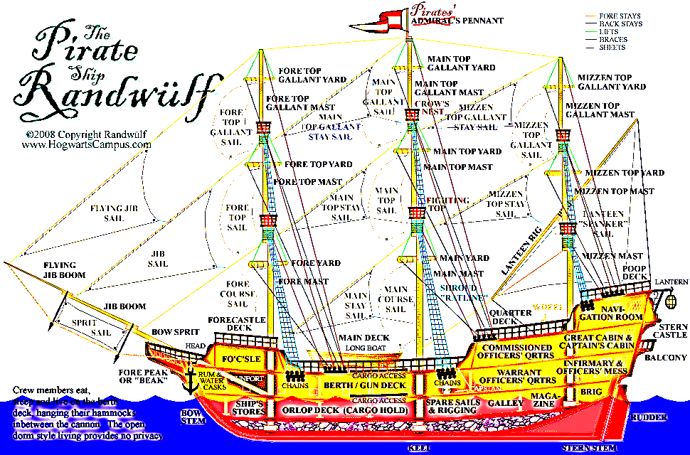
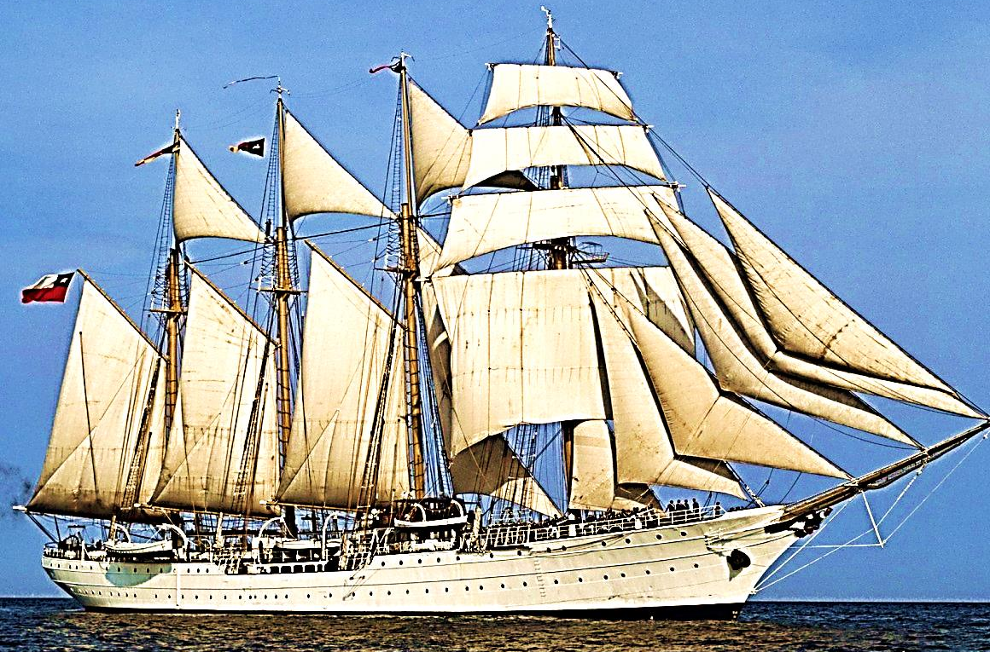
From seeing the need, to concept,
to planning, to hard work, and on to launching.

Slide 6
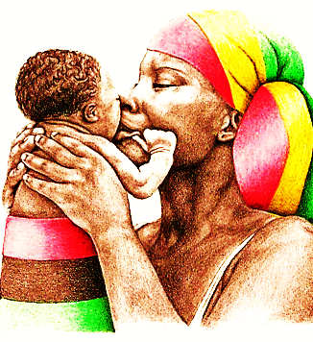
A mother’s job is to love and launch her child.

Slide 7
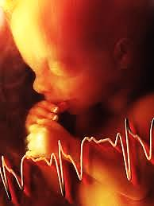
Human birth is a picture of the launching process.
The child begins life near the mother’s heart -- protected, growing and developing.

Slide 8
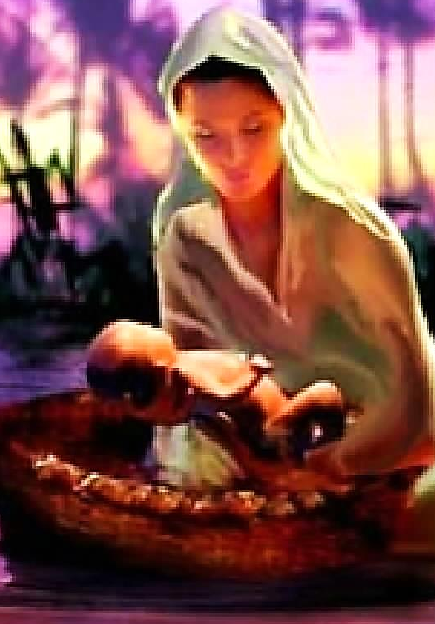
Eventually, birth will come and that which has been conceived will be launched.
Moses’ mother launched her precious son down the Nile toward his life’s mission.
(This however, was symbolic, for he was given back to her to nurture until his real time had come.)

Slide 9
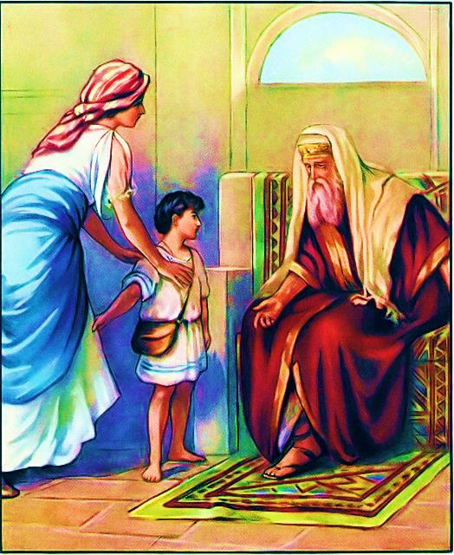
Hannah took her young son Samuel to the Temple to fulfill his mission.

Slide 10
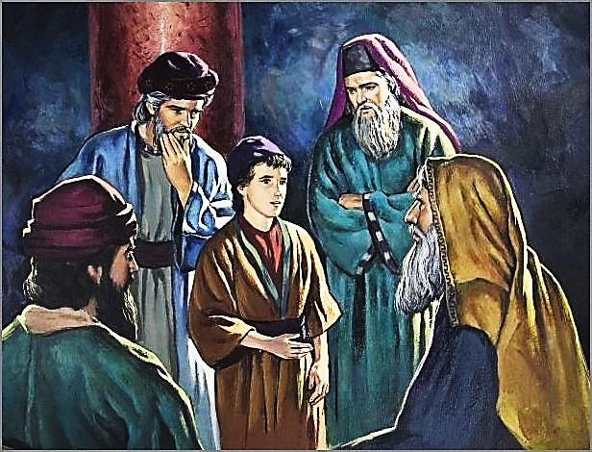
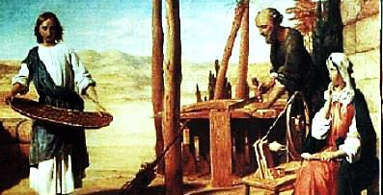
Jesus was ready to be launched at 12 yrs. old, but he humbled himself in submission to his parents until God’s time.

Slide 11
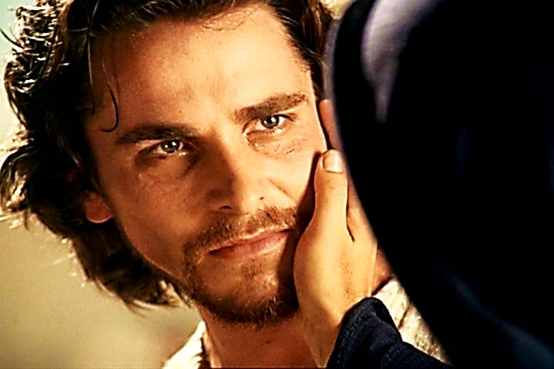
Mary understood she would have to let go of her Son & give Him to His destiny – painful!.

Slide 12
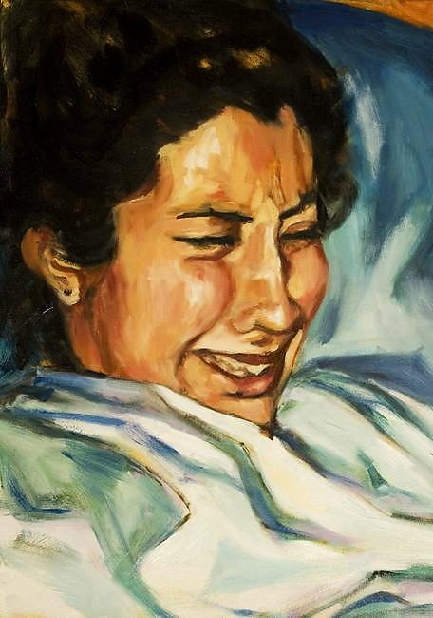
Birthing is painful – it is the act of pushing something away.

Slide 13
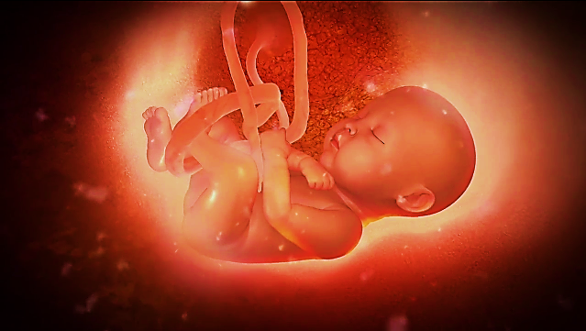
The mother’s heart is deserted.
The womb is left behind.

Slide 14
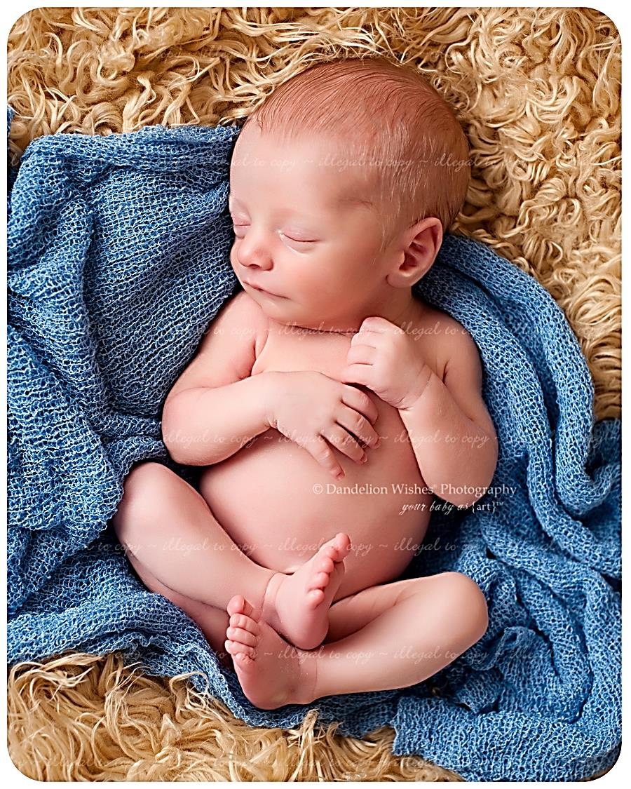
That child, which is birthed will have its own journey to embark.
This may be a human child, a project, a campaign, a ministry or even a movement.

Slide 15
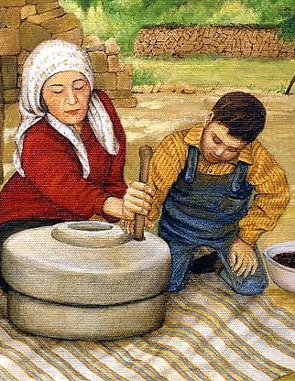
The mother has a role for a season.
She protects, nurtures and trains.

Slide 16
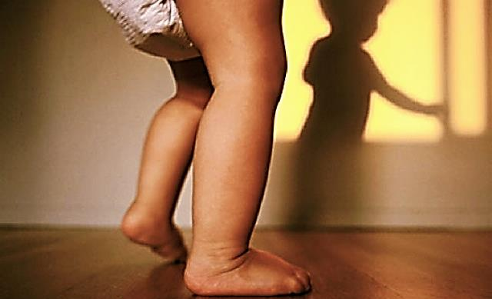
At some point the child takes on a life of its own & is only influenced by the our training.

Slide 17
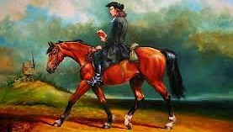
John Wesley had to make a choice to let go of total control, and train students to preach. His mother convinced him to launch students.

Slide 18
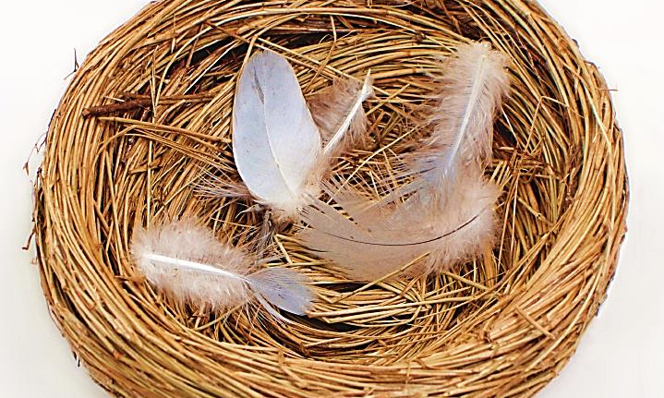
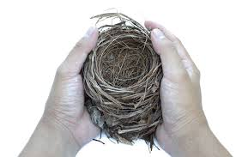
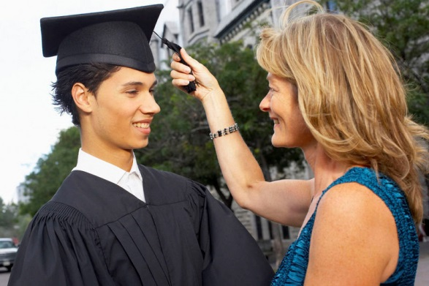
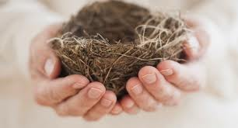
The mother is left behind, not forgotten but no longer holding or protecting.

Slide 19
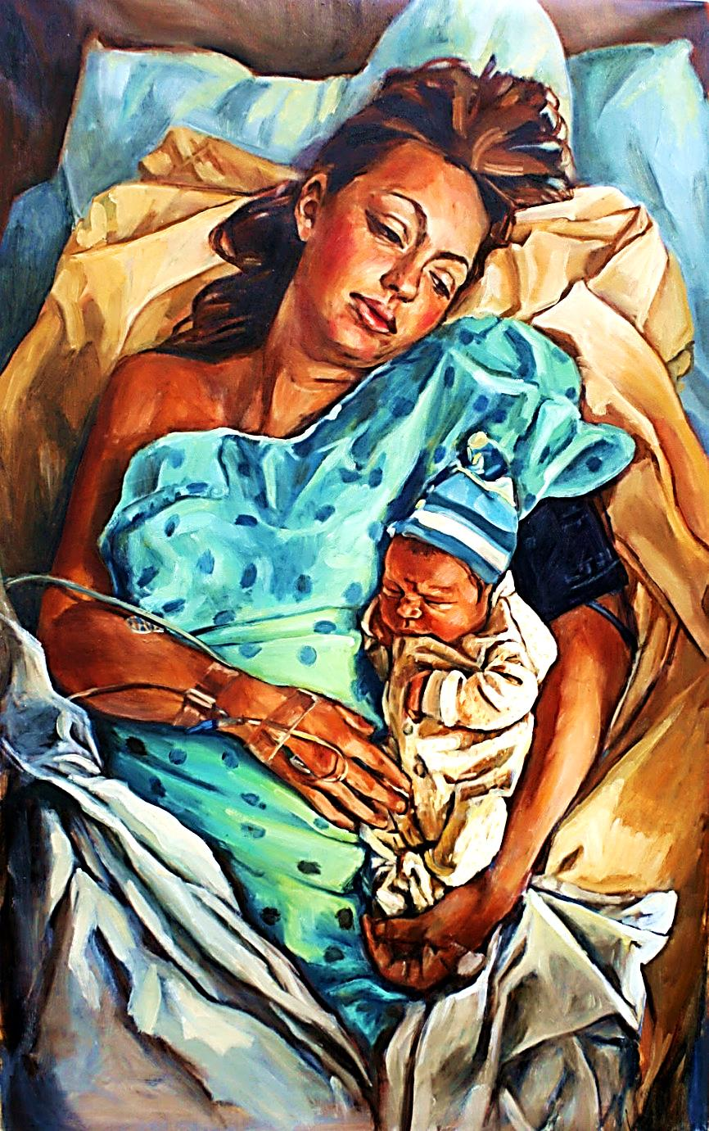
“A woman, when she gives birth to a child, has grief (anguish, agony) because her time has come. But when she has delivered the child, she no longer remembers her pain (trouble, anguish) because she is so glad that a man (a child, a human being) has been born into the world.” John 16:21 (AMP)

Slide 20
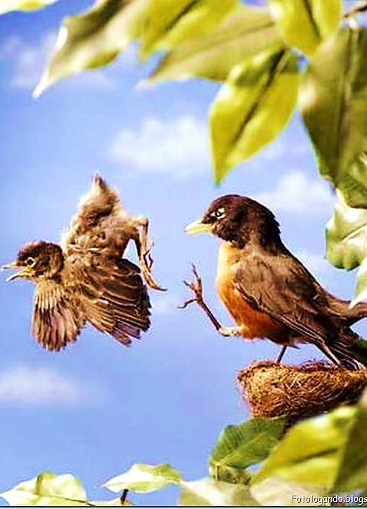
Sometimes there is Failure to Launch
Some babies don’t want to launch.
Mother birds put them out or even put thorns in the nest.

Slide 21
“Pain has come to the people like the pain of childbirth, but they are like a child who resists being born. The moment of birth has arrived, but they stay in the womb!” Hos 13:13 (NLT)

Slide 22
“You have been believers so long now that you ought to be teaching others. Instead, you need someone to teach you again the basic things about God's word. You are like babies who need milk and cannot eat solid food.” Heb 5:12

Slide 23
Some mothers don’t want to let go.
In such cases, the child may start putting thorns in the nest.

Slide 24
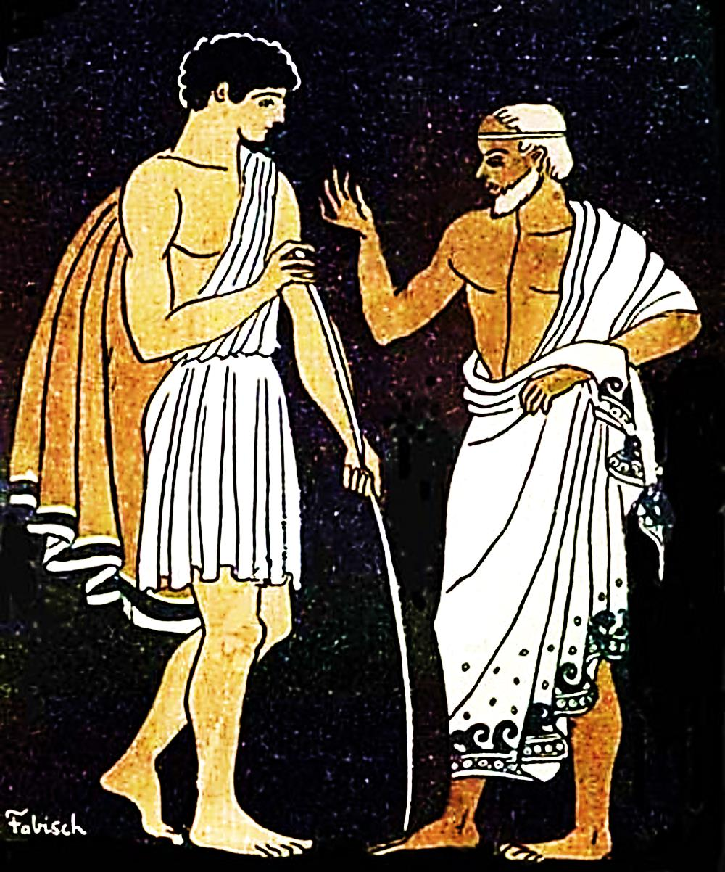
Ministry leaders shouldn’t give their charges responsibility too early, but sometimes they can’t let go when God’s time comes.

Slide 25
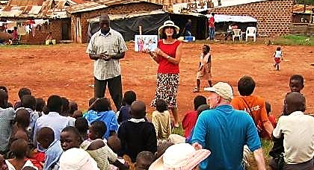
We cannot keep what is God’s to lead – God has plans for them that do not include us.

Slide 26
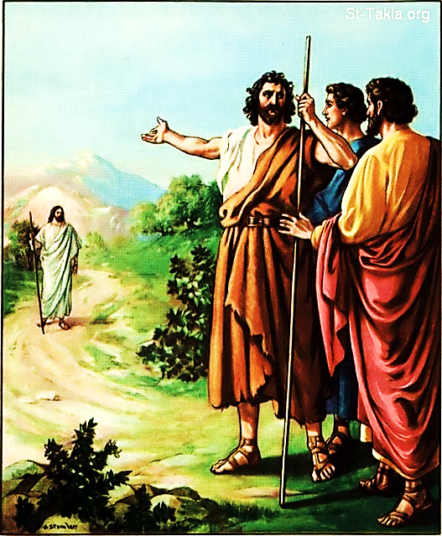
John the Baptist allowed his followers to move on to Jesus as their new teacher.
He understood his part was done in their journey.

Slide 27
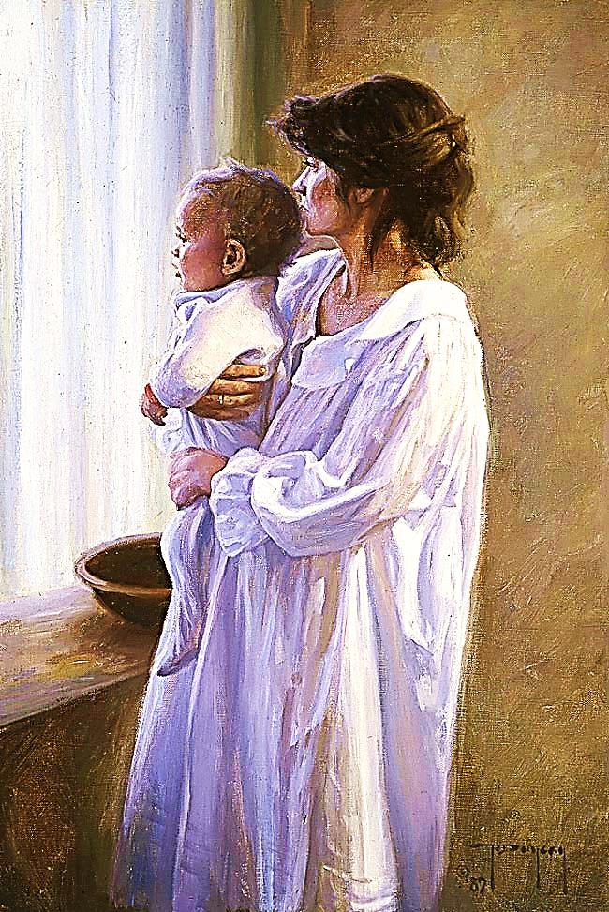
Like Mothers, ministers feel the pain of their students ‘moving on.’
But, it is often, just God’s path for them.

Slide 28
Next Slide → Song: God Has a Plan For Me Download Here: http://youtu.be/78jXwLQ9QWI

Slide 29
Is Jesus Speaking to You?
“They said to each other, ‘Did not our hearts burn within us while he talked to us on the road, while he opened to us the Scriptures?’”
John Wesley Said:
“…the preacher was describing the change which God works in the heart through faith in Christ and I felt my heart strangely warmed.”
Jesus makes His presence Known by a small voice!

Slide 31
What is the Sinner‘s Prayer?
This is a prayer we can pray when we are ready to admit we are sinners and need Christ’s forgiveness.
It must be prayed with faith in our hearts and a readiness to have a life-changing encounter with Jesus Christ.

Slide 32
A prayer of faith → Pray this prayer if :
If you never have before
You have in the past, but you think it would mean more today
You have been walking afar off and you want to come back
You want to set an example & show others how it is done
You just like to give your heart to Jesus again & again
Faith

Slide 33
We Declare Our Faith Publicly Because Jesus Declared His LOVE Publicly
“If you stand before others and are willing to say you believe in me, then I will tell my Father in heaven that you belong to me.” Mat 10:32

Slide 34
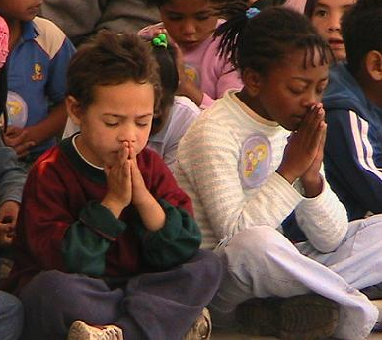
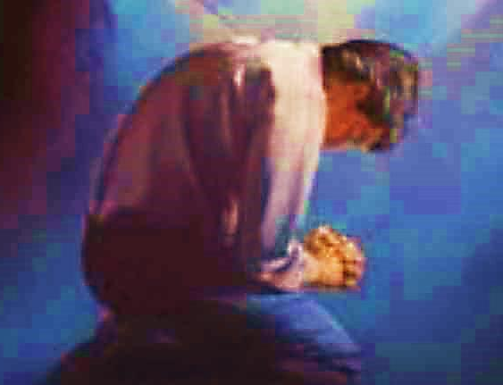
Important Questions
Do you want to know Jesus as your Savior right now?
Do you believe He died to save you from your sins & that He rose from the dead?
Do you believe that He is here, waiting to save you right now?

Slide 35
The Prayer of a Sinner Turning to Jesus
Dear Jesus, I know that I have sinned against You and that my sins separate me from You.
I am truly sorry.
Right now, I turn away from my sinful past .
Please forgive me, and help me to keep from sin.
I believe You died for my sins.
I Believe You rose from the dead, you are alive, and you hear this prayer from my heart.
I invite You Jesus to be both my Savior and the Lord of my life.
I want You to rule my life from now on.

Slide 36
“But some people did accept him. They believed in him, and he gave them the right to become children of God.”
John 1:12

Slide 38
“If you openly say, ‘Jesus is Lord’ and believe in your heart that God raised him from death, you will be saved.”
Rom. 10:9
What did you learn today?
What is the meaning of the name-tag?
What have you been thinking about God lately?
What do you want to tell the world about Jesus?

Slide 39
“Draw near to God, and He will draw near to you…
Altar Time
…Cleanse your hands, you sinners, and make your hearts pure, you who are half-hearted towards God.” James 4:8 WNT

Slide 40
Close in Prayer

Slide 41
Note: Any videos in this presentation will only play online. After you download the slideshow, you will need to also download the videos from YouTube & add them back into your PowerPoint.
We present these messages at Bee Creek Park in College Station, TX. If you would like to watch the video of the service with this message, click here:
http://campaignkerusso.org/?p=10532
We would love to know more about the people who download our lessons & sermons. We invite you to email us & let us know where & how you use them.
info@ckbrazos.org

Slide 42
Welcome to Aggieland Faith Family Style Worship

Slide 43
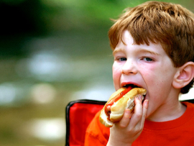
CURRENT SCHEDULE: See www.Aggielandfaith.org
SATURDAY —
At Bee Creek Park
2:00-4:00pm: Through the bible with felt-board stories – plus hot-dogs & drinks
SUNDAY —
At Bee Creek Park
2:00-4pm: Free snacks, drinks, kids crafts, prizes, singing & bible preaching

Slide 44
Would You Like Prayer or Bible Study at Your House?
Personal Prayer: We can come to your home & pray with you, or you can email us when you need prayer.
Home Bible Study: We will come to your home & hold a bible study for you & your friends.
Bible Party: We will hold a Kid’s Bible Party: You provide the food & kids - we will do the bible fun & stories.

Slide 45
Would You Like Visitation?
We will visit a friend, loved one in the hospital or in prison to pray for them & share Christ with them.
Contact: info@aggielandfaith.org

Slide 46
www.aggielandfaith.org
Go here to see pictures & videos
Go here to subscribe to e-mails about changes & cancellations

Slide 47
Note: Any videos in this presentation will only play online. After you download the slideshow, you will need to also download the videos from YouTube & add them back into your PowerPoint.
We present these messages at Bee Creek Park in College Station, TX. If you would like to watch the video of the service with this message, click here:
http://campaignkerusso.org/?p=10532
We would love to know more about the people who download our lessons & sermons. We invite you to email us & let us know where & how you use them.
info@ckbrazos.org

