Slide 1
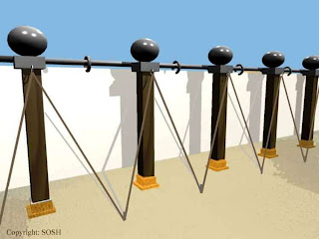
Tabernacle pt. 13 The Fence Pillars: My Redeemer Lives

Slide 2
Note: Any videos in this presentation will only play online. After you download the slideshow, you will need to also download the videos from YouTube & add them back into your PowerPoint.
We present these messages at Bee Creek Park in College Station, TX. If you would like to watch the video of the service with this message, click here:
http://campaignkerusso.org/?p=11531
We would love to know more about the people who download our lessons & sermons. We invite you to email us & let us know where & how you use them.
info@ckbrazos.org

Slide 3
Tabernacle pt. 13 The Fence Pillars: My Redeemer Lives

Slide 4
Next Slide - Song:
I Know My Redeemer Lives →
Download Here:
http://youtu.be/wH0Mc7zn4vc

Slide 6
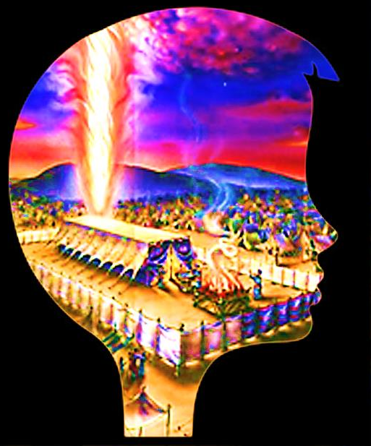
Review:
All God cares about is being with mankind forever.
The Tabernacle was a temporary meeting place until the day we would become His dwelling place.
As the Tabernacle was mobile, Christian fellowship is a walk with God.
To God, worship is service & service is worship.
God takes us through the wilderness to learn how to be dependent children.
Every part of the Tabernacle points to the Gospel.
The coverings and the frame boards point to Jesus.

Slide 7
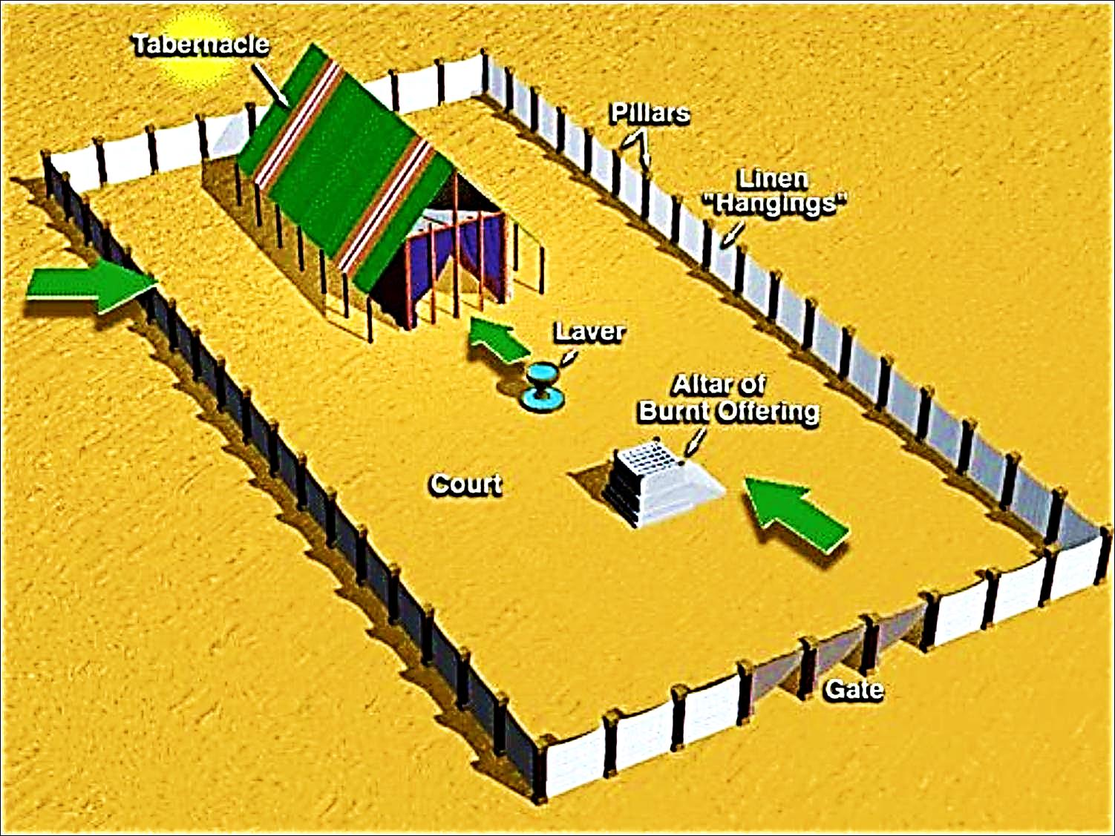

Slide 8
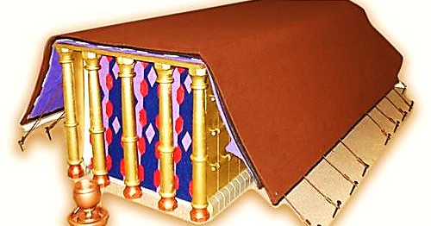
The Entrance Had Five Pillars
(Five is the number of GRACE)
No one can enter God’s dwelling place except by God’s GRACE

Slide 9
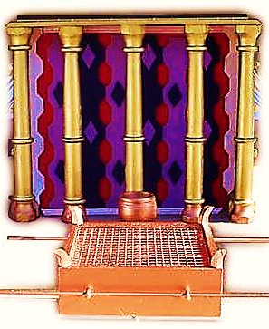
The Pillars stood in sockets of bronze.
Bronze represents God’s judgment.
God’s grace is not rooted in mere tolerance of sin, but on God’s judgment (of sin) being satisfied at the Cross.

Slide 10
The Pure White Linen Fence: This fence formed a pure white barrier around the house of God.
“Make a courtyard for the Holy Tent… These curtains must be made from fine linen.”
Ex. 27:9
The white fence kept out the impure Israelites. It kept God’s tent holy.

Slide 11
But, God has a plan to wash us “white as snow.”
Later, we hear about this white linen cloth again.
The Bride of Christ is wearing it!

Slide 12
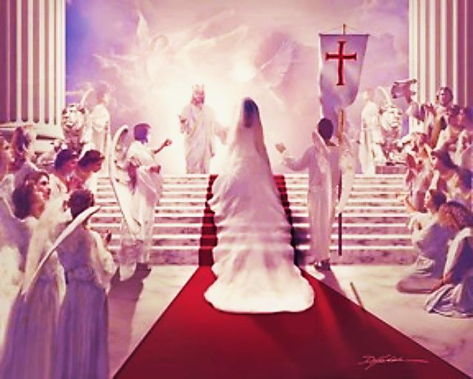
Let us rejoice and be happy and give God glory! Give God glory, because the wedding of the Lamb has come. And the Lamb’s bride has made herself ready. Fine linen was given to the bride for her to wear. The linen was bright and clean.”
Rev. 19:7, 8

Slide 13
Pure ‘White Linen’ Righteousness
→ Foreshadowed in the Fence
→ Fulfilled in Christ
→ Freely GIVEN to the Believer

Slide 14
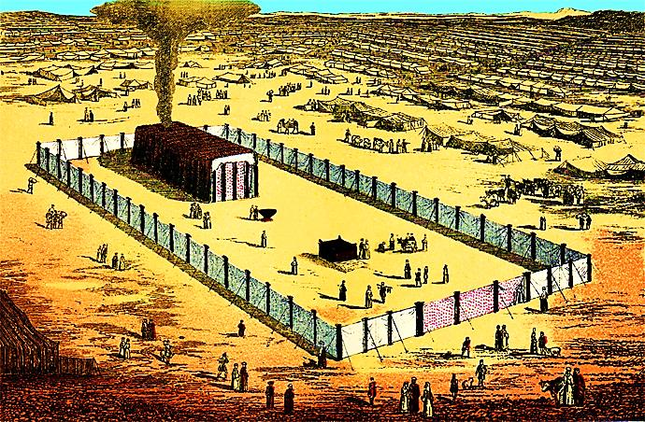
Just as they could be outside the fence, we can be outside of God’s righteousness.

Slide 15
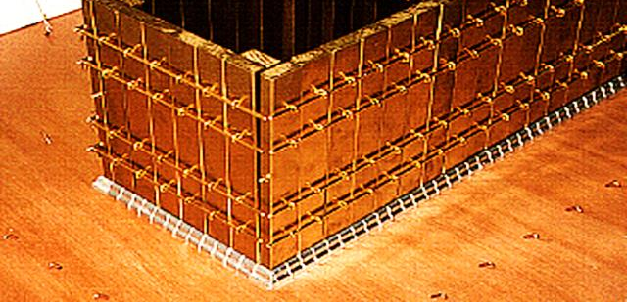
The Tabernacle frame boards were inside the fence.
They stood in sockets of silver.
Silver was the Old Testament redemption money.
It foreshadowed the blood of Jesus that He would offer to His Father in Heaven to buy our souls.

Slide 16
Held together by 5 bars (5 represents grace).
God’s grace made them one—like the Church.
Many parts but one body standing on the blood of Jesus.

Slide 17
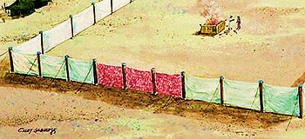
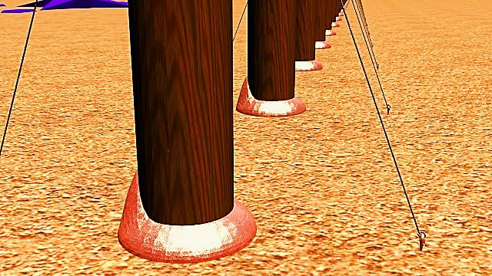
The fence pillars stand in bronze sockets.
Bronze represents God’s judgment.
“He has set a day when he will judge the world’s people with fairness.”
Acts 17:31

Slide 18
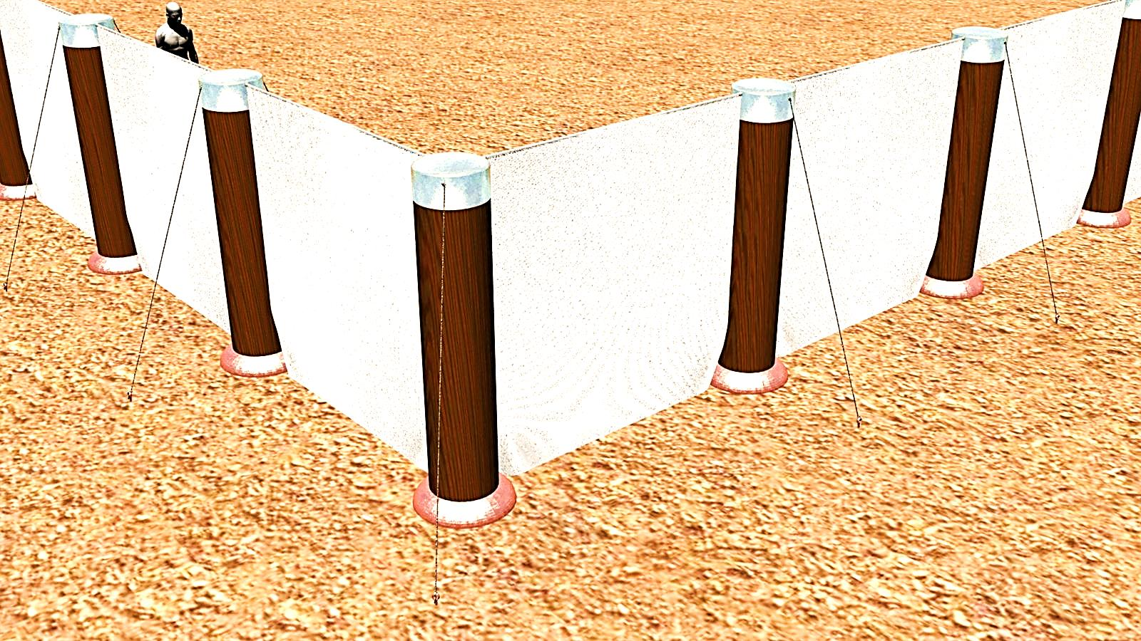
Each pillar was capped with silver (redemption).
On Earth, Jesus was judged (bronze socket).
In Heaven, He offers our redemption payment (His blood) to the Father.
His judgment on the cross (socket) and blood payment (cap) form the pillar of our salvation.

Slide 20
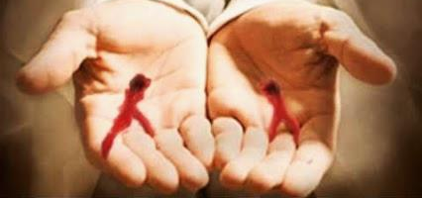
“He took his own blood. And he went into the Most Holy Place just once. He paid for our sins and made us free forever.” Heb. 9:12
“He is so rich in kindness and grace that he purchased our freedom with the blood of his Son and forgave our sins.” Eph. 1:7

Slide 21
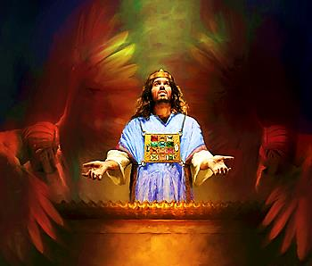
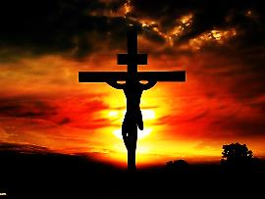
Our pillar:
Judged on Earth (brass)
Eternal redeemer in Heaven! (silver)
“But the Lord is still in his holy temple; he still rules from heaven. He closely watches everything that happens here on earth.”
Psalm 11:4
I lift up my eyes to You, O You Whose throne is in the heavens. Psalm 123:1

Slide 22
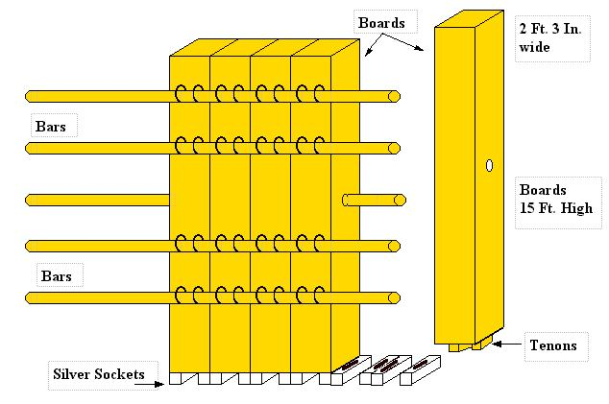
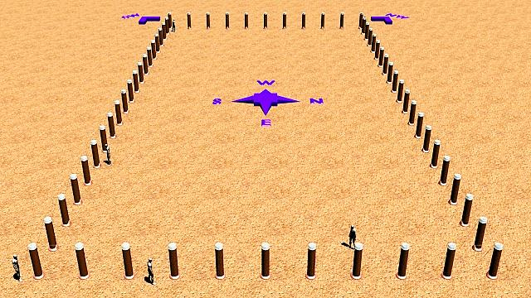
Also a Picture of Mankind
The boards (within the fence) were fitly joined together and stood as one unit upon a foundation of silver (redemption).
The pillars of the fence stood independently on brass (judgment) just as each one of us stands alone in the final judgment.
“For we must all stand before Christ to be judged and have our lives laid bare—before him.” 2 Cor. 5:10

Slide 23
And a Picture of the Believer
We are judged by God but we look up to Heaven where Jesus serves us as our eternal redeemer.
“I lift up my eyes to You, O You Whose throne is in the heavens.” Psalm 123:1
“But as for me, I will look to the Lord; I will wait for the God of my salvation; my God will hear me.” Micah 7:7
“Let the words of my mouth and the meditation of my heart be acceptable to you, O Lord, my rock and my redeemer.” Psalm 19:14

Slide 24
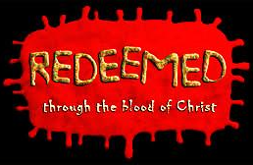
“Those people are happy whose sinful acts are forgiven and whose sins are covered.
Rom. 4:7
“You took away Your people’s guilt; You covered all their sin.” Psalm 85:2
“For I know that my Redeemer lives.” Job 19:25

Slide 25
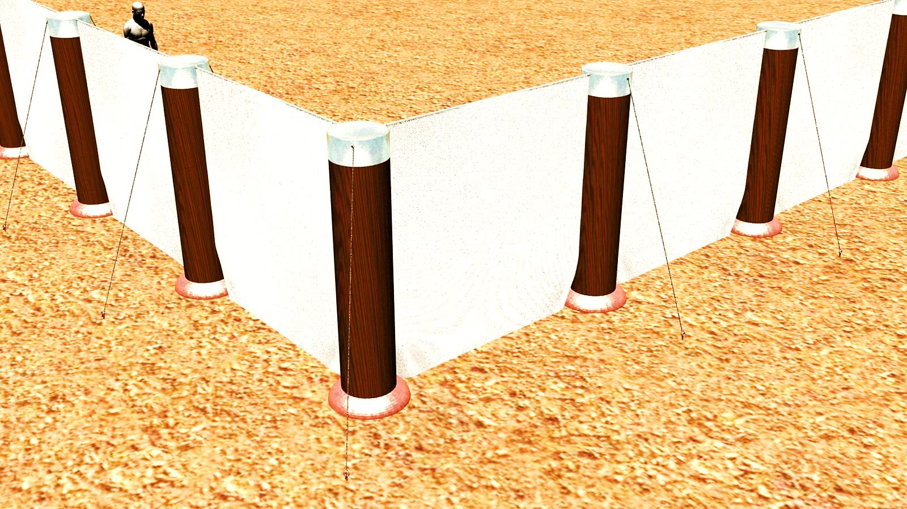
The pillars were 5 cubits (number of grace) high and there was a pillar every 5 cubits—that’s grace squared!
This fence was crying out, “Grace, Grace, Grace.”
“Though your sins are bright red, they will become as white as snow.” Isa. 1:18

Slide 26
Next Slide - Song:
I Know My Redeemer Lives →
Download Here:
http://youtu.be/wH0Mc7zn4vc

Slide 27
Is Jesus Speaking to You?
“They said to each other, ‘Did not our hearts burn within us while he talked to us on the road, while he opened to us the Scriptures?’”
John Wesley Said:
“…the preacher was describing the change which God works in the heart through faith in Christ and I felt my heart strangely warmed.”
Jesus makes His presence Known by a small voice!

Slide 29
What is the Sinner‘s Prayer?
This is a prayer we can pray when we are ready to admit we are sinners and need Christ’s forgiveness.
It must be prayed with faith in our hearts and a readiness to have a life-changing encounter with Jesus Christ.

Slide 30
A prayer of faith → Pray this prayer if :
If you never have before
You have in the past, but you think it would mean more today
You have been walking afar off and you want to come back
You want to set an example & show others how it is done
You just like to give your heart to Jesus again & again
Faith

Slide 31
We Declare Our Faith Publicly Because Jesus Declared His LOVE Publicly
“If you stand before others and are willing to say you believe in me, then I will tell my Father in heaven that you belong to me.” Mat 10:32

Slide 32
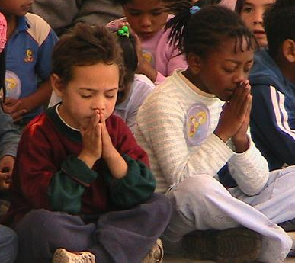
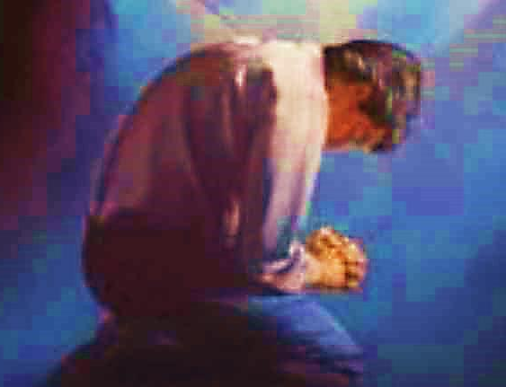
Important Questions
Do you want to know Jesus as your Savior right now?
Do you believe He died to save you from your sins & that He rose from the dead?
Do you believe that He is here, waiting to save you right now?

Slide 33
The Prayer of a Sinner Turning to Jesus
Dear Jesus, I know that I have sinned against You and that my sins separate me from You.
I am truly sorry.
Right now, I turn away from my sinful past .
Please forgive me, and help me to keep from sin.
I believe You died for my sins.
I Believe You rose from the dead, you are alive, and you hear this prayer from my heart.
I invite You Jesus to be both my Savior and the Lord of my life.
I want You to rule my life from now on.

Slide 34
“But some people did accept him. They believed in him, and he gave them the right to become children of God.”
John 1:12

Slide 36
“If you openly say, ‘Jesus is Lord’ and believe in your heart that God raised him from death, you will be saved.”
Rom. 10:9
What did you learn today?
What is the meaning of the name-tag?
What have you been thinking about God lately?
What do you want to tell the world about Jesus?

Slide 37
“Draw near to God, and He will draw near to you…
Altar Time
…Cleanse your hands, you sinners, and make your hearts pure, you who are half-hearted towards God.” James 4:8 WNT

Slide 38
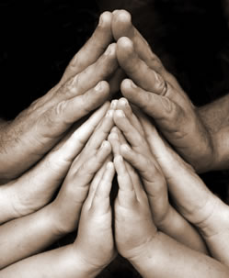
Close in Prayer

Slide 39
Note: Any videos in this presentation will only play online. After you download the slideshow, you will need to also download the videos from YouTube & add them back into your PowerPoint.
We present these messages at Bee Creek Park in College Station, TX. If you would like to watch the video of the service with this message, click here:
http://campaignkerusso.org/?p=11531
We would love to know more about the people who download our lessons & sermons. We invite you to email us & let us know where & how you use them.
info@ckbrazos.org

Slide 40
Welcome to Aggieland Faith Family Style Worship

Slide 41
CURRENT SCHEDULE: See www.Aggielandfaith.org
Three Sunday Services
First Sunday Service:
Basics – 15-20 min.
Includes – Snacks, Crafts, Prizes & Bible
We are going through the New Testament
Second Sunday Service:
Middle Level – 20-30 min.
Includes – Snacks, Prizes & Bible
We are going through the Old Testament
Third Sunday Service:
Advanced – 30-40 min.
Includes – Snacks, Prizes & Bible
We are studying the Tabernacle

Slide 42
Would You Like Prayer or Bible Study at Your House?
Personal Prayer: We can come to your home & pray with you, or you can email us when you need prayer.
Home Bible Study: We will come to your home & hold a bible study for you & your friends.
Bible Party: We will hold a Kid’s Bible Party: You provide the food & kids - we will do the bible fun & stories.

Slide 43
Would You Like Visitation?
We will visit a friend, loved one in the hospital or in prison to pray for them & share Christ with them.
Contact: info@aggielandfaith.org

Slide 44
www.aggielandfaith.org
Go here to see pictures & videos
Go here to subscribe to e-mails about changes & cancellations

Slide 45
Note: Any videos in this presentation will only play online. After you download the slideshow, you will need to also download the videos from YouTube & add them back into your PowerPoint.
We present these messages at Bee Creek Park in College Station, TX. If you would like to watch the video of the service with this message, click here:
http://campaignkerusso.org/?p=11531
We would love to know more about the people who download our lessons & sermons. We invite you to email us & let us know where & how you use them.
info@ckbrazos.org

