Slide 1
The Bells

Slide 2
Note: Any videos in this presentation will only play online. After you download the slideshow, you will need to also download the videos from YouTube & add them back into your PowerPoint.
We present these messages at Bee Creek Park in College Station, TX. If you would like to watch the video of the service with this message, click here:
http://campaignkerusso.org/?p=12816
We would love to know more about the people who download our lessons & sermons. We invite you to email us & let us know where & how you use them.
info@ckbrazos.org

Slide 3
The Bells

Slide 4
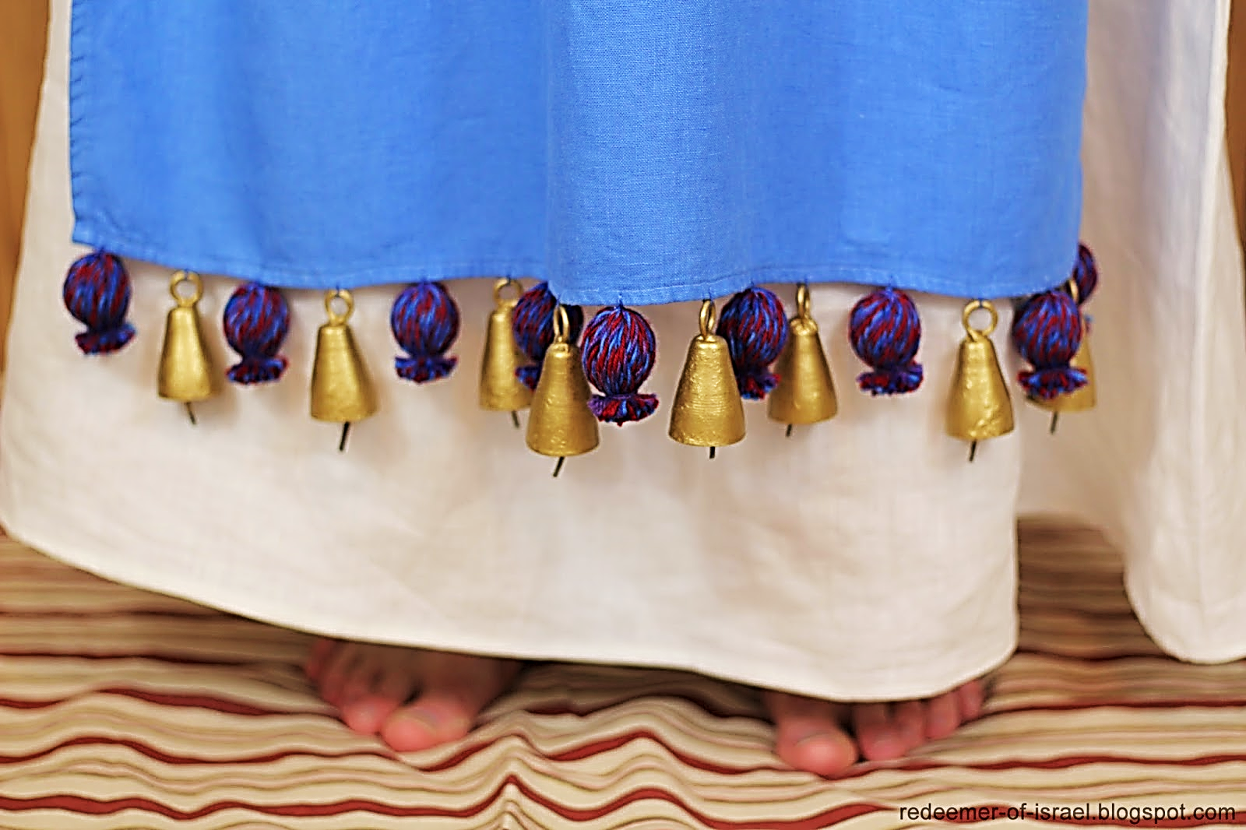
The only bells in the bible were the ones worn by the High Priest around the hem of his robe.
They made the ‘sound’ of the High Priest as he moved.

Slide 5
“Put a gold bell and a pomegranate, then a gold bell and a pomegranate, all the way around the bottom of this clothing. Aaron will wear it when…

Slide 6
…he serves Me. The sound of the bells will be heard when he goes in the holy place and when he comes out so that he will not die.”
Ex. 28:34, 35 (NLV)

Slide 7
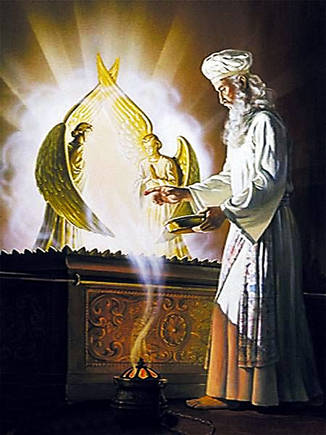
The High Priest went into a room (behind a veil) called the Holy of Holies where he offered the blood of the lamb as a sacrifice for the sins of the people.

Slide 8
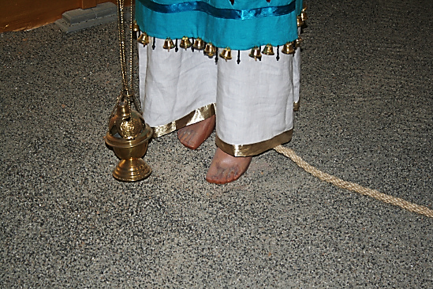
If the High Priest made an imperfect sacrifice, he would be struck dead. Tradition says they tied a rope to his leg so they could…
…retrieve his dead body without entering the Holy of Holies themselves.

Slide 9
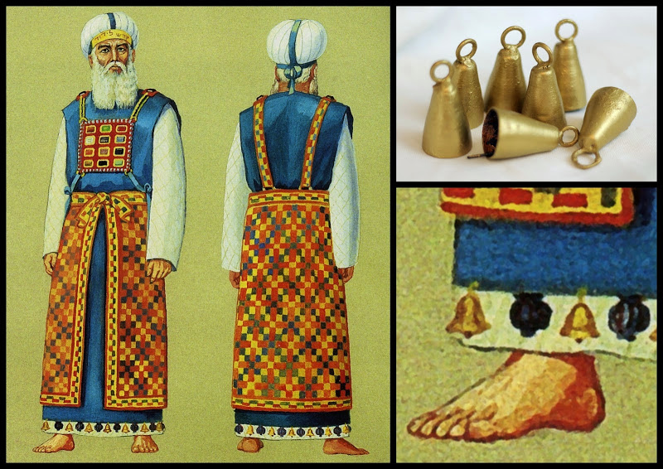
These 72 bells were the sound of the priest. Evidence of his existence behind the veil.

Slide 10
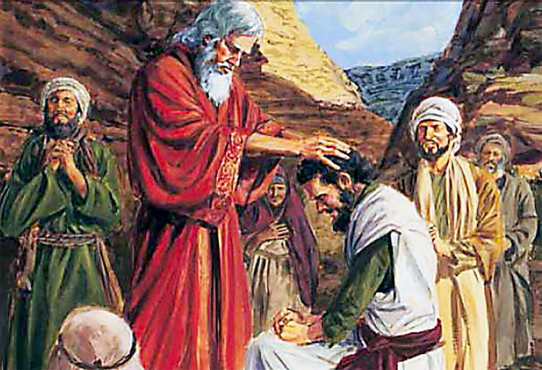
Only Moses & Aaron spoke for God until God told Moses to set aside 70 elders to also be His voices (His bells). Then there were 72 bells for God.

Slide 11
“Then the Lord said to Moses, “Summon before me seventy of the leaders of Israel; bring them to the Tabernacle, to stand there with you. I will come down and talk with you there, and I will take of the Spirit which is on you and will put it upon them also; they shall bear the burden of the people along with you, so that you will not have the task alone.”
Num. 11:16, 17 (TLB)

Slide 12
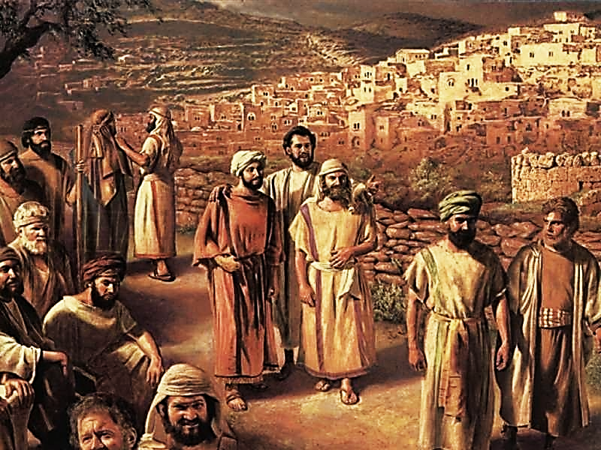
Jesus also sent out 72 ringing bells to proclaim His good news.

Slide 13
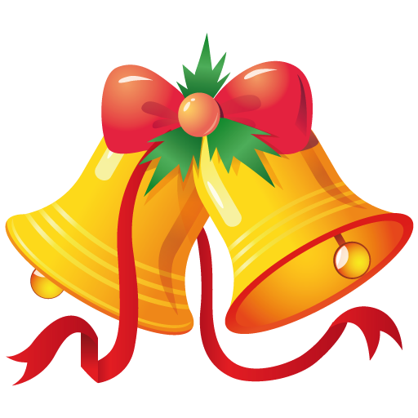
“After this the Lord appointed 72 others. He sent them out two by two ahead of him. They went to every town and place where he was about to go.”
Lk. 10:1 (NIRV)

Slide 14
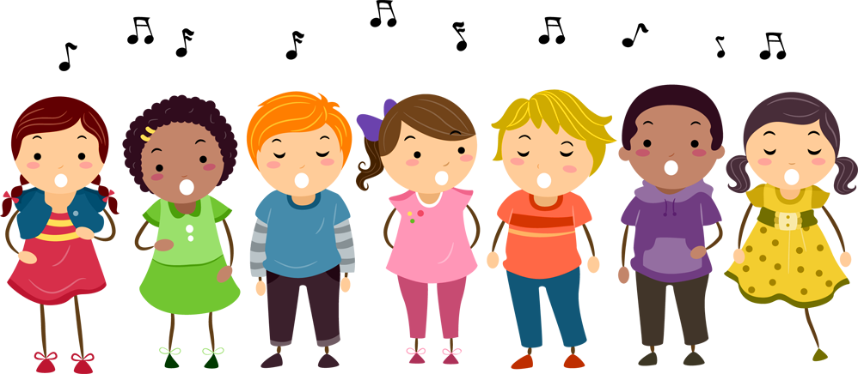
The bible number 72 represents the group who speaks for God. Today it is His Church. Jesus is in Heaven and we are around His hem, representing Him on Earth (remember the woman who touched His hem and was healed). We are the audible evidence of Him for a world that can’t see him. We are the sound of God.

Slide 15
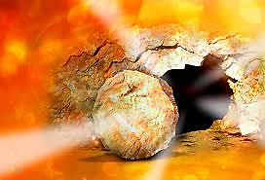
We are the hem bells that tell the world that our High Priest, Jesus has made a perfect sacrifice, accepted by the Father and He is still alive!

Slide 16
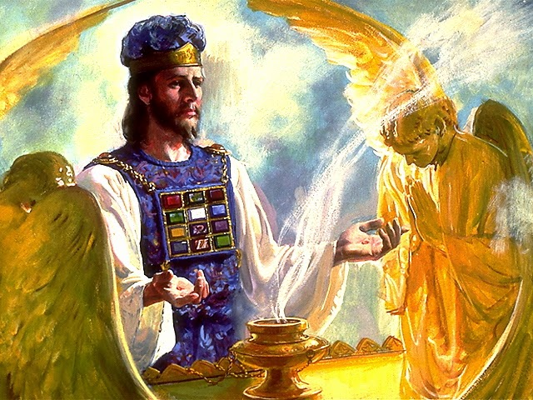
We are the hem bells that tell the world that our High Priest is still busy on our behalf. Let every move the priest makes be announced & sung about by His bells.

Slide 17
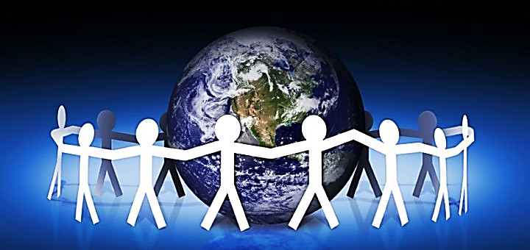
We are the hem bells that sing of “Peace on Earth, Good Will toward Men” through the sacrifice of Jesus.
We are the bells of Christmas Day!

Slide 18
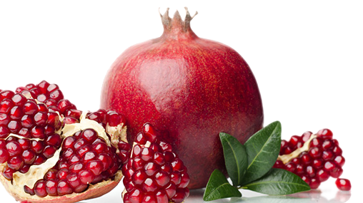
Each joyful bell was to be flanked by a fruitful, seed-filled pomegranate on either side.

Slide 19
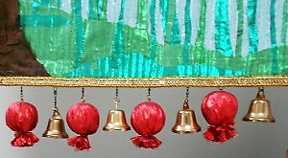
Fruitful, Joyful, Fruitful, Joyful, Fruitful, Joyful
The hem bells are joyful & fruitful:
“The fruit of those who are right with God is a tree of life, and he who wins souls is wise.”
Pv. 11:30 (TLB)
“Shout for joy to the Lord, everyone on earth. Burst into joyful songs and make music.”
Ps. 98:4 (GW)

Slide 20
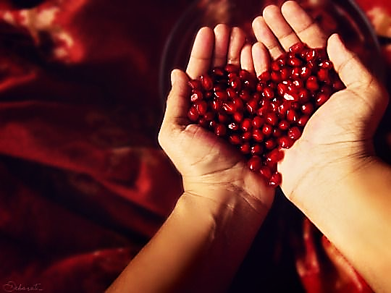
In the abundance of fruit we have the most joy!
Ring the bells, sing the songs.

Slide 21
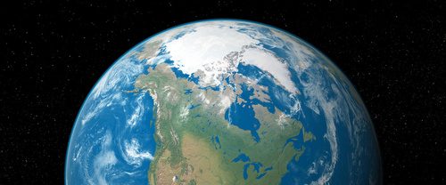
“We, however, are citizens of heaven, and we eagerly wait for our Savior, the Lord Jesus Christ, to come from heaven.”
Phil. 3:20 (GNT)

Slide 22
We are part of our High Priest, our Head in Heaven. We are attached to the hem of His garment, but we are near enough to Earth for the world to hear our song & message.
We are the sound of God on Earth.

Slide 23
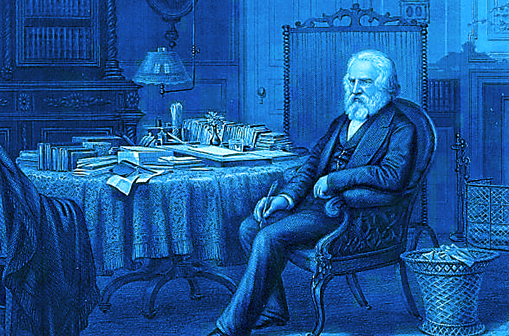
Poet, Henry Wadsworth Longfellow wanted to tune out the bells, to muffle his hearing, to darken their meaning.
The past two years had brought him great sorrow:

Slide 24
Two years prior, he had sustained serious burns attempting to put out a fire on the dress of his beloved wife, Frances . Sadly, she died.
And now he is caring for his dear boy who has come home after being badly injured in the Civil war.
In the distance he hears the cheerful tolling of Christmas bells and so begins the inner struggle that ultimately ends his pain with the birth of new faith… he pens this new poem:

Slide 25
Next Slide - Song: I Heard the Bells (Burl Ives) Download Here: https://www.youtube.com/watch?v=2nk77EOgapg

Slide 26
Next Slide - Song: I Heard the Bells (Casting Crowns) Download Here: https://www.youtube.com/watch?v=M5vgyj_aQkw

Slide 27
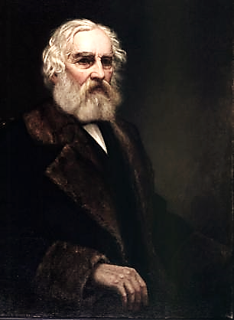
In his heart, Longfellow heard the message of the Christmas bells:
1) Jesus is not dead.
2) He is still working on our behalf.
3) Believers will have fruitfulness & joy.

Slide 28
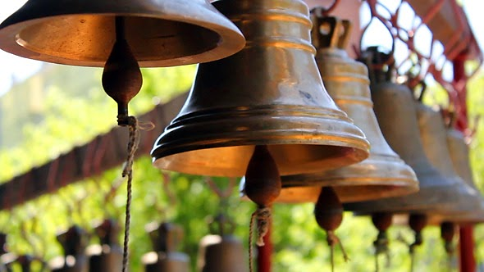
We are the Church—we are God’s church bells.
Our true citizenship is in Heaven, but we can be heard on Earth… we tell the world about our High Priest, Jesus.
Ring bells! Tell the world:
- Jesus is alive.
- He is working on our behalf.
- His children are full of joy!

Slide 29
Next Slide - Song: Ring Those Bells Download Here: https://www.youtube.com/watch?v=d39dQhQP38A

Slide 30
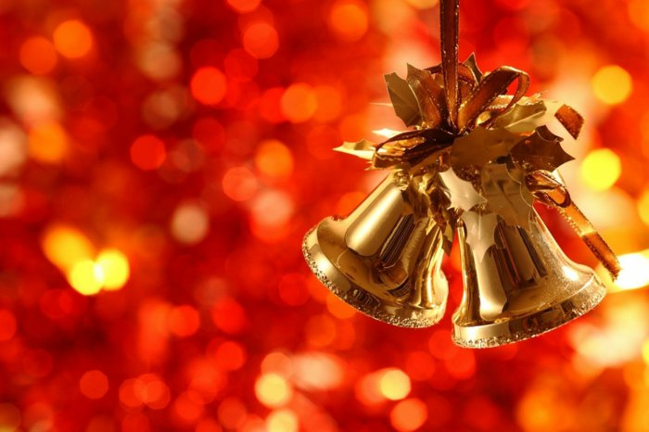
Peace on Earth
Good Will to Men

Slide 31
Is Jesus Speaking to You?
“They said to each other, ‘Did not our hearts burn within us while he talked to us on the road, while he opened to us the Scriptures?’”
John Wesley Said:
“…the preacher was describing the change which God works in the heart through faith in Christ and I felt my heart strangely warmed.”
Jesus makes His presence Known by a small voice!

Slide 33
What is the Sinner‘s Prayer?
This is a prayer we can pray when we are ready to admit we are sinners and need Christ’s forgiveness.
It must be prayed with faith in our hearts and a readiness to have a life-changing encounter with Jesus Christ.

Slide 34
A prayer of faith → Pray this prayer if :
If you never have before
You have in the past, but you think it would mean more today
You have been walking afar off and you want to come back
You want to set an example & show others how it is done
You just like to give your heart to Jesus again & again
Faith

Slide 35
We Declare Our Faith Publicly Because Jesus Declared His LOVE Publicly
“If you stand before others and are willing to say you believe in me, then I will tell my Father in heaven that you belong to me.” Mat 10:32

Slide 36
Important Questions
Do you want to know Jesus as your Savior right now?
Do you believe He died to save you from your sins & that He rose from the dead?
Do you believe that He is here, waiting to save you right now?

Slide 37
The Prayer of a Sinner Turning to Jesus
Dear Jesus, I know that I have sinned against You and that my sins separate me from You.
I am truly sorry.
Right now, I turn away from my sinful past .
Please forgive me, and help me to keep from sin.
I believe You died for my sins.
I Believe You rose from the dead, you are alive, and you hear this prayer from my heart.
I invite You Jesus to be both my Savior and the Lord of my life.
I want You to rule my life from now on.

Slide 38
“But some people did accept him. They believed in him, and he gave them the right to become children of God.”
John 1:12

Slide 40
“If you openly say, ‘Jesus is Lord’ and believe in your heart that God raised him from death, you will be saved.”
Rom. 10:9
What did you learn today?
What have you been thinking about God lately?
What do you want to tell others about Jesus?

Slide 41
“Draw near to God, and He will draw near to you…
Altar Time
…Cleanse your hands, you sinners, and make your hearts pure, you who are half-hearted towards God.” James 4:8 WNT

Slide 42
Close in Prayer

Slide 43
Note: Any videos in this presentation will only play online. After you download the slideshow, you will need to also download the videos from YouTube & add them back into your PowerPoint.
We present these messages at Bee Creek Park in College Station, TX. If you would like to watch the video of the service with this message, click here:
http://campaignkerusso.org/?p=12816
We would love to know more about the people who download our lessons & sermons. We invite you to email us & let us know where & how you use them.
info@ckbrazos.org

Slide 44
Welcome to Aggieland Faith Family Style Worship

Slide 45
Would You Like Prayer or Bible Study at Your House?
Personal Prayer: We can come to your home & pray with you, or you can email us when you need prayer.
Home Bible Study: We will come to your home & hold a bible study for you & your friends.
Bible Party: We will hold a Kid’s Bible Party: You provide the food & kids - we will do the bible fun & stories.

Slide 46
Would You Like Visitation?
We will visit a friend, loved one in the hospital or in prison to pray for them & share Christ with them.
Contact: info@aggielandfaith.org

Slide 47
www.aggielandfaith.org
Go here to see pictures & videos
Go here to subscribe to e-mails about changes & cancellations

Slide 48
Note: Any videos in this presentation will only play online. After you download the slideshow, you will need to also download the videos from YouTube & add them back into your PowerPoint.
We present these messages at Bee Creek Park in College Station, TX. If you would like to watch the video of the service with this message, click here:
http://campaignkerusso.org/?p=12816
We would love to know more about the people who download our lessons & sermons. We invite you to email us & let us know where & how you use them.
info@ckbrazos.org

