Slide 1
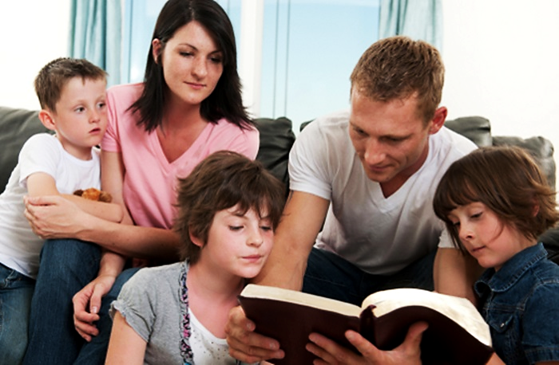
God’s Preferred Way to Save:
An Entire Household at a Time!
“They said to him, ‘Believe in the Lord Jesus and you will be saved—you and all the people in your house.’” Acts 16:31 (ERV)

Slide 2



Note: Any videos in this presentation will only play online. After you download the slideshow, you will need to also download the videos from YouTube & add them back into your PowerPoint.
We present these messages at Bee Creek Park in College Station, TX.
If you would like to watch the video of the service with this message, click here: http://campaignkerusso.org/?p=6860
We would love to know more about the people who download our lessons & sermons. We invite you to email us & let us know where & how you use them.
info@campaignkerusso.org

Slide 3
God’s Preferred Way to Save:
An Entire Household at a Time!
“They said to him, ‘Believe in the Lord Jesus and you will be saved—you and all the people in your house.’” Acts 16:31 (ERV)

Slide 4
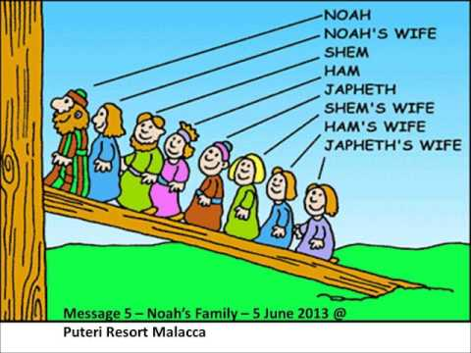
God’s Plan is Household Salvation
" Then the Lord said to Noah, “Go into the ark, you and all your household.” Gen. 7:1 (ESV)
"A few, that is, eight souls, were brought safely through by water." 1 Pet. 3:20 (ESV)

Slide 5
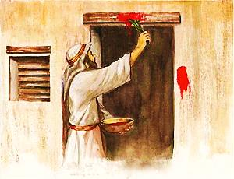
God’s ideal is
Household Salvation.
One lamb was slain for everyone in the house.
“…Each man must get one lamb. It is for the people in his house.... take some of the blood… put it on the sides and tops of the doorframes. ” Ex.12:3-7 (ICB)

Slide 6
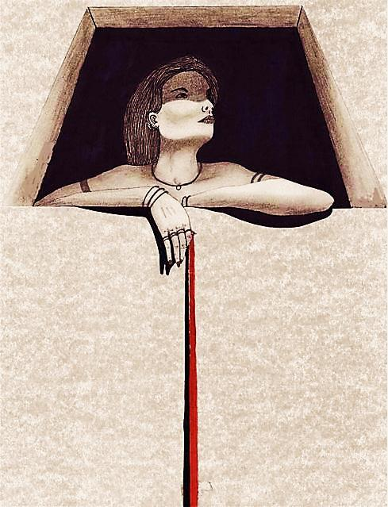
“Only Rahab the harlot shall live, she and all who are with her in her house…”
Josh. 6:17 (NKJV)

Slide 7

A Promise of Household Salvation is Given Throughout the Bible
The House of Zaccheus
"Jesus said to him, Today salvation has come to this house." Luke 19:9 (NIV)
The Household of Cornelius
“He will tell you how you and everyone in your household can be saved!” Acts 11:14 (NLT)
The Household of Lydia
"She was baptized, as well as her household." Acts 16:15 (RV)

Slide 8
The Philippian Jailer
"Believe in the Lord Jesus and you will be saved, along with everyone in your household." Acts 16:31 (NLV)
The Household of Crispus
"Crispus, the ruler of the synagogue, believed in the Lord with his whole household... and were baptized."
Acts 18:8 (RV)
The Household of Stephanas
"I did baptize the household of Stephanas also.” 1 Cor. 1:16 (AMP)

Slide 9

At first, salvation may bring separation to families.
“… For I have come to 'set a man against his father, a daughter against her mother… and a man’s enemies will be those of his own household.”
Mat.10:34-36 (NKJV)
The separated one then becomes a beacon of light for his household.

Slide 10
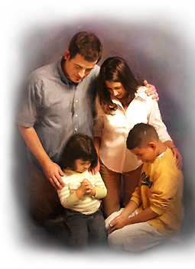
There is a role for each family member to play in the salvation of their households.

Slide 11
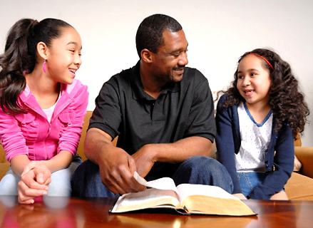
Godly father’s lead their families to household salvation.
“As for me and my house, we will serve the Lord.” Josh. 24:15 (KJV)

Slide 12
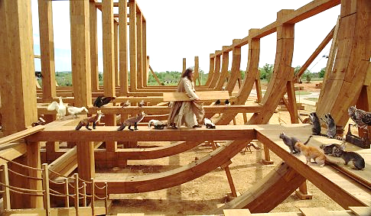
Fathers build an ‘ark’ using only God’s plan – including one ‘door’ & a single ‘window’ at the roof.

Slide 13
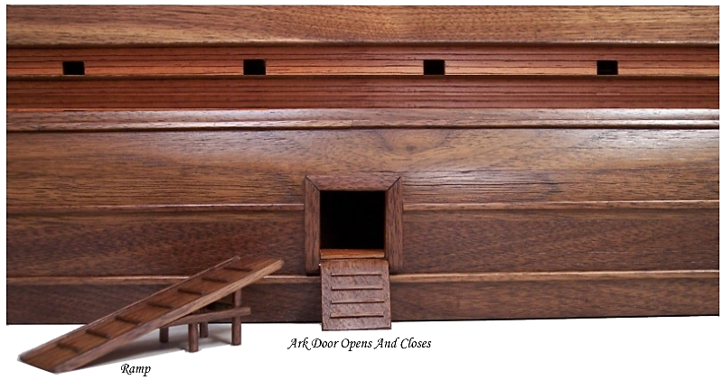
That Door is Jesus, our one and only Salvation.
“I am the door: by me if any man enter in, he shall be saved…” (John 10:9 (KJV)

Slide 14
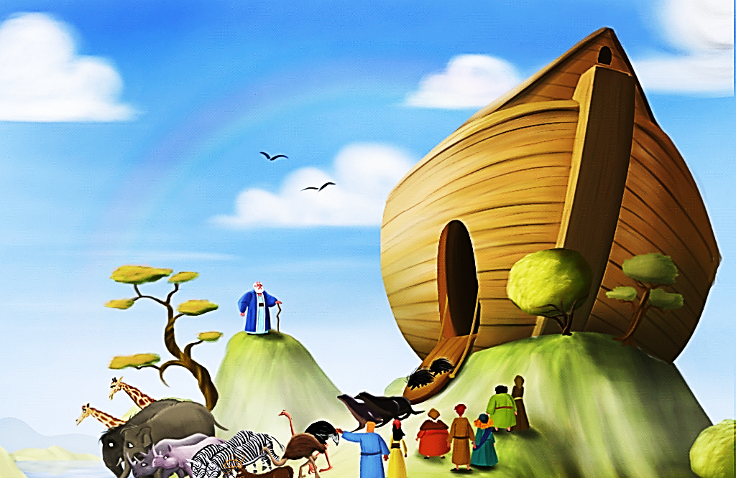
That Window is Jesus, Our Hope!
Teach Your Family to Look Up!
“Think only about the things in heaven, not the things on earth.” Col. 3:2 ICB
“In the end, they will be destroyed. They do whatever their bodies want, they are proud of their shameful acts, and they think only about earthly things. But our homeland is in heaven, and we are waiting for our Savior, the Lord Jesus Christ, to come from heaven.”
Phil. 3:19-20 (NCV)

Slide 15
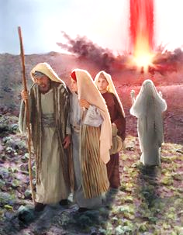
Fathers Must Not Fail to Teach God’s Word to their Families
God wanted to save Lot’s entire household, but his leadership was weak. Therefore, he was barely able to save himself with his two daughters.
First, get yourself right with God: then get your household right.

Slide 16
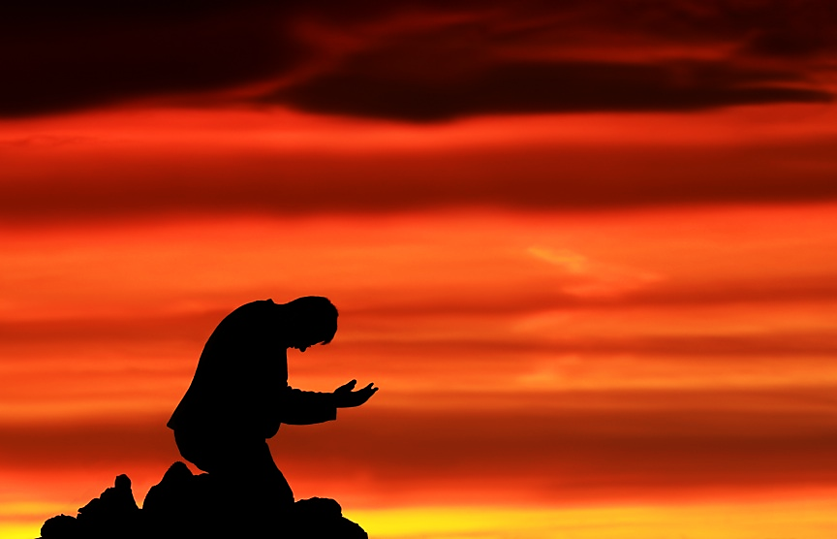
Fathers Must Not Fail to Pray Earnestly for their Families.
"Moreover as for me, God forbid that I should sin against the LORD in ceasing to pray for you: but I will teach you the good and the right way" I Sam. 12:23

Slide 17
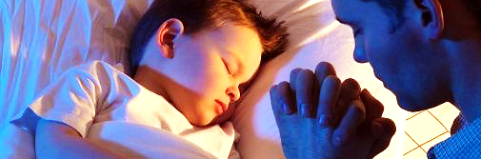
“The day after each of these parties, Job got up early in the morning, sent for his children, and offered a burnt offering for each of them. He thought, “Maybe my children were careless and sinned against God at their party.” Job always did this so that his children would be forgiven of their sins.”
Job 1:5 (ERV)

Slide 18
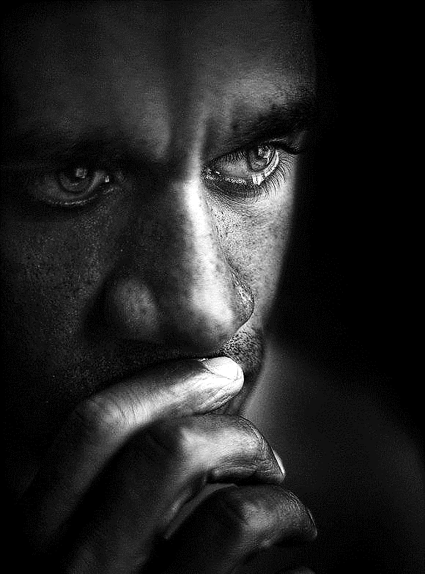
God Searches for Righteous Men with Deep and Prolonged Prayer Lives.
“I sought for a man among them, who should build up the wall, and stand in the gap before me for the land, that I should not destroy it; but I found no one.” Ezk.22:30 (WEB)

Slide 19
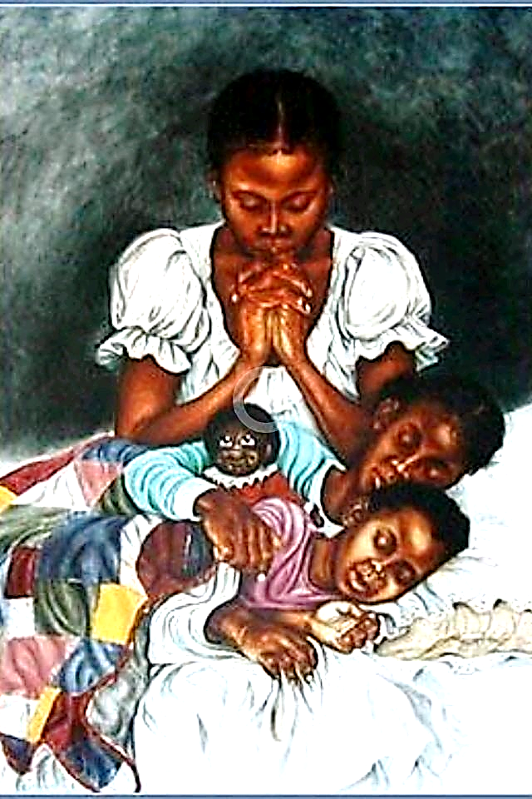
Some homes don‘t have godly father.
What can a Christian mother do?
They Can Model Godliness!
“Wives, follow the lead of your husbands. Suppose some of them don't believe God's word. Then let them be won to Christ without words by seeing how their wives behave. Let them see how pure you are. Let them see that your lives are full of respect for God.”
1 Pet. 3:1, 2 (NIRV)

Slide 20
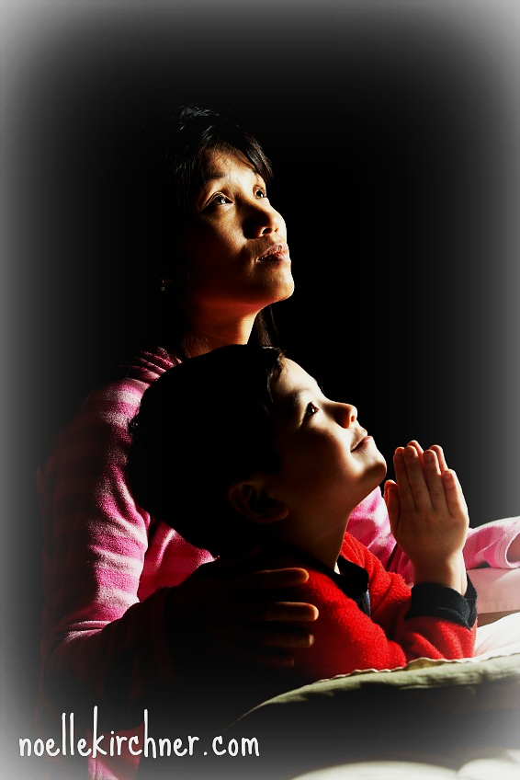
Children also have a role:
They MOTIVATE their parents by believing & being excited about Jesus.
“And he will turn the hearts of fathers to their children and the hearts of children to their fathers”
(ESV) Mal. 4:6

Slide 21
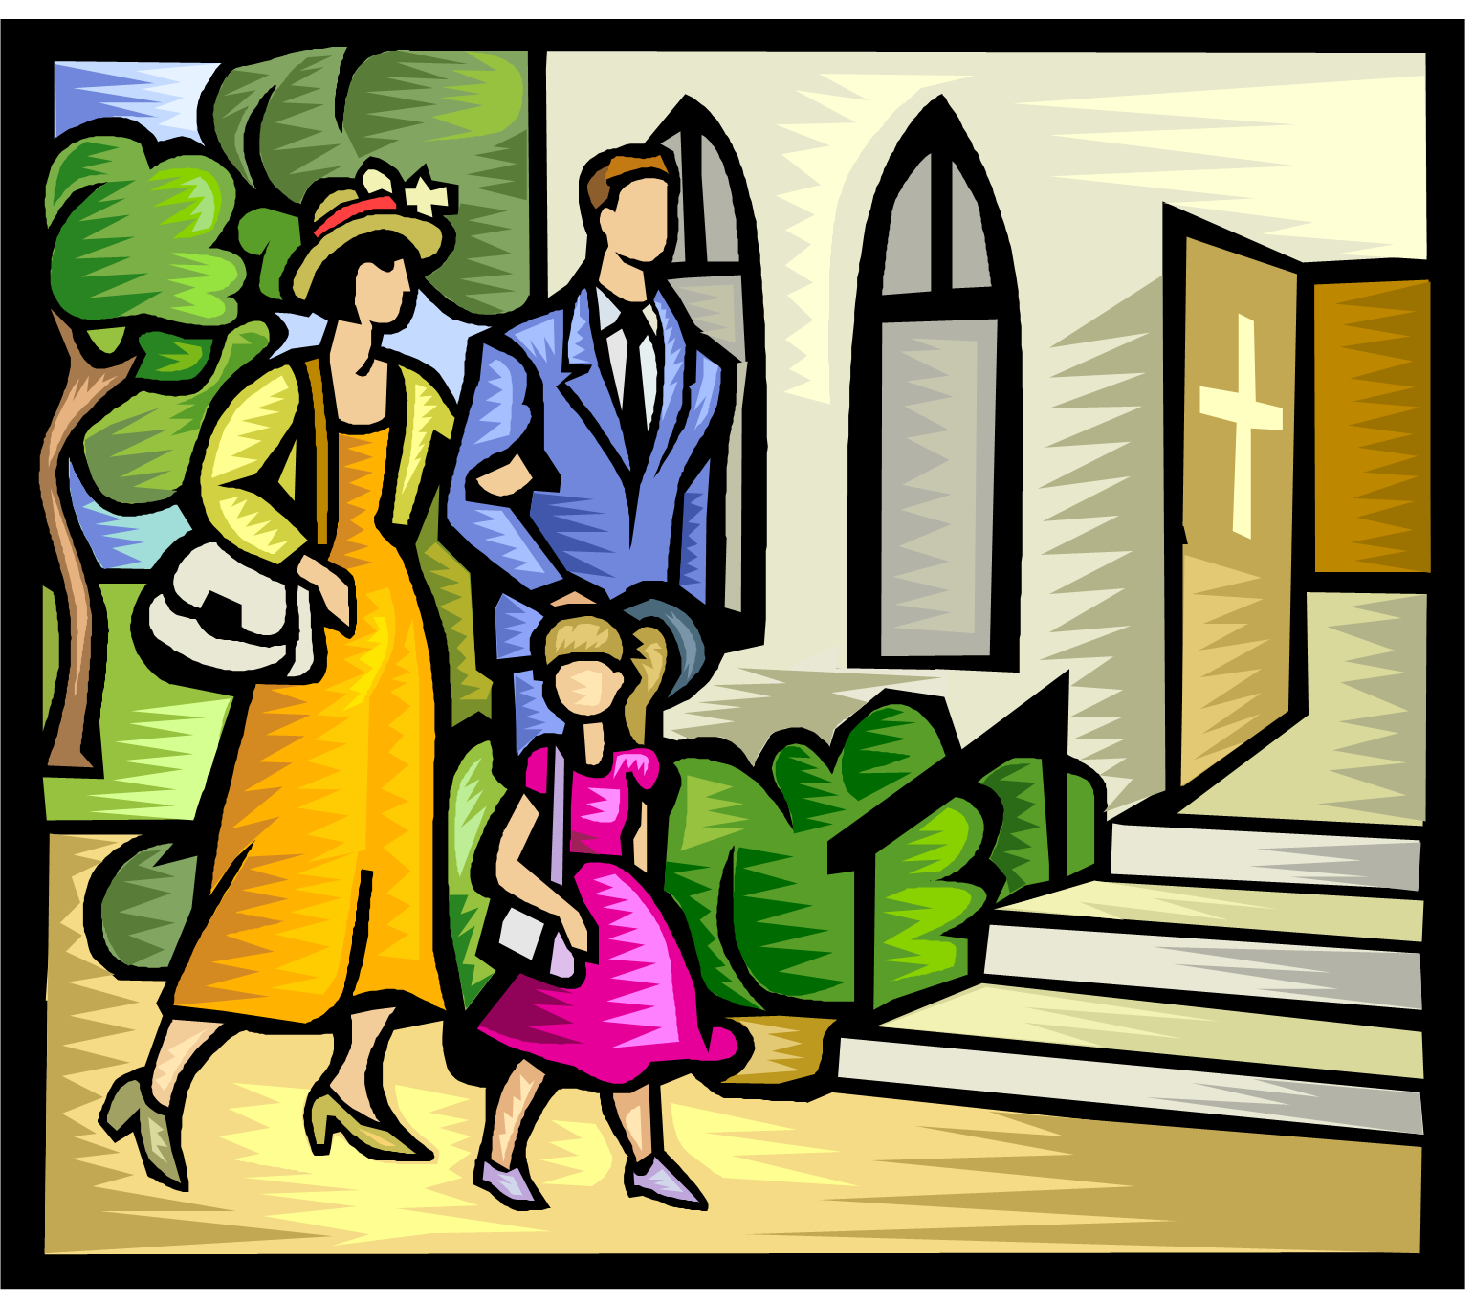
“…And a little child shall lead them.” Isa.11:6
The connection between parents and their children can lead to household salvation.

Slide 22
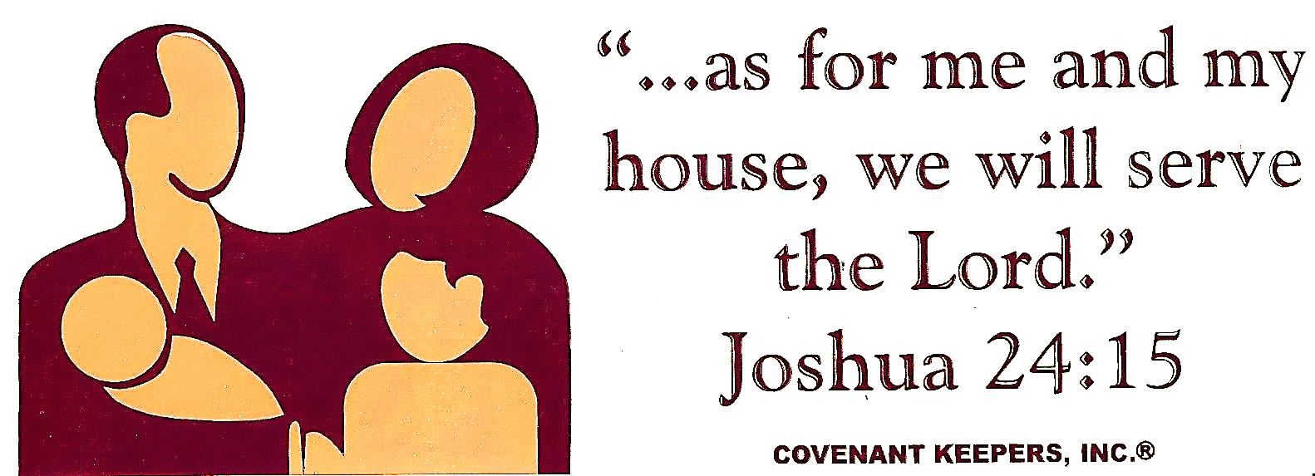
Determine to See Your Family Saved
“Believe in the Lord Jesus and you will be saved, along with everyone in your household.”
Acts 16:31 (NLT)

Slide 23
Next Slide - Song:
As For Me & My House →
Download Here: http://www.youtube.com/watch?v=t2w_pGMVR-o

Slide 24
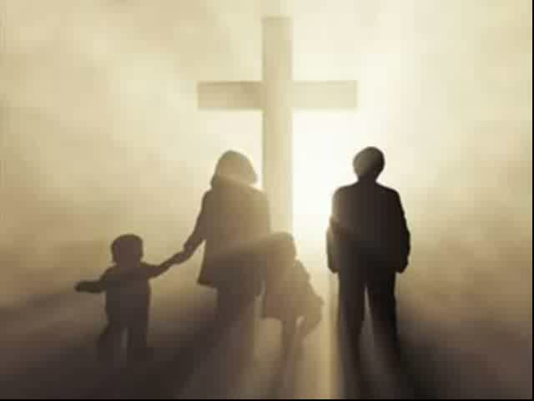
Song: As For Me and My House

Slide 25

What is the Sinner‘s Prayer?
This is a prayer we can pray when we are ready to admit we are sinners and need Christ’s forgiveness.
It must be prayed with faith in our hearts and a readiness to have a life-changing encounter with Jesus Christ.

Slide 26
You Should Pray this Prayer If:
If you never have before
You have in the past, but you think you would mean it more today
You have been walking afar off, and you want to come back
You want to set an example and show others how it is done
You just like to give your heart to Jesus again & again

Slide 27
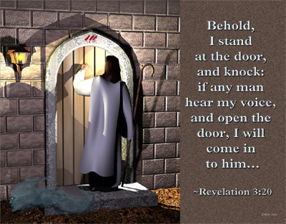

Slide 28

Dear Jesus,
I know I am a sinner & need your forgiveness.
I believe you died for my sins.
I now turn from sin.
Come into my heart I pray.
Do you want to meet Jesus as your Savior right now?
Do you believe He died to save you from your sins & that He rose from the dead?
Do you believe that He is waiting to save you right now?

Slide 29


“But to all who believed him and accepted him, he gave the right to become children of God.” John 1:12

Slide 30



Slide 31


“If you declare with your mouth that Jesus is
Lord, and believe in your heart that God raised him from the dead, you
will be
saved.” Rom. 10:9
What did you learn today?
How does this lesson apply to our lives today?
What do you want to say about Jesus today?

Slide 32

“Draw near to God, and He will draw near to you…
…Cleanse your hands, you sinners, and make your hearts pure, you who are half-hearted towards God.” James 4:8 WNT

Slide 33
Note: Any videos in this presentation will only play online. After you download the slideshow, you will need to also download the videos from YouTube & add them back into your PowerPoint.
We present these messages at Bee Creek Park in College Station, TX.
If you would like to watch the video of the service with this message, click here: http://campaignkerusso.org/?p=6860
We would love to know more about the people who download our lessons & sermons. We invite you to email us & let us know where & how you use them.
info@campaignkerusso.org

Slide 34

Welcome to Aggieland Faith
Family Style Worship

Slide 35

CURRENT SCHEDULE:
See www.Aggielandfaith.org
SATURDAY —
At Bee Creek Park
2:00-4:00pm: Through the Bible with felt-board stories – plus hot-dogs & drinks
SUNDAY —
At Bee Creek Park
2:00-4pm: Free snacks, drinks, kids crafts, prizes, singing & bible preaching

Slide 36


Would You Like Prayer or Bible Study at Your House?
Personal Prayer:
We can come to your home & pray with you, or you can email us when you need prayer.
Home Bible Study:
We will come to your home & hold
a Bible study for you & your friends.
Bible Party:
We will hold a Kid’s Bible Party:
You provide the food & kids—we
will do the Bible fun & stories.

Slide 37

Would You Like Visitation?
We will visit a friend, loved one in the hospital or in prison to pray for them & share Christ with them.
Contact: info@aggielandfaith.org

Slide 38

www.aggielandfaith.org
Go here to see pictures & videos
Go here to subscribe to e-mails about changes & cancellations

Slide 39
Note: Any videos in this presentation will only play online. After you download the slideshow, you will need to also download the videos from YouTube & add them back into your PowerPoint.
We present these messages at Bee Creek Park in College Station, TX.
If you would like to watch the video of the service with this message, click here: http://campaignkerusso.org/?p=6860
We would love to know more about the people who download our lessons & sermons. We invite you to email us & let us know where & how you use them.
info@campaignkerusso.org

