Slide 1
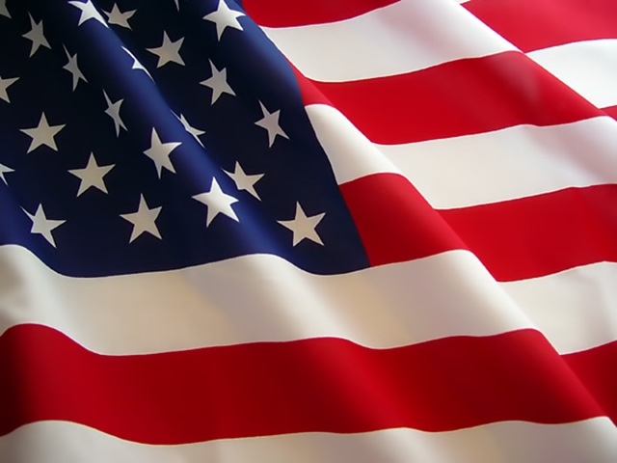
Jesus, the Ultimate Stars & Stripes

Slide 2
Note: Any videos in this presentation may only play online. After you download the slideshow, you may also need to download the videos from YouTube & add them back into your PowerPoint.
We have presented these messages at Bee Creek Park in College Station, TX. See the videos of our messages here: http://campaignkerusso.org/videos
We would love to know more about the people who download our lessons & sermons. We invite you to email us & let us know where & how you use them.
info@campaignkerusso.org

Slide 3
Jesus, the Ultimate Stars & Stripes

Slide 4
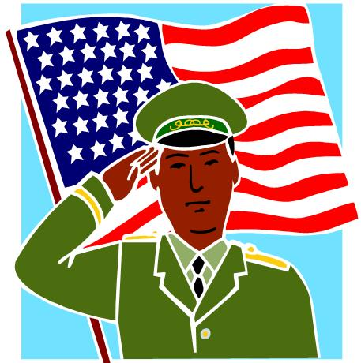
A Flag is a nation’s banner – its identity.
It represents its history & values.

Slide 5
On the battlefield, men identify themselves by the flag they stand under.
They are saying, “This is my tribe and I am willing to die for it.”

Slide 6
Martyrs
The bible likens the church to just such an army:
“Who is this woman? …She is as majestic as troops carrying their banners.” Song 6:10

Slide 7
Christians have their own banner
But this piece of flapping cloth isn’t it !
Our “banner” is a person.
Moses said:
“… The Lord Is My Banner” Ex. 17:15
Let’s Shout it out loud:
“The Lord is my Banner.”

Slide 8
Some Christian symbolism in the American flag:
The Stars: Remind us of Christ’s Heavenly nature.
The White Stripes: Remind us of Christ’s purity.
The Red Stripes: Remind us of His blood spilled for our freedom.
Christ, our banner, is flown where people need to be set free.

Slide 9
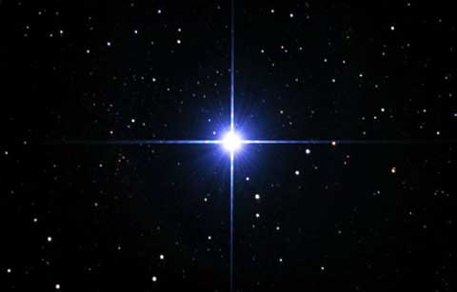
The Stars & Stripes of Jesus
Jesus was born under a star and is called “The Morning Star”—His Heavenly nature.
He died after being tortured with 39 cruel stripes—what He suffered to win our freedom.

Slide 10
"Who Himself bore our sins in His own body on the tree… by whose stripes you were healed.”
1 Peter 2:24

Slide 11
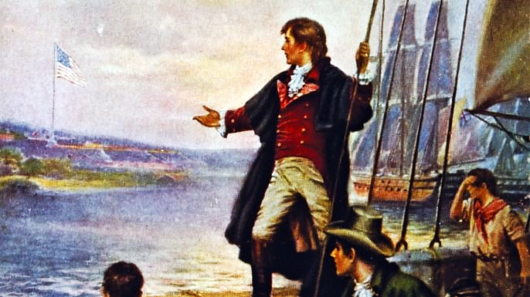
The Story behind the
Star Spangled Banner

Slide 12
Next Slide - Video: Story Behind Star Spangled Banner → Download Here: https://www.youtube.com/watch?v=YaxGNQE5ZLA

Slide 13
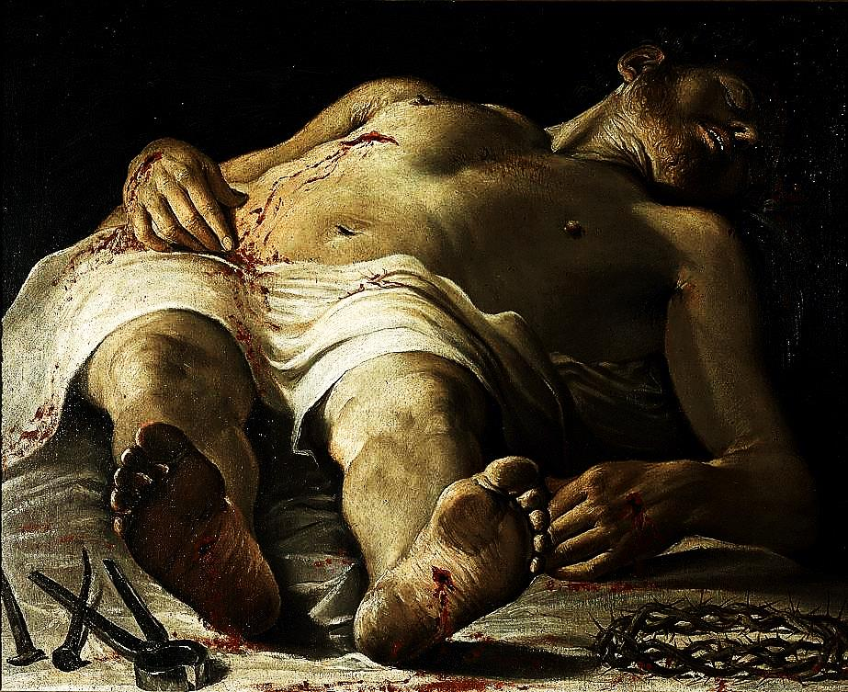
The Story of Christ, Our Banner
Our enemy took mankind prisoner.
A legal release had been negotiated at the cross—rendering the prisoners officially free.
However, one more, potentially devastating battle might render that deal irrelevant. Jesus still had to face the grave & Hell itself.
Mankind was watching. Will Jesus rise or remain in Hell—defeated? What will happen to our banner?

Slide 14
The prisoners are set free.
Praise God, after a long three day watch, Jesus did Rise on Easter Morning…
‘…by the dawn’s early light’
Indeed, our banner yet waves!

Slide 15
In the ‘Star Spangled Banner’ story, each group of loyalists took up the flag and died holding it, only to be replaced by another group willing to die to keep it flying.
Generation after generation, the church has proudly waved, stood for and died for her glorious banner – the crucified & risen Christ.

Slide 16
As demonstrated by this famous moment in baseball history, a beloved banner will be fiercely defended by those who love it.

Slide 17
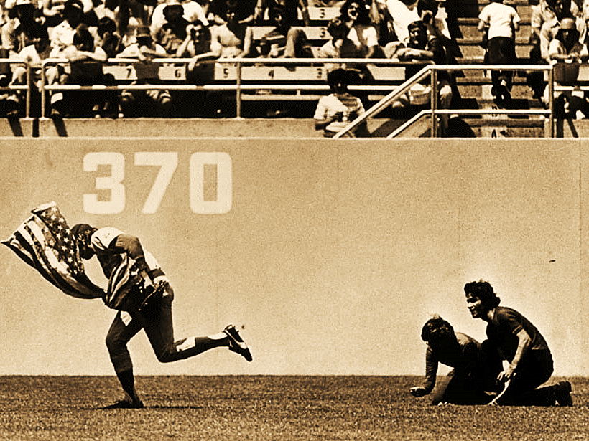
The Greatest Play in Baseball History Rick Monday saves the Flag.

Slide 18
Next Slide - Video: The Greatest Play in Baseball – Rick Monday saves the Flag → Download Here: https://www.youtube.com/watch?v=t0j1CpbC1t4 (***Note) This one takes a couple seconds to start playing.

Slide 19
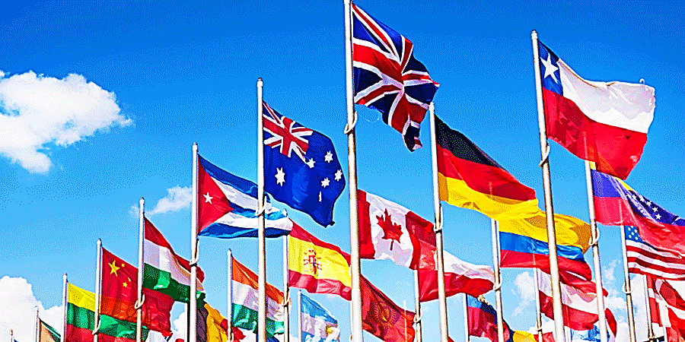
If men will lay down their lives for love of a flag…

Slide 20
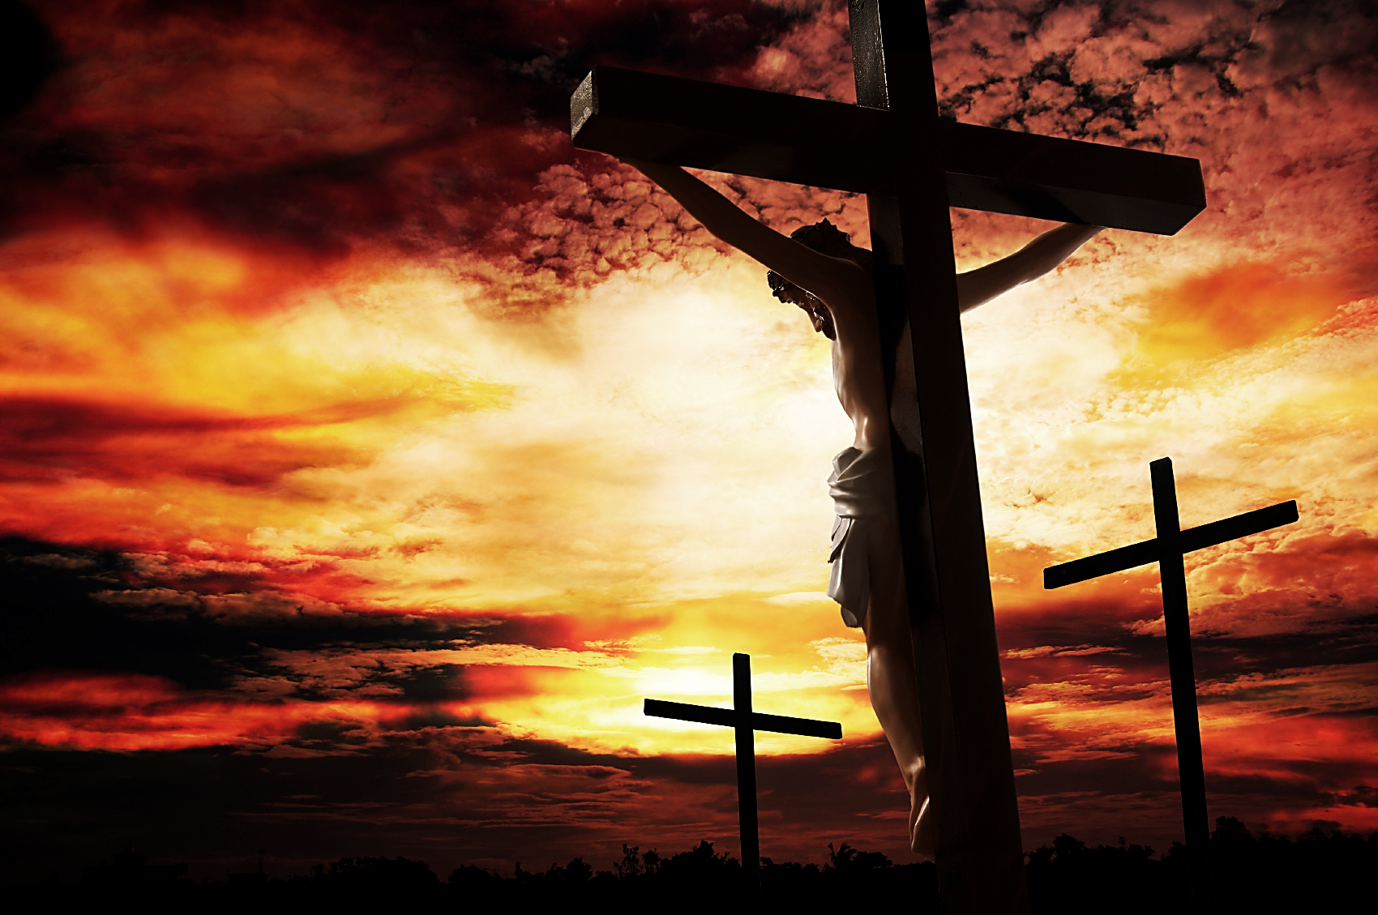
…how much more worthy of our devotion is the One who died to purchase our salvation?
What would we endure for His namesake?

Slide 21
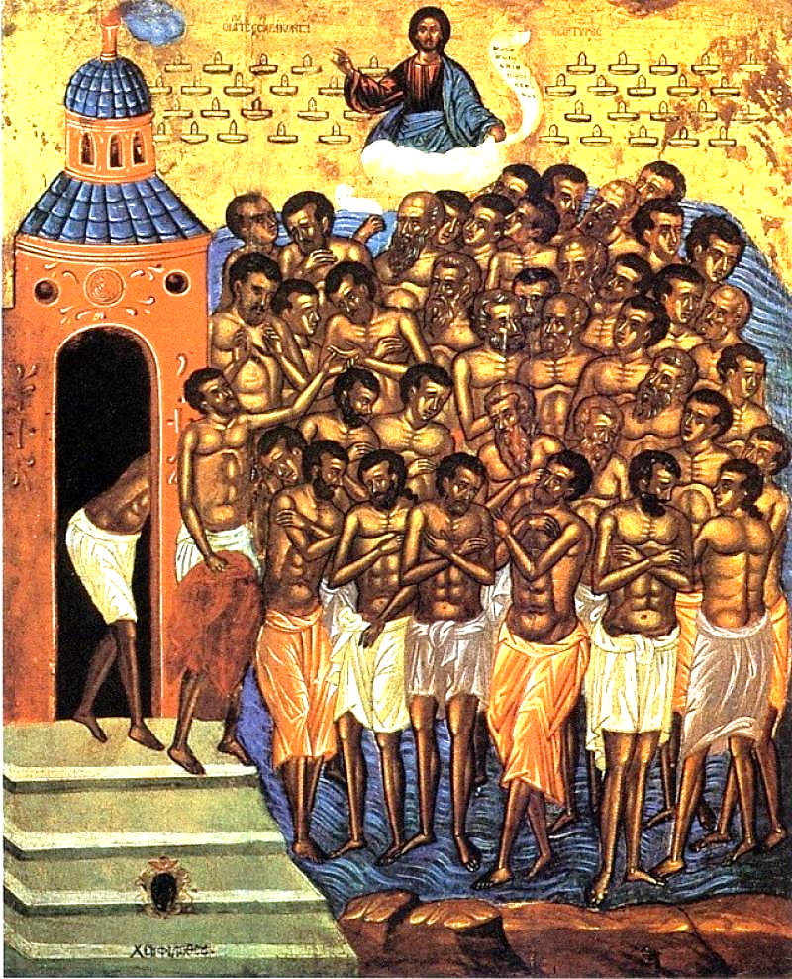
Listen to the true story of the Forty Martyrs of Sevaste— A story of fierce devotion to Christ.

Slide 22
Next Slide - Video: Amazing Story of Devotion—Forty Brave Soldiers → Download Here: https://www.youtube.com/watch?v=pXgEzauXUdc

Slide 23
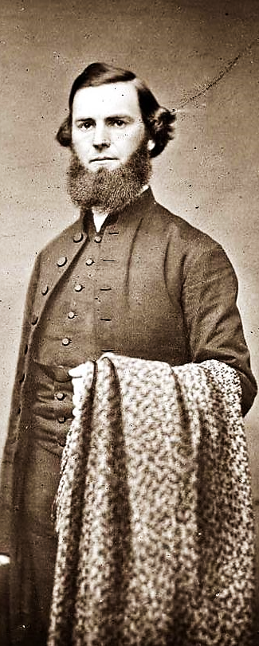
Rev. Dudley A. Tyng, a YMCA preacher, helped lead Philadelphia into major revival in the 1850’s.
During one service, while preaching on the text: “Ye that are men, go and serve the Lord” Ex.10:11, he shouted:
“I would rather this right arm were amputated at the trunk than that I should come short of my duty to you in delivering God’s message.”

Slide 24
Two weeks later, he accidently got his arm caught in a corn-thrasher where it was ripped out at the socket.
As he lay dying he said, “Tell my brethren… to stand up for Jesus.”
Upon hearing this story at Rev. Tyng’s funeral, his friend, Pastor George Duffield, was inspired to pen the words to this song: “Stand up for Jesus.”

Slide 25
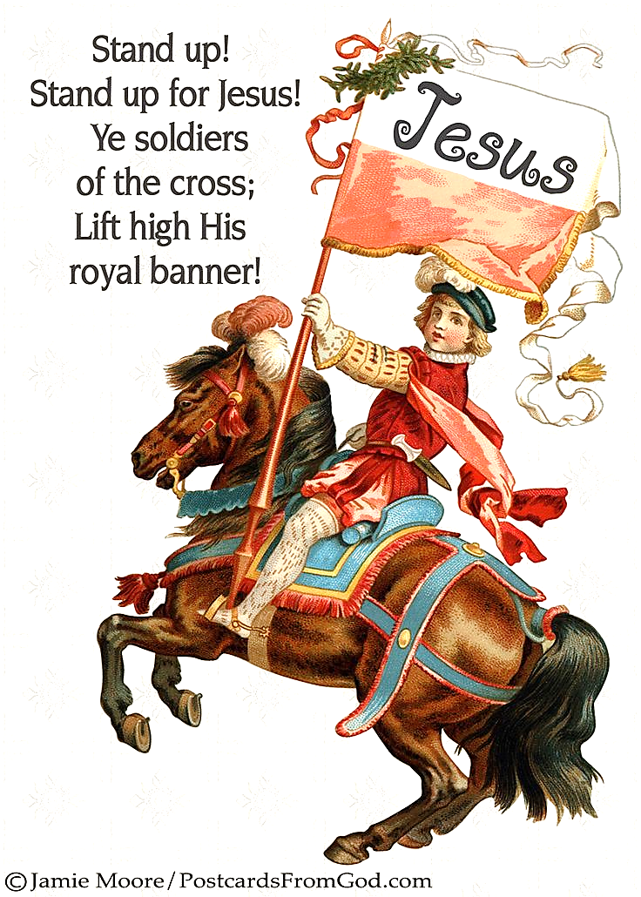
Be proud and wave our flag—We love Jesus, our Lord and Savior!
Let’s sing: Stand Up for Jesus.

Slide 26
Next Slide - Song: Stand Up, Stand Up → Download Here: https://www.youtube.com/watch?v=JcibPjUn4Fo

Slide 27
Is Jesus Speaking to You?
“They said to each other, ‘Did not our hearts burn within us while he talked to us on the road, while he opened to us the Scriptures?’”
John Wesley Said:
“…the preacher was describing the change which God works in the heart through faith in Christ and I felt my heart strangely warmed.”
Jesus makes His presence Known by a small voice!

Slide 29
What is the Sinner‘s Prayer?
This is a prayer we can pray when we are ready to admit we are sinners and need Christ’s forgiveness.
It must be prayed with faith in our hearts and a readiness to have a life-changing encounter with Jesus Christ.

Slide 30
A Prayer of Faith → Pray this prayer if :
If you never have before.
You have in the past, but you think it would mean more today.
You have been walking afar off and you want to come back.
You want to set an example & show others how it is done.
You just like to give your heart to Jesus again & again.
Faith

Slide 31
We Declare Our Faith Publicly Because Jesus Declared His LOVE Publicly
“If you stand before others and are willing to say you believe in me, then I will tell my Father in heaven that you belong to me.” Mat 10:32

Slide 32
Important Questions
Do you want to know Jesus as your Savior right now?
Do you believe He died to save you from your sins & that He rose from the dead?
Do you believe that He is here, waiting to save you right now?

Slide 33
The Prayer of a Sinner Turning to Jesus
Dear Jesus, I know that I have sinned against You and that my sins separate me from You.
I am truly sorry.
Right now, I turn away from my sinful past .
Please forgive me, and help me to keep from sin.
I believe You died for my sins.
I Believe You rose from the dead, you are alive, and you hear this prayer from my heart.
I invite You Jesus to be both my Savior and the Lord of my life.
I want You to rule my life from now on.

Slide 34
“But some people did accept him. They believed in him, and he gave them the right to become children of God.”
John 1:12

Slide 36
“If you openly say, ‘Jesus is Lord’ and believe in your heart that God raised him from death, you will be saved.”
Rom. 10:9
What did you learn today?
What have you been thinking about God lately?
What do you want to tell others about Jesus?

Slide 37
Draw near to God, and He will draw near to you…
Altar Time
…Cleanse your hands, you sinners, and make your hearts pure, you who are half-hearted towards God.” James 4:8 WNT

Slide 38
Let’s Close in Prayer

Slide 39
Note: Any videos in this presentation may only play online. After you download the slideshow, you may also need to download the videos from YouTube & add them back into your PowerPoint.
We have presented these messages at Bee Creek Park in College Station, TX. See the videos of our messages here: http://campaignkerusso.org/videos
We would love to know more about the people who download our lessons & sermons. We invite you to email us & let us know where & how you use them.
info@campaignkerusso.org

