Slide 1
Our lesson today is called: No Peanut Butter and Jelly

Slide 2
Welcome All

Slide 3
Note: Any videos in this presentation will only play online. After you download the slideshow, you will need to also download the videos from YouTube & add them back into your PowerPoint.
We present these messages at Bee Creek Park in College Station, TX. If you would like to watch the video of the service with this message, click here:
http://campaignkerusso.org/?p=13396
We would love to know more about the people who download our lessons & sermons. We invite you to email us & let us know where & how you use them.
info@campaignkerusso.org

Slide 4
Let’s Begin with Prayer

Slide 5
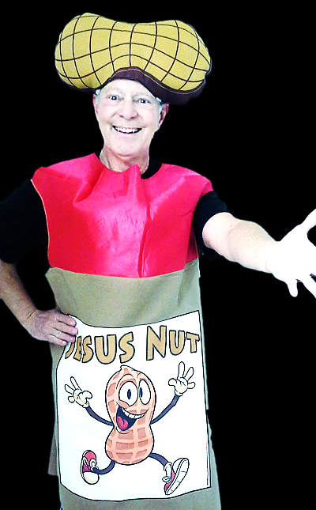
Let’s all give a warm welcome to…
The Jesus Nut

Slide 6
Insert Next Slide Here Video: Peanut Butter & Jelly Download here: https://youtu.be/ugB-aqagOwc

Slide 7
Our lesson today is called: No Peanut Butter and Jelly

Slide 8
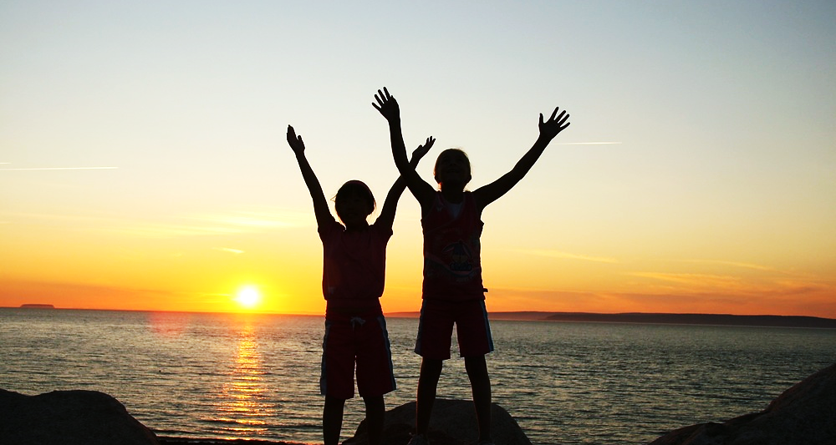
But first…We’re going to sing a song
Let’s Learn the Actions

Slide 9
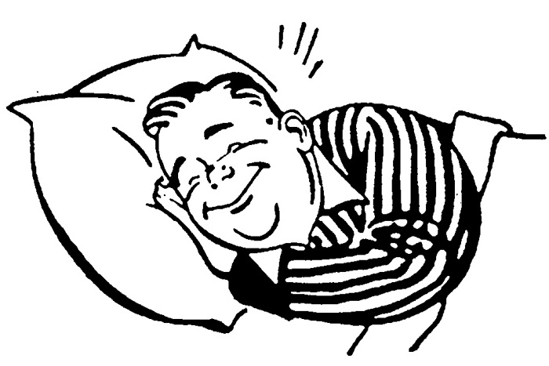
Give me Jesus in the morning

Slide 10
Give me Jesus in the evening

Slide 11
Every minute of the day…

Slide 12
Give me Jesus

Slide 13
He’s my reason for living

Slide 14
He’s my source of survival

Slide 15
Every minute of the day…

Slide 16
Give me Jesus

Slide 17
Insert Next Slide Here Video: Give Me Jesus Download here: https://youtu.be/P5HuOsV-6Tc

Slide 18
Who wants to see a Nutty magic trick ?

Slide 19
Insert Next Slide Here Music: Magic Background Music Download here: https://youtu.be/psN0jkAY1lI ***** You can buy this Magic Trick Here: http://stores.silkmagictricks.com/products/peanut-butter-and-jelly-illusion-pro-model.html?gclid=CjwKEAiAmo_CBRC9qbGQssjqi28SJABYTgZxhErgePDb3SEl7MOCv0gqQanjTJtNrDjo_LGzilVq8RoC2Mnw_wcB

Slide 20
Did you watch closely?
What did you see happen?
Why is food (like this peanut butter & jelly) so important to us?
Are you hungry right now?
Questions:

Slide 21
Who wants some peanut butter and jelly crackers right now?

Slide 22
Insert Next Slide Here Video: The Time Jesus was Hungry Download here: https://youtu.be/ag8Npzs7mXY

Slide 23
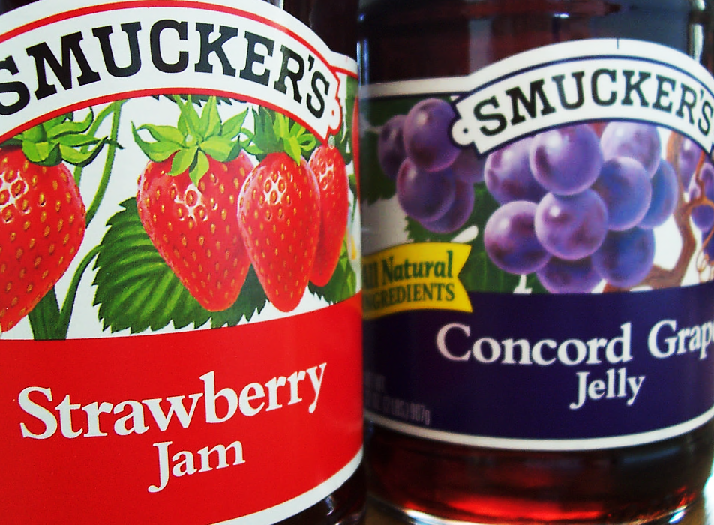
Did you know… There are two kinds of foods and two kinds of hunger?

Slide 24
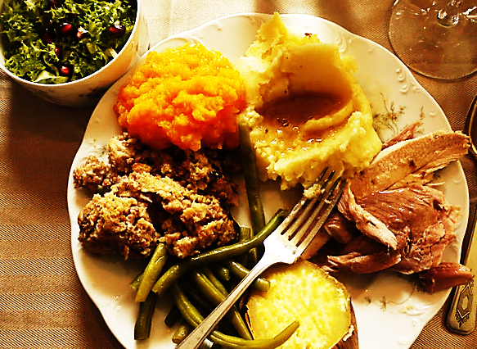
One kind of food feeds our bodies…
The other
feeds our souls

Slide 25
One makes us bigger…
The other makes us better

Slide 26
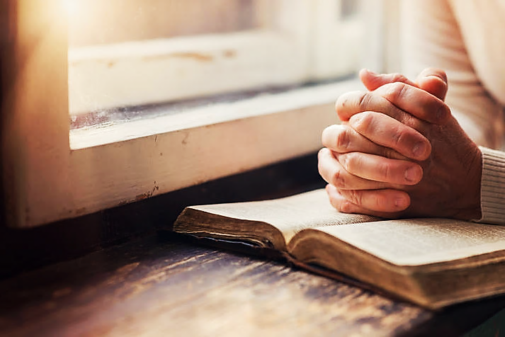
One saves our lives today…
The other saves our souls forever.

Slide 27
Jesus said:
“He who comes to me will never go hungry.”

Slide 28
Jesus also said:
“He who comes to me will never thirst.”
He who comes to me will never go hungry

Slide 29
Insert Next Slide Here Video: The Time Jesus was Hungry Download here: https://youtu.be/2kQGAXRSn-s Note: The music in this video softens halfway through to allow you to speak with a musical background if you like.

Slide 30
What are the two kinds of hunger?
What are the two kinds of food?
What did the mother think her son wanted?
What did he really want?
Why did he want Jesus more than peanut butter and jelly?
Questions:

Slide 31
Is Jesus Speaking
to You?
“They began telling each other how their hearts had felt strangely warm as he talked with them…”
Lk.24:32 (TLB)
John Wesley Said:
“…the preacher was describing the change which God works in the heart… and I felt my heart strangely warmed.”
Jesus makes His presence Known by a small voice!

Slide 32
What is the Sinner‘s Prayer?
This is a prayer we can pray when we are ready to admit we are sinners and need Christ’s forgiveness.
It must be prayed with faith in our hearts and a readiness to have a life-changing encounter with Jesus Christ.

Slide 33
A prayer of faith → Pray this prayer if :
If you never have before
You have in the past, but you think it would mean more today
You have been walking afar off and you want to come back
You want to set an example & show others how it is done
You just like to give your heart to Jesus again & again
Faith

Slide 34
Important Questions
Do you want to know Jesus as your Savior right now?
Do you believe He died to save you from your sins & that He rose from the dead?
Do you believe that He is here, waiting to save you right now?

Slide 35
We Declare Our Faith Publicly Because Jesus Declared His LOVE Publicly
“If you stand before others and are willing to say you believe in me, then I will tell my Father in heaven that you belong to me.” Mat 10:32

Slide 36
The Prayer of a Sinner Turning to Jesus
Dear Jesus, I know that I have sinned against You and that my sins separate me from You.
I am truly sorry.
Right now, I turn away from my sinful past .
Please forgive me, and help me to keep from sin.
I believe You died for my sins.
I Believe You rose from the dead, you are alive, and you hear this prayer from my heart.
I invite You Jesus to be both my Savior and the Lord of my life.
I want You to rule my life from now on.

Slide 37
“But some people did accept him. They believed in him, and he gave them the right to become children of God.”
John 1:12

Slide 39
“If you openly say, ‘Jesus is Lord’ and believe in your heart that God raised him from death, you will be saved.”
Rom. 10:9
What did you learn today?
Why is Jesus better than peanut butter and jelly?
What have you been thinking about God lately?
What do you want to tell the world about Jesus?

Slide 40
Let’s Close with Prayer

Slide 41
Note: Any videos in this presentation will only play online. After you download the slideshow, you will need to also download the videos from YouTube & add them back into your PowerPoint.
We present these messages at Bee Creek Park in College Station, TX. If you would like to watch the video of the service with this message, click here:
http://campaignkerusso.org/?p=13396
We would love to know more about the people who download our lessons & sermons. We invite you to email us & let us know where & how you use them.
info@campaignkerusso.org

