Slide 1
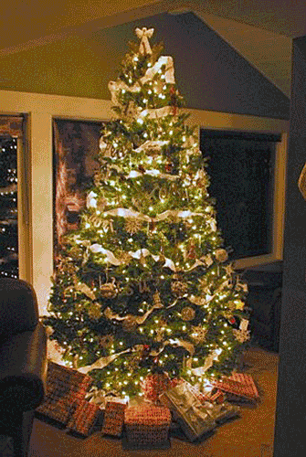
The Most Beautiful Tree

Slide 2
Welcome All

Slide 3
Let’s Begin with Prayer

Slide 4
The Most Beautiful Tree

Slide 5
What is the prettiest Christmas tree you remember seeing?

Slide 6
Here is New York City’s 2016 Tree
How Tall?
94 Feet Tall
How Wide?
56 Feet Wide
Size of Truck?
115 Foot long Flat Bed Truck
How many lights?
30,000 LED Lights
What happens to the tree after Christmas?
Its milled into lumber and donated to Habitat for Humanity to build homes for those in need.

Slide 7
What did we just see and learn?
What happens in the video?
The Tree is laid bare and a Cross is formed
What does a tree, turning into a cross, tell us, about Christmas and the Christmas Story?
God became a man, to give His life for mankind
Why do we forget what Christmas is about?
We look at all the shiny gifts but forget about the Heavenly Giver who is God.
What is the greatest gift that God has given us?
His Son Jesus, to die on the Cross for our sins

Slide 8
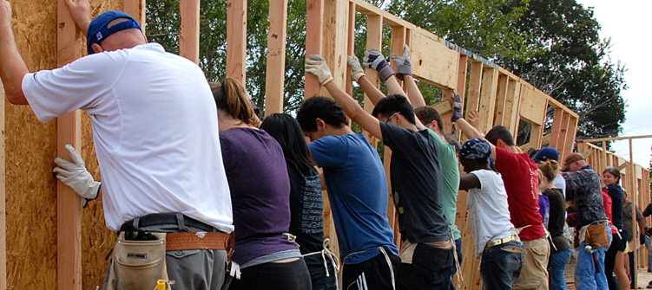
Like the Time Square Tree that was eventually brought down and became lumber for Habitat for Humanity, Jesus chose to come down from His high place of glory and allow His body to be broken so that He might save souls.

Slide 9
“Who, though he was God, did not demand and cling to his rights as God, but laid aside his mighty power and glory, taking the disguise of a slave and becoming like men. And he humbled himself even further, going so far as actually to die a criminal’s death on a cross.” Phil. 2:6-8

Slide 10
Next Slide-Song: The Cross is My Christmas Tree→ Download Here: https://youtu.be/nugZyi4OfA0

Slide 11
Next Slide-Song: It’s About the Cross→ Download Here: https://youtu.be/aKmUQHhyYwE

Slide 12
The Cross is the World’s Most Beautiful Tree

Slide 13
It was not made of fragrant spruce or pine, but rather, old scrap wood.
“…Christ, who loved us and gave himself for us. He was a sacrificial offering that smelled sweet to God.” Eph.5:2 (CEB)

Slide 14
There were no ornaments hanging
on this tree, but rather the suffering body of a loving Savior:
“He Himself bore our sins in His body on the tree” I Pet. 2:24

Slide 15
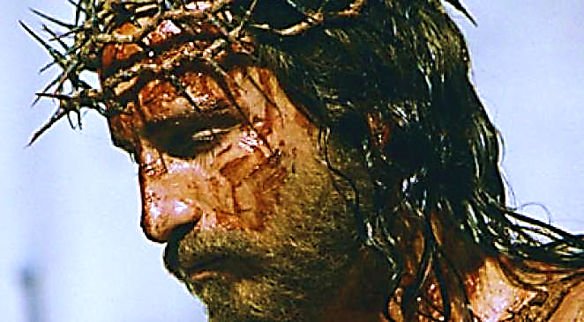
...instead, a crown of thorns encircled His brow.
There was no garland wrapped around this tree…

Slide 16
Rather than streams of festive tinsel, the Lord’s blood cascaded down this tree—the price paid to cleanse us of our sins.

Slide 17
…but a sign which read “Jesus of Nazareth, King of the Jews.” The King of all Creation became a man, and died for man’s sins.
There was no star at the top…

Slide 18
The Most Beautiful Tree
Nothing will ever surpass this tree, for beauty.
Nothing will ever touch our hearts so deeply…
Or fulfill our lives so completely.

Slide 19
He loved us then, and He loves us now!

Slide 21
Is Jesus Speaking
to You?
“They began telling each other how their hearts had felt strangely warm as he talked with them…”
Lk.24:32 (TLB)
John Wesley Said:
“…the preacher was describing the change which God works in the heart… and I felt my heart strangely warmed.”
Jesus makes His presence Known by a small voice!

Slide 22
What is the Sinner‘s Prayer?
This is a prayer we can pray when we are ready to admit we are sinners and need Christ’s forgiveness.
It must be prayed with faith in our hearts and a readiness to have a life-changing encounter with Jesus Christ.

Slide 23
A prayer of faith → Pray this prayer if :
If you never have before
You have in the past, but you think it would mean more today
You have been walking afar off and you want to come back
You want to set an example & show others how it is done
You just like to give your heart to Jesus again & again
Faith

Slide 24
Important Questions
Do you want to know Jesus as your Savior right now?
Do you believe He died to save you from your sins & that He rose from the dead?
Do you believe that He is here, waiting to save you right now?

Slide 25
We Declare Our Faith Publicly Because Jesus Declared His LOVE Publicly
“If you stand before others and are willing to say you believe in me, then I will tell my Father in heaven that you belong to me.” Mat 10:32

Slide 26
The Prayer of a Sinner Turning to Jesus
Dear Jesus, I know that I have sinned against You and that my sins separate me from You.
I am truly sorry.
Right now, I turn away from my sinful past .
Please forgive me, and help me to keep from sin.
I believe You died for my sins.
I believe You rose from the dead, you are alive, and you hear this prayer from my heart.
I invite You Jesus to be both my Savior and the Lord of my life.
I want You to rule my life from now on.

Slide 27
“But some people did accept him. They believed in him, and he gave them the right to become children of God.”
John 1:12

Slide 29
“If you openly say, ‘Jesus is Lord’ and believe in your heart that God raised him from death, you will be saved.”
Rom. 10:9
What did you learn today?
Tell me about the real most beautiful Christmas tree.
What have you been thinking about God lately?
What do you want to tell the world about Jesus?

Slide 30
Let’s Close in Prayer

Slide 31
Extra Slide Suggestion - Song: Strange Way to Save the World→ Download Here: https://youtu.be/YBCVIJBB7o4?list=RDODKC0VdKfoU

Slide 32
Extra Slide Suggestion -Video: The Three Trees → Download Here: http://www.youtube.com/watch?v=MBZ-gYHBMeA

Slide 33
Extra Slide Suggestion - Song: Born to Die → Download Here: http://www.youtube.com/watch?v=Z75tEiGet3Q

Slide 34
Extra Slide Suggestion - Song: What Christmas Really Means→ Download Here: https://youtu.be/ECNKQDT0F2M

Slide 35
Extra Slide Suggestion - Song: Let Us Not Forget → Download Here: http://www.youtube.com/watch?v=HQLPx0pK9d4

