Slide 1
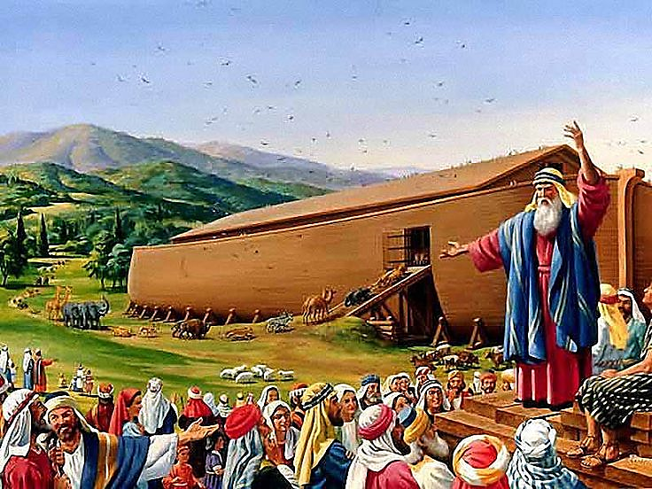
Eight Lessons From Noah‘s Ark

Slide 2
Note: After you download the slideshow, you may also need to download some videos from YouTube & add them into this PowerPoint. This tool can help you: Free YouTube Download
We present these messages in outdoor venues using the SonShineTent. Watch the video of our service that goes with this message, click here: http://campaignkerusso.org/?p=6932
We would love to know more about the people who download our lessons & sermons. We invite you to email us & let us know where & how you use them.
info@campaignkerusso.org

Slide 3
Welcome All

Slide 4
Let’s Begin with Prayer

Slide 5
Eight Lessons From Noah‘s Ark

Slide 6
Next Slide Goes Here
Video: Noah’s Ark Download Here:
https://youtu.be/zto7JZHOQgI

Slide 7
Lesson One: God always warns and longs to save everyone from sin’s judgement.
People Sin:
“For everyone has sinned; we all fall short of God's glorious standard.”
Rom 3:23
God Punishes Sin:
“Indeed, just as people are destined to die once and after that to be judged.” Heb. 9:27

Slide 8
He Always Gives People a Choice
“…unless you repent,
you too will all perish.”
Luke 13:5
“Whoever believes in the Son has eternal life, but whoever rejects the Son will not see life, for God's wrath remains on him."
John 3:36

Slide 9
Lesson Two: God patiently waits even while people scoff.
"The Lord is slow to anger and great in power” Nah. 1:3
“He is patient with you, not wanting anyone to perish, but everyone to come to repentance.”
2 Pet. 3:9
“…If only you would listen to his voice today! Ps. 95:7

Slide 10
God Freely Publishes His Plans
"Come to me, all you who are weary and burdened, and I will give you rest." Mat. 11:28
He said to them, "Go into all the world and preach the good news to all creation.”
Mark 16:15

Slide 11
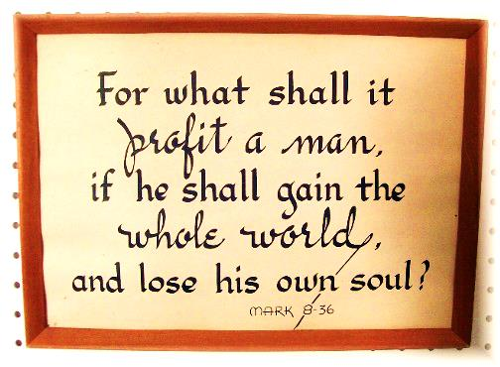
One day all chances will come to an end and judgement will come. Are we Ready?

Slide 12
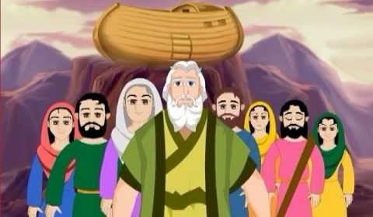
Lesson Three: God wants to save whole families.
"And the Lord said unto Noah, Come thou and all thy house into the ark “ Gen. 7:1
"A few, that is, eight souls, were brought safely through by water." 1 Pet. 3:20

Slide 13
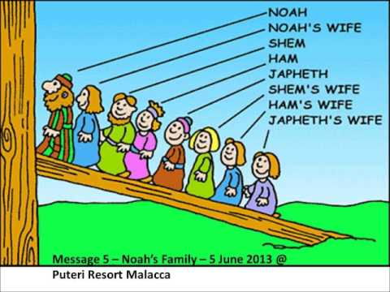
God’s Plan is Household Salvation
" Then the Lord said to Noah, “Go into the ark, you and all your household.” Gen. 7:1 (ESV)
"A few, that is, eight souls, were brought safely through by water." 1 Pet. 3:20 (ESV)

Slide 14
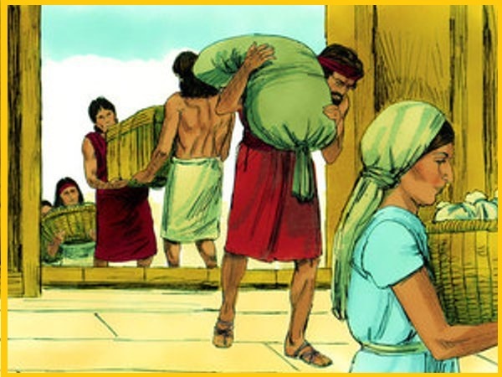
God Loves to Save Whole Households at a Time!
“…Believe in the Lord Jesus and you will be saved, along with everyone in your household." Acts 16:31

Slide 15
Lesson Four: God made a plan—a way of salvation—we must choose to enter in.

Slide 16
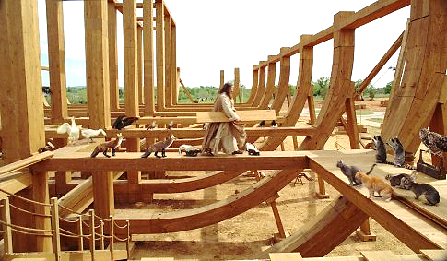
Long before the rain started, God led Noah to build an ark and gave him the plans – including one door, one window by the roof, and pitch all over.

Slide 17
God always had a plan to save the world! Jesus is the “Lamb slain from the foundation of the world.” Rev. 13:8

Slide 19
God Made a Simple Salvation Plan
“…takes no pleasure in the death of the wicked.”
Ezk. 33:11
Just come to the Ark!
Just come to Jesus -- He Our Ark!!

Slide 21
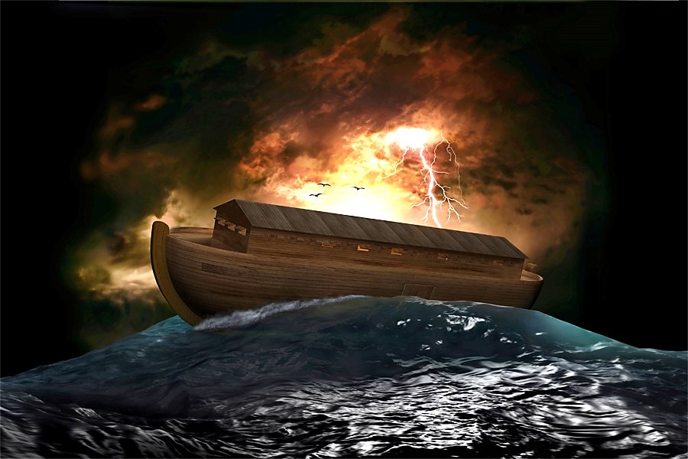
Lesson Five: Jesus is like the ark and we must be IN Him to be saved.

Slide 22
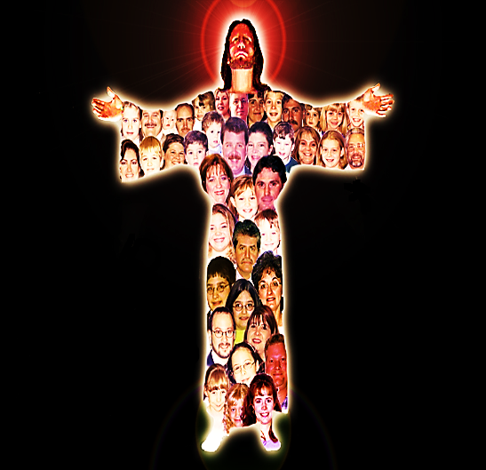
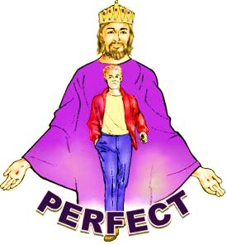

Slide 23
“There is therefore now no condemnation for those who are IN Christ Jesus.” Rom. 8:1
"…we are IN Him that is true, even IN His Son Jesus Christ." 1 John 5:20
“Therefore, if anyone is IN Christ, he is a new creation. The old has passed away; behold, the new has come.” 2 Cor. 5:17

Slide 24
Lesson Six: The ark has only one door. Jesus said He is the only door to salvation.

Slide 25
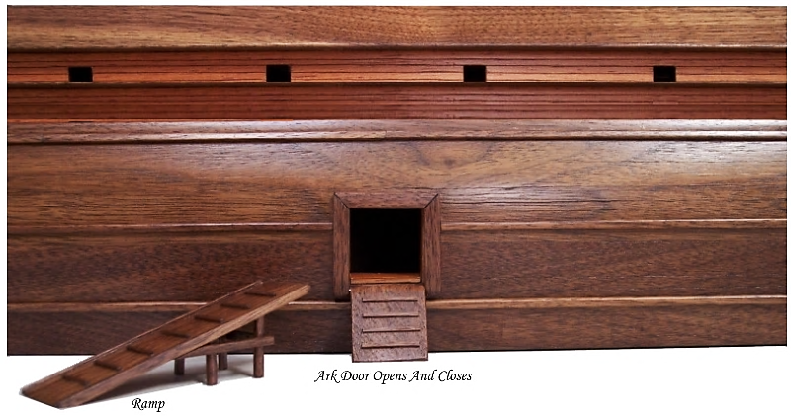
The Door is like Jesus. He is Our One Way of Salvation.

Slide 27
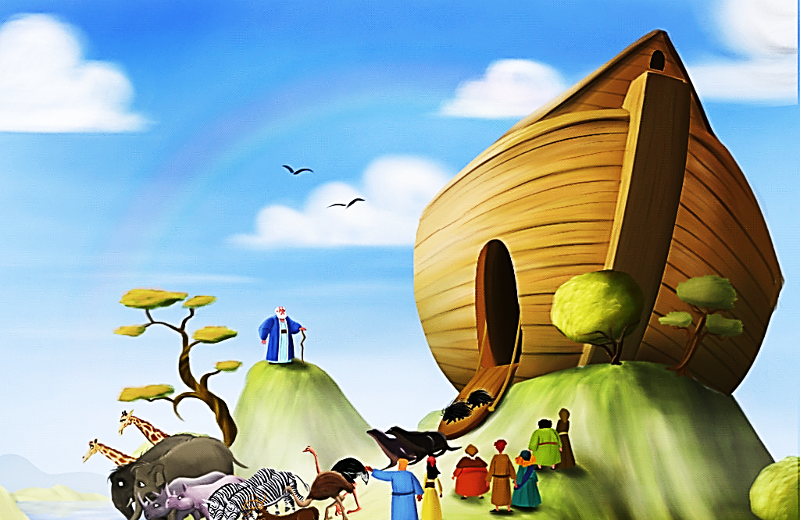
Lesson Seven :
The ark had one window by the roof. We must look to Heaven for salvation.
“Think only about the things in heaven, not the things on earth.” Col. 3:2 ICB
“In the end, they will be destroyed. They do whatever their bodies want, they are proud of their shameful acts, and they think only about earthly things. But our homeland is in heaven, and we are waiting for our Savior, the Lord Jesus Christ, to come from heaven.” Phil. 3:19-20 (NCV)

Slide 28
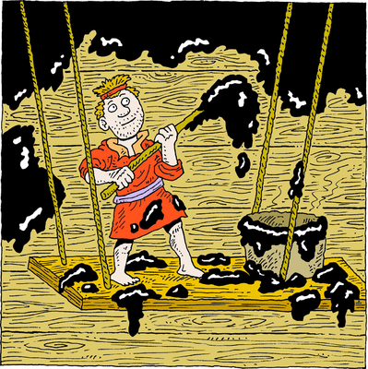
Lesson Eight: The Pitch is Like the Blood of Jesus that Covers & Protects Believers
Make yourself an ark of gopher wood. Make rooms in the ark, and cover it inside and out with pitch.
Gen, ^:14

Slide 29
As long as the timber was covered with pitch, the waters of judgement could not hurt it.

Slide 30
The Hebrew word for “pitch” is “kopher.” It means, “ransom” –the price of a man’s life.
“For the Son of Man did not come to be served, but to serve and to give his life as a ransom for many.”
Mat. 20:28 CJB

Slide 31
The Blood of Jesus is Our “Pitch”
“We have been made right with God by the blood sacrifice of Christ. So through Christ we will surely be saved from God’s anger.” Rom. 5:9 ERV

Slide 32
Next Slide Goes Here
Song: Noah’s Ark Download Here:
https://youtu.be/4r78BLBszQ0

Slide 34
Is Jesus
Speaking to You?
“They said to each other, ‘Did not our hearts burn within us while he talked to us on the road, while he opened to us the Scriptures?’”
John Wesley Said:
“…the preacher was describing the change which God works in the heart through faith in Christ and I felt my heart strangely warmed.”
Jesus makes His presence Known by a small voice!

Slide 35
What is the Sinner‘s Prayer?
This is a prayer we can pray when we are ready to admit we are sinners and need Christ’s forgiveness.
It must be prayed with faith in our hearts and a readiness to have a life-changing encounter with Jesus Christ.

Slide 36
A prayer of faith → Pray this prayer if :
If you never have before
You have in the past, but you think it would mean more today
You have been walking afar off and you want to come back
You want to set an example & show others how it is done
You just like to give your heart to Jesus again & again
Faith

Slide 37
We Declare Our Faith Publicly Because Jesus Declared His LOVE Publicly
“If you stand before others and are willing to say you believe in me, then I will tell my Father in heaven that you belong to me.” Mat 10:32

Slide 38
Three Important Questions
Do you want to know Jesus as your Savior right now?
Do you believe He died to save you from your sins & that He rose from the dead?
Do you believe that He is here, waiting to save you right now?

Slide 39
The Prayer of a Sinner Turning to Jesus
Dear Jesus, I know that I have sinned against You and that my sins separate me from You.
I am truly sorry.
Right now, I turn away from my sinful past .
Please forgive me, and help me to keep from sin.
I believe You died for my sins.
I Believe You rose from the dead, you are alive, and you hear this prayer from my heart.
I invite You Jesus to be both my Savior and the Lord of my life.
I want You to rule my life from now on.

Slide 40
“But some people did accept him. They believed in him, and he gave them the right to become children of God.”
John 1:12

Slide 42
“If you openly say, ‘Jesus is Lord’ and believe in your heart that God raised him from death, you will be saved.”
Rom. 10:9
What did you learn today?
What about Jesus & Noah’s Ark
What have you been thinking about God lately?
What do you want to tell others about Jesus?

Slide 43
Let’s Close in Prayer

Slide 44
Note: After you download the slideshow, you may also need to download some videos from YouTube & add them into this PowerPoint. This tool can help you: Free YouTube Download
We present these messages in outdoor venues using the SonShineTent. Watch the video of our service that goes with this message, click here: http://campaignkerusso.org/?p=6932
We would love to know more about the people who download our lessons & sermons. We invite you to email us & let us know where & how you use them.
info@campaignkerusso.org

