Slide 1
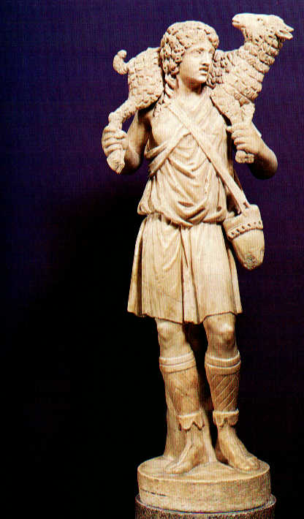
The Good Shepherd
and His Sheep pt. 1 (He Seeks the Lost)

Slide 2
Note: Any videos in this presentation will only play online. After you download the slideshow, you will need to also download the videos from YouTube & add them back into your PowerPoint.
We present these messages at outdoor events around Texas. If you would like to watch the video of the service with this message, click here:
http://campaignkerusso.org/?p=11515
We would love to know more about the people who download our lessons & sermons. We invite you to email us & let us know where & how you use them.
info@ckbrazos.org

Slide 3
Welcome All

Slide 4
Let’s Begin with Prayer

Slide 5
The Good Shepherd
and His Sheep pt. 1 (He Seeks the Lost)

Slide 6
This Slide - Song: Ba. Ba, He’s the Good Shepherd → Download Here: http://youtu.be/PGPQX3vQtU8

Slide 7
This Slide - Song: I Am a Sheep Download Here: https://youtu.be/KEvhGuxOGg0

Slide 8
Throughout history,
mankind has been
compared to sheep.
Both men & sheep
can be…
LED ASTRAY
and
GET COMPLETELY LOST

Slide 9
This Slide - Song: You Say You are My Sheep → Download Here: http://youtu.be/ZVr8rThOBqA

Slide 10
Israel has a history of behaving
like lost sheep.

Slide 11
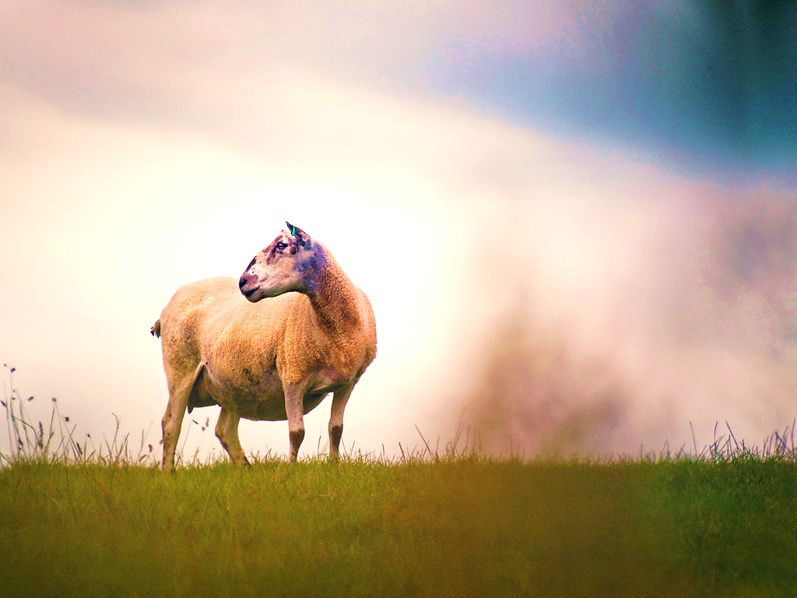
“Because the sheep had no shepherd, they were scattered, and wild animals killed and ate them.” Ezk 34:5

Slide 12
Israel also has a history of being taken captive by their enemies.

Slide 13
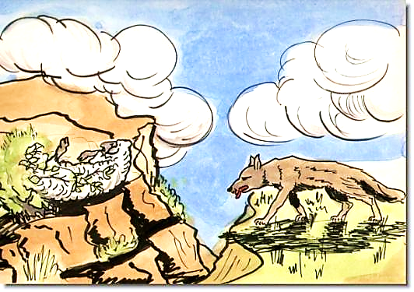
“Whoever saw my people hurt them. And those enemies said, ‘We did nothing wrong. Those people sinned against the Lord” Jer. 50:7

Slide 14
Sadly, Israel also has a history of being led by evil shepherds.

Slide 15
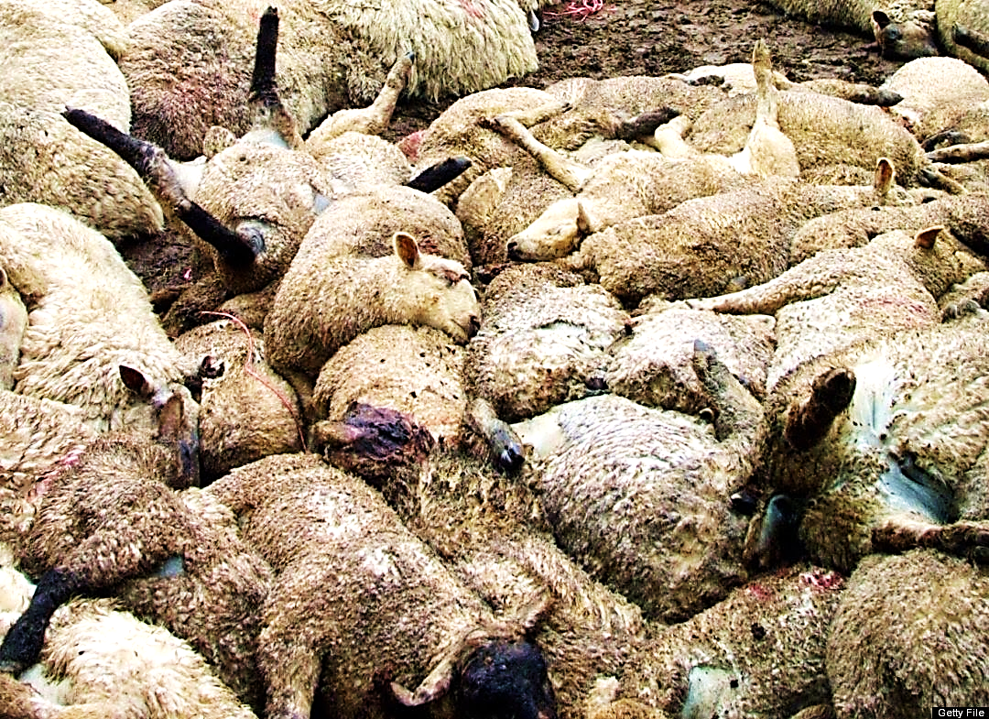
“You do not strengthen the weak, heal the sick, bind up the broken, bring back the stray or seek the lost. Instead, you have ruled over them with force and cruelty.” Ezk. 34:4

Slide 16
We are just like Israel—lost
and in desperate need of a truly
good shepherd
who will seek us when we’re lost and heal our wounds.

Slide 17
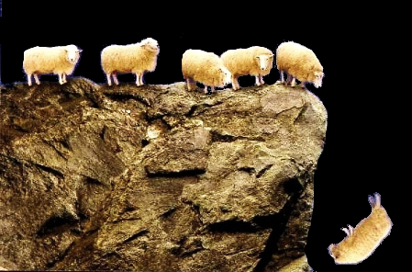
“All we like sheep have gone astray; we have turned every one to his own way” Isa. 53:6

Slide 18
We find a loving, compassionate Shepherd in Jesus Christ… “The Good Shepherd!”

Slide 19
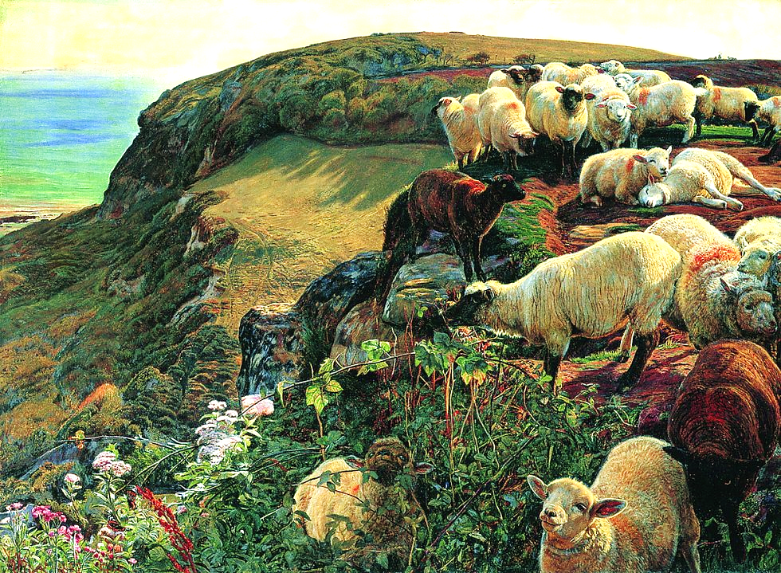
“…But when He
saw the multitudes, He was moved
with compassion
for them, because they were weary
and scattered, like sheep having no shepherd.” Matt. 9:35, 36

Slide 20
We are each valued
by our Shepherd.

Slide 21
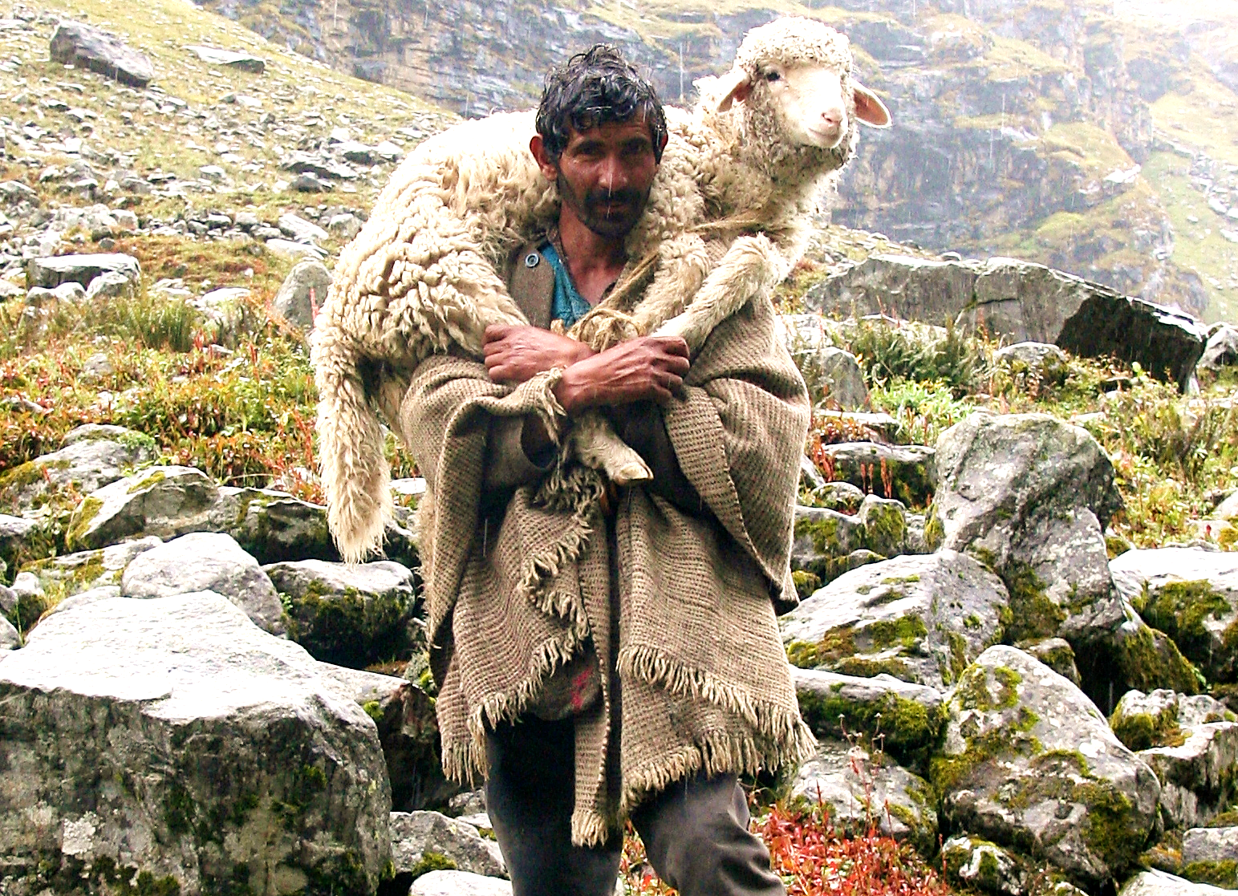
“If a man has 100 sheep, but 1 of the sheep gets lost, he will leave the other 99 sheep on the hill. He will go to look for the lost sheep.” Mat. 18:12

Slide 22
This Slide - Video: Parable of the Losr Sheep Download Here: https://youtu.be/tyWZeOlaRo4

Slide 23
This Slide - Song: I’ll lead you home → Download Here: http://youtu.be/kgnLfY0t3Mc

Slide 24
Is Jesus
Speaking to You?
“They said to each other, ‘Did not our hearts burn within us while he talked to us on the road, while he opened to us the Scriptures?’”
John Wesley Said:
“…the preacher was describing the change which God works in the heart through faith in Christ and I felt my heart strangely warmed.”
Jesus makes His presence Known by a small voice!

Slide 26
What is the Sinner‘s Prayer?
This is a prayer we can pray when we are ready to admit we are sinners and need Christ’s forgiveness.
It must be prayed with faith in our hearts and a readiness to have a life-changing encounter with Jesus Christ.

Slide 27
A prayer of faith → Pray this prayer if :
If you never have before
You have in the past, but you think it would mean more today
You have been walking afar off and you want to come back
You want to set an example & show others how it is done
You just like to give your heart to Jesus again & again
Faith

Slide 28
We Declare Our Faith Publicly Because Jesus Declared His LOVE Publicly
“If you stand before others and are willing to say you believe in me, then I will tell my Father in heaven that you belong to me.” Mat 10:32

Slide 29
Three Important Questions
Do you want to know Jesus as your Savior right now?
Do you believe He died to save you from your sins & that He rose from the dead?
Do you believe that He is here, waiting to save you right now?

Slide 30
The Prayer of a Sinner Turning to Jesus
Dear Jesus, I know that I have sinned against You and that my sins separate me from You.
I am truly sorry.
Right now, I turn away from my sinful past .
Please forgive me, and help me to keep from sin.
I believe You died for my sins.
I Believe You rose from the dead, you are alive, and you hear this prayer from my heart.
I invite You Jesus to be both my Savior and the Lord of my life.
I want You to rule my life from now on.

Slide 31
“But some people did accept him. They believed in him, and he gave them the right to become children of God.”
John 1:12

Slide 33
“If you openly say, ‘Jesus is Lord’ and believe in your heart that God raised him from death, you will be saved.”
Rom. 10:9
What did you learn today?
What about Our Good Shepherd?
What have you been thinking about God lately?
What do you want to tell others about Jesus?

Slide 34
Let’s Close in Prayer

Slide 35
Note: Any videos in this presentation will only play online. After you download the slideshow, you will need to also download the videos from YouTube & add them back into your PowerPoint.
We present these messages at outdoor events around Texas. If you would like to watch the video of the service with this message, click here:
http://campaignkerusso.org/?p=11515
We would love to know more about the people who download our lessons & sermons. We invite you to email us & let us know where & how you use them.
info@ckbrazos.org

