Slide 1
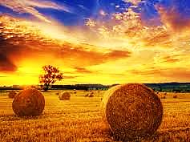
Working the
Harvest

Slide 2
Note: After you download the slideshow, you may also need to download some videos from YouTube & add them into this PowerPoint. This tool can help you: Free YouTube Download
We present these messages in outdoor venues using the SonShineTent. Watch the video of our service that goes with this message, click here: http://campaignkerusso.org/?p=11870
We would love to know more about the people who download our lessons & sermons. We invite you to email us & let us know where & how you use them.
info@campaignkerusso.org

Slide 3
Welcome All

Slide 4
Let’s Begin with Prayer

Slide 5
Working the
Harvest

Slide 6
Song: Harvest Samba
Video Goes Here Title: Harvest Samba Download Here:
https://www.youtube.com/watch?v=NTdIrlTlXks

Slide 7
Song: It’s Harvest Time
Video Goes Here Title: It’s Harvest Time Download Here:
http://youtu.be/cPJyKOdeM7o

Slide 8
Working the
Harvest

Slide 9
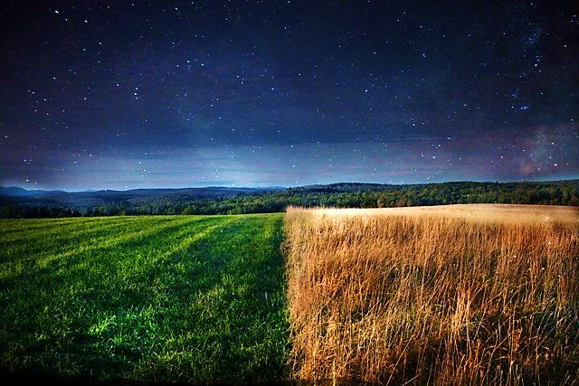
God Invented Seasons:
“As long as the world exists, there will be a time for planting and a time for harvest…” Gen. 8:22
Seed Time
Harvest

Slide 10
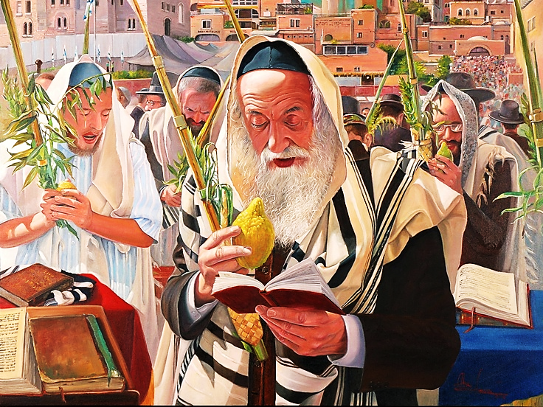
The Jews Harvest Season:
We will look at two of their major feast days during the this season:
1) The Feast of Firstfruits
2) The Feast of Harvest

Slide 11
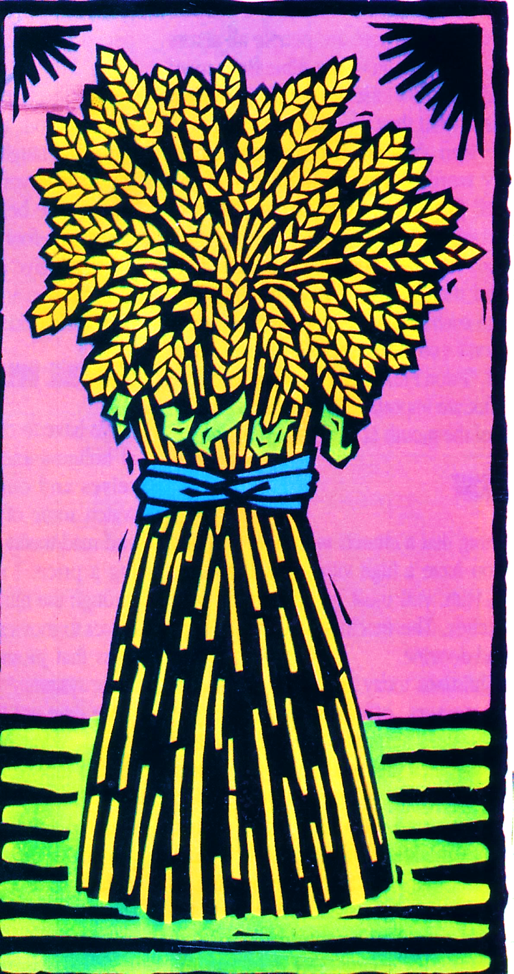
1st - The Feast of Firstfruits
This took place three days after Passover.
On this day they brought the first sheave of grain to the Temple. The priest held it up and waved before the Lord.

Slide 12
This Reminds us of Jesus
“… you must bring the first bundle of grain from your harvest to the priest…
he will present the bundle on the day after the Sabbath…
offer a male lamb, one year old, that has nothing wrong with it...” Lev. 23:10-12

Slide 13
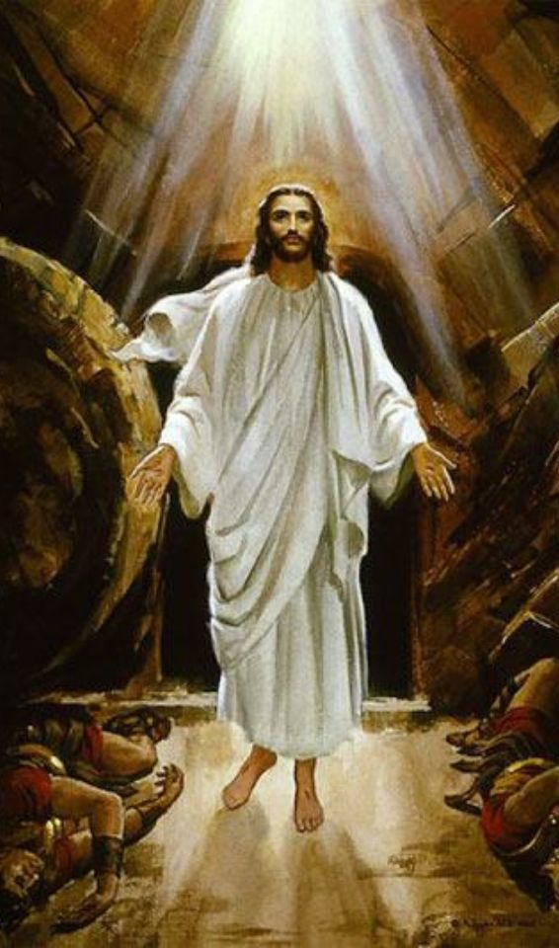
Jesus is God’s Firstfruits
Jesus died on Passover Day. He was perfect!
Like a seed, He was planted in the earth.
Three days later (during the Feast of Firstfruits), Jesus came out of he ground. The first fruit to ripen in God’s harvest.

Slide 14
Jesus is God’s Firstfruits
"… Christ … raised from the dead, the firstfruits …
in Christ, all will be made alive…
Christ, the firstfruits;
afterward, at His coming, those who belong to Christ.” 1 Cor. 15:20-23.
Believers are the rest of the Harvest.

Slide 15
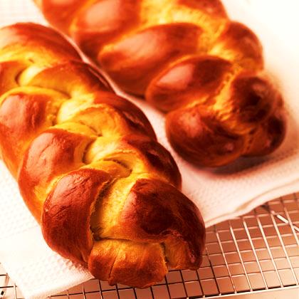
2nd - The Feast of Harvest
This takes place 50 days after the “Firstfruits”.
Also called “Pentecost”.
On this day, at harvest’s end, two loaves of bread were waved before the Lord.
“Bring two loaves of bread…fine flour… baked with yeast. Bring them to me as a wave offering...” Lev. 23:15-17

Slide 16
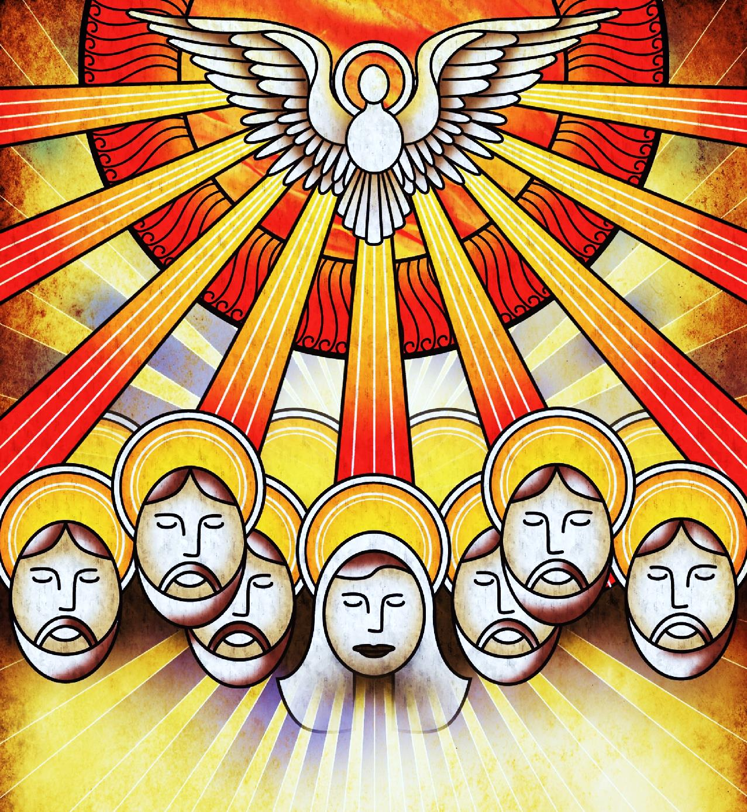
On this very day (Pentecost), the Holy Spirit fell upon the disciples & 3,000 souls were saved. This was the harvest God longed for—the birth of the Church.
“Then they were all filled with the Holy Spirit… and that day about 3,000 people were added” Acts 2:4,41

Slide 17
The Church was born on the very day these two loaves were being waved before the Lord.
One representing the Jews & the other representing the Gentiles.
Unlike the unleavened bread that represented the sinless Christ, these loaves contained yeast, reminding us of our forgiven sins.
This is a picture of God’s Harvest of SOULS!

Slide 18
God Invented Seasons:
“As long as the world exists, there will be a time for planting and a time for harvest…” Gen. 8:22
Seed Time:
Jesus’ death & burial
Harvest:
Jesus first, then the Church

Slide 19
The Sowing Season (Seed Time)
“A man went out to sow some seed. Some … fell on the road… Some… fell on good ground… The seed grew and the plants gave more seed.” Matt. 13:3-8
Seed Time:
Believers preach God’s Word
Harvest:
Jesus first, then the Church

Slide 20
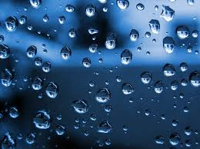
The Two Rainy Seasons
Former
Rain for the…
Latter
Rain for the…
Seed Time:
Believers preach God’s Word
Harvest:
Jesus first raised, then the Church

Slide 21
Rain Represents the Holy Spirit
“He will be like rain falling on the fields. He will be like showers watering the earth.” Ps. 72:6

Slide 22
Two Seasons of Rain
“I will give the rain for your land in its season, the early rain and the latter rain, that you may gather in your grain…” Deut. 11:14
“…He shall come unto us as the rain, as the latter and former rain unto the earth.” Hosea 6:3
Seed
Time
Former
Rain
Wait
Patiently
Latter
Rain
Harvest

Slide 23
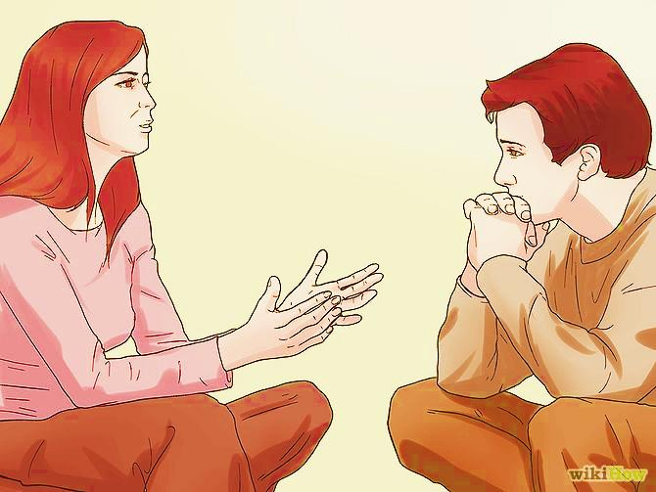
The former rain comes at the beginning of the growing season when
the seeds go into the ground.
The Holy Spirit makes God’s Word come to
life.

Slide 24
The Two Rainy Seasons
Former
Rain for the…
Latter
Rain for the…
Seed Time:
Few want to do this vital work.
Harvest:
Many imagine this… but it cannot happen without the seed time.

Slide 25
…The seed begins to grow but he doesn't know what makes it grow…” Mk. 4:28 (WE)
“… A man sows some seed in the ground. Then he goes on just as he did before. He sleeps at night and wakes up in the morning…

Slide 26
The time between the two rainy seasons is not the Church’s job. It’s God’s! We wait and
we pray.

Slide 27
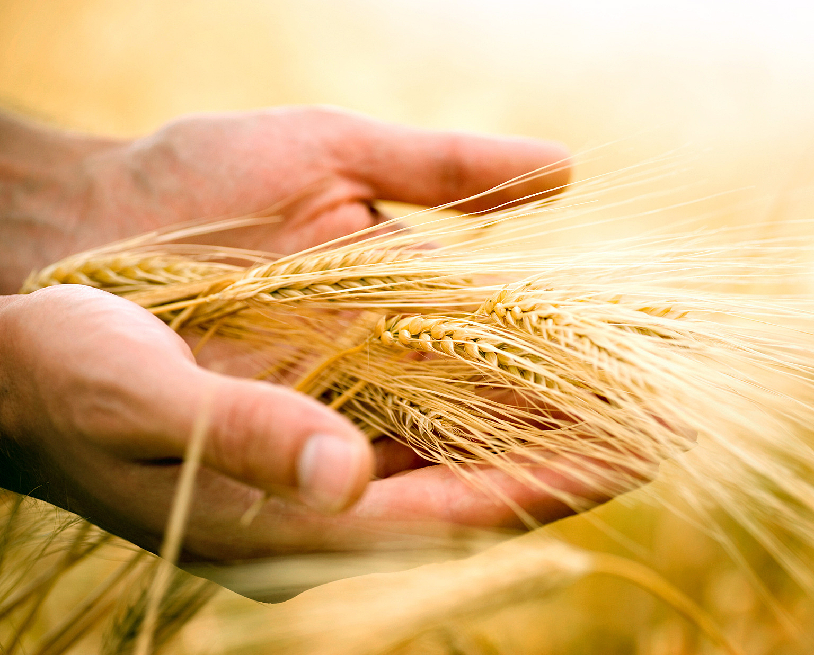
…When the harvest is really ready, he cuts it right away because the harvest time has come.” Mark 4:26-29

Slide 28
“…Behold, the farmer waits for the precious fruit of the earth, and has long patience for it, until he receives the early and latter rain.”
James 5:7-8:

Slide 29
The latter rain comes just before the harvest. It brings forth the final ripening.

Slide 30
“Ask ye of the Lord rain in the time of the latter rain; so the Lord shall make bright clouds, and give them showers of rain…”Zech. 10:1
It is linked to prayer.

Slide 31
“They waited for me as for the rain; and they opened their mouth wide as for the latter rain.” Job 29:23

Slide 32
When we challenge people to trust in Christ, the Spirit convinces them. We need not fear giving altar calls.

Slide 33
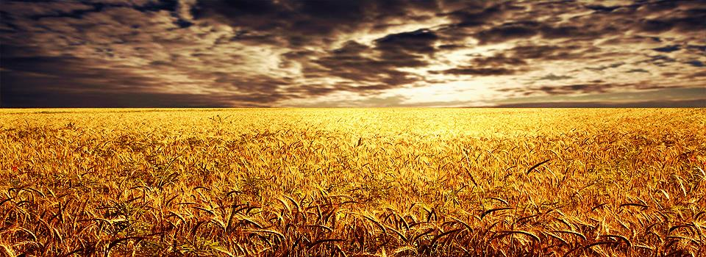
Like planting, harvesting is the Church’s job!
“He said to them, ‘The harvest is bigger than you can imagine, but there are few workers.
Therefore, plead with the Lord of the harvest to send out workers for his harvest.’ ” Lk. 10:2

Slide 34
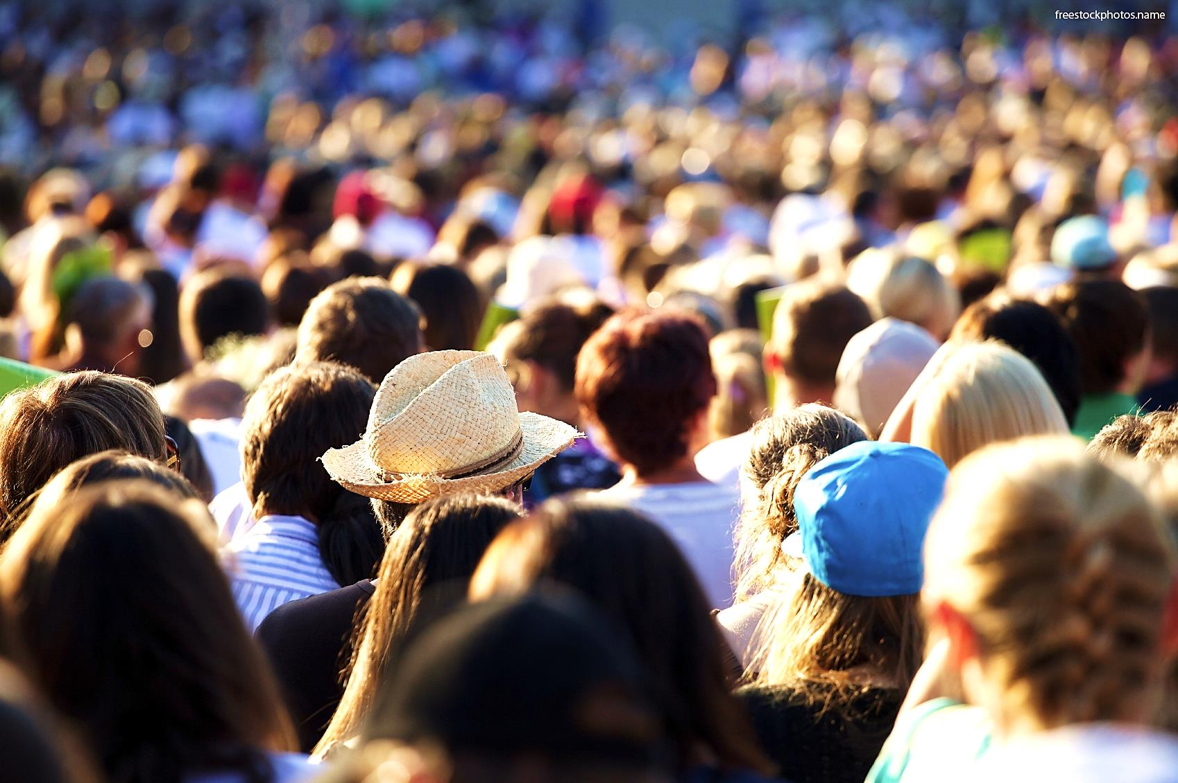
“Do you think the work of harvesting will not begin until the summer ends four months from now?
Look around you! Vast fields of human souls are ripening all around us, and are ready now for reaping.”
John 4:35

Slide 35
We don’t always get to see our seeds harvested.
“Some plant the seed, and others harvest the crop.” John 4:34-37

Slide 36
“They weep as they go to plant their seed, but they sing as they return with the harvest.” Ps. 126:6
Sometimes the work is hard and discouraging.

Slide 37
Even now the harvest workers are receiving their reward by gathering a harvest that brings eternal life. Then everyone who planted the seed and everyone who harvests the crop will celebrate together. John 4:36-38
Reaping IS its own reward.

Slide 38
“A wise son harvests in the summer; a disgraceful son sleeps right through the harvest.” Pr. 10:5
There is a sense of urgency:

Slide 39
We will go to Heaven, but we may lose our opportunity to work in the harvest.

Slide 40
The harvest is in our hands.
“Harvest has passed, summer has ended, but we have not been saved.” Jer. 8:20

Slide 41
Song: The Harvest
Video Goes Here Title: The Harvest Download Here:
https://www.youtube.com/watch?v=2b4ljC_Vook

Slide 42
Is Jesus
Speaking to You?
“They said to each other, ‘Did not our hearts burn within us while he talked to us on the road, while he opened to us the Scriptures?’”
John Wesley Said:
“…the preacher was describing the change which God works in the heart through faith in Christ and I felt my heart strangely warmed.”
Jesus makes His presence Known by a small voice!

Slide 44
What is the Sinner‘s Prayer?
This is a prayer we can pray when we are ready to admit we are sinners and need Christ’s forgiveness.
It must be prayed with faith in our hearts and a readiness to have a life-changing encounter with Jesus Christ.

Slide 45
A prayer of faith → Pray this prayer if :
If you never have before
You have in the past, but you think it would mean more today
You have been walking afar off and you want to come back
You want to set an example & show others how it is done
You just like to give your heart to Jesus again & again
Faith

Slide 46
We Declare Our Faith Publicly Because Jesus Declared His LOVE Publicly
“If you stand before others and are willing to say you believe in me, then I will tell my Father in heaven that you belong to me.” Mat 10:32

Slide 47
Three Important Questions
Do you want to know Jesus as your Savior right now?
Do you believe He died to save you from your sins & that He rose from the dead?
Do you believe that He is here, waiting to save you right now?

Slide 48
The Prayer of a Sinner Turning to Jesus
Dear Jesus, I know that I have sinned against You and that my sins separate me from You.
I am truly sorry.
Right now, I turn away from my sinful past .
Please forgive me, and help me to keep from sin.
I believe You died for my sins.
I Believe You rose from the dead, you are alive, and you hear this prayer from my heart.
I invite You Jesus to be both my Savior and the Lord of my life.
I want You to rule my life from now on.

Slide 49
“But some people did accept him. They believed in him, and he gave them the right to become children of God.”
John 1:12

Slide 51
“If you openly say, ‘Jesus is Lord’ and believe in your heart that God raised him from death, you will be saved.”
Rom. 10:9
What did you learn today?
What about…
What have you been thinking about God lately?
What do you want to tell others about Jesus?

Slide 52
Let’s Close in Prayer

Slide 53
Note: After you download the slideshow, you may also need to download some videos from YouTube & add them into this PowerPoint. This tool can help you: Free YouTube Download
We present these messages in outdoor venues using the SonShineTent. Watch the video of our service that goes with this message, click here: http://campaignkerusso.org/?p=11870
We would love to know more about the people who download our lessons & sermons. We invite you to email us & let us know where & how you use them.
info@campaignkerusso.org

