Slide 2
Note: After you download the slideshow, you may also need to download some videos from YouTube & add them into this PowerPoint. This tool can help you: Free YouTube Download
We present these messages in outdoor venues using the SonShineTent. Watch the video of our service that goes with this message, click here: http://campaignkerusso.org/?p=14695
We would love to know more about the people who download our lessons & sermons. We invite you to email us & let us know where & how you use them.
info@campaignkerusso.org

Slide 3
Welcome All

Slide 4
Let’s Begin with Prayer

Slide 5
Song: Never Too Broken
Video Goes Here Title: Never Too Broken Download Here:
https://www.youtube.com/watch?v=HCJfal9DBYM

Slide 6
Notes:
When you order something and it comes damaged, what do you do? You reject it and send it back

Slide 7
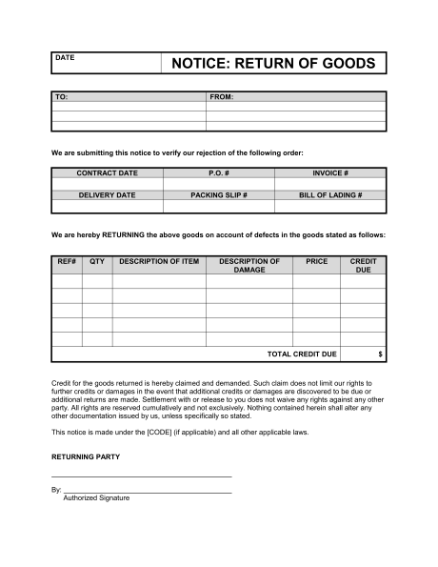
It used to be, you had to fill out a form of some kind to get a return authorization and sometimes even pay the return shipping costs.
Now, in the age of the Internet, it’s much easier:
Notes:
Used to be, you had to fill out a form of some kind, get a return authorization and sometimes even pay the return shipping costs.
Now in the age of the Internet, it’s much easier:

Slide 8
Send it back!
Notes:
Look familiar?
But there is a another opinion out there, about what to do with damaged goods:
Let’s read about it:

Slide 9
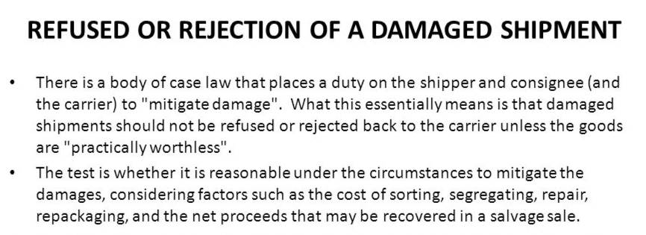
Have YOU ever felt, deep inside, that you were “damaged goods?”
Notes:
NOW, Let’s take a look at what the Bible says about damaged goods:
But a different kind of damaged goods…
Not merchandise – but Mankind,
Not stuff – but Souls,
The apostle Paul told the people of the church at Corinth, (in the book of 1st Corinthians, chapter 1) that no matter how broken their lives had been, no matter how rejected they felt by the society around them, there was a Savior who was going to accept them.

Slide 10
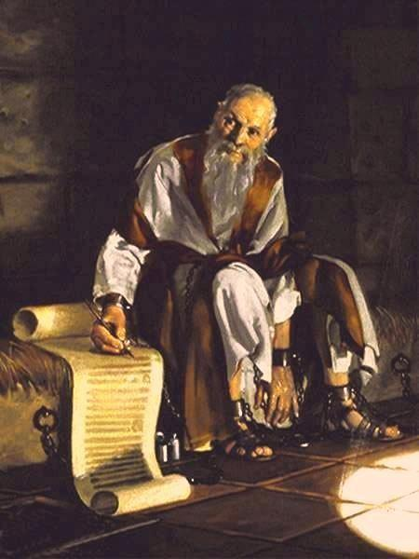
Brothers and sisters, God chose you to be his.
Think about that!
Not many of you were wise in the way the world judges wisdom.
Not many of you had great influence, and not many of you came from important families.
But God chose the foolish things of the world to shame the wise.

Slide 11
He chose the weak things of the world to shame the strong.
And God chose what the world thinks is not important—what the world hates and thinks is nothing.
God did this so that no one can stand before him and boast about anything.

Slide 12
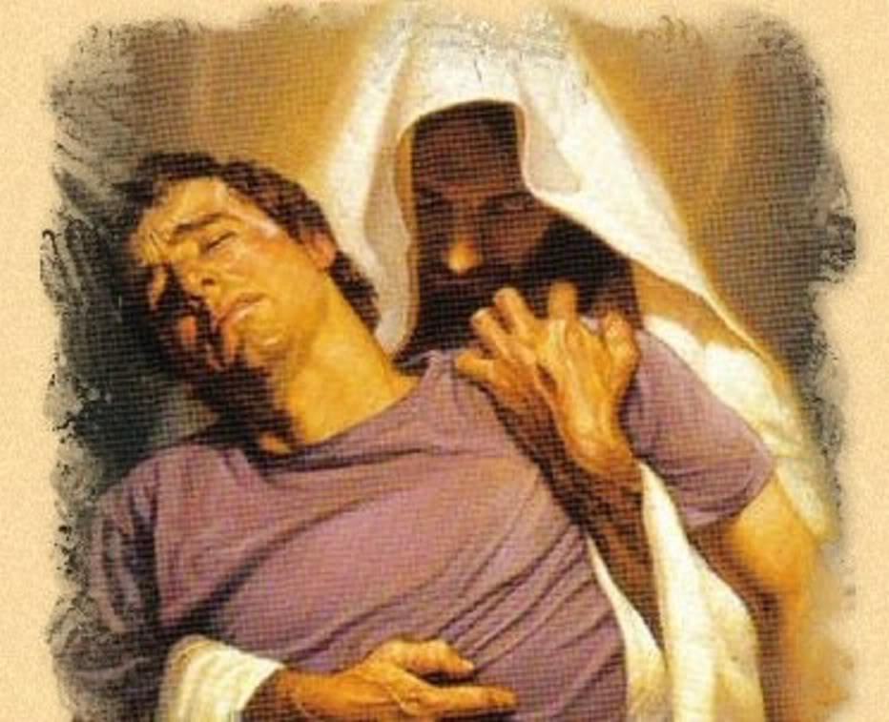
Jesus is in the business of accepting damaged goods
Notes:
I You feel broken, Jesus will still accept you
Listen to a song called, BROKEN THINGS

Slide 13
Song: Broken Things
Video Goes Here Title: Broken Things Download Here:
https://youtu.be/WdUu6ZsdVfM

Slide 14
Jesus is in the business of accepting damaged goods!
Notes:
Remember what we read about damaged goods before.? Know this: YOU CAN BE MENDED!

Slide 15
You can be Mended
Jesus is in the business of accepting damaged goods
Notes:
Matthew West wrote a song called “Mended”. Let’s listen to him talk about it before he sings it

Slide 16
Video: Matthew West Testimony
Video Goes Here Title: Matthew West Testimony Download Here:
https://youtu.be

Slide 17
Song: Mended
Video Goes Here Title: Mended Download Here:
https://youtu.be

Slide 18
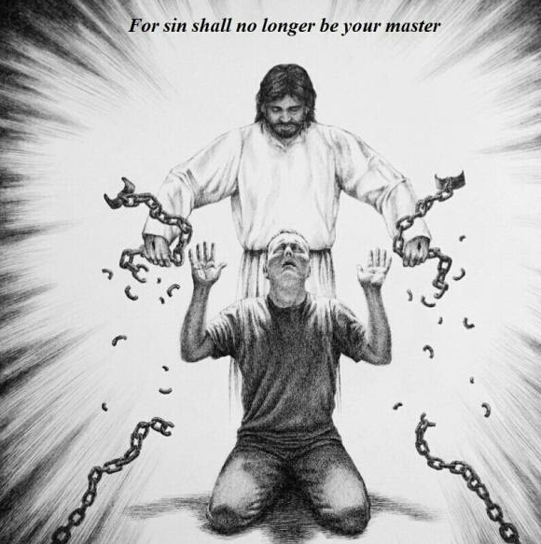
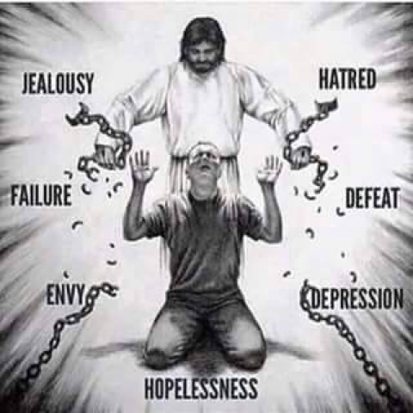
Notes:
What kind of chains do you have? Everybody has chains… Christ can break them ALL… if we turn our lives over to him
Remember: THERE IS POWER IN THE NAME OF JESUS. (Listen with me to this song)

Slide 19
Song: There is Power in the Name of Jesus
Video Goes Here Title: There is Power in the Name of Jesus Download Here:
https://youtu.be

Slide 20
Is Jesus
Speaking to You?
“They said to each other, ‘Did not our hearts burn within us while he talked to us on the road, while he opened to us the Scriptures?’”
John Wesley Said:
“…the preacher was describing the change which God works in the heart through faith in Christ and I felt my heart strangely warmed.”
Jesus makes His presence Known by a small voice!

Slide 22
What is the Sinner‘s Prayer?
This is a prayer we can pray when we are ready to admit we are sinners and need Christ’s forgiveness.
It must be prayed with faith in our hearts and a readiness to have a life-changing encounter with Jesus Christ.

Slide 23
A prayer of faith → Pray this prayer if :
If you never have before
You have in the past, but you think it would mean more today
You have been walking afar off and you want to come back
You want to set an example & show others how it is done
You just like to give your heart to Jesus again & again
Faith

Slide 24
We Declare Our Faith Publicly Because Jesus Declared His LOVE Publicly
“If you stand before others and are willing to say you believe in me, then I will tell my Father in heaven that you belong to me.” Mat 10:32

Slide 25
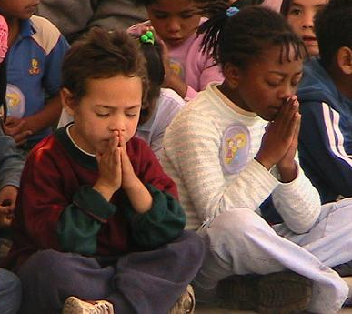
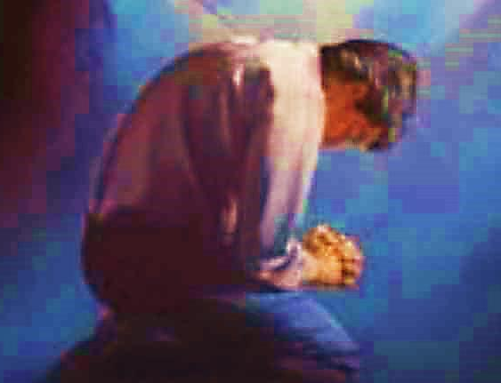
Three Important Questions
Do you want to know Jesus as your Savior right now?
Do you believe He died to save you from your sins & that He rose from the dead?
Do you believe that He is here, waiting to save you right now?

Slide 26
The Prayer of a Sinner Turning to Jesus
Dear Jesus, I know that I have sinned against You and that my sins separate me from You.
I am truly sorry.
Right now, I turn away from my sinful past .
Please forgive me, and help me to keep from sin.
I believe You died for my sins.
I Believe You rose from the dead, you are alive, and you hear this prayer from my heart.
I invite You Jesus to be both my Savior and the Lord of my life.
I want You to rule my life from now on.

Slide 27
“But some people did accept him. They believed in him, and he gave them the right to become children of God.”
John 1:12

Slide 29
“If you openly say, ‘Jesus is Lord’ and believe in your heart that God raised him from death, you will be saved.”
Rom. 10:9
What did you learn today?
What about…
What have you been thinking about God lately?
What do you want to tell others about Jesus?

Slide 30
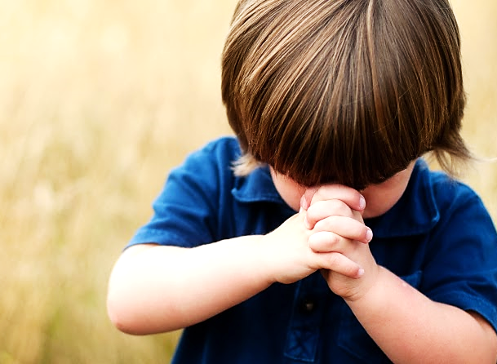
Let’s Close in Prayer

Slide 31
Note: After you download the slideshow, you may also need to download some videos from YouTube & add them into this PowerPoint. This tool can help you: Free YouTube Download
We present these messages in outdoor venues using the SonShineTent. Watch the video of our service that goes with this message, click here: http://campaignkerusso.org/?p=14695
We would love to know more about the people who download our lessons & sermons. We invite you to email us & let us know where & how you use them.
info@campaignkerusso.org

