Slide 1
SMALL

Slide 2
Note: After you download the slideshow, you may also need to download some videos from YouTube & add them into this PowerPoint. This tool can help you: Free YouTube Download
We present these messages in outdoor venues using the SonShineTent. Watch the video of our service that goes with this message, click here: http://campaignkerusso.org/?p=8050
We would love to know more about the people who download our lessons & sermons. We invite you to email us & let us know where & how you use them.
info@campaignkerusso.org

Slide 3
Song: How Great is Our God
Video Goes Here Title: How Great is Our God Download Here:
https://youtu.be/jjxPG_mRHDs

Slide 4
SMALL

Slide 6
We love the idea of a big, big God!
Super-sized!

Slide 7
When God Spoke to Moses it shook Mt. Sinai.

Slide 8
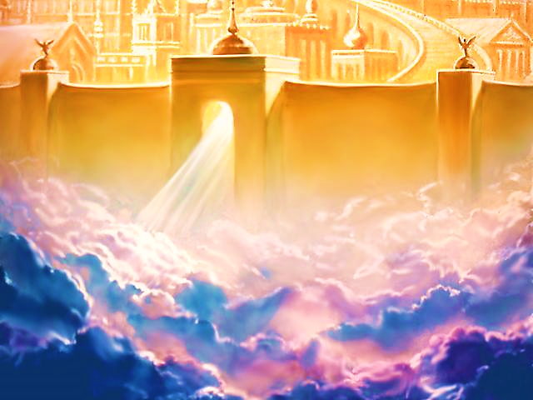
Imagine the Majesty
of Heaven

Slide 9
Even mega churches seem quite thrilling.

Slide 10
Yet, an atom is just about the smallest thing in the universe and it holds within it a another universe all its own.

Slide 11
The Canaanite woman brought her sick daughter to Jesus, but Jesus asked her why she, a non-Jew, would dare
to ask God
for a miracle.
He wanted the whole world to hear her answer and witness her great faith.

Slide 13
The woman knew that even the smallest crumb from Jesus was enough to the heal her daughter.

Slide 14
The little bit of God is every bit as great as a huge chunk of God.
Because it is still all God!

Slide 15
The gentle presence of Jesus in our lives is nothing less than the great majesty of God.
Nothing compares with
just being with Jesus.

Slide 16
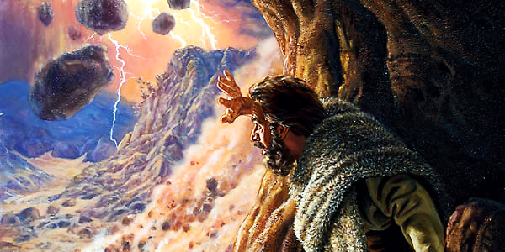
Elijah’s mountain experience was quite different than that of Moses.

Slide 17
“The Lord said, ‘Go out. Stand on the mountain in front of me. I am going to pass by.’
As the Lord approached, a very powerful wind tore the mountains apart.
It broke up the rocks…

Slide 18
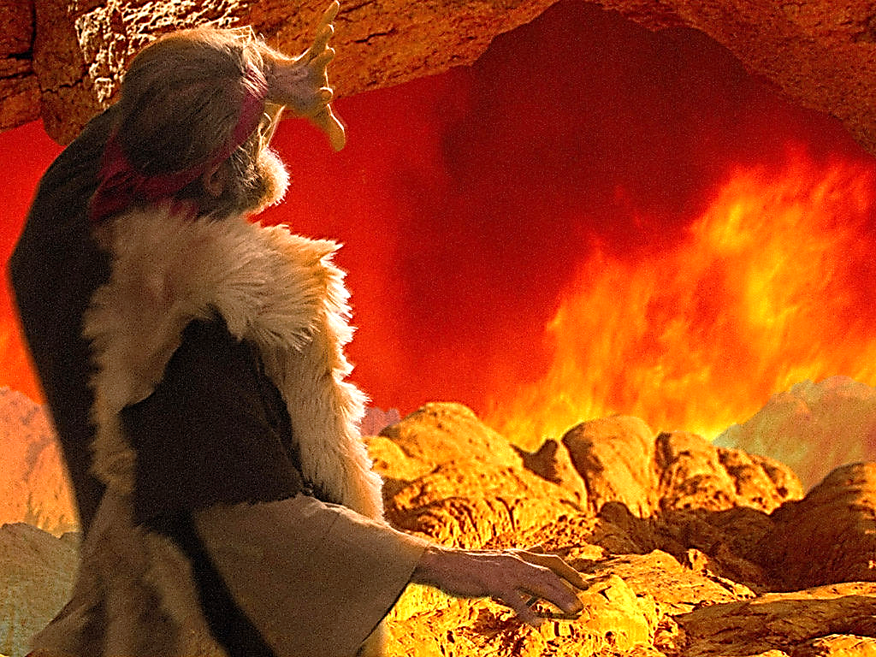
“But the Lord wasn’t in the wind.
After the wind there was an earthquake.
But the Lord wasn’t in the earthquake.
After the earthquake a fire came.
But the Lord wasn’t in the fire.

Slide 19
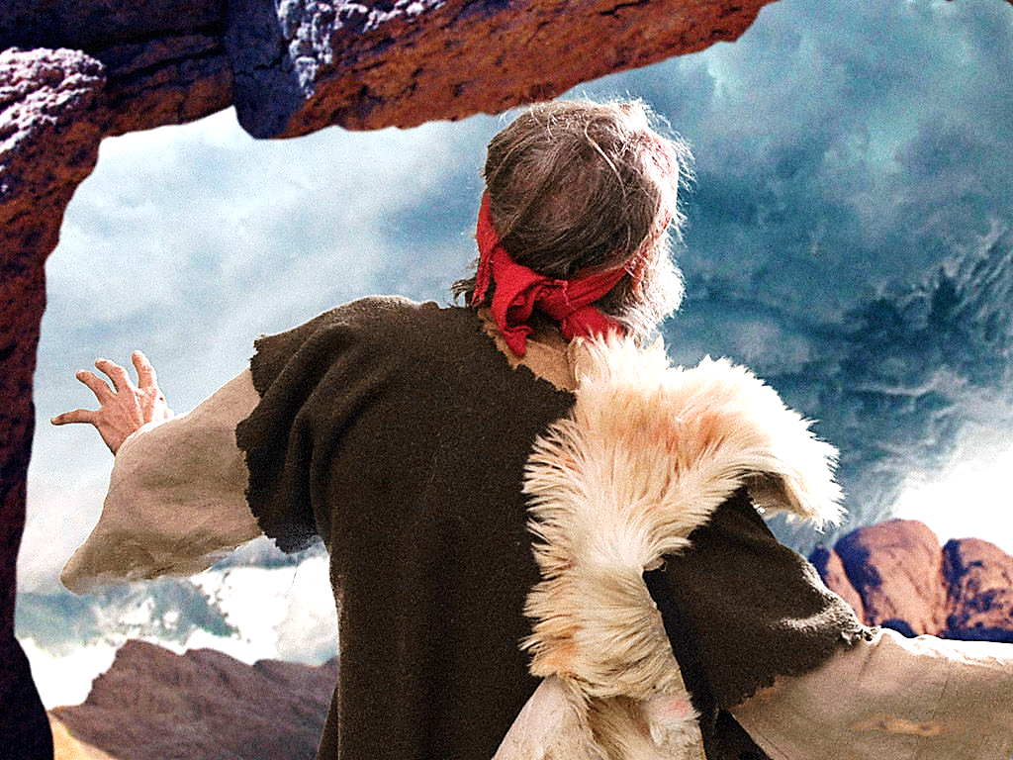
…And after the fire there was only a gentle whisper. When Elijah heard it, he pulled his coat over his face. He went out and stood at the entrance to the cave…

Slide 20
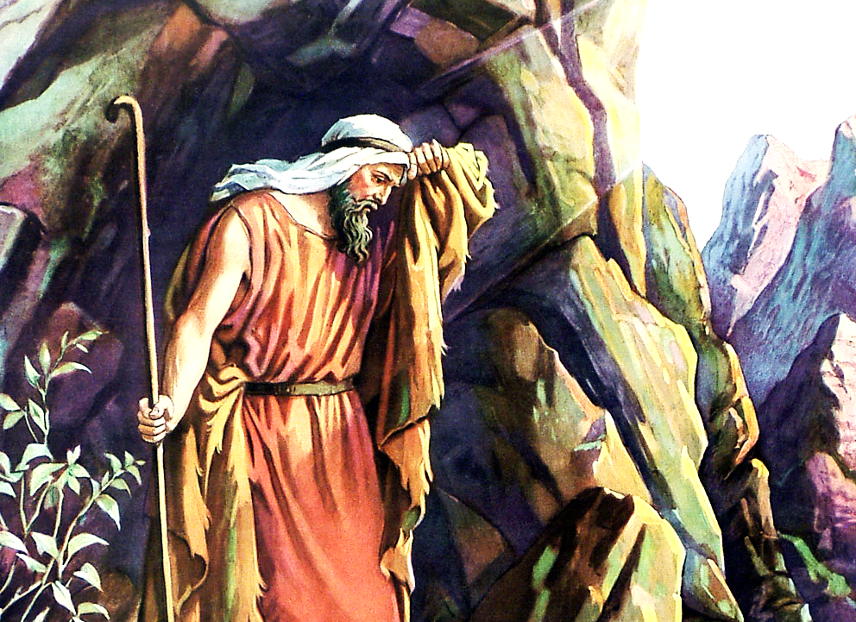
“…Then a voice said to him, “Elijah, what are you doing here?”
1 Kings 9:11,12 (1NIRV)

Slide 21
Video: Elijah & the Small Voice
Video Goes Here Title: Elijah & the Small Voice Download Here:
http://www.youtube.com/watch?v=EgGiMF0zvmY

Slide 22
Song: The Small Voice Song
Video Goes Here Title: The Small Voice Song Download Here:
http://www.youtube.com/watch?v=qGCvsVGQGa8

Slide 23
Two Men Meet God at Mt. Sinai
Meek Moses needed to meet & appreciate his BIG God.
Bold Elijah needed to meet & appreciate His small God

Slide 24
WIND
EARTHQUAKE
FIRE
Elijah had done what he thought was big things for God and he likely expected a big result and a big Moses-like response from God Himself.
But, where was God?

Slide 25
It turns out God was just being small and ordinary— telling Elijah to just get back to being faithful to his everyday ministry!!!

Slide 26
Matthew Henry Observed:
“The wind, and earthquake, and fire, did not make him cover his face, but the still voice did.
Gracious souls are more affected by the tender mercies of the Lord, than by his terrors…

Slide 27
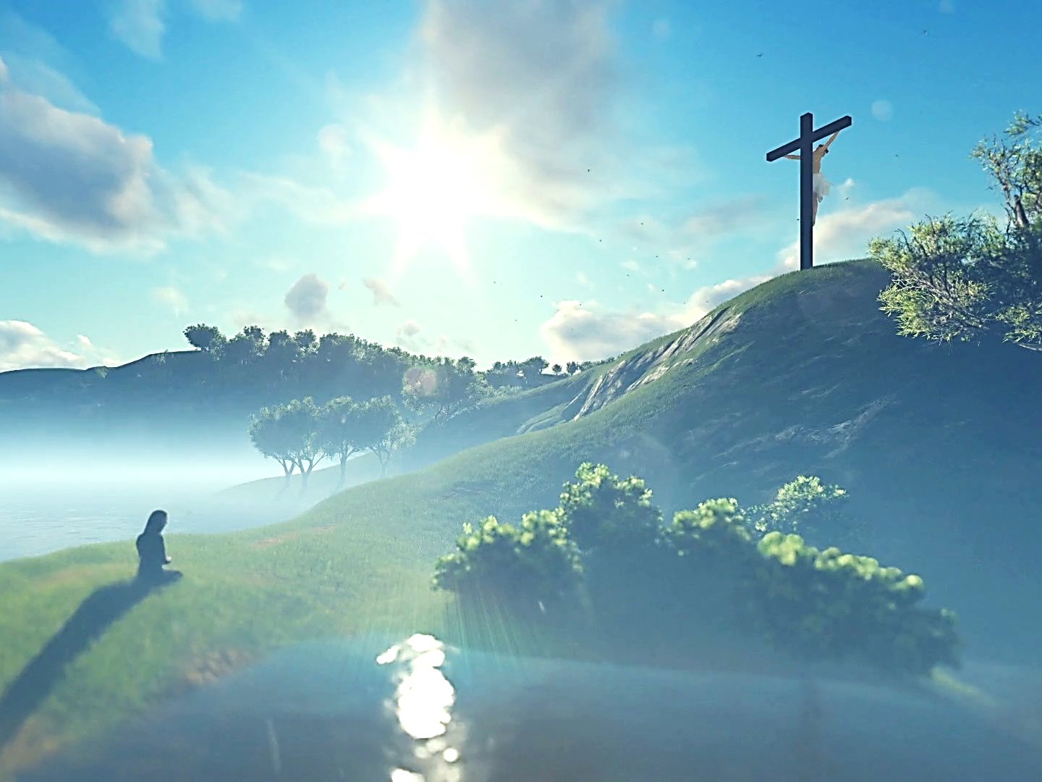
…The mild voice of Him who speaks from the cross… is accompanied with peculiar power in taking possession of the heart.”

Slide 28
When we need comfort; when we need forgiveness; when we need assurance; thunder and lightning are meaningless. But, a touch or Word from Jesus is everything.

Slide 29
Heaven is wherever Jesus is..
For the three Hebrew children, Heaven was in the fiery furnace.

Slide 30
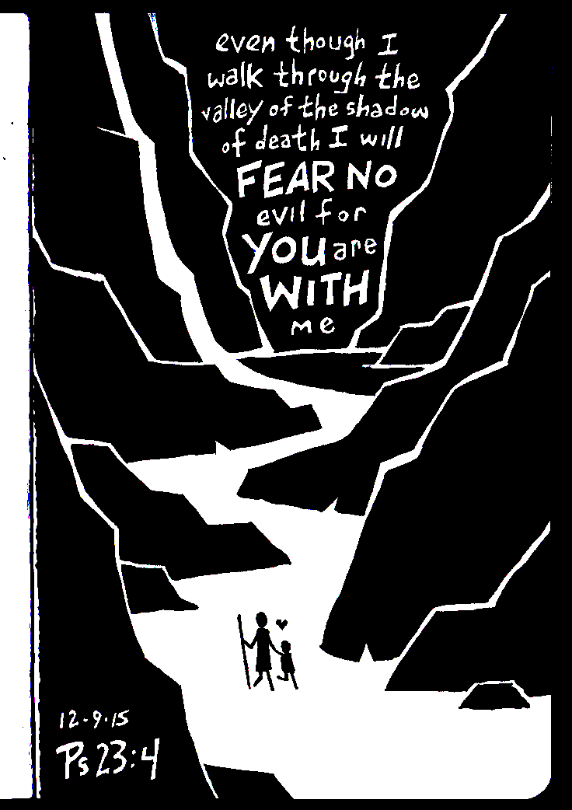
Heaven is wherever Jesus is.
For David, it was in the Valley of the Shadow of Death.

Slide 31
Heaven is wherever Jesus is.
For a Certain thief,
it was on the cross.

Slide 32
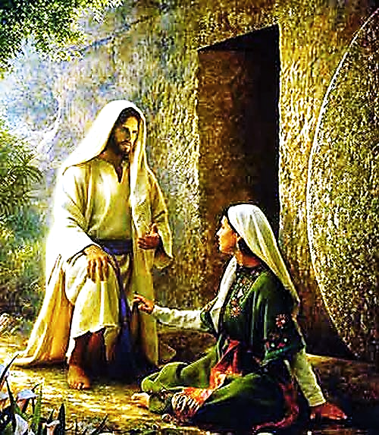
Heaven is wherever
Jesus is.
For Mary Magdalene, it was in the Garden when He softly said her name.
His quiet presence in our daily lives is as BIG as ‘knowing Jesus’ gets!

Slide 33
Everything else is mere sparklers & firecrackers.
Breathtaking,
awe inspiring,
mind tickling,
but not as soul satisfying as a single comforting Word or loving touch from the heart of Jesus.

Slide 34
We don’t need bigger and bigger experiences with Jesus. We need to value all the small bits with Him.
Love Him big—love Him small!

Slide 35
We must begin to truly value every bitty crumb of Jesus which we now have in our lives.
Time in Prayer
Word of God
Steps of Faith
Worship
Acts of Kindness
Fellow Believers
Family
Daily Blessings

Slide 36
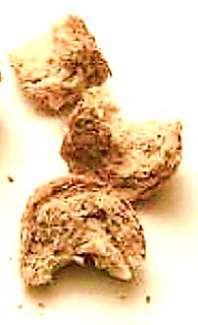
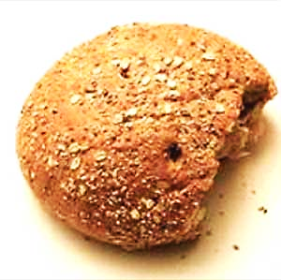
If we don’t love these…
…then, we don’t love this.

Slide 37
Like the tiny atom, Jesus’ dealings with us sometimes seem rather small,
but, in truth, He is always BIG!
Only when we begin to value ‘small’ Jesus,
We can then discover His true depths:
His Capacity to Love
His Tenderness & Longsuffering
His Daily Faithfulness
Delving deeply into ‘small’ Jesus, we will find the true ‘BIG’ Jesus.

Slide 38
The wonderful thing about Jesus is not so much WHAT He
can do, but rather,
WHO He is.
It is His HEART that is truly great and His
LOVE that is so amazing!

Slide 39
Song: Because of Who You Are
Video Goes Here Title: Because of Who You Are Download Here:
https://youtu.be/C6WexG9uAJI

Slide 40
Is Jesus
Speaking to You?
“They said to each other, ‘Did not our hearts burn within us while he talked to us on the road, while he opened to us the Scriptures?’”
John Wesley Said:
“…the preacher was describing the change which God works in the heart through faith in Christ and I felt my heart strangely warmed.”
Jesus makes His presence Known by a small voice!

Slide 42
What is the Sinner‘s Prayer?
This is a prayer we can pray when we are ready to admit we are sinners and need Christ’s forgiveness.
It must be prayed with faith in our hearts and a readiness to have a life-changing encounter with Jesus Christ.

Slide 43
A prayer of faith → Pray this prayer if :
If you never have before
You have in the past, but you think it would mean more today
You have been walking afar off and you want to come back
You want to set an example & show others how it is done
You just like to give your heart to Jesus again & again
Faith

Slide 44
We Declare Our Faith Publicly Because Jesus Declared His LOVE Publicly
“If you stand before others and are willing to say you believe in me, then I will tell my Father in heaven that you belong to me.” Mat 10:32

Slide 45
Three Important Questions
Do you want to know Jesus as your Savior right now?
Do you believe He died to save you from your sins & that He rose from the dead?
Do you believe that He is here, waiting to save you right now?

Slide 46
The Prayer of a Sinner Turning to Jesus
Dear Jesus, I know that I have sinned against You and that my sins separate me from You.
I am truly sorry.
Right now, I turn away from my sinful past .
Please forgive me, and help me to keep from sin.
I believe You died for my sins.
I Believe You rose from the dead, you are alive, and you hear this prayer from my heart.
I invite You Jesus to be both my Savior and the Lord of my life.
I want You to rule my life from now on.

Slide 47
“But some people did accept him. They believed in him, and he gave them the right to become children of God.”
John 1:12

Slide 49
“If you openly say, ‘Jesus is Lord’ and believe in your heart that God raised him from death, you will be saved.”
Rom. 10:9
What did you learn today?
What about our great “SMALL” God?
What have you been thinking about God lately?
What do you want to tell others about Jesus?

Slide 50
Let’s Close in Prayer

Slide 51
Note: After you download the slideshow, you may also need to download some videos from YouTube & add them into this PowerPoint. This tool can help you: Free YouTube Download
We present these messages in outdoor venues using the SonShineTent. Watch the video of our service that goes with this message, click here: http://campaignkerusso.org/?p=8050
We would love to know more about the people who download our lessons & sermons. We invite you to email us & let us know where & how you use them.
info@campaignkerusso.org

