Slide 1
Lot Chooses Bad Friends

Slide 2
Note: The videos in this presentation will only play online. After you download the slideshow, you will need to also download the videos from YouTube & add them back into your PowerPoint.
We present these messages at Bee Creek Park in College Station, TX. If you would like to watch the video with this message, click here: http://campaignkerusso.org/?p=7592
We would love to know more about the people who download our lessons & sermons. We invite you to email us & let us know where & how you use them.
info@ckbrazos.org

Slide 3
Sins from the Bible
They will talk about themselves and be proud
They will say wrong things about people
They will not obey their parents
They will not be thankful
They will not keep anything holy
They will have no love
People will love themselves
They will love money

Slide 4
They will beat people.
They will not love anything that is good
They cannot be trusted
They will act quickly, without thinking
They are proud of themselves
They love to have fun more than they love God 2 Tim. 3:1-4
They will not agree with anybody
They will tell lies about people
They will have no self-control

Slide 5
Write a Chalk Circle of Sins
Sins Are Words, Thoughts & Actions Against God’s Will Using sidewalk chalk, we will draw a circle and fill it with sins people might do.

Slide 6
Video Next Slide: Lot Chooses Bad Friends → Download at: http://www.youtube.com/watch?v=LdJddXduWjs

Slide 7
“FLEE the evil desires of youth, and pursue righteousness, faith, love and peace, along with those who call on the Lord out of a pure heart.” 2 Tim. 2:22
“Turn away from evil and do good; so shall you dwell forever.” Psalm 37:27

Slide 8
“Whoever walks with the wise becomes wise, but the companion of fools will suffer harm.” Prov.13:20
“…Wicked friends lead to evil ends." 1 Cor. 15:33
“And Jesus answered them, “See that no one leads you astray.” Matthew 24:4

Slide 9
“Dear friend, do not imitate what is evil but what is good. Anyone who does what is good is from God. Anyone who does what is evil has not seen God.”
3 John 1:11
“Therefore be imitators of God, as beloved children.” Eph. 5:1

Slide 10
Questions:
Why did God want to destroy Sodom?
What is sin?
God said He would not destroy Sodom if there were how many good people in the city?
Who told Lot to leave Sodom?
What happened to Sodom and Gomorrah?
What happened to Lot’s wife?

Slide 11
What is the Sinner‘s Prayer?
This is a prayer we can pray when we are ready to admit we are sinners and need Christ’s forgiveness.
It must be prayed with faith in our hearts and a readiness to have a life-changing encounter with Jesus Christ.

Slide 13
John Wesley’s Testimony
“…the preacher was describing the change which God works in the heart through faith in Christ and I felt my heart strangely warmed.”
Disciple’s Testimony
“They said to each other, ‘Did not our hearts burn within us while he talked to us on the road, while he opened to us the Scriptures?’”

Slide 14
A prayer of faith → Pray this prayer if :
If you never have before
You have in the past, but you think it would mean more today
You have been walking afar off and you want to come back
You want to set an example & show others how it is done
You just like to give your heart to Jesus again & again
Faith

Slide 15
We Declare Our Faith Publicly Because Jesus Declared His LOVE Publicly
“If you stand before others and are willing to say you believe in me, then I will tell my Father in heaven that you belong to me.” Mat 10:32

Slide 16
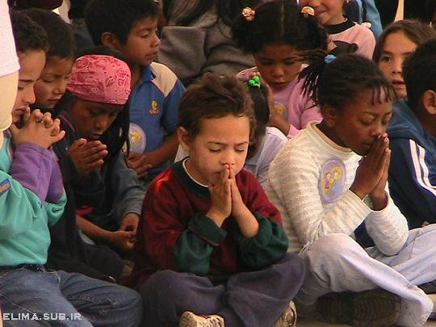
Dear Jesus,
I know I am a sinner & need your forgiveness.
I believe you died for my sins.
I now turn from sin.
Come into my heart I pray.
Do you want to meet Jesus as your savior right now?
Do you believe He died to save you from your sins & that He rose from the dead?
Do you believe that He is waiting to save you right now?

Slide 17
“But some people did accept him. They believed in him, and he gave them the right to become children of God.” John 1:12

Slide 19
“If you openly say, ‘Jesus is Lord’ and believe in your heart that God raised him from death, you will be saved.”
Rom. 10:9
What did you learn today?
What is the meaning of the name-tag?
What have you neen thinking about God lately?
What do you want to tell the world about Jesus?

Slide 20
“Draw near to God, and He will draw near to you…
…Cleanse your hands, you sinners, and make your hearts pure, you who are half-hearted towards God.” James 4:8 WNT

Slide 21
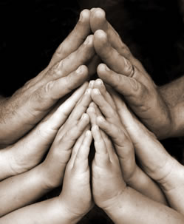
Close in Prayer

Slide 22
Note: Any videos in this presentation will only play online. After you download the slideshow, you will need to also download the videos from YouTube & add them back into your PowerPoint.
We present these messages at Bee Creek Park in College Station, TX. If you would like to watch the video of the service with this message, click here:
http://campaignkerusso.org/?p=7592
We would love to know more about the people who download our lessons & sermons. We invite you to email us & let us know where & how you use them.
info@ckbrazos.org

Slide 23
Welcome to Aggieland Faith Family Style Worship

Slide 24
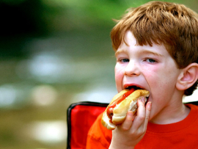
CURRENT SCHEDULE: See www.Aggielandfaith.org
SATURDAY —
At Bee Creek Park
2:00-4:00pm: Through the bible with felt-board stories – plus hot-dogs & drinks
SUNDAY —
At Bee Creek Park
2:00-4pm: Free snacks, drinks, kids crafts, prizes, singing & bible preaching

Slide 25
Would You Like Prayer or Bible Study at Your House?
Personal Prayer: We can come to your home & pray with you, or you can email us when you need prayer.
Home Bible Study: We will come to your home & hold a bible study for you & your friends.
Bible Party: We will hold a Kid’s Bible Party: You provide the food & kids - we will do the bible fun & stories.

Slide 26
Would You Like Visitation?
We will visit a friend, loved one in the hospital or in prison to pray for them & share Christ with them.
Contact: info@aggielandfaith.org

Slide 27
www.aggielandfaith.org
Go here to see pictures & videos
Go here to subscribe to e-mails about changes & cancellations

Slide 28
Note: Any videos in this presentation will only play online. After you download the slideshow, you will need to also download the videos from YouTube & add them back into your PowerPoint.
We present these messages at Bee Creek Park in College Station, TX. If you would like to watch the video of the service with this message, click here:
http://campaignkerusso.org/?p=7592
We would love to know more about the people who download our lessons & sermons. We invite you to email us & let us know where & how you use them.
info@ckbrazos.org

