Slide 1
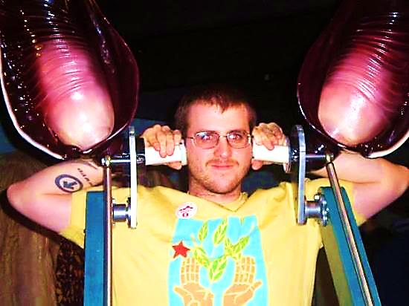
“Putting on God’s
Bat-Ears”
-- On Hearing God --
Simulated Bat Ears - The Bat Jungle
Costa Rica

Slide 2



Note: Any videos in this presentation will only play online. After you download the slideshow, you will need to also download the videos from YouTube & add them back into your PowerPoint.
We present these messages at Bee Creek Park in College Station, TX.
See the videos of our messages here:
http://campaignkerusso.org/videos
We would love to know more about the people who download our lessons & sermons. We invite you to email us & let us know where & how you use them.
info@ckbrazos.org

Slide 3
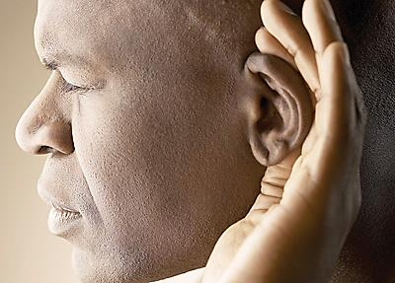
“Putting on God’s Bat-Ears”
-- On Hearing God --
“So then, faith cometh by hearing, and hearing by the word of God.” Romans 10:17
Seeing Jesus gives us comfort, hearing Jesus gives us faith.

Slide 4
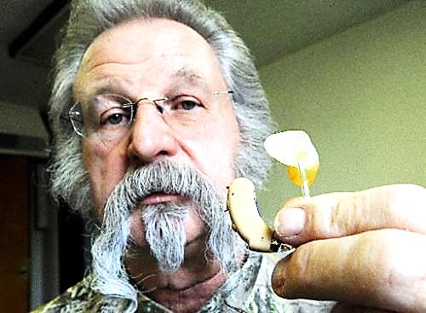
Joke: How is Your Hearing?
A man bragged that he had the finest hearing aid available.
A friend asked, "What kind is it?"
He replied,
  "About 2:30."

Slide 5
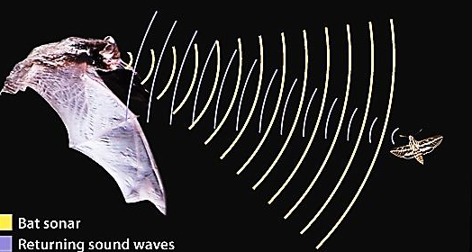
Bats “See” With Their Ears
Bats have tiny eyes and large ears. God has given them another way to “see” — by using their ears — known as echolocation.
Bats make sounds that humans cannot hear. The sound waves strike an object →

Slide 6
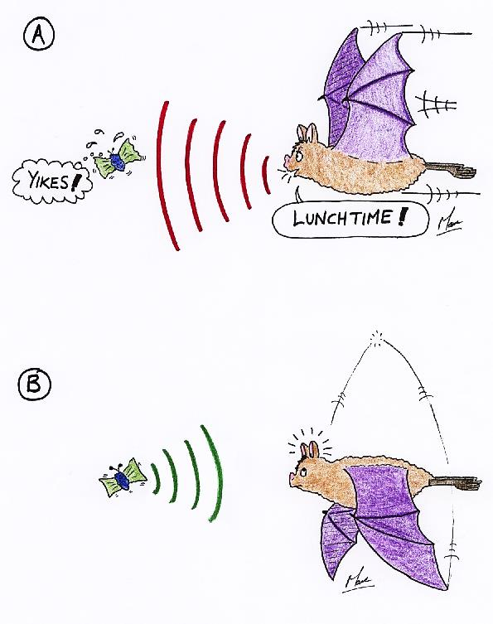
Then, a fraction of a second later, an echo returns to the bat’s eardrums.
The bat hears the echo and is able to tell how far away the object is — and in what direction.

Slide 7
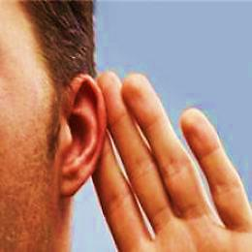
With God’s “Heavenly Bat Ears” Believers “See”
While we hear God’s Word with an open heart, God imparts the gift of “spiritual ears.” These are called “ears to hear” or “hearing.”
These special ears work along with the Word of God to produce faith in us.
“…faith cometh by hearing, and hearing by the word of God.” Romans 10:17

Slide 8

With God’s “Bat Ears” Believers “See”
“He that hath ears to hear, let him hear.” Matt.11:15
“…the hearing of faith?” Galatians 3:2
God’s “hearing” imparts faith.

Slide 9

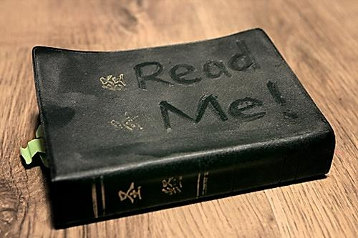
With God’s “Bat Ears”
We See
We enter God’s “bat cave” (the Bible) as blind men.
We arise with faith.
Joke: A little girl said, "I know everything that's in the Bible. Let's see - there's a lock of hair, some dried flowers…"

Slide 10

With God’s “Bat Ears” We See
"I can find ten men who will die for the Bible for every one who will read it” Spurgeon

Slide 11
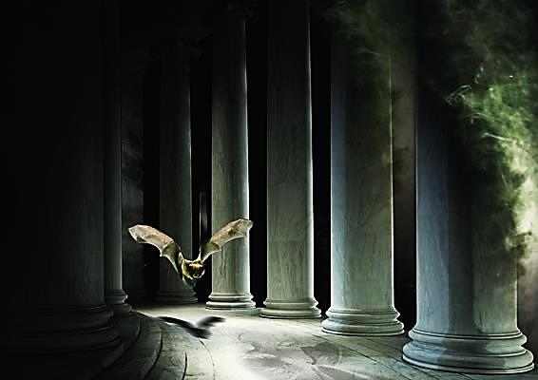
“For we walk by faith, not by sight.” 2 Cor. 5:7
Scientists have learned that even though their eyesight is extremely poor, by using echolocation, bats can fly through difficult spaces.

Slide 12
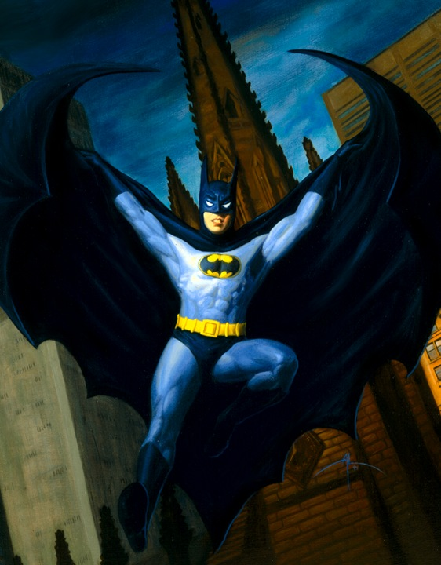
God’s “batman” soars fearlessly believing what he has heard from God!
“… but the word preached did not profit them, not being mixed with faith… Heb.4:2
“…what ye hear in the ear, that preach ye upon the housetops.” Matt.10:27

Slide 13
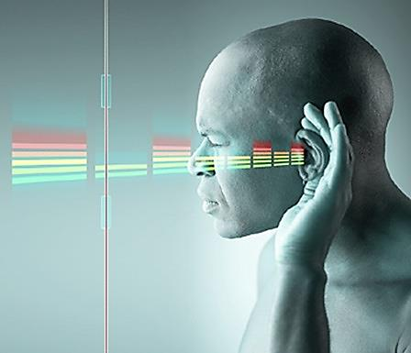
Like the bat, the believer hears the echoes -- God’s Word bouncing back in his “Heavenly bat ears” saying, “do this,” “say this,” “move forward,” and “don’t be afraid.”
We soar through the unknown maze of the life without fear – hearing the voice of God echo in our ear.

Slide 14
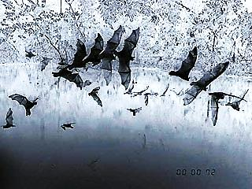
Sight is how unbelievers navigate.
Hearing is how the believers fearlessly soar.
"God who made the birds never made bird cages. It's men who make bird cages and after a while we become cramped and can do nothing but chirp and stand on one leg." Oswald Chambers

Slide 15
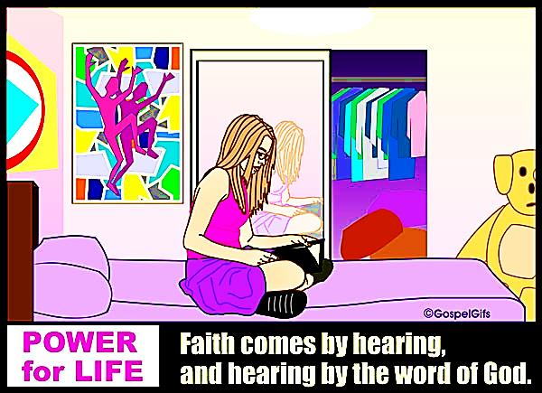
With God’s “Bat Ears”
We Soar
Things may look impossible but our Heavenly bat-ears tell us to “go on, God is with us.”
God’s Heavenly Bat Cave: Spend time in prayerful bible study, and come out ready to soar.

Slide 16
Hearing God – Part 2

Slide 17
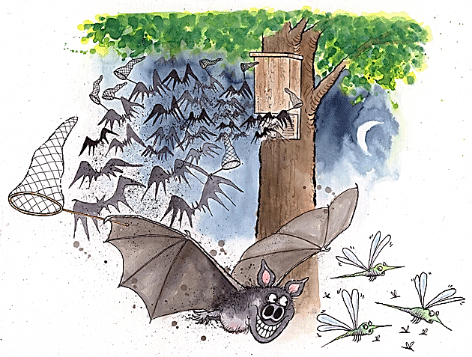
With God’s Ears We Eat Good Food
Bats use echolocation to hit an insect with sound waves, understand where it is, catch and eat it in mid-air!
Bats are so good at this it is almost impossible to trick them. In a series of experiments, scientists threw things like rocks in front of bats. →

Slide 18

With God’s Ears We Eat Good Food
The bats sent out sound waves and “saw” the rocks, but they did not try to eat them as they would a flying insect.
Somehow the bats are able to tell by the echoes whether or not the object is something that can be eaten! How amazing is that?!

Slide 19
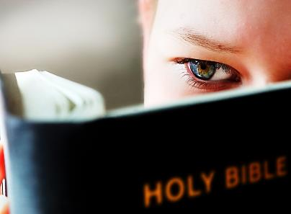
With God’s Ears We Eat Good Food
When we read or hear the Word of God wearing our “Heavenly bat-ears,” we become wiser. We begin to make better choices. We know what to swallow and what to just ignore.

Slide 20
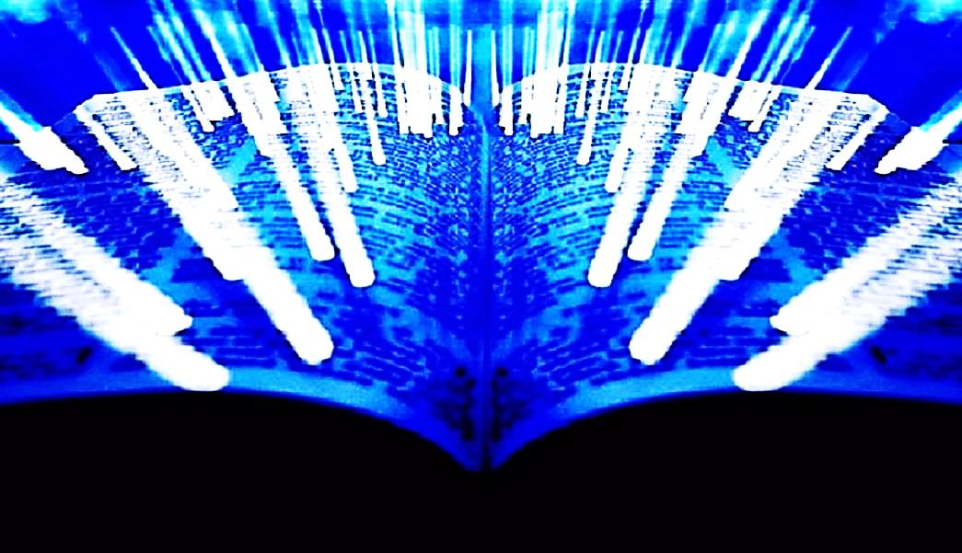
“And we also thank God constantly for this, that when you received the word of God, which you heard from us, you accepted it not as the word of men but as what it really is, the word of God, which is at work in you believers.” 1 Thess. 2:13

Slide 21
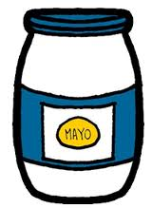
With God’s Ears We Eat Good Food
A man walked into a small grocery store to buy a box of cereal. He was amazed to see every shelf in the store filled with jars of mayonnaise. He told the owner of the store, “I want to buy a box of cereal but I can’t find any.” The grocer said, “It’s in the basement. Follow me.” →

Slide 22
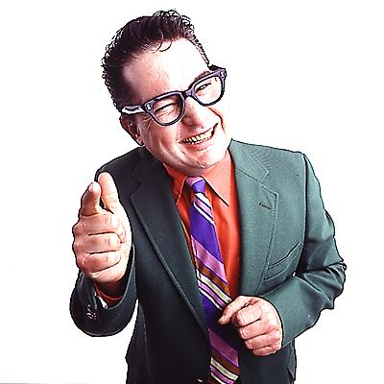
With God’s Ears We Eat Good Food
They went down into the basement and it too was filled with cartons and cartons of mayonnaise. The man said, “Wow, you must sell a lot of mayonnaise!” The grocer said, “No, I don't sell much mayonnaise. But the guy who sells me mayonnaise—boy, can he sell mayonnaise!”

Slide 23
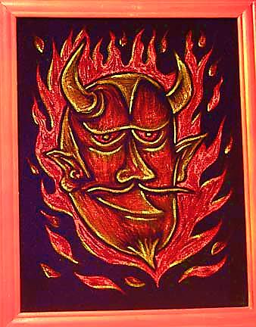
Some people will buy anything if the salesman is convincing enough. Satan is an excellent salesman!
If we hear teachings and advice and don’t listen with our “Heavenly bat ears,” we could be buying a lot of things we don’t need.
We will be vulnerable to swallowing all kinds of junk.

Slide 24
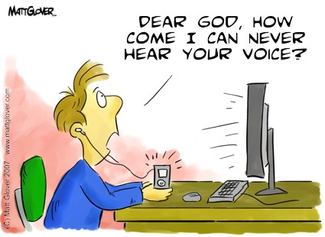
Wax in Our Heavenly Bat Ears
So why can’t we hear and receive what God is saying to us?
Our sinful desires are like wax in our ears.
“…and they sit before thee as my people, and they hear thy words, but they will not do them: for with their mouth they shew much love, but their heart goeth after their covetousness.” Ezekiel 33:31

Slide 25
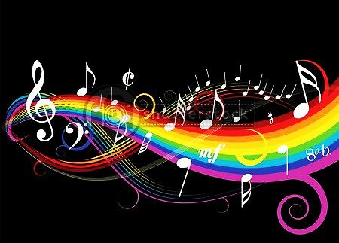
Wax in God’s Heavenly
Bat Ears
“And, lo, thou art unto them as a very lovely song of one that hath a pleasant voice, and can play well on an instrument: for they hear thy words, but they do them not.” Ezekiel 33:32
We say, “Great sermon pastor,” but it doesn’t change our life.

Slide 26
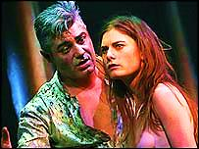
Greed is Wax in Our Ears
This is how Satan was able to deceive Eve in The Garden.
“When the woman saw that the fruit of the tree was good for food and pleasing to the eye, and also desirable for gaining wisdom, she took some and ate it. She also gave some to her husband, who was with her, and he ate it.” Genesis 3:6

Slide 27
She coveted with her belly for the food
With her eyes for the sensory pleasure
With her pride for the hidden knowledge.
Listening to Satan made her stop listening to God who had said “Ye shall not eat of it.”
She was soon easily deceived.
She had wax in her bat-ears and was soon buying into lies.

Slide 28
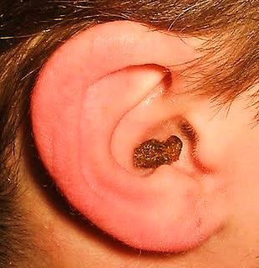
Greed is Wax in Our Ears
And they shall turn away their ears from the truth, and shall be turned unto fables. 2 Tim. 4:4

Slide 29

I listen to my local radio station while I'm driving in my car. When I drive away from the radio tower, the signal gets weaker and weaker. But, if I turn the car around and drive back into town, the signal becomes stronger -- I can hear it again!!
In the same way, we stop hearing God when we drift away from Him. But if we will turn around and come back to Him, we'll hear His voice again. The closer we are to God, more clearly we can hear Him.

Slide 30

We need to spend time in God’s bat-cave. Spend time in His word, prayerfully taking it to heart, loving it.
We need to come to church to listen, clear the wax build up of sin and listen to what God is speaking to us personally.

Slide 31
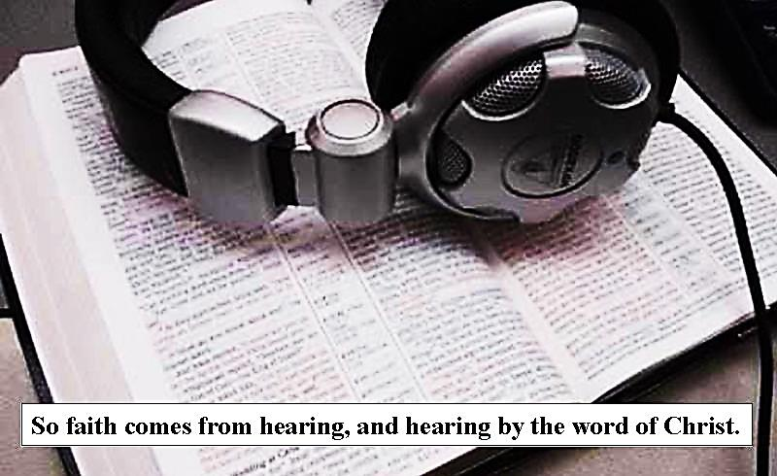

Slide 32
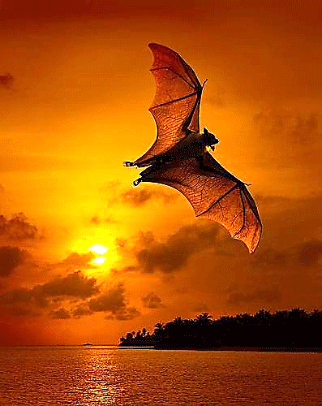
When we hear God’s Word with God’s special “hearing” gift, we will:
SEE and no longer be confused
SOAR with faith and do brave things for God
SWALLOW only truth

Slide 33

What is the Sinner‘s Prayer?
This is a prayer we can pray when we are ready to admit we are sinners and need Christ’s forgiveness.
It must be prayed with faith in our hearts and a readiness to have a life-changing encounter with Jesus Christ.

Slide 34
You Should Pray this Prayer If :
If you never have before
You have in the past, but you think you would mean it more today
You have been walking afar off and you want to come back
You want to set an example and show others how it is done
You just like to give your heart to Jesus again & again

Slide 35
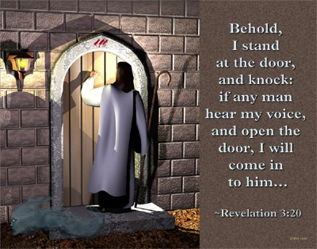

Slide 36

Dear Jesus,
I know I am a sinner & need your forgiveness.
I believe you died for my sins.
I now turn from sin.
Come into my heart I pray.
Do you want to meet Jesus as your savior right now?
Do you believe He died to save you from your sins & that He rose from the dead?
Do you believe that He is waiting to save you right now?

Slide 37


“But to all who believed him and accepted him, he gave the right to become children of God.” John 1:12

Slide 38



Slide 39


“If you declare with your mouth that Jesus is
Lord, and believe in your heart that God raised him from the dead, you
will be
saved.” Rom. 10:9
What did you learn today?
How does this lesson apply to our lives today?
What do you want to say about Jesus today?

Slide 40

“Draw near to God, and He will draw near to you…
…Cleanse your hands, you sinners, and make your hearts pure, you who are half-hearted towards God.” James 4:8 WNT

Slide 41
Note: Any videos in this presentation will only play online. After you download the slideshow, you will need to also download the videos from YouTube & add them back into your PowerPoint.
We present these messages at Bee Creek Park in College Station, TX.
See the videos of our messages here:
http://campaignkerusso.org/videos
We would love to know more about the people who download our lessons & sermons. We invite you to email us & let us know where & how you use them.
info@ckbrazos.org

Slide 42
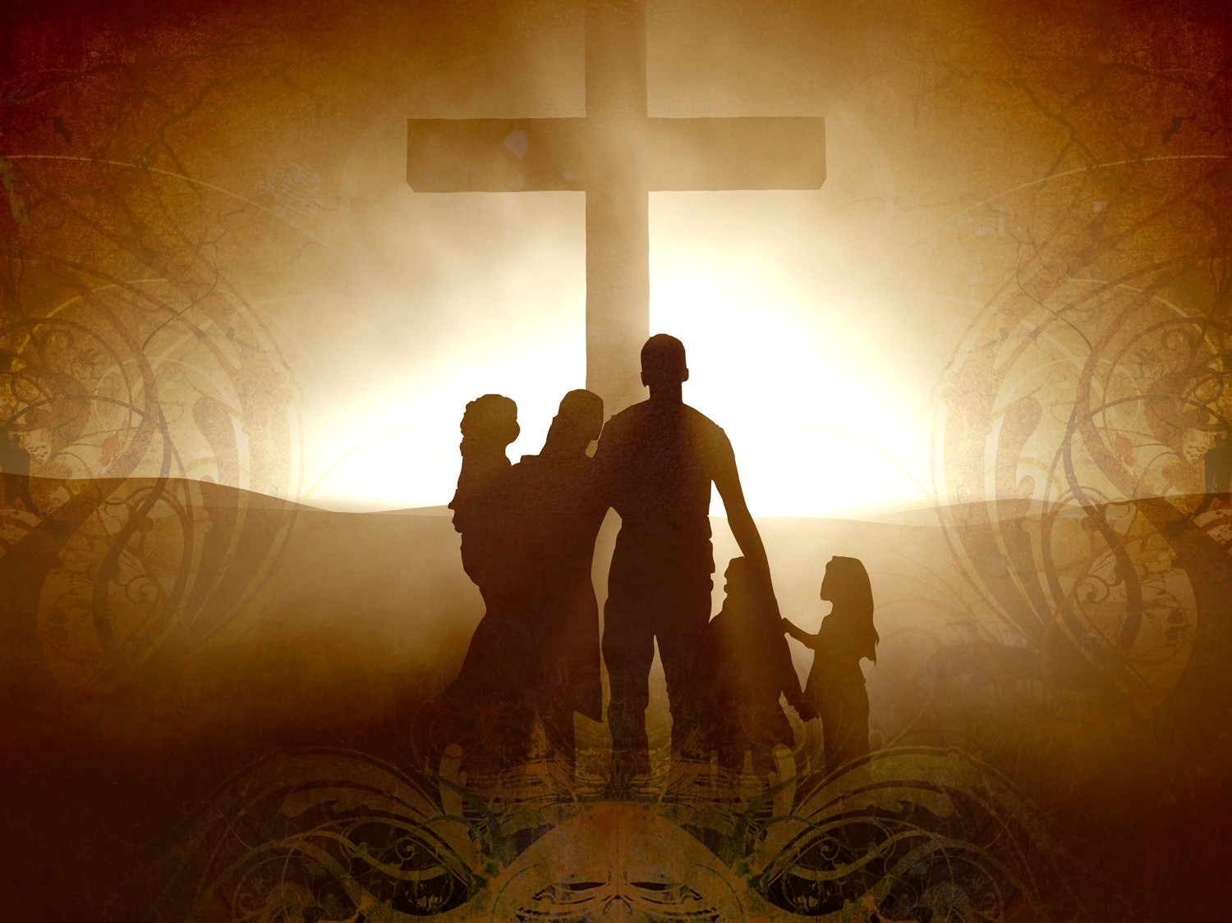
Welcome to Aggieland Faith
Family Style Worship

Slide 43

CURRENT SCHEDULE:
See www.Aggielandfaith.org
SATURDAY —
At Bee Creek Park
2:00-4:00pm: Through the bible with felt-board stories – plus hot-dogs & drinks
SUNDAY —
At Bee Creek Park
2:00-4pm: Free snacks, drinks, kids crafts, prizes, singing & bible preaching

Slide 44


Would You Like Prayer or Bible Study at Your House?
Personal Prayer:
We can come to your home & pray with you, or you can email us when you need prayer.
Home Bible Study:
We will come to your home & hold
a bible study for you & your friends.
Bible Party:
We will hold a Kid’s Bible Party:
You provide the food & kids - we
will do the bible fun & stories.

Slide 45

Would You Like Visitation?
We will visit a friend, loved one in the hospital or in prison to pray for them & share Christ with them.
Contact: info@aggielandfaith.org

Slide 46

www.aggielandfaith.org
Go here to see pictures & videos
Go here to subscribe to e-mails about changes & cancellations

Slide 47
Note: Any videos in this presentation will only play online. After you download the slideshow, you will need to also download the videos from YouTube & add them back into your PowerPoint.
We present these messages at Bee Creek Park in College Station, TX.
See the videos of our messages here:
http://campaignkerusso.org/videos
We would love to know more about the people who download our lessons & sermons. We invite you to email us & let us know where & how you use them.
info@ckbrazos.org

