Slide 1
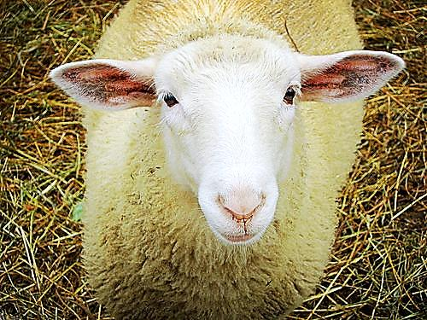
The Lamb of God

Slide 2



Note: Any videos in this presentation will only play online. After you download the slideshow, you will need to also download the videos from YouTube & add them back into your PowerPoint.
We present these messages at Bee Creek Park in College Station, TX.
See the videos of our messages here:
http://campaignkerusso.org/videos
We would love to know more about the people who download our lessons & sermons. We invite you to email us & let us know where & how you use them.
info@ckbrazos.org

Slide 3
Next Slide - Song:
Are You Washed→
Download Here: https://www.youtube.com/watch?v=h9oW91Iv8D8

Slide 4
Next Slide - Song:
Holy is the Lamb of God →
Download Here: http://youtu.be/m5x1_VQstAg

Slide 5

When Jesus Went as a Lamb
The Bible has two main sections:
The first tells us what happened before Jesus was born
The second tells us what happened after Jesus was born
BUT, Jesus WAS in the first section… in a disguise…

Slide 6
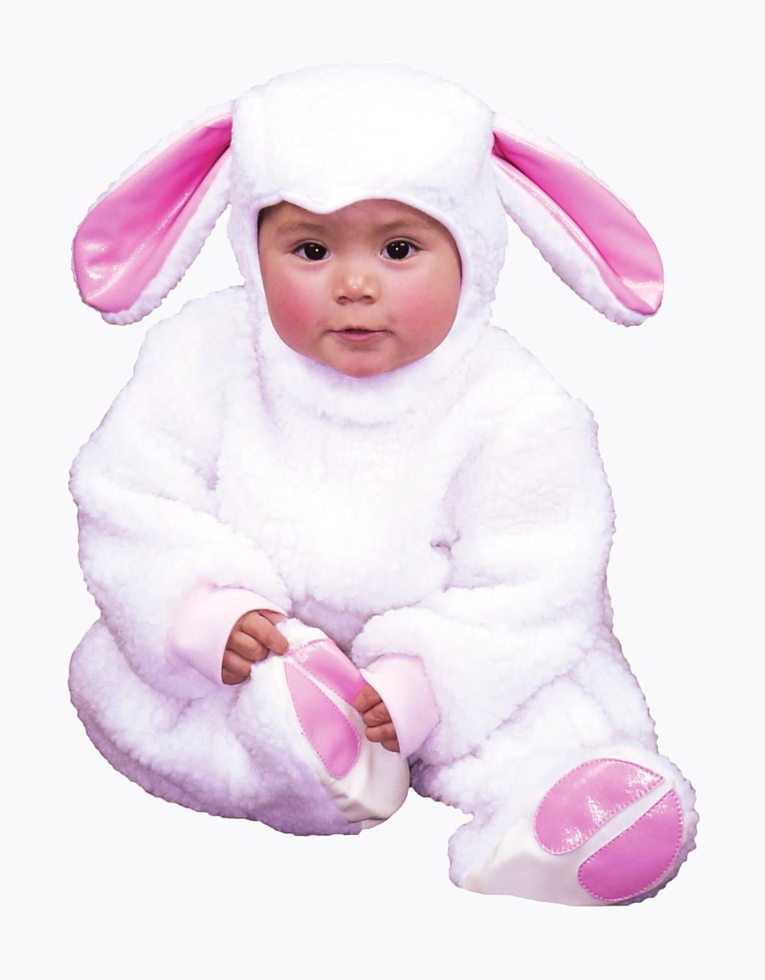
When Jesus Went as a Lamb
At Halloween time, some people wear costumes.
It is hard to see who they really are under the costume
Jesus was in the Old Testament a great deal
He was often pictured as a little lamb

Slide 7
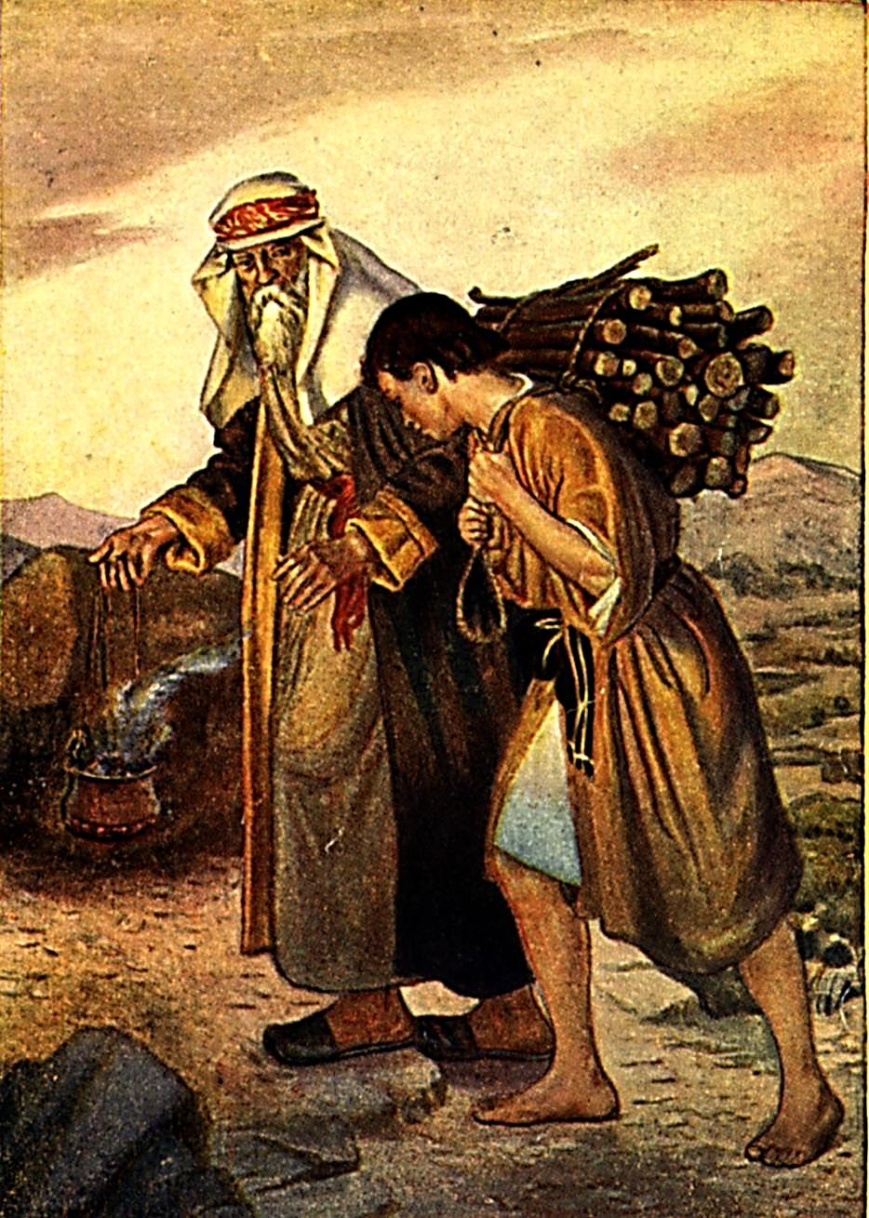
Everyone living then knew that a lamb was the usual sacrifice for sin
Isaac wondered how they could make a sacrifice without a lamb
Abraham answered: “My son, God will provide HIMSELF a lamb for a burnt offering” Genesis 22:8
He was seeing into the future

Slide 8
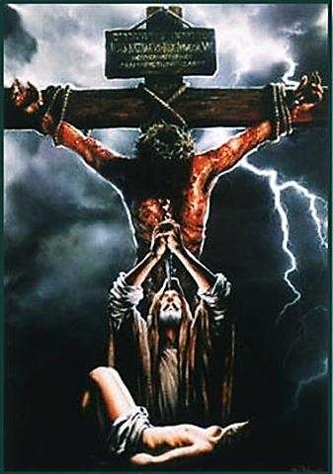
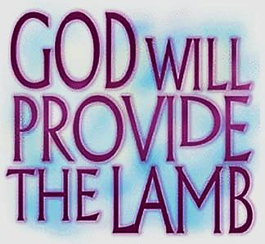
For the Sacrifice -- God had His Own Son (not Abraham’s) in Mind!

Slide 9
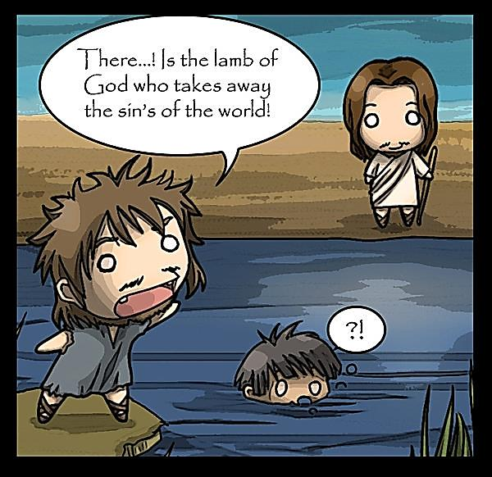
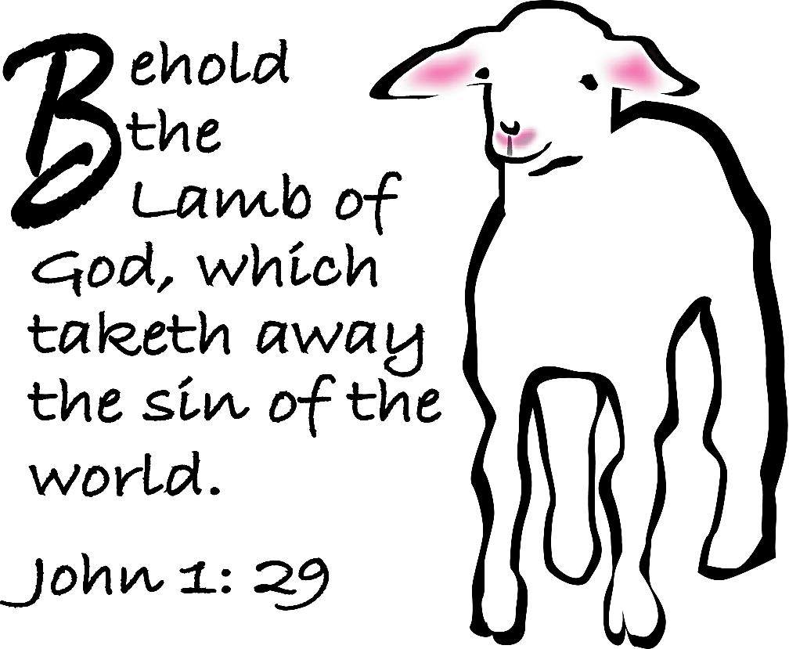
People wondered who this Lamb would be and how He would take away the sin of the world.
John the Baptist pointed right at Jesus and said “Behold the Lamb of God.”

Slide 10
Next Slide - Video:
John the Baptist →
Download Here: http://www.youtube.com/watch?v=vzpu5Ql1THk

Slide 11
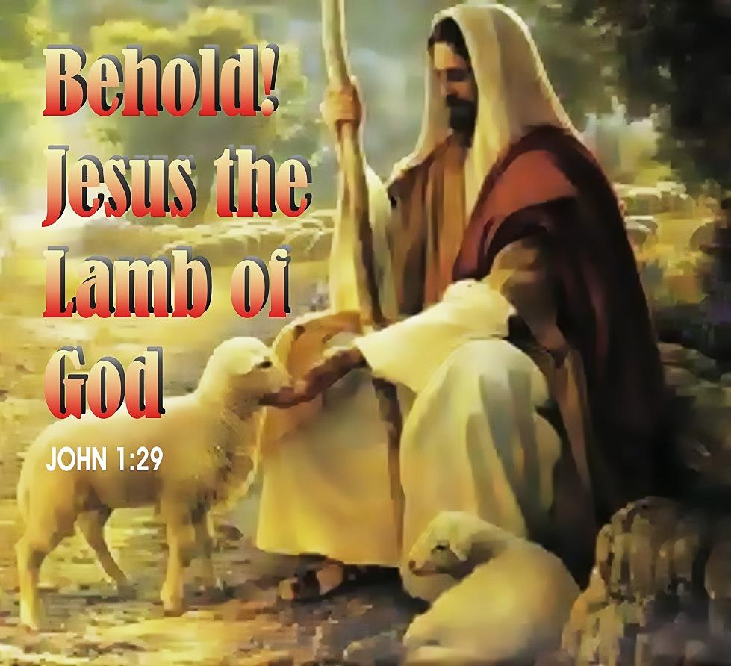
How is Jesus the Lamb of God?
We need to look at the story of the Passover to see why lambs are so important to God
We will look at a night that all the Hebrew people were saved because of a lamb

Slide 12
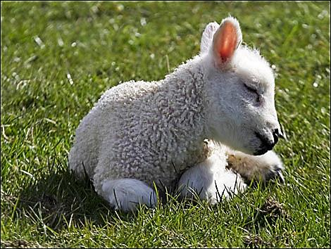
Passover
On this day the death angel would take all the first born sons of the Egyptians.
But God said, each family that sacrifices a lamb and puts its blood on their doorposts will be saved
He promised that the death angel would just pass over your house
But, the lamb had to be special…

Slide 13
Next Slide - Video:
Passover Lamb →
Download Here: http://www.youtube.com/watch?v=QZuiH6dYHv4

Slide 14
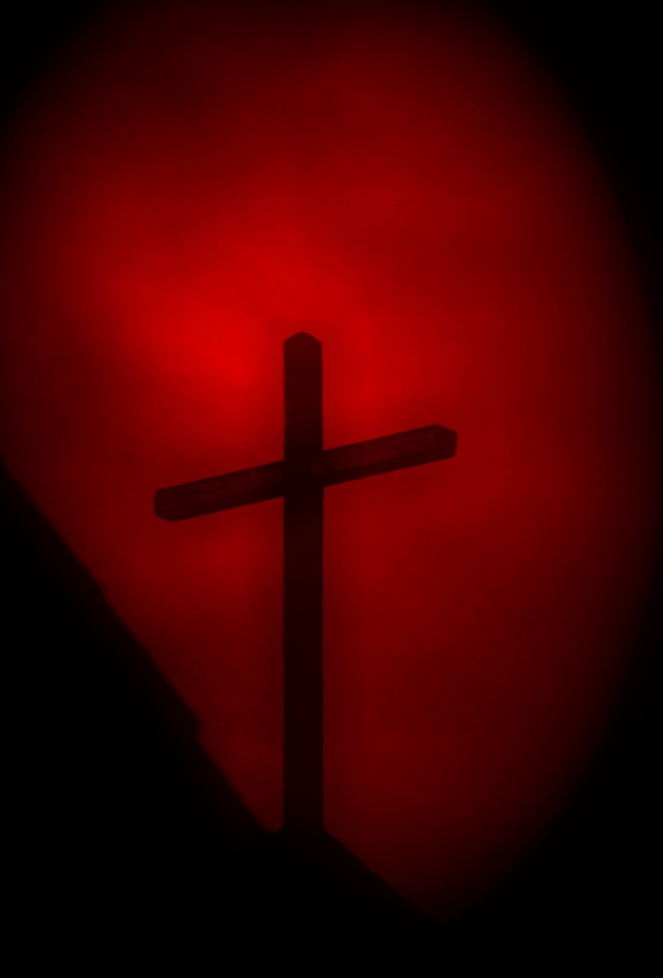

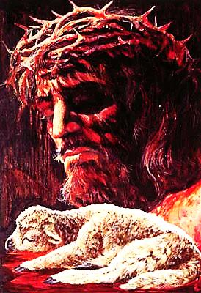

Slide 15
The Lamb Must be Perfect
“…but with the precious blood of Christ, a lamb without blemish or defect.”
1 Peter 1:19

Slide 16
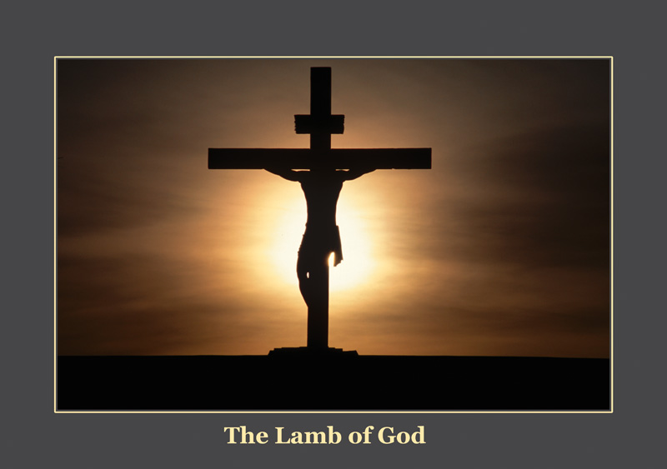
A lamb for a family. Jesus was the Lamb for God’s lost family – the whole world!

Slide 17
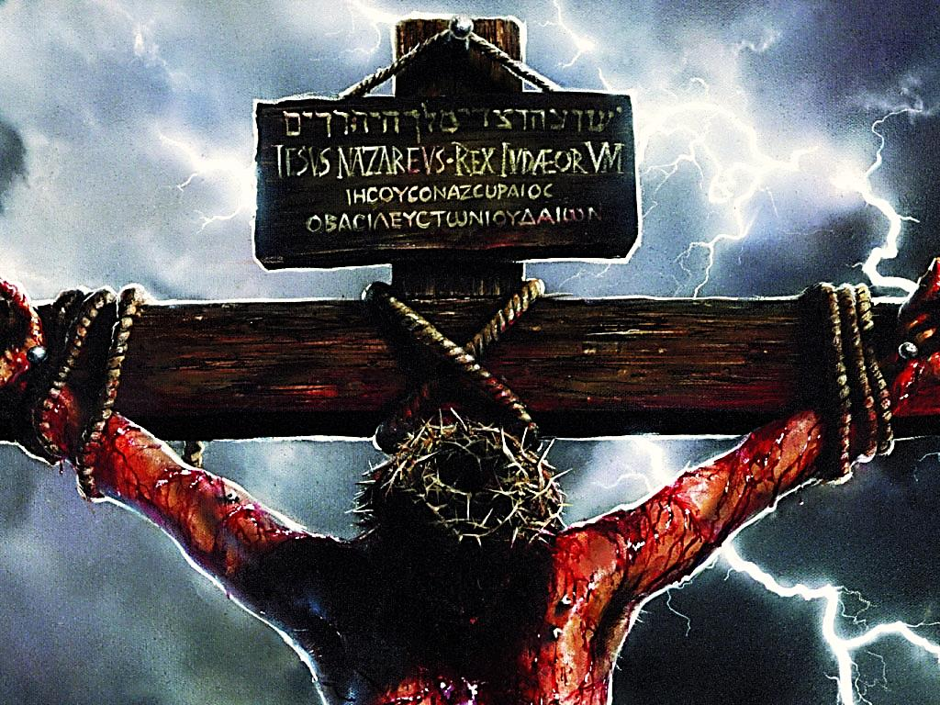
It Must be Slain & Burned with Fire
Fire speaks of the judgment of God.
Our sins were judged on the cross
If we believe, we will never face another judgment

Slide 18
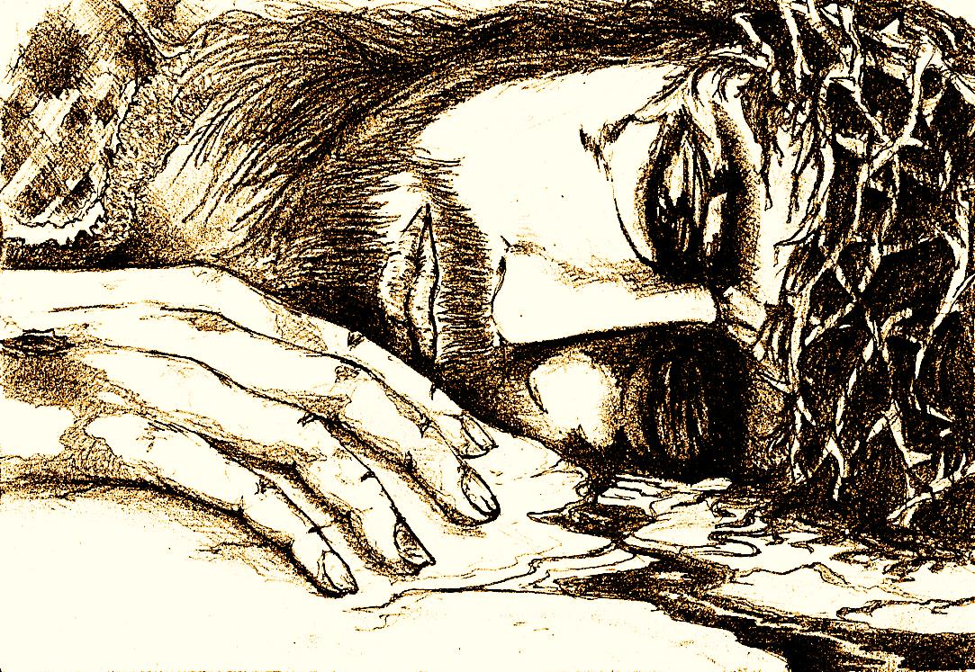
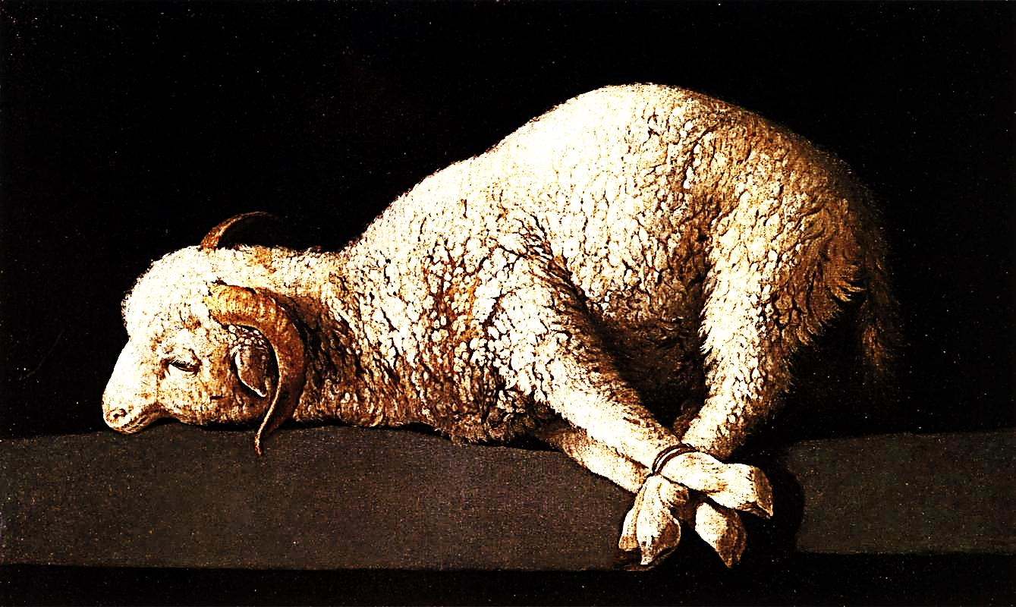
Jesus Laid Down His Life Willingly
“He was oppressed, and he was afflicted, yet he opened not his mouth: he is brought as a lamb to the slaughter, and as a sheep before her shearers is dumb, so he openeth not his mouth”
Isaiah 53:7

Slide 19
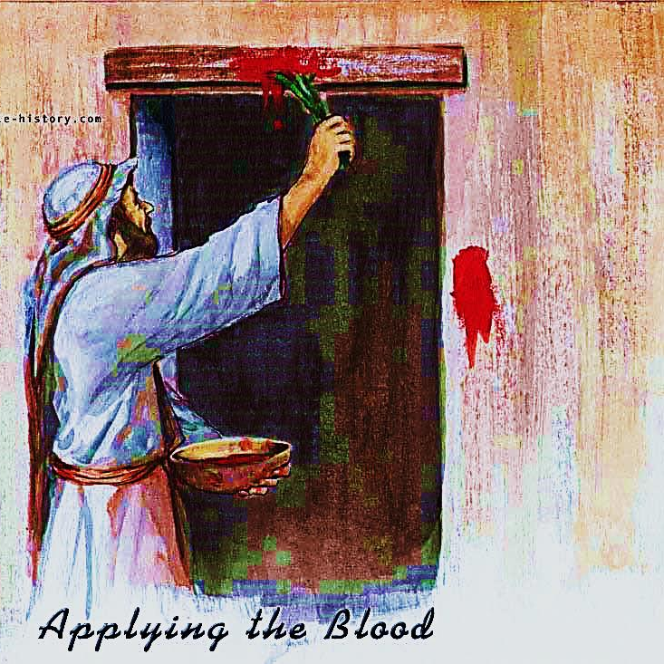
The Blood Must be Applied by Faith
“The blood will be a sign for you on the houses where you are; and when I see the blood, I will pass over you.”
Exodus 12:13

Slide 20


The Blood Must be Applied by Faith
“ …think how much more the blood of Christ will purify our consciences from sinful deeds....” Heb. 9:14

Slide 21
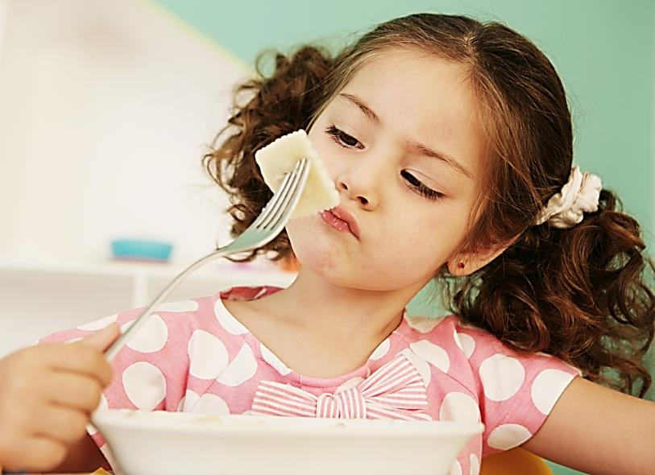
The Meat Must be Fully Consumed
“Whoever eats my flesh and drinks my blood has eternal life, and I will raise him up at the last day…” John 6:54
Jesus wants us to consume Him -- No picky eaters
Jesus requires 100% commitment – no half way Christians

Slide 22
Next Slide - Song:
Lamb of God →
Download Here: http://www.youtube.com/watch?v=pW7UgzFG4v4

Slide 23

What is the Sinner‘s Prayer?
This is a prayer we can pray when we are ready to admit we are sinners and need Christ’s forgiveness.
It must be prayed with faith in our hearts and a readiness to have a life-changing encounter with Jesus Christ.

Slide 24
You Should Pray this Prayer If :
If you never have before
You have in the past, but you think you would mean it more today
You have been walking afar off and you want to come back
You want to set an example and show others how it is done
You just like to give your heart to Jesus again & again

Slide 25
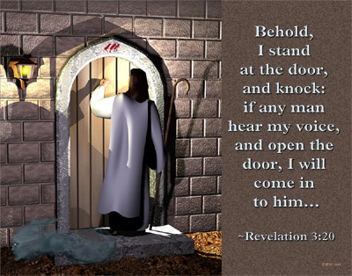

Slide 26

Dear Jesus,
I know I am a sinner & need your forgiveness.
I believe you died for my sins.
I now turn from sin.
Come into my heart I pray.
Do you want to meet Jesus as your savior right now?
Do you believe He died to save you from your sins & that He rose from the dead?
Do you believe that He is waiting to save you right now?

Slide 27


“But to all who believed him and accepted him, he gave the right to become children of God.” John 1:12

Slide 28



Slide 29


“If you declare with your mouth that Jesus is
Lord, and believe in your heart that God raised him from the dead, you
will be
saved.” Rom. 10:9
What did you learn today?
How does this lesson apply to our lives today?
What do you want to say about Jesus today?

Slide 30

“Draw near to God, and He will draw near to you…
…Cleanse your hands, you sinners, and make your hearts pure, you who are half-hearted towards God.” James 4:8 WNT

Slide 31
Note: Any videos in this presentation will only play online. After you download the slideshow, you will need to also download the videos from YouTube & add them back into your PowerPoint.
We present these messages at Bee Creek Park in College Station, TX.
See the videos of our messages here:
http://campaignkerusso.org/videos
We would love to know more about the people who download our lessons & sermons. We invite you to email us & let us know where & how you use them.
info@ckbrazos.org

Slide 32
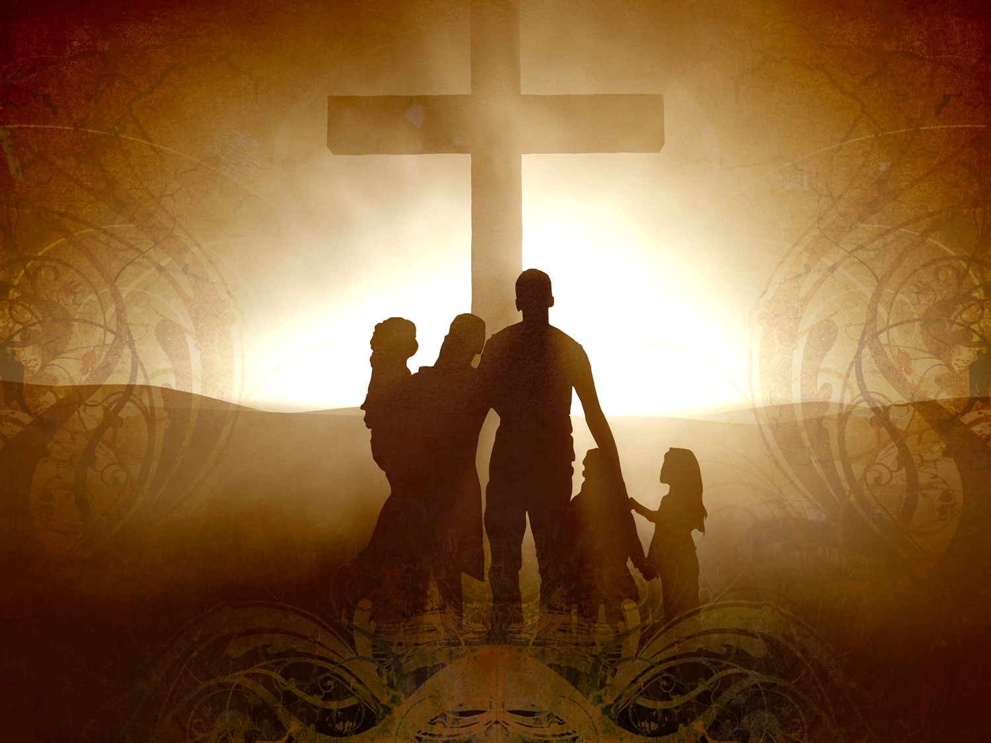
Welcome to Aggieland Faith
Family Style Worship

Slide 33

CURRENT SCHEDULE:
See www.Aggielandfaith.org
SATURDAY —
At Bee Creek Park
2:00-4:00pm: Through the bible with felt-board stories – plus hot-dogs & drinks
SUNDAY —
At Bee Creek Park
2:00-4pm: Free snacks, drinks, kids crafts, prizes, singing & bible preaching

Slide 34


Would You Like Prayer or Bible Study at Your House?
Personal Prayer:
We can come to your home & pray with you, or you can email us when you need prayer.
Home Bible Study:
We will come to your home & hold
a bible study for you & your friends.
Bible Party:
We will hold a Kid’s Bible Party:
You provide the food & kids - we
will do the bible fun & stories.

Slide 35

Would You Like Visitation?
We will visit a friend, loved one in the hospital or in prison to pray for them & share Christ with them.
Contact: info@aggielandfaith.org

Slide 36

www.aggielandfaith.org
Go here to see pictures & videos
Go here to subscribe to e-mails about changes & cancellations

Slide 37
Note: Any videos in this presentation will only play online. After you download the slideshow, you will need to also download the videos from YouTube & add them back into your PowerPoint.
We present these messages at Bee Creek Park in College Station, TX.
See the videos of our messages here:
http://campaignkerusso.org/videos
We would love to know more about the people who download our lessons & sermons. We invite you to email us & let us know where & how you use them.
info@ckbrazos.org

