Slide 1
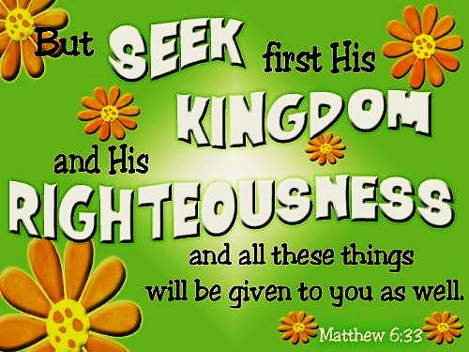

Slide 2



Note: Any videos in this presentation will only play online. After you download the slideshow, you will need to also download the videos from YouTube & add them back into your PowerPoint.
We present these messages at Bee Creek Park in College Station, TX.
If you would like to watch the video of the service with this message, click here:
http://campaignkerusso.org/2012/11/free-powerpoint-sermon-joseph-god-has-the-plan/
We would love to know more about the people who download our lessons & sermons. We invite you to email us & let us know where & how you use them.
info@ckbrazos.org

Slide 3
Next Slide – Song:
Seek Ye First the Kingdom of God →
Download Here: http://youtu.be/syrHB3n6sq0

Slide 4
In Matthew 6:19-33 Jesus teaches us four truths about how we should think about our things here on Earth. He talks about:
TREASURE
LIGHT
MONEY
WORRY

Slide 5
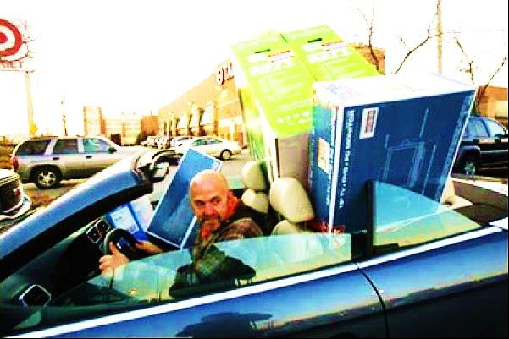
Treasures
Don’t store up treasures on earth! Moths and rust can destroy them, and thieves can break in and steal them. Matthew 6:19

Slide 6
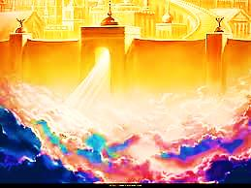
Treasures
Instead, store up your treasures in heaven, where moths and rust cannot destroy them, and thieves cannot break in and steal them. Your heart will always where your treasure is. Matthew 6:20-21

Slide 7
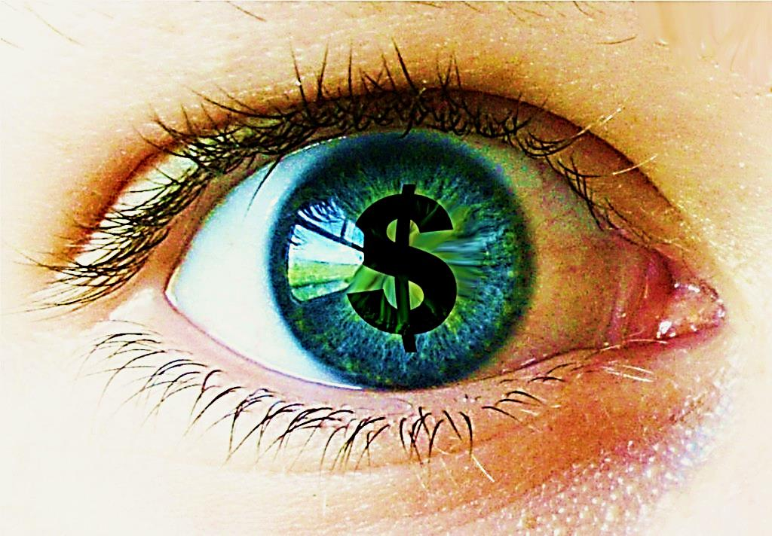
light
Eyes are like a window for your body. When they are good, you have all the light you need. But when your eyes are bad, everything is dark. If the light inside you is dark, you surely are in the dark.
Matthew 6:22-23

Slide 8
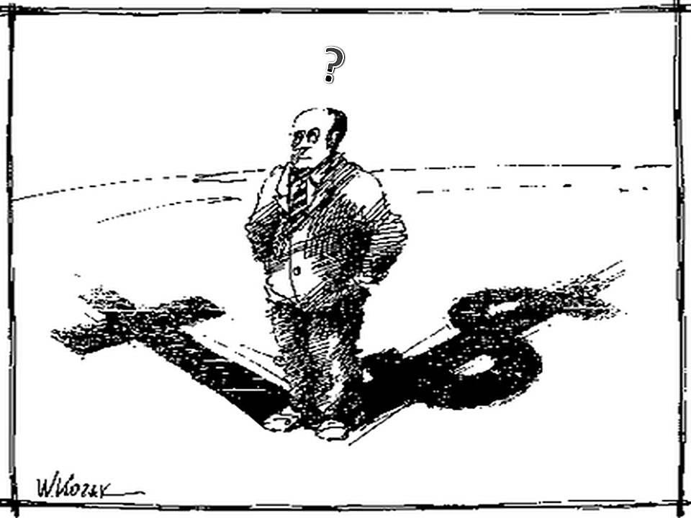
Money
“You cannot be the slave of two masters! You will like one more than the other…
…or be more loyal to one than the other. You cannot serve both God and money.”
Matthew 6:24)

Slide 9

Worry
“Don’t worry and ask yourselves, “Will we have anything to eat? Will we have anything to drink?
Will we have any clothes to wear?” Only people who don’t know God are always worrying about such things.” Matthew 6:31-32a

Slide 10

Worry
“Your Father in heaven knows that you need all of these. But more than anything else, put God’s work first and do what he wants. Then the other things will be yours as well.” Mat. 6:32b-33

Slide 11
Next Slide – Song:
The Lumber Song →
Download Here: http://youtu.be/31xRZFs-Gj4

Slide 12

What is the Sinner‘s Prayer?
This is a prayer we can pray when we are ready to admit we are sinners and need Christ’s forgiveness.
It must be prayed with faith in our hearts and a readiness to have a life-changing encounter with Jesus Christ.

Slide 13
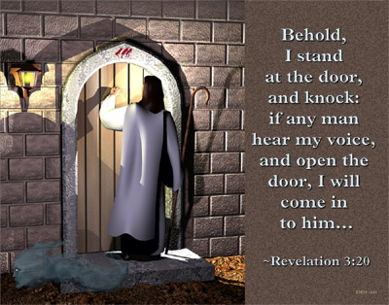

Slide 14
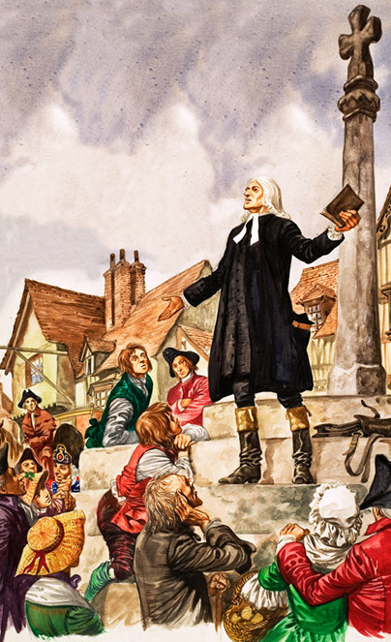
John Wesley’s Testimony
“About a quarter before nine, while the preacher was describing the change which God works in the heart -- through faith in Christ -- I felt my heart strangely warmed.
I felt I did trust in Christ, Christ alone for salvation, and an assurance was given me that he had taken away my sins, even mine, and saved me from the law of sin and death."

Slide 15

A prayer of faith → Pray this prayer if :
If you never have before
You have in the past, but you think you would mean it more today
You have been walking afar off and you want to come back
You want to set an example & show others how it is done
You just like to give your heart to Jesus again & again

Slide 16
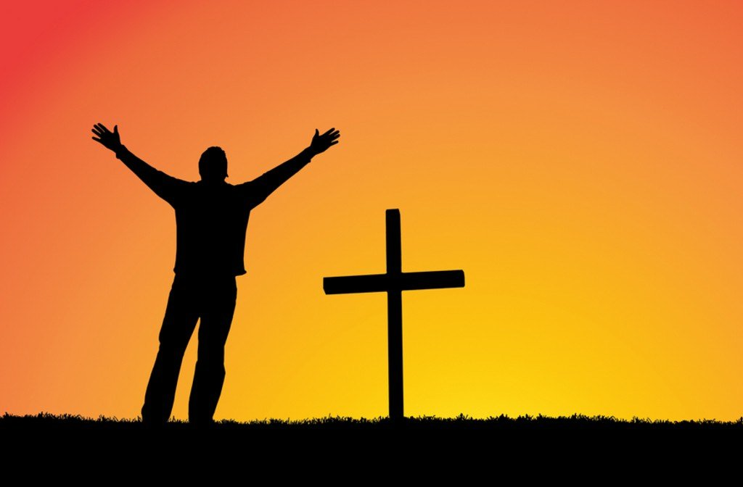
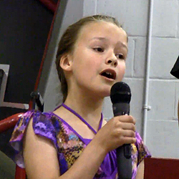
We Declare Our Faith Publicly Because Jesus Declared His LOVE Publicly
“If you stand before others and are willing to say you believe in me, then I will tell my Father in heaven that you belong to me.” Mat 10:32

Slide 17

Dear Jesus,
I know I am a sinner & need your forgiveness.
I believe you died for my sins.
I now turn from sin.
Come into my heart I pray.
Do you want to meet Jesus as your savior right now?
Do you believe He died to save you from your sins & that He rose from the dead?
Do you believe that He is waiting to save you right now?

Slide 18


“But some people did accept him. They believed in him, and he gave them the right to become children of God.” John 1:12

Slide 19



Slide 20


“If you openly say, ‘Jesus is Lord’ and believe in your heart that God raised him from death, you will be saved.”
Rom. 10:9
What did you learn today?
What is the meaning of the name-tag?
What is God speaking to you lately?
What do you want to tell the world about Jesus?

Slide 21

“Draw near to God, and He will draw near to you…
…Cleanse your hands, you sinners, and make your hearts pure, you who are half-hearted towards God.” James 4:8 WNT

Slide 22
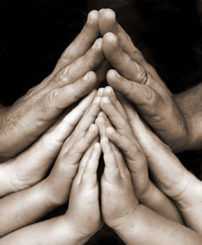
Close in Prayer

Slide 23
Note: Any videos in this presentation will only play online. After you download the slideshow, you will need to also download the videos from YouTube & add them back into your PowerPoint.
We present these messages at Bee Creek Park in College Station, TX.
If you would like to watch the video of the service with this message, click here:
http://campaignkerusso.org/2012/11/free-powerpoint-sermon-joseph-god-has-the-plan/
We would love to know more about the people who download our lessons & sermons. We invite you to email us & let us know where & how you use them.
info@ckbrazos.org

Slide 24
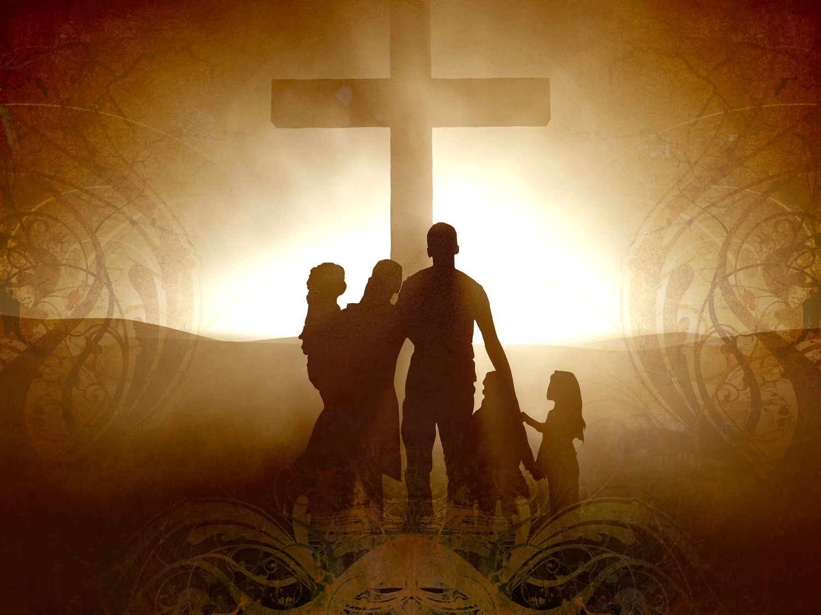
Welcome to Aggieland Faith
Family Style Worship

Slide 25

CURRENT SCHEDULE:
See www.Aggielandfaith.org
SATURDAY —
At Bee Creek Park
2:00-4:00pm: Through the bible with felt-board stories – plus hot-dogs & drinks
SUNDAY —
At Bee Creek Park
2:00-4pm: Free snacks, drinks, kids crafts, prizes, singing & bible preaching

Slide 26


Would You Like Prayer or Bible Study at Your House?
Personal Prayer:
We can come to your home & pray with you, or you can email us when you need prayer.
Home Bible Study:
We will come to your home & hold
a bible study for you & your friends.
Bible Party:
We will hold a Kid’s Bible Party:
You provide the food & kids - we
will do the bible fun & stories.

Slide 27

Would You Like Visitation?
We will visit a friend, loved one in the hospital or in prison to pray for them & share Christ with them.
Contact: info@aggielandfaith.org

Slide 28

www.aggielandfaith.org
Go here to see pictures & videos
Go here to subscribe to e-mails about changes & cancellations

Slide 29
Note: Any videos in this presentation will only play online. After you download the slideshow, you will need to also download the videos from YouTube & add them back into your PowerPoint.
We present these messages at Bee Creek Park in College Station, TX.
If you would like to watch the video of the service with this message, click here:
http://campaignkerusso.org/2012/11/free-powerpoint-sermon-joseph-god-has-the-plan/
We would love to know more about the people who download our lessons & sermons. We invite you to email us & let us know where & how you use them.
info@ckbrazos.org

