Slide 1
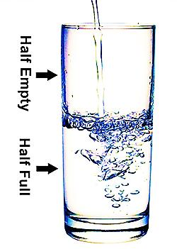
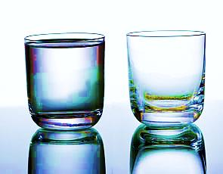
The Truth is…
Our hearts are either:
All Full or All Empty
Some are said to view the world as either half full or half empty.

Slide 2



Note: Any videos in this presentation will only play online. After you download the slideshow, you will need to also download the videos from YouTube & add them back into your PowerPoint.
We present these messages at Bee Creek Park in College Station, TX.
If you would like to watch the video of the service with this message, click here:
http://campaignkerusso.org/?p=6451
We would love to know more about the people who download our lessons & sermons. We invite you to email us & let us know where & how you use them.
info@ckbrazos.org

Slide 3

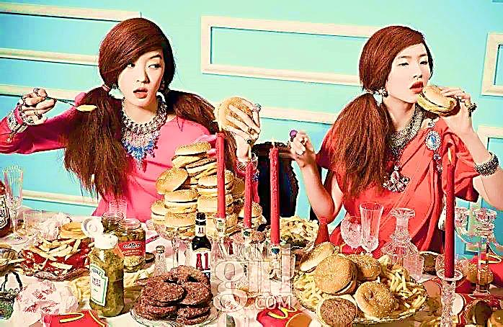
Things that are Never Satisfied
Leeches:
“The leech has two daughters, crying, ‘Give, Give.’”
Proverbs 30:15

Slide 4
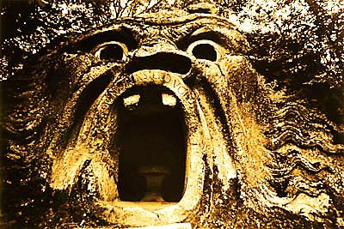
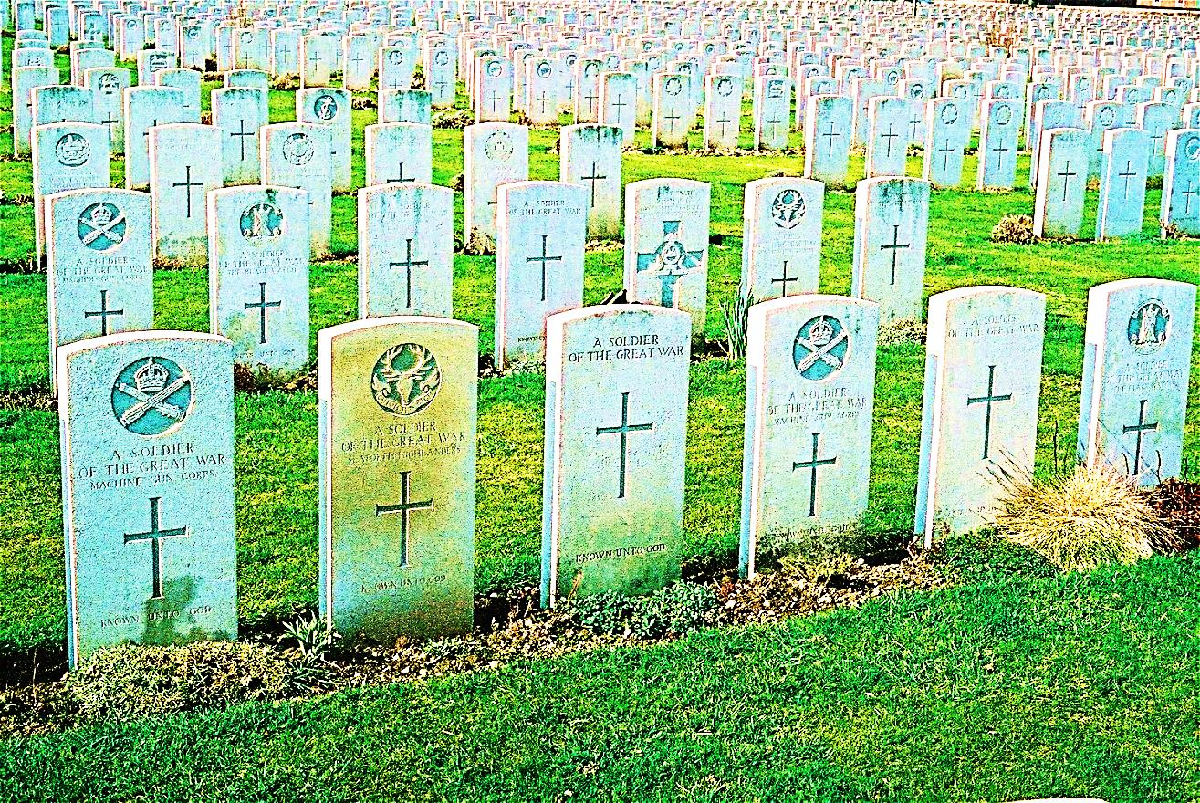
Things that are Never Satisfied
Death
“Therefore the grave enlarges its appetite and opens its mouth without limit…”
Isa.5:14

Slide 5
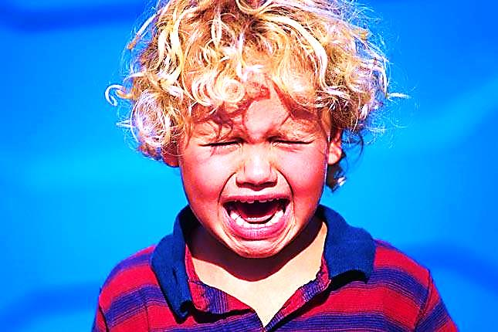
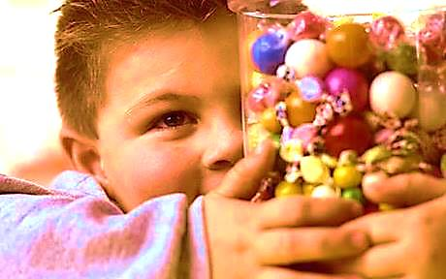
Things that are Never Satisfied
Human Desire
“Just as Death and Destruction are never satisfied, so human desire is never satisfied.”
Prov. 27:20

Slide 6
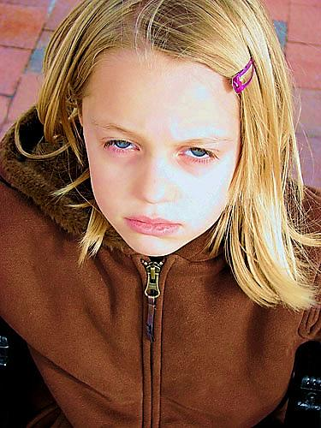
Things that are Never Satisfied
Ungrateful Children & Grown-Ups
“Some people curse their father and do not thank their mother. Prov. 30:11
“…for men shall be lovers of themselves, lovers of money… disobedient to parents, unthankful, unkind,…” 2 Tim 3:1, 2

Slide 7
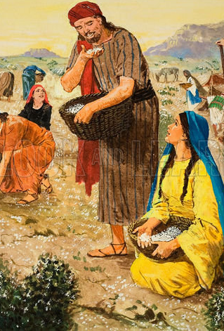
The Ungrateful Heart is Always Empty
(no matter what it has).
All the pleasures of the world will not satisfy it.
Even the kind gifts of God will not satisfy it.
“…they spoke against God and against Moses, and said, "Why have you brought us up out of Egypt to die in the desert? There is no bread! There is no water! And we detest this miserable food!"
Num. 21:5

Slide 8
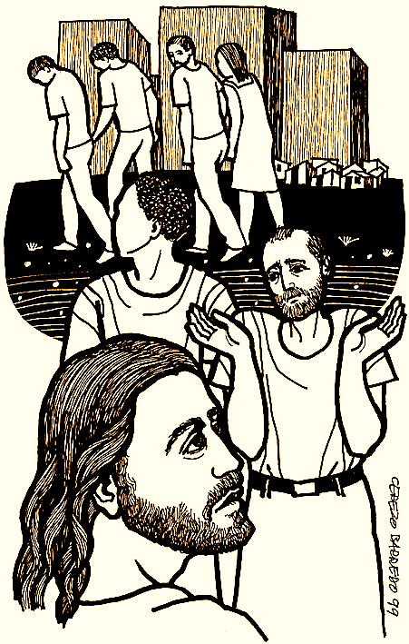
The Ungrateful Heart is Always Empty
(no matter what it has)
Jesus Himself
Cannot Satisfy It
“From this time many of his disciples turned back and no longer followed him.
You do not want to leave too, do you?” Jesus asked the Twelve.
Simon Peter answered him, “Lord, to whom shall we go? You have the words of eternal life.”
John 6:68

Slide 9

The Grateful Heart is
Always Full
(no matter what it doesn’t have)
It thanks God for everything & for nothing
“…in everything give thanks; for this is God's will for you in Christ Jesus…”
1 Thess. 5:18

Slide 10
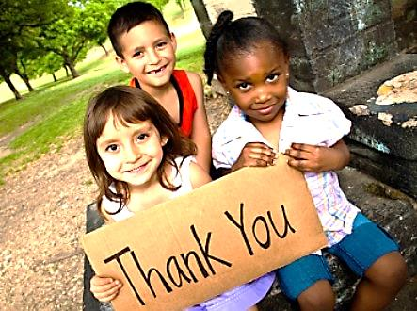
The Grateful Heart is Always Full
(no matter what it doesn’t have)
It thanks God for even nothing
“And he said, “Naked I came from my mother's womb, and naked shall I return. The Lord gave, and the Lord has taken away; blessed be the name of the Lord.”
Job 1:21

Slide 11

The Grateful Heart is Always Full
(no matter what it doesn’t have)
It is Satisfied with Jesus Alone
“He gave plenty to drink to those who were thirsty. He filled those who were hungry with good food.” Psa. 107:9

Slide 12
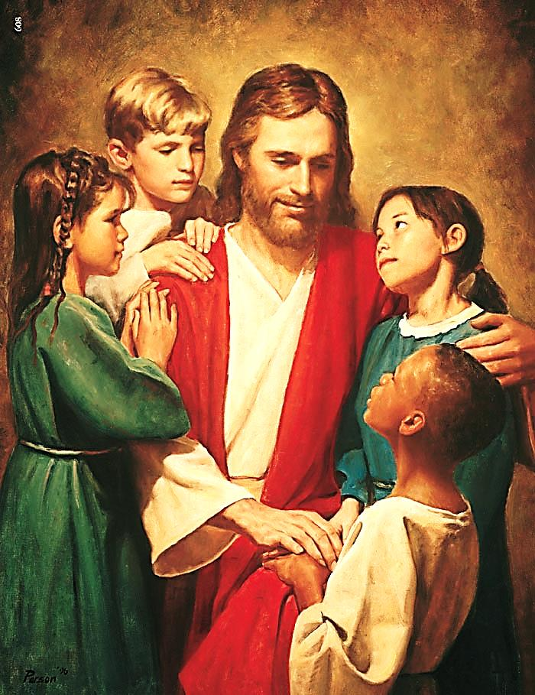
The Grateful Heart is Always Full
(no matter what it doesn’t have)
The company of Jesus is what makes Heaven → Heaven.
Not streets of gold…
Not angels…
Not mansions…
I want to see Jesus!

Slide 13
Next Slide -Video:
I Bowed on My Knees →
Download Here: http://www.youtube.com/watch?v=9v885asw4uk

Slide 14
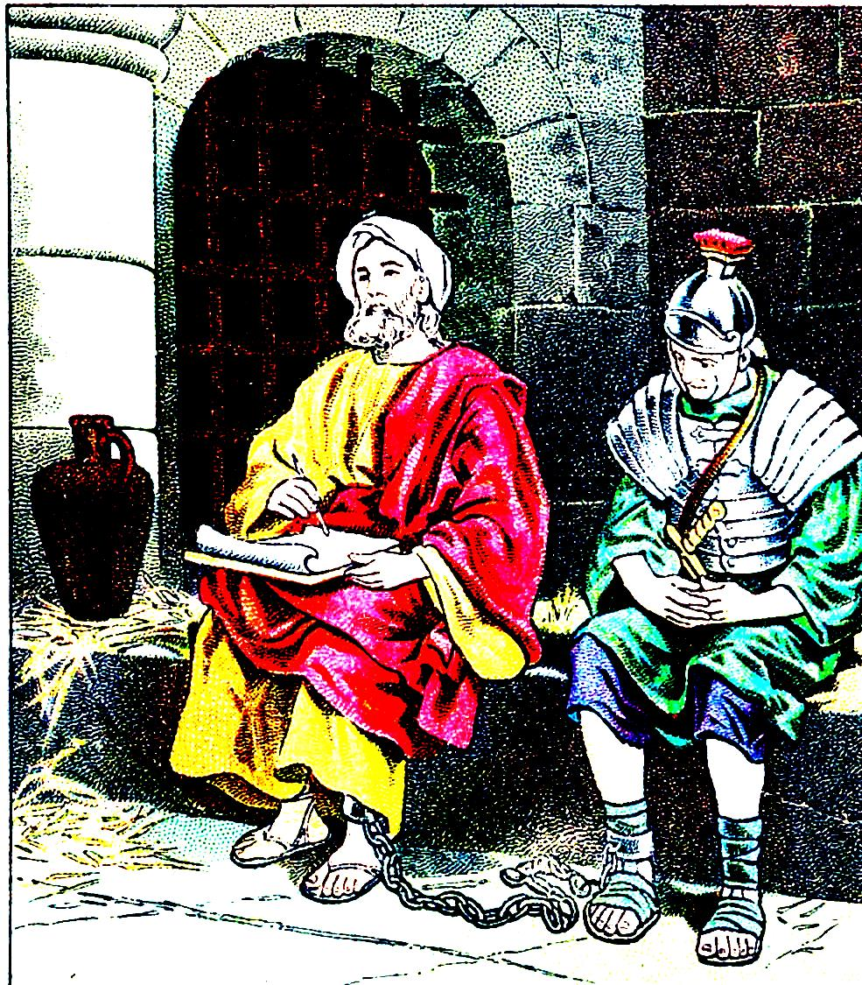
The Grateful Heart is Always Full
(no matter what it doesn’t have)
It fills by emptying!
“I thank Christ Jesus our Lord, who has strengthened me, because He considered me faithful, putting me into service, even though I was formerly a blasphemer and a persecutor and a violent aggressor.”
1 Tim. 1:12, 13

Slide 15
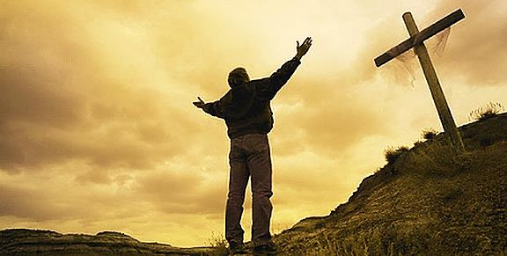
How Do We Get a Grateful Heart?
God gives us a grateful heart when we realize how much Jesus has done for us.
The more we understand the cost of His gift, the more grateful we are for everything.
Only Jesus can truly satisfy your soul!

Slide 16
Next Slide - Song:
Fill My Cup Lord →
Download Here: http://www.youtube.com/watch?v=s4l2yY2r95g

Slide 17
Next Slide - Song:
Only You Can Satisfy →
Download Here: http://www.youtube.com/watch?v=ZeGQzpFCePk

Slide 18

What is the Sinner‘s Prayer?
This is a prayer we can pray when we are ready to admit we are sinners and need Christ’s forgiveness.
It must be prayed with faith in our hearts and a readiness to have a life-changing encounter with Jesus Christ.

Slide 19
You Should Pray this Prayer If :
If you never have before
You have in the past, but you think you would mean it more today
You have been walking afar off and you want to come back
You want to set an example and show others how it is done
You just like to give your heart to Jesus again & again

Slide 20
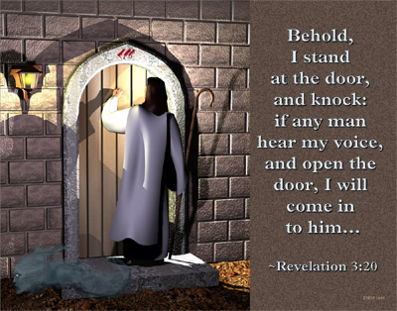

Slide 21

Dear Jesus,
I know I am a sinner & need your forgiveness.
I believe you died for my sins.
I now turn from sin.
Come into my heart I pray.
Do you want to meet Jesus as your savior right now?
Do you believe He died to save you from your sins & that He rose from the dead?
Do you believe that He is waiting to save you right now?

Slide 22


“But to all who believed him and accepted him, he gave the right to become children of God.” John 1:12

Slide 23



Slide 24


“If you declare with your mouth that Jesus is
Lord, and believe in your heart that God raised him from the dead, you
will be
saved.” Rom. 10:9
What did you learn today?
How does this lesson apply to our lives today?
What do you want to say about Jesus today?

Slide 25

“Draw near to God, and He will draw near to you…
…Cleanse your hands, you sinners, and make your hearts pure, you who are half-hearted towards God.” James 4:8 WNT

Slide 26
Note: Any videos in this presentation will only play online. After you download the slideshow, you will need to also download the videos from YouTube & add them back into your PowerPoint.
We present these messages at Bee Creek Park in College Station, TX.
If you would like to watch the video of the service with this message, click here:
http://campaignkerusso.org/?p=6451
We would love to know more about the people who download our lessons & sermons. We invite you to email us & let us know where & how you use them.
info@ckbrazos.org

Slide 27
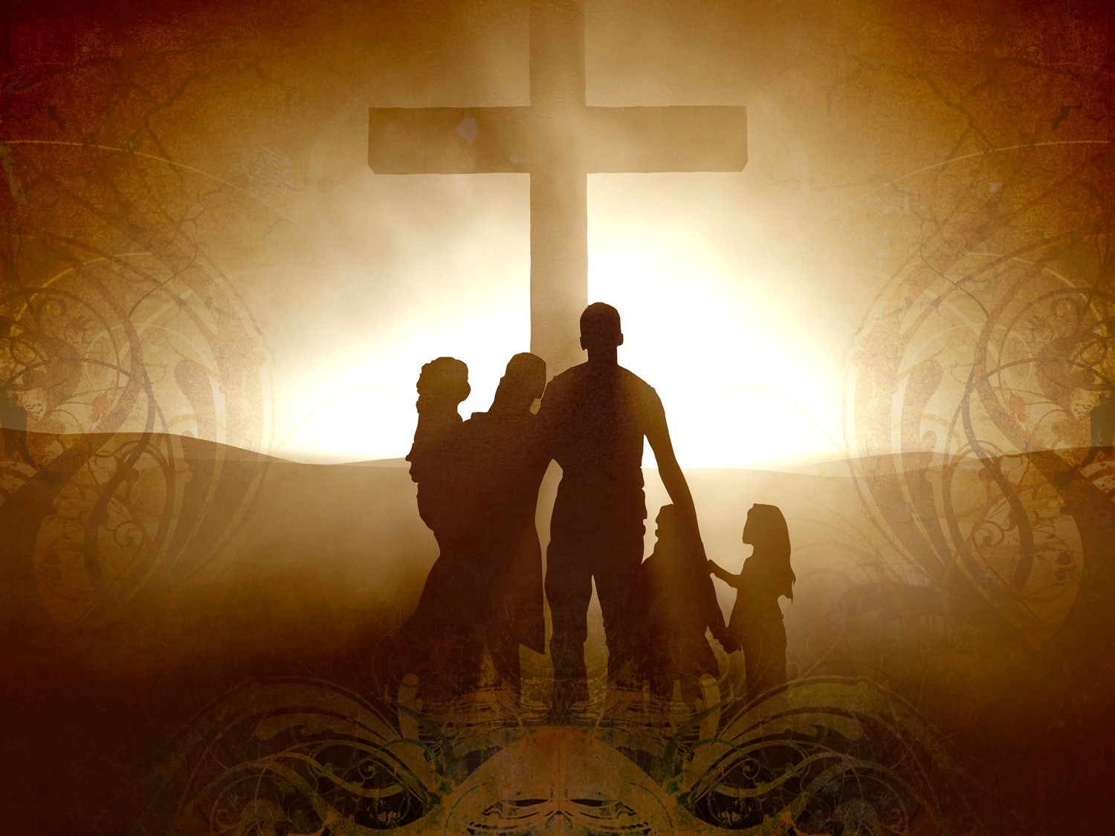
Welcome to Aggieland Faith
Family Style Worship

Slide 28

CURRENT SCHEDULE:
See www.Aggielandfaith.org
SATURDAY —
At Bee Creek Park
2:00-4:00pm: Through the bible with felt-board stories – plus hot-dogs & drinks
SUNDAY —
At Bee Creek Park
2:00-4pm: Free snacks, drinks, kids crafts, prizes, singing & bible preaching

Slide 29


Would You Like Prayer or Bible Study at Your House?
Personal Prayer:
We can come to your home & pray with you, or you can email us when you need prayer.
Home Bible Study:
We will come to your home & hold
a bible study for you & your friends.
Bible Party:
We will hold a Kid’s Bible Party:
You provide the food & kids - we
will do the bible fun & stories.

Slide 30

Would You Like Visitation?
We will visit a friend, loved one in the hospital or in prison to pray for them & share Christ with them.
Contact: info@aggielandfaith.org

Slide 31

www.aggielandfaith.org
Go here to see pictures & videos
Go here to subscribe to e-mails about changes & cancellations

Slide 32
Note: Any videos in this presentation will only play online. After you download the slideshow, you will need to also download the videos from YouTube & add them back into your PowerPoint.
We present these messages at Bee Creek Park in College Station, TX.
If you would like to watch the video of the service with this message, click here:
http://campaignkerusso.org/?p=6451
We would love to know more about the people who download our lessons & sermons. We invite you to email us & let us know where & how you use them.
info@ckbrazos.org

