Slide 1

Part 1

Slide 2



Note: Any videos in this presentation will only play online. After you download the slideshow, you will need to also download the videos from YouTube & add them back into your PowerPoint.
We present these messages at Bee Creek Park in College Station, TX.
If you would like to watch the video of the service with this message, click here:
http://campaignkerusso.org/?p=9162
We would love to know more about the people who download our lessons & sermons. We invite you to email us & let us know where & how you use them.
info@ckbrazos.org

Slide 3

What was Earth like in the beginning?
What did the Spirit of God do?
What is the first thing God said?
What happened when God said that?
What did God see about everything that He made?
What did God create man to be like?
What happened when God breathed into the man’s nostrils?

Slide 4
Next Slide - Video: Story of Bible – 1a
Download Here: http://youtu.be/bjBgHuz2DdA

Slide 5
What was Earth like in the beginning?
What did the Spirit of God do?
What is the first thing God said?
What happened when God said that?
What did God see about everything that He made?
What did God create man to be like?
What happened when God breathed into the man’s nostrils?

Slide 6
What did God plant?
What did God give man to do?
What did God forbid man to do?
What freedom did God give man and angels?
What caused the angel Lucifer (also called Satan) to fall from Heaven?
What form did Satan take in the Garden?
What is Satan the father of?

Slide 7
Next Slide - Video: Story of Bible – 1b
Download Here: http://youtu.be/9AaP-hJ_p-E

Slide 8
What did God plant?
What did God give man to do?
What did God forbid man to do?
What freedom did God give man and angels?
What caused the angel Lucifer (also called Satan) to fall from Heaven?
What form did Satan take in the Garden?
What is Satan the father of?

Slide 9
What did the woman do?
What happened to them when they sinned?
What did the Lord shout out in the Garden?
Why did Adam hide from God?
Who did Adam blame for his sin?
Who did the woman blame?
What did God say a future descendant of Eve would do to Satan?

Slide 10
Next Slide - Video: Story of Bible – 1c
Download Here: http://youtu.be/kNj89VqdEMI

Slide 11
What did the woman do?
What happened to them when they sinned?
What did the Lord shout out in the Garden?
Why did Adam hide from God?
Who did Adam blame for his sin?
Who did the woman blame?
What did God say a future descendant of Eve would do to Satan?

Slide 12

What is the Sinner‘s Prayer?
This is a prayer we can pray when we are ready to admit we are sinners and need Christ’s forgiveness.
It must be prayed with faith in our hearts and a readiness to have a life-changing encounter with Jesus Christ.

Slide 13
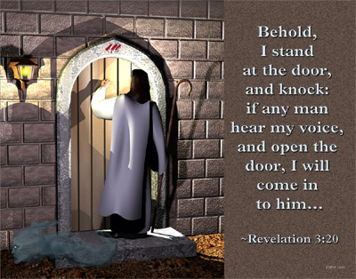

Slide 14
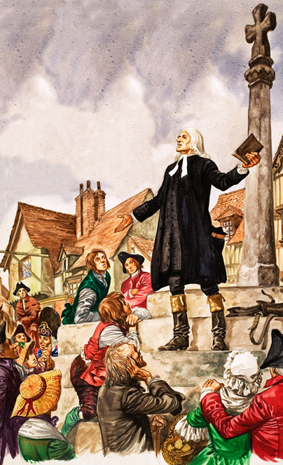
John Wesley’s Testimony
“About a quarter before nine, while the preacher was describing the change which God works in the heart -- through faith in Christ -- I felt my heart strangely warmed.
I felt I did trust in Christ, Christ alone for salvation, and an assurance was given me that he had taken away my sins, even mine, and saved me from the law of sin and death."

Slide 15

A prayer of faith → Pray this prayer if :
If you never have before
You have in the past, but you think you would mean it more today
You have been walking afar off and you want to come back
You want to set an example & show others how it is done
You just like to give your heart to Jesus again & again

Slide 16
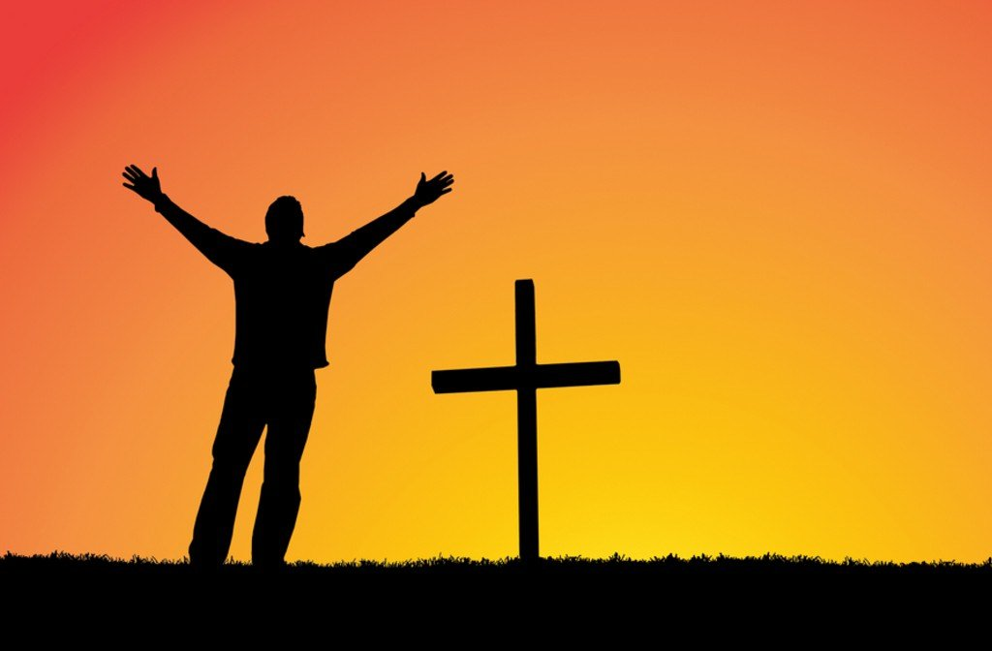
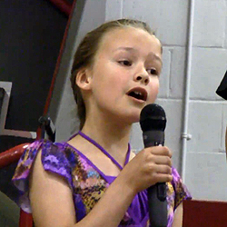
We Declare Our Faith Publicly Because Jesus Declared His LOVE Publicly
“If you stand before others and are willing to say you believe in me, then I will tell my Father in heaven that you belong to me.” Mat 10:32

Slide 17

Dear Jesus,
I know I am a sinner & need your forgiveness.
I believe you died for my sins.
I now turn from sin.
Come into my heart I pray.
Do you want to meet Jesus as your savior right now?
Do you believe He died to save you from your sins & that He rose from the dead?
Do you believe that He is waiting to save you right now?

Slide 18


“But some people did accept him. They believed in him, and he gave them the right to become children of God.” John 1:12

Slide 19



Slide 20


“If you openly say, ‘Jesus is Lord’ and believe in your heart that God raised him from death, you will be saved.”
Rom. 10:9
What did you learn today?
What is the meaning of the name-tag?
What is God speaking to you lately?
What do you want to tell the world about Jesus?

Slide 21

“Draw near to God, and He will draw near to you…
…Cleanse your hands, you sinners, and make your hearts pure, you who are half-hearted towards God.” James 4:8 WNT

Slide 22
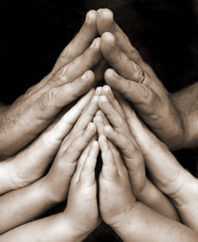
Close in Prayer

Slide 23
Note: Any videos in this presentation will only play online. After you download the slideshow, you will need to also download the videos from YouTube & add them back into your PowerPoint.
We present these messages at Bee Creek Park in College Station, TX.
If you would like to watch the video of the service with this message, click here:
http://campaignkerusso.org/?p=9162
We would love to know more about the people who download our lessons & sermons. We invite you to email us & let us know where & how you use them.
info@ckbrazos.org

Slide 24
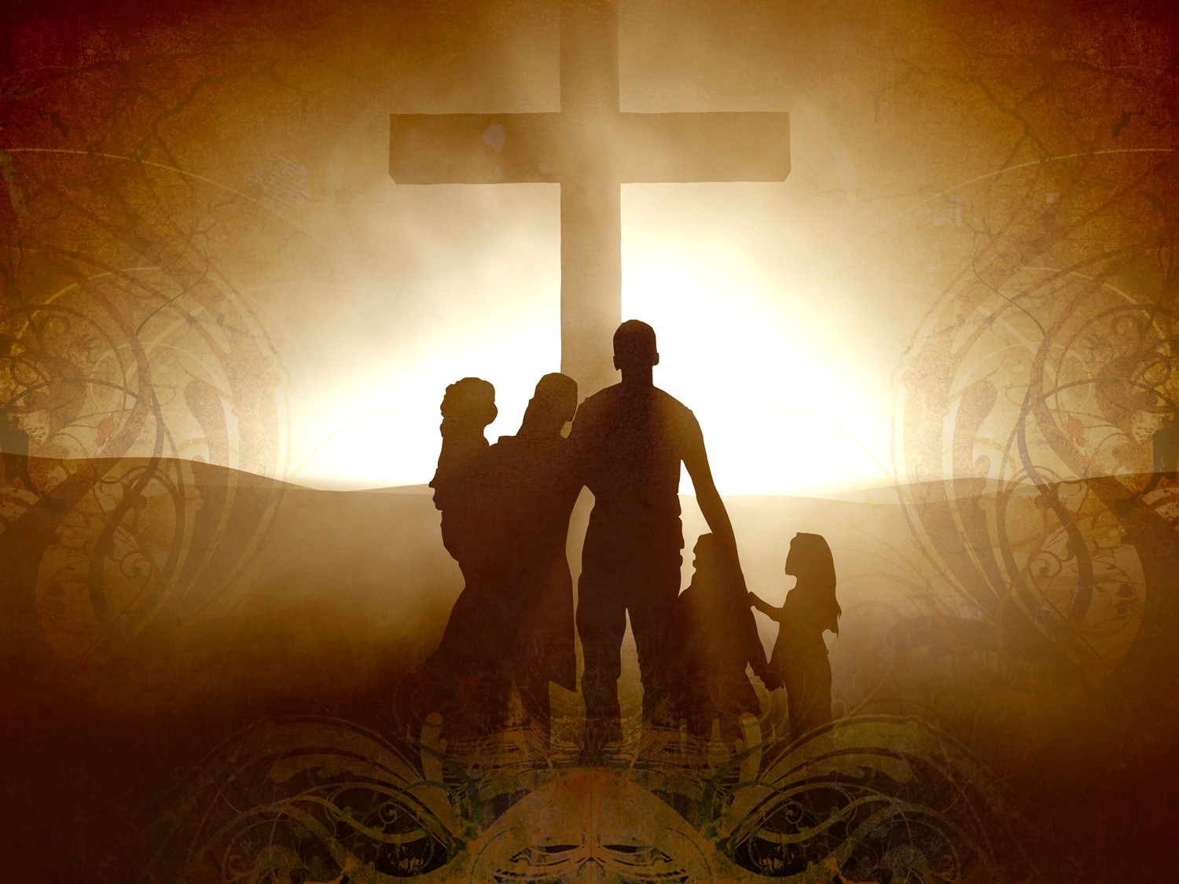
Welcome to Aggieland Faith
Family Style Worship

Slide 25

CURRENT SCHEDULE:
See www.Aggielandfaith.org
SATURDAY —
At Bee Creek Park
2:00-4:00pm: Through the bible with felt-board stories – plus hot-dogs & drinks
SUNDAY —
At Bee Creek Park
2:00-4pm: Free snacks, drinks, kids crafts, prizes, singing & bible preaching

Slide 26


Would You Like Prayer or Bible Study at Your House?
Personal Prayer:
We can come to your home & pray with you, or you can email us when you need prayer.
Home Bible Study:
We will come to your home & hold
a bible study for you & your friends.
Bible Party:
We will hold a Kid’s Bible Party:
You provide the food & kids - we
will do the bible fun & stories.

Slide 27

Would You Like Visitation?
We will visit a friend, loved one in the hospital or in prison to pray for them & share Christ with them.
Contact: info@aggielandfaith.org

Slide 28

www.aggielandfaith.org
Go here to see pictures & videos
Go here to subscribe to e-mails about changes & cancellations

Slide 29
Note: Any videos in this presentation will only play online. After you download the slideshow, you will need to also download the videos from YouTube & add them back into your PowerPoint.
We present these messages at Bee Creek Park in College Station, TX.
If you would like to watch the video of the service with this message, click here:
http://campaignkerusso.org/?p=9162
We would love to know more about the people who download our lessons & sermons. We invite you to email us & let us know where & how you use them.
info@ckbrazos.org

