Slide 1
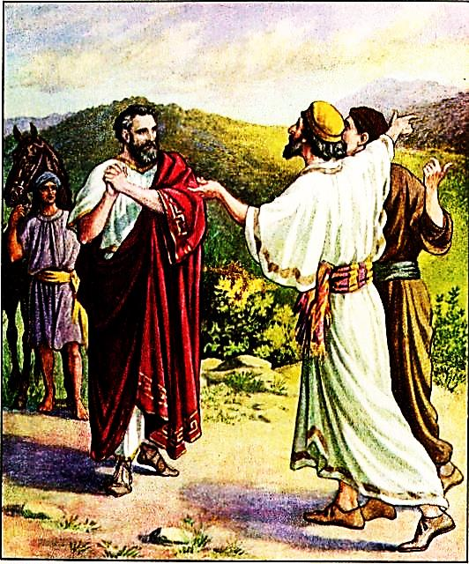
Our On
Time-God
Healing of the Nobleman’s Son

Slide 2



Note: Any videos in this presentation will only play online. After you download the slideshow, you will need to also download the videos from YouTube & add them back into your PowerPoint.
We present these messages at Bee Creek Park in College Station, TX.
If you would like to watch the video of the service with this message, click here: http://campaignkerusso.org/?p=6960
We would love to know more about the people who download our lessons & sermons. We invite you to email us & let us know where & how you use them.
info@ckbrazos.org

Slide 3
Next Slide - Video: God is Always an
“On Time” God →
(Note: This film has embedded questions with time added to discuss them.)
Download Here: http://www.youtube.com/watch?v=_ztWfcj6M6s

Slide 4

Our God is an “On-Time” God
1. The Nobleman knew that his son was healed by Jesus the day before he got home. Jesus was on time!
2. Mary and Martha thought that Jesus was too late to heal Lazarus, but instead he raised him from the dead. Jesus was on time!
3. Just when the Israelites thought they were doomed, God opened a path through an ocean!

Slide 5
Next Slide - Song: On time God →
Download Here:
http://www.youtube.com/watch?v=5U1nfbQwEzE

Slide 6
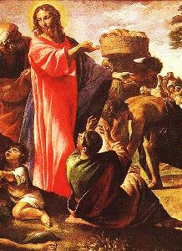
Unless you people see signs and wonders,” Jesus told him, “you will never believe.”

Slide 7


Slide 8


Slide 9


Slide 10
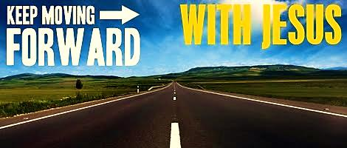
A miracle is just a sign from God that He is with us and cares for us. Don’t wait at the sign, follow God!

Slide 11

What is the Sinner‘s Prayer?
This is a prayer we can pray when we are ready to admit we are sinners and need Christ’s forgiveness.
It must be prayed with faith in our hearts and a readiness to have a life-changing encounter with Jesus Christ.

Slide 12
You Should Pray this Prayer If :
If you never have before
You have in the past, but you think you would mean it more today
You have been walking afar off and you want to come back
You want to set an example and show others how it is done
You just like to give your heart to Jesus again & again

Slide 13
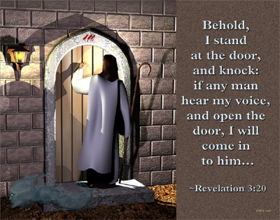

Slide 14

Dear Jesus,
I know I am a sinner & need your forgiveness.
I believe you died for my sins.
I now turn from sin.
Come into my heart I pray.
Do you want to meet Jesus as your savior right now?
Do you believe He died to save you from your sins & that He rose from the dead?
Do you believe that He is waiting to save you right now?

Slide 15


“But to all who believed him and accepted him, he gave the right to become children of God.” John 1:12

Slide 16



Slide 17


“If you declare with your mouth that Jesus is
Lord, and believe in your heart that God raised him from the dead, you
will be
saved.” Rom. 10:9
What did you learn today?
How does this lesson apply to our lives today?
What do you want to say about Jesus today?

Slide 18

“Draw near to God, and He will draw near to you…
…Cleanse your hands, you sinners, and make your hearts pure, you who are half-hearted towards God.” James 4:8 WNT

Slide 19
Note: Any videos in this presentation will only play online. After you download the slideshow, you will need to also download the videos from YouTube & add them back into your PowerPoint.
We present these messages at Bee Creek Park in College Station, TX.
If you would like to watch the video of the service with this message, click here: http://campaignkerusso.org/?p=6960
We would love to know more about the people who download our lessons & sermons. We invite you to email us & let us know where & how you use them.
info@ckbrazos.org

Slide 20
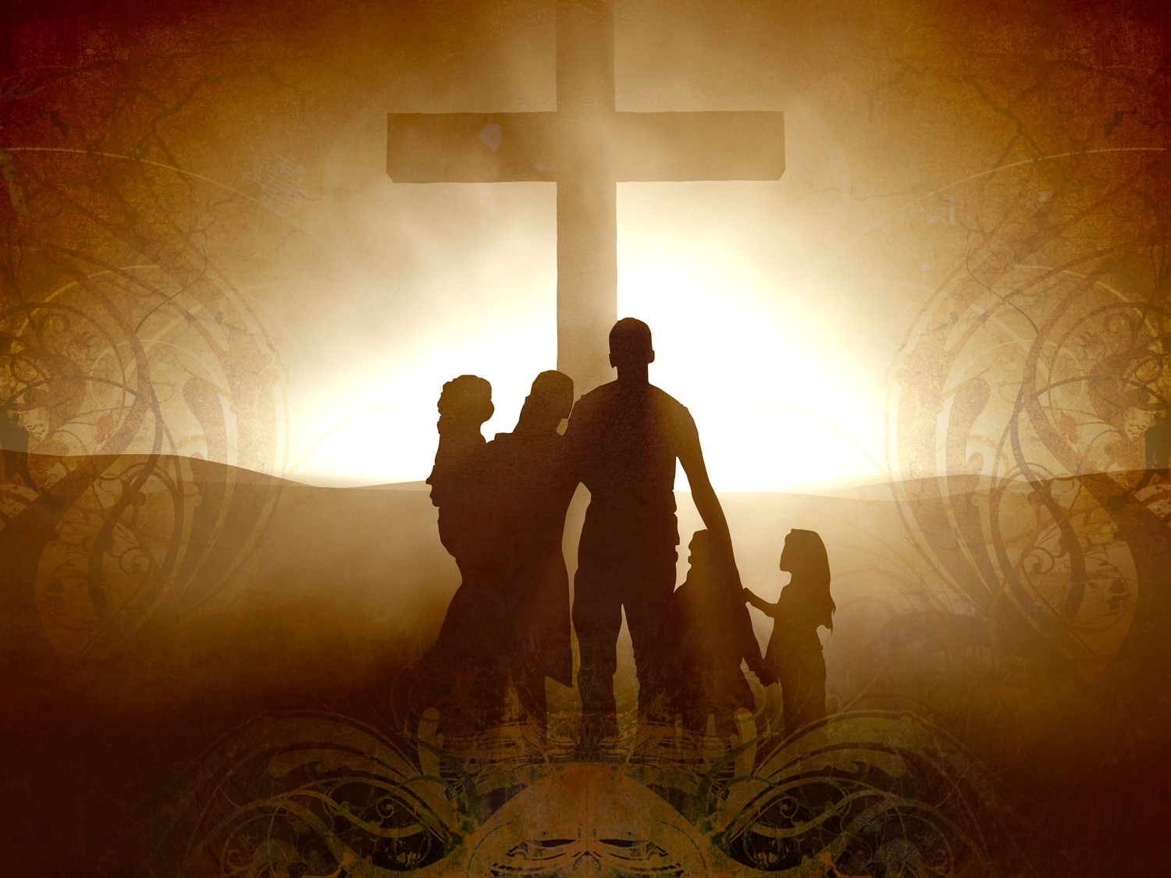
Welcome to Aggieland Faith
Family Style Worship

Slide 21

CURRENT SCHEDULE:
See www.Aggielandfaith.org
SATURDAY —
At Bee Creek Park
2:00-4:00pm: Through the bible with felt-board stories – plus hot-dogs & drinks
SUNDAY —
At Bee Creek Park
2:00-4pm: Free snacks, drinks, kids crafts, prizes, singing & bible preaching

Slide 22


Would You Like Prayer or Bible Study at Your House?
Personal Prayer:
We can come to your home & pray with you, or you can email us when you need prayer.
Home Bible Study:
We will come to your home & hold
a bible study for you & your friends.
Bible Party:
We will hold a Kid’s Bible Party:
You provide the food & kids - we
will do the bible fun & stories.

Slide 23

Would You Like Visitation?
We will visit a friend, loved one in the hospital or in prison to pray for them & share Christ with them.
Contact: info@aggielandfaith.org

Slide 24

www.aggielandfaith.org
Go here to see pictures & videos
Go here to subscribe to e-mails about changes & cancellations

Slide 25
Note: Any videos in this presentation will only play online. After you download the slideshow, you will need to also download the videos from YouTube & add them back into your PowerPoint.
We present these messages at Bee Creek Park in College Station, TX.
If you would like to watch the video of the service with this message, click here: http://campaignkerusso.org/?p=6960
We would love to know more about the people who download our lessons & sermons. We invite you to email us & let us know where & how you use them.
info@ckbrazos.org

