Slide 1
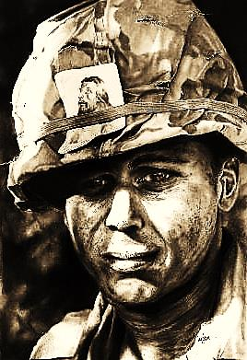
Soldiers and Jesus

Slide 2



Note: Any videos in this presentation will only play online. After you download the slideshow, you will need to also download the videos from YouTube & add them back into your PowerPoint.
We present these messages at Bee Creek Park in College Station, TX.
See the videos of our messages here:
http://campaignkerusso.org/?p=6237
We would love to know more about the people who download our lessons & sermons. We invite you to email us & let us know where & how you use them.
info@ckbrazos.org

Slide 3
Next Slide - Song:
Soldiers & Jesus →
Download Here: http://www.youtube.com/watch?v=YbDFgbKDTTE

Slide 4
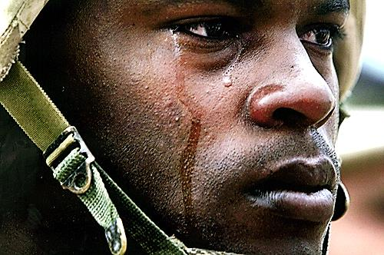
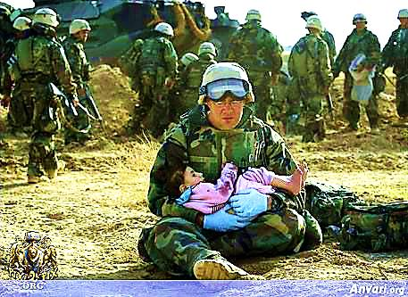
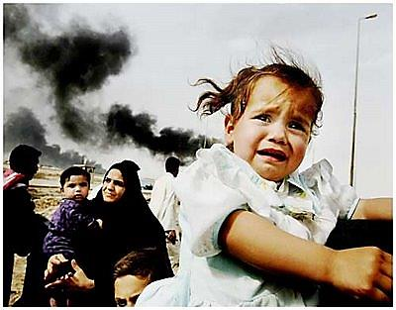
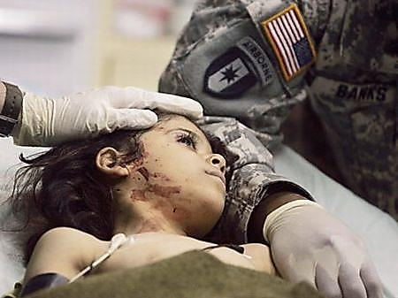
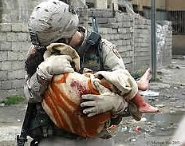
A soldier understands that the world needs his help.

Slide 5
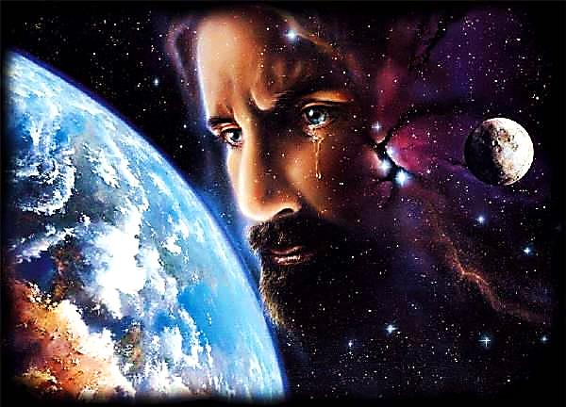
Jesus understood that the world needed his help.

Slide 6
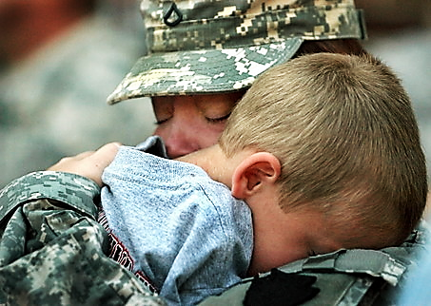
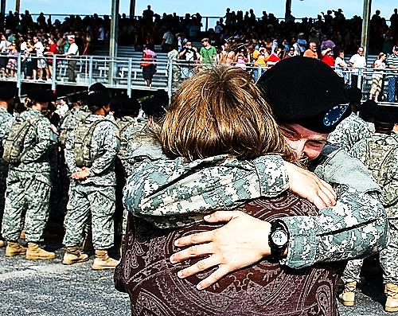
A soldier leaves his happy home to serve strangers in foreign lands.

Slide 7
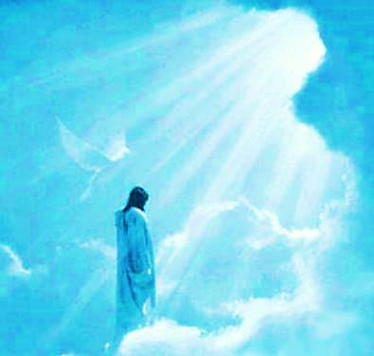
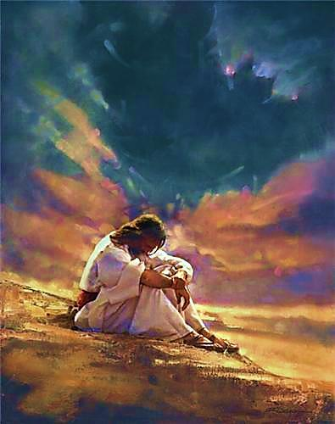
Jesus left his Heavenly home to serve ungrateful men on Earth.

Slide 8
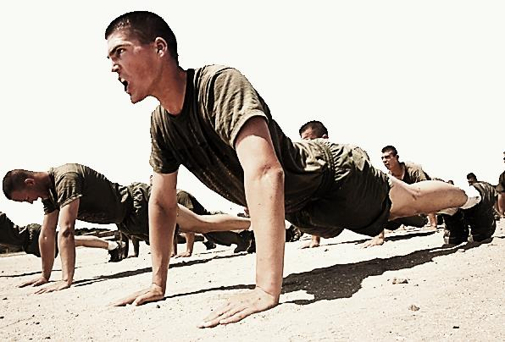

A soldier spends time training and serving.

Slide 9
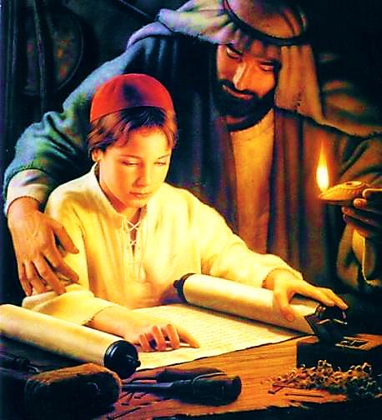
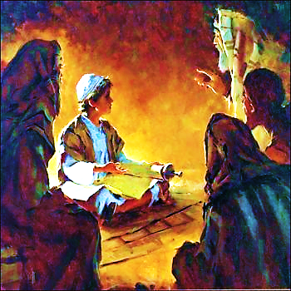
Jesus grew, learned & taught.

Slide 10
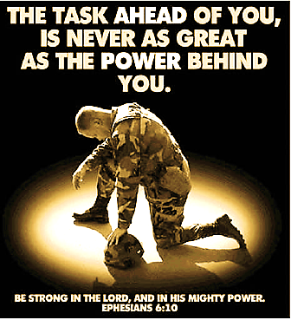
A soldier faces his fears right before the battle and then he goes forward.

Slide 11
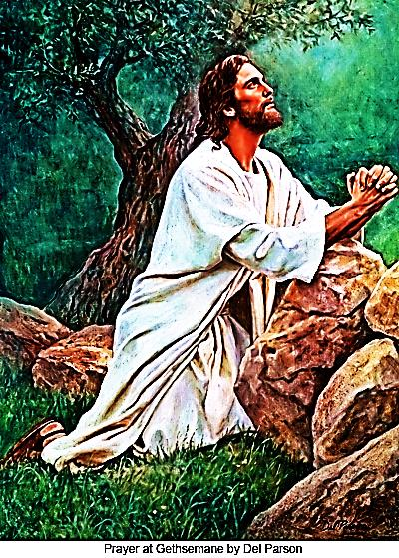
Jesus spent a night in the Garden praying to be delivered (if there was any other way).
There wasn’t, so He went forward into battle.

Slide 12
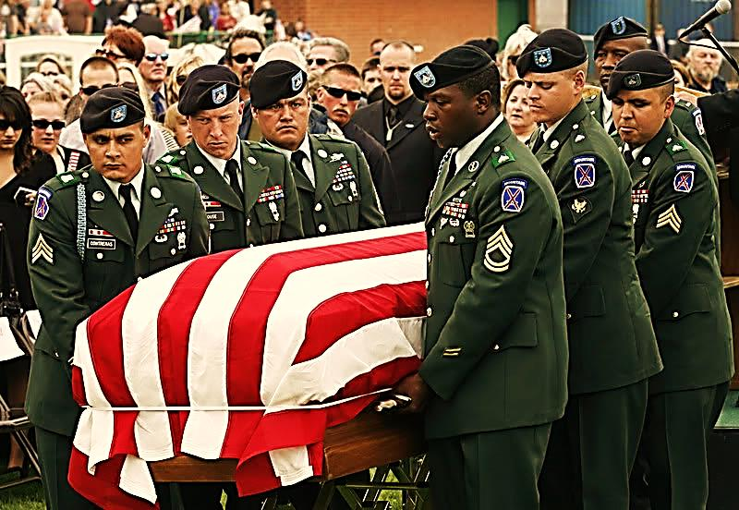
A soldier is willing to lay down His life so that others may have freedom from oppression.

Slide 13
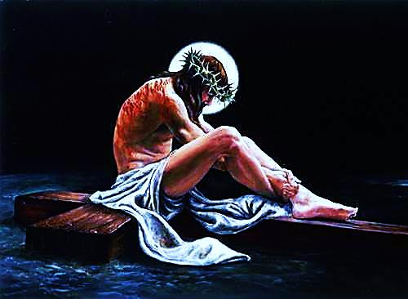
Jesus laid down His life to win our freedom from sin’s oppression.

Slide 14
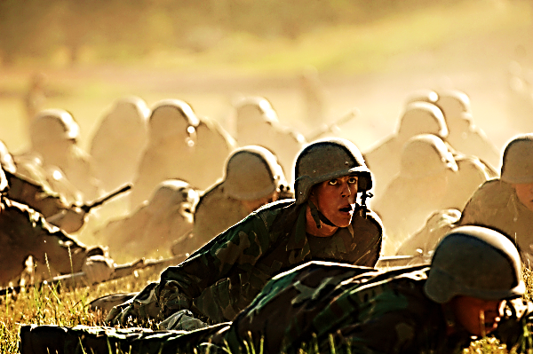
A soldier faces the enemy at the front.

Slide 15
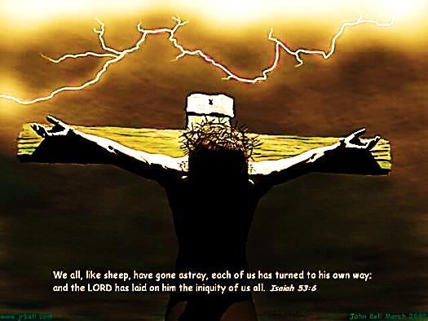
Jesus faced man’s sin and
God’s judgment on the cross.

Slide 16
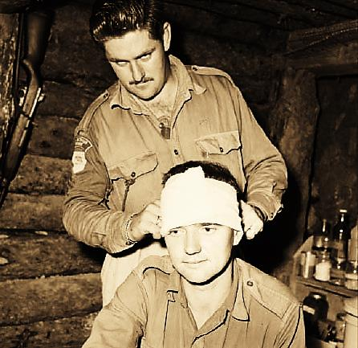
A soldier often bears the wounds of war in his body.

Slide 17
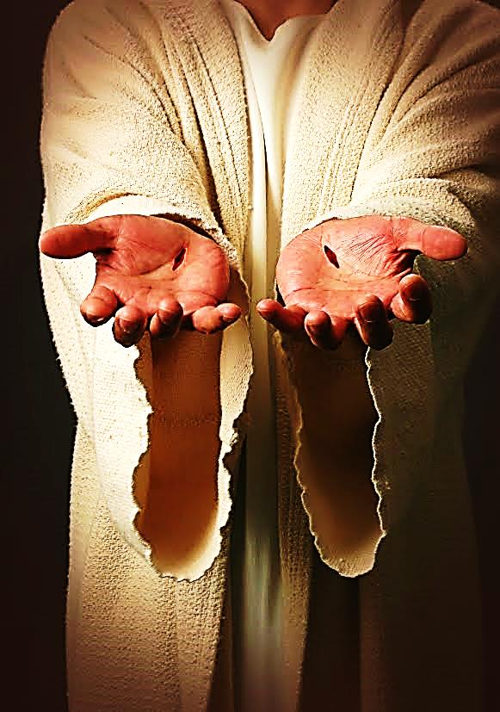
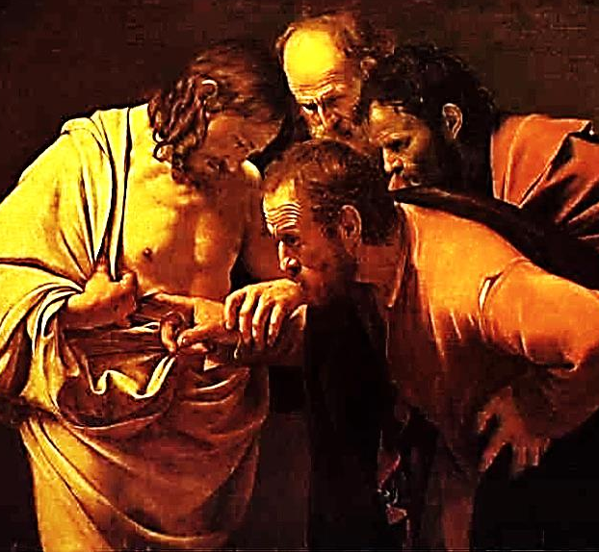
Jesus bears scars on His hands and side – the wounds of war.

Slide 18
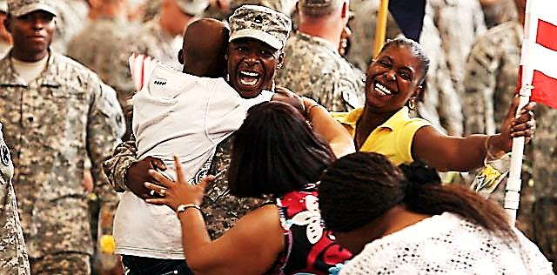
A soldier returns home alive or in a coffin.

Slide 19
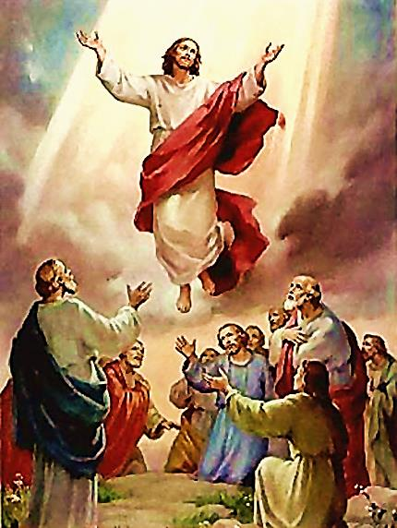
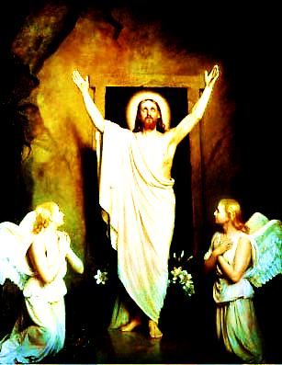
Jesus died, rose & returned to His Father in Heaven.

Slide 20

A heroic soldier is given a Medal of Honor.

Slide 21

Jesus will be honored by all:
Every knee will bow & every tongue will confess that He is Lord!

Slide 22

A wounded soldier is given a Purple Heart.

Slide 23


Jesus should be given the grateful hearts of us all.

Slide 24
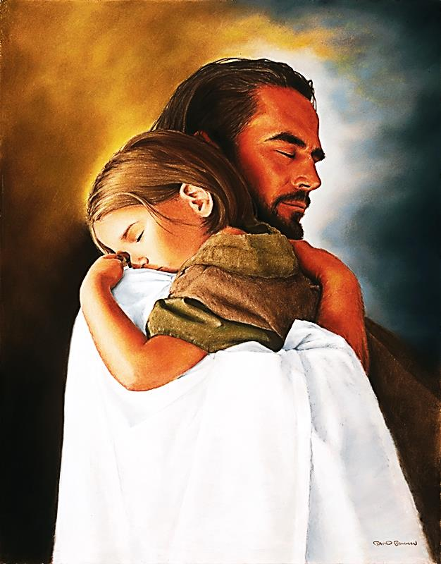
Lord Jesus, You gave me your life…
I give you my heart!
I love you.

Slide 25

What is the Sinner‘s Prayer?
This is a prayer we can pray when we are ready to admit we are sinners and need Christ’s forgiveness.
It must be prayed with faith in our hearts and a readiness to have a life-changing encounter with Jesus Christ.

Slide 26
You Should Pray this Prayer If :
If you never have before
You have in the past, but you think you would mean it more today
You have been walking afar off and you want to come back
You want to set an example and show others how it is done
You just like to give your heart to Jesus again & again

Slide 27
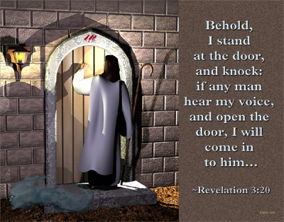

Slide 28

Dear Jesus,
I know I am a sinner & need your forgiveness.
I believe you died for my sins.
I now turn from sin.
Come into my heart I pray.
Do you want to meet Jesus as your savior right now?
Do you believe He died to save you from your sins & that He rose from the dead?
Do you believe that He is waiting to save you right now?

Slide 29


“But to all who believed him and accepted him, he gave the right to become children of God.” John 1:12

Slide 30



Slide 31


“If you declare with your mouth that Jesus is
Lord, and believe in your heart that God raised him from the dead, you
will be
saved.” Rom. 10:9
What did you learn today?
How does this lesson apply to our lives today?
What do you want to say about Jesus today?

Slide 32

“Draw near to God, and He will draw near to you…
…Cleanse your hands, you sinners, and make your hearts pure, you who are half-hearted towards God.” James 4:8 WNT

Slide 33
Note: Any videos in this presentation will only play online. After you download the slideshow, you will need to also download the videos from YouTube & add them back into your PowerPoint.
We present these messages at Bee Creek Park in College Station, TX.
See the videos of our messages here:
http://campaignkerusso.org/?p=6237
We would love to know more about the people who download our lessons & sermons. We invite you to email us & let us know where & how you use them.
info@ckbrazos.org

Slide 34
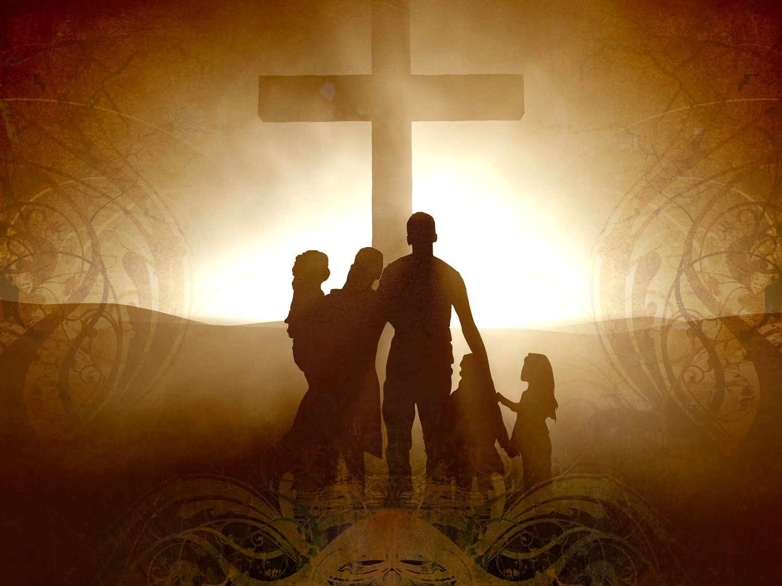
Welcome to Aggieland Faith
Family Style Worship

Slide 35

CURRENT SCHEDULE:
See www.Aggielandfaith.org
SATURDAY —
At Bee Creek Park
2:00-4:00pm: Through the bible with felt-board stories – plus hot-dogs & drinks
SUNDAY —
At Bee Creek Park
2:00-4pm: Free snacks, drinks, kids crafts, prizes, singing & bible preaching

Slide 36


Would You Like Prayer or Bible Study at Your House?
Personal Prayer:
We can come to your home & pray with you, or you can email us when you need prayer.
Home Bible Study:
We will come to your home & hold
a bible study for you & your friends.
Bible Party:
We will hold a Kid’s Bible Party:
You provide the food & kids - we
will do the bible fun & stories.

Slide 37

Would You Like Visitation?
We will visit a friend, loved one in the hospital or in prison to pray for them & share Christ with them.
Contact: info@aggielandfaith.org

Slide 38

www.aggielandfaith.org
Go here to see pictures & videos
Go here to subscribe to e-mails about changes & cancellations

Slide 39
Note: Any videos in this presentation will only play online. After you download the slideshow, you will need to also download the videos from YouTube & add them back into your PowerPoint.
We present these messages at Bee Creek Park in College Station, TX.
See the videos of our messages here:
http://campaignkerusso.org/?p=6237
We would love to know more about the people who download our lessons & sermons. We invite you to email us & let us know where & how you use them.
info@ckbrazos.org

