Slide 1

YOU Turn: Repentance is a Choice

Slide 2



Note: Any videos in this presentation will only play online. After you download the slideshow, you will need to also download the videos from YouTube & add them back into your PowerPoint.
We present these messages at Bee Creek Park in College Station, TX.
If you would like to watch the video of the service with this message, click here:
http://campaignkerusso.org/?p=6630
We would love to know more about the people who download our lessons & sermons. We invite you to email us & let us know where & how you use them.
info@ckbrazos.org

Slide 3
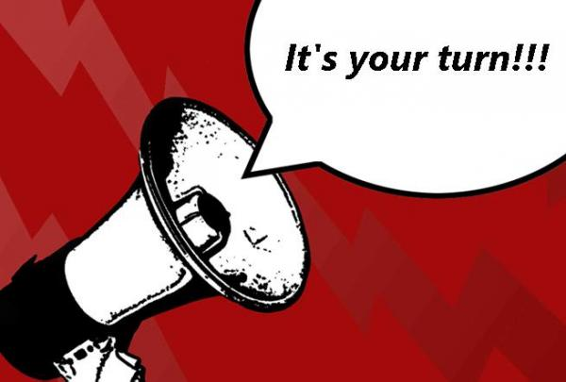
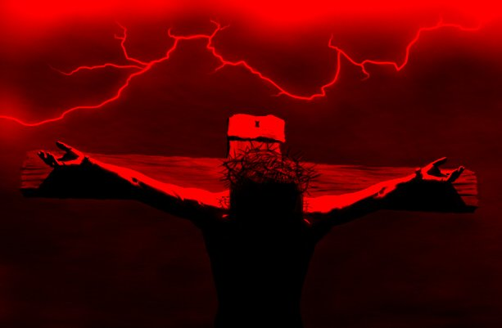


Christ died for you, now
It’s your turn to turn to Him.
No one can turn for you.

Slide 4
Next Slide - Video:
Choices →
Download Here: http://www.youtube.com/watch?v=8aoOAXqX6tA

Slide 5
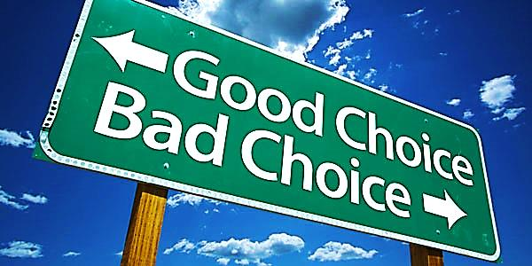
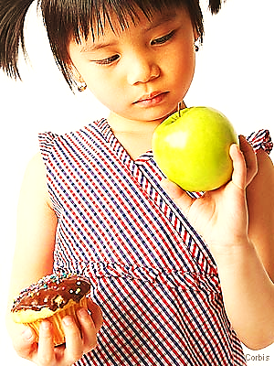
All of Life is Choices
Our Choices
change our destiny
Our Choices determine who we are
Our Choices build our history

Slide 6

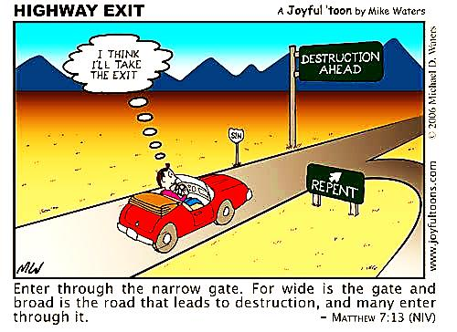
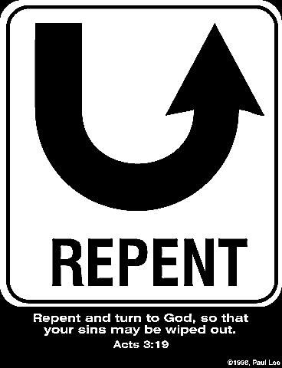
‘Repent’ Simply Means to Change Your Choice

Slide 7
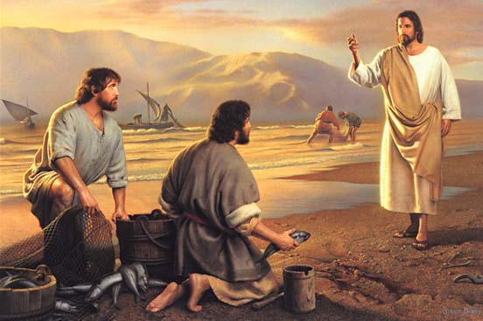
Good Choices are Seldom Easy
Choosing always means going after something & leaving something else else behind.

Slide 8
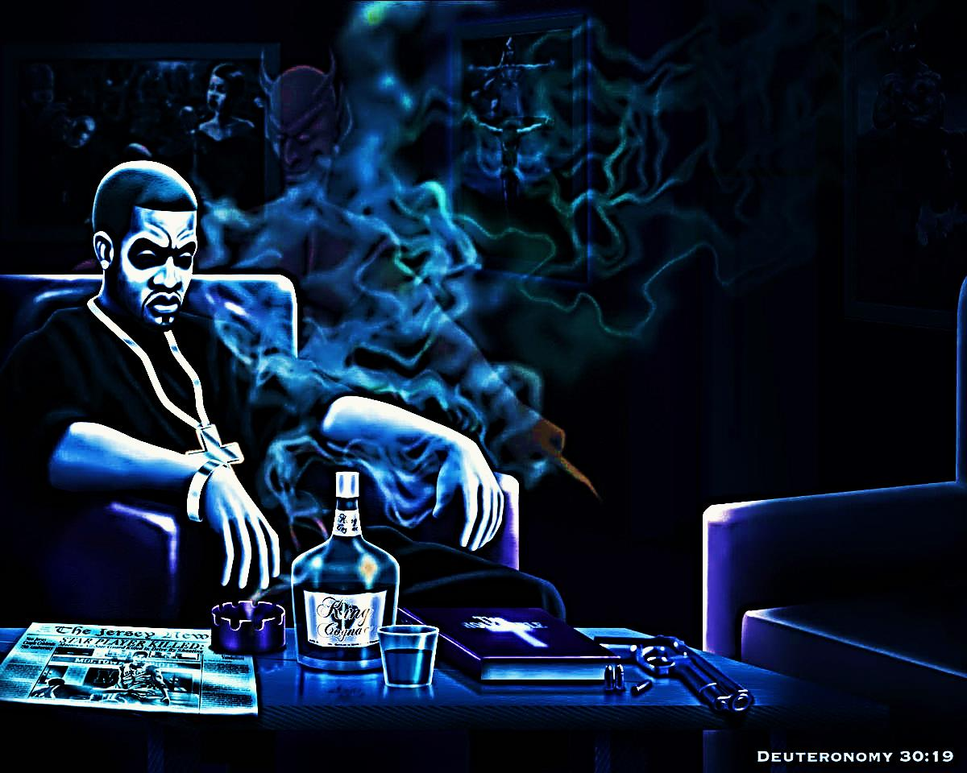
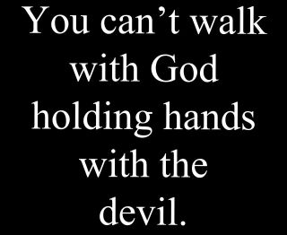
You Cannot Make two Choices at the
Same Time – or Have Two Masters

Slide 9
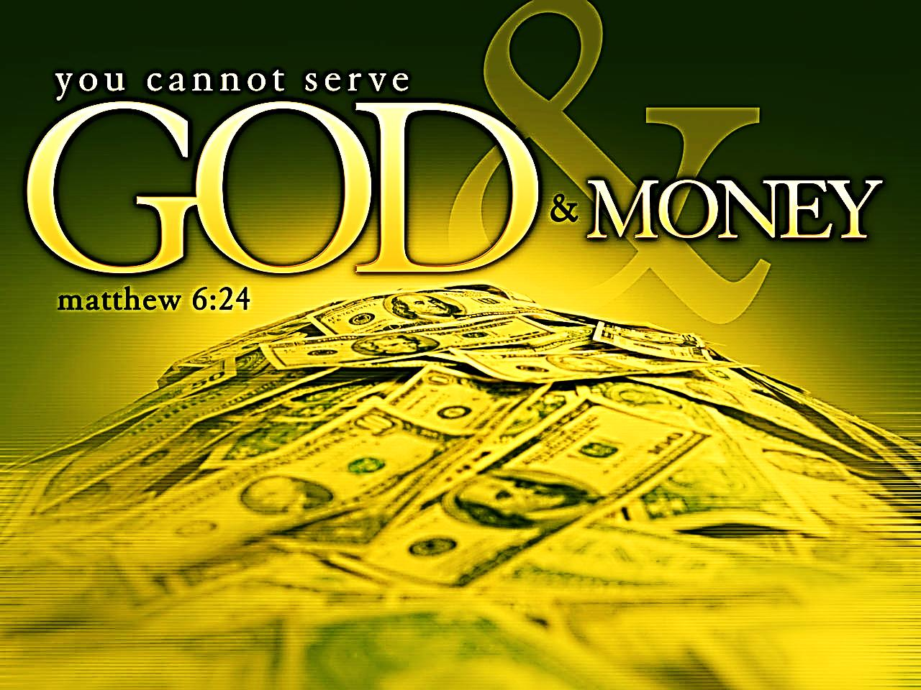
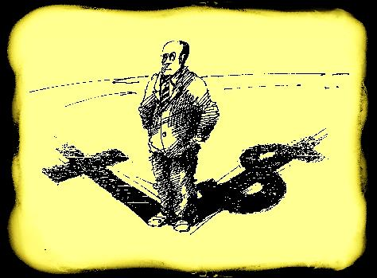
Our Choices Reveal our True Gods → Our True Heart’s Desire

Slide 10
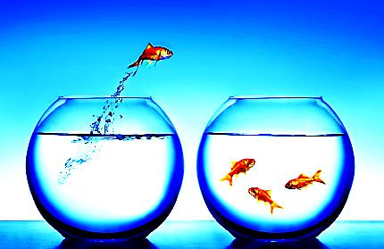
Our Choices Form Our Friendships and Determine Our ‘Teams’

Slide 11
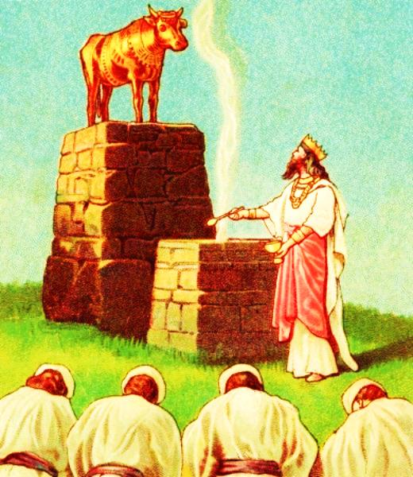
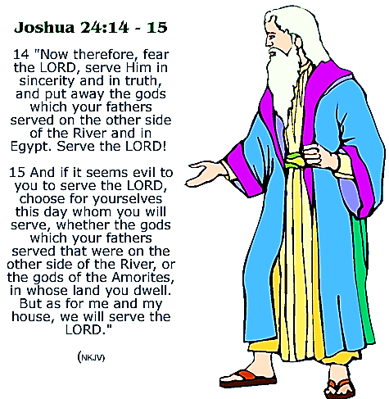
Choosing God May Separate Us From Others.
Joshua cared little for what his neighbors did.

Slide 12
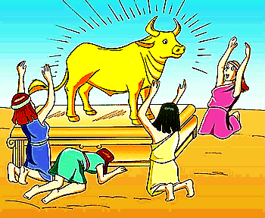
Our Gods are
What We Worship
We worship with our interest
We worship with our bodies
We worship with our time
We worship with our mouth
We worship with our money
We worship with our thoughts

Slide 13
Next Slide - Video:
Idol Worship →
Download Here: http://www.youtube.com/watch?v=QPil9Br-5lE

Slide 14
Next Slide - Video:
What is Your God? →
Download Here: http://www.youtube.com/watch?v=QdKpDWHPZag

Slide 15
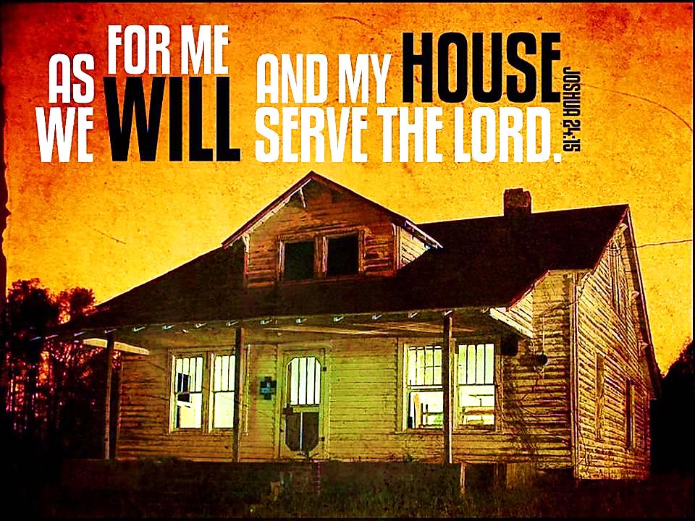
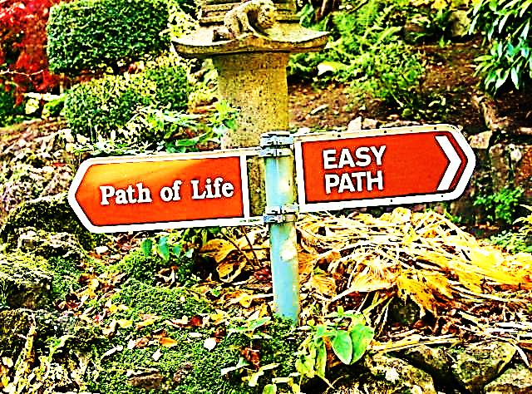
Choosing God May Separate Us From Others

Slide 16
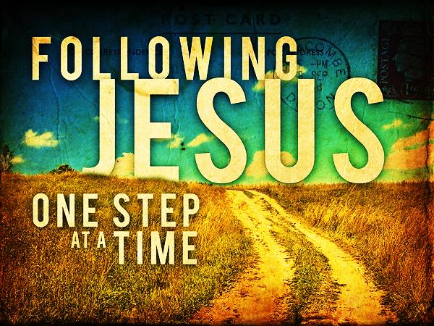
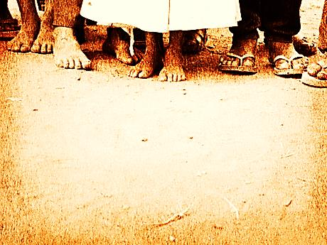
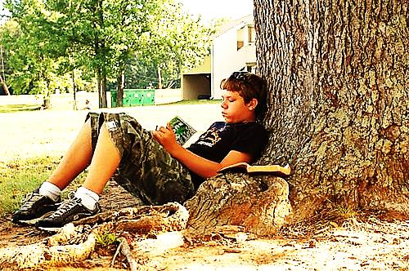
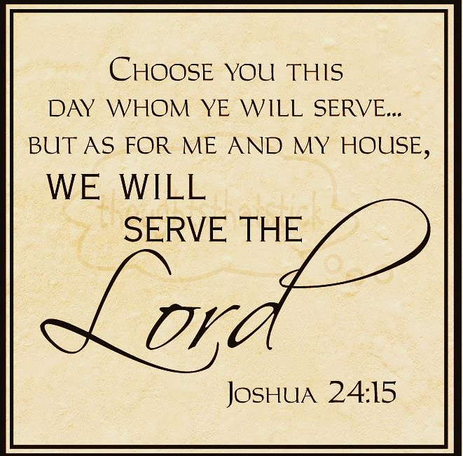

Slide 17
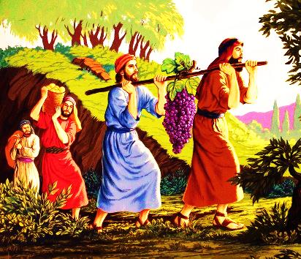

Our Choices Often Reveal Our Fears
Fear of changing our lives
Fear of being mocked by friends
Fear of facing our personal demons

Slide 18
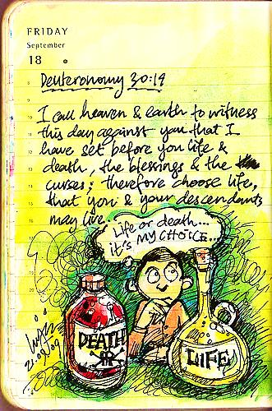
God Requires that We Make a Choice
"Today I have given you the choice between life and death, between blessings and curses. Now I call on heaven and earth to witness the choice you make. Oh, that you would choose life, so that you and your descendants might live! Duet. 30:19

Slide 19
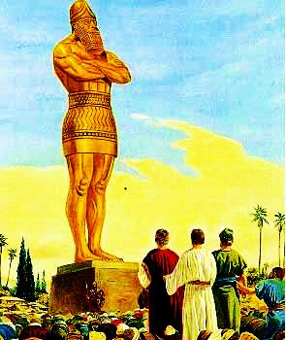
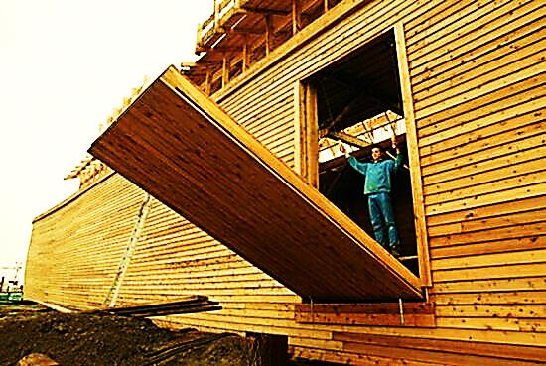
God Requires that We Make a Choice
The people of Noah’s time refused 120 years to heed God’s warning – they chose sin!
Shadrach, Meshach & Abednego refused to bow to the heathen statue – they preferred the fiery furnace – they chose God!

Slide 20
Next Slide - Video:
Shadrach, Meshach & Abednego →
Download Here: http://www.youtube.com/watch?v=PAi36I2husQ

Slide 21

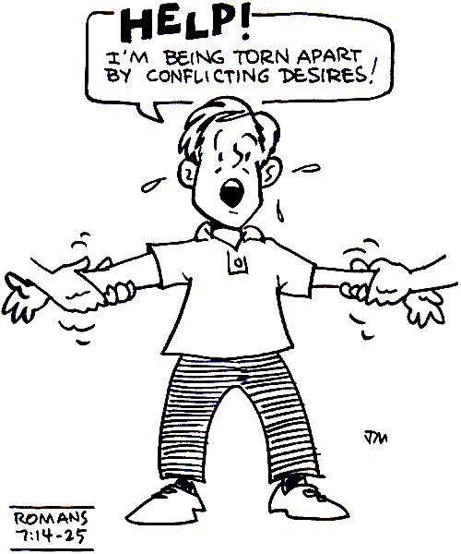
“Elijah came near to all the people and said, “How long will you go limping between two different opinions? If the Lord is God, follow him; but if Baal, then follow him.” 1 Kings 18:21

Slide 22
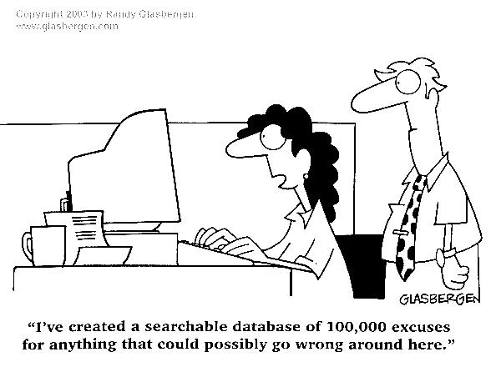
Everybody Does Make a Choice
It just happened
I had a good reason
Nobody under-stands me
Everybody does it
I had a bad day

Slide 23
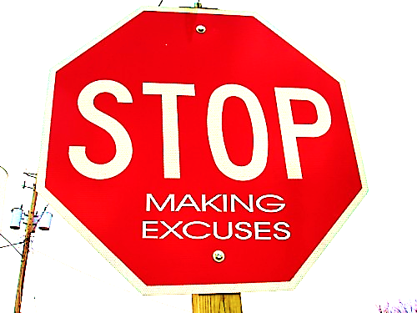

Everybody Does Make a Choice
We must take responsibility for our actions & TURN to God!

Slide 24
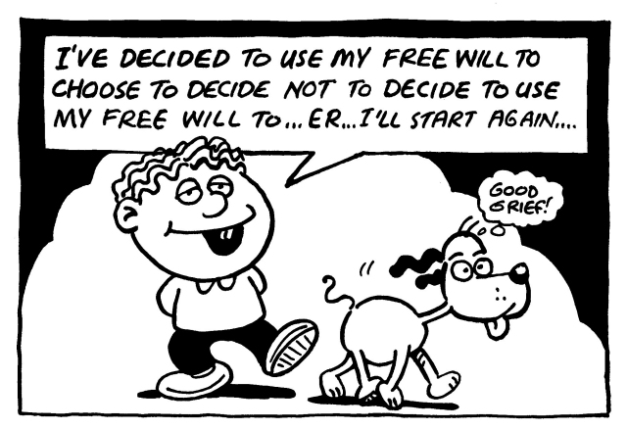
We Must Make a Clear Choice for Jesus
"Repent of your sins and TURN to God, for the Kingdom of Heaven is near." Mat. 4:17
“Let my heart be TURNED to your unchanging word, and not to evil desire.”
Psalm 119:36

Slide 25
Next Slide - Song:
As For Me & My House (Waller) →
Download Here: http://www.youtube.com/watch?v=vhaadvMYk_k&

Slide 26
Next Slide - Song:
I Choose Jesus →
Download Here: http://www.youtube.com/watch?v=ANAOg1rnTAo

Slide 27

What is the Sinner‘s Prayer?
This is a prayer we can pray when we are ready to admit we are sinners and need Christ’s forgiveness.
It must be prayed with faith in our hearts and a readiness to have a life-changing encounter with Jesus Christ.

Slide 28
You Should Pray this Prayer If :
If you never have before
You have in the past, but you think you would mean it more today
You have been walking afar off and you want to come back
You want to set an example and show others how it is done
You just like to give your heart to Jesus again & again

Slide 29
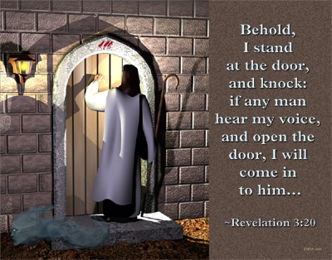

Slide 30

Dear Jesus,
I know I am a sinner & need your forgiveness.
I believe you died for my sins.
I now turn from sin.
Come into my heart I pray.
Do you want to meet Jesus as your savior right now?
Do you believe He died to save you from your sins & that He rose from the dead?
Do you believe that He is waiting to save you right now?

Slide 31


“But to all who believed him and accepted him, he gave the right to become children of God.” John 1:12

Slide 32



Slide 33


“If you declare with your mouth that Jesus is
Lord, and believe in your heart that God raised him from the dead, you
will be
saved.” Rom. 10:9
What did you learn today?
How does this lesson apply to our lives today?
What do you want to say about Jesus today?

Slide 34

“Draw near to God, and He will draw near to you…
…Cleanse your hands, you sinners, and make your hearts pure, you who are half-hearted towards God.” James 4:8 WNT

Slide 35
Note: Any videos in this presentation will only play online. After you download the slideshow, you will need to also download the videos from YouTube & add them back into your PowerPoint.
We present these messages at Bee Creek Park in College Station, TX.
If you would like to watch the video of the service with this message, click here:
http://campaignkerusso.org/?p=6630
We would love to know more about the people who download our lessons & sermons. We invite you to email us & let us know where & how you use them.
info@ckbrazos.org

Slide 36
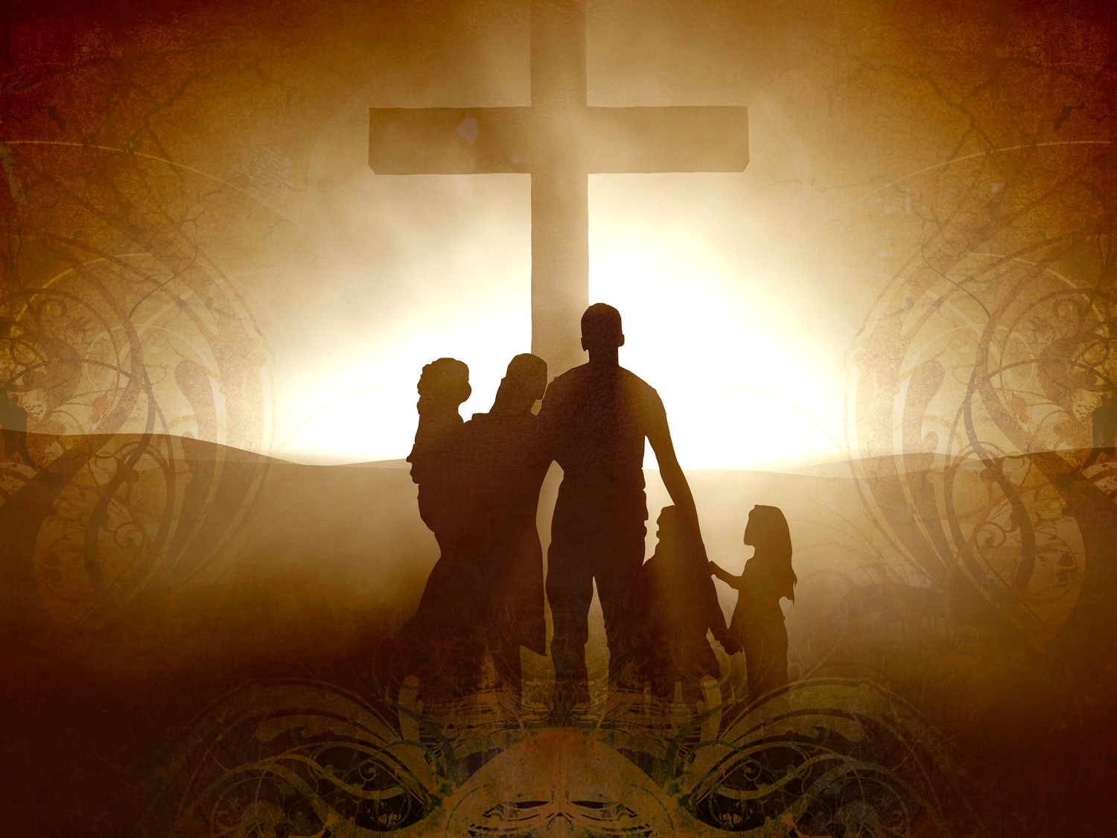
Welcome to Aggieland Faith
Family Style Worship

Slide 37

CURRENT SCHEDULE:
See www.Aggielandfaith.org
SATURDAY —
At Bee Creek Park
2:00-4:00pm: Through the bible with felt-board stories – plus hot-dogs & drinks
SUNDAY —
At Bee Creek Park
2:00-4pm: Free snacks, drinks, kids crafts, prizes, singing & bible preaching

Slide 38


Would You Like Prayer or Bible Study at Your House?
Personal Prayer:
We can come to your home & pray with you, or you can email us when you need prayer.
Home Bible Study:
We will come to your home & hold
a bible study for you & your friends.
Bible Party:
We will hold a Kid’s Bible Party:
You provide the food & kids - we
will do the bible fun & stories.

Slide 39

Would You Like Visitation?
We will visit a friend, loved one in the hospital or in prison to pray for them & share Christ with them.
Contact: info@aggielandfaith.org

Slide 40

www.aggielandfaith.org
Go here to see pictures & videos
Go here to subscribe to e-mails about changes & cancellations

Slide 41
Note: Any videos in this presentation will only play online. After you download the slideshow, you will need to also download the videos from YouTube & add them back into your PowerPoint.
We present these messages at Bee Creek Park in College Station, TX.
If you would like to watch the video of the service with this message, click here:
http://campaignkerusso.org/?p=6630
We would love to know more about the people who download our lessons & sermons. We invite you to email us & let us know where & how you use them.
info@ckbrazos.org

