Slide 1
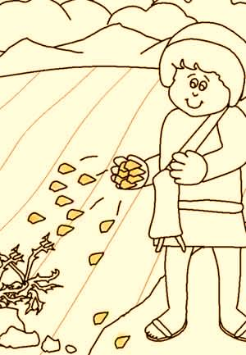
Parable of the Sower

Slide 2



Note: Any videos in this presentation will only play online. After you download the slideshow, you will need to also download the videos from YouTube & add them back into your PowerPoint.
We present these messages at Bee Creek Park in College Station, TX.
If you would like to watch the videos, click here:
http://campaignkerusso.org/?p=7391
We would love to know more about the people who download our lessons & sermons. We invite you to email us & let us know where & how you use them.
info@ckbrazos.org

Slide 3
Next Slide - Song: God’s Holy Business
Download Here: http://youtu.be/7vYzryS4OdE

Slide 4
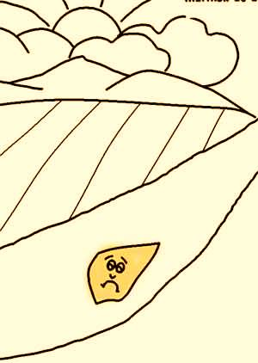
“A farmer went out to plant seeds. As he was scattering the seeds, some fell on the hardened path.
[People walked on the paths and this made them very hard. So the seeds would lie on top and the birds could quickly eat these seeds.]
Then some birds came and ate all those seeds.” Matthew 13:4

Slide 5
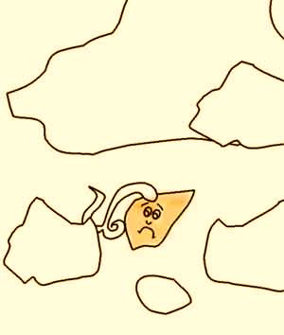
“Other seeds fell on rocky ground, where there was not much earth. The seeds could only grow up (but not down) because of all the rocks.
But the heat of the sun burned the young plants. Then they dried up and died because they did not have deep roots.” Matthew 13:5,6

Slide 6
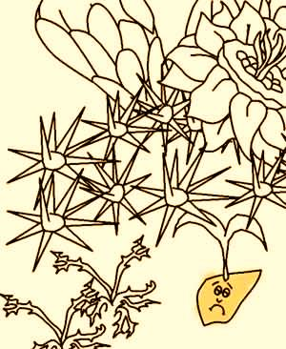
“Other seeds fell among weeds. The weeds grew faster and bigger, so that the good plants had no room to grow.” Matthew 13:7

Slide 7
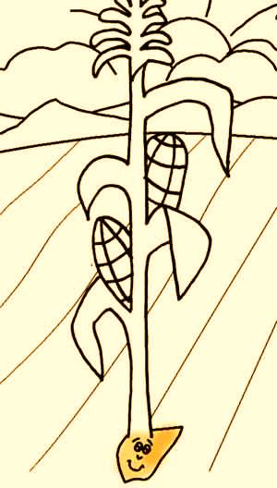
“Still other seeds fell on good earth. They grew and produced a crop. Some seeds produced 100 times more than the farmer planted. Some produced 60 times more and some 30 times more than the farmer planted.” Matthew 13:8

Slide 8
Video: Parable of the Sower
See next slide →
Download Here: http://www.youtube.com/watch?v=V9IOhGPrRvY

Slide 9
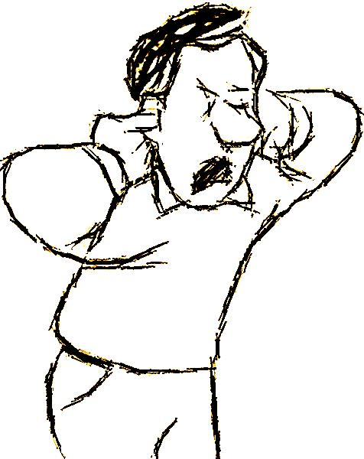
“Like the seeds that fell on the hard path…
Some people do not accept God’s message because their hearts are hard like the path.
Then Satan comes
[like the bird who steals seeds from the ground]
and steals away the message from their minds.” Matthew 13:19

Slide 10
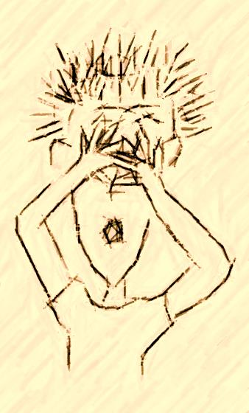
“Like the seeds that fell on the rocky soil and grew up quickly, some people listen to God’s message and seem happy. But they do not believe it very strongly…
They are like little plants with no roots. And soon their faith dries up when difficulties and troubles come”.

Slide 11
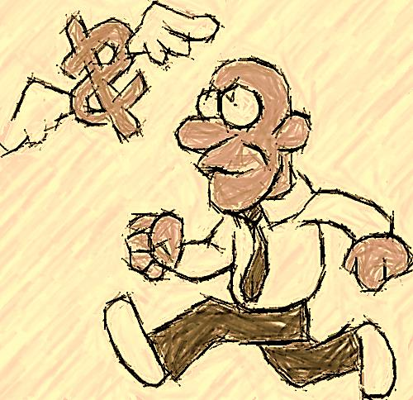
“Like the seeds that fell on the soil crowded with weeds, some people’s lives are crowded with other things. They want money to buy things and go places. They must work long hours for the money they need to buy those things and go to those places. And after all that, there is no room left for God’s message to grow or produce good things in their lives.” Matthew 13:22

Slide 12
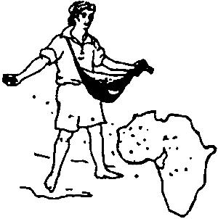
“But some seeds fell on good soil. That soil produced a good crop. It was a 100, 60 or 30 times more than the farmer had planted.
That soil is like people who really listen to the message.
They understand it and believe it, even when they face trouble.
They change the way they live and produce many good things in their lives, like telling others the wonderful Christian message which they have received” Matthew 13:23

Slide 13
Next Slide - Song: The Parable of the Sower →
Download Here: http://youtu.be/M174Pyf7Q9g

Slide 14

What is the Sinner‘s Prayer?
This is a prayer we can pray when we are ready to admit we are sinners and need Christ’s forgiveness.
It must be prayed with faith in our hearts and a readiness to have a life-changing encounter with Jesus Christ.
You Should Pray this Prayer If :
If you never have before
You have in the past, but you think you would mean it more today
You have been walking afar off and you want to get closer
You want to set an example and show others how it is done
You just like to give your heart to Jesus again & again

Slide 15

Dear Jesus,
I know I am a sinner & need your forgiveness.
I believe you died for my sins.
I now turn from sin & ask you into my heart.
Do you want to meet Jesus & know Him as your personal savior?
Do you believe Jesus died to save you from your sins & that He rose from the dead?
Do you believe that He is waiting to save you right now?

Slide 16


“If you declare with your mouth that Jesus is
Lord, and believe in your heart that God raised him from the dead, you
will be
saved.”
Rom. 10:9
What did you learn today?
How does this lesson apply to us today?
What do you want to say about Jesus today?

Slide 17


“But to all who believed him and accepted him, he gave the right to become children of God.” John 1:12

Slide 18



Slide 19

“Draw near to God, and He will draw near to you…
…Cleanse your hands, you sinners, and make your hearts pure, you who are half-hearted towards God.” James 4:8 WNT

Slide 20
Note: Any videos in this presentation will only play online. After you download the slideshow, you will need to also download the videos from YouTube & add them back into your PowerPoint.
We present these messages at Bee Creek Park in College Station, TX.
If you would like to watch the videos, click here: http://campaignkerusso.org/?p=7391
We would love to know more about the people who download our lessons & sermons. We invite you to email us & let us know where & how you use them.
info@ckbrazos.org

Slide 21
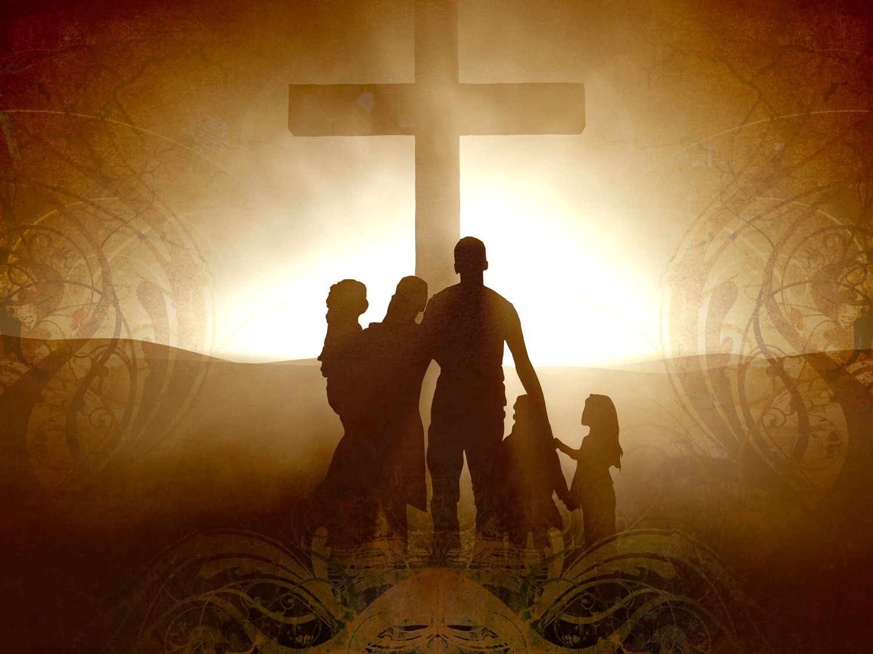
Welcome to Aggieland Faith
Family Style Worship

Slide 22

CURRENT SCHEDULE:
See www.Aggielandfaith.org
SATURDAY —
At Bee Creek Park
2:00-4:00pm: Through the bible with felt-board stories – plus hot-dogs & drinks
SUNDAY —
At Bee Creek Park
2:00-4pm: Free snacks, drinks, kids crafts, prizes, singing & bible preaching

Slide 23


Would You Like Prayer or Bible Study at Your House?
Personal Prayer:
We can come to your home & pray with you, or you can email us when you need prayer.
Home Bible Study:
We will come to your home & hold
a bible study for you & your friends.
Bible Party:
We will hold a Kid’s Bible Party:
You provide the food & kids - we
will do the bible fun & stories.

Slide 24

Would You Like Visitation?
We will visit a friend, loved one in the hospital or in prison to pray for them & share Christ with them.
Contact: info@aggielandfaith.org

Slide 25

www.aggielandfaith.org
Go here to see pictures & videos
Go here to subscribe to e-mails about changes & cancellations

Slide 26
Note: Any videos in this presentation will only play online. After you download the slideshow, you will need to also download the videos from YouTube & add them back into your PowerPoint.
We present these messages at Bee Creek Park in College Station, TX.
If you would like to watch the videos, click here: http://campaignkerusso.org/?p=7391
We would love to know more about the people who download our lessons & sermons. We invite you to email us & let us know where & how you use them.
info@ckbrazos.org

