Slide 1
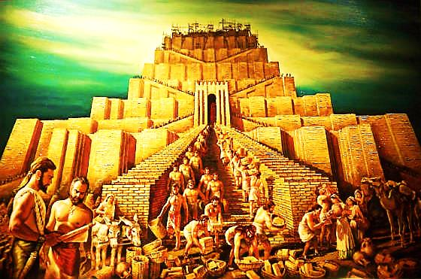


Slide 2



Note: Any videos in this presentation will only play online. After you download the slideshow, you will need to also download the videos from YouTube & add them back into your PowerPoint.
We present these messages at Bee Creek Park in College Station, TX.
If you would like to watch the video of the service with this message, click here: http://campaignkerusso.org/?p=6970
We would love to know more about the people who download our lessons & sermons. We invite you to email us & let us know where & how you use them.
info@ckbrazos.org

Slide 3
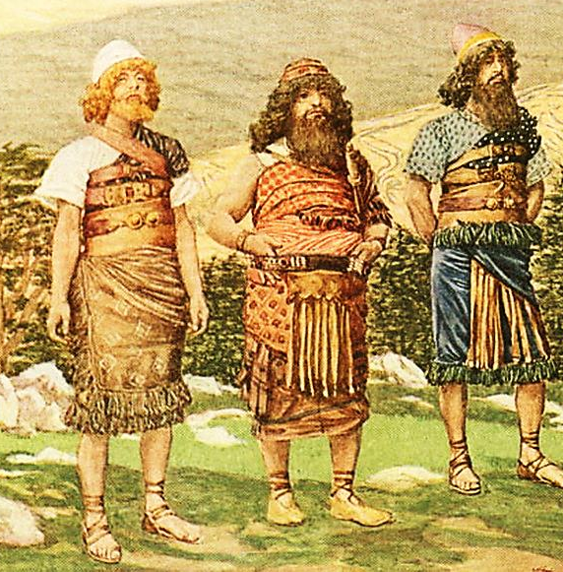
Man Resists God’s Will
“And God blessed Noah and his sons, and said unto them, ‘Be fruitful and multiply, and replenish the earth.’” Gen. 9:1

Slide 4
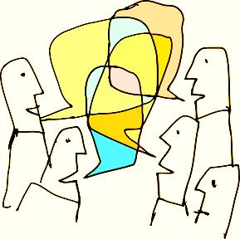
Unity of Purpose: “Replenish the Earth”
And the whole earth was of one language, and of one speech.
Gen 11:1

Slide 5
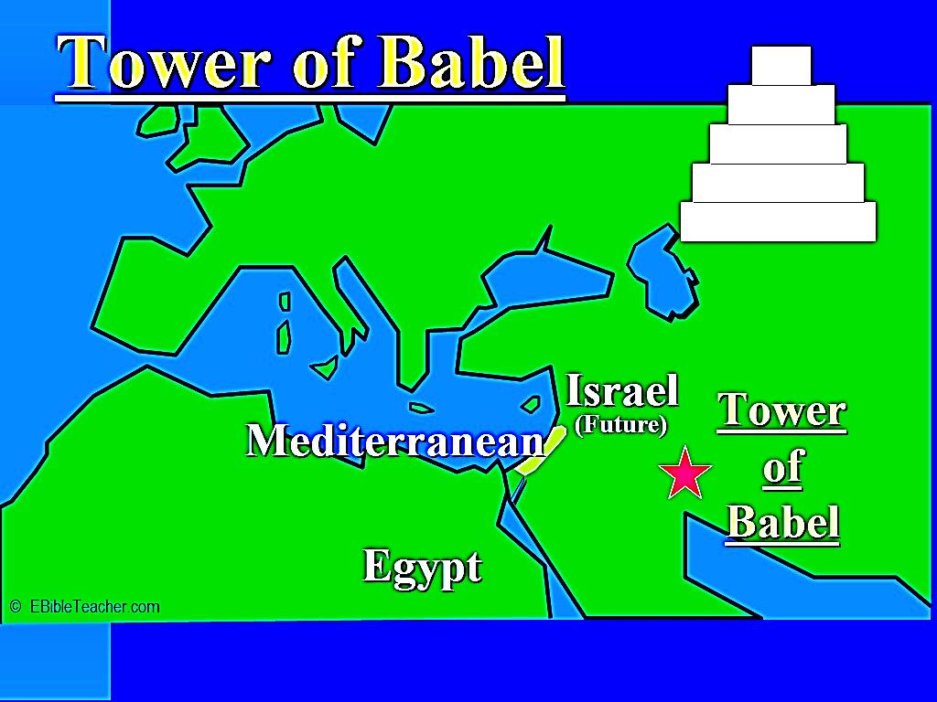
Then They Stopped Spreading Out
And it came to pass, as they journeyed from the east, that they found a plain in the land of Shinar, and they dwelt there. Gen. 11:2

Slide 6
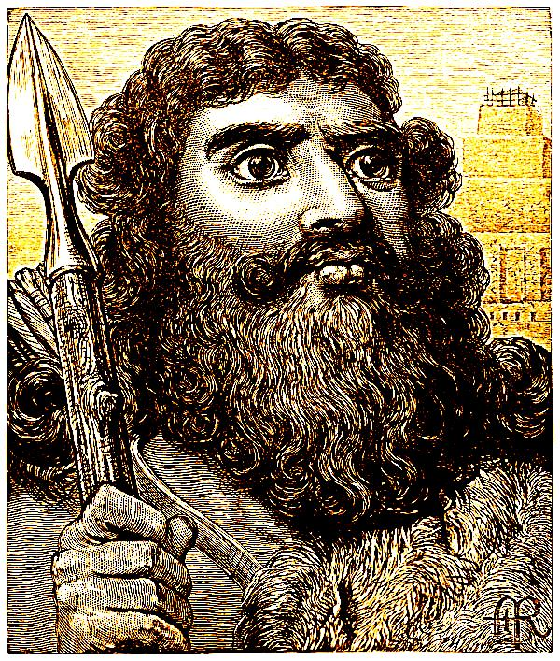
Their Leader, Nimrod was the first Heroic Warrior – The First Sports Celebrity
“…he was the greatest hunter in the world… People would say, ‘This man is like Nimrod, the greatest hunter in the world.’
He built his kingdom in the land of Babylonia”
Gen.10: 8-10

Slide 7
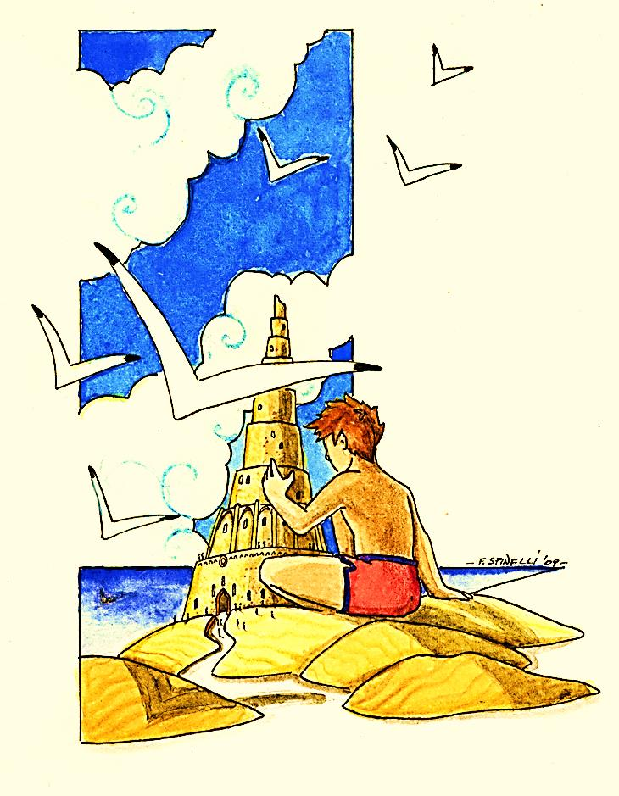
We Build Our Personal Kingdoms
“And they said one to another, "Come, let us make bricks and burn them thoroughly." And they had brick for stone, and slime had they for mortar.”
Gen. 11:3
They began to develop skills & new technologies
They became very good at brick making

Slide 8
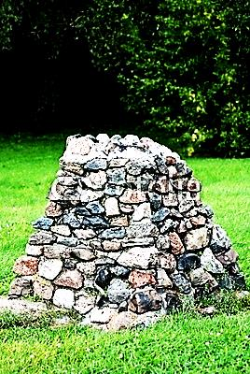
God is Not Impressed with Our Skills
Our Skills often make us Act Like Show-Offs
"Then build an altar there to the LORD your God, using natural, uncut stones. You must not shape the stones with an iron tool.” Duet 27:5
He values our heartfelt worship, not our skills and abilities

Slide 9
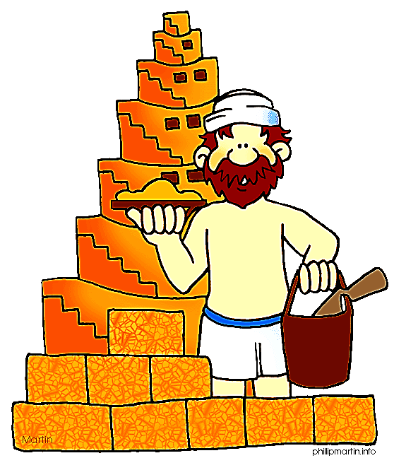
“…but his pride will be humbled together with the craft of his hands.” Isa. 25:11
“Just as it is not good to eat too much honey, it is not good for people to think about all the honors they deserve.” Prov. 25:7

Slide 10
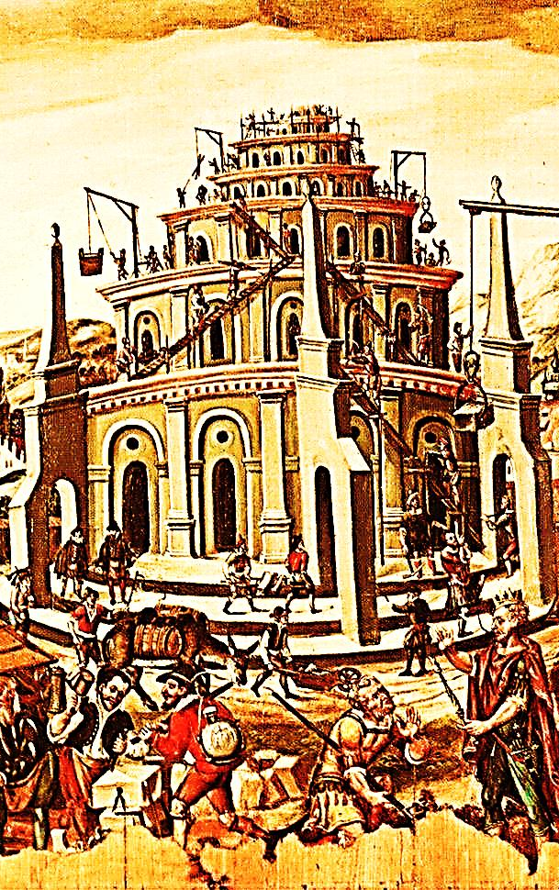
And they said, "Come, let us build us a city and a tower whose top may reach unto heaven; and let us make us a name, lest we be scattered abroad upon the face of the whole earth.”
Gen. 11:4

Slide 11


First We Notice Our Abilities…
Then We Want to Be Famous for Them
“For when he dies he will carry nothing away; his glory will not go down after him.”
Ps. 49:17

Slide 12
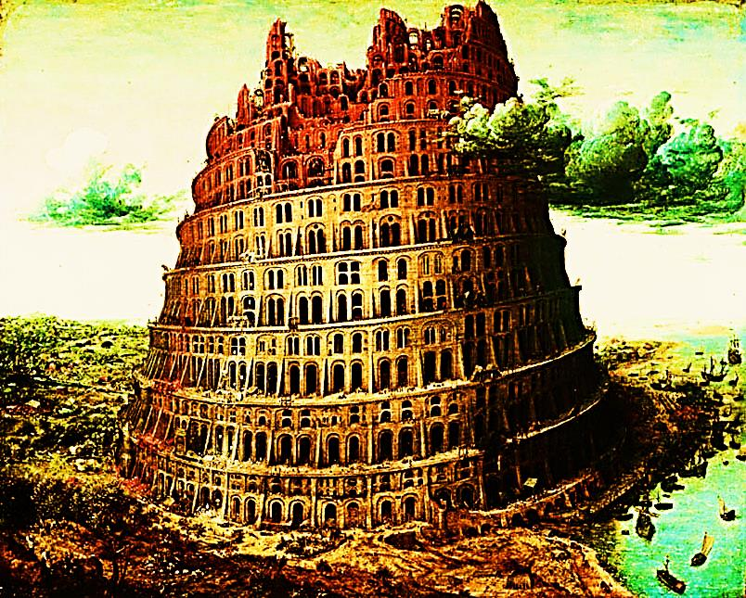
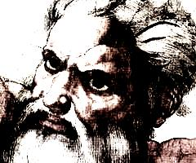
“And the LORD came down to see the city and the tower which the children of men built.” Gen. 11:5

Slide 13
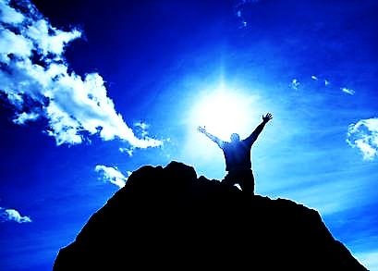
"I am the LORD; that is my name! I will not give my glory to anyone else…” Isa. 42:8
"Whoever exalts himself shall be humbled; and whoever humbles himself shall be exalted.
Mat. 23:12
"...let us exalt his name together“
Ps. 34:3

Slide 14
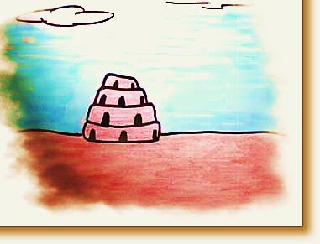
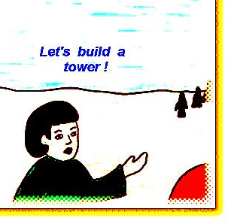
The Power of Unity & Communication
“And the LORD said, "Behold, the people are one and they have all one language, and this they begin to do; and now nothing will be withheld from them which they have imagined to do.” Gen. 11:6

Slide 15
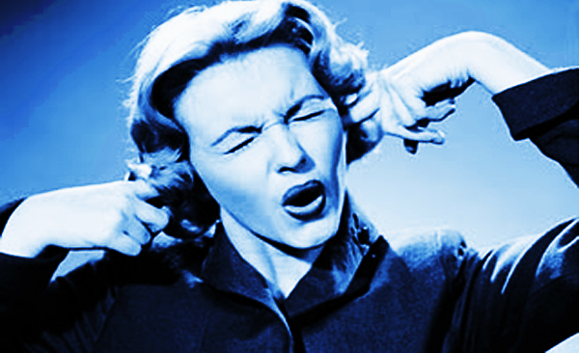
“Come, let Us go down, and there confound their language, that they may not understand one another's speech." Gen. 11:7
So the Trinity went all the way down to see man’s little tower!

Slide 16
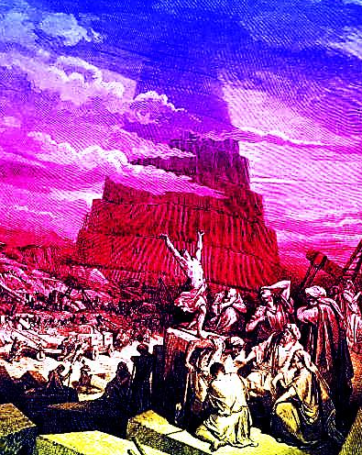
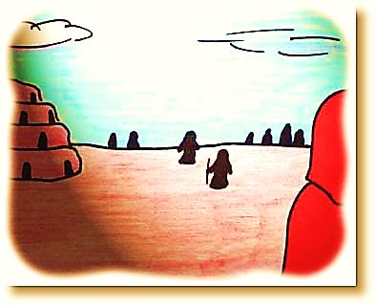
“So the LORD scattered them abroad from thence upon the face of all the earth; and they left off building the city.” Gen.11:8

Slide 17
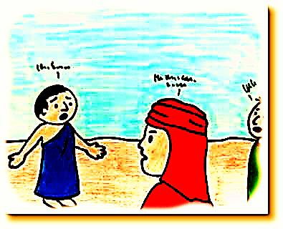
“Therefore is the name of it called Babel [that is, Confusion], because the LORD did there confound the language of all the earth; and from thence did the LORD scatter them abroad upon the face of all the earth.” Gen. 11:9

Slide 18

United for Evil
“Every one that is proud in heart is an abomination to the LORD: though hand joins in hand, he shall not be unpunished.” Prov. 16:5

Slide 19
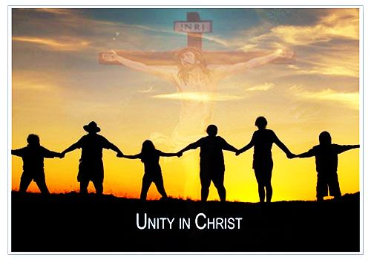
United for Good
Remember to be Fruitful & Multiply… To Build God’s Kingdom – Not Our Own
“I pray that they will all be one, just as you and I are one - as you are in me, Father, and I am in you. And may they be in us so that the world will believe you sent me.” John 17:21

Slide 20
Next Slide -Video: Tower of Babel →
Download Here:
http://www.youtube.com/watch?v=FZDfzArL42I

Slide 21

1. At first the people spoke
FOUR, SIX, ONE, languages.
2. The people decided to build a city and a
TOWER, BRIDGE, TEMPLE, to make a name for themselves.
3. The city and tower were made of
STRAW,WOOD, BRICKS.
4. The tower was built to reach
HEAVEN, 50 FEET, THE CLOUDS.
5. In their plans, the people forgot about
IDOLS, GOD, MONEY.

Slide 22
6. God said "Let US go down and
SPEAK, CHANGE, CONFUSE, their language.
7. The phrase "Let US" shows us
the THREENESS, HOLINESS, ONENESS, of God.
8. The people were scattered
TO THE MOUNTAINS, TO CHINA,
ALL OVER THE EARTH.
9. The tower was called
BABEL, BATTLE, BARBARA.
10. The tower was FINISHED IN A YEAR, LEFT UNFINISHED, BURNED.

Slide 23
11. The tower was called Babel because God confused
THEIR LANGUAGE, THEIR THINKING, THEIR BABIES.
12. The people had
OBEYED, LISTENED TO, DISOBEYED, God when they built the tower.
13. God had told the people to
SPREAD ALL OVER THE EARTH, STAY IN SHINAR, BUILD A TOWER TO AN IDOL.
14. When we disobey God, He is
HAPPY WITH US, DISPLEASED WITH US, HATES US.

Slide 24

What is the Sinner‘s Prayer?
This is a prayer we can pray when we are ready to admit we are sinners and need Christ’s forgiveness.
It must be prayed with faith in our hearts and a readiness to have a life-changing encounter with Jesus Christ.

Slide 25
You Should Pray this Prayer If :
If you never have before
You have in the past, but you think you would mean it more today
You have been walking afar off and you want to come back
You want to set an example and show others how it is done
You just like to give your heart to Jesus again & again

Slide 26
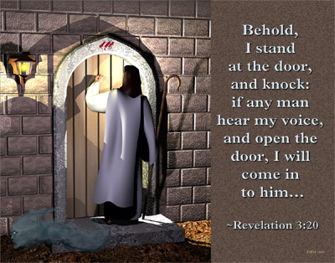

Slide 27

Dear Jesus,
I know I am a sinner & need your forgiveness.
I believe you died for my sins.
I now turn from sin.
Come into my heart I pray.
Do you want to meet Jesus as your savior right now?
Do you believe He died to save you from your sins & that He rose from the dead?
Do you believe that He is waiting to save you right now?

Slide 28


“But to all who believed him and accepted him, he gave the right to become children of God.” John 1:12

Slide 29



Slide 30


“If you declare with your mouth that Jesus is
Lord, and believe in your heart that God raised him from the dead, you
will be
saved.” Rom. 10:9
What did you learn today?
How does this lesson apply to our lives today?
What do you want to say about Jesus today?

Slide 31

“Draw near to God, and He will draw near to you…
…Cleanse your hands, you sinners, and make your hearts pure, you who are half-hearted towards God.” James 4:8 WNT

Slide 32
Note: Any videos in this presentation will only play online. After you download the slideshow, you will need to also download the videos from YouTube & add them back into your PowerPoint.
We present these messages at Bee Creek Park in College Station, TX.
If you would like to watch the video of the service with this message, click here: http://campaignkerusso.org/?p=6970
We would love to know more about the people who download our lessons & sermons. We invite you to email us & let us know where & how you use them.
info@ckbrazos.org

Slide 33
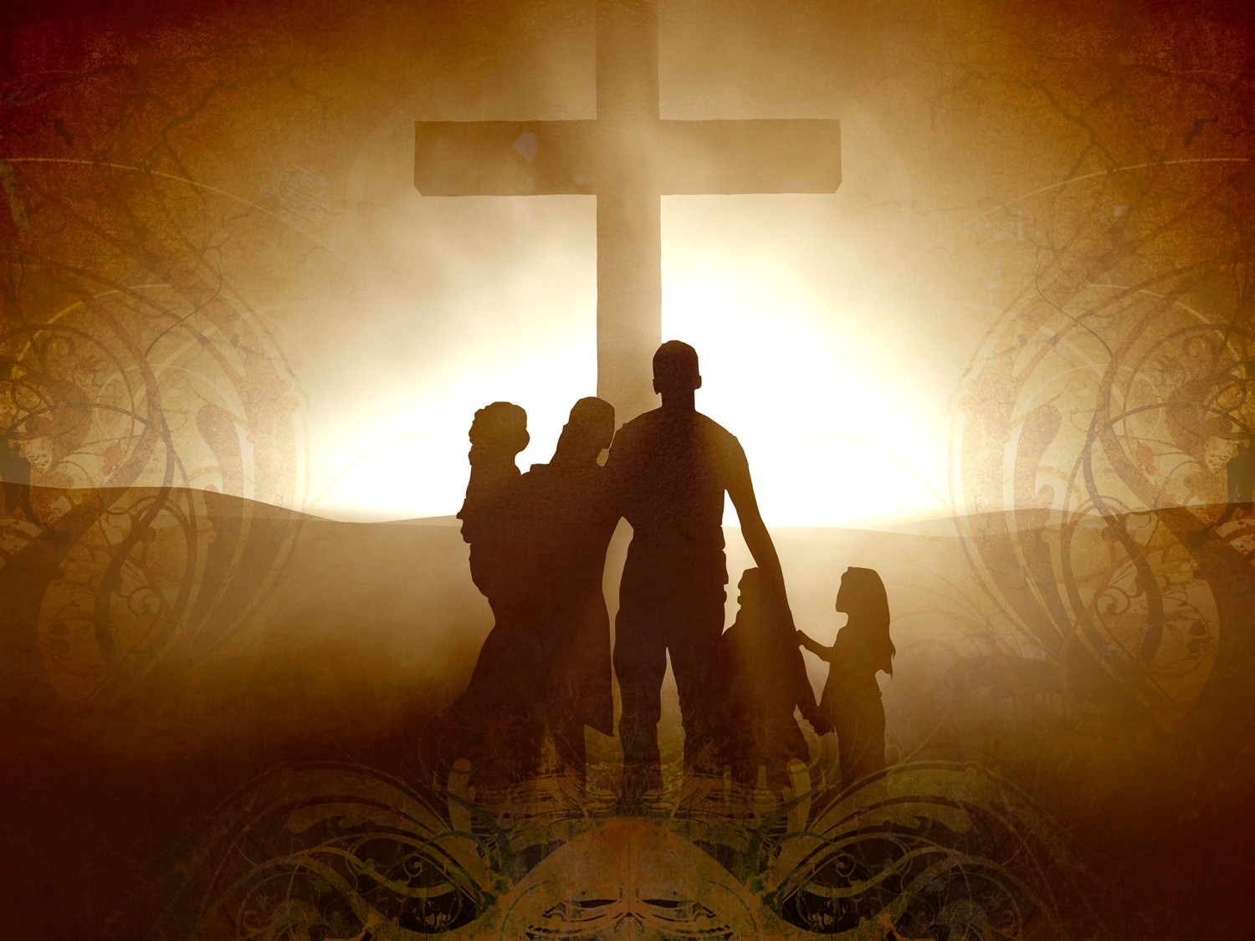
Welcome to Aggieland Faith
Family Style Worship

Slide 34

CURRENT SCHEDULE:
See www.Aggielandfaith.org
SATURDAY —
At Bee Creek Park
2:00-4:00pm: Through the bible with felt-board stories – plus hot-dogs & drinks
SUNDAY —
At Bee Creek Park
2:00-4pm: Free snacks, drinks, kids crafts, prizes, singing & bible preaching

Slide 35


Would You Like Prayer or Bible Study at Your House?
Personal Prayer:
We can come to your home & pray with you, or you can email us when you need prayer.
Home Bible Study:
We will come to your home & hold
a bible study for you & your friends.
Bible Party:
We will hold a Kid’s Bible Party:
You provide the food & kids - we
will do the bible fun & stories.

Slide 36

Would You Like Visitation?
We will visit a friend, loved one in the hospital or in prison to pray for them & share Christ with them.
Contact: info@aggielandfaith.org

Slide 37

www.aggielandfaith.org
Go here to see pictures & videos
Go here to subscribe to e-mails about changes & cancellations

Slide 38
Note: Any videos in this presentation will only play online. After you download the slideshow, you will need to also download the videos from YouTube & add them back into your PowerPoint.
We present these messages at Bee Creek Park in College Station, TX.
If you would like to watch the video of the service with this message, click here: http://campaignkerusso.org/?p=6970
We would love to know more about the people who download our lessons & sermons. We invite you to email us & let us know where & how you use them.
info@ckbrazos.org

