Slide 1
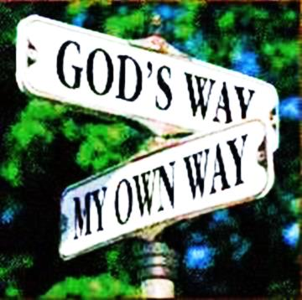
The Beatitudes (beautiful attitudes) or The Bad Attitudes

Slide 2



Note: Any videos in this presentation will only play online. After you download the slideshow, you will need to also download the videos from YouTube & add them back into your PowerPoint.
We present these messages at Bee Creek Park in College Station, TX.
If you would like to watch the video of the service with this message, click here:
http://campaignkerusso.org/?p=7387
We would love to know more about the people who download our lessons & sermons. We invite you to email us & let us know where & how you use them.
info@ckbrazos.org

Slide 3
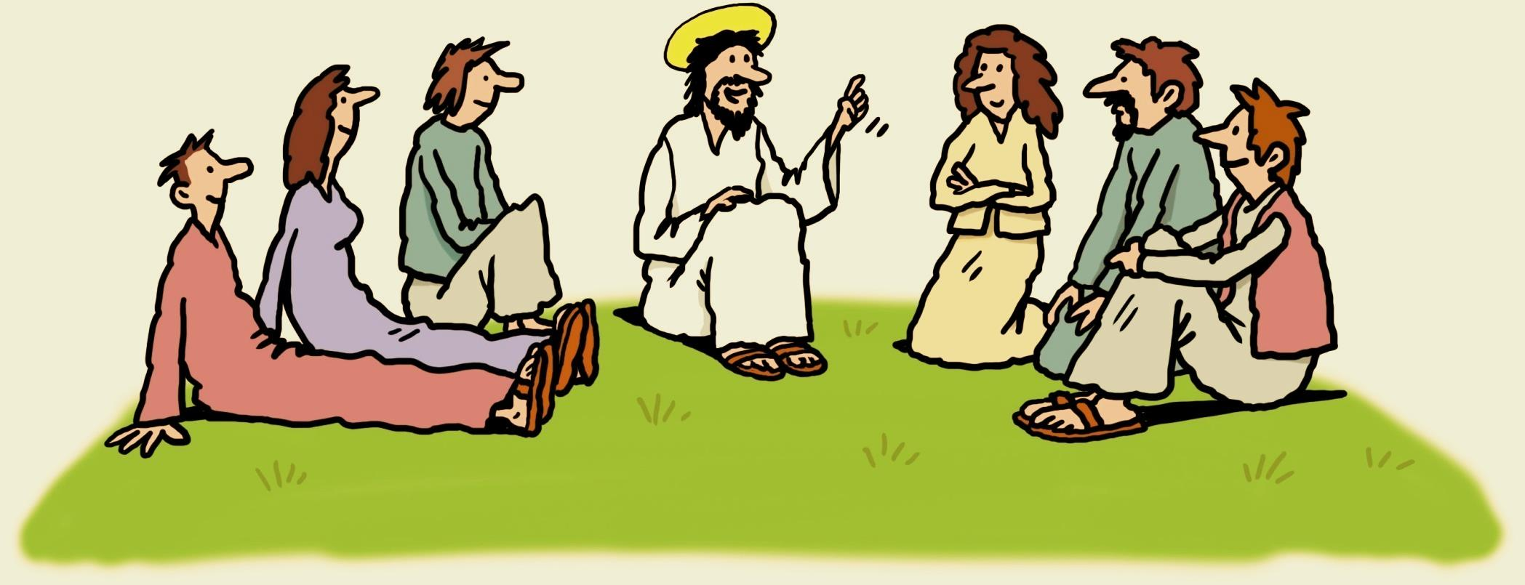
Jesus
went up on a
mountainside and sat down...
and he began to
BUT, WHAT DID HE TEACH?
Teach

Slide 4
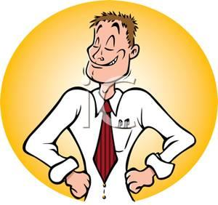
The world loves a
big shot
Or…

Slide 5

Blessed are the
humble minded
for theirs is the kingdom of heaven

Slide 6
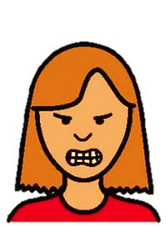
The world says
be angry,
be tough
Or…

Slide 7
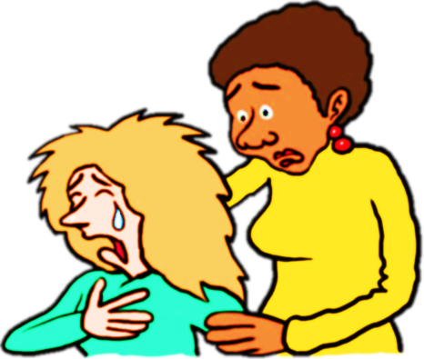
Blessed are those who
mourn,
for
they will be comforted

Slide 8
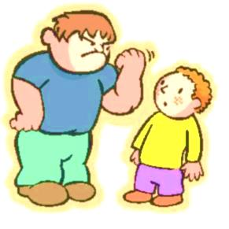
The world says
might makes
right
Or…

Slide 9

Blessed are the
meek,
for
they
will
inherit the
earth

Slide 10
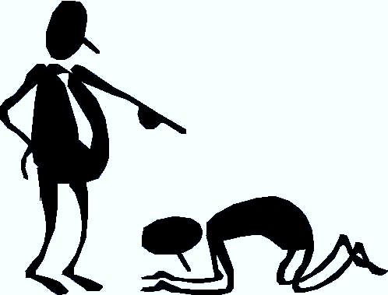
The world says
it’s either you or the
Other guy
Or…

Slide 11
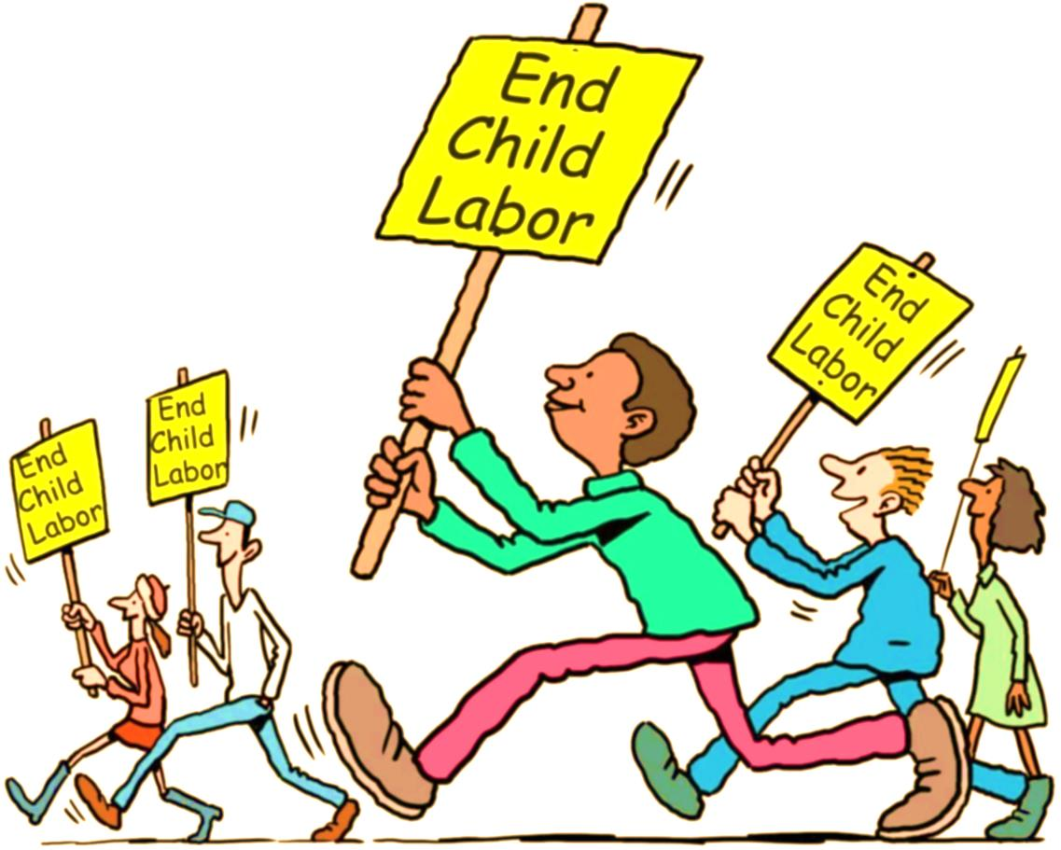
Blessed
are those who
hunger and thirst
for
Fairness and
Justice
for
They shall
be
filled

Slide 12
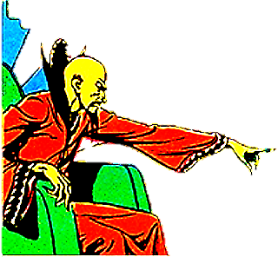
The world says
Weakness
is dangerous
Show no mercy
Or…

Slide 13
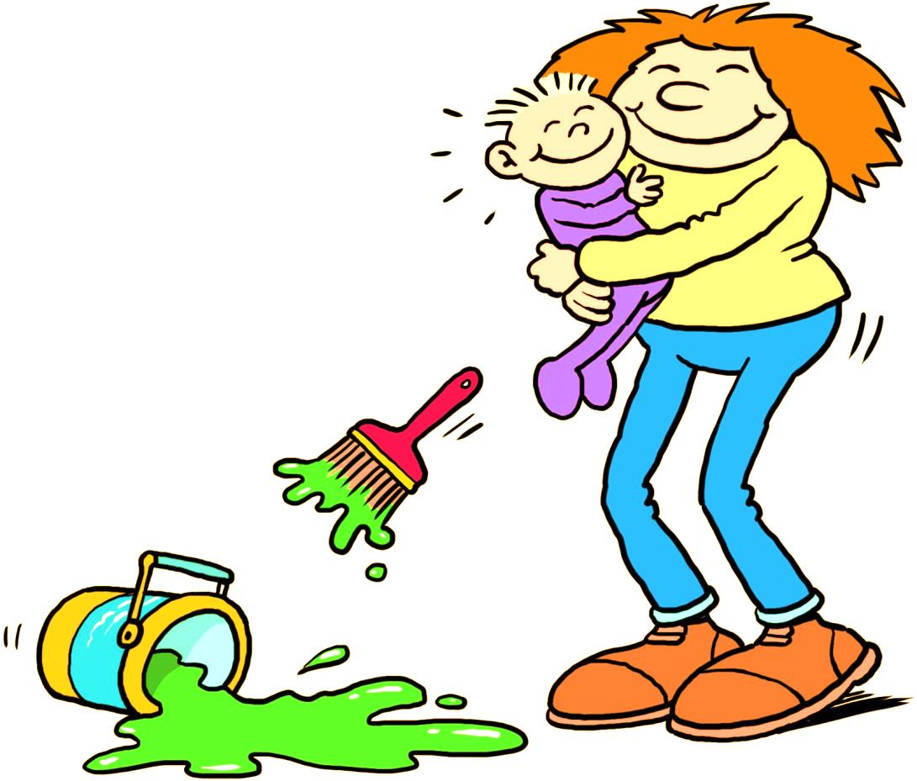
Blessed
are the
merciful,
for
they
will be shown mercy

Slide 14
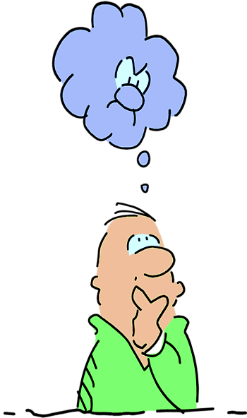
The world says
it won’t hurt to
Think about
bad things
Or…

Slide 15
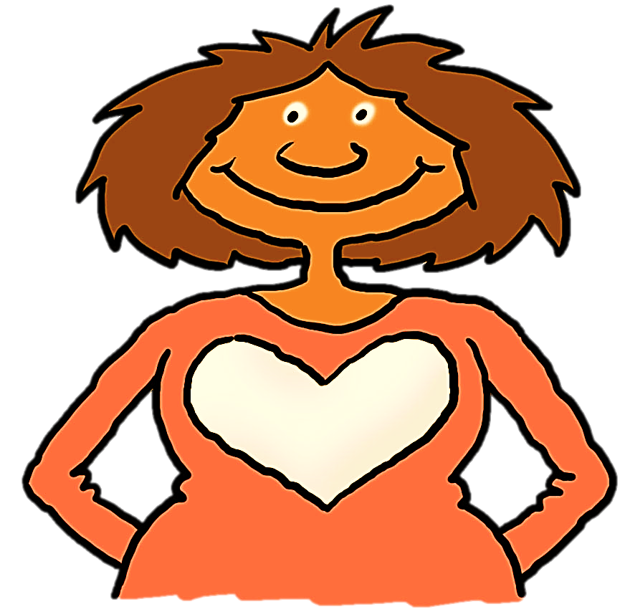
Blessed
are the
pure in heart,
for
they
will see God

Slide 16
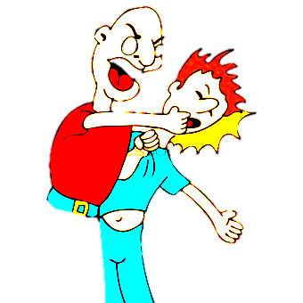
The world loves
a good
fight
Or…

Slide 17
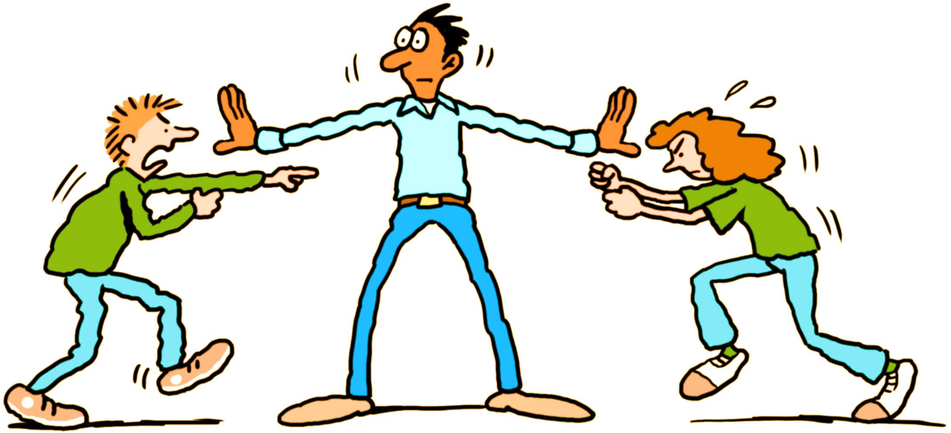
Blessed
are the
peacemakers,
they
for
will be called children of God

Slide 18
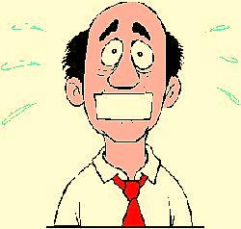
The world wants
You to be afraid
To talk about
Jesus
or

Slide 19
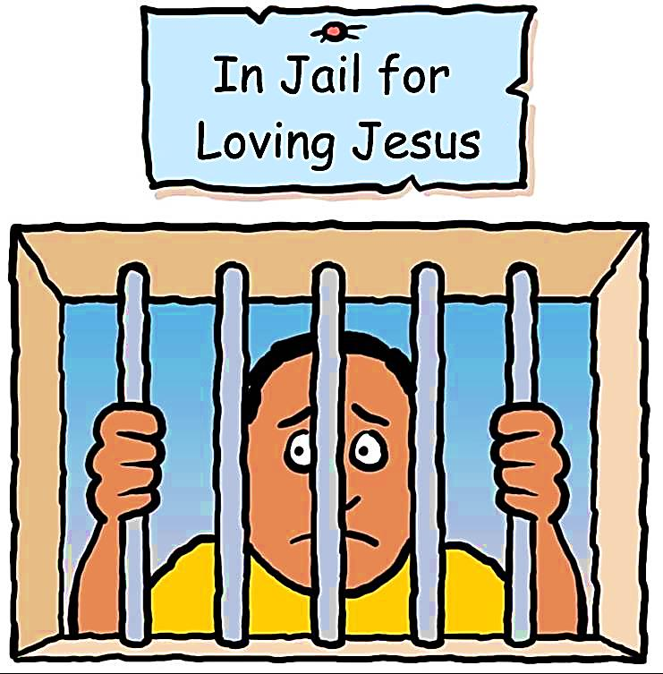
Blessed
are those who are
persecuted because of righteousness,
for
theirs is the
kingdom of heaven
And finally, jesus says:

Slide 20
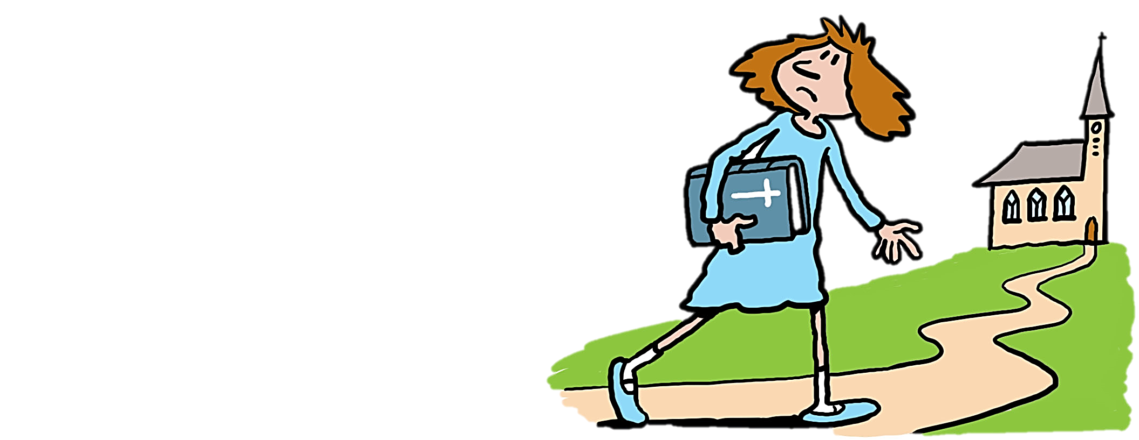
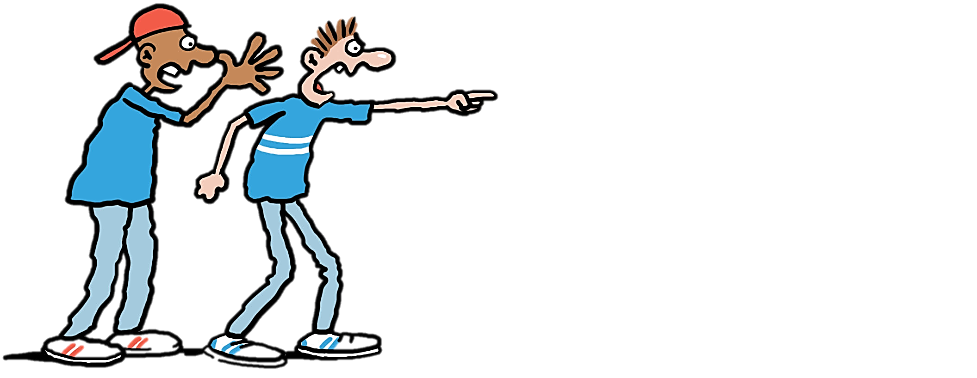
Blessed are you
when people insult you,
persecute you… because you love me
Rejoice
and be glad, because
great is your reward in heaven

Slide 21
REVIEW
1. Jesus said “Blessed are the poor in
spirit, for _____.”
A. they shall be comforted
B. theirs is the kingdom of heaven.
C. they shall be filled

Slide 22
2. “Blessed are those who mourn for
_____.”
A. they shall be filled
B. theirs is the kingdom of heaven
C. they shall be comforted.

Slide 23
3. “Blessed are those who hunger and
thirst after righteousness for _____.”
A. they shall be called sons of God
B. they shall be filled.
C. they shall see God

Slide 24
4. “Blessed are the merciful for _____.”
A. they shall obtain mercy.
B. they shall see God
C. theirs is the kingdom of heaven

Slide 25
5. “Blessed are the pure in heart for
_____.”
A. they shall obtain mercy
B. they shall be filled
C. they shall see God.

Slide 26
6. “Blessed are the peacemakers for
_____.
A. they shall be comforted
B. they shall be called the sons of God.
C. they shall be filled

Slide 27
7. When we suffer even though we have
done nothing wrong we are being _____.
A. persecuted for righteousness sake.
B. a peacemaker
C. merciful

Slide 28
8. People who are pure in heart _____.
A. watch bad shows on television
B. play violent video games
C. fill their minds with good thoughts.

Slide 29
9. The person who hungers and thirsts
for righteousness wants to _____.
A. eat all the time
B. learn more about God.
C. read more history books

Slide 30
10. To be truly blessed or happy we
must put Jesus first, _____.
A. ourselves second and others last
B. others second and ourselves last.
C. and care for no one else

Slide 31

What is the Sinner‘s Prayer?
This is a prayer we can pray when we are ready to admit we are sinners and need Christ’s forgiveness.
It must be prayed with faith in our hearts and a readiness to have a life-changing encounter with Jesus Christ.

Slide 32
You Should Pray this Prayer If :
If you never have before
You have in the past, but you think you would mean it more today
You have been walking afar off and you want to come back
You want to set an example and show others how it is done
You just like to give your heart to Jesus again & again

Slide 33
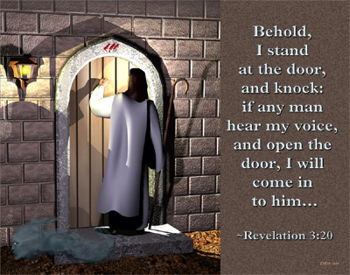

Slide 34

Dear Jesus,
I know I am a sinner & need your forgiveness.
I believe you died for my sins.
I now turn from sin.
Come into my heart I pray.
Do you want to meet Jesus as your savior right now?
Do you believe He died to save you from your sins & that He rose from the dead?
Do you believe that He is waiting to save you right now?

Slide 35


“But to all who believed him and accepted him, he gave the right to become children of God.” John 1:12

Slide 36



Slide 37


“If you declare with your mouth that Jesus is
Lord, and believe in your heart that God raised him from the dead, you
will be
saved.” Rom. 10:9
What did you learn today?
How does this lesson apply to our lives today?
What do you want to say about Jesus today?

Slide 38

“Draw near to God, and He will draw near to you…
…Cleanse your hands, you sinners, and make your hearts pure, you who are half-hearted towards God.” James 4:8 WNT

Slide 39
Note: Any videos in this presentation will only play online. After you download the slideshow, you will need to also download the videos from YouTube & add them back into your PowerPoint.
We present these messages at Bee Creek Park in College Station, TX.
If you would like to watch the video of the service with this message, click here: http://campaignkerusso.org/?p=7387
We would love to know more about the people who download our lessons & sermons. We invite you to email us & let us know where & how you use them.
info@ckbrazos.org

Slide 40
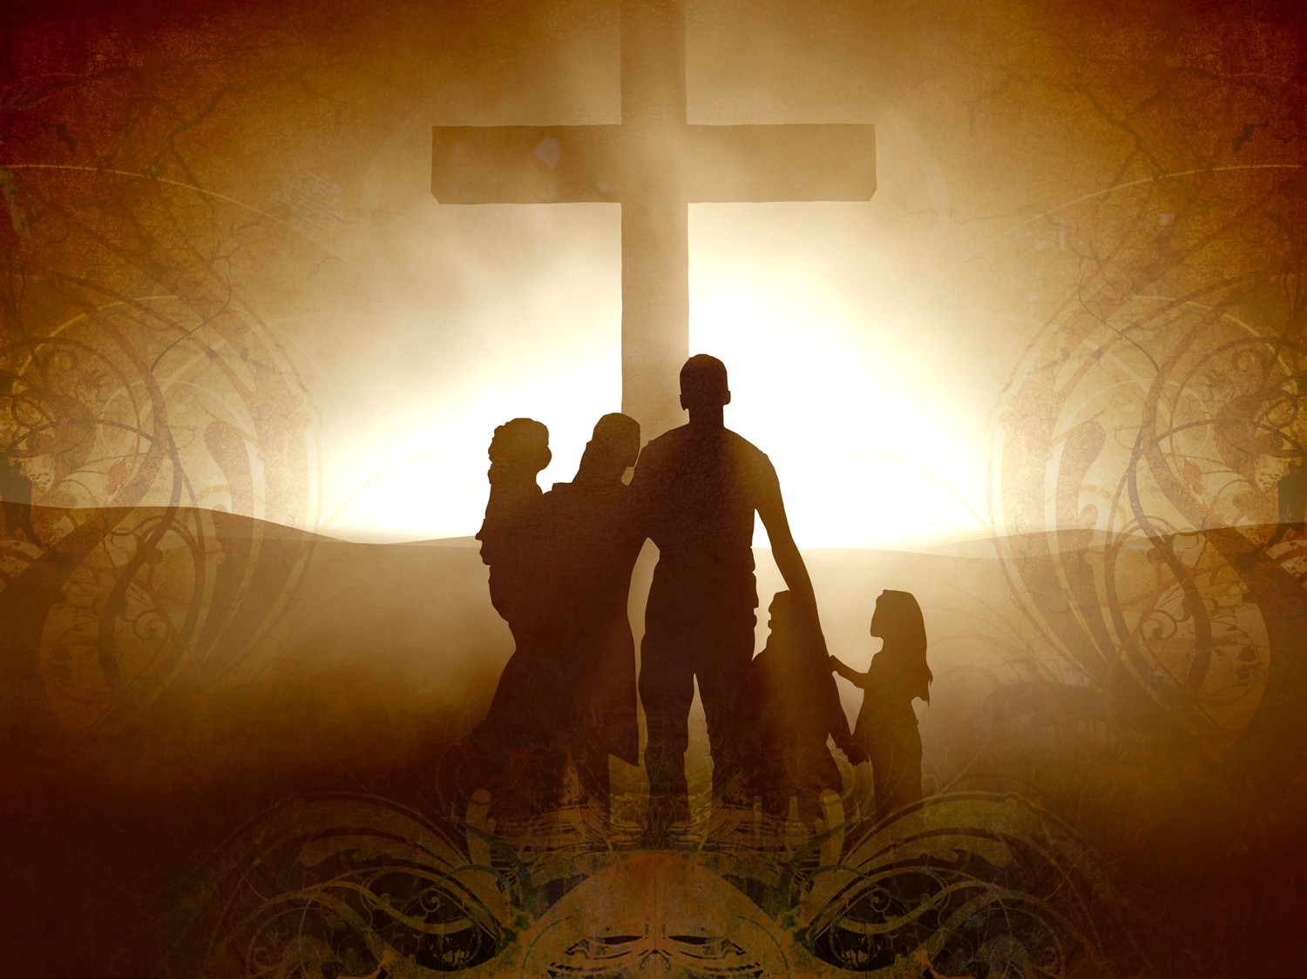
Welcome to Aggieland Faith
Family Style Worship

Slide 41

CURRENT SCHEDULE:
See www.Aggielandfaith.org
SATURDAY —
At Bee Creek Park
2:00-4:00pm: Through the bible with felt-board stories – plus hot-dogs & drinks
SUNDAY —
At Bee Creek Park
2:00-4pm: Free snacks, drinks, kids crafts, prizes, singing & bible preaching

Slide 42


Would You Like Prayer or Bible Study at Your House?
Personal Prayer:
We can come to your home & pray with you, or you can email us when you need prayer.
Home Bible Study:
We will come to your home & hold
a bible study for you & your friends.
Bible Party:
We will hold a Kid’s Bible Party:
You provide the food & kids - we
will do the bible fun & stories.

Slide 43

Would You Like Visitation?
We will visit a friend, loved one in the hospital or in prison to pray for them & share Christ with them.
Contact: info@aggielandfaith.org

Slide 44

www.aggielandfaith.org
Go here to see pictures & videos
Go here to subscribe to e-mails about changes & cancellations

Slide 45
Note: Any videos in this presentation will only play online. After you download the slideshow, you will need to also download the videos from YouTube & add them back into your PowerPoint.
We present these messages at Bee Creek Park in College Station, TX.
If you would like to watch the video of the service with this message, click here: http://campaignkerusso.org/?p=7387
We would love to know more about the people who download our lessons & sermons. We invite you to email us & let us know where & how you use them.
info@ckbrazos.org

