Slide 1


Slide 2



Note: Any videos in this presentation will only play online. After you download the slideshow, you will need to also download the videos from YouTube & add them back into your PowerPoint.
We present these messages at Bee Creek Park in College Station, TX.
If you would like to watch the video of the service with this message, click here: http://campaignkerusso.org/?p=7027
We would love to know more about the people who download our lessons & sermons. We invite you to email us & let us know where & how you use them.
info@ckbrazos.org

Slide 3
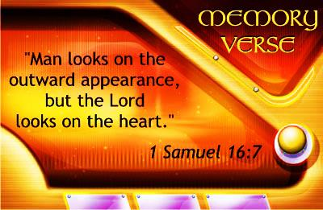

Slide 4
Next Slide - Song :
The Lord Looks at the Heart →
Download Here:
http://www.youtube.com/watch?v=4noirajzCnI

Slide 5
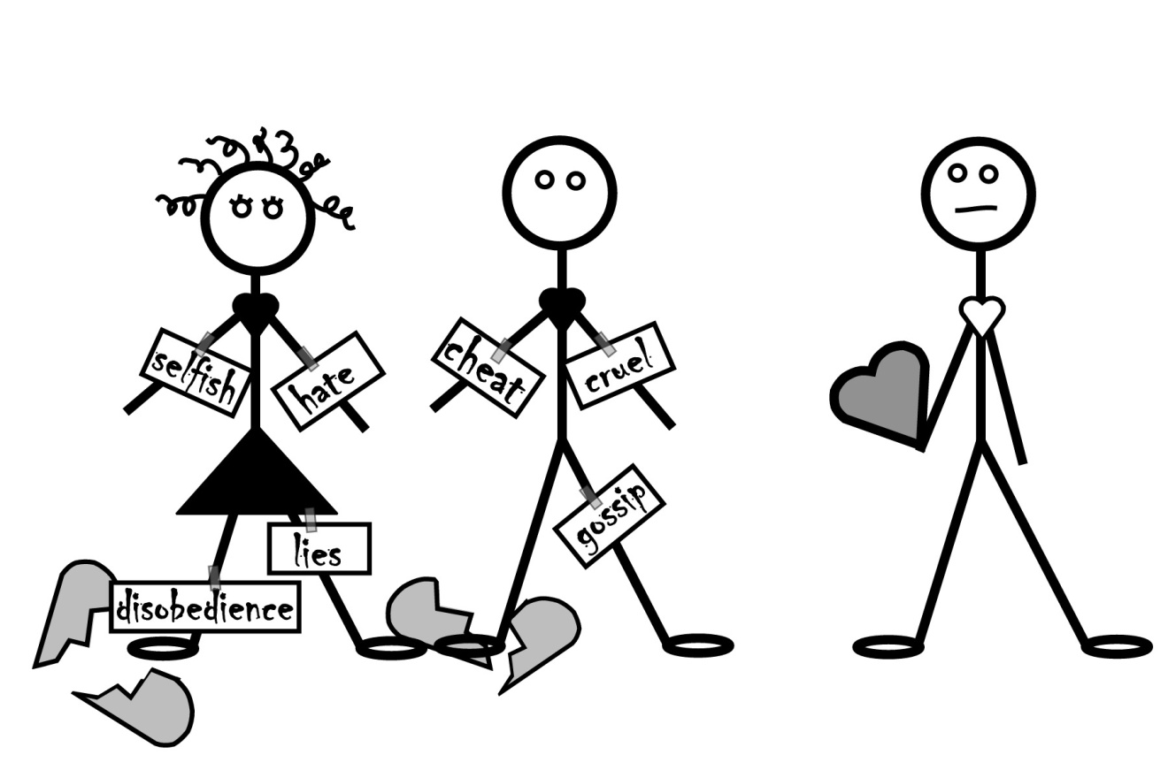
“Man looks at the outward appearance but the Lord looks at the heart.” 1 Sam. 16:7

Slide 6
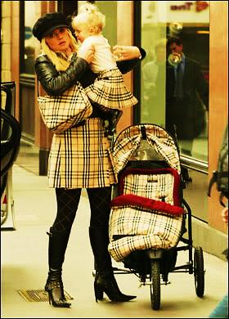

What does this woman care about?

Slide 7
Next Slide - Video:
Dove Commercial →
Download Here:
http://www.youtube.com/watch?v=ADHyt1XsZRM

Slide 8
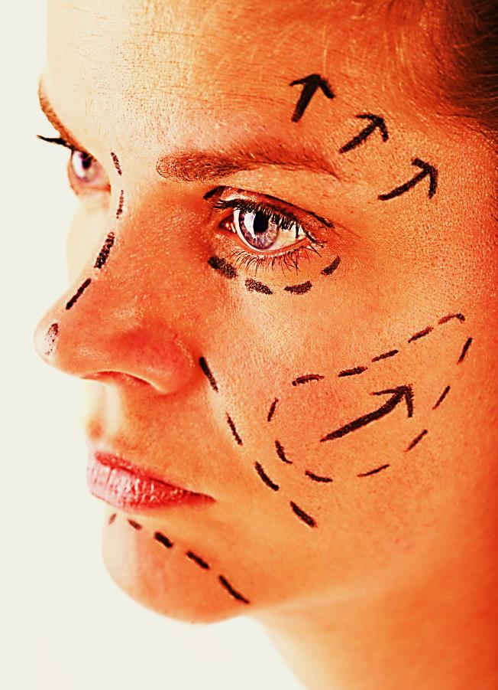
Outer beauty fades.
“So we do not lose heart. Though our outer self is wasting away, our inner self is being renewed day by day.”
1 Cor. 4:16

Slide 9
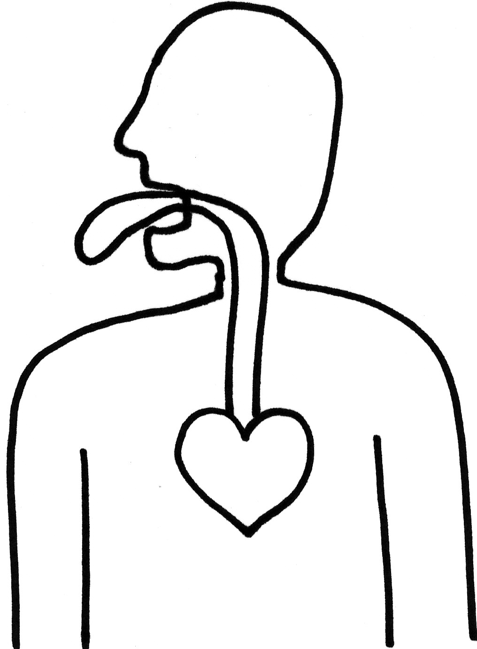
Our Tongue Reveals How Our Hearts Really Look
“But the things that come out of the mouth come from the heart…” Mat.15:18

Slide 10

“Do not let your adorning be external—the braiding of hair and the putting on of gold jewelry, or the clothing you wear— but let your adorning be the hidden person of the heart with the imperishable beauty of a gentle and quiet spirit, which in God's sight is very precious.”
1 Pet. 3:3,4

Slide 11

What is the Sinner‘s Prayer?
This is a prayer we can pray when we are ready to admit we are sinners and need Christ’s forgiveness.
It must be prayed with faith in our hearts and a readiness to have a life-changing encounter with Jesus Christ.

Slide 12
You Should Pray this Prayer If :
If you never have before
You have in the past, but you think you would mean it more today
You have been walking afar off and you want to come back
You want to set an example and show others how it is done
You just like to give your heart to Jesus again & again

Slide 13
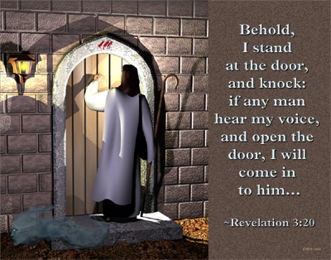

Slide 14

Dear Jesus,
I know I am a sinner & need your forgiveness.
I believe you died for my sins.
I now turn from sin.
Come into my heart I pray.
Do you want to meet Jesus as your savior right now?
Do you believe He died to save you from your sins & that He rose from the dead?
Do you believe that He is waiting to save you right now?

Slide 15


“But to all who believed him and accepted him, he gave the right to become children of God.” John 1:12

Slide 16



Slide 17


“If you declare with your mouth that Jesus is
Lord, and believe in your heart that God raised him from the dead, you
will be
saved.” Rom. 10:9
What did you learn today?
How does this lesson apply to our lives today?
What do you want to say about Jesus today?

Slide 18

“Draw near to God, and He will draw near to you…
…Cleanse your hands, you sinners, and make your hearts pure, you who are half-hearted towards God.” James 4:8 WNT

Slide 19
Note: Any videos in this presentation will only play online. After you download the slideshow, you will need to also download the videos from YouTube & add them back into your PowerPoint.
We present these messages at Bee Creek Park in College Station, TX.
If you would like to watch the video of the service with this message, click here: http://campaignkerusso.org/?p=7027
We would love to know more about the people who download our lessons & sermons. We invite you to email us & let us know where & how you use them.
info@ckbrazos.org

Slide 20
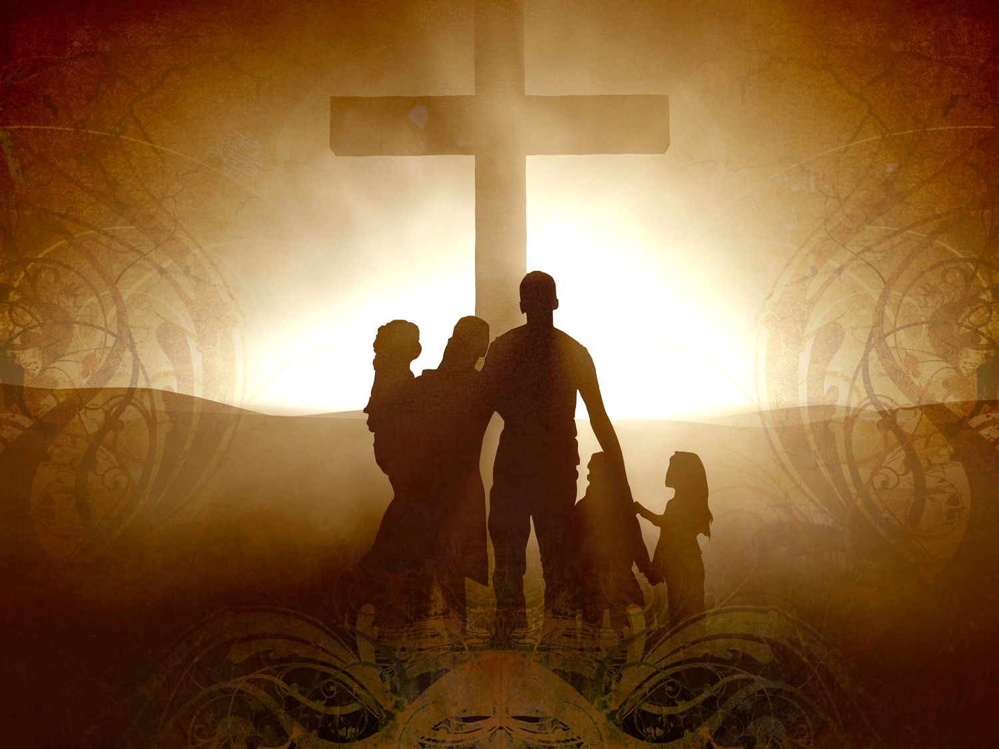
Welcome to Aggieland Faith
Family Style Worship

Slide 21

CURRENT SCHEDULE:
See www.Aggielandfaith.org
SATURDAY —
At Bee Creek Park
2:00-4:00pm: Through the bible with felt-board stories – plus hot-dogs & drinks
SUNDAY —
At Bee Creek Park
2:00-4pm: Free snacks, drinks, kids crafts, prizes, singing & bible preaching

Slide 22


Would You Like Prayer or Bible Study at Your House?
Personal Prayer:
We can come to your home & pray with you, or you can email us when you need prayer.
Home Bible Study:
We will come to your home & hold
a bible study for you & your friends.
Bible Party:
We will hold a Kid’s Bible Party:
You provide the food & kids - we
will do the bible fun & stories.

Slide 23

Would You Like Visitation?
We will visit a friend, loved one in the hospital or in prison to pray for them & share Christ with them.
Contact: info@aggielandfaith.org

Slide 24

www.aggielandfaith.org
Go here to see pictures & videos
Go here to subscribe to e-mails about changes & cancellations

Slide 25
Note: Any videos in this presentation will only play online. After you download the slideshow, you will need to also download the videos from YouTube & add them back into your PowerPoint.
We present these messages at Bee Creek Park in College Station, TX.
If you would like to watch the video of the service with this message, click here: http://campaignkerusso.org/?p=7027
We would love to know more about the people who download our lessons & sermons. We invite you to email us & let us know where & how you use them.
info@ckbrazos.org

