Slide 1
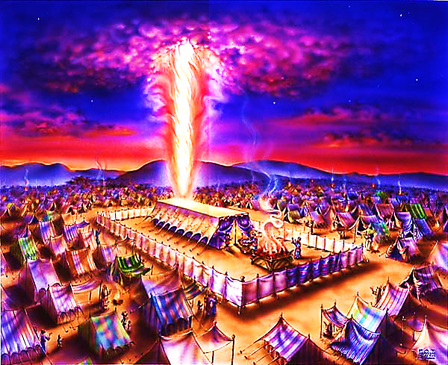
The Tabernacle in the Wilderness pt. 2

Slide 2



Note: Any videos in this presentation will only play online. After you download the slideshow, you will need to also download the videos from YouTube & add them back into your PowerPoint.
We present these messages at Bee Creek Park in College Station, TX.
If you would like to watch the videos of the service, click here: http://campaignkerusso.org/?p=7688
We would love to know more about the people who download our lessons & sermons. We invite you to email us & let us know where & how you use them.
info@ckbrazos.org

Slide 3



Slide 4
To temporally dwell with His people and to illustrate how He planned to make it a permanent living situation.
Why a
Tabernacle?

Slide 5
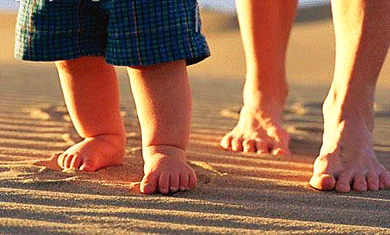
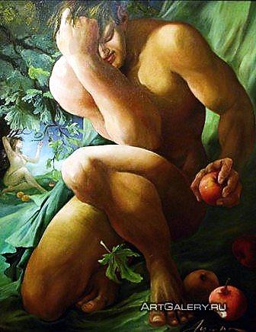
Sin destroyed our relationship with God…
God wants it back!

Slide 6
The Beauty of God’s Consistency
From Genesis to Revelation:
The bible is one story… It is the story of God making a way in which He can dwell with men.

Slide 7
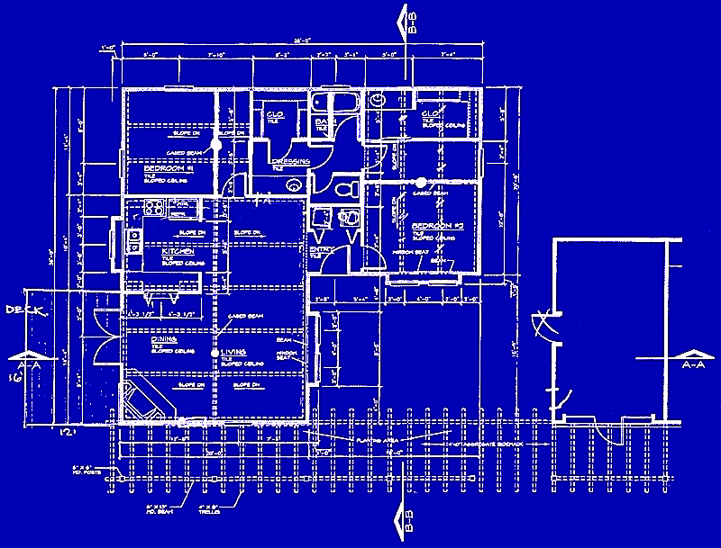
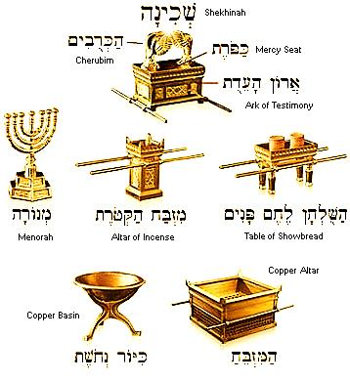
The Tabernacle is actually God’s blueprint of His gospel plan.

Slide 8
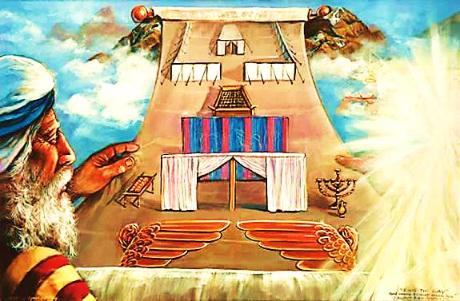
The original tabernacle exists in Heaven.
A copy (shadow) was built by Moses.
The original tabernacle existed before time and will continue after time.

Slide 9
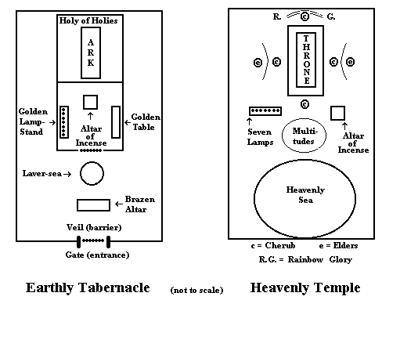

Slide 10
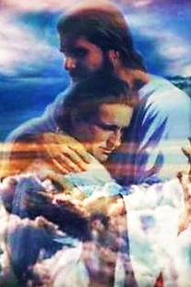
The perfect universe looks like this: God dwells with man!
Sin destroys this, but God repairs it.
That’s the whole bible story… that’s the Gospel.
God wants us to come home and dwell with Him.

Slide 11
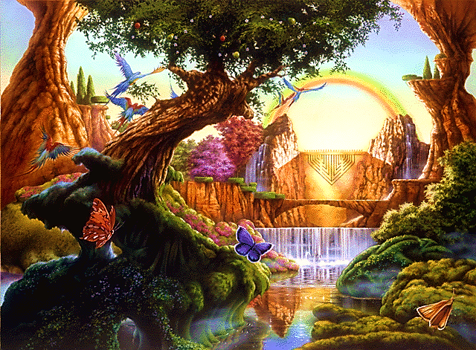
“Thy will be done on Earth as it is in Heaven.”
Eden looked a lot like Heaven

Slide 12
“Thy will be done on Earth as it is in Heaven.”
Heaven:
River of life
Tree of Life
Mountain
Eden:
River of life
Tree of Life
Mountain

Slide 13
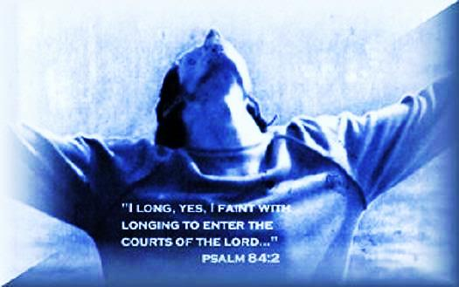
God’s Dwelling Places
Heavenly Tabernacle
Garden of Eden
Hebrew Tabernacle
Jesus
Believers

Slide 14
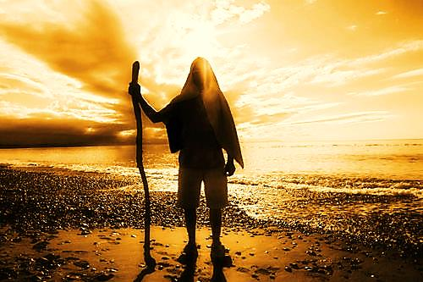
Tabernacle
“Moreover, I will make My dwelling among you, and My soul will not reject you. I will also walk among you and be your God, and you shall be My people.”
Lev. 26:11, 12
Believer
“For we are the temple of the living God. As God said: "I will live in them and walk among them. I will be their God, and they will be my people.”
2 Cor. 6:16

Slide 15
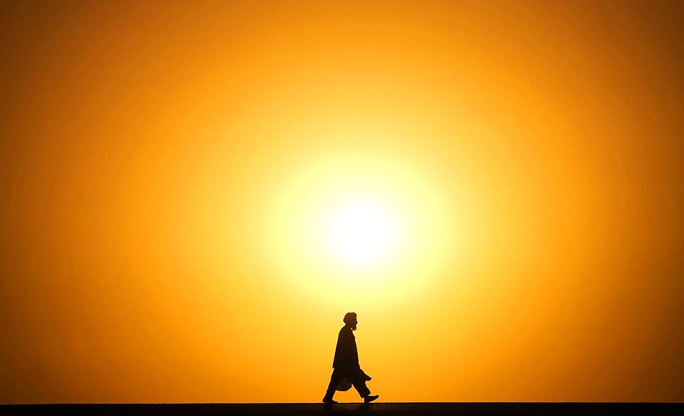
God is a Walker –
He Loves to Walk With Men
“Noah was a righteous man, blameless in his generation. Noah walked with God.” Genesis 6:9
“Enoch walked with God, and he was not, for God took him.” Genesis 5:24
Jesus and His disciples were always walking & talking.

Slide 16
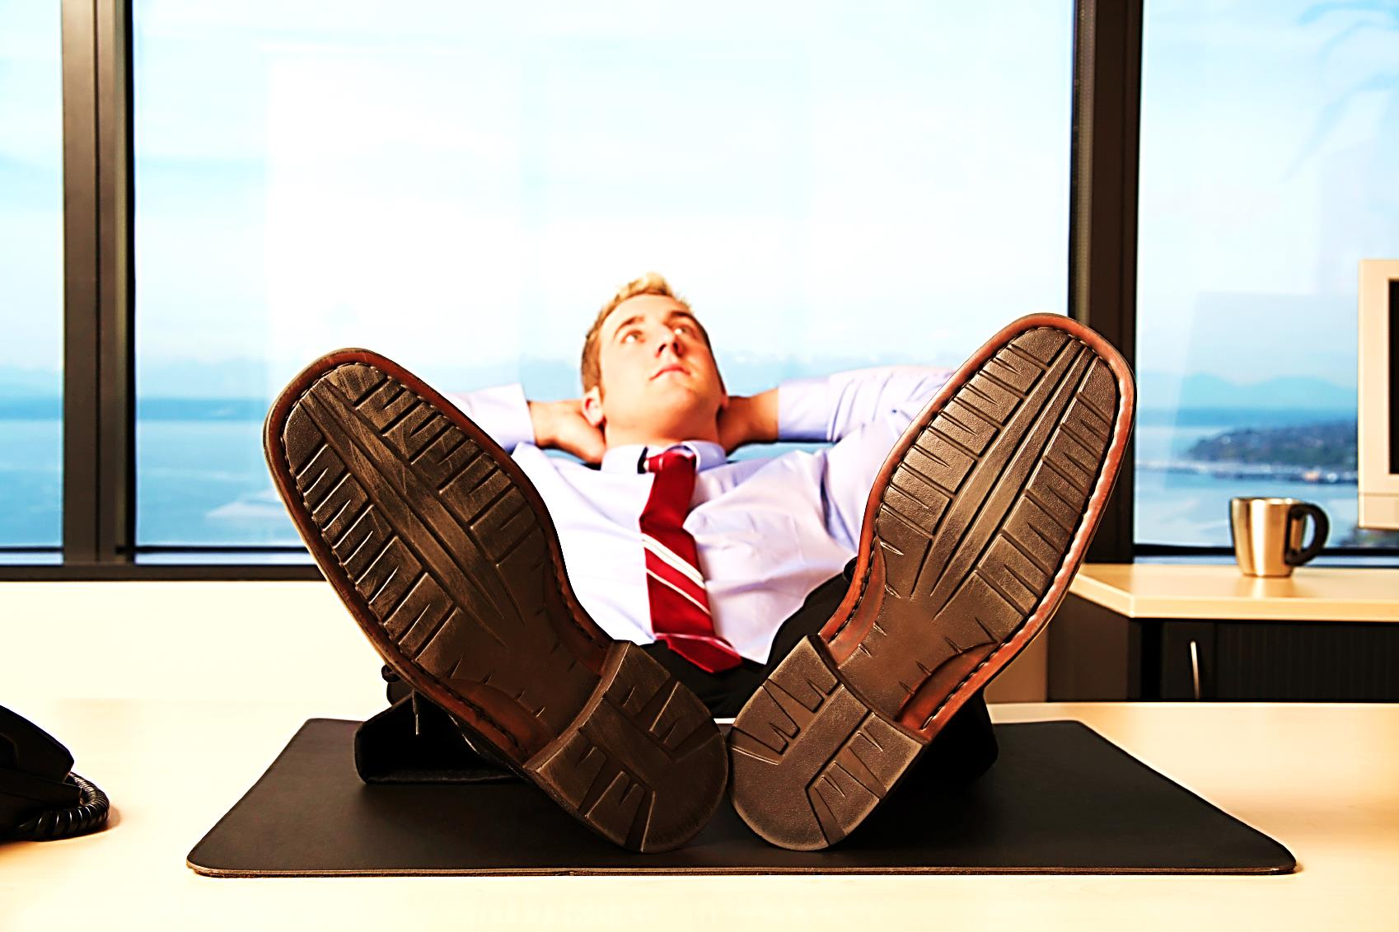
It’s called the ‘Christian Walk,’ not merely the ‘Christian Thought.’

Slide 17
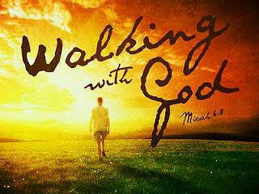
God prefers forward motion to stagnation. His idea of ‘dwelling’ is a walking with His people. He is going somewhere!

Slide 18
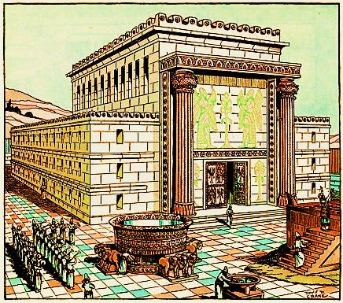
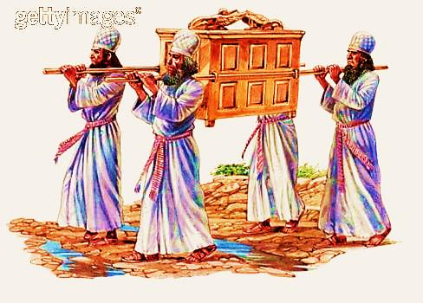
The Ark of the Covenant was to be carried by the priests as the nation moved forward.
A fixed, immobile Temple (though permitted by God) was not His preference.

Slide 19
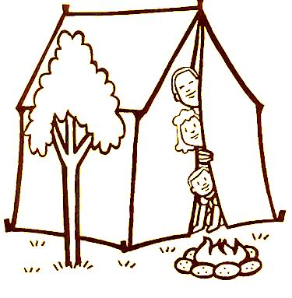
The Feast of Tabernacles Reminds
Us that the World is Not Our Home
“For seven days you will be living in tents; all those who are Israelites by birth are to make tents their living-places.”
Lev. 23:42
God doesn’t want our hearts fixed to Earth & Earthly things.

Slide 20
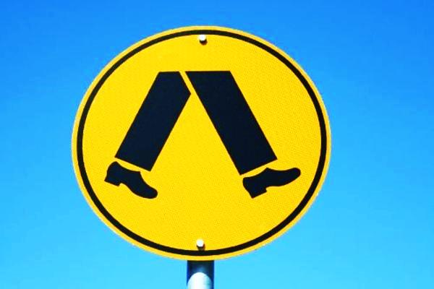
He wants us following – walking
Walking with Him, in His direction, is transforming
“Whoever says he abides in him ought to walk in the same way in which he walked.” 1 John 2:6
“Do two walk together, unless they have agreed…” Amos 3:3
“…what does the Lord require of you but to do justice, and to love kindness, and to walk humbly with your God?” Micah 6:8

Slide 21
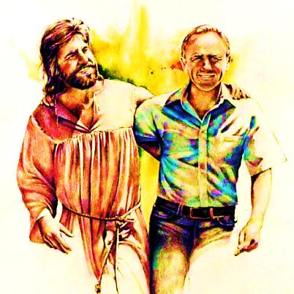
“Let’s Go for a Walk!”
“Walk, talk and become more intimate with Me.”

Slide 22

What is the Sinner‘s Prayer?
This is a prayer we can pray when we are ready to admit we are sinners and need Christ’s forgiveness.
It must be prayed with faith in our hearts and a readiness to have a life-changing encounter with Jesus Christ.

Slide 23
You Should Pray this Prayer If :
If you never have before
You have in the past, but you think you would mean it more today
You have been walking afar off and you want to come back
You want to set an example and show others how it is done
You just like to give your heart to Jesus again & again

Slide 24
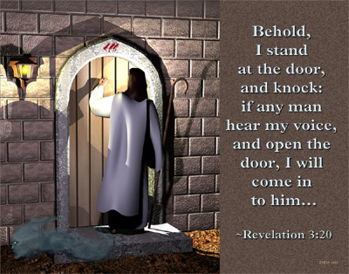

Slide 25

Dear Jesus,
I know I am a sinner & need your forgiveness.
I believe you died for my sins.
I now turn from sin.
Come into my heart I pray.
Do you want to meet Jesus as your savior right now?
Do you believe He died to save you from your sins & that He rose from the dead?
Do you believe that He is waiting to save you right now?

Slide 26


“But to all who believed him and accepted him, he gave the right to become children of God.” John 1:12

Slide 27



Slide 28


“If you declare with your mouth that Jesus is
Lord, and believe in your heart that God raised him from the dead, you
will be
saved.” Rom. 10:9
What did you learn today?
How does this lesson apply to our lives today?
What do you want to say about Jesus today?

Slide 29

“Draw near to God, and He will draw near to you…
…Cleanse your hands, you sinners, and make your hearts pure, you who are half-hearted towards God.” James 4:8 WNT

Slide 30
Note: Any videos in this presentation will only play online. After you download the slideshow, you will need to also download the videos from YouTube & add them back into your PowerPoint.
We present these messages at Bee Creek Park in College Station, TX.
If you would like to watch the videos of the service, click here: http://campaignkerusso.org/?p=7688
We would love to know more about the people who download our lessons & sermons. We invite you to email us & let us know where & how you use them.
info@ckbrazos.org

Slide 31
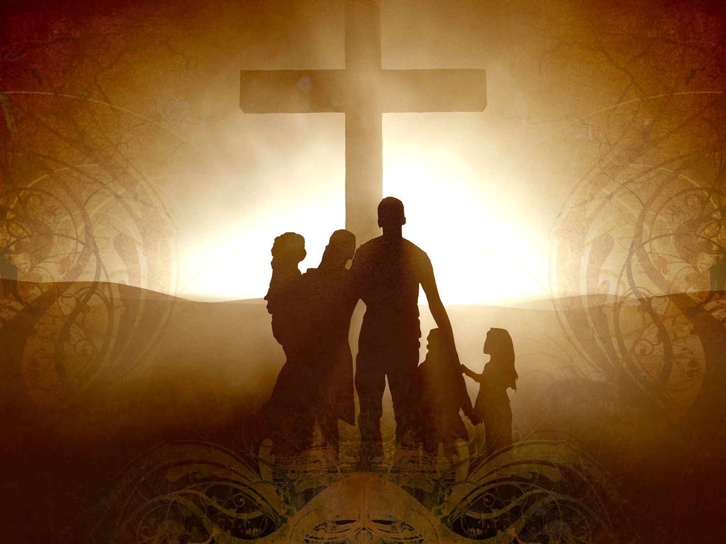
Welcome to Aggieland Faith
Family Style Worship

Slide 32

CURRENT SCHEDULE:
See www.Aggielandfaith.org
SATURDAY —
At Bee Creek Park
2:00-4:00pm: Through the bible with felt-board stories – plus hot-dogs & drinks
SUNDAY —
At Bee Creek Park
2:00-4pm: Free snacks, drinks, kids crafts, prizes, singing & bible preaching

Slide 33


Would You Like Prayer or Bible Study at Your House?
Personal Prayer:
We can come to your home & pray with you, or you can email us when you need prayer.
Home Bible Study:
We will come to your home & hold
a bible study for you & your friends.
Bible Party:
We will hold a Kid’s Bible Party:
You provide the food & kids - we
will do the bible fun & stories.

Slide 34

Would You Like Visitation?
We will visit a friend, loved one in the hospital or in prison to pray for them & share Christ with them.
Contact: info@aggielandfaith.org

Slide 35

www.aggielandfaith.org
Go here to see pictures & videos
Go here to subscribe to e-mails about changes & cancellations

Slide 36
Note: Any videos in this presentation will only play online. After you download the slideshow, you will need to also download the videos from YouTube & add them back into your PowerPoint.
We present these messages at Bee Creek Park in College Station, TX.
If you would like to watch the videos of the service, click here: http://campaignkerusso.org/?p=7688
We would love to know more about the people who download our lessons & sermons. We invite you to email us & let us know where & how you use them.
info@ckbrazos.org

