Slide 1
The Bible is Pictures of Jesus

Slide 2
Note: Any videos in this presentation will only play online. After you download the slideshow, you will need to also download the videos from YouTube & add them back into your PowerPoint.
We present these messages at Bee Creek Park in College Station, TX. If you would like to watch the videos of the service, click here: http://campaignkerusso.org/?p=7680
We would love to know more about the people who download our lessons & sermons. We invite you to email us & let us know where & how you use them.
info@ckbrazos.org

Slide 3
Remember the Where's Waldo Books? The Bible is a Where’s Jesus Book!

Slide 4
There are pictures of Jesus in every story in the bible. We just need to practice looking for them.

Slide 5
The Bible is God’s Family Album all about His Wonderful Son → JESUS

Slide 6
It’s Like Looking for Golden Nuggets

Slide 7
Searching for Jesus… Look for these things…
Someone who was killed by those he loved
Someone who saved others
Someone whose pain and sacrifice helped others
Someone who came from Heaven
Someone who sees that we are hurting

Slide 8
Searching for Jesus… Look for these things…
Someone who made a way to get to heaven
Someone who lost something he loved
Someone who searches for what he lost
Someone who pays a price to get us well
Someone who is coming back someday.

Slide 9
Searching for Jesus… Look for these things…
Someone who has prepared something wonderful for those who come
Someone who sends out servants to invite people to come
Someone who covers His guests in clean, sinless white garments
Someone who is the one way

Slide 10
Can We Find Jesus in the Bible Stories?
Let’s look at each of the following stories & see if we can match them to our truths about Jesus.

Slide 11
Joseph: a Picture of Jesus

Slide 12
Which of these apply to Joseph’s story?
Someone who was killed by those he loved
Someone who saved others

Slide 13
Noah’s Ark a Picture of Jesus

Slide 14
Which of these apply to Noah’s Ark?
Someone (or something) which saved others
Someone who is the one way (the ONE door in the ark)

Slide 15
Sacrificial Lamb: a Picture of Jesus

Slide 16
Which of these apply to the Sacrificed Lamb?
Someone who was killed by those he loved
Someone who saved others
Someone who’s pain and sacrifice helped others
Someone who made a way to get to heaven (temporarily have their sins covered)

Slide 17
Jacob's Ladder a Picture of Jesus

Slide 18
Which of these apply to Jacob's Ladder ?
Someone (something) who came from Heaven
Someone who made a way to get to heaven
Someone who is the one way

Slide 19
The Lost Sheep: a Picture of Jesus

Slide 20
Which of these apply to the Shepherd?
Someone who saved others
Someone who sees that we are hurting
Someone who lost something he loved
Someone who searches for what he lost

Slide 21
The Wedding Feast: a Picture of Jesus

Slide 22
Which of these apply to the Kings Feast?
Someone who has prepared something wonderful for those who come
Someone who sends out servants to invite people to come
Someone who covers His guests in clean, sinless white garments

Slide 23
The Good Samaritan: a Picture of Jesus

Slide 24
The Good Samaritan
Someone who saved others
Someone who sees that we are hurting
Someone who pays a price to get us well
Someone who is coming back someday

Slide 25
There are pictures of Jesus in every story in the bible. We just need to practice looking for them.

Slide 26
The Bible is Pictures of Jesus

Slide 27
What is the Sinner‘s Prayer?
This is a prayer we can pray when we are ready to admit we are sinners and need Christ’s forgiveness.
It must be prayed with faith in our hearts and a readiness to have a life-changing encounter with Jesus Christ.

Slide 29
John Wesley’s Testimony
“…the preacher was describing the change which God works in the heart through faith in Christ and I felt my heart strangely warmed.”
Disciple’s Testimony
“They said to each other, ‘Did not our hearts burn within us while he talked to us on the road, while he opened to us the Scriptures?’”

Slide 30
A prayer of faith → Pray this prayer if :
If you never have before
You have in the past, but you think it would mean more today
You have been walking afar off and you want to come back
You want to set an example & show others how it is done
You just like to give your heart to Jesus again & again
Faith

Slide 31
We Declare Our Faith Publicly Because Jesus Declared His LOVE Publicly
“If you stand before others and are willing to say you believe in me, then I will tell my Father in heaven that you belong to me.” Mat 10:32

Slide 32
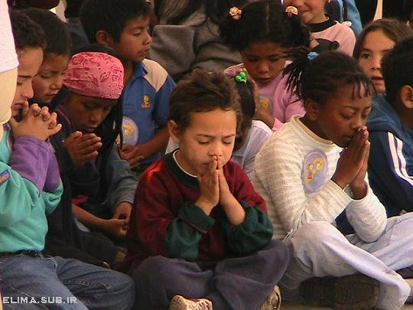
Dear Jesus,
I know I am a sinner & need your forgiveness.
I believe you died for my sins.
I now turn from sin.
Come into my heart I pray.
Do you want to meet Jesus as your savior right now?
Do you believe He died to save you from your sins & that He rose from the dead?
Do you believe that He is waiting to save you right now?

Slide 33
“But some people did accept him. They believed in him, and he gave them the right to become children of God.” John 1:12

Slide 35
“If you openly say, ‘Jesus is Lord’ and believe in your heart that God raised him from death, you will be saved.”
Rom. 10:9
What did you learn today?
What is the meaning of the name-tag?
What have you neen thinking about God lately?
What do you want to tell the world about Jesus?

Slide 36
“Draw near to God, and He will draw near to you…
…Cleanse your hands, you sinners, and make your hearts pure, you who are half-hearted towards God.” James 4:8 WNT

Slide 37
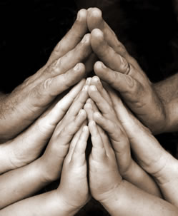
Close in Prayer

Slide 38
Note: Any videos in this presentation will only play online. After you download the slideshow, you will need to also download the videos from YouTube & add them back into your PowerPoint.
We present these messages at Bee Creek Park in College Station, TX. If you would like to watch the video of the service with this message, click here:
http://campaignkerusso.org/?p=7680
We would love to know more about the people who download our lessons & sermons. We invite you to email us & let us know where & how you use them.
info@ckbrazos.org

Slide 39
Welcome to Aggieland Faith Family Style Worship

Slide 40
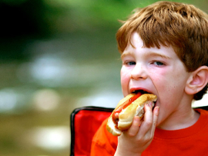
CURRENT SCHEDULE: See www.Aggielandfaith.org
SATURDAY —
At Bee Creek Park
2:00-4:00pm: Through the bible with felt-board stories – plus hot-dogs & drinks
SUNDAY —
At Bee Creek Park
2:00-4pm: Free snacks, drinks, kids crafts, prizes, singing & bible preaching

Slide 41
Would You Like Prayer or Bible Study at Your House?
Personal Prayer: We can come to your home & pray with you, or you can email us when you need prayer.
Home Bible Study: We will come to your home & hold a bible study for you & your friends.
Bible Party: We will hold a Kid’s Bible Party: You provide the food & kids - we will do the bible fun & stories.

Slide 42
Would You Like Visitation?
We will visit a friend, loved one in the hospital or in prison to pray for them & share Christ with them.
Contact: info@aggielandfaith.org

Slide 43
www.aggielandfaith.org
Go here to see pictures & videos
Go here to subscribe to e-mails about changes & cancellations

Slide 44
Note: Any videos in this presentation will only play online. After you download the slideshow, you will need to also download the videos from YouTube & add them back into your PowerPoint.
We present these messages at Bee Creek Park in College Station, TX. If you would like to watch the video of the service with this message, click here:
http://campaignkerusso.org/?p=7680
We would love to know more about the people who download our lessons & sermons. We invite you to email us & let us know where & how you use them.
info@ckbrazos.org

