Slide 1
The Greatest Memorial

Slide 2
Note: Any videos in this presentation will only play online. After you download the slideshow, you will need to also download the videos from YouTube & add them back into your PowerPoint.
We present these messages at Bee Creek Park in College Station, TX. If you would like to watch the video of the service, click here: http://campaignkerusso.org/?p=7693
We would love to know more about the people who download our lessons & sermons. We invite you to email us & let us know where & how you use them.
info@ckbrazos.org

Slide 3
Song: I Am Not Forgotten → See Next Slide Download Here: http://www.youtube.com/watch?v=5L9n_Tb3PRc

Slide 4
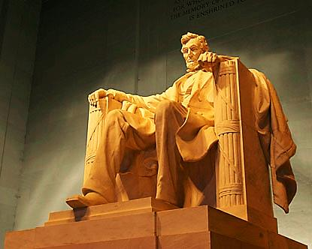
Memorials are a part of the human experience.
Graves are a form of memorial; so are markers left along highways, monuments in town squares and the pyramids of Egypt.

Slide 5
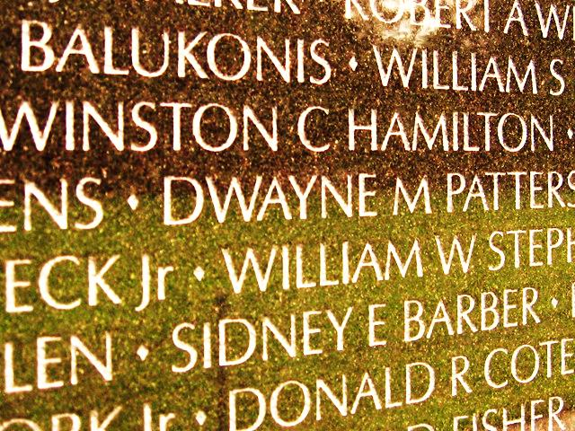
Recent ones, such as the Vietnam Veterans Memorial, are etched with lists of names.
Memorials Help
Us Remember

Slide 6
God’s People Need Memorials to Remind Us of God’s Faithfulness
God Blesses us All the Time but…
We Are Quick to Forget

Slide 7
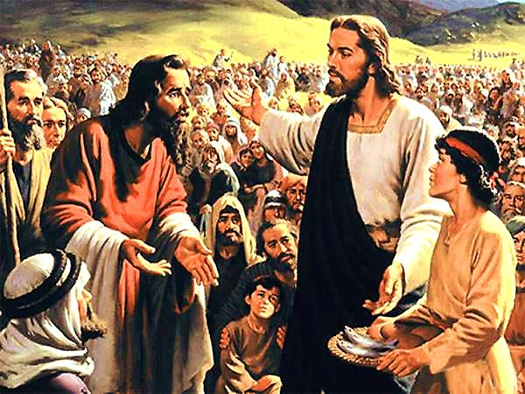
The disciples forgot that Jesus has a way with bread!
“Do ye not yet understand neither remember the five loaves of the five thousand, and how many baskets ye took up?”

Slide 8
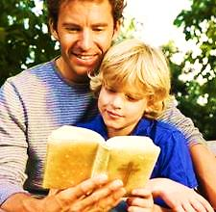
We need to remember how good God is and teach our children.
“But be careful! Watch out and don't forget the things you have seen. Don't forget them as long as you live, but teach them to your children and grandchildren.”
Deut. 4:9

Slide 9
Memorials & Special Days Help Us Do This
“These stones will remind the people of what the Lord has done. In the future, when your children ask what these stones mean to you” Joshua 4:6

Slide 10
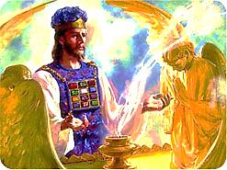
Jesus Himself is a living memorial who daily reminds The Father about His love & sacrifice for us.

Slide 11
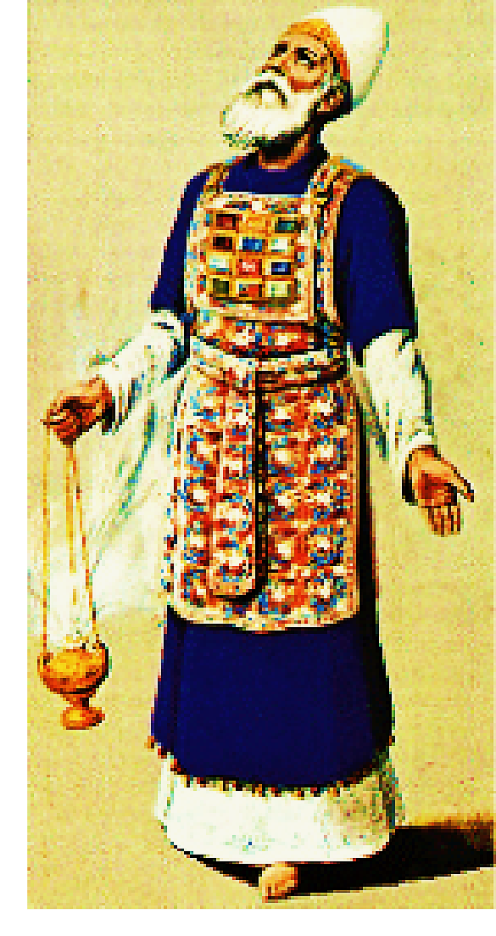
The High Priest wore stones engraved with the names of Israel on his SHOULDERS
“Then put the two stones on the two straps of the holy vest as reminders of the twelve sons of Israel. Aaron is to wear their names on his shoulders in the presence of the Lord as reminders of the sons of Israel.” Exodus 28:12

Slide 12
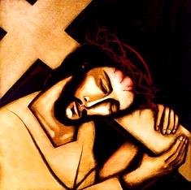
Our High Priest, JESUS, also carried something on His shoulders that was all about us. A heavy cross! It our cross which we had earned with our sins. So (in a way) it had our names on it – it was meant for us

Slide 13
Also, the High Priest carried the names of Israel on engraved stones OVER HIS CHEST
“When Aaron enters the Holy Place, he will wear this breastpiece engraved with the names of the tribes of Israel, so that I, the Lord, will always remember my people.”
Exodus 28:29

Slide 14
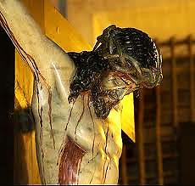
Our High Priest had His Side Engraved

Slide 15
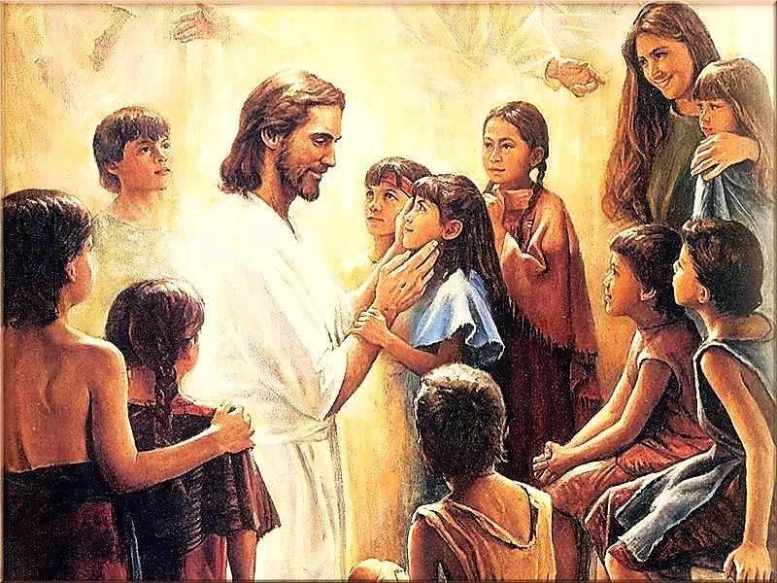
Jesus Loves Us & Knows Each One by Name

Slide 16
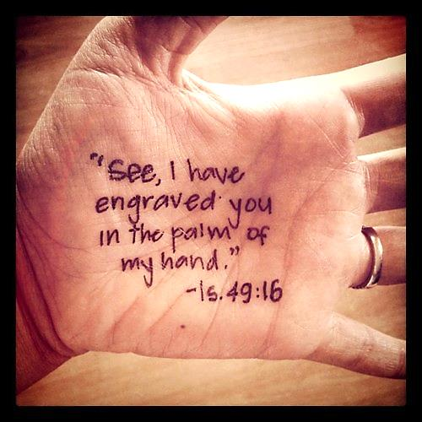
“Can a woman forget her sucking child, that she should not have compassion on the son of her womb? yea, they may forget , yet will I not forget thee.
Behold, I have graven thee upon the palms of my hands; thy walls are continually before me.” Isa. 49:15,16

Slide 17
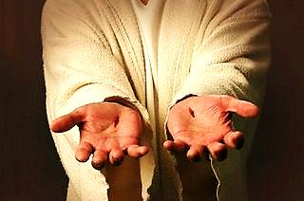
Jesus had His Hands Engraved
When the Father looks at them – it is our names he sees.
The body of Jesus is engraved forever because of His love of us.

Slide 18
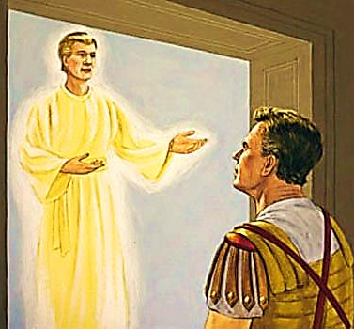
We are Also Memorials, Reminding God of Our Needs
A man named Cornelius had a vision of the Angel of the Lord.
He told him something special.

Slide 19
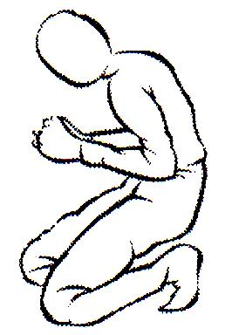
Every Time He Prayed, He was a Memorial for God
“And when he looked on him, he was afraid, and said , What is it , Lord? And he said unto him, Thy prayers and thine alms are come up for a memorial before God.” Acts 10:4

Slide 20
“On your walls, O Jerusalem, I have set watchmen; all the day and all the night they shall never be silent. You who put the LORD in remembrance, take no rest.” Isaiah 62:6

Slide 21
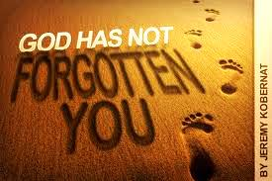
He never forgets, but He wants us to be ever in His presence reminding Him.

Slide 22
He Remembers Us – Let Us Remember Him

Slide 23
Song: We Will Remember → See Next Slide Download Here: http://www.youtube.com/watch?v=DzoxsxsIMCE

Slide 24
What is the Sinner‘s Prayer?
This is a prayer we can pray when we are ready to admit we are sinners and need Christ’s forgiveness.
It must be prayed with faith in our hearts and a readiness to have a life-changing encounter with Jesus Christ.

Slide 26
John Wesley’s Testimony
“…the preacher was describing the change which God works in the heart through faith in Christ and I felt my heart strangely warmed.”
Disciple’s Testimony
“They said to each other, ‘Did not our hearts burn within us while he talked to us on the road, while he opened to us the Scriptures?’”

Slide 27
A prayer of faith → Pray this prayer if :
If you never have before
You have in the past, but you think it would mean more today
You have been walking afar off and you want to come back
You want to set an example & show others how it is done
You just like to give your heart to Jesus again & again
Faith

Slide 28
We Declare Our Faith Publicly Because Jesus Declared His LOVE Publicly
“If you stand before others and are willing to say you believe in me, then I will tell my Father in heaven that you belong to me.” Mat 10:32

Slide 29
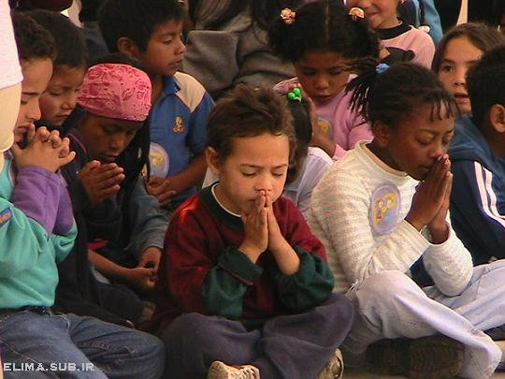
Dear Jesus,
I know I am a sinner & need your forgiveness.
I believe you died for my sins.
I now turn from sin.
Come into my heart I pray.
Do you want to meet Jesus as your savior right now?
Do you believe He died to save you from your sins & that He rose from the dead?
Do you believe that He is waiting to save you right now?

Slide 30
“But some people did accept him. They believed in him, and he gave them the right to become children of God.” John 1:12

Slide 32
“If you openly say, ‘Jesus is Lord’ and believe in your heart that God raised him from death, you will be saved.”
Rom. 10:9
What did you learn today?
What is the meaning of the name-tag?
What have you neen thinking about God lately?
What do you want to tell the world about Jesus?

Slide 33
“Draw near to God, and He will draw near to you…
…Cleanse your hands, you sinners, and make your hearts pure, you who are half-hearted towards God.” James 4:8 WNT

Slide 34
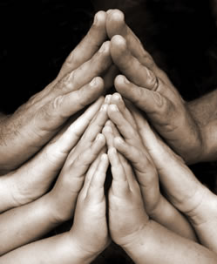
Close in Prayer

Slide 35
Note: Any videos in this presentation will only play online. After you download the slideshow, you will need to also download the videos from YouTube & add them back into your PowerPoint.
We present these messages at Bee Creek Park in College Station, TX. If you would like to watch the video of the service with this message, click here:
http://campaignkerusso.org/?p=9369
We would love to know more about the people who download our lessons & sermons. We invite you to email us & let us know where & how you use them.
info@ckbrazos.org

Slide 36
Welcome to Aggieland Faith Family Style Worship

Slide 37
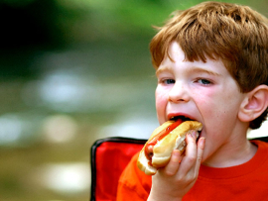
CURRENT SCHEDULE: See www.Aggielandfaith.org
SATURDAY —
At Bee Creek Park
2:00-4:00pm: Through the bible with felt-board stories – plus hot-dogs & drinks
SUNDAY —
At Bee Creek Park
2:00-4pm: Free snacks, drinks, kids crafts, prizes, singing & bible preaching

Slide 38
Would You Like Prayer or Bible Study at Your House?
Personal Prayer: We can come to your home & pray with you, or you can email us when you need prayer.
Home Bible Study: We will come to your home & hold a bible study for you & your friends.
Bible Party: We will hold a Kid’s Bible Party: You provide the food & kids - we will do the bible fun & stories.

Slide 39
Would You Like Visitation?
We will visit a friend, loved one in the hospital or in prison to pray for them & share Christ with them.
Contact: info@aggielandfaith.org

Slide 40
www.aggielandfaith.org
Go here to see pictures & videos
Go here to subscribe to e-mails about changes & cancellations

Slide 41
Note: Any videos in this presentation will only play online. After you download the slideshow, you will need to also download the videos from YouTube & add them back into your PowerPoint.
We present these messages at Bee Creek Park in College Station, TX. If you would like to watch the video of the service with this message, click here:
http://campaignkerusso.org/?p=9369
We would love to know more about the people who download our lessons & sermons. We invite you to email us & let us know where & how you use them.
info@ckbrazos.org

