Slide 2
Note: Any videos in this presentation will only play online. After you download the slideshow, you will need to also download the videos from YouTube & add them back into your PowerPoint.
We present these messages at Bee Creek Park in College Station, TX. If you would like to watch the video of the service with this message, click here:
http://youtu.be/p0XRJh2O2nc
We would love to know more about the people who download our lessons & sermons. We invite you to email us & let us know where & how you use them.
info@ckbrazos.org

Slide 3
Write Down Your Favorite 1] Foods 2] Things 3] People 4] Places to Relax 5] Future Dreams

Slide 4
Abraham had a son named Isaac… Isaac had prayed to the LORD that his wife would have a child…
The LORD heard his prayers and Rebecca his wife was with child inside her.
When she finally gave birth, she had twin boys.

Slide 5
Twin Brothers with Very Different Desires

Slide 6
Jacob liked his faith & God & his Mother’s teachings about God’s future promises & blessings

Slide 7
Esau liked his own hunting skills, his strong body & his Father’s praise

Slide 8
“One day Jacob was cooking a stew. Esau came in from the field, starved. Esau said to Jacob, “Give me some of that red stew — I’m starved!”… Jacob said, “Make me a trade: my stew for your rights as the firstborn.”

Slide 9
“Esau said, ‘I’m starving! What good is a birthright if I’m dead?’ Jacob said, ‘First,
swear to me.’ And he did it. On oath, Esau traded away his rights as the firstborn. Jacob gave him bread and the stew of lentils. He ate and drank, got up and left. That’s how Esau shrugged off his rights as the firstborn.” Gen. 25:29-34

Slide 10
Next Slide Video: Jacob & Esau →
Download Here:
http://youtu.be/gSX1fOBae0M

Slide 11
What Would You Trade for Jesus?
Next Slide Video: Jacob & Esau Cartoon →
Download Here:
http://www.youtube.com/watch?v=oq6j5n0HWhM

Slide 12
Jesus is Better than Everything
“Watch out for immoral and ungodly people like Esau, who sold his future blessing for only one meal.” Heb.12:16
Never trade Jesus for anything!

Slide 13
Jesus is Better than Pleasures
“Look, I am about to die,” Esau said. “What good is the birthright to me?”
Gen.25:32

Slide 14
Jesus is Better than all our Favorite Things
“Jesus said to him… go, sell what you have and give to the poor, and you will have treasure in heaven; and come, follow Me.’”
Mat. 19:21
“But seek first the kingdom of God and all these things shall be added to you.”
Mat 6:31–33

Slide 15
Jesus is Better than Our Favorite People
“Whoever loves father or mother more than me is not worthy of me, and whoever loves son or daughter more than me is not worthy of me.” Mat.10:37
“Still another man said, “I will follow you, Lord. But first let me go back and say good-by to my family.” But Jesus told him, “Anyone who puts his hand to the plough and then looks behind him is useless for the kingdom of God.” Luke 9:61,62

Slide 16
Jesus is Better than Our Future Plans
“But they all had the same idea. They began to make excuses. The first one said, ‘I have just bought a field. I have to go and see it. Please excuse me.’
“Another said, ‘I have just bought five pairs of oxen. I’m on my way to try them out. Please excuse me.’” Luke 14:18, 19

Slide 17
Jesus is Better than Home & Comfort
“Once Jesus and those who were with him were walking along the road. A man said to Jesus, ‘I will follow you no matter where you go.’ Jesus replied, ‘Foxes have holes. Birds of the air have nests. But the Son of Man has no place to lay his head.’” Luke 9: 57, 58

Slide 18
Jesus is Better than Angels
“Being made so much better than the angels, as he has by inheritance obtained a more excellent name than they.” Heb. 1:4

Slide 19
Jesus is Better than Our Very Lives
“Those who love their life in this world will lose it. Those who care nothing for their life in this world will keep it for eternity.” John 12:25

Slide 21
Jesus is Better than Anything
Jesus can never be #2 in our lives – He is either #1 or He is rejected

Slide 22
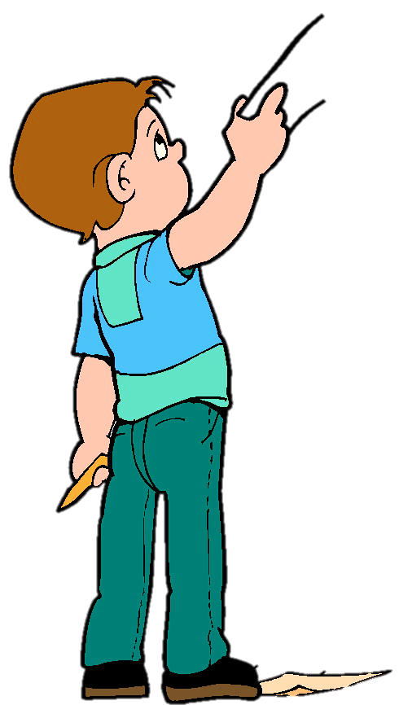
Who wants to come up here and turn in your papers with your favorite things?
In its place, I will give you a paper that just says JESUS…
Because… Jesus is BETTER
Than anything on your paper.

Slide 23
Next Slide Video: Jesus is Better Than Football →
Download Here:
http://www.youtube.com/watch?v=zDj3WZUXCmw

Slide 24
What is the Sinner‘s Prayer?
This is a prayer we can pray when we are ready to admit we are sinners and need Christ’s forgiveness.
It must be prayed with faith in our hearts and a readiness to have a life-changing encounter with Jesus Christ.

Slide 26
John Wesley’s Testimony
“…the preacher was describing the change which God works in the heart through faith in Christ and I felt my heart strangely warmed.”
Disciple’s Testimony
“They said to each other, ‘Did not our hearts burn within us while he talked to us on the road, while he opened to us the Scriptures?’”

Slide 27
A prayer of faith → Pray this prayer if :
If you never have before
You have in the past, but you think it would mean more today
You have been walking afar off and you want to come back
You want to set an example & show others how it is done
You just like to give your heart to Jesus again & again
Faith

Slide 28
We Declare Our Faith Publicly Because Jesus Declared His LOVE Publicly
“If you stand before others and are willing to say you believe in me, then I will tell my Father in heaven that you belong to me.” Mat 10:32

Slide 29
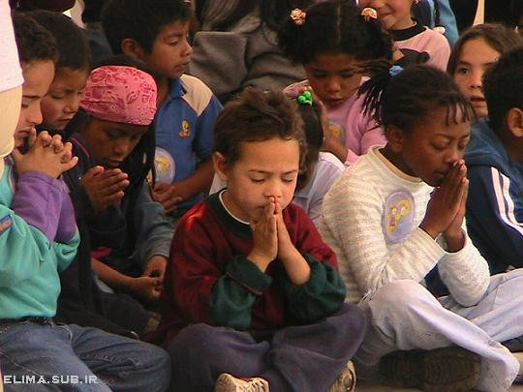
Dear Jesus,
I know I am a sinner & need your forgiveness.
I believe you died for my sins.
I now turn from sin.
Come into my heart I pray.
Do you want to meet Jesus as your savior right now?
Do you believe He died to save you from your sins & that He rose from the dead?
Do you believe that He is waiting to save you right now?

Slide 30
“But some people did accept him. They believed in him, and he gave them the right to become children of God.” John 1:12

Slide 32
“If you openly say, ‘Jesus is Lord’ and believe in your heart that God raised him from death, you will be saved.”
Rom. 10:9
What did you learn today?
What is the meaning of the name-tag?
What have you neen thinking about God lately?
What do you want to tell the world about Jesus?

Slide 33
“Draw near to God, and He will draw near to you…
…Cleanse your hands, you sinners, and make your hearts pure, you who are half-hearted towards God.” James 4:8 WNT

Slide 34
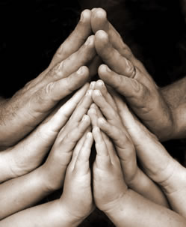
Close in Prayer

Slide 35
Note: Any videos in this presentation will only play online. After you download the slideshow, you will need to also download the videos from YouTube & add them back into your PowerPoint.
We present these messages at Bee Creek Park in College Station, TX. If you would like to watch the video of the service with this message, click here:
http://campaignkerusso.org/?p=9369
We would love to know more about the people who download our lessons & sermons. We invite you to email us & let us know where & how you use them.
info@ckbrazos.org

Slide 36
Welcome to Aggieland Faith Family Style Worship

Slide 37
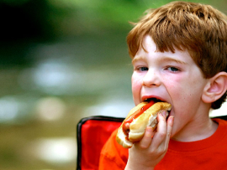
CURRENT SCHEDULE: See www.Aggielandfaith.org
SATURDAY —
At Bee Creek Park
2:00-4:00pm: Through the bible with felt-board stories – plus hot-dogs & drinks
SUNDAY —
At Bee Creek Park
2:00-4pm: Free snacks, drinks, kids crafts, prizes, singing & bible preaching

Slide 38
Would You Like Prayer or Bible Study at Your House?
Personal Prayer: We can come to your home & pray with you, or you can email us when you need prayer.
Home Bible Study: We will come to your home & hold a bible study for you & your friends.
Bible Party: We will hold a Kid’s Bible Party: You provide the food & kids - we will do the bible fun & stories.

Slide 39
Would You Like Visitation?
We will visit a friend, loved one in the hospital or in prison to pray for them & share Christ with them.
Contact: info@aggielandfaith.org

Slide 40
www.aggielandfaith.org
Go here to see pictures & videos
Go here to subscribe to e-mails about changes & cancellations

Slide 41
Note: Any videos in this presentation will only play online. After you download the slideshow, you will need to also download the videos from YouTube & add them back into your PowerPoint.
We present these messages at Bee Creek Park in College Station, TX. If you would like to watch the video of the service with this message, click here:
http://campaignkerusso.org/?p=9369
We would love to know more about the people who download our lessons & sermons. We invite you to email us & let us know where & how you use them.
info@ckbrazos.org

