Slide 1
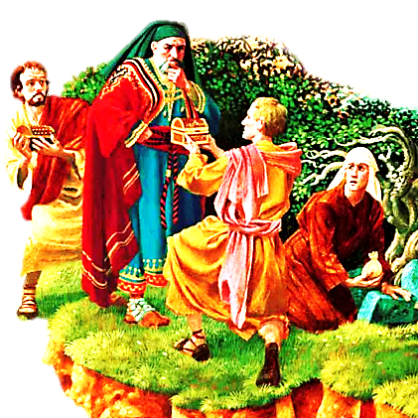
Parable of the Talents

Slide 2



Note: Any videos in this presentation will only play online. After you download the slideshow, you will need to also download the videos from YouTube & add them back into your PowerPoint.
We present these messages at Bee Creek Park in College Station, TX.
If you would like to watch the video of the service with this message, click here:
http://campaignkerusso.org/?p=8591
We would love to know more about the people who download our lessons & sermons. We invite you to email us & let us know where & how you use them.
info@ckbrazos.org

Slide 3
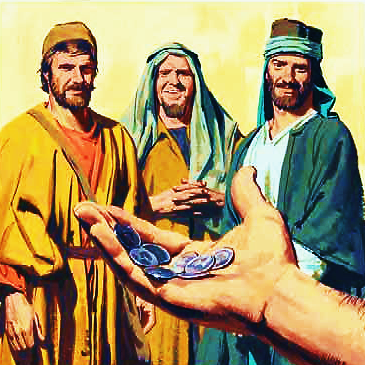
Jesus told His disciples a story about a man who gave his servants some talents.
Jesus also gave us talents of a different kind.
A talent was a large amount of money.

Slide 4

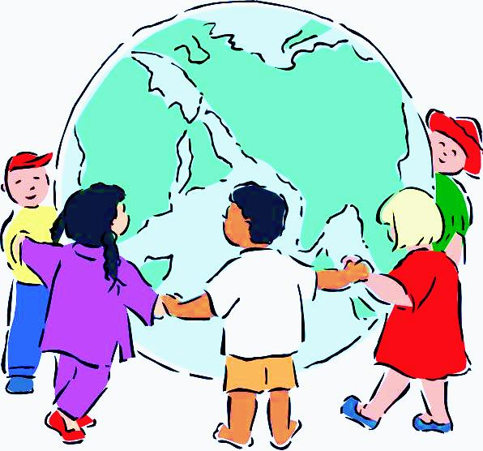
In the parable, the talents refer to pieces of money.
For us, talents are the gifts we use to serve Jesus, spread the good news about Jesus and help others.

Slide 5
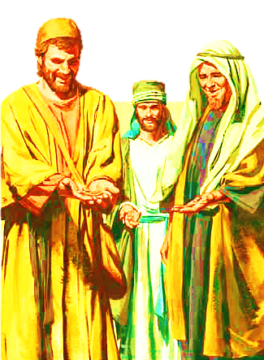
The man gave one servant five talents.
He gave another servant two talents.
He gave a third servant one talent.
He gave each the amount he could take care of. Then he went on his journey.
Jesus is also on a journey to Heaven, and He too is coming back.

Slide 6
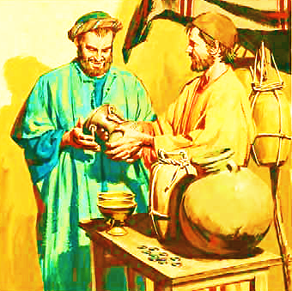
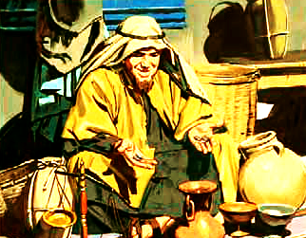
The servant with five talents worked hard.
He earned five more talents. He now had ten talents.
The servant with two talents also worked hard.
He earned two more talents. He now had four talents.

Slide 7
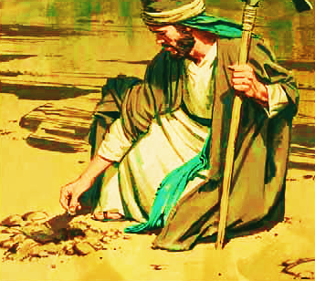
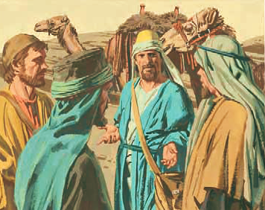
The servant with one talent buried it in the ground. He was afraid he would lose it.
He did not work to earn any more talents.
When the man came back, he asked the servants what they had done with his talents.

Slide 8
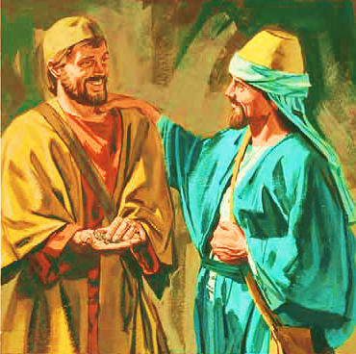
The first servant brought him ten talents.
The man was happy.
He made the servant a leader over many things and told him to be joyful.
“God's gifts come in many forms. Each of you has received a gift in order to serve others. You should use it faithfully.” 1 Peter 4:10

Slide 9
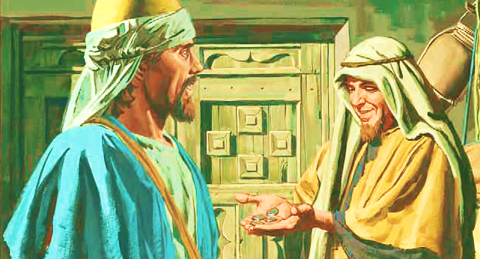
The second servant brought the man four talents.
This also made the man happy.
He made the second servant a leader over many things and told him to be joyful.
“In all the work you are doing, work the best you can. Work as if you were doing it for the Lord, not for people.” Col. 3:23

Slide 10
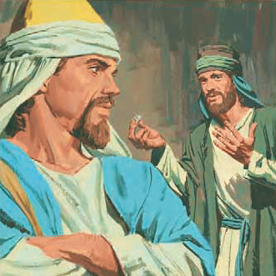
The third servant gave the man back the talent he had buried.
The man was not happy. He said the servant was lazy.
He should have worked hard to earn more talents.
There is an old saying: “If you want to get a job done, give it to a busy person.” Lazy people never seem to find the time to work.

Slide 11
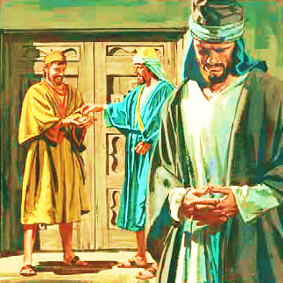
The man took the talent from the third servant and gave it to the first servant. He was the busiest servant.
Then he sent the lazy servant away.
The rich man in the story is like Jesus and we are like his servants with jobs to do for Him.
Jesus will judge how we each use the gifts and work we have been given.

Slide 12
Q) In the story, who is the master of the servants?
A) In the story, the master of the servants represents God.
Q) In the story, who are the servants?
A) The servants are the people of God.
Q) In the story, the master gives the servants a lot of money. What does the money represent?
A) The money represents all the gifts that God gives to his people.

Slide 13
Q) What did the fearful servant do with the money?
A) The fearful servant buried the money in the ground.
Q) What does God want us to do with all the things he gives us?
A) God wants us to use and to share with others all the things that he gives us.

Slide 14
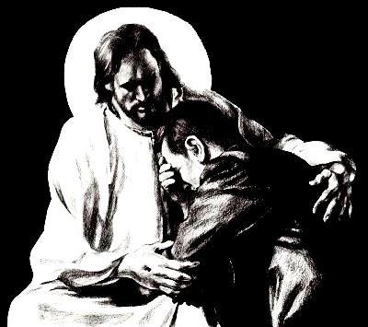
What is the Sinner‘s Prayer?
This is a prayer we can pray when we are ready to admit we are sinners and need Christ’s forgiveness.
It must be prayed with faith in our hearts and a readiness to have a life-changing encounter with Jesus Christ.

Slide 15
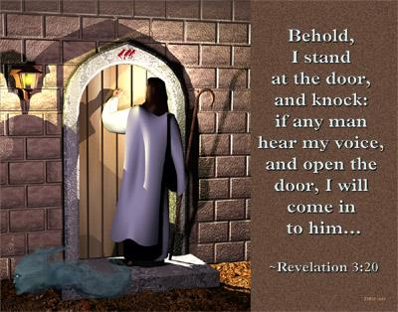

Slide 16
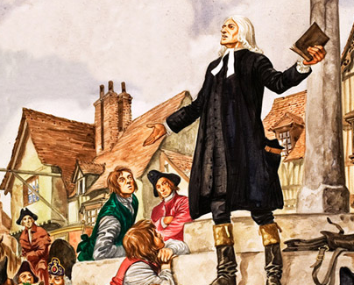
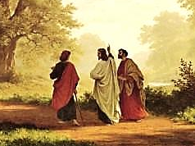
John Wesley’s Testimony
“…the preacher was describing the change which God works in the heart through faith in Christ and I felt my heart strangely warmed.”
Disciple’s Testimony
“They said to each other, ‘Did not our hearts burn within us while he talked to us on the road, while he opened to us the Scriptures?’”

Slide 17
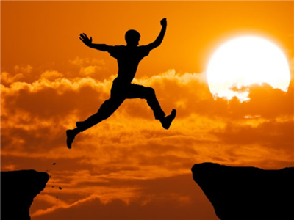
A prayer of faith → Pray this prayer if :
If you never have before
You have in the past, but you think it would mean more today
You have been walking afar off and you want to come back
You want to set an example & show others how it is done
You just like to give your heart to Jesus again & again
Faith

Slide 18
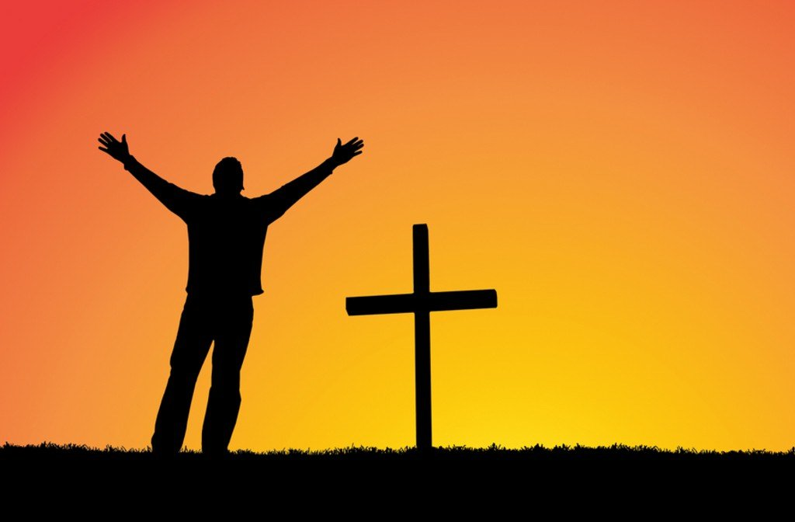
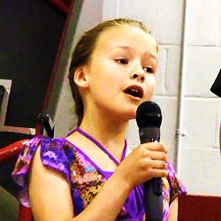
We Declare Our Faith Publicly Because Jesus Declared His LOVE Publicly
“If you stand before others and are willing to say you believe in me, then I will tell my Father in heaven that you belong to me.” Mat 10:32

Slide 19

Dear Jesus,
I know I am a sinner & need your forgiveness.
I believe you died for my sins.
I now turn from sin.
Come into my heart I pray.
Do you want to meet Jesus as your savior right now?
Do you believe He died to save you from your sins & that He rose from the dead?
Do you believe that He is waiting to save you right now?

Slide 20


“But some people did accept him. They believed in him, and he gave them the right to become children of God.” John 1:12

Slide 21



Slide 22


“If you openly say, ‘Jesus is Lord’ and believe in your heart that God raised him from death, you will be saved.”
Rom. 10:9
What did you learn today?
What is the meaning of the name-tag?
What have you neen thinking about God lately?
What do you want to tell the world about Jesus?

Slide 23

“Draw near to God, and He will draw near to you…
…Cleanse your hands, you sinners, and make your hearts pure, you who are half-hearted towards God.” James 4:8 WNT

Slide 24
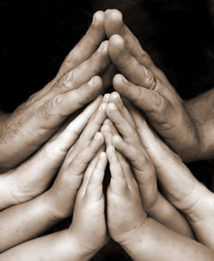
Close in Prayer

Slide 25
Note: Any videos in this presentation will only play online. After you download the slideshow, you will need to also download the videos from YouTube & add them back into your PowerPoint.
We present these messages at Bee Creek Park in College Station, TX.
If you would like to watch the video of the service with this message, click here:
http://campaignkerusso.org/?p=8591
We would love to know more about the people who download our lessons & sermons. We invite you to email us & let us know where & how you use them.
info@ckbrazos.org

Slide 26
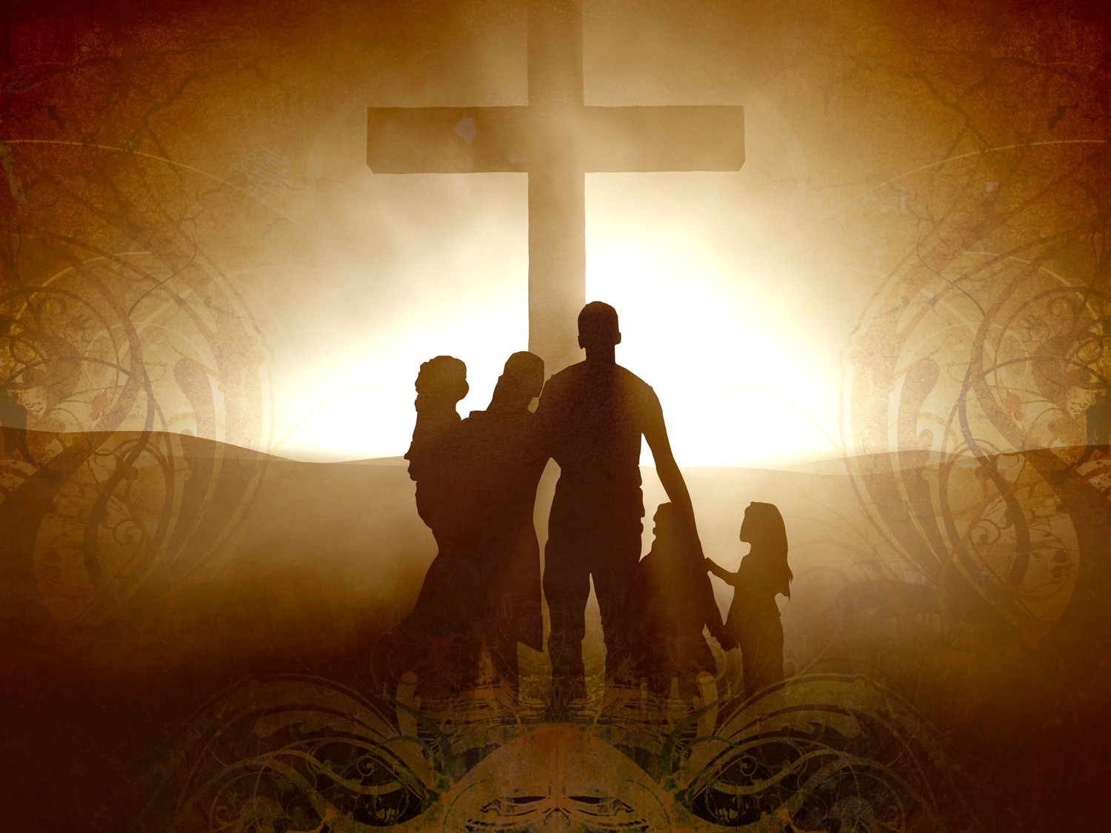
Welcome to Aggieland Faith
Family Style Worship

Slide 27

CURRENT SCHEDULE:
See www.Aggielandfaith.org
SATURDAY —
At Bee Creek Park
2:00-4:00pm: Through the bible with felt-board stories – plus hot-dogs & drinks
SUNDAY —
At Bee Creek Park
2:00-4pm: Free snacks, drinks, kids crafts, prizes, singing & bible preaching

Slide 28


Would You Like Prayer or Bible Study at Your House?
Personal Prayer:
We can come to your home & pray with you, or you can email us when you need prayer.
Home Bible Study:
We will come to your home & hold
a bible study for you & your friends.
Bible Party:
We will hold a Kid’s Bible Party:
You provide the food & kids - we
will do the bible fun & stories.

Slide 29

Would You Like Visitation?
We will visit a friend, loved one in the hospital or in prison to pray for them & share Christ with them.
Contact: info@aggielandfaith.org

Slide 30

www.aggielandfaith.org
Go here to see pictures & videos
Go here to subscribe to e-mails about changes & cancellations

Slide 31
Note: Any videos in this presentation will only play online. After you download the slideshow, you will need to also download the videos from YouTube & add them back into your PowerPoint.
We present these messages at Bee Creek Park in College Station, TX.
If you would like to watch the video of the service with this message, click here:
http://campaignkerusso.org/?p=8591
We would love to know more about the people who download our lessons & sermons. We invite you to email us & let us know where & how you use them.
info@ckbrazos.org

