Slide 1
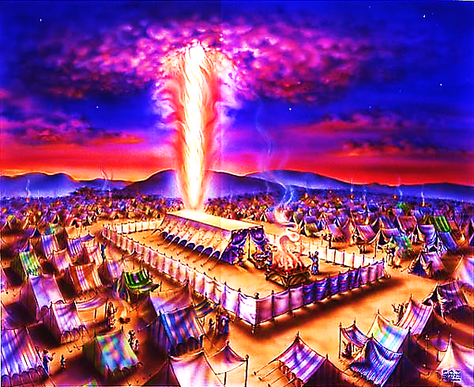
The Tabernacle in the Wilderness pt. 3

Slide 2
Note: Any videos in this presentation will only play online. After you download the slideshow, you will need to also download the videos from YouTube & add them back into your PowerPoint.
We present these messages at Bee Creek Park in College Station, TX. If you would like to watch the video of the service with this message, click here:
http://campaignkerusso.org/?p=8066
We would love to know more about the people who download our lessons & sermons. We invite you to email us & let us know where & how you use them.
info@ckbrazos.org

Slide 4
The Beauty of God’s Consistency
From Exodus to Revelation:
The bible is one story… It is the story of God making a way in which He can dwell with men.

Slide 5
The Tabernacle is actually God’s blueprint of His gospel plan.

Slide 6
The original tabernacle exists in Heaven.
A copy (shadow) was built by Moses.
The original tabernacle existed before time and will continue after time.

Slide 7
“Thy will be done on Earth as it is in Heaven.” God’s Dwellings Have Similarities
Eden:
River of life
Tree of Life
Mountain
Heaven:
River of life
Tree of Life
Mountain

Slide 8
God’s Dwelling Places
Garden
Tabernacle
Jesus
Believers
Heavenly Tabernacle

Slide 9
Tabernacle
“Moreover, I will make My dwelling among you, and My soul will not reject you. I will also walk among you and be your God, and you shall be My people.”
Lev. 26:11, 12
Believer
“For we are the temple of the living God. As God said: "I will live in them and walk among them. I will be their God, and they will be my people.”
2 Cor. 6:16

Slide 10
The Ark of the Covenant was to be carried by the priests as the nation moved forward.
A fixed, immobile Temple (though permitted by God) was not His preference.

Slide 11
He wants us following – walking Walking with Him, in His direction, is transforming
“Whoever says he abides in him ought to walk in the same way in which he walked.” 1 John 2:6
“Do two walk together, unless they have agreed…” Amos 3:3
“…what does the Lord require of you but to do justice, and to love kindness, and to walk humbly with your God?” Micah 6:8

Slide 12
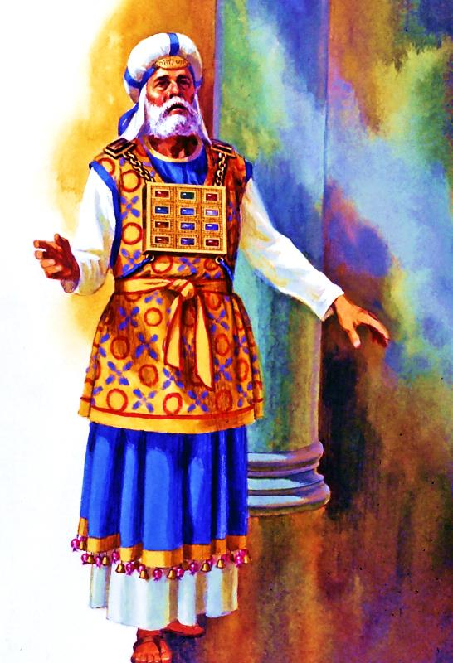
Each of God’s Dwellings is Appointed a Priest with Certain Duties – Serve/Worship & Guard
Adam Priest Christian

Slide 13
Word Study: Hebrew – “Abad”
1) to work or serve
2) to worship
“And say to him, ‘The LORD, the God of the Hebrews, sent me to you, saying, “Let my people go, that they may serve (Abad) me in the wilderness.” Ex. 7:16
Serve/Work/Worship/Abad Me in the Wilderness
Abad:
Translated “Worship Me” in NIV, NLT, GWT
Translated “Serve Me” in ESV, NAS, KJV

Slide 14
“I want them to ABAD (Serve/Worship) Me in the Wilderness.” Ex. 7:16
Our First Duty is to Worship God – This is the calling of All Creation!
Earth is our wilderness --
Heaven is our home

Slide 15
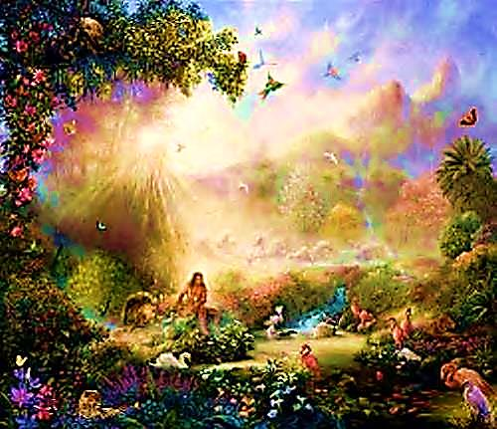
This same word is used regarding Adam
“The LORD God took the man and put him in the garden of Eden to work (Abad) it and keep (Shamar) it.” Gen. 2:15
Adam was the “Priest” of Eden (Where God Dwelt with Man)
He was to Work & Take Care of the Garden
Hebrew: To Abad (work) & Shamar (Act as Guard or Doorkeeper)

Slide 16
Aaron & His Sons were the Priests of the Tabernacle (Where God Dwelt with Man)
They were to Work & Take Care of the Tabernacle
“…to do the work (Abad) of the tabernacle. And they shall keep (Shamar) all the furnishings of the tabernacle…” Numbers 3:7,8
Like the police, priests “Serve & Protect”

Slide 17
Do the ‘Work’ .
First Let’s Look at Work
Priests perform the daily duties of the Tabernacle
This service is their worship - ALSO -
Worshiping was the nature of their work
Therefore:
Service is Worship of God - And -
Worship is Service to God

Slide 18
Abad means both Worship & Serve because: Serving is Worship & Worship is Service… Therefore… Worship like it is Service & Serve like it is Worship

Slide 19
Care, Guard, Keep Holy
The duty of Adam in Eden
“He drove out the man, and at the east of the Garden of Eden he placed the cherubim and a flaming sword that turned every way to guard the way to the tree of life.” Gen. 3:24
Hebrew: Shamar (Part of Adam’s Job)
It became the duty of the angel at the Garden gate, but Adam was God’s first choice

Slide 20
Adam was to guard God’s dwelling
An angel was given the job by default
Angels were depicted on the tabernacle curtains as if guarding God’s dwelling
The duty of the priests in the Tabernacle was to guard it & keep it holy
We too are priests – we are to both Abad (worship/serve) & Shamar (guard His temple)

Slide 21
“Or do you not know that your body is a temple of the Holy Spirit within you, whom you have from God? You are not your own, for you were bought with a price. So glorify God in your body.” 1 Cor. 6:19, 20
“Do you not know that you are God's temple and that God's Spirit dwells in you? … For God's temple is holy, and you are that temple.”
1 Cor. 16: 17

Slide 22
We Have Two Main Priestly Duties
Our hearts & bodies are His temple
Our service is worship & our worship is service.
Also, we guard our hearts & minds from sin & lies.
Angels, however, cannot be priests of God – they cannot represent humanity – they are not God’s dwelling

Slide 23
Review
The purpose of the Tabernacle
To dwell with men
To typify (shadow) the Gospel plan for a permanent solution
God’s idea of ‘dwelling’ with men
Walking together
Communing
Moving forward
The Five Dwelling Places of God
Heavenly Tabernacle, Garden of Eden, Wilderness Tabernacle, Incarnate Jesus, The Believer
The Duties of the Priests
To serve as worship
To worship as service
To guard God’s house

Slide 24
Next, we will begin to look at what each tabernacle piece tells us about God’s plan of salvation.

Slide 25
What is the Sinner‘s Prayer?
This is a prayer we can pray when we are ready to admit we are sinners and need Christ’s forgiveness.
It must be prayed with faith in our hearts and a readiness to have a life-changing encounter with Jesus Christ.

Slide 27
John Wesley’s Testimony
“…the preacher was describing the change which God works in the heart through faith in Christ and I felt my heart strangely warmed.”
Disciple’s Testimony
“They said to each other, ‘Did not our hearts burn within us while he talked to us on the road, while he opened to us the Scriptures?’”

Slide 28
A prayer of faith → Pray this prayer if :
If you never have before
You have in the past, but you think it would mean more today
You have been walking afar off and you want to come back
You want to set an example & show others how it is done
You just like to give your heart to Jesus again & again
Faith

Slide 29
We Declare Our Faith Publicly Because Jesus Declared His LOVE Publicly
“If you stand before others and are willing to say you believe in me, then I will tell my Father in heaven that you belong to me.” Mat 10:32

Slide 30
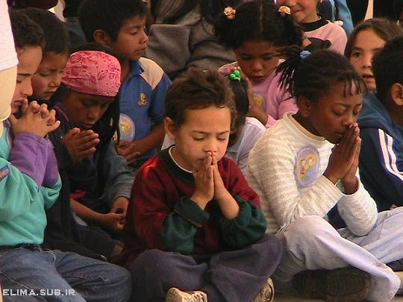
Dear Jesus,
I know I am a sinner & need your forgiveness.
I believe you died for my sins.
I now turn from sin.
Come into my heart I pray.
Do you want to meet Jesus as your savior right now?
Do you believe He died to save you from your sins & that He rose from the dead?
Do you believe that He is waiting to save you right now?

Slide 31
“But some people did accept him. They believed in him, and he gave them the right to become children of God.” John 1:12

Slide 33
“If you openly say, ‘Jesus is Lord’ and believe in your heart that God raised him from death, you will be saved.”
Rom. 10:9
What did you learn today?
What is the meaning of the name-tag?
What have you neen thinking about God lately?
What do you want to tell the world about Jesus?

Slide 34
“Draw near to God, and He will draw near to you…
…Cleanse your hands, you sinners, and make your hearts pure, you who are half-hearted towards God.” James 4:8 WNT

Slide 35
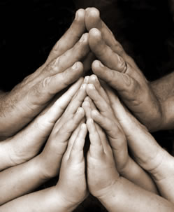
Close in Prayer

Slide 36
Note: Any videos in this presentation will only play online. After you download the slideshow, you will need to also download the videos from YouTube & add them back into your PowerPoint.
We present these messages at Bee Creek Park in College Station, TX. If you would like to watch the video of the service with this message, click here:
http://campaignkerusso.org/?p=8066
We would love to know more about the people who download our lessons & sermons. We invite you to email us & let us know where & how you use them.
info@ckbrazos.org

Slide 37
Welcome to Aggieland Faith Family Style Worship

Slide 38
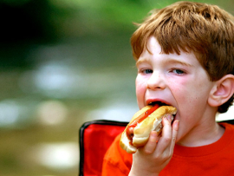
CURRENT SCHEDULE: See www.Aggielandfaith.org
SATURDAY —
At Bee Creek Park
2:00-4:00pm: Through the bible with felt-board stories – plus hot-dogs & drinks
SUNDAY —
At Bee Creek Park
2:00-4pm: Free snacks, drinks, kids crafts, prizes, singing & bible preaching

Slide 39
Would You Like Prayer or Bible Study at Your House?
Personal Prayer: We can come to your home & pray with you, or you can email us when you need prayer.
Home Bible Study: We will come to your home & hold a bible study for you & your friends.
Bible Party: We will hold a Kid’s Bible Party: You provide the food & kids - we will do the bible fun & stories.

Slide 40
Would You Like Visitation?
We will visit a friend, loved one in the hospital or in prison to pray for them & share Christ with them.
Contact: info@aggielandfaith.org

Slide 41
www.aggielandfaith.org
Go here to see pictures & videos
Go here to subscribe to e-mails about changes & cancellations

Slide 42
Note: Any videos in this presentation will only play online. After you download the slideshow, you will need to also download the videos from YouTube & add them back into your PowerPoint.
We present these messages at Bee Creek Park in College Station, TX. If you would like to watch the video of the service with this message, click here:
http://campaignkerusso.org/?p=8066
We would love to know more about the people who download our lessons & sermons. We invite you to email us & let us know where & how you use them.
info@ckbrazos.org

