Slide 1
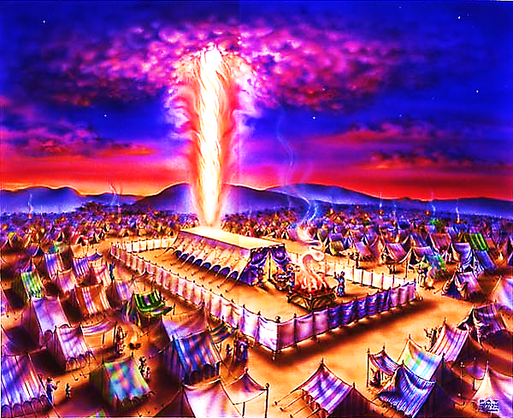
The Tabernacle in the Wilderness pt. 4

Slide 2
Note: Any videos in this presentation will only play online. After you download the slideshow, you will need to also download the videos from YouTube & add them back into your PowerPoint.
We present these messages at Bee Creek Park in College Station, TX. If you would like to watch the video of the service with this message, click here:
http://youtu.be/Y5_mHnLvEN0
We would love to know more about the people who download our lessons & sermons. We invite you to email us & let us know where & how you use them.
info@ckbrazos.org

Slide 3
Review:
Why God built the tabernacle → To reveal His plan for being with us again
The nature of our relationship with God → Intimate, walking friendship (not stagnate)
Our priestly duties → worship/serve in God’s house & guard God’s house
God provided one way into His presence → The one opening in the tabernacle’s Eastern wall reminds us that the one way back into God’s presence is through the rent body of the crucified Christ
Review

Slide 4
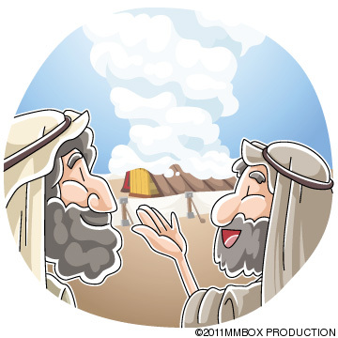
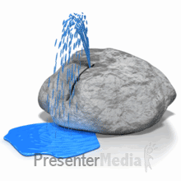
God’s Wilderness School
Manna | Pillar of Smoke | Rock
God’s Three Teaching Aids to Teach Us One Lesson…

Slide 5
How to Be Children
“Jesus said, ‘Unless you become like a child, you cannot come into the Kingdom of Heaven.” Mat. 18:3
Rather than growing up – we need to grow down!

Slide 6
Wilderness School –> How to Be Children
In the wilderness, God teaches us & Israel to trust Him – to lean on Him – to rely on Him for guidance, food & happiness

Slide 7
This lesson can only be learned in the wilderness…
It cannot be learned
when we feel rich

Slide 8
God Reveals His Glory in the Wilderness – He appears out of nowhere to save the day. He is even better than a knight in shining armor.

Slide 9
The main lesson of the wilderness is child-like dependence
“The Israelites said to them: ‘We wish that the Lord had killed us in Egypt! There, we sat round pots of meat. We ate all the food that we wanted. But now you have brought us into this desert. We shall all die, every one of us, because there is no food to eat.” Ex.16:3

Slide 10
"Do not be worried about food and drink to stay alive. Do not be worried about clothes to wear…
Think about the wild birds...
God gives them food. And you are much more valuable than the birds. Mat. 6:25,26

Slide 11
"Do not always be thinking about where you will find food and drink and clothes…
People who do not know God are always thinking about these things…
You should do everything that you can to obey God…
God will also give you the other things that you need.” Mat 6:31,33

Slide 12
"I will cause bread to fall down from the sky for you. Each day, the people must go out and pick up enough bread for that day…
And in the morning, you will see how great and powerful the Lord is. The Lord has heard the bad things that you have said against him.”
Ex 16: 4-6

Slide 13
“And they saw the glory of the Lord! It appeared in the cloud…
And in the morning, there was something like rain on all the ground where the Israelites were living. When the ground was dry again, small white pieces… remained on the ground…”
Ex 16:10-14

Slide 14
“When the Israelites saw these pieces, they said: ‘What is it?’ They did not understand what it was. But Moses said to them: ‘This is the bread that the Lord has given to you. It is for you to eat.. Every man must pick up as much as he needs to eat…’”
Ex 16:15,16

Slide 15
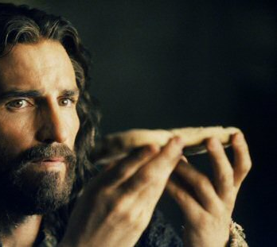
“It was not Moses who gave that bread to you from heaven. No, but it is my Father who really gives to you the bread from heaven. God’s bread is HE who comes down from heaven. He causes people in the world to live.’ So they said to Him, ‘Sir, give this bread to us now and always.’ Then
Jesus said to them, ‘I am the bread that causes people to live. Anyone who comes to me will never be hungry. Anyone who believes me will never be thirsty.
John 6:32-35

Slide 16
Jesus is the life giving food for our souls. People are always hungry – never satisfied
Like Manna, Jesus came down from Heaven, and He is all that we need – He is enough!
He is the gift of God – our Heavenly bread – gather as much of Jesus as you need.

Slide 17
“Then Moses said to them: ‘Do not keep any of it until the morning.’
But some of them did not listen to Moses. They kept part of the food until the morning. But, very small snakes appeared in it. And it began to have a bad smell” Ex 16:19,20

Slide 18
It couldn’t be stored – it turned to worms over night.
Jesus is new every morning! He must be sought with new love and devotion daily. He wants a relationship.
“The Lord's love never ends; his mercies never stop. They are new every morning…”
Lam. 3:22-24

Slide 19
“Each morning, everyone picked up as much food as he needed. But, when the heat of the sun became strong, the food became soft. Then it went away.” Ex 16:21

Slide 20
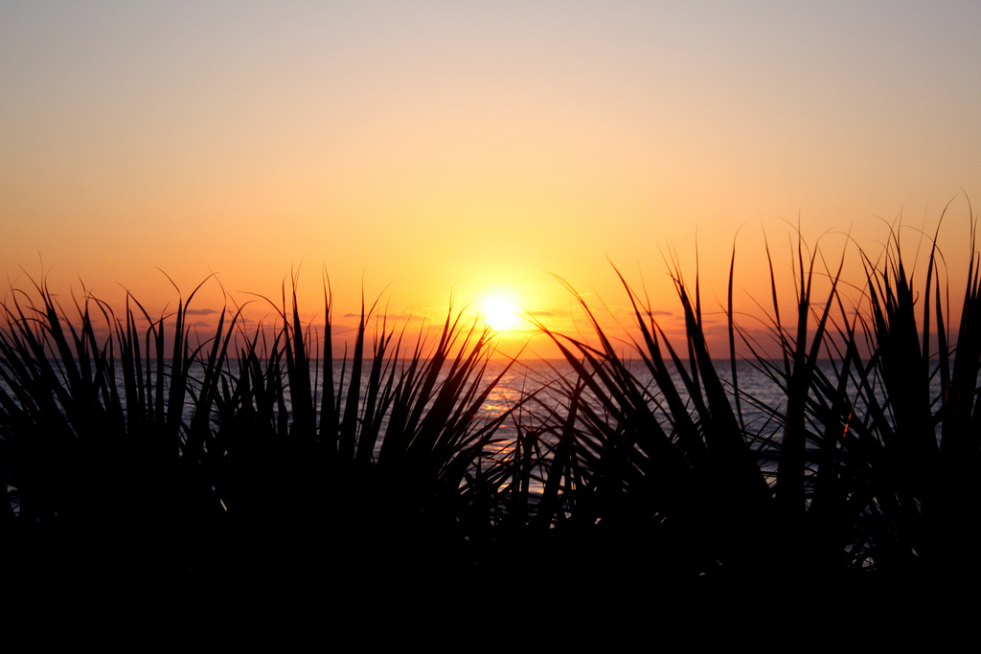
Gather Him Early
Gather it first thing – it melted in the afternoon.
This is about seeking Jesus first – Early in the day!
Early in our life -- Early in our planning
Our faith melts away when we make Him our ‘last resort.’
Those who seek Him early shall find Him.

Slide 21
Manna = What is it?
They didn’t recognize the Manna as food – it was not what they thought they needed.
We don’t understand what truly feeds us – what meets our soul’s deepest need.
This is why so many pass Jesus by and fail to see Him as the answer to their heart’s cry.

Slide 22
What is the Sinner‘s Prayer?
This is a prayer we can pray when we are ready to admit we are sinners and need Christ’s forgiveness.
It must be prayed with faith in our hearts and a readiness to have a life-changing encounter with Jesus Christ.

Slide 24
John Wesley’s Testimony
“…the preacher was describing the change which God works in the heart through faith in Christ and I felt my heart strangely warmed.”
Disciple’s Testimony
“They said to each other, ‘Did not our hearts burn within us while he talked to us on the road, while he opened to us the Scriptures?’”

Slide 25
A prayer of faith → Pray this prayer if :
If you never have before
You have in the past, but you think it would mean more today
You have been walking afar off and you want to come back
You want to set an example & show others how it is done
You just like to give your heart to Jesus again & again
Faith

Slide 26
We Declare Our Faith Publicly Because Jesus Declared His LOVE Publicly
“If you stand before others and are willing to say you believe in me, then I will tell my Father in heaven that you belong to me.” Mat 10:32

Slide 27
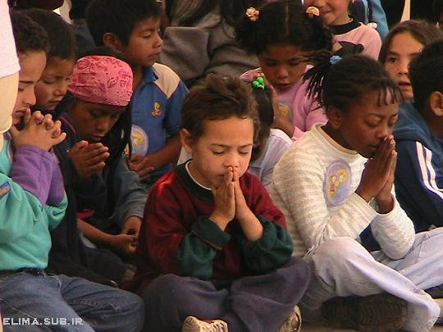
Dear Jesus,
I know I am a sinner & need your forgiveness.
I believe you died for my sins.
I now turn from sin.
Come into my heart I pray.
Do you want to meet Jesus as your savior right now?
Do you believe He died to save you from your sins & that He rose from the dead?
Do you believe that He is waiting to save you right now?

Slide 28
“But some people did accept him. They believed in him, and he gave them the right to become children of God.” John 1:12

Slide 30
“If you openly say, ‘Jesus is Lord’ and believe in your heart that God raised him from death, you will be saved.”
Rom. 10:9
What did you learn today?
What is the meaning of the name-tag?
What have you neen thinking about God lately?
What do you want to tell the world about Jesus?

Slide 31
“Draw near to God, and He will draw near to you…
…Cleanse your hands, you sinners, and make your hearts pure, you who are half-hearted towards God.” James 4:8 WNT

Slide 32
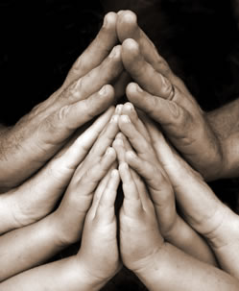
Close in Prayer

Slide 33
Note: Any videos in this presentation will only play online. After you download the slideshow, you will need to also download the videos from YouTube & add them back into your PowerPoint.
We present these messages at Bee Creek Park in College Station, TX. If you would like to watch the video of the service with this message, click here:
http://campaignkerusso.org/?p=9369
We would love to know more about the people who download our lessons & sermons. We invite you to email us & let us know where & how you use them.
info@ckbrazos.org

Slide 34
Welcome to Aggieland Faith Family Style Worship

Slide 35
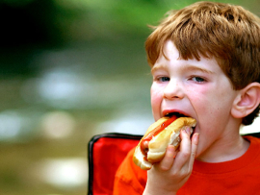
CURRENT SCHEDULE: See www.Aggielandfaith.org
SATURDAY —
At Bee Creek Park
2:00-4:00pm: Through the bible with felt-board stories – plus hot-dogs & drinks
SUNDAY —
At Bee Creek Park
2:00-4pm: Free snacks, drinks, kids crafts, prizes, singing & bible preaching

Slide 36
Would You Like Prayer or Bible Study at Your House?
Personal Prayer: We can come to your home & pray with you, or you can email us when you need prayer.
Home Bible Study: We will come to your home & hold a bible study for you & your friends.
Bible Party: We will hold a Kid’s Bible Party: You provide the food & kids - we will do the bible fun & stories.

Slide 37
Would You Like Visitation?
We will visit a friend, loved one in the hospital or in prison to pray for them & share Christ with them.
Contact: info@aggielandfaith.org

Slide 38
www.aggielandfaith.org
Go here to see pictures & videos
Go here to subscribe to e-mails about changes & cancellations

Slide 39
Note: Any videos in this presentation will only play online. After you download the slideshow, you will need to also download the videos from YouTube & add them back into your PowerPoint.
We present these messages at Bee Creek Park in College Station, TX. If you would like to watch the video of the service with this message, click here:
http://campaignkerusso.org/?p=9369
We would love to know more about the people who download our lessons & sermons. We invite you to email us & let us know where & how you use them.
info@ckbrazos.org

