Slide 1
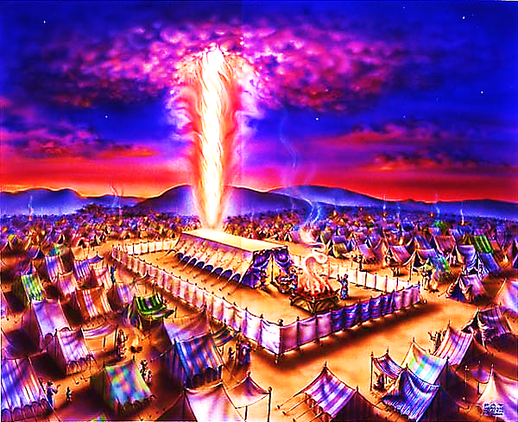
The Tabernacle in the Wilderness pt. 5

Slide 2
Note: Any videos in this presentation will only play online. After you download the slideshow, you will need to also download the videos from YouTube & add them back into your PowerPoint.
We present these messages at Bee Creek Park in College Station, TX. If you would like to watch the video of the service with this message, click here:
http://campaignkerusso.org/?p=8572
We would love to know more about the people who download our lessons & sermons. We invite you to email us & let us know where & how you use them.
info@ckbrazos.org

Slide 3
Video Next Slide → Tabernacle Tour
Download Here:
http://www.youtube.com/watch?v=66I33r7y_IY

Slide 4
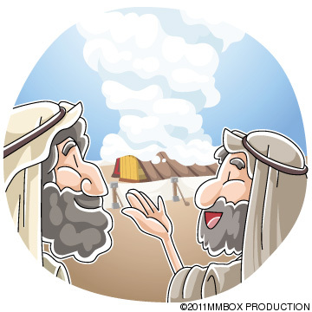
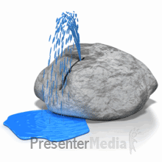
God’s Wilderness School
Manna | Pillar of Smoke | Rock
God’s Three Teaching Aids to Teach Us One Lesson…

Slide 5
How to Be Children
“Jesus said, ‘Unless you become like a child, you cannot come into the Kingdom of Heaven.” Mat. 18:3
Rather than growing up – we need to grow down!

Slide 6
Wilderness School –> How to Be Children
In the wilderness, God teaches us & Israel to trust Him – to lean on Him – to rely on Him for guidance, food & happiness

Slide 7
The manna was sent from Heaven → How is this like Jesus?

Slide 8
The manna kept them alive → How is this like Jesus?

Slide 9
The manna was always enough to fill them & meet their needs. → How is this like Jesus?

Slide 10
They needed to gather their own manna. → How is this like Jesus?

Slide 11
They needed to gather manna daily. → How is this like Jesus?

Slide 12
They needed to gather manna early in the day. → How is this like Jesus?

Slide 13
At first they didn’t understand what manna was and how it could save them. → How is this like Jesus?

Slide 14
Guidance
The second thing God used to train them in the wilderness was a great pillar of smoke by day and fire by night.
It was a manifestation of the Glory of the Lord.
As the Manna made them trust God for food, the pillar made them trust for guidance.

Slide 15
“Then the cloud covered the Tent… The glory of the Lord filled the tabernacle…
The Israelites followed the cloud during all their journeys. Every time the cloud rose up from the tabernacle, they would begin their journey again. But, if the cloud remained on the tabernacle, the Israelites did not move…
During the night, there was fire in the cloud. And all the Israelites could see the cloud during all their journeys.” Ex. 40:34-38

Slide 16
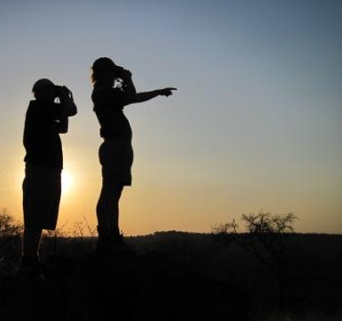
Children Are Dependant
They look to their parents for food, guidance and happiness. Adults try to provide these things for themselves
Dependence on God is a parent/child relationship. God wants us to trust He will provide what we need. He will guide us through the wilderness.
Sometimes, we want to provide for ourselves, plan our own direction in life and pursue our own forms of happiness.

Slide 17
There was one more wilderness training tool → a water rock that followed them around.
“God, you gave the Jews bread from heaven when they were hungry. You gave them water from a rock to drink...” Neh. 9:15
They drank from the spiritual rock that went with them. And Christ was that rock. 1 Cor. 10:4

Slide 18
“Jesus stood up and spoke with a loud voice. He said, ‘If anyone is thirsty, he should come to me and drink… God will cause streams of water to pour out from anyone who believes me.’”
John 7:37-38

Slide 19
Everyone thirsts – life sometimes seems dry and we look for things to liven it up – we are seeking happiness.
The bread speaks of our needs (salvation).
Water speaks of joy.
Jesus is like that rock, following us around saying, “Let Me turn your dry boring life into gushing, gurgling, bubbling streams of living water. I want to quench you heart’s thirst.”

Slide 20
Dependence takes humility and trust in God as we move through this wilderness called life.
We remember His blessings are new every morning.
Next: A verse about graduating from God’s Wilderness School →

Slide 21
“…the Lord your God led you all the way in the desert… He did this for two reasons. He wanted to know if you would obey him. And he wanted know if you would believe his words. He caused you to be hungry and then he fed you with special food called manna.
…By this, he taught you that a man does not live only on bread. A man also needs every word that God speaks to him.” Duet. 8:2.3

Slide 22
Next Slide Song → “Fill My Cup Lord”
Download Here:
http://www.youtube.com/watch?v=s4l2yY2r95g

Slide 23
What is the Sinner‘s Prayer?
This is a prayer we can pray when we are ready to admit we are sinners and need Christ’s forgiveness.
It must be prayed with faith in our hearts and a readiness to have a life-changing encounter with Jesus Christ.

Slide 25
John Wesley’s Testimony
“…the preacher was describing the change which God works in the heart through faith in Christ and I felt my heart strangely warmed.”
Disciple’s Testimony
“They said to each other, ‘Did not our hearts burn within us while he talked to us on the road, while he opened to us the Scriptures?’”

Slide 26
A prayer of faith → Pray this prayer if :
If you never have before
You have in the past, but you think it would mean more today
You have been walking afar off and you want to come back
You want to set an example & show others how it is done
You just like to give your heart to Jesus again & again
Faith

Slide 27
We Declare Our Faith Publicly Because Jesus Declared His LOVE Publicly
“If you stand before others and are willing to say you believe in me, then I will tell my Father in heaven that you belong to me.” Mat 10:32

Slide 28
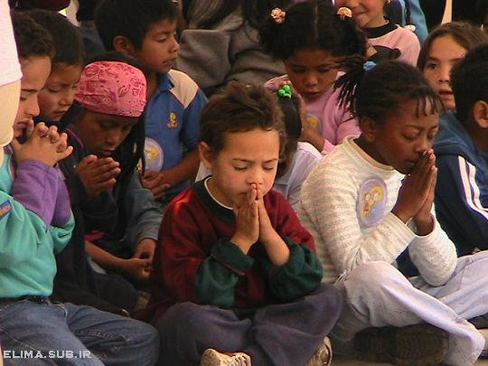
Dear Jesus,
I know I am a sinner & need your forgiveness.
I believe you died for my sins.
I now turn from sin.
Come into my heart I pray.
Do you want to meet Jesus as your savior right now?
Do you believe He died to save you from your sins & that He rose from the dead?
Do you believe that He is waiting to save you right now?

Slide 29
“But some people did accept him. They believed in him, and he gave them the right to become children of God.” John 1:12

Slide 31
“If you openly say, ‘Jesus is Lord’ and believe in your heart that God raised him from death, you will be saved.”
Rom. 10:9
What did you learn today?
What is the meaning of the name-tag?
What have you neen thinking about God lately?
What do you want to tell the world about Jesus?

Slide 32
“Draw near to God, and He will draw near to you…
…Cleanse your hands, you sinners, and make your hearts pure, you who are half-hearted towards God.” James 4:8 WNT

Slide 33
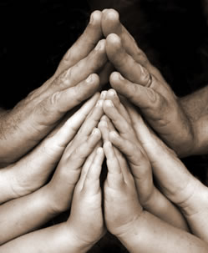
Close in Prayer

Slide 34
Note: Any videos in this presentation will only play online. After you download the slideshow, you will need to also download the videos from YouTube & add them back into your PowerPoint.
We present these messages at Bee Creek Park in College Station, TX. If you would like to watch the video of the service with this message, click here:
http://campaignkerusso.org/?p=8572
We would love to know more about the people who download our lessons & sermons. We invite you to email us & let us know where & how you use them.
info@ckbrazos.org

Slide 35
Welcome to Aggieland Faith Family Style Worship

Slide 36
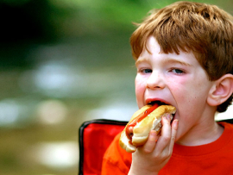
CURRENT SCHEDULE: See www.Aggielandfaith.org
SATURDAY —
At Bee Creek Park
2:00-4:00pm: Through the bible with felt-board stories – plus hot-dogs & drinks
SUNDAY —
At Bee Creek Park
2:00-4pm: Free snacks, drinks, kids crafts, prizes, singing & bible preaching

Slide 37
Would You Like Prayer or Bible Study at Your House?
Personal Prayer: We can come to your home & pray with you, or you can email us when you need prayer.
Home Bible Study: We will come to your home & hold a bible study for you & your friends.
Bible Party: We will hold a Kid’s Bible Party: You provide the food & kids - we will do the bible fun & stories.

Slide 38
Would You Like Visitation?
We will visit a friend, loved one in the hospital or in prison to pray for them & share Christ with them.
Contact: info@aggielandfaith.org

Slide 39
www.aggielandfaith.org
Go here to see pictures & videos
Go here to subscribe to e-mails about changes & cancellations

Slide 40
Note: Any videos in this presentation will only play online. After you download the slideshow, you will need to also download the videos from YouTube & add them back into your PowerPoint.
We present these messages at Bee Creek Park in College Station, TX. If you would like to watch the video of the service with this message, click here:
http://campaignkerusso.org/?p=8572
We would love to know more about the people who download our lessons & sermons. We invite you to email us & let us know where & how you use them.
info@ckbrazos.org

