Slide 1
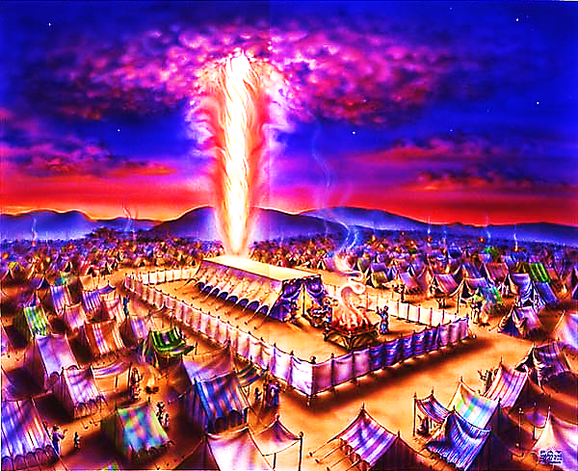
The Tabernacle in the Wilderness pt. 6

Slide 2
Note: Any videos in this presentation will only play online. After you download the slideshow, you will need to also download the videos from YouTube & add them back into your PowerPoint.
We present these messages at Bee Creek Park in College Station, TX. If you would like to watch the video of the service with this message, click here:
http://campaignkerusso.org/?p=8643
We would love to know more about the people who download our lessons & sermons. We invite you to email us & let us know where & how you use them.
info@ckbrazos.org

Slide 4
There was one more wilderness training tool → a water rock that followed them around.
“God, you gave the Jews bread from heaven when they were hungry. You gave them water from a rock to drink...” Neh. 9:15
They drank from the spiritual rock that went with them. And Christ was that rock. 1 Cor. 10:4

Slide 5
“Jesus stood up and spoke with a loud voice. He said, ‘If anyone is thirsty, he should come to me and drink… God will cause streams of water to pour out from anyone who believes me.’”
John 7:37-38

Slide 6
Dry Mouth?
Speak to the Rock
Dry Soul?
Speak to Jesus!
Become a water rock for others… streams will pour out of your belly as you give them the Word of God!

Slide 7
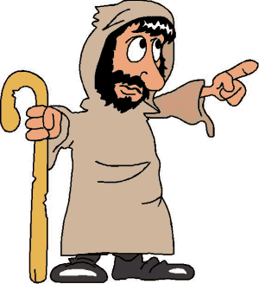
The Waters of Joy FOLLOW Us as We Obey & Follow the Will & Guidance of God…

Slide 8
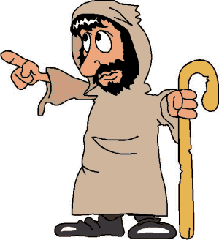
Not the Other Way Around! We can’t say, “Lord make me happy, and then I will follow you.” It’s the following of Him that brings the joyful springs.

Slide 9
Everything About the Tabernacle Points to Jesus

Slide 10
First, it was the center tent in their camp. Jesus must become the center of our lives. Nothing else is more important!

Slide 11
Their tents were laid out in the shape of a cross. From God’s point of view, they looked like a giant cross traveling across the wilderness.
The cross of Jesus is our salvation!

Slide 12
The Lord showed Moses exactly what pieces of furniture they were to build – each one will tell us something about Jesus.

Slide 13
The Lord showed Moses exactly how to place the furniture. Do you see the cross?

Slide 14
Do you see the cross now?

Slide 15
Now, we will begin to look at the tabernacle tent itself.

Slide 16
It was a tent, made of mere fabric, yet it was full of the glory of God!

Slide 17
Jesus became mere flesh, and He too was full of the glory of God! “And the Word became flesh, and did tabernacle among us, and we beheld his glory, glory as of an only begotten of a father, full of grace and truth.” John 1:14 YLT

Slide 18
His Body was His Tent – He Wanted to Live with Us
Human Flesh is Very Fragile Tent Material – It can Feel Pain – It can be Broken

Slide 19
The Pure White Linen Fence: This fence formed a pure white barrier around the house of God
“Make a courtyard for the Holy Tent… These curtains must be made from fine linen.”
Ex. 27:9
The white fence kept out the impure Israelites. It kept God’s tent holy.

Slide 20
But, God has a plan to wash us “white as snow” and later, we hear about this white linen cloth again…
the Bride of Christ is wearing it!

Slide 21
“Let us rejoice and be happy and give God glory! Give God glory, because the wedding of the Lamb has come. And the Lamb’s bride has made herself ready. Fine linen was given to the bride for her to wear. The linen was bright and clean.” Rev. 19:7,8

Slide 22
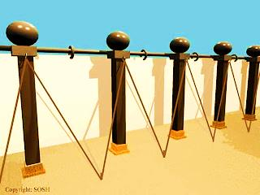
Pure ‘White Linen’ Righteousness: → Foreshadowed in the Fence → Fulfilled in Christ → Freely Given to the Believer

Slide 23
What is the Sinner‘s Prayer?
This is a prayer we can pray when we are ready to admit we are sinners and need Christ’s forgiveness.
It must be prayed with faith in our hearts and a readiness to have a life-changing encounter with Jesus Christ.

Slide 25
John Wesley’s Testimony
“…the preacher was describing the change which God works in the heart through faith in Christ and I felt my heart strangely warmed.”
Disciple’s Testimony
“They said to each other, ‘Did not our hearts burn within us while he talked to us on the road, while he opened to us the Scriptures?’”

Slide 26
A prayer of faith → Pray this prayer if :
If you never have before
You have in the past, but you think it would mean more today
You have been walking afar off and you want to come back
You want to set an example & show others how it is done
You just like to give your heart to Jesus again & again
Faith

Slide 27
We Declare Our Faith Publicly Because Jesus Declared His LOVE Publicly
“If you stand before others and are willing to say you believe in me, then I will tell my Father in heaven that you belong to me.” Mat 10:32

Slide 28
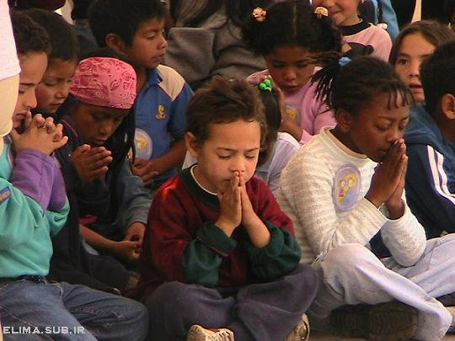
Dear Jesus,
I know I am a sinner & need your forgiveness.
I believe you died for my sins.
I now turn from sin.
Come into my heart I pray.
Do you want to meet Jesus as your savior right now?
Do you believe He died to save you from your sins & that He rose from the dead?
Do you believe that He is waiting to save you right now?

Slide 29
“But some people did accept him. They believed in him, and he gave them the right to become children of God.” John 1:12

Slide 31
“If you openly say, ‘Jesus is Lord’ and believe in your heart that God raised him from death, you will be saved.”
Rom. 10:9
What did you learn today?
What is the meaning of the name-tag?
What have you neen thinking about God lately?
What do you want to tell the world about Jesus?

Slide 32
“Draw near to God, and He will draw near to you…
…Cleanse your hands, you sinners, and make your hearts pure, you who are half-hearted towards God.” James 4:8 WNT

Slide 33
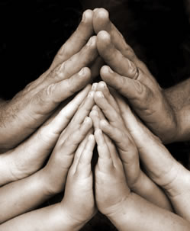
Close in Prayer

Slide 34
Note: Any videos in this presentation will only play online. After you download the slideshow, you will need to also download the videos from YouTube & add them back into your PowerPoint.
We present these messages at Bee Creek Park in College Station, TX. If you would like to watch the video of the service with this message, click here:
http://campaignkerusso.org/?p=8643
We would love to know more about the people who download our lessons & sermons. We invite you to email us & let us know where & how you use them.
info@ckbrazos.org

Slide 35
Welcome to Aggieland Faith Family Style Worship

Slide 36
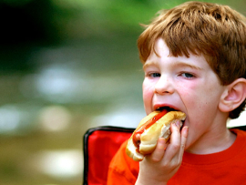
CURRENT SCHEDULE: See www.Aggielandfaith.org
SATURDAY —
At Bee Creek Park
2:00-4:00pm: Through the bible with felt-board stories – plus hot-dogs & drinks
SUNDAY —
At Bee Creek Park
2:00-4pm: Free snacks, drinks, kids crafts, prizes, singing & bible preaching

Slide 37
Would You Like Prayer or Bible Study at Your House?
Personal Prayer: We can come to your home & pray with you, or you can email us when you need prayer.
Home Bible Study: We will come to your home & hold a bible study for you & your friends.
Bible Party: We will hold a Kid’s Bible Party: You provide the food & kids - we will do the bible fun & stories.

Slide 38
Would You Like Visitation?
We will visit a friend, loved one in the hospital or in prison to pray for them & share Christ with them.
Contact: info@aggielandfaith.org

Slide 39
www.aggielandfaith.org
Go here to see pictures & videos
Go here to subscribe to e-mails about changes & cancellations

Slide 40
Note: Any videos in this presentation will only play online. After you download the slideshow, you will need to also download the videos from YouTube & add them back into your PowerPoint.
We present these messages at Bee Creek Park in College Station, TX. If you would like to watch the video of the service with this message, click here:
http://campaignkerusso.org/?p=8643
We would love to know more about the people who download our lessons & sermons. We invite you to email us & let us know where & how you use them.
info@ckbrazos.org

