Slide 1
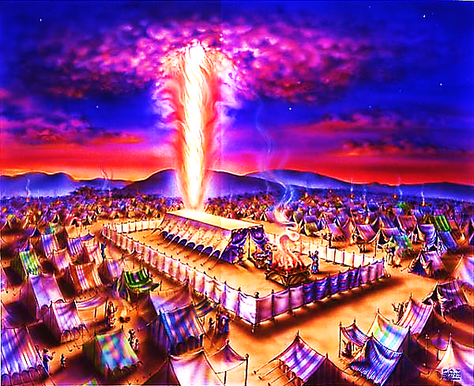
The Tabernacle in the Wilderness pt. 10

Slide 2
Note: Any videos in this presentation will only play online. After you download the slideshow, you will need to also download the videos from YouTube & add them back into your PowerPoint.
We present these messages at Bee Creek Park in College Station, TX. If you would like to watch the video of the service with this message, click here:
http://campaignkerusso.org/?p=10277
We would love to know more about the people who download our lessons & sermons. We invite you to email us & let us know where & how you use them.
info@ckbrazos.org

Slide 3
Next Slide → Song: The Cornerstone Download Here: http://youtu.be/d88K3YDlD9I

Slide 4
Everything About the Tabernacle Points to Jesus

Slide 5
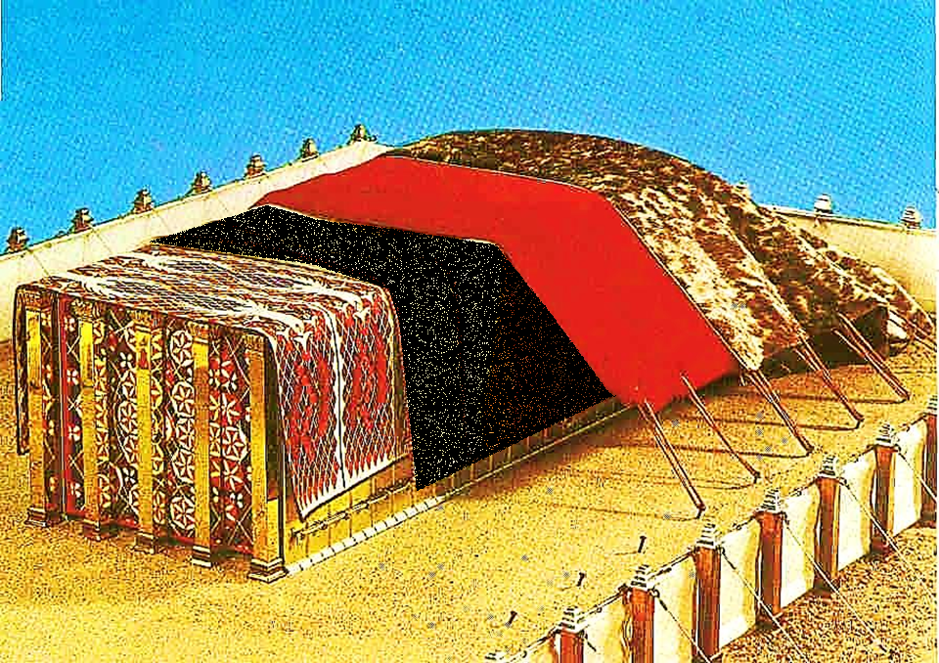
The First Covering Reminded Us of Our Divine Christ (four colors & angels)
Our Divine
Christ

Slide 6
The Second Cover Reminded us of Our Sin & Jesus Our Sin Offering
Our Sin Offering
Our Divine
Christ

Slide 7
The Third Cover Reminds Us of the Blood Jesus Which Bought Our Salvation
Our Redeemer
Our Sin Offering
Our Divine
Christ

Slide 8
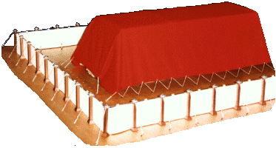
Ram’s Skin Dyed Red

Slide 9
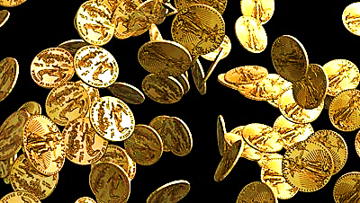
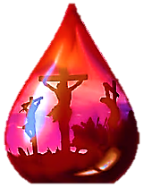
"…you were not bought with things that can pass away, like silver or gold…. Instead, you were bought by the priceless blood of Christ…
Pet. 1:18-19

Slide 10
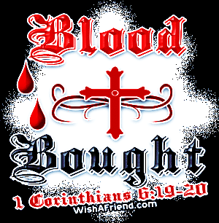

Slide 11
Now, The Fourth Cover Reminds Us of Our Humble Servant
Our Humble Servant
Our Redeemer
Our Sin Offering
Our Divine
Christ

Slide 12
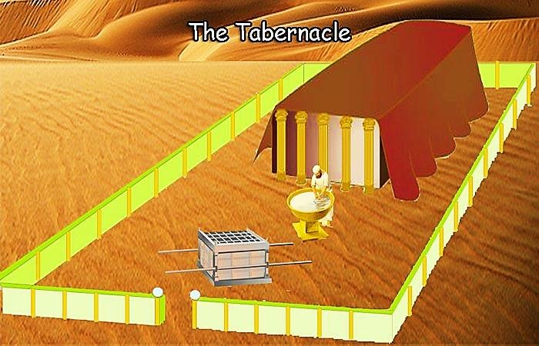
This Badger Skin cover is plain and brown – it hides all the treasure within!

Slide 13
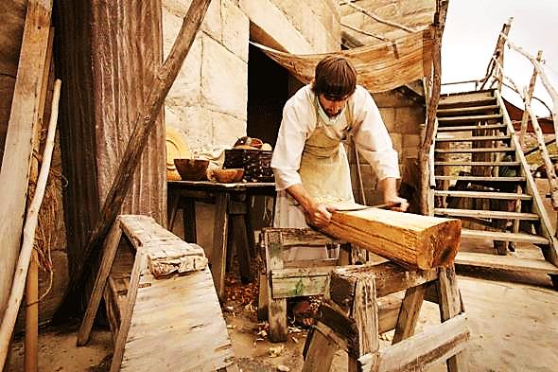
It reminds us of when Jesus came as a plain, ordinary man… yet, He was God within.

Slide 14
Jesus Wasn’t Good Looking
“…he grew up like a young plant, like a root out of dry ground. He was not well-formed or especially handsome; we saw him, but his appearance did not attract us.”Is.53

Slide 15
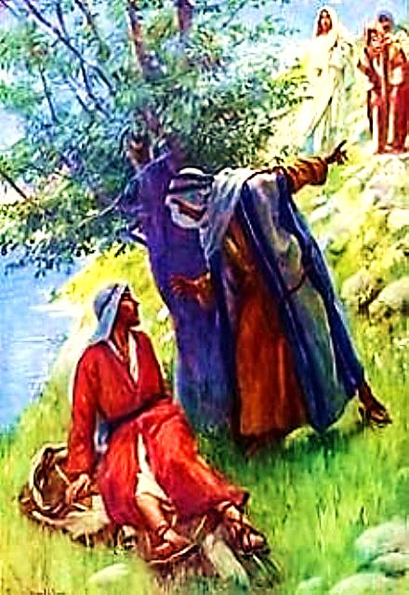
Jesus had an Unimpressive Background
"Nazareth! Can anything good come from there?" Nathanael asked. "Come and see," said Philip.” Jn.1: 45-46

Slide 16
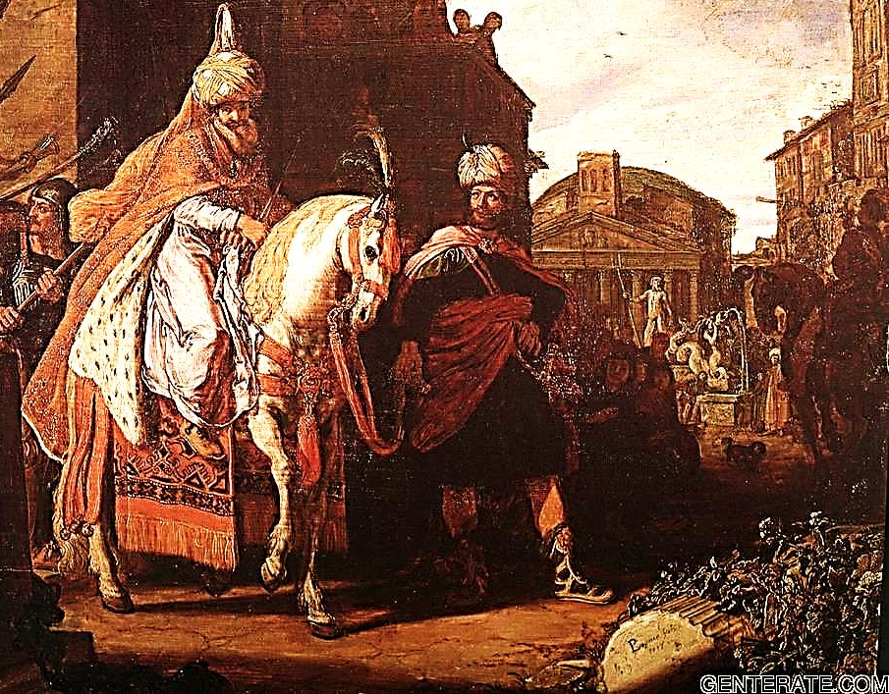
Nazareth was most likely part of an area named by King Hiram…
“What kind of cities have you given me, brother?” he asked. So he named it the region of Cabul [Good for Nothing]. (They’re still called that today.) 1Kings 9: 13

Slide 17
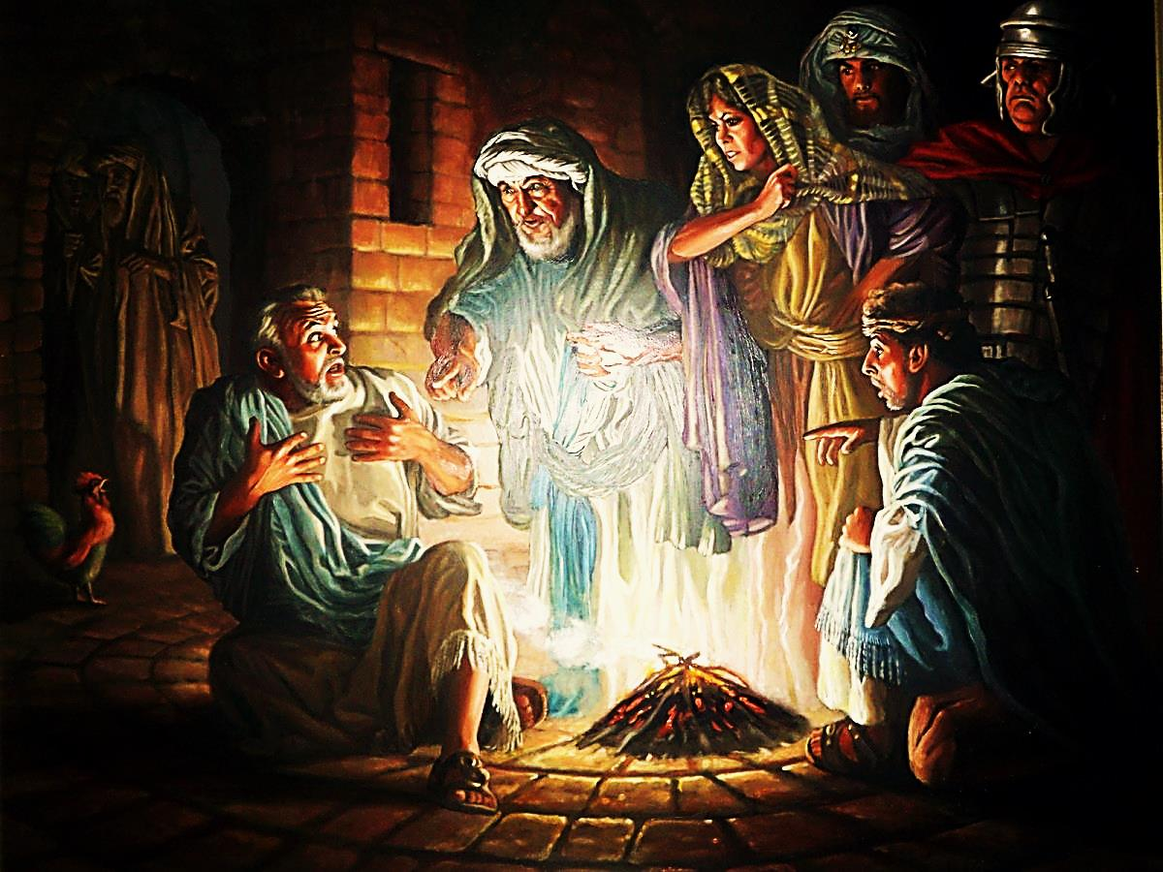
Jesus Likely had a Lower Class Speech Pattern
“Later, those who stood around said to Peter again, ‘For sure you are one of them. You are from the country of Galilee. You talk like they do.’” Mark 14:69-71

Slide 18
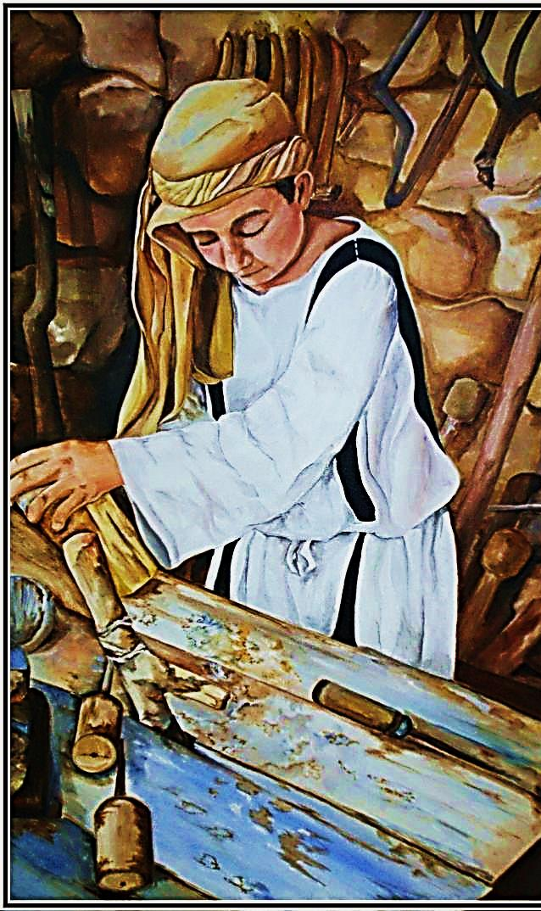
Jesus had a ‘Blue Collar,’ Working Earthly Dad “Then they scoffed, ‘He’s just the carpenter’s son, and we know Mary, his mother, and his brothers...’”Mat.13: 55

Slide 19
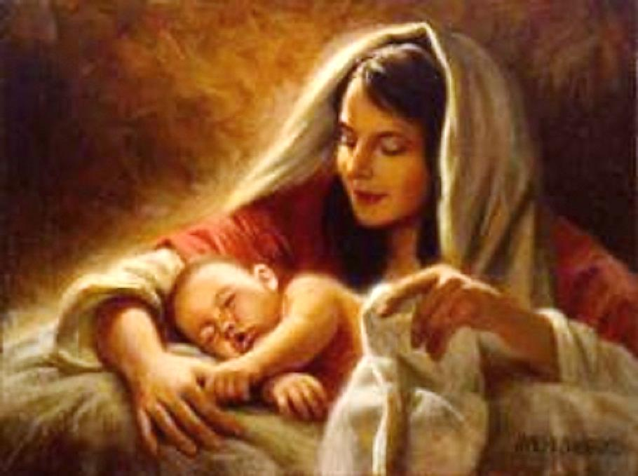
His Parents Had Very Little Money
“Her first son was born. She put cloth around Him and laid Him in a place where cattle are fed. There was no room for them in the place where people stay for the night.” Luke.2: 7

Slide 20
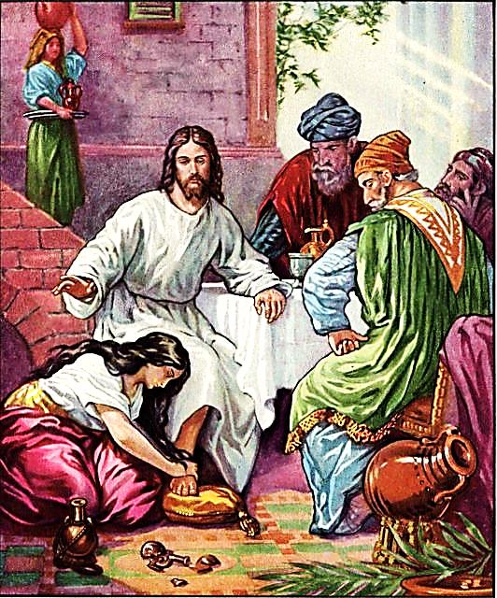
Jesus has Outcasts as Friends
“He is even a friend of tax collectors and sinners.”
Mat.11: 19

Slide 21
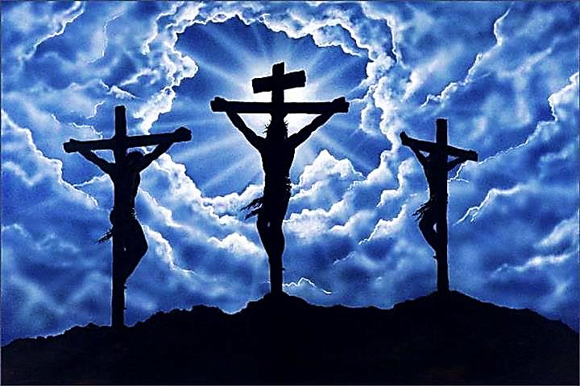
Jesus Died Like a Common Criminal
“They nailed two robbers to crosses beside Him. One was on His right side. The other was on His left side.”
Mat.27: 38

Slide 22
“He was considered a criminal, but the truth is, he carried away the sins of many.” Is.53: 12

Slide 23
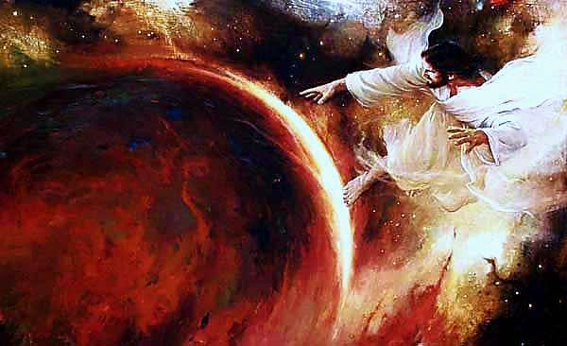
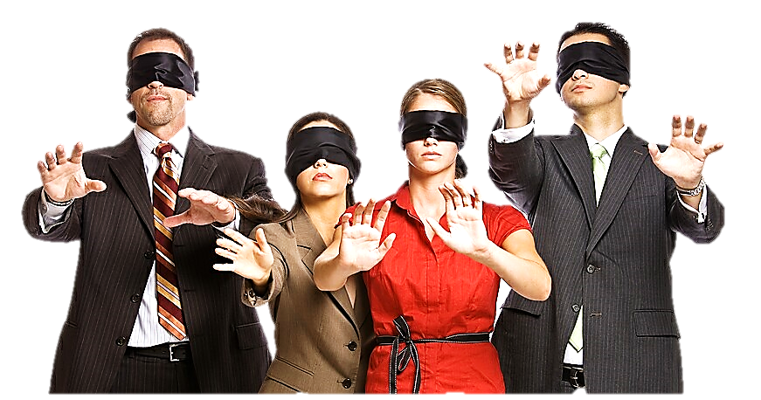
“The world was made through him, but the world did not know him.” John 1:10

Slide 25
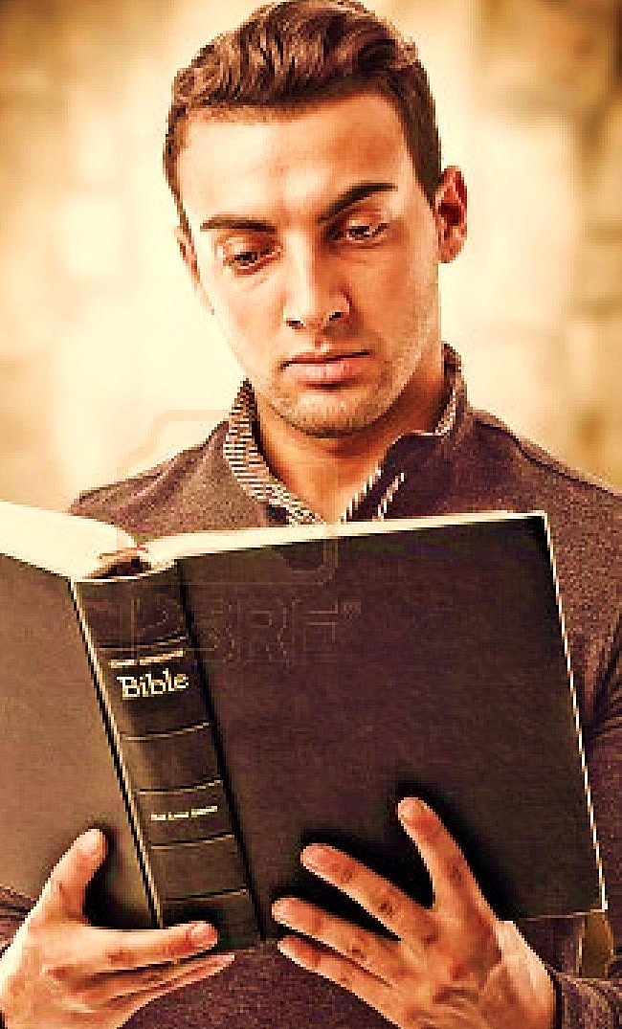
Only His Children Really Understand Him
“We know God’s Son has come. He has given us the understanding to know Him Who is the true God.”
1 John 5:20

Slide 26
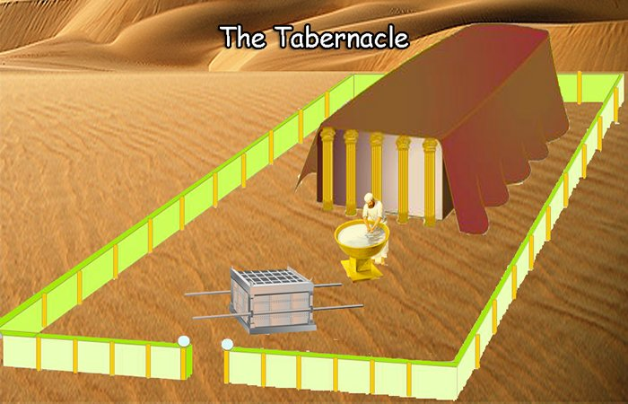
Just as the Tabernacle looked like only a simple brown tent in a barren wilderness…

Slide 27
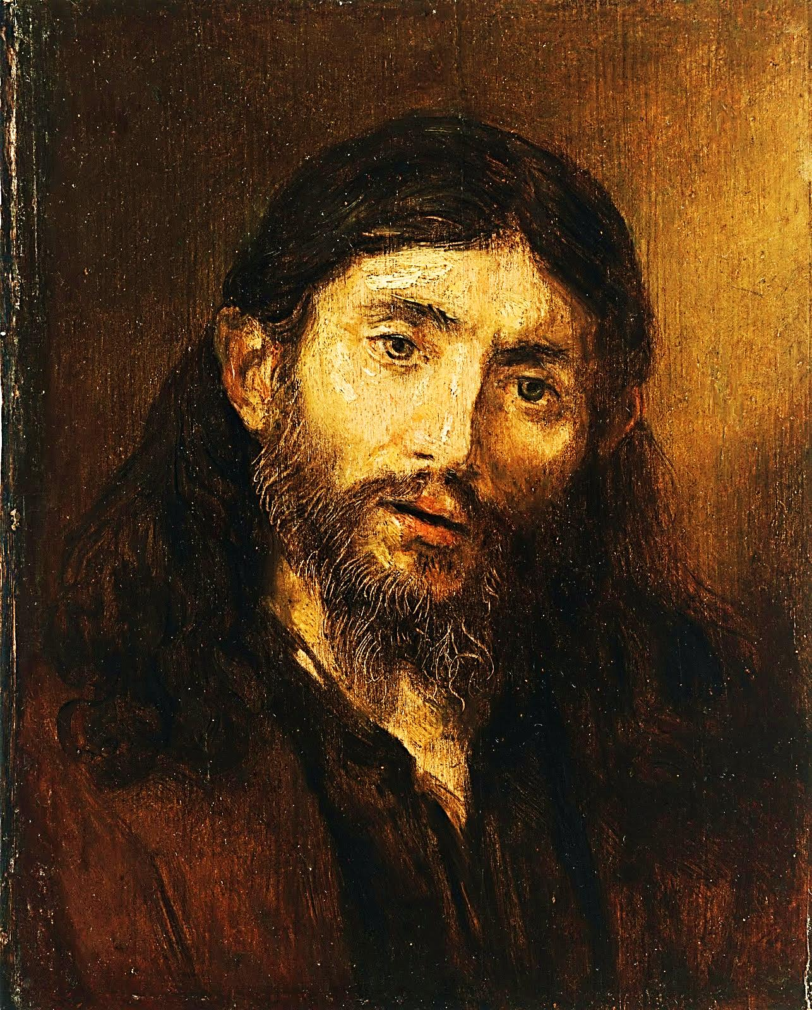
And, just as Jesus looked like a poor man, from a poor family, from the worst side of town, who died like a criminal…

Slide 28
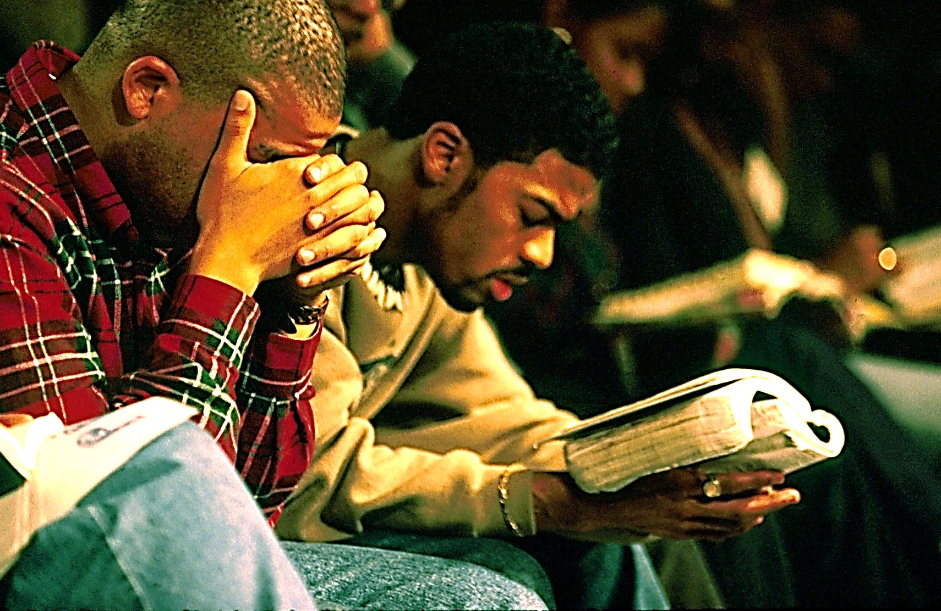
To some, the Gospel seems foolish, narrow minded and old fashioned . They can’t understand why believers love Jesus so! They just don’t see Him like His children see Him.

Slide 29
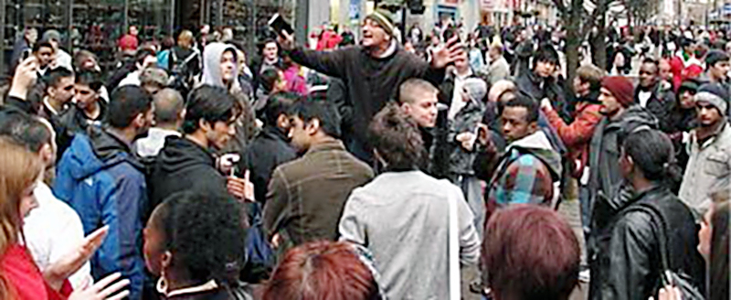
“But the person who is not a Christian does not understand these words from the Holy Spirit. He thinks they are foolish.
He cannot understand them because he does not have the Holy Spirit to help him understand. ” 1 Cor. 2:14

Slide 30
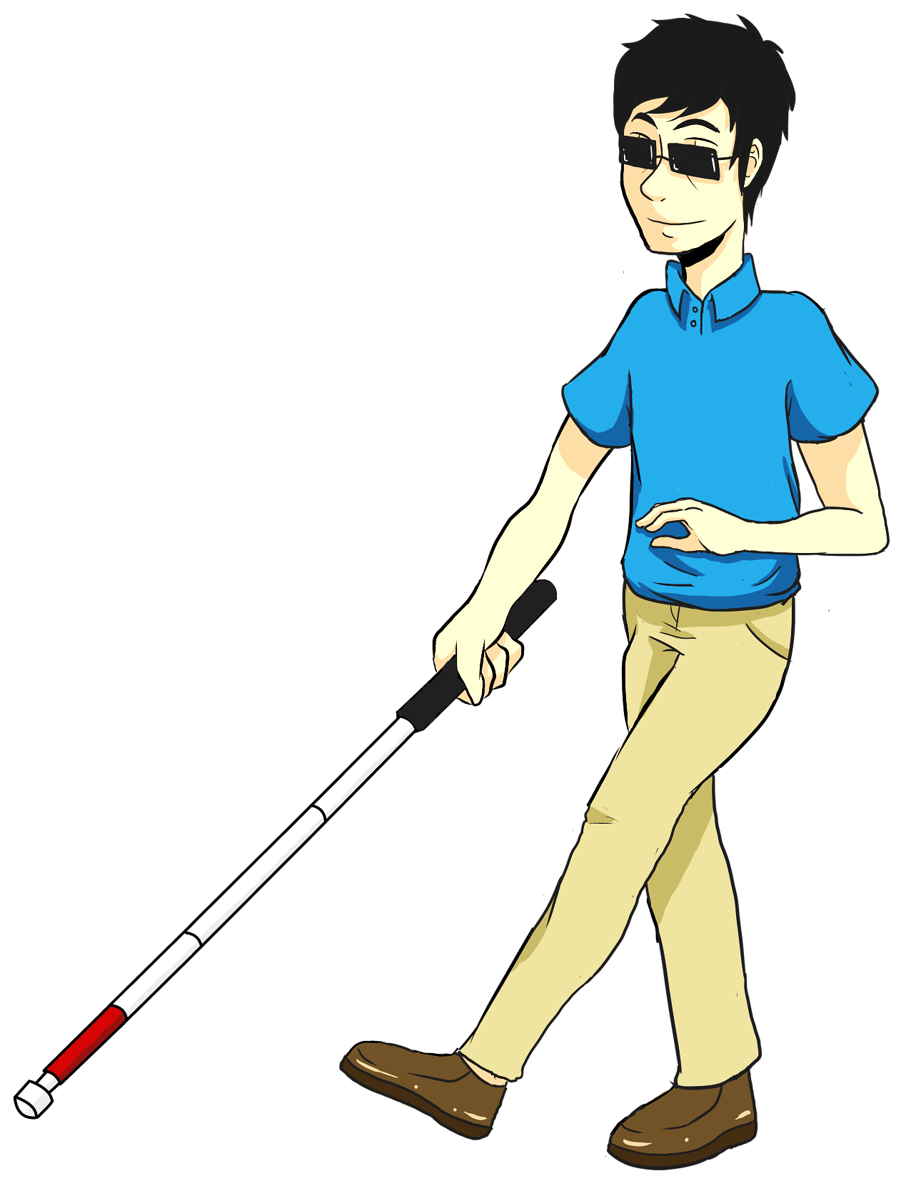
Both the Gospel & Believers in Christ, seem to be of very little value in the unbeliever’s eye, but they are spiritually blind.

Slide 31
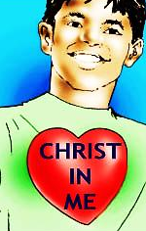
In Truth:
The Tabernacle
The Man Jesus
The Gospel &
The Believer
Are full of the glory of God
“The Kingdom of God is within you.”
Luke 17:21

Slide 32
Next Slide: Song: No, I Am Not Ashamed Download Here: http://www.youtube.com/watch?v=Lmm6EQWHS0o

Slide 33
What is the Sinner‘s Prayer?
This is a prayer we can pray when we are ready to admit we are sinners and need Christ’s forgiveness.
It must be prayed with faith in our hearts and a readiness to have a life-changing encounter with Jesus Christ.

Slide 35
John Wesley’s Testimony
“…the preacher was describing the change which God works in the heart through faith in Christ and I felt my heart strangely warmed.”
Disciple’s Testimony
“They said to each other, ‘Did not our hearts burn within us while he talked to us on the road, while he opened to us the Scriptures?’”

Slide 36
A prayer of faith → Pray this prayer if :
If you never have before
You have in the past, but you think it would mean more today
You have been walking afar off and you want to come back
You want to set an example & show others how it is done
You just like to give your heart to Jesus again & again
Faith

Slide 37
We Declare Our Faith Publicly Because Jesus Declared His LOVE Publicly
“If you stand before others and are willing to say you believe in me, then I will tell my Father in heaven that you belong to me.” Mat 10:32

Slide 38
Dear Jesus,
I know I am a sinner & need your forgiveness.
I believe you died for my sins.
I now turn from sin.
Come into my heart I pray.
Do you want to meet Jesus as your Savior right now?
Do you believe He died to save you from your sins & that He rose from the dead?
Do you believe that He is waiting to save you right now?

Slide 39
“But some people did accept him. They believed in him, and he gave them the right to become children of God.” John 1:12

Slide 41
“If you openly say, ‘Jesus is Lord’ and believe in your heart that God raised him from death, you will be saved.”
Rom. 10:9
What did you learn today?
What is the meaning of the name-tag?
What have you been thinking about God lately?
What do you want to tell the world about Jesus?

Slide 42
“Draw near to God, and He will draw near to you…
…Cleanse your hands, you sinners, and make your hearts pure, you who are half-hearted towards God.” James 4:8 WNT

Slide 43
Close in Prayer

Slide 44
Note: Any videos in this presentation will only play online. After you download the slideshow, you will need to also download the videos from YouTube & add them back into your PowerPoint.
We present these messages at Bee Creek Park in College Station, TX. If you would like to watch the video of the service with this message, click here:
http://campaignkerusso.org/?p=10277
We would love to know more about the people who download our lessons & sermons. We invite you to email us & let us know where & how you use them.
info@ckbrazos.org

Slide 45
Welcome to Aggieland Faith Family Style Worship

Slide 46
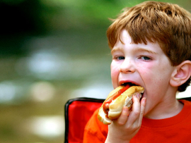
CURRENT SCHEDULE: See www.Aggielandfaith.org
SATURDAY —
At Bee Creek Park
2:00-4:00pm: Through the Bible with felt-board stories – plus hot-dogs & drinks
SUNDAY —
At Bee Creek Park
2:00-4pm: Free snacks, drinks, kids crafts, prizes, singing & bible preaching

Slide 47
Would You Like Prayer or Bible Study at Your House?
Personal Prayer: We can come to your home & pray with you, or you can email us when you need prayer.
Home Bible Study: We will come to your home & hold A Bible study for you & your friends.
Bible Party: We will hold a Kid’s Bible Party: You provide the food & kids - we will do the bible fun & stories.

Slide 48
Would You Like Visitation?
We will visit a friend, loved one in the hospital or in prison to pray for them & share Christ with them.
Contact: info@aggielandfaith.org

Slide 49
www.aggielandfaith.org
Go here to see pictures & videos
Go here to subscribe to e-mails about changes & cancellations

Slide 50
Note: Any videos in this presentation will only play online. After you download the slideshow, you will need to also download the videos from YouTube & add them back into your PowerPoint.
We present these messages at Bee Creek Park in College Station, TX. If you would like to watch the video of the service with this message, click here:
http://campaignkerusso.org/?p=10277
We would love to know more about the people who download our lessons & sermons. We invite you to email us & let us know where & how you use them.
info@ckbrazos.org

