Slide 1
The Fight of the Two Wolves

Slide 2
Note: Any videos in this presentation will only play online. After you download the slideshow, you will need to also download the videos from YouTube & add them back into your PowerPoint.
We present these messages at Bee Creek Park in College Station, TX. If you would like to watch the video of the service with this message, click here:
http://campaignkerusso.org/?p=10284
We would love to know more about the people who download our lessons & sermons. We invite you to email us & let us know where & how you use them.
info@ckbrazos.org

Slide 3
Next Slide → Song: Be Careful Little Eyes Download Here: https://www.youtube.com/watch?v=pqFrXwpTI-w Download American Indian Background Music Here: http://campaignkerusso.org/wp-content/uploads/2013/03/Two-wolves-fighting-in-my-heart-YouTube.mp3

Slide 4
An old Indian tells his granddaughter:

Slide 8
The old Indian then told her:

Slide 10
She turned and asked:

Slide 11
Her grandfather answered:

Slide 12
The Bible tells us:
“We know that the Law is right and good, but I am a person who does what is wrong and bad. I am not my own boss. Sin is my boss...
Who can set me free from my sinful old self?”

Slide 13
The Bible also tells us:
“I thank God I can be free through Jesus Christ our Lord!”

Slide 14
DON’T FEED
YOUR
EVIL WOLF

Slide 15
FEED YOUR
GOOD WOLF

Slide 16
DON’T GIVE IN TO SIN

Slide 17
GIVE IN TO
JESUS

Slide 19
Bad Movies and Video Games
Which wolf are you feeding?

Slide 20
Gossip, Talking Trash
Which wolf are you feeding?

Slide 21
Which wolf will you feed?
Are all T.V. programs O.K?

Slide 22
Ways to
Feed the Good Wolf

Slide 23
Read your Bible

Slide 24
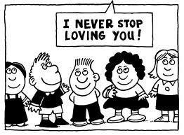
Think about the love of God

Slide 25
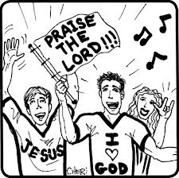
Sing God’s songs and Praise Him

Slide 26
Next Slide → Song: Be Careful Little Eyes Download Here: https://www.youtube.com/watch?v=pqFrXwpTI-w

Slide 27
What is the Sinner‘s Prayer?
This is a prayer we can pray when we are ready to admit we are sinners and need Christ’s forgiveness.
It must be prayed with faith in our hearts and a readiness to have a life-changing encounter with Jesus Christ.

Slide 29
John Wesley’s Testimony
“…the preacher was describing the change which God works in the heart through faith in Christ and I felt my heart strangely warmed.”
Disciple’s Testimony
“They said to each other, ‘Did not our hearts burn within us while he talked to us on the road, while he opened to us the Scriptures?’”

Slide 30
A prayer of faith → Pray this prayer if :
If you never have before
You have in the past, but you think it would mean more today
You have been walking afar off and you want to come back
You want to set an example & show others how it is done
You just like to give your heart to Jesus again & again
Faith

Slide 31
We Declare Our Faith Publicly Because Jesus Declared His LOVE Publicly
“If you stand before others and are willing to say you believe in me, then I will tell my Father in heaven that you belong to me.” Mat 10:32

Slide 32
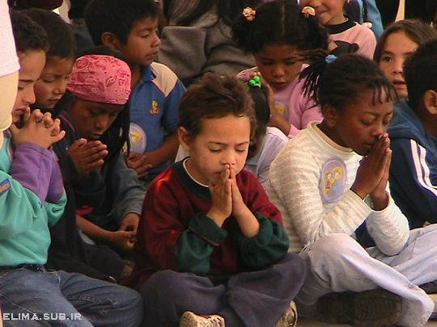
Dear Jesus,
I know I am a sinner & need your forgiveness.
I believe you died for my sins.
I now turn from sin.
Come into my heart I pray.
Do you want to meet Jesus as your Savior right now?
Do you believe He died to save you from your sins & that He rose from the dead?
Do you believe that He is waiting to save you right now?

Slide 33
“But some people did accept him. They believed in him, and he gave them the right to become children of God.” John 1:12

Slide 35
“If you openly say, ‘Jesus is Lord’ and believe in your heart that God raised him from death, you will be saved.”
Rom. 10:9
What did you learn today?
What is the meaning of the name-tag?
What have you been thinking about God lately?
What do you want to tell the world about Jesus?

Slide 36
“Draw near to God, and He will draw near to you…
…Cleanse your hands, you sinners, and make your hearts pure, you who are half-hearted towards God.” James 4:8 WNT

Slide 37
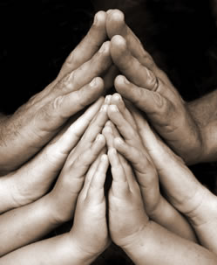
Close in Prayer

Slide 38
Note: Any videos in this presentation will only play online. After you download the slideshow, you will need to also download the videos from YouTube & add them back into your PowerPoint.
We present these messages at Bee Creek Park in College Station, TX. If you would like to watch the video of the service with this message, click here:
http://campaignkerusso.org/?p=10284
We would love to know more about the people who download our lessons & sermons. We invite you to email us & let us know where & how you use them.
info@ckbrazos.org

Slide 39
Welcome to Aggieland Faith Family Style Worship

Slide 40
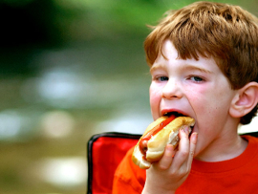
CURRENT SCHEDULE: See www.Aggielandfaith.org
SATURDAY —
At Bee Creek Park
2:00-4:00pm: Through the Bible with felt-board stories – plus hot-dogs & drinks
SUNDAY —
At Bee Creek Park
2:00-4pm: Free snacks, drinks, kids crafts, prizes, singing & bible preaching

Slide 41
Would You Like Prayer or Bible Study at Your House?
Personal Prayer: We can come to your home & pray with you, or you can email us when you need prayer.
Home Bible Study: We will come to your home & hold A Bible study for you & your friends.
Bible Party: We will hold a Kid’s Bible Party: You provide the food & kids - we will do the bible fun & stories.

Slide 42
Would You Like Visitation?
We will visit a friend, loved one in the hospital or in prison to pray for them & share Christ with them.
Contact: info@aggielandfaith.org

Slide 43
www.aggielandfaith.org
Go here to see pictures & videos
Go here to subscribe to e-mails about changes & cancellations

Slide 44
Note: Any videos in this presentation will only play online. After you download the slideshow, you will need to also download the videos from YouTube & add them back into your PowerPoint.
We present these messages at Bee Creek Park in College Station, TX. If you would like to watch the video of the service with this message, click here:
http://campaignkerusso.org/?p=10284
We would love to know more about the people who download our lessons & sermons. We invite you to email us & let us know where & how you use them.
info@ckbrazos.org

