Slide 1
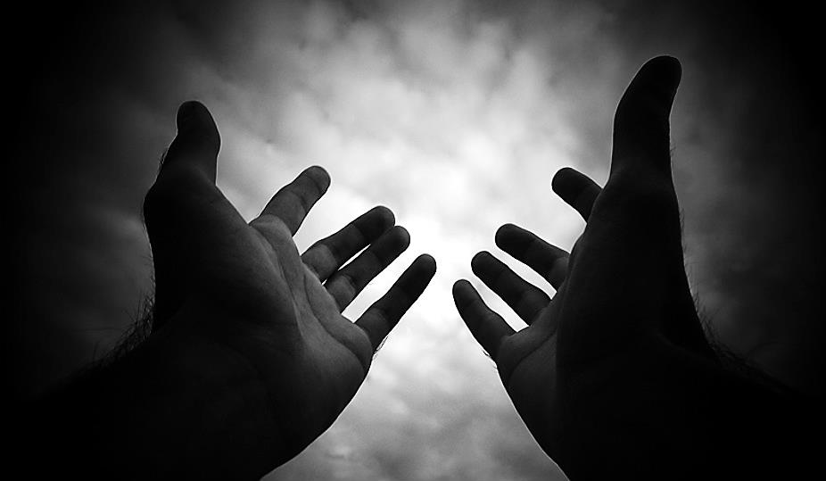
Birthing & Launching Ministries & Movements (Part 2)
Part 2

Slide 2
Note: Any videos in this presentation will only play online. After you download the slideshow, you will need to also download the videos from YouTube & add them back into your PowerPoint.
We present these messages at Bee Creek Park in College Station, TX. If you would like to watch the video of the service with this message, click here:
http://campaignkerusso.org/?p=10532
We would love to know more about the people who download our lessons & sermons. We invite you to email us & let us know where & how you use them.
info@ckbrazos.org

Slide 3
Next Slide → Song: Use Me Download Here: http://youtu.be/I0YdrhxwSk0

Slide 4
Honor Your Mother & Father

Slide 5
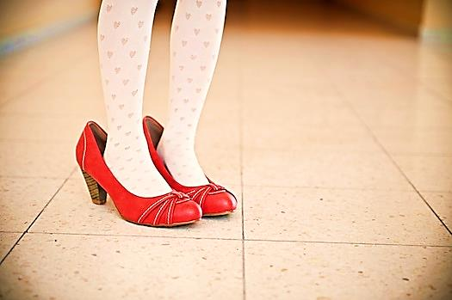
We honor our parents, not with gifts, but by our character – by the people we grow up to be.

Slide 6
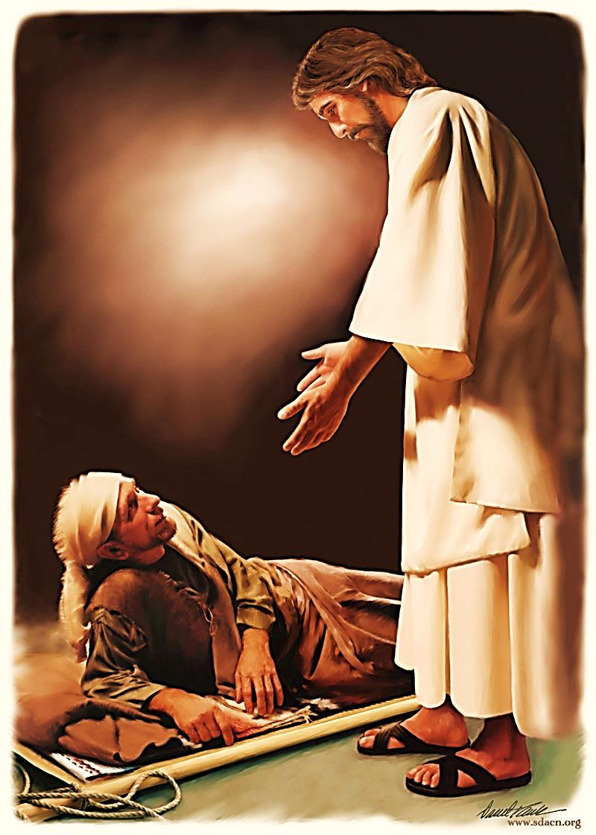
Mary is blessed above all mothers because her son is a man of exceptional character.

Slide 7
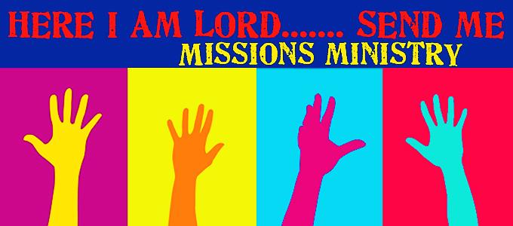
A great ministry honors its founder by its character.

Slide 8
“A wise son makes a glad father, but a foolish man despises his mother.” Proverbs 15:20

Slide 9
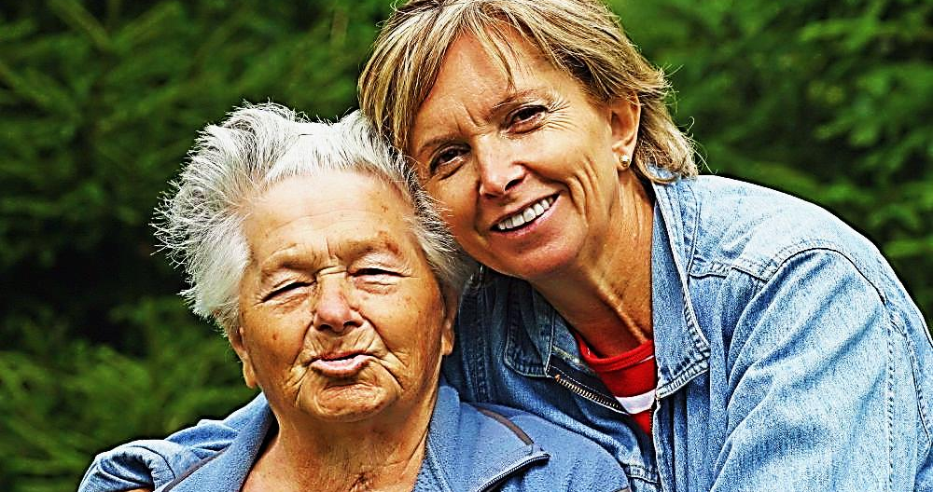
“Hear, my son, your father's instruction, and forsake not your mother's teaching,” Proverbs 1:8

Slide 10
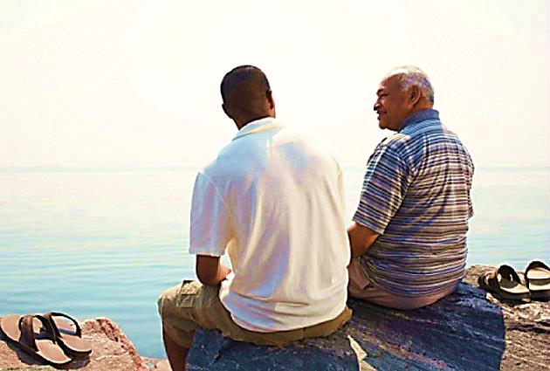
It is the duty of the offspring to return to and honor their parents.
“Listen to your father who gave you life, and do not despise your mother when she is old.” Prov 23:22

Slide 11
A child returns to honor its parents
A ministry or nation returns to honor its founders
A student returns to honor his teacher/mentor
And the Church returns to Honor the Cross of Jesus Christ.
The cross launched the Church, and in return She must forever embrace & honor that exact moment and act that gave Her life.

Slide 12
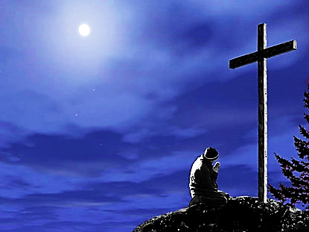
“For I decided to know nothing among you except Jesus Christ and him crucified.” 1 Cor 2:2
“But far be it from me to boast except in the cross of our Lord Jesus Christ…” Gal 6:14

Slide 13
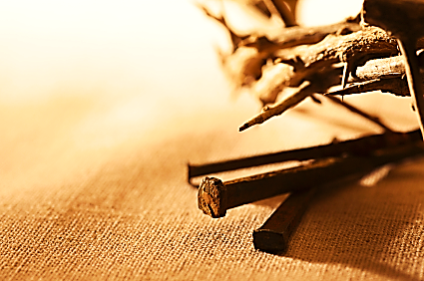
We owe it to Jesus to preach the CROSS every time we preach.

Slide 14
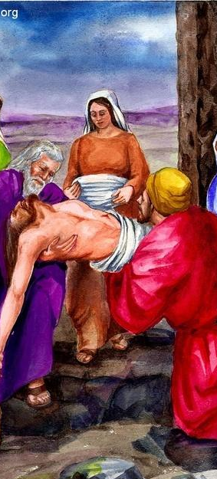
Travail is the Cost of a Life Giving Ministry
“It will be like a woman suffering the pains of labor. When her child is born, her anguish gives way to JOY because she has brought a new baby into the world.” John 16:21
“Let us keep looking to Jesus… He did not give up when He had to suffer shame and die on a cross. He knew of the JOY that would be His later…” Heb 12:2

Slide 15
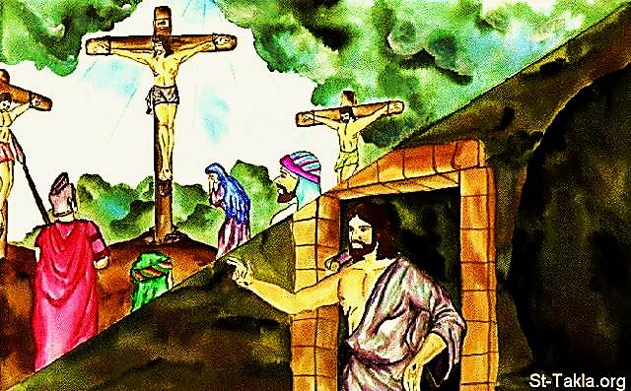
Jesus launched the Church through the painful process of death and resurrection.

Slide 16
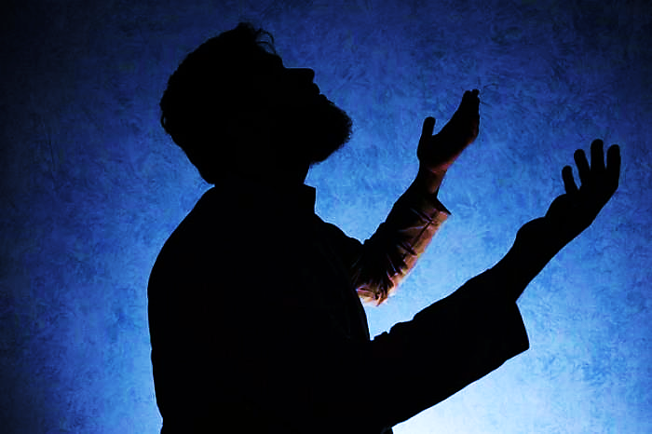
We are called to birth souls & even revivals in this generation. It will require labor. This may be in the form of evangelism, prayer & fasting, loss & betrayal – but it will all be forgotten if souls are saved.

Slide 17
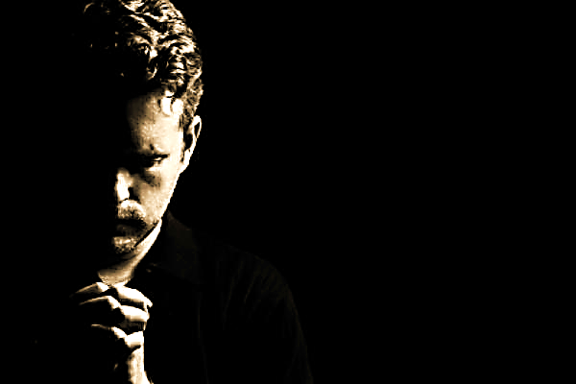
Andrew Strom, a well-known student of Christian Revivals says:
“Revival history shows again and again that if there are two key elements to obtaining true Revival, they would have to be DEEP REPENTANCE and AGONIZING' PRAYER. “
The Church must give birth to revival and then let God lead it where He wills.

Slide 18
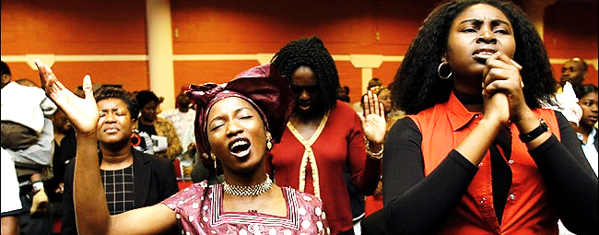
Charles Finney Said:
"Revival is no more a miracle than a crop of wheat. Revival comes from heaven when heroic souls enter the conflict determined to win or die - or if need be, to win and die! 'The kingdom of heaven suffers violence, and the VIOLENT take it by force.'"

Slide 19
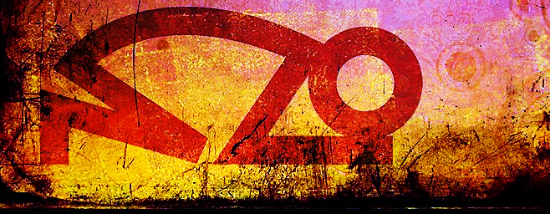
John Wesley said:
“Have you any days of fasting and prayer? Storm the throne of grace and persevere therein, and mercy will come down.”
Birth requires travail. What are we birthing, what stage are we at: Seeing the need, planning, hard work, repentance, labor in prayer?

Slide 20
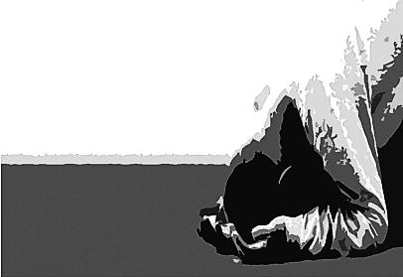
Why “press through” to revival?
“For we are not fighting against human
beings but against the wicked
spiritual forces…” Eph. 6:12
But, we fight more than the
‘wicked spiritual forces.’
Revival requires
repentance &
prayer.

Slide 22
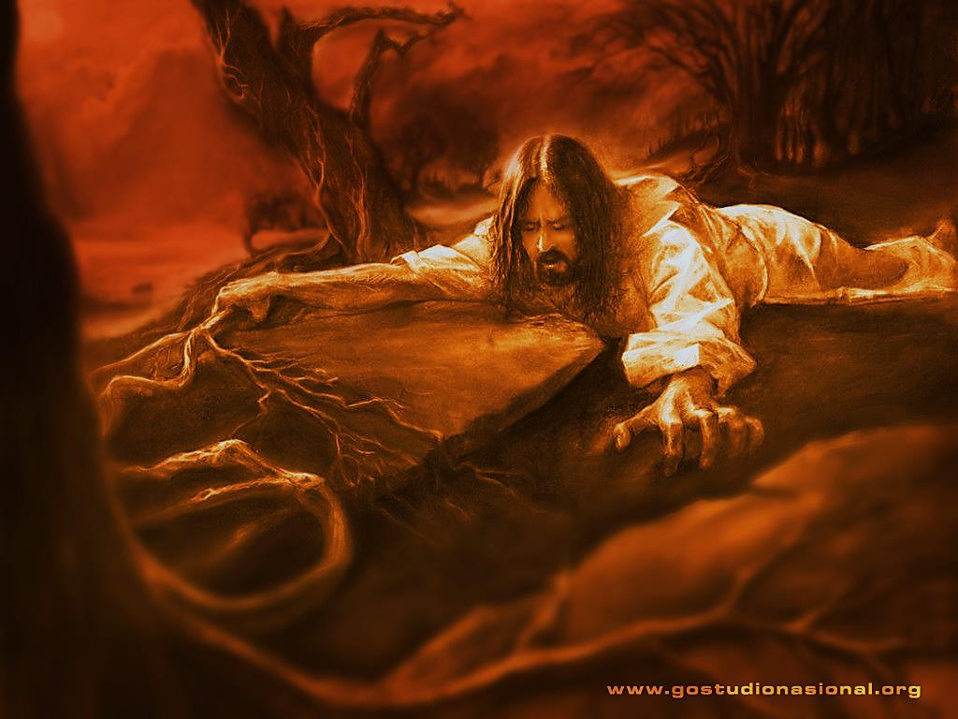
Just as the Cross is a picture of the ‘travail’ that birthed the Church (through resurrection), Jesus’ hours of struggling prayer, spent in Gethsemane, picture the labor pains of revival.

Slide 23
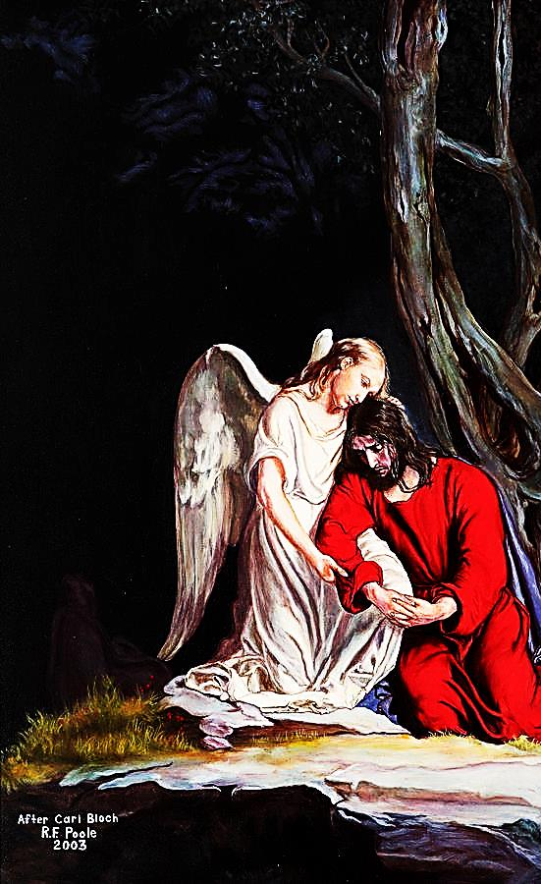
Struggling in Prayer, is an act of obedience. Even Jesus became perfect through obedience.
“God had the power to save Jesus from death. And while Jesus was on earth, he begged God with loud crying and tears to save him. He truly worshiped God, and God listened to his prayers.
Jesus is God’s own Son, but still he had to suffer before he could learn what it really means to obey God.
Suffering made Jesus perfect, and now he can save forever all who obey him.” Heb. 5:7-9

Slide 24
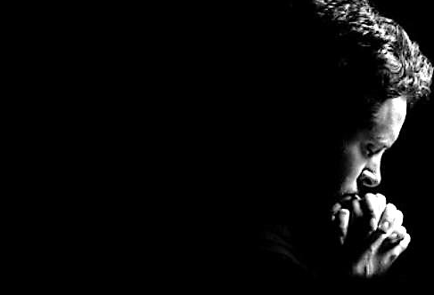
Jesus was wrestling His own
human flesh WILL. Peter failed to do this and it left him too weak to handle the challenge just ahead.
Like a butterfly struggling out of its cocoon, travailing prayer strengthens the move of God which is to be born.
The generation that does not struggle to give birth to its own transforming revival, is destined to be a weak, ineffective generation of believers.

Slide 25
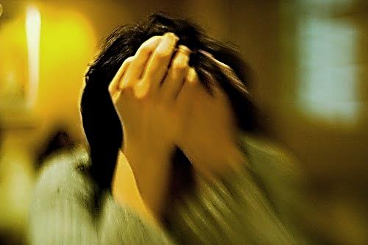
Struggling with our own indifference (remember Peter) and disobedience, through time spent in prayer, waiting for our will to break & God’s to prevail is the only way this generation will see revival in our time.

Slide 26
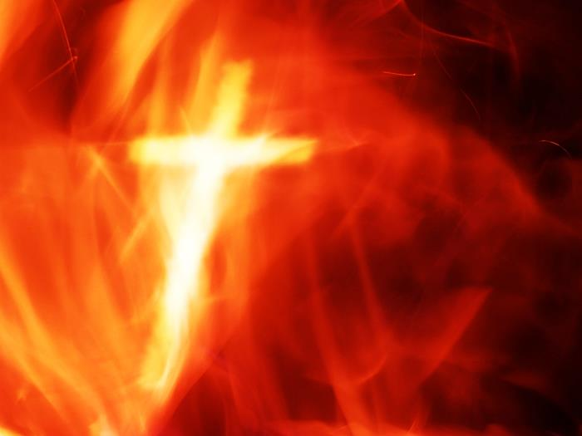
Great Godly Travail

Slide 27
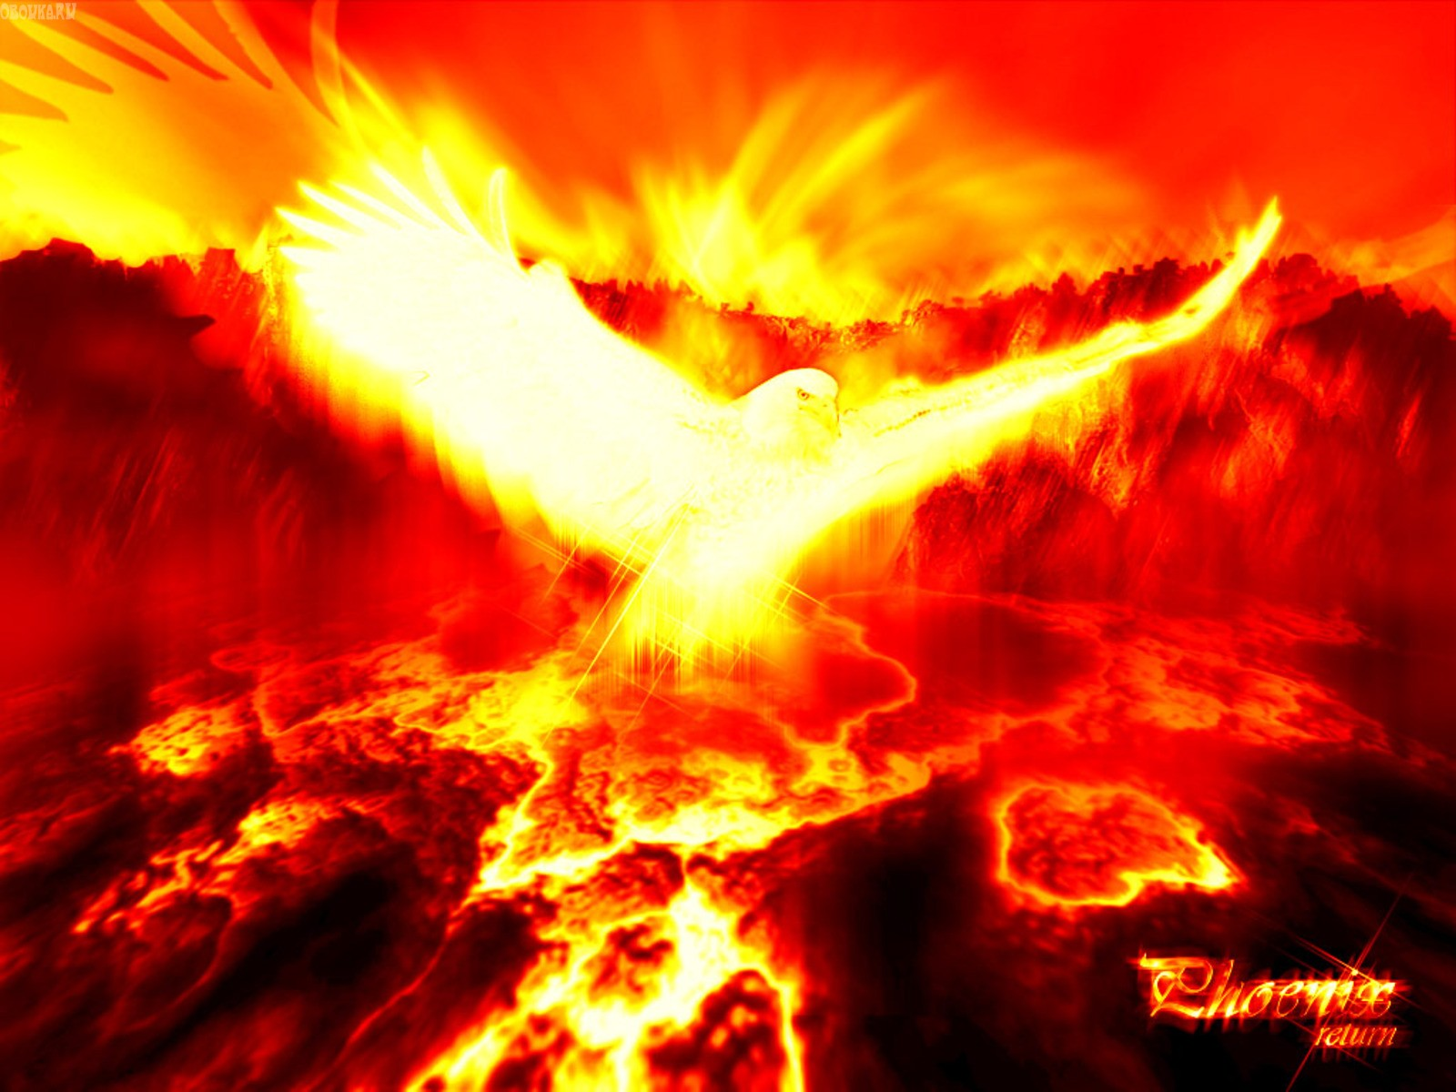
Will Birth True Revival

Slide 28
Next Slide → Song: Use Me Download Here: http://youtu.be/I0YdrhxwSk0

Slide 29
Is Jesus Speaking to You?
“They said to each other, ‘Did not our hearts burn within us while he talked to us on the road, while he opened to us the Scriptures?’”
John Wesley Said:
“…the preacher was describing the change which God works in the heart through faith in Christ and I felt my heart strangely warmed.”
Jesus makes His presence Known by a small voice!

Slide 31
What is the Sinner‘s Prayer?
This is a prayer we can pray when we are ready to admit we are sinners and need Christ’s forgiveness.
It must be prayed with faith in our hearts and a readiness to have a life-changing encounter with Jesus Christ.

Slide 32
A prayer of faith → Pray this prayer if :
If you never have before
You have in the past, but you think it would mean more today
You have been walking afar off and you want to come back
You want to set an example & show others how it is done
You just like to give your heart to Jesus again & again
Faith

Slide 33
We Declare Our Faith Publicly Because Jesus Declared His LOVE Publicly
“If you stand before others and are willing to say you believe in me, then I will tell my Father in heaven that you belong to me.” Mat 10:32

Slide 34
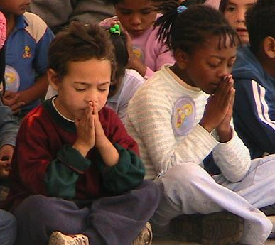
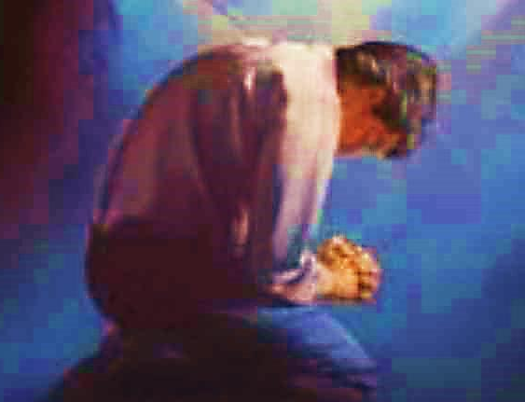
Important Questions
Do you want to know Jesus as your Savior right now?
Do you believe He died to save you from your sins & that He rose from the dead?
Do you believe that He is here, waiting to save you right now?

Slide 35
The Prayer of a Sinner Turning to Jesus
Dear Jesus, I know that I have sinned against You and that my sins separate me from You.
I am truly sorry.
Right now, I turn away from my sinful past .
Please forgive me, and help me to keep from sin.
I believe You died for my sins.
I Believe You rose from the dead, you are alive, and you hear this prayer from my heart.
I invite You Jesus to be both my Savior and the Lord of my life.
I want You to rule my life from now on.

Slide 36
“But some people did accept him. They believed in him, and he gave them the right to become children of God.”
John 1:12

Slide 38
“If you openly say, ‘Jesus is Lord’ and believe in your heart that God raised him from death, you will be saved.”
Rom. 10:9
What did you learn today?
What is the meaning of the name-tag?
What have you been thinking about God lately?
What do you want to tell the world about Jesus?

Slide 39
“Draw near to God, and He will draw near to you…
Altar Time
…Cleanse your hands, you sinners, and make your hearts pure, you who are half-hearted towards God.” James 4:8 WNT

Slide 40
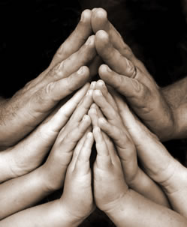
Close in Prayer

Slide 41
Note: Any videos in this presentation will only play online. After you download the slideshow, you will need to also download the videos from YouTube & add them back into your PowerPoint.
We present these messages at Bee Creek Park in College Station, TX. If you would like to watch the video of the service with this message, click here:
http://campaignkerusso.org/?p=10532
We would love to know more about the people who download our lessons & sermons. We invite you to email us & let us know where & how you use them.
info@ckbrazos.org

Slide 42
Welcome to Aggieland Faith Family Style Worship

Slide 43
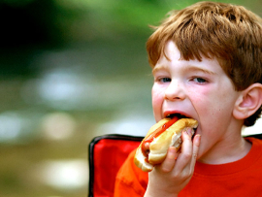
CURRENT SCHEDULE: See www.Aggielandfaith.org
SATURDAY —
At Bee Creek Park
2:00-4:00pm: Through the bible with felt-board stories – plus hot-dogs & drinks
SUNDAY —
At Bee Creek Park
2:00-4pm: Free snacks, drinks, kids crafts, prizes, singing & bible preaching

Slide 44
Would You Like Prayer or Bible Study at Your House?
Personal Prayer: We can come to your home & pray with you, or you can email us when you need prayer.
Home Bible Study: We will come to your home & hold a bible study for you & your friends.
Bible Party: We will hold a Kid’s Bible Party: You provide the food & kids - we will do the bible fun & stories.

Slide 45
Would You Like Visitation?
We will visit a friend, loved one in the hospital or in prison to pray for them & share Christ with them.
Contact: info@aggielandfaith.org

Slide 46
www.aggielandfaith.org
Go here to see pictures & videos
Go here to subscribe to e-mails about changes & cancellations

Slide 47
Note: Any videos in this presentation will only play online. After you download the slideshow, you will need to also download the videos from YouTube & add them back into your PowerPoint.
We present these messages at Bee Creek Park in College Station, TX. If you would like to watch the video of the service with this message, click here:
http://campaignkerusso.org/?p=10532
We would love to know more about the people who download our lessons & sermons. We invite you to email us & let us know where & how you use them.
info@ckbrazos.org

