Slide 1
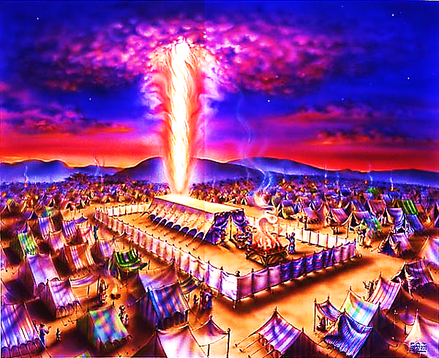
The Tabernacle in the Wilderness pt. 12

Slide 2
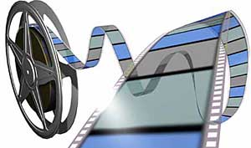
Note: Any videos in this presentation will only play online. After you download the slideshow, you will need to also download the videos from YouTube & add them back into your PowerPoint.
We present these messages at Bee Creek Park in College Station, TX. If you would like to watch the video of the service with this message, click here:
http://campaignkerusso.org/?p=10726
We would love to know more about the people who download our lessons & sermons. We invite you to email us & let us know where & how you use them.
info@ckbrazos.org

Slide 3
Next Slide →Song: We are the Body of Christ Download Here: http://youtu.be/7WJL5Ccw3b8

Slide 4
The Tabernacle in the Wilderness pt. 12

Slide 5
The Frame – The Body of Christ Part 2

Slide 6
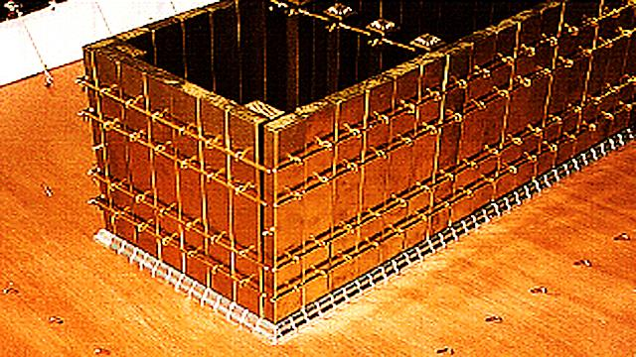
We have been looking at the coverings of the tent, now we will look at the framing.

Slide 7
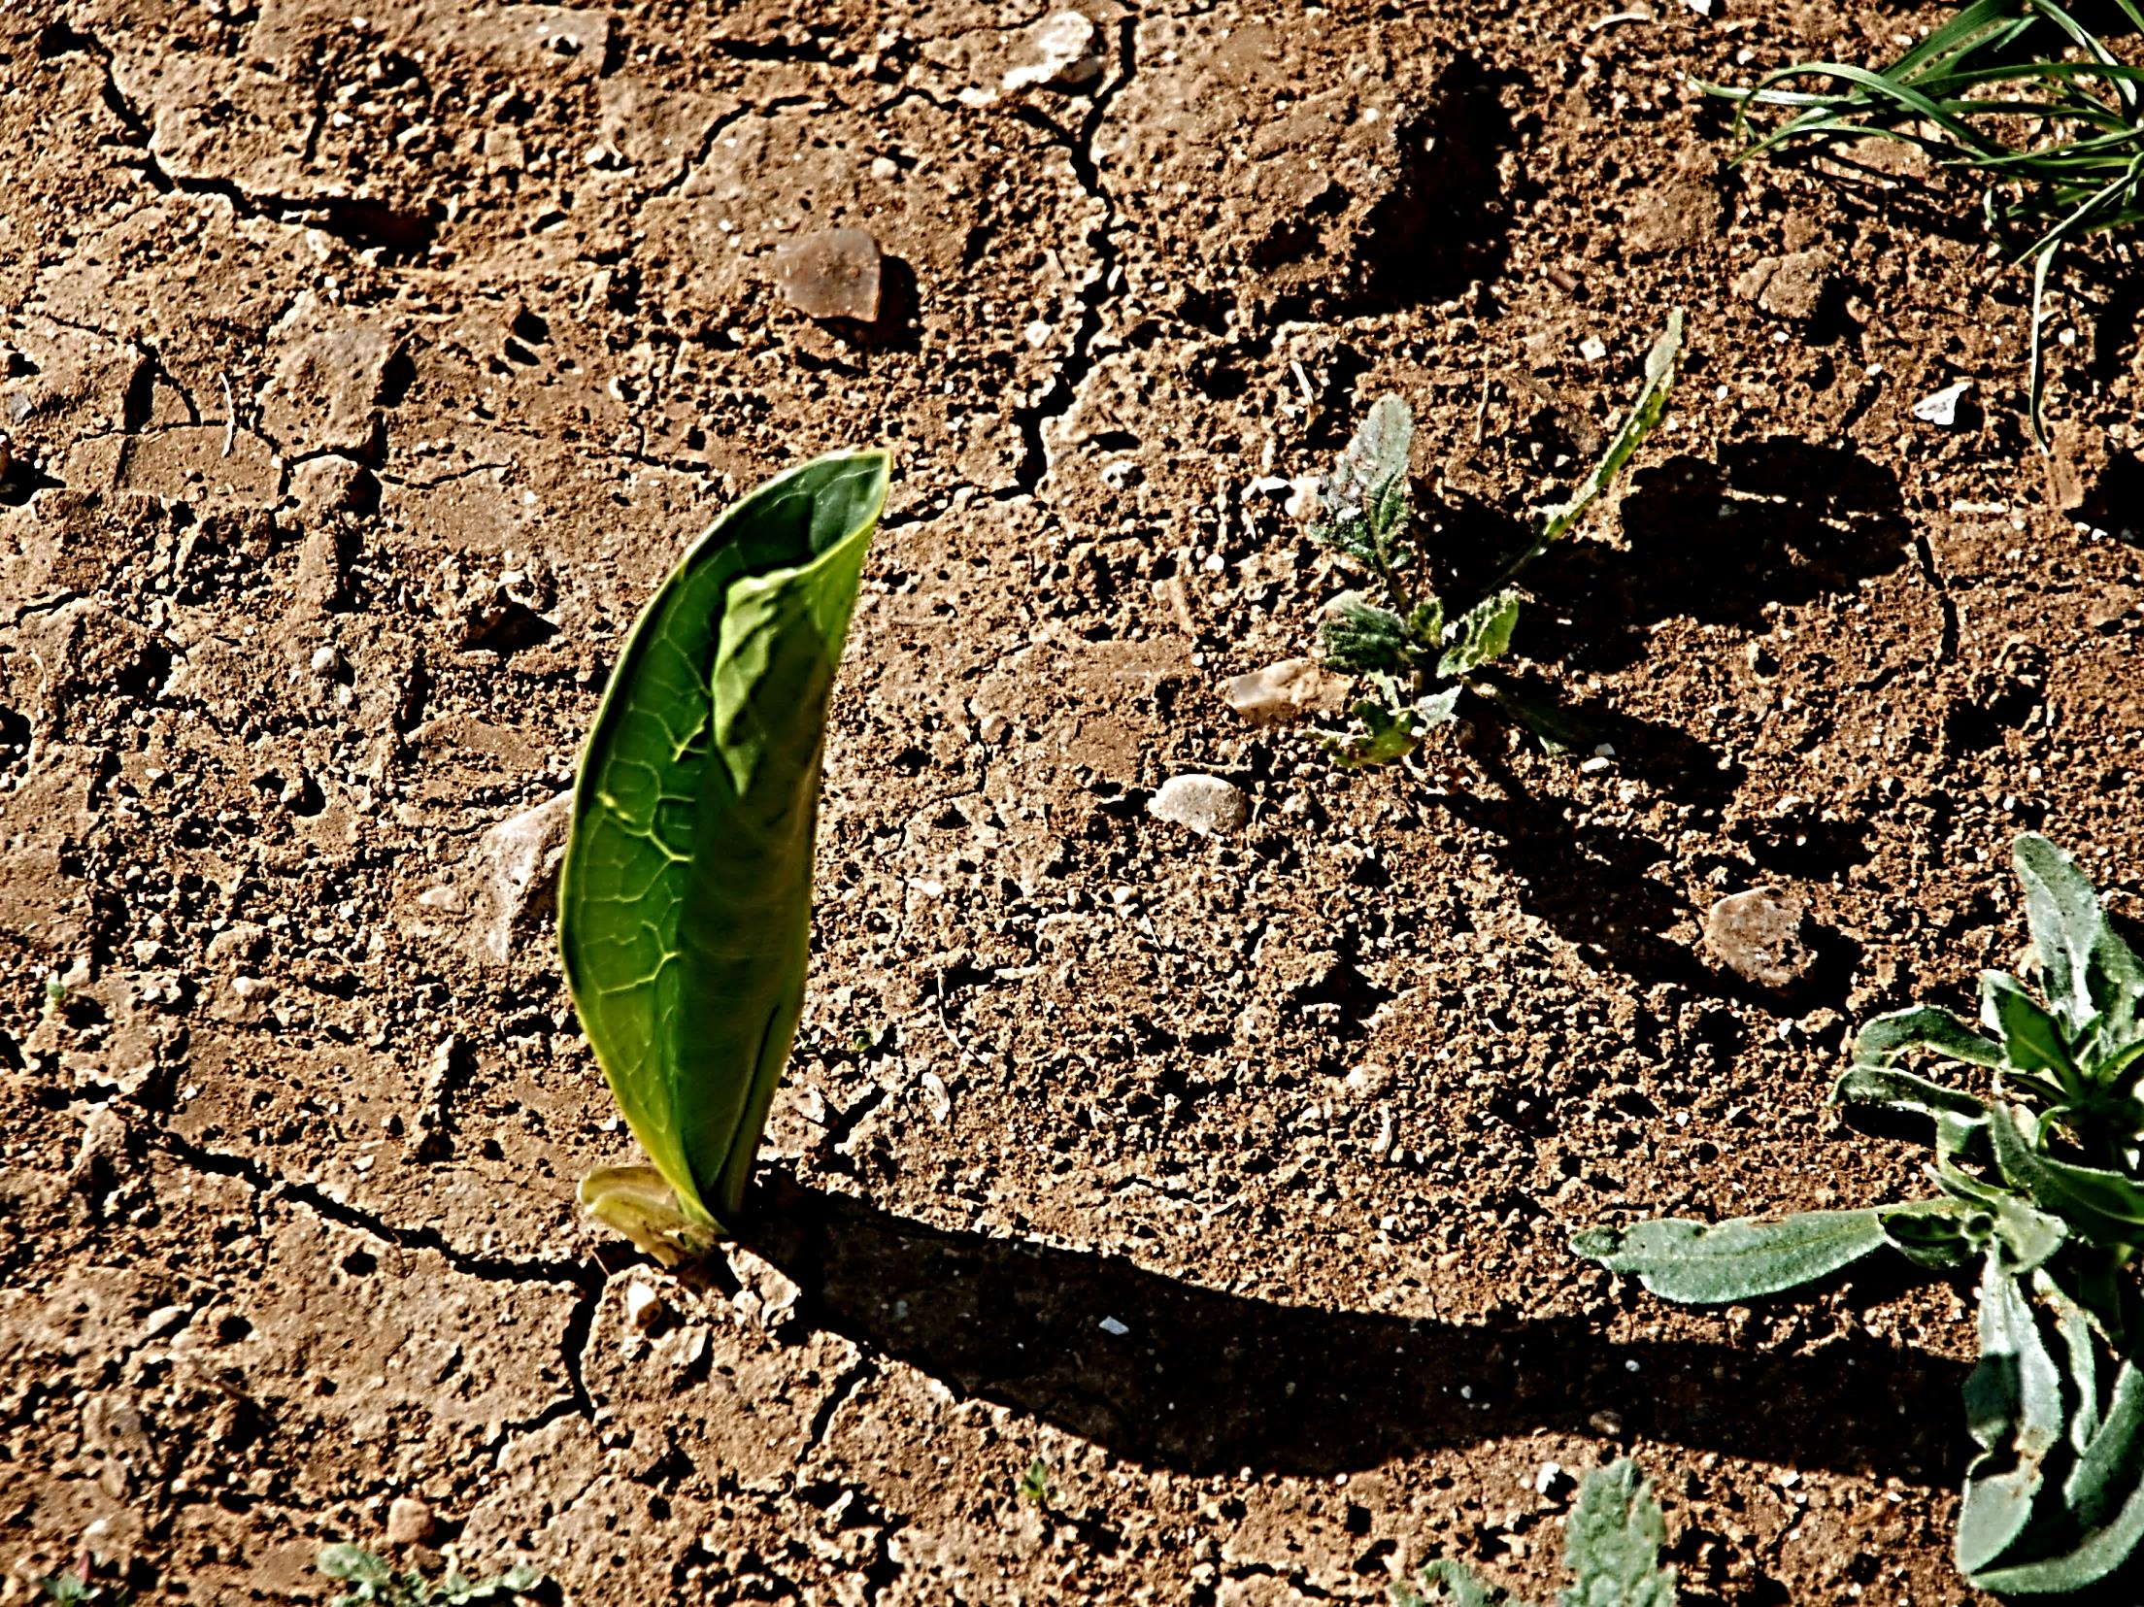
The wood framing (desert tree wood) covered with gold reminds us of Jesus’ dual nature.
“Like a young plant or a root that sprouts in dry ground, the servant grew up obeying the Lord.”
Isa. 53:2

Slide 8
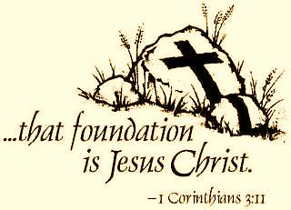
The silver sockets formed the Tabernacle foundation.
“…because Christ is the only foundation.”
1 Cor. 3:11

Slide 9
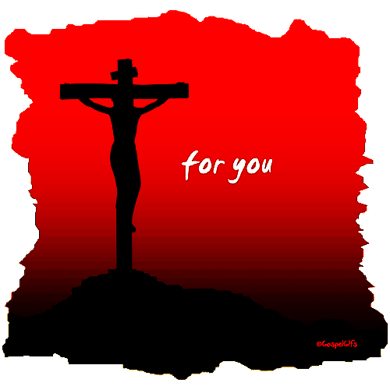
“You know you were not bought and made free from sin by paying gold or silver which comes to an end… The blood of Christ saved you. This blood is of great worth and no amount of money can buy it…” 1 Pet 1:18-19

Slide 10
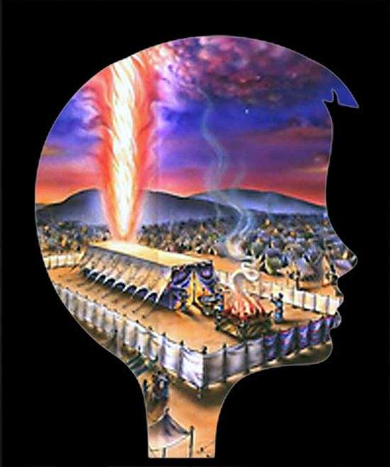
“You surely know that your body is a temple where the Holy Spirit lives. The Spirit is in you and is a gift from God. You are no longer your own. God paid a great price for you. So use your body to honor God.”
1 Cor. 6:19-20

Slide 11
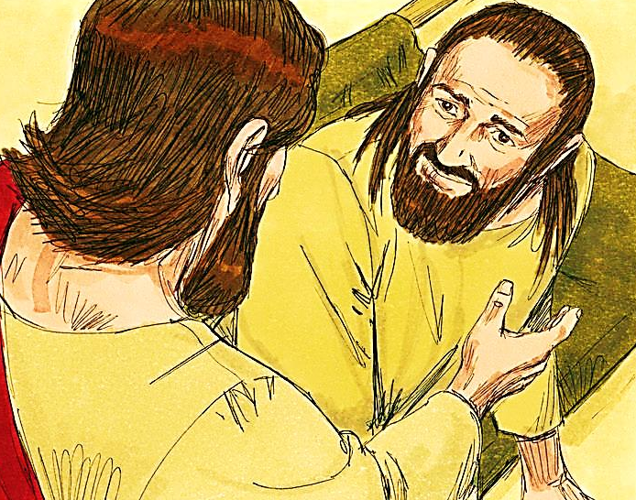
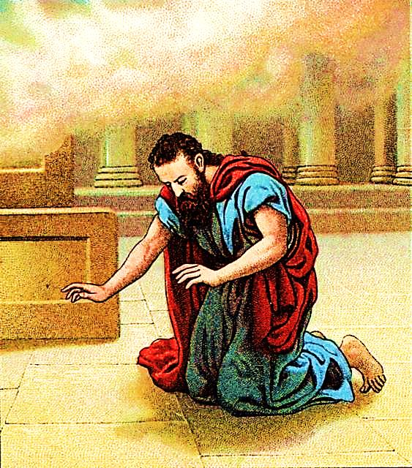
“When Simon Peter realized what had happened, he fell to his knees before Jesus and said, “Oh, Lord, please leave me—I’m too much of a sinner to be around you.”
Luke 5:8
“I said, “Oh, no! I will be destroyed. I am not pure, and I live among people who are not pure, but I have seen the King, the Lord All-Powerful.” Isa. 6:5

Slide 12
Because the blood of Jesus forms our personal foundation, we can indeed each stand in His holy presence.

Slide 13
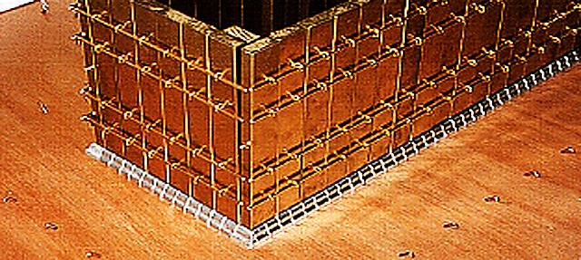
Held Together by Five Bars
(Five is the number of grace)
“Christ is the one who holds the building together and makes it grow into a holy temple for the Lord. And you are part of that building that Christ has built as a place for God’s own Spirit to live.” Eph. 2:21,22

Slide 14
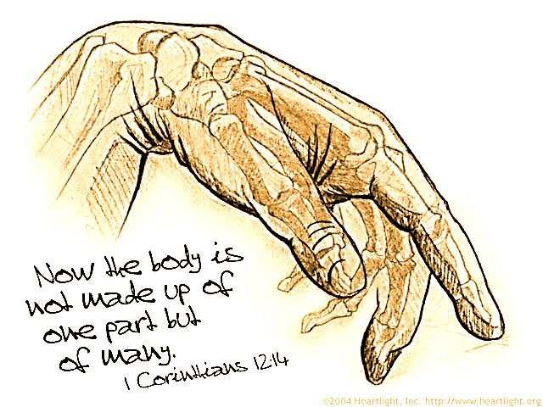
“Our bodies don’t have just one part. They have many parts.
Suppose a foot says, “I’m not a hand, and so I’m not
part of the body.” Wouldn’t the foot still belong to the body?” 1 Cor. 12:14,!5

Slide 15
Next Slide →Video: 1 Corinthians 12 12-27 Download Here: http://www.youtube.com/watch?v=AMt7-SVZc-U

Slide 16
“In the same way, though we are many, we are one body in union with Christ, and we are all joined to each other as different parts of one body.” Rom. 12:5

Slide 17
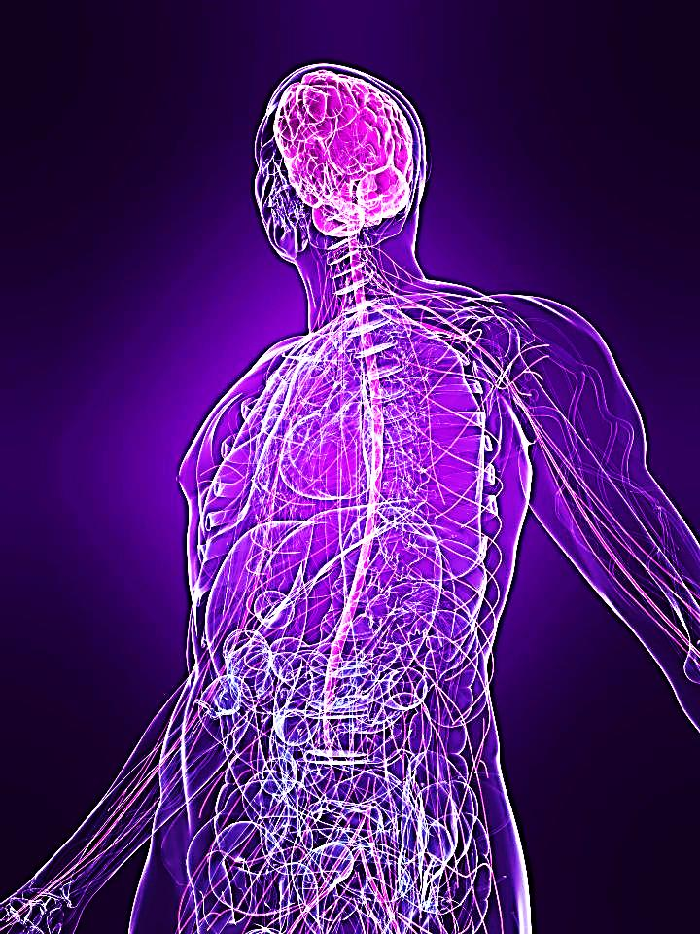
“Under Christ's control the whole body is nourished and held together by its joints and ligaments, and it grows as God wants it to grow.” Col. 2:19

Slide 18
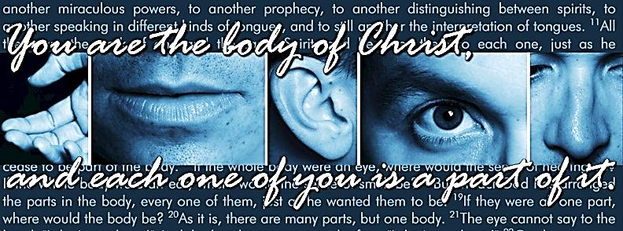
“He makes the whole body fit together perfectly. As each part does its own special work, it helps the other parts grow, so that the whole body is healthy and growing and full of love.” Eph. 4:16

Slide 19
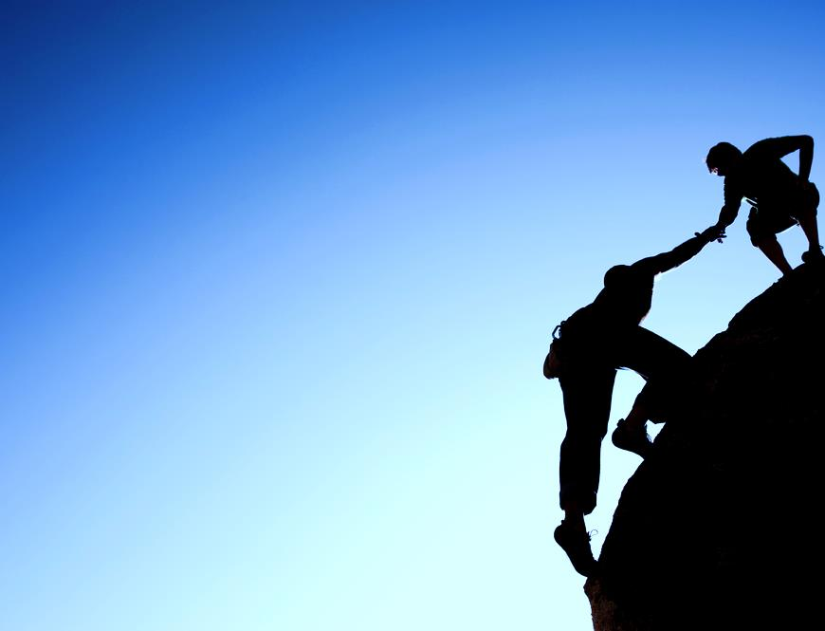
“Then make me truly happy by agreeing wholeheartedly with each other, loving one another, and working together with one mind and purpose. Don’t be selfish; don’t try to impress others...

Slide 20
…Be humble,
thinking of others as better
than yourselves. Don’t
look out only for your own
interests, but take an interest
in others, too. You must
have the same attitude that
Christ Jesus had.” Phil. 2:2-5

Slide 21
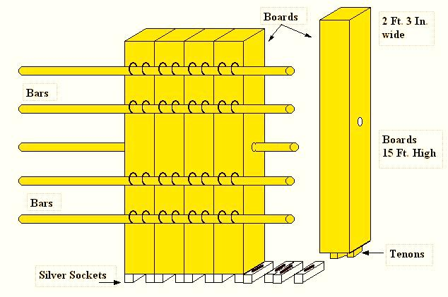
The central bar was actually inserted through the middle of the boards……
Jesus Christ and Him crucified is the central truth of the Gospel. When we receive Christ (by faith) at the cross, His nature in inserted into us.

Slide 22
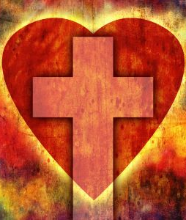
“and that Christ will live in your hearts because of your faith. Stand firm and be deeply rooted in his love.” Eph 1:17

Slide 23
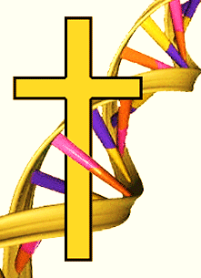
“God made great and marvelous promises, so that his nature would become part of us. Then we could escape our evil desires and the corrupt influences of this world.” 2 Pt. 1:4
“…Christ in you, the hope of glory” Col. 1:27

Slide 24
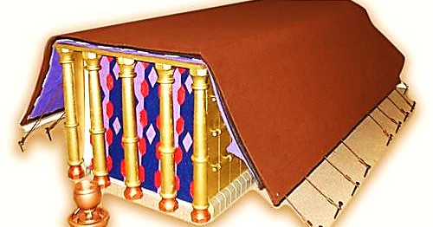
The Entrance Had Five Pillars
(Five is the number of GRACE)
No one can enter God’s dwelling place except by God’s GRACE

Slide 25
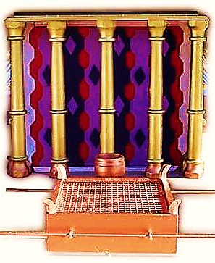
The Pillars stood in sockets of bronze.
Bronze represents God’s judgment.
God’s grace is not rooted in mere tolerance of sin, but on God’s judgment being satisfied at the Cross.

Slide 26
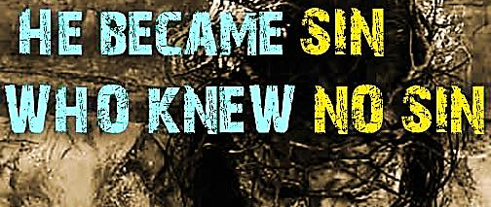
“Christ never sinned! But God treated him as a sinner, so that Christ could make us acceptable to God.” 2 Cor. 5:21
“He carried our sins in His own body when He died on a cross.” 1 Pet. 2:24

Slide 27
Next Slide → Song: How Beautiful Download Here: http://www.youtube.com/watch?v=QJfSp_rceFs

Slide 28
What is the Sinner‘s Prayer?
This is a prayer we can pray when we are ready to admit we are sinners and need Christ’s forgiveness.
It must be prayed with faith in our hearts and a readiness to have a life-changing encounter with Jesus Christ.

Slide 30
John Wesley’s Testimony
“…the preacher was describing the change which God works in the heart through faith in Christ and I felt my heart strangely warmed.”
Disciple’s Testimony
“They said to each other, ‘Did not our hearts burn within us while he talked to us on the road, while he opened to us the Scriptures?’”

Slide 31
A prayer of faith → Pray this prayer if :
If you never have before
You have in the past, but you think it would mean more today
You have been walking afar off and you want to come back
You want to set an example & show others how it is done
You just like to give your heart to Jesus again & again
Faith

Slide 32
We Declare Our Faith Publicly Because Jesus Declared His LOVE Publicly
“If you stand before others and are willing to say you believe in me, then I will tell my Father in heaven that you belong to me.” Mat 10:32

Slide 33
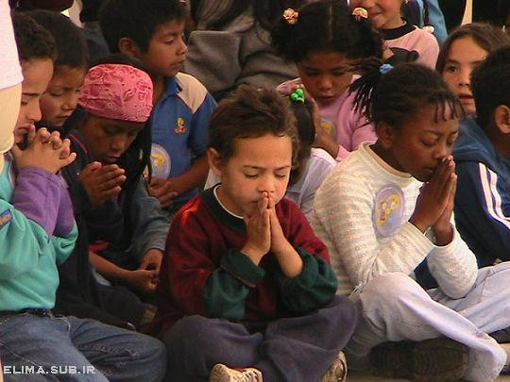
Dear Jesus,
I know I am a sinner & need your forgiveness.
I believe you died for my sins.
I now turn from sin.
Come into my heart I pray.
Do you want to meet Jesus as your savior right now?
Do you believe He died to save you from your sins & that He rose from the dead?
Do you believe that He is waiting to save you right now?

Slide 34
“But some people did accept him. They believed in him, and he gave them the right to become children of God.” John 1:12

Slide 36
“If you openly say, ‘Jesus is Lord’ and believe in your heart that God raised him from death, you will be saved.”
Rom. 10:9
What did you learn today?
What is the meaning of the name-tag?
What have you neen thinking about God lately?
What do you want to tell the world about Jesus?

Slide 37
“Draw near to God, and He will draw near to you…
…Cleanse your hands, you sinners, and make your hearts pure, you who are half-hearted towards God.” James 4:8 WNT

Slide 38
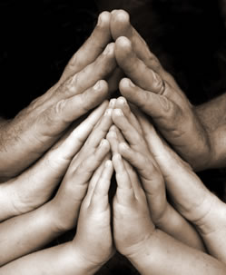
Close in Prayer

Slide 39
Note: Any videos in this presentation will only play online. After you download the slideshow, you will need to also download the videos from YouTube & add them back into your PowerPoint.
We present these messages at Bee Creek Park in College Station, TX. If you would like to watch the video of the service with this message, click here:
http://campaignkerusso.org/?p=10726
We would love to know more about the people who download our lessons & sermons. We invite you to email us & let us know where & how you use them.
info@ckbrazos.org

Slide 40
Welcome to Aggieland Faith Family Style Worship

Slide 41
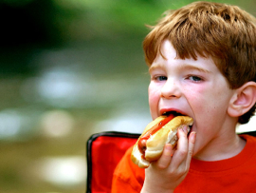
CURRENT SCHEDULE: See www.Aggielandfaith.org
SATURDAY —
At Bee Creek Park
2:00-4:00pm: Through the bible with felt-board stories – plus hot-dogs & drinks
SUNDAY —
At Bee Creek Park
2:00-4pm: Free snacks, drinks, kids crafts, prizes, singing & bible preaching

Slide 42
Would You Like Prayer or Bible Study at Your House?
Personal Prayer: We can come to your home & pray with you, or you can email us when you need prayer.
Home Bible Study: We will come to your home & hold a bible study for you & your friends.
Bible Party: We will hold a Kid’s Bible Party: You provide the food & kids - we will do the bible fun & stories.

Slide 43
Would You Like Visitation?
We will visit a friend, loved one in the hospital or in prison to pray for them & share Christ with them.
Contact: info@aggielandfaith.org

Slide 44
www.aggielandfaith.org
Go here to see pictures & videos
Go here to subscribe to e-mails about changes & cancellations

Slide 45
Note: Any videos in this presentation will only play online. After you download the slideshow, you will need to also download the videos from YouTube & add them back into your PowerPoint.
We present these messages at Bee Creek Park in College Station, TX. If you would like to watch the video of the service with this message, click here:
http://campaignkerusso.org/?p=10726
We would love to know more about the people who download our lessons & sermons. We invite you to email us & let us know where & how you use them.
info@ckbrazos.org

