Slide 1
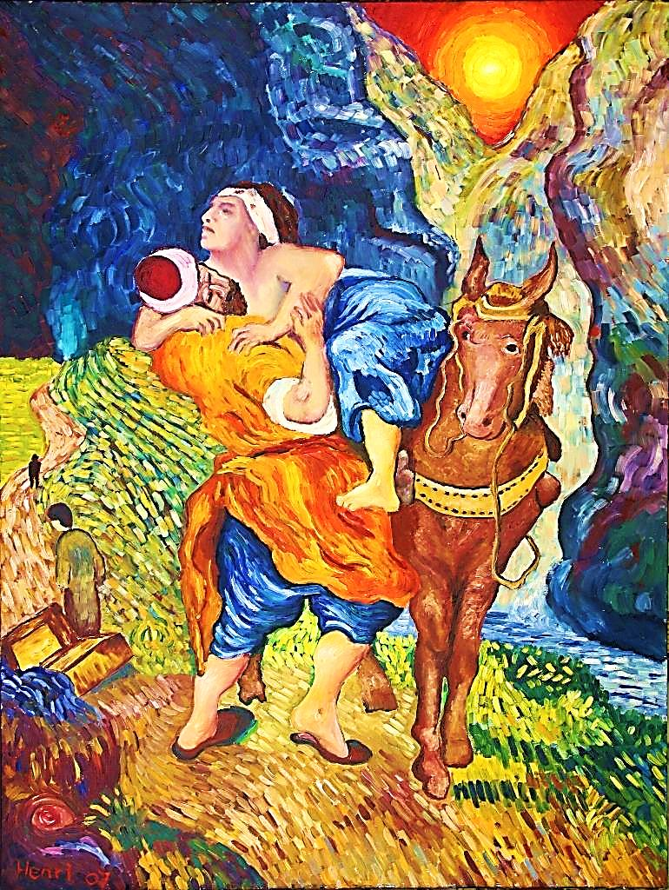
Jesus is Our
Good Samaritan

Slide 2
Note: Any videos in this presentation will only play online. After you download the slideshow, you will need to also download the videos from YouTube & add them back into your PowerPoint.
We present these messages at Bee Creek Park in College Station, TX. If you would like to watch the video of the service with this message, click here:
http://campaignkerusso.org/?p=7597
We would love to know more about the people who download our lessons & sermons. We invite you to email us & let us know where & how you use them.
info@ckbrazos.org

Slide 3
Jesus is Our
Good Samaritan

Slide 4
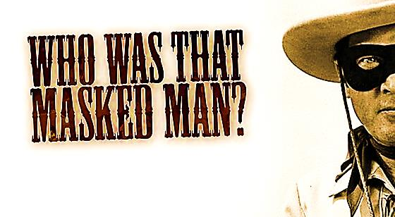
The Lone Ranger was a TV show about a masked, nameless man who made it his business to help people.

Slide 5
Next Slide →
Video: Who was that masked man?
Download Here:
http://youtu.be/N9-o-YDcq6I

Slide 6
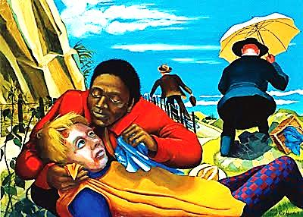
Another nameless,
but famous person:
THE GOOD SAMARITAN

Slide 7
TEXAS AREA CHURCH MINISTRIES NAMED “GOOD SAMARITAN”
GOOD SAMARITAN CENTER OF SAN ANTONIO
GOOD SAMARITAN CHRISTIAN SERVICES INC
GOOD SAMARITAN ENDOWMENT INC
GOOD SAMARITAN FOUNDATION OF TEXAS INC
GOOD SAMARITAN MINISTRIES OF REFUGIO COUNTY
GOOD SAMARITAN MISSIONARY BAPT CHURCH
GOOD SAMARITAN MISSIONS INC
GOOD SAMARITAN OUTREACH
GOOD SAMARITAN RESCUE MISSION
GOOD SAMARITANS CHURCH
GOOD SAMARITANS INTERNATIONAL
GOOD SAMARITANS OF GARLAND INC

Slide 8
Next Slide →
Video: Animated Good Samaritan
Download Here:
http://youtu.be/aYipDtdAcRc

Slide 9
About the care of those around us
the other characters in our story
LESSONS TO LEARN

Slide 10
Next Slide →
Video: Good Samaritan-My Hands
Download Here:
http://youtu.be/ZSxqHwZTT_A

Slide 11
An expert in the Law of Moses stood up and asked Jesus a question to see what he would say. “Teacher,” he asked, “what must I do to have eternal life?”
Jesus answered, “What
is written in the
Scriptures? How do
you understand them?”

Slide 12
The man replied, “The Scriptures say, ‘Love the Lord your God with all your heart, soul, strength, and mind.’ They also say, ‘Love your neighbors as much as you love yourself.’”
Jesus said, “You have
given the right answer.
If you do this, you
will have eternal life.”

Slide 13
But the man wanted to show that he knew what he was talking about. So he asked Jesus, “Who are my neighbors?”
Jesus replied: As a man was going down from Jerusalem to Jericho,
robbers attacked him
and grabbed
everything he had.

Slide 14
They beat him up and ran off, leaving him half dead.
A priest happened to be going down the same road. But when he saw the man, he walked by on the other
side. Later a temple
helper came to the
same place.

Slide 15
But when he saw the man who had been beaten up, he also went by on the other side. Later a temple helper came to the same place. But when he saw the man who had been beaten
up, he also went by
on the other side.

Slide 16
A man from Samaria then came traveling along that road. When he saw the man, he felt sorry for him and went over to him. He treated his wounds with olive oil and wine and bandaged
them. Then he put
him on his own
donkey and took him…

Slide 17
…to an inn, where he took care of him.
The next morning he gave the innkeeper two silver coins and said, “Please take care of the man. If you spend more than this on him, I will pay
you when I return.”

Slide 18
Then Jesus asked, “Which one of these three people was a real neighbor to the man who was beaten up by robbers?”
The teacher answered, “The one who showed pity.” Jesus
said, “Go and do the
same!”

Slide 19
Next Slide →
Video:
Samaritan Story-Without Words
Download Here:
http://youtu.be/KTG8h5bqKuI

Slide 20
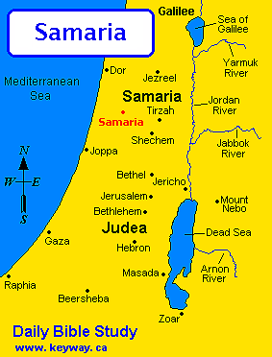
Jesus often traveled from Judea to Samaria through Jericho

Slide 21
The original road from Jerusalem to Jericho was (and still is)
a very rough 15 mile journey.

Slide 22
Next Slide →
Video:
Jerusalem to Jericho Terrain
Download Here:
http://youtu.be/a96uHuwQT2g

Slide 24
Next Slide →
Video:
From Jerusalem to Jericho-Hank Williams
Download Here:
http://youtu.be/vi_GZ_hTjZg

Slide 25
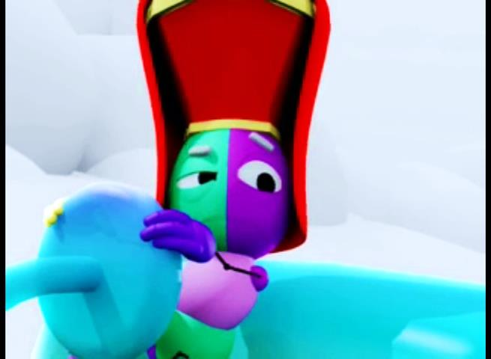
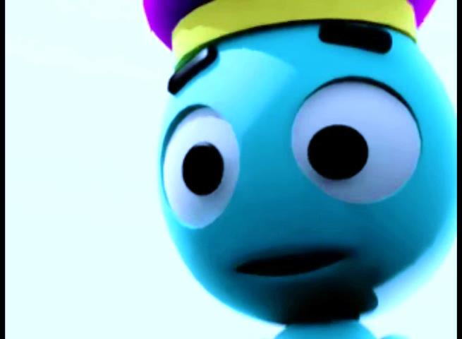
He saved us because of his mercy, not because of any good things we did. He saved us through the washing that made us new people. He saved us by making us new through the Holy Spirit. Titus 3:5
The Priest & the Levite were no help.

Slide 26
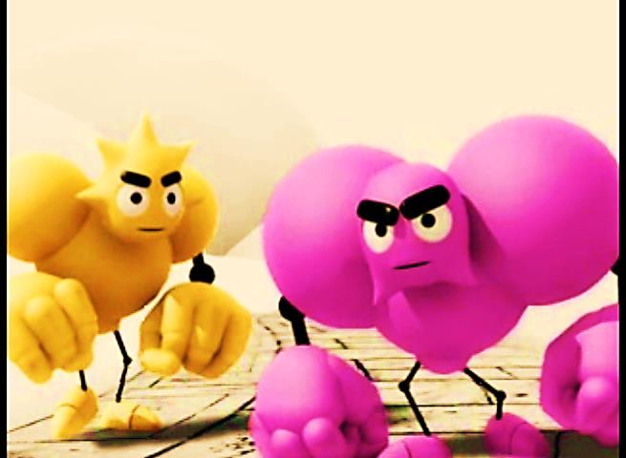
Surely you know that you become the slaves of whatever you give yourselves to. Anything or anyone you follow will be your master.
You can follow sin, or you can obey God. Following sin brings spiritual death, but obeying God makes you right with him. Rom 6:16
Bullies on the Road

Slide 27
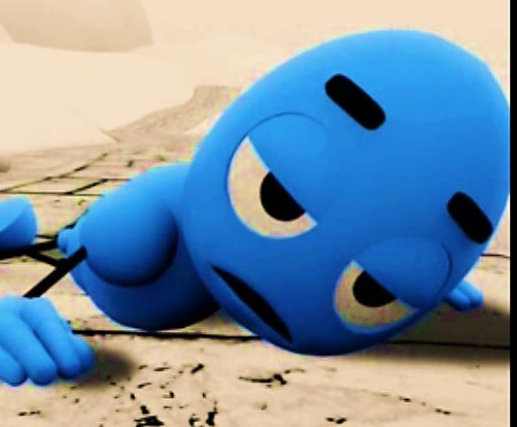
Dear friends, you are like visitors and strangers in this world. So I beg you to keep your lives free from the evil things you want to do, those desires that fight against your true selves.
1Peter 2:11
The Beaten Traveler

Slide 28
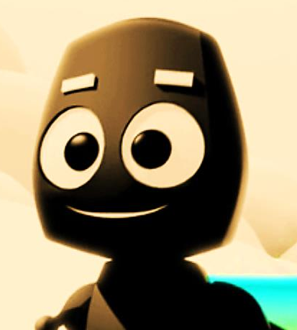
He was like God in every way, but he did not think that his being equal with God was something to use for his own benefit.
Instead, he gave up everything, even his place with God. He accepted the role of a servant, appearing in human form. Phil. 2:6-7
The Samaritan

Slide 29
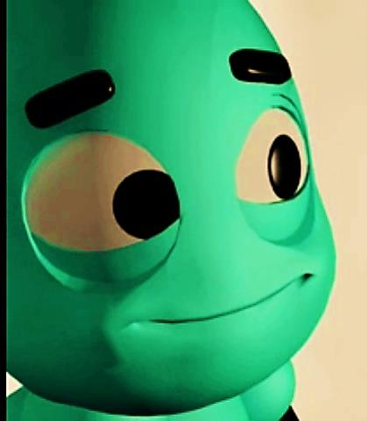
After I go and prepare a place for you, I will come back. John 14:3
Let me assure you, it is better for you that I go away. I say this because when I go away I will send the Helper to you. John 16:7
The Innkeeper

Slide 30
The Priest & Levite
Who was…

Slide 31
The Priest & Levite
Good Deeds & Religion
Who was…

Slide 32
The Priest & Levite
Good Deeds & Religion
Bullies on the Road
Who was…

Slide 33
The Priest & Levite
Good Deeds & Religion
Bullies on the Road
Consequences of Sin
Who was…

Slide 34
The Priest & Levite
Good Deeds & Religion
Bullies on the Road
Consequences of Sin
The Beaten Traveler
Who was…

Slide 35
The Priest & Levite
Good Deeds & Religion
Bullies on the Road
Consequences of Sin
The Beaten Traveler
All of Mankind
Who was…

Slide 36
The Priest & Levite
Good Deeds & Religion
Bullies on the Road
Consequences of Sin
The Beaten Traveler
All of Mankind
The Good Samaritan
Who was…

Slide 37
The Priest & Levite
Good Deeds & Religion
Bullies on the Road
Consequences of Sin
The Beaten Traveler
All of Mankind
The Good Samaritan
Who was…
Jesus

Slide 38
The Priest & Levite
Good Deeds & Religion
Bullies on the Road
Consequences of Sin
The Beaten Traveler
All of Mankind
The Good Samaritan
The Inn
Who was…
Jesus

Slide 39
The Priest & Levite
Good Deeds & Religion
Bullies on the Road
Consequences of Sin
The Beaten Traveler
All of Mankind
The Good Samaritan
The Inn
Who was…
Jesus
The Church

Slide 40
The Priest & Levite
Good Deeds & Religion
Bullies on the Road
Consequences of Sin
The Beaten Traveler
All of Mankind
The Good Samaritan
The Inn
The Innkeeper
Who was…
Jesus
The Church

Slide 41
The Priest & Levite
Good Deeds & Religion
Bullies on the Road
Consequences of Sin
The Beaten Traveler
All of Mankind
The Good Samaritan
The Inn
The Innkeeper
Who was…
Jesus
The Church
The Holy Spirit

Slide 42
Next Slide →
Video:
From Jerusalem to Jericho-Hank Williams
Download Here:
http://youtu.be/vi_GZ_hTjZg

Slide 43
Is Jesus Speaking to You?
“They said to each other, ‘Did not our hearts burn within us while he talked to us on the road, while he opened to us the Scriptures?’”
John Wesley Said:
“…the preacher was describing the change which God works in the heart through faith in Christ and I felt my heart strangely warmed.”
Jesus makes His presence Known by a small voice!

Slide 45
What is the Sinner‘s Prayer?
This is a prayer we can pray when we are ready to admit we are sinners and need Christ’s forgiveness.
It must be prayed with faith in our hearts and a readiness to have a life-changing encounter with Jesus Christ.

Slide 46
A prayer of faith → Pray this prayer if :
If you never have before
You have in the past, but you think it would mean more today
You have been walking afar off and you want to come back
You want to set an example & show others how it is done
You just like to give your heart to Jesus again & again
Faith

Slide 47
We Declare Our Faith Publicly Because Jesus Declared His LOVE Publicly
“If you stand before others and are willing to say you believe in me, then I will tell my Father in heaven that you belong to me.” Mat 10:32

Slide 48
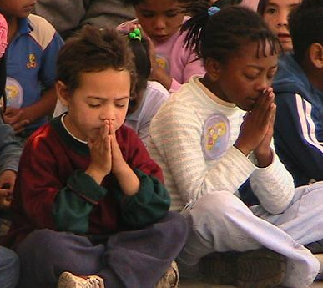
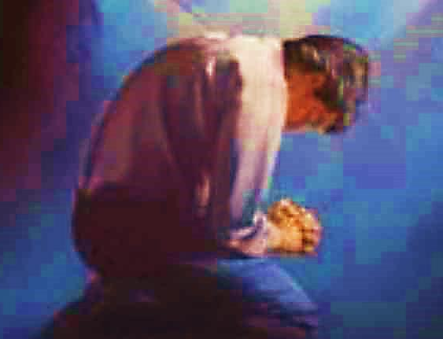
Important Questions
Do you want to know Jesus as your Savior right now?
Do you believe He died to save you from your sins & that He rose from the dead?
Do you believe that He is here, waiting to save you right now?

Slide 49
The Prayer of a Sinner Turning to Jesus
Dear Jesus, I know that I have sinned against You and that my sins separate me from You.
I am truly sorry.
Right now, I turn away from my sinful past .
Please forgive me, and help me to keep from sin.
I believe You died for my sins.
I Believe You rose from the dead, you are alive, and you hear this prayer from my heart.
I invite You Jesus to be both my Savior and the Lord of my life.
I want You to rule my life from now on.

Slide 50
“But some people did accept him. They believed in him, and he gave them the right to become children of God.”
John 1:12

Slide 52
“If you openly say, ‘Jesus is Lord’ and believe in your heart that God raised him from death, you will be saved.”
Rom. 10:9
What did you learn today?
What is the meaning of the name-tag?
What have you been thinking about God lately?
What do you want to tell the world about Jesus?

Slide 53
“Draw near to God, and He will draw near to you…
Altar Time
…Cleanse your hands, you sinners, and make your hearts pure, you who are half-hearted towards God.” James 4:8 WNT

Slide 54
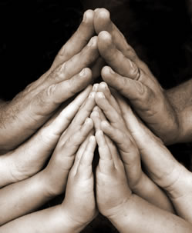
Close in Prayer

Slide 55
Note: Any videos in this presentation will only play online. After you download the slideshow, you will need to also download the videos from YouTube & add them back into your PowerPoint.
We present these messages at Bee Creek Park in College Station, TX. If you would like to watch the video of the service with this message, click here:
http://campaignkerusso.org/?p=7597
We would love to know more about the people who download our lessons & sermons. We invite you to email us & let us know where & how you use them.
info@ckbrazos.org

Slide 56
Welcome to Aggieland Faith Family Style Worship

Slide 57
CURRENT SCHEDULE: www.Aggielandfaith.org
Three Sunday Sermons
From 2 pm till about 4 pm
Through the New Testament
Through the Old Testament
Topical or Series
(Current Series: Tabernacle)

Slide 58
Would You Like Prayer or Bible Study at Your House?
Personal Prayer: We can come to your home & pray with you, or you can email us when you need prayer.
Home Bible Study: We will come to your home & hold a bible study for you & your friends.
Bible Party: We will hold a Kid’s Bible Party: You provide the food & kids - we will do the bible fun & stories.

Slide 59
Would You Like Visitation?
We will visit a friend, loved one in the hospital or in prison to pray for them & share Christ with them.
Contact: info@aggielandfaith.org

Slide 60
www.aggielandfaith.org
Go here to see pictures & videos
Go here to subscribe to e-mails about changes & cancellations

Slide 61
Note: Any videos in this presentation will only play online. After you download the slideshow, you will need to also download the videos from YouTube & add them back into your PowerPoint.
We present these messages at Bee Creek Park in College Station, TX. If you would like to watch the video of the service with this message, click here:
http://campaignkerusso.org/?p=7597
We would love to know more about the people who download our lessons & sermons. We invite you to email us & let us know where & how you use them.
info@ckbrazos.org

