Slide 1
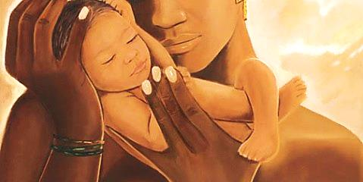
Seven Bible Mothers

Slide 2
Note: Any videos in this presentation will only play online. After you download the slideshow, you will need to also download the videos from YouTube & add them back into your PowerPoint.
We present these messages at Bee Creek Park in College Station, TX. If you would like to watch the video of the service with this message, click here:
http://campaignkerusso.org/?p=11683
We would love to know more about the people who download our lessons & sermons. We invite you to email us & let us know where & how you use them.
info@ckbrazos.org

Slide 3
Seven Bible Mothers

Slide 4
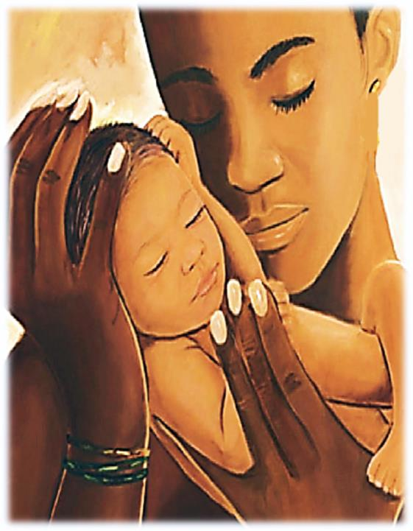
Eve
Eve was the first woman and the first mother. "Mother of All the Living." She and Adam lived in Paradise, but they listened to Satan instead of God. Eve suffered grief when her son Cain murdered his brother Abel. Eve went on to fulfill God's plan of populating the Earth.

Slide 5
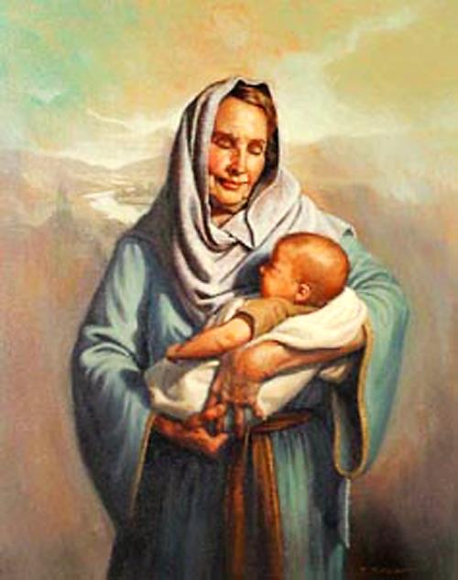
Sarah
She was the wife of Abraham, the mother of the nation of Israel, yet Sarah was barren. She conceived in spite of her old age. Sarah was a good wife, a loyal helper and builder with Abraham. Her faith serves as a shining example for every person who has to wait on God to act.

Slide 6
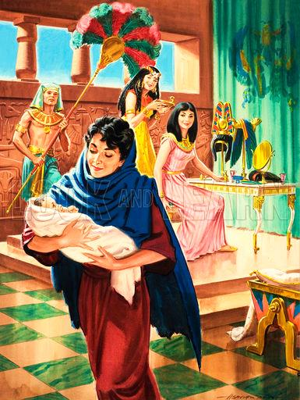
Jochebed
Jochebed is the mother of Moses. To avoid the mass slaughter of Hebrew boys, she set her baby adrift in the Nile River, hoping someone would find him and raise him. Her baby was found by Pharaoh's daughter. Jochebed became her own son's nurse.

Slide 7
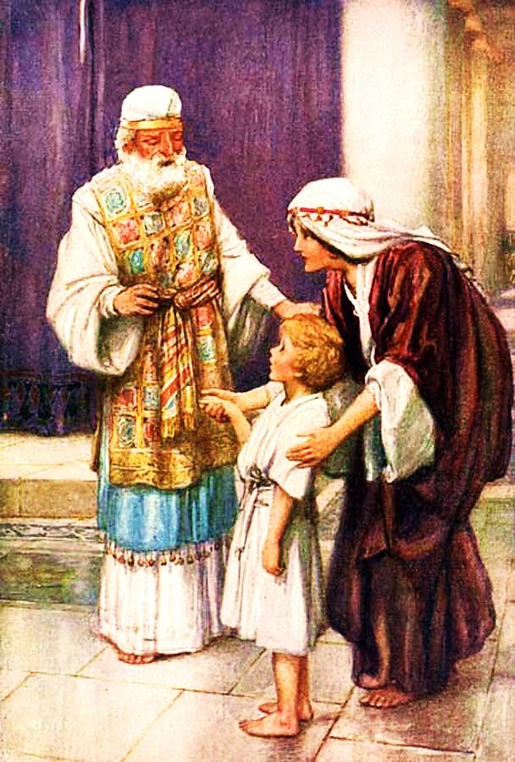
Hannah
She suffered long years of barrenness and was cruelly taunted by her husband's other wife. But Hannah never gave up on God. Finally, her prayers were answered. She gave birth to Samuel and then did something entirely selfless. God favored Hannah with five more children.

Slide 8
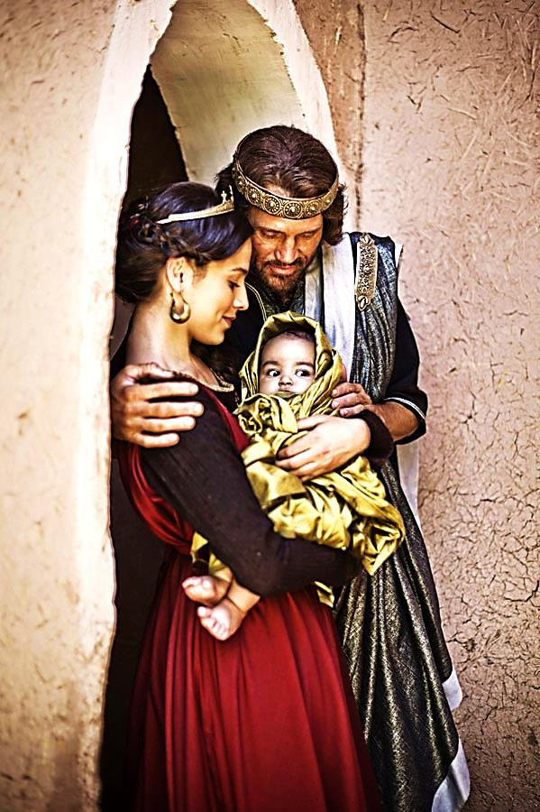
Bathsheba
David stole her from her husband Uriah and even had him killed. God was displeased and sadly, their first baby died. Still, Bathsheba was loyal to David and their next son, Solomon, became Israel's greatest king. From David's line would come Jesus Christ. Bathsheba is one of five women listed in Messiah's ancestry.

Slide 9
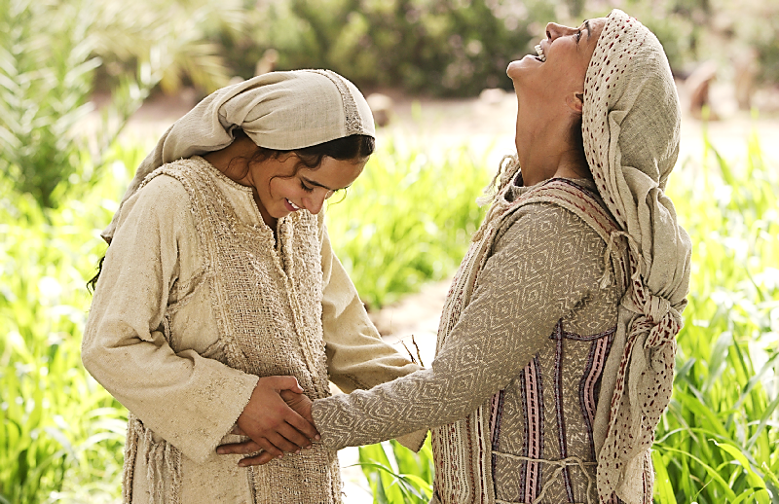
Elizabeth
She was barren in her old age, and by a miracle, gave birth to a son named John (as an angel had instructed). Elizabeth's joy was complete when her relative Mary visited her, pregnant herself, with the future Savior of the World. John became a great prophet.

Slide 10
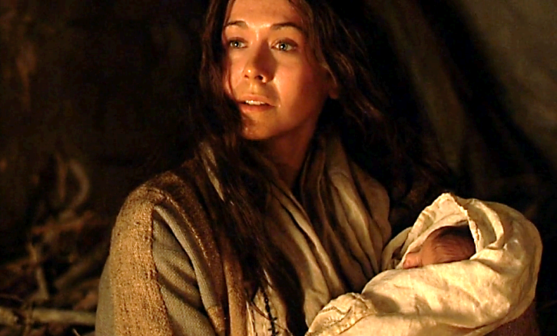
Mary
She is the human mother of Jesus. Although she was only a young, humble peasant, Mary accepted God's will for her life. She suffered shame, yet never doubted her Son for a moment. Mary was highly favored by God, a shining example of obedience and submission to God.

Slide 11
Is Jesus Speaking to You?
“They said to each other, ‘Did not our hearts burn within us while he talked to us on the road, while he opened to us the Scriptures?’”
John Wesley Said:
“…the preacher was describing the change which God works in the heart through faith in Christ and I felt my heart strangely warmed.”
Jesus makes His presence Known by a small voice!

Slide 13
What is the Sinner‘s Prayer?
This is a prayer we can pray when we are ready to admit we are sinners and need Christ’s forgiveness.
It must be prayed with faith in our hearts and a readiness to have a life-changing encounter with Jesus Christ.

Slide 14
A prayer of faith → Pray this prayer if :
If you never have before
You have in the past, but you think it would mean more today
You have been walking afar off and you want to come back
You want to set an example & show others how it is done
You just like to give your heart to Jesus again & again
Faith

Slide 15
We Declare Our Faith Publicly Because Jesus Declared His LOVE Publicly
“If you stand before others and are willing to say you believe in me, then I will tell my Father in heaven that you belong to me.” Mat 10:32

Slide 16
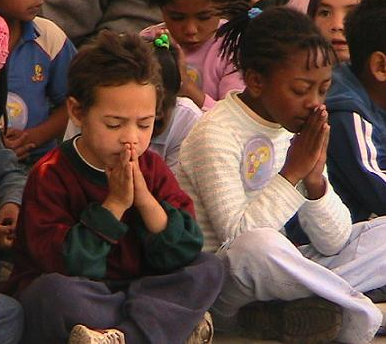
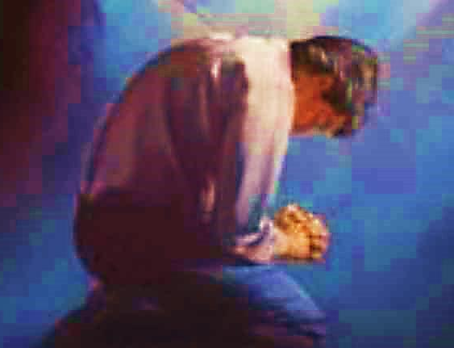
Important Questions
Do you want to know Jesus as your Savior right now?
Do you believe He died to save you from your sins & that He rose from the dead?
Do you believe that He is here, waiting to save you right now?

Slide 17
The Prayer of a Sinner Turning to Jesus
Dear Jesus, I know that I have sinned against You and that my sins separate me from You.
I am truly sorry.
Right now, I turn away from my sinful past .
Please forgive me, and help me to keep from sin.
I believe You died for my sins.
I Believe You rose from the dead, you are alive, and you hear this prayer from my heart.
I invite You Jesus to be both my Savior and the Lord of my life.
I want You to rule my life from now on.

Slide 18
“But some people did accept him. They believed in him, and he gave them the right to become children of God.”
John 1:12

Slide 20
“If you openly say, ‘Jesus is Lord’ and believe in your heart that God raised him from death, you will be saved.”
Rom. 10:9
What did you learn today?
What is the meaning of the name-tag?
What have you been thinking about God lately?
What do you want to tell the world about Jesus?

Slide 21
“Draw near to God, and He will draw near to you…
Altar Time
…Cleanse your hands, you sinners, and make your hearts pure, you who are half-hearted towards God.” James 4:8 WNT

Slide 22
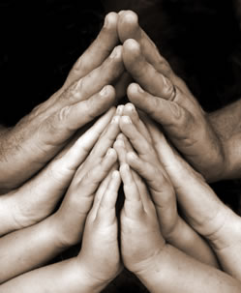
Close in Prayer

Slide 23
Note: Any videos in this presentation will only play online. After you download the slideshow, you will need to also download the videos from YouTube & add them back into your PowerPoint.
We present these messages at Bee Creek Park in College Station, TX. If you would like to watch the video of the service with this message, click here:
http://campaignkerusso.org/?p=11683
We would love to know more about the people who download our lessons & sermons. We invite you to email us & let us know where & how you use them.
info@ckbrazos.org

Slide 24
Welcome to Aggieland Faith Family Style Worship

Slide 25
CURRENT SCHEDULE: www.Aggielandfaith.org
Three Sunday Sermons
From 2 pm till about 4 pm
Through the New Testament
Through the Old Testament
Topical or Series
(Current Series: Tabernacle)

Slide 26
Would You Like Prayer or Bible Study at Your House?
Personal Prayer: We can come to your home & pray with you, or you can email us when you need prayer.
Home Bible Study: We will come to your home & hold a bible study for you & your friends.
Bible Party: We will hold a Kid’s Bible Party: You provide the food & kids - we will do the bible fun & stories.

Slide 27
Would You Like Visitation?
We will visit a friend, loved one in the hospital or in prison to pray for them & share Christ with them.
Contact: info@aggielandfaith.org

Slide 28
www.aggielandfaith.org
Go here to see pictures & videos
Go here to subscribe to e-mails about changes & cancellations

Slide 29
Note: Any videos in this presentation will only play online. After you download the slideshow, you will need to also download the videos from YouTube & add them back into your PowerPoint.
We present these messages at Bee Creek Park in College Station, TX. If you would like to watch the video of the service with this message, click here:
http://campaignkerusso.org/?p=11683
We would love to know more about the people who download our lessons & sermons. We invite you to email us & let us know where & how you use them.
info@ckbrazos.org

