Slide 1
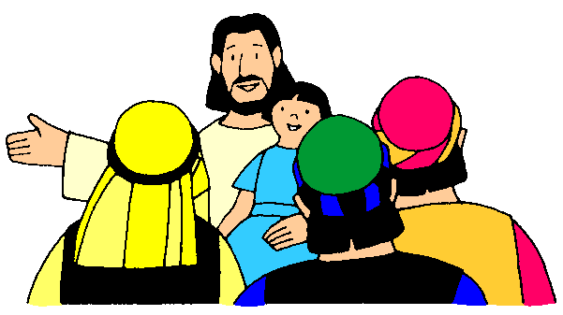
Holy Week & Easter

Slide 2
Note: Any videos in this presentation will only play online. After you download the slideshow, you will need to also download the videos from YouTube & add them back into your PowerPoint.
We present these messages at Bee Creek Park in College Station, TX. If you would like to watch the video of the service with this message, click here:
http://campaignkerusso.org/?p=10267
We would love to know more about the people who download our lessons & sermons. We invite you to email us & let us know where & how you use them.
info@ckbrazos.org

Slide 3
Next Slide → Song: He is Risen Download Here: http://youtu.be/MXlNGcHPYGE

Slide 4
Holy Week & Easter Lesson 1

Slide 7
Next Slide → Video:
Jesus on Donkey
Download Here:
http://youtu.be/DX54WZeRq0A

Slide 8
Let’s Talk About It – 1a
Why do you think Jesus liked to be with people?
Why did several people like to be with Jesus?
When Jesus spent time with people, why did He use the time to teach them?
What does the time of His “passion” mean?
Do you think He wanted to suffer and die?
Would you suffer and die to save the people you love?
How would you act if you knew you had just one more week to live?
If Jesus knew they would kill Him in Jerusalem, why did He go to there?

Slide 9
Let’s Talk About It – 1b
Why didn’t Jesus run and hide?
Why do you think Jesus rode on a humble donkey instead of a big fancy horse like the Roman leaders liked to do?
What did the people do when Jesus rode into town on the donkey?
What would the stones do if the people had stopped shouting--why?
Why would the people shout His praises one day and then kill Him a week later?
Do we ever act one way in church and then another way away from church?

Slide 10
“If you openly say, ‘Jesus is Lord’ and believe in your heart that God raised him from death, you will be saved.”
Rom. 10:9
What did you learn today?
What have you been thinking about The Lord lately?

Slide 11
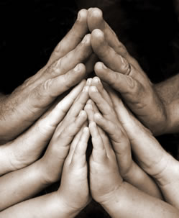
Close in Prayer

Slide 12
Holy Week & Easter Lesson 2

Slide 14
Next Slide → Video:
Money Changers
Download Here:
http://youtu.be/42Wy5CXwoz0

Slide 15
Talk About It – 2a
What did Jesus do to the money hungry merchants in the Temple?
How did Jesus feel about the Temple?
According to Scripture, how was the Temple supposed to be used?
How were the greedy merchants using it?
Do people today try to use the church and Christianity just to fill their own packets—how?
The bible says our bodies are also God’s Temple—How does Jesus feel about us?
How are we suppose to use our bodies?
Do we ever use our bodies in bad ways? When?

Slide 16
“If you openly say, ‘Jesus is Lord’ and believe in your heart that God raised him from death, you will be saved.”
Rom. 10:9
What did you learn today?
What have you been thinking about The Lord lately?

Slide 17
Close in Prayer

Slide 18
Holy Week & Easter Lesson 3

Slide 20
Next Slide → Video:
Jesus Teaches
Download Here:
http://youtu.be/seC3_JET2SI

Slide 21
Talk About It – 3a
Did you ever sit in church and feel like the preacher was talking all about you personally?
Does that make you mad or sad?
Jesus told a story about a man who owned a grape farm and He rented it out to His workers—did they happily do their work and give Him His grape harvest?
What did the bad tenants do to the three messengers sent to gather the harvest?
What did people do to the prophets God sent?
Whom did the vineyard owner send next thinking they would surely love and respect him?

Slide 22
Talk About It – 3b
Who did the Father send expecting that they would love and respect him?
What did the evil tenants do to the owner’s son?
What did people do to God’s son?
Why did the religious elders get mad at Jesus for telling this story?
What happened to the stone that the builders rejected?
How is Jesus like the rejected stone?
How can we fall on the stone?
What will happen to our old sinful self if we fall on Jesus and ask His forgiveness?

Slide 23
Talk About It – 3c
What will happen if we resist Jesus and never fall on our face before Him?
Why do you think the religious elders wanted to rid themselves of Jesus?
What happened to the disciple named Judas?

Slide 24
“If you openly say, ‘Jesus is Lord’ and believe in your heart that God raised him from death, you will be saved.”
Rom. 10:9
What did you learn today?
What have you been thinking about The Lord lately?

Slide 25
Close in Prayer

Slide 26
Holy Week & Easter Lesson 4

Slide 29
Next Slide → Video:
Last Supper
Download Here:
http://youtu.be/qZwaCLZG1x0

Slide 30
Talk About It – 4a
What do we call the last meal Jesus ate with His friends?
Why do you think Jesus liked eating meals with His friends?
What did Jesus do before He tore (or broke) the bread?
Why did Jesus say that a broken, torn loaf of bread is like His body?
How is receiving Jesus into our hearts like eating a piece of bread?
What did Jesus say the grape wine was like?
In what way was it like His blood?

Slide 31
Talk About It – 4b
Why did Jesus let the bad people spill (or pour out) His blood?
How many people can be forgiven now that Jesus let them break His body and pour out His blood?
What bad person did Jesus say was sitting with them at the table?
Why do you think Jesus liked to call Himself “The Son of Man?”
What did Jesus say must happen to Him?
Where did they all go after dinner?

Slide 33
Next Slide → Video:
Jesus Prays
Download Here:
http://youtu.be/YuQ8G7xb1bo

Slide 34
Talk About It – 4c
In the Garden, what did Jesus ask His friends to do for Him?
When Jesus asked His Father for another “cup” to drink (meaning a less painful way to save the world from sin) what was He feeling?
Why do you think Jesus said, “Let your will be done rather than mine?”
What appeared to strengthen Jesus?
How does God strengthen us sometimes?
Jesus’ inner struggle was so intense, what happened to His sweat?

Slide 35
Talk About It – 4d
What kinds of prayers in our lives might be a struggle (a battle) for us?
What were Jesus’ friends doing while he was struggling in prayer?
What did He warn them to pray for themselves?
In what ways might Christians be sleeping when we should be watching and praying?
What might happen to us if we fail to watch and pray?

Slide 36
“If you openly say, ‘Jesus is Lord’ and believe in your heart that God raised him from death, you will be saved.”
Rom. 10:9
What did you learn today?
What have you been thinking about The Lord lately?

Slide 37
Close in Prayer

Slide 38
Holy Week & Easter Lesson 5

Slide 40
Next Slide → Video:
Betrayal and Arrest
Download Here:
http://youtu.be/r7MY3e1ckz4

Slide 41
Talk About It – 5a
What did Judas (Jesus’ dear friend) do?
Do we ever betray Jesus? How?
Do we ever act as if we love Him but, at the same time, we are betraying Him in our lives?
Why did Jesus tell His friends not fight for Him with swords?
What are some right ways to fight for Jesus?
What did He do for the wounded soldier’s ear?
Can we love people who are trying to hurt us?
Why did Jesus’ friends all run away?
Are we ever afraid (like them) to tell the world that we love Jesus?

Slide 43
Next Slide → Video:
Arrest and Questioning
Download Here:
http://youtu.be/SVYWJSb_ueU

Slide 44
Talk About It – 5b
Do you think Jesus had a fair trial? Why not?
How does it feel when people lie and say bad things about you?
Do people often say bad things about Christians? Why?
Was Jesus really The Messiah—The Son of God?
Where did Jesus say He (The Son of Man) would be sitting from then on?
Why is Jesus called both the “Son of God” and the “Son of Man?”
Where did they decide to take Jesus at the end of the trial?

Slide 45
“If you openly say, ‘Jesus is Lord’ and believe in your heart that God raised him from death, you will be saved.”
Rom. 10:9
What did you learn today?
What have you been thinking about The Lord lately?

Slide 46
Close in Prayer

Slide 47
Holy Week & Easter Lesson 6

Slide 49
Next Slide → Video:
Arrest and Questioning
Download Here:
http://youtu.be/SVYWJSb_ueU

Slide 50
Talk About It – 6a
When they took Jesus to Pontius Pilate, did the Roman leader believe the lies of the Jewish leaders?
Do we ever turn against Jesus, or do things we know are wrong? Why?
Do you think Pilate knew the Jewish religious leaders were just jealous of Jesus?
Was Jesus the King of the Jews?
Was He an Earthly king that Caesar had to fear?
Why do you think the soldiers made fun of Jesus?

Slide 51
Talk About It – 6b
Do they still make fun of Jesus’ children? Why?
Why do you think the Jewish leaders chose the criminal, Barabbas, over Jesus?
The bible says that we, who are sinners, deserve punishment. Why do you think Jesus was willing to take our whipping?

Slide 53
Next Slide → Video:
Jesus’ Death
Download Here:
http://youtu.be/iJblZg3-Pnc

Slide 54
Talk About It – 6c
How did they hang Jesus on the cross?
Did Jesus deserve to die?
Who deserves to die?
Are we all sinners?
Why was Jesus willing to die in our place?
Why did Jesus shout, “It is finished?”
Who’s punishment did Jesus suffer?
As Jesus hung on the cross, what did He ask His Father to do?
Could Jesus have saved Himself if He wanted to?
What did Jesus promise the thief hanging next to Him?

Slide 55
“If you openly say, ‘Jesus is Lord’ and believe in your heart that God raised him from death, you will be saved.”
Rom. 10:9
What did you learn today?
What have you been thinking about The Lord lately?

Slide 56
Close in Prayer

Slide 57
Holy Week & Easter Lesson 7

Slide 59
Next Slide → Video:
Burial of Jesus
Download Here:
http://youtu.be/jCmyWLeED8g

Slide 60
Talk About It – 7a
Where did they bury Jesus?
Did Jesus own a house, a horse or even His own tomb?
Why do you think owning things on Earth wasn’t very important to Jesus?
If we are busy doing God’s work rather than trying to get things here on Earth, how will we get the things we might need (like when Jesus needed a tomb).
Why were Jesus’ friends sad when He died?

Slide 63
Next Slide → Video:
Empty Tomb
Download Here:
http://youtu.be/NUSPq_N-WV4

Slide 64
Talk About It – 7b
Why did the women go to the tomb of Jesus?
How are dead traditions different than a living relationship with Jesus?
Do we sometimes act like Jesus is just a dead man from history… and what is He really?
When the women got to the tomb, what did they find?
What amazing thing did the angel tell the women about Jesus?
Why do you think Jesus left behind His old clothes?

Slide 65
Talk About It – 7c
We can all put on our new lives if we, like old garments, leave behind our old lives. What will that new life be like?
What did the angel tell the women to do with the amazing news that only they knew?
Now that we know that Jesus is risen from the dead, what do you suppose God wants us to do with that knowledge?

Slide 66
“If you openly say, ‘Jesus is Lord’ and believe in your heart that God raised him from death, you will be saved.”
Rom. 10:9
What did you learn today?
What have you been thinking about The Lord lately?

Slide 67
Close in Prayer

Slide 68
Holy Week & Easter Lesson 8

Slide 71
Next Slide → Video:
Resurrected Jesus
Download Here:
http://youtu.be/oQGsyXXQx20

Slide 72
Talk About It – 8a
When did the women see Jesus, in the tomb or as they were going out to tell the others about Jesus being risen?
Why are we more likely to encounter Jesus as we are out doing His work?
What did Jesus do to help the others believe what the women were telling them?
How does Jesus help us do His work?
Why do you think Jesus wanted to be in the upper room with His friends?
What did Jesus have that a ghost does not have?

Slide 73
Talk About It – 8b
According to scripture, what was going to begin in Jerusalem?
What was the last thing Jesus told us to do?

Slide 77
Talk About It – 8c
Why is Easter so important?
What does Jesus’ death and resurrection mean for us?
Could we go to Heaven if Jesus had not died for us? Why not?
Why did Jesus do this for us?
What do we have to do to know Jesus and have our sins forgiven?
What happens when do we tell Jesus 3 things:
We are sorry for being bad (sinners).
We believe that He is God & He died for us & rose again.
We want to give our hearts and lives to Him.
;

Slide 78
“If you openly say, ‘Jesus is Lord’ and believe in your heart that God raised him from death, you will be saved.”
Rom. 10:9
What did you learn today?
What have you been thinking about The Lord lately?

Slide 79
Close in Prayer

Slide 80
What is the Sinner‘s Prayer?
This is a prayer we can pray when we are ready to admit we are sinners and need Christ’s forgiveness.
It must be prayed with faith in our hearts and a readiness to have a life-changing encounter with Jesus Christ.

Slide 82
John Wesley’s Testimony
“…the preacher was describing the change which God works in the heart through faith in Christ and I felt my heart strangely warmed.”
Disciple’s Testimony
“They said to each other, ‘Did not our hearts burn within us while he talked to us on the road, while he opened to us the Scriptures?’”

Slide 83
A prayer of faith → Pray this prayer if :
If you never have before
You have in the past, but you think it would mean more today
You have been walking afar off and you want to come back
You want to set an example & show others how it is done
You just like to give your heart to Jesus again & again
Faith

Slide 84
We Declare Our Faith Publicly Because Jesus Declared His LOVE Publicly
“If you stand before others and are willing to say you believe in me, then I will tell my Father in heaven that you belong to me.” Mat 10:32

Slide 85
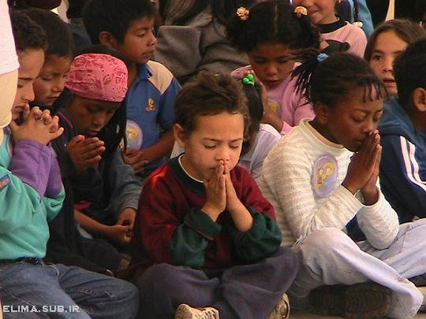
Dear Jesus,
I know I am a sinner & need your forgiveness.
I believe you died for my sins.
I now turn from sin.
Come into my heart I pray.
Do you want to meet Jesus as your savior right now?
Do you believe He died to save you from your sins & that He rose from the dead?
Do you believe that He is waiting to save you right now?

Slide 86
“But some people did accept him. They believed in him, and he gave them the right to become children of God.” John 1:12

Slide 88
“If you openly say, ‘Jesus is Lord’ and believe in your heart that God raised him from death, you will be saved.”
Rom. 10:9
What did you learn today?
What is the meaning of the name-tag?
What have you neen thinking about God lately?
What do you want to tell the world about Jesus?

Slide 89
“Draw near to God, and He will draw near to you…
…Cleanse your hands, you sinners, and make your hearts pure, you who are half-hearted towards God.” James 4:8 WNT

Slide 90
Close in Prayer

Slide 91
Note: Any videos in this presentation will only play online. After you download the slideshow, you will need to also download the videos from YouTube & add them back into your PowerPoint.
We present these messages at Bee Creek Park in College Station, TX. If you would like to watch the video of the service with this message, click here:
http://campaignkerusso.org/?p=10267
We would love to know more about the people who download our lessons & sermons. We invite you to email us & let us know where & how you use them.
info@ckbrazos.org

Slide 92
Welcome to Aggieland Faith Family Style Worship

Slide 93
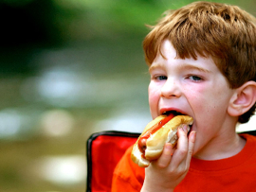
CURRENT SCHEDULE: See www.Aggielandfaith.org
SATURDAY —
At Bee Creek Park
2:00-4:00pm: Through the bible with felt-board stories – plus hot-dogs & drinks
SUNDAY —
At Bee Creek Park
2:00-4pm: Free snacks, drinks, kids crafts, prizes, singing & bible preaching

Slide 94
Would You Like Prayer or Bible Study at Your House?
Personal Prayer: We can come to your home & pray with you, or you can email us when you need prayer.
Home Bible Study: We will come to your home & hold a bible study for you & your friends.
Bible Party: We will hold a Kid’s Bible Party: You provide the food & kids - we will do the bible fun & stories.

Slide 95
Would You Like Visitation?
We will visit a friend, loved one in the hospital or in prison to pray for them & share Christ with them.
Contact: info@aggielandfaith.org

Slide 96
www.aggielandfaith.org
Go here to see pictures & videos
Go here to subscribe to e-mails about changes & cancellations

Slide 97
Note: Any videos in this presentation will only play online. After you download the slideshow, you will need to also download the videos from YouTube & add them back into your PowerPoint.
We present these messages at Bee Creek Park in College Station, TX. If you would like to watch the video of the service with this message, click here:
http://campaignkerusso.org/?p=10267
We would love to know more about the people who download our lessons & sermons. We invite you to email us & let us know where & how you use them.
info@ckbrazos.org

