Slide 1
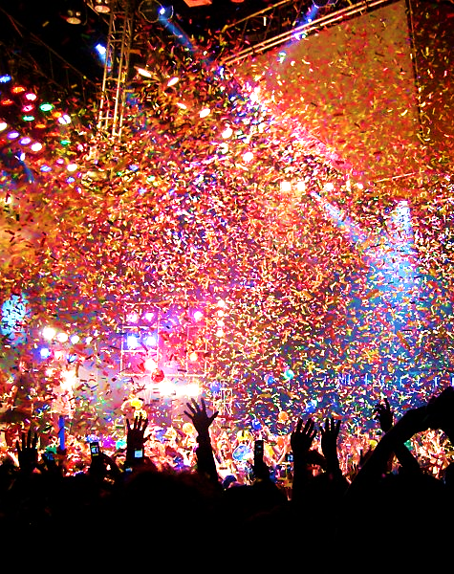
Pastor Please…
Sprinkle
Us!

Slide 2
Note: Any videos in this presentation will only play online. After you download the slideshow, you will need to also download the videos from YouTube & add them back into your PowerPoint.
We present these messages at Bee Creek Park in College Station, TX. If you would like to watch the video of the service with this message, click here:
http://campaignkerusso.org/?p=11472
We would love to know more about the people who download our lessons & sermons. We invite you to email us & let us know where & how you use them.
info@ckbrazos.org

Slide 3
Pastor Please…
Sprinkle
Us!

Slide 4
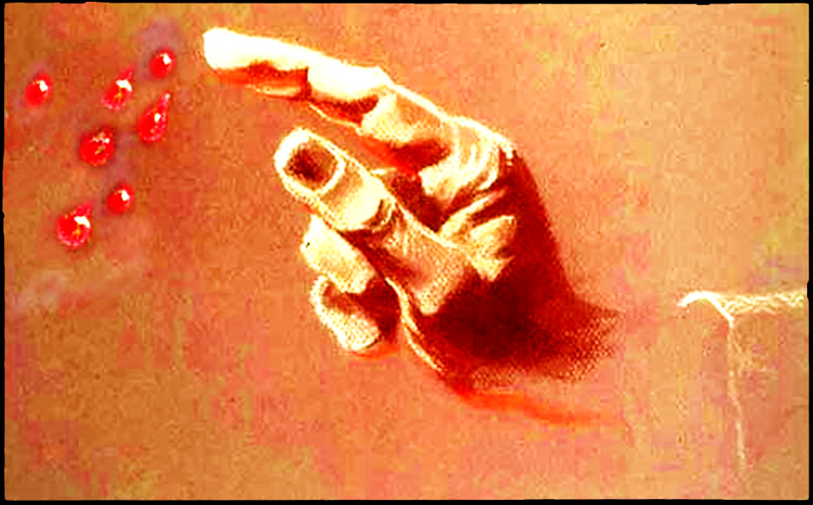
Priests Sprinkle That’s what they do!

Slide 5
The Priest Sprinkles with Blood

Slide 6
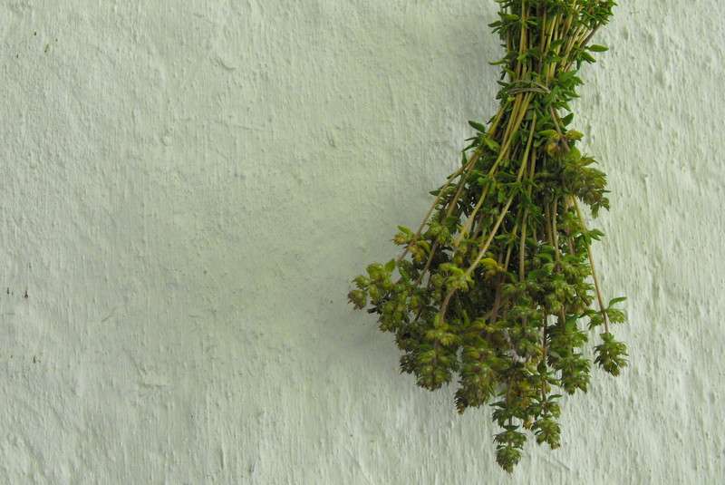
“When Moses had proclaimed every command of the law to all the people, he took the blood of calves, together with water, scarlet wool and branches of hyssop, and
sprinkled the scroll and all the people.”
Heb. 9:19

Slide 7
The Hyssop Branch Points to the Cross
“Later, knowing that everything had now been finished, and so that Scripture would be fulfilled, Jesus said, “I am thirsty.”
A jar of wine vinegar was there, so they soaked a sponge in it, put the sponge on a stalk of the hyssop plant, and lifted it to Jesus’ lips.
When he had received the drink, Jesus said, “It is finished.” With that, he bowed his head and gave up his spirit.” John 19:28-30

Slide 8
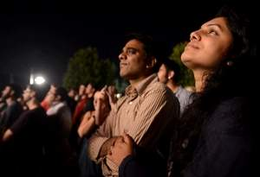
The Cross is the branch God chose to sprinkle a dying world with the Blood of Christ.

Slide 9
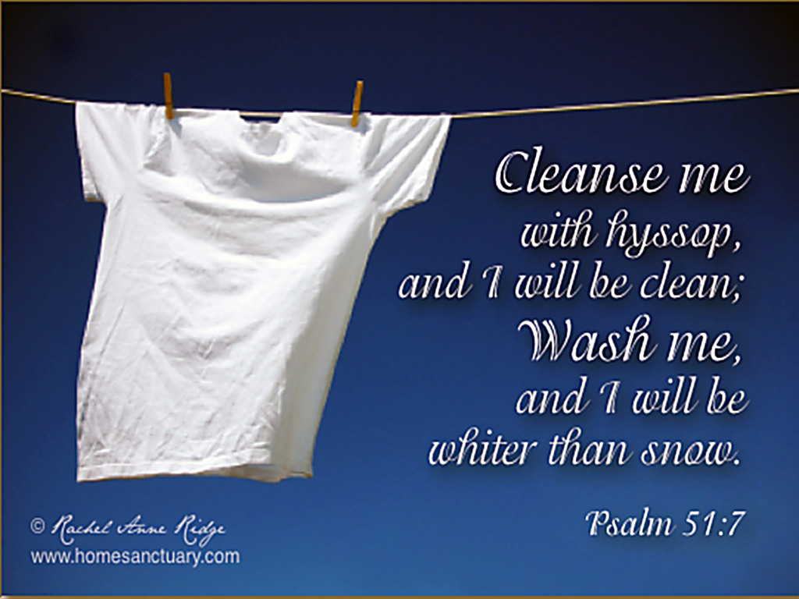

Slide 10
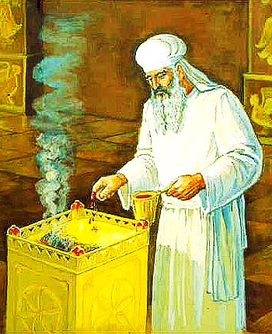
“In the same way, he sprinkled with the blood both the tabernacle and everything used in its ceremonies.”
Heb. 9:21

Slide 11
But only the high priest entered the inner room…
and never without blood…
Heb. 9:7

Slide 12
“For I resolved to know nothing while I was with you except Jesus Christ and him crucified. 1 Cor. 2:2
“…but we preach Christ crucified: a stumbling block to Jews and foolishness to Gentiles”
1 Cor. 1:23
“May I never boast except in the cross of our Lord Jesus Christ…” Gal. 6:14

Slide 13
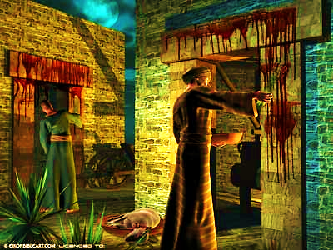
Our Duty to be Priests at Home
Take a bunch of hyssop, dip it into the blood in the basin and put some of the blood on the top and on both sides of the doorframe. None of you shall go out of the door of your house until morning. Ex. 12:22

Slide 14
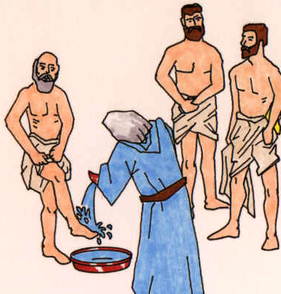
The Priest Sprinkles Water & Salt
“Then Moses brought Aaron and his sons forward and washed them with water.”
Lev. 8:6

Slide 15
Water is the Word of God
“…to make her holy, cleansing her by the…
washing with water through the word.”
Eph. 5:26
“You are already clean because of the word I have spoken to you.” John 15:3
“Sanctify them by the truth; your word is truth.” John 17:17

Slide 16
The Word as Water washes the heart and mind of the believer.
This is the Word as a benefit for believers.

Slide 17
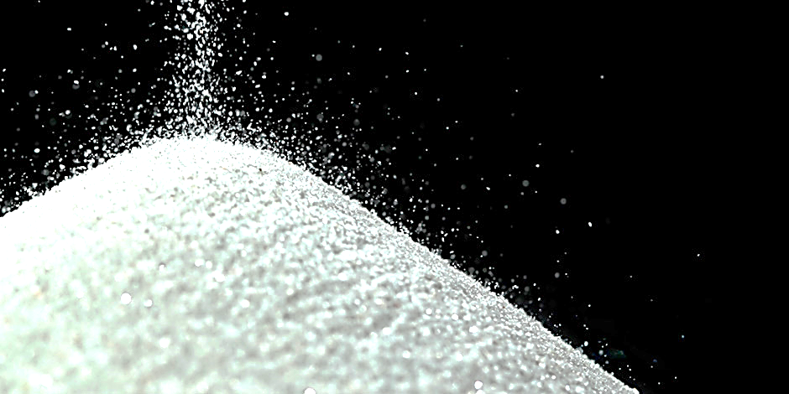
Salt is the Word of God
Sprinkled by the Church
The Blood Sacrifice Needed Salt:
“You are to offer them before the LORD, and the priests are to sprinkle salt on them and sacrifice them as a burnt offering to the LORD.” Ezk. 43:24

Slide 18
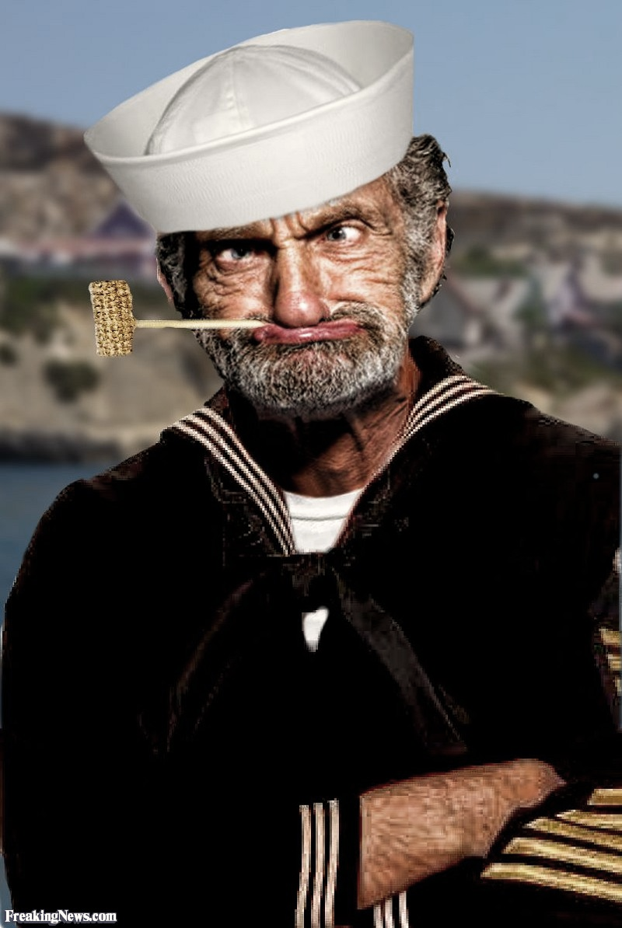
Sailors are said to have “Salty Language” because it may be riddled with curse words.
But, true Salty Language is riddled with the Gospel!

Slide 19
“Let your conversation be always full of grace, seasoned with salt, so that you may know how to answer everyone.” Col. 4:6

Slide 20
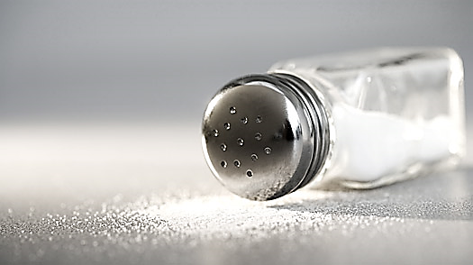
The Word as Salt spreads the Gospel to a dying world.
This is the Word as a benefit for unbelievers.

Slide 21
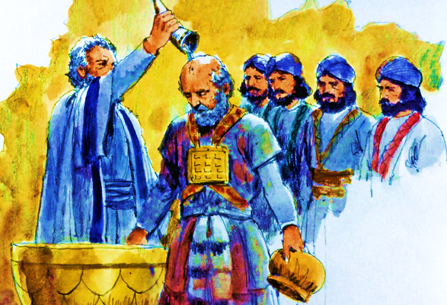
The Priest Sprinkles Oil

Slide 22
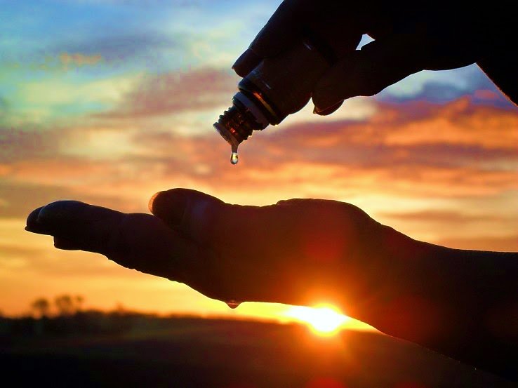
The priest is to pour some of the oil into the palm of his own left hand, and with his right forefinger sprinkle some of the oil…
Lev. 14:26, 27
Some of the oil in his palm he is to put on the same places he put the blood of the guilt offering… Lev. 14:28
When Moses finished setting up the tabernacle… He also anointed and consecrated the altar and all its utensils.
Num. 7:1

Slide 23
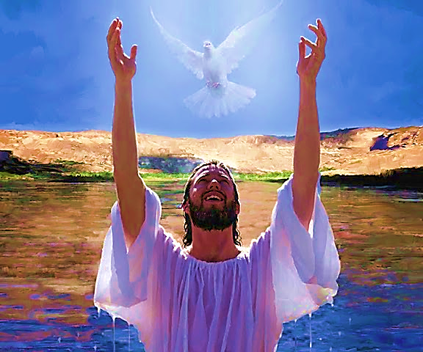
“…how God anointed Jesus of Nazareth with the Holy Spirit and power, and how he went around doing good and healing all who were under the power of the devil, because God was with him.”
Acts 10:38

Slide 24
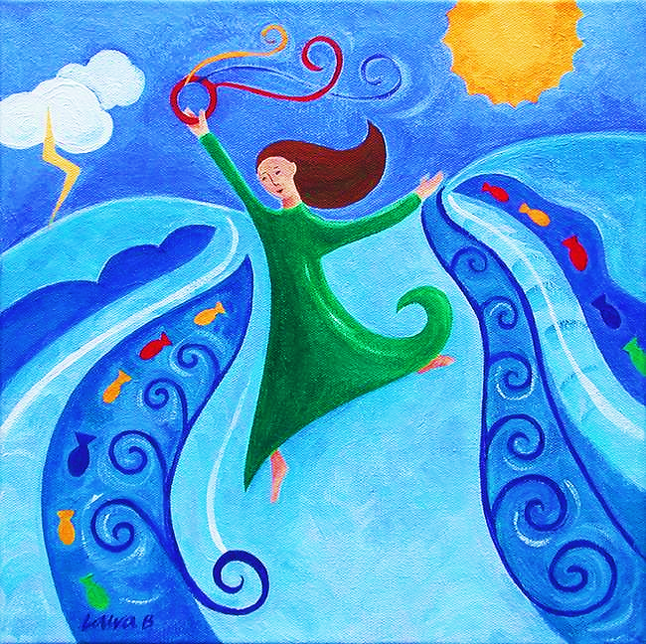
…therefore God, your God, has set you above your companions by anointing you with the oil of joy. Ps. 45:7
…a crown of beauty instead of ashes, the oil of joy instead of mourning, and a garment of praise instead of a spirit of despair.... Isa. 61:3

Slide 25
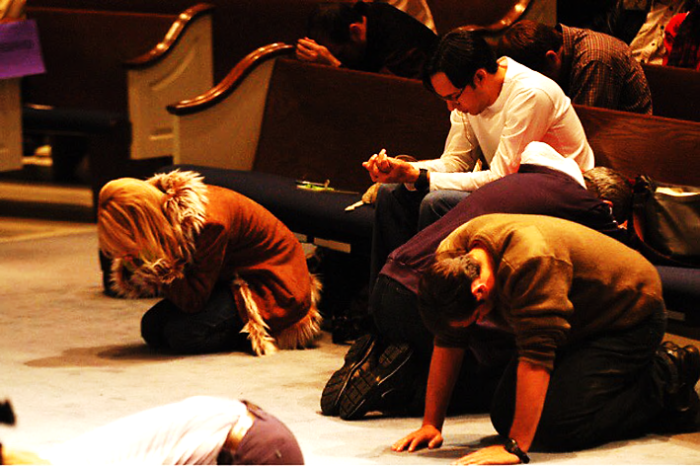
“…We do not know what we ought to pray for, but the Spirit himself intercedes for us through wordless groans. And he who searches our hearts
knows the mind of the Spirit, because the Spirit intercedes for God’s people in accordance with the will of God.”
Rom. 8:26, 27

Slide 26
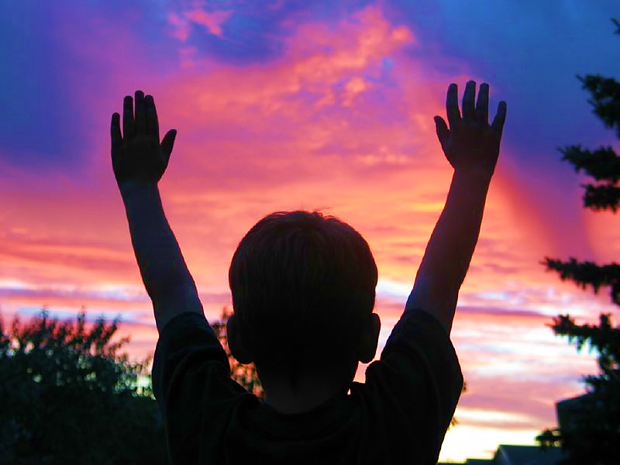
“…the Spirit you received brought about your adoption to sonship. And by him we cry, ‘Abba, Father.’ The Spirit himself testifies with our spirit that we are God’s children.”
Rom. 8:15, 16
The way to connect to God
“And pray in the Spirit on all occasions with all kinds of prayers and requests. With this in mind, be alert and always keep on praying for all the Lord's people.”
Eph. 6:18

Slide 27
Called to be Both Saved & Spirit Filled
Always be clothed in white, and always anoint your head with oil. Eccl. 9:8

Slide 28
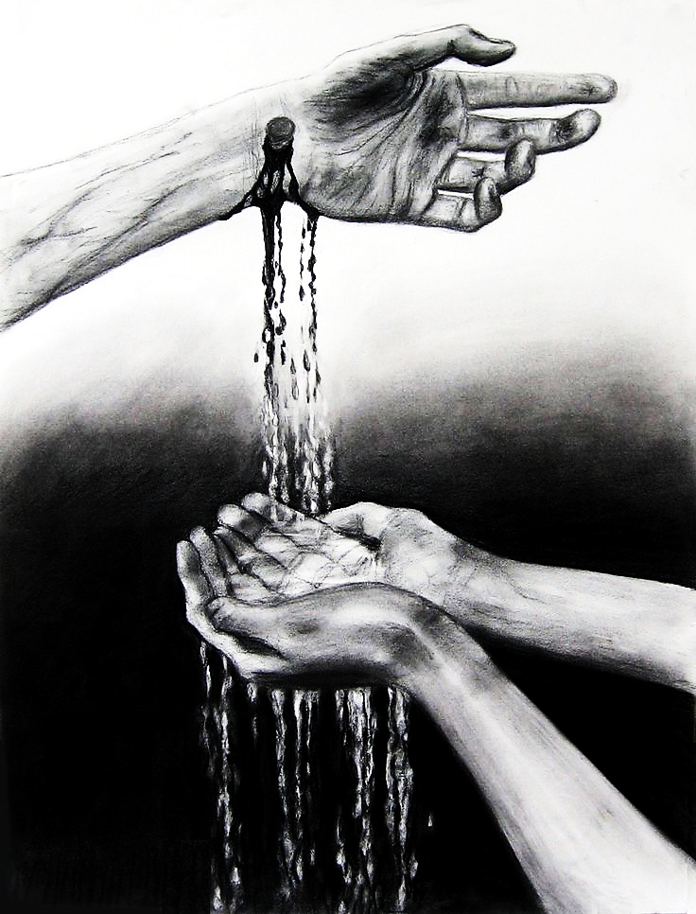
Our Priest Jesus Sprinkles
“…chosen… to be obedient to Jesus Christ and sprinkled with his blood…” 1 Pet. 1:2
“…I will put my words in his mouth. He will tell them everything I command him.” Deut. 18:18
“All of them were filled with the Holy Spirit and began to speak in other tongues as the Spirit enabled them.” Acts 2:4

Slide 29
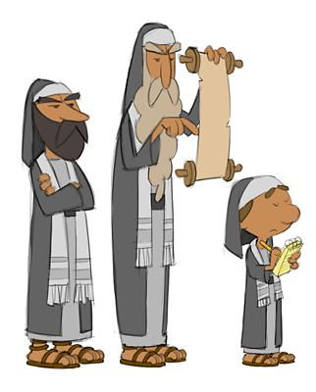
The Word without the Blood is Meaningless Ritual.

Slide 30
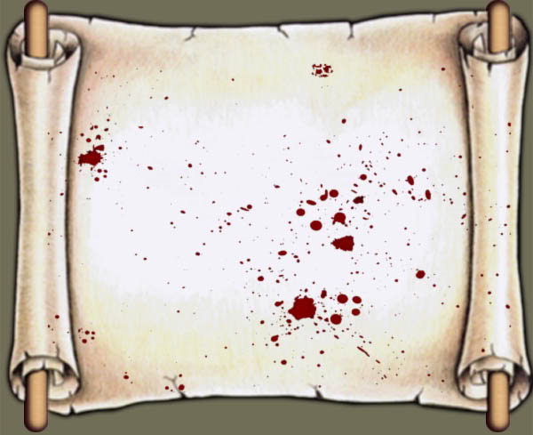
“When Moses had proclaimed every command of the law… he… sprinkled the scroll and all the people.”
Heb. 9:19

Slide 31
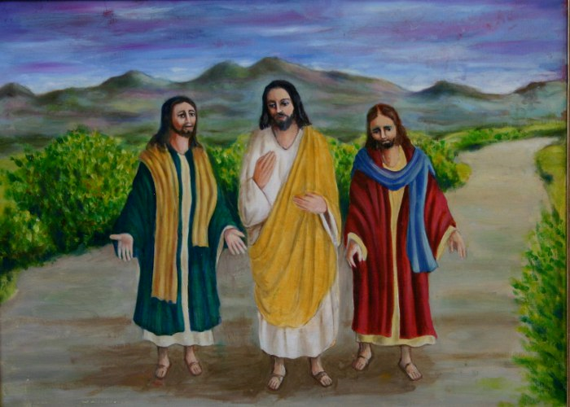
The Old Testament is inundated with the Cross of Jesus!
“And beginning with Moses and all the Prophets, he explained to them what was said in all the Scriptures concerning himself.” Luke 24:27

Slide 32
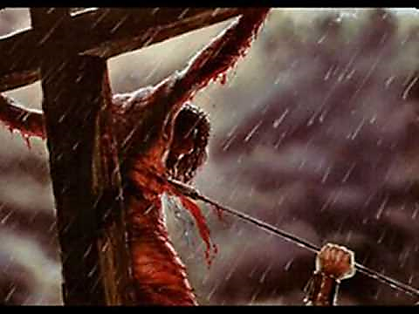
Blood without the Word to dispense and apply it is Ineffective.
“…one of the soldiers pierced Jesus' side with a spear, bringing a sudden flow of blood and water.” John 19:34
“…having our hearts sprinkled to cleanse us from a guilty conscience and having our bodies washed with pure water.
Heb. 10:22

Slide 33
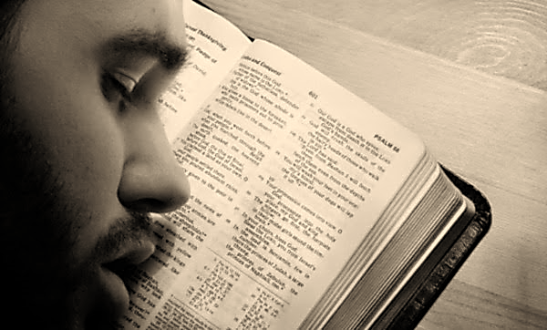
“We have much to say about this, but it is hard to make it clear to you because you no longer try to understand. In fact, though by this time you ought to be teachers, you need someone to teach you the elementary truths of God’s word all over again. You need milk, not solid food!”
Heb. 5:11, 12

Slide 34
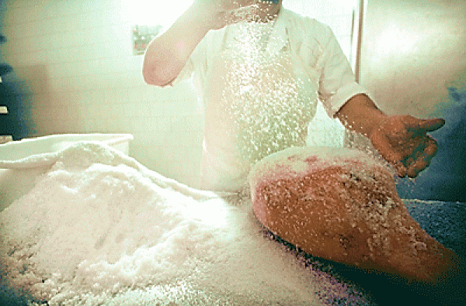
Unused Salt:
“Season all your grain offerings with salt. Do not leave the salt of the covenant of your God out of your grain offerings; add salt to all your offerings.” Lev. 2:13
Defiled Salt (Contaminated or Mere Filler):
"Salt is good, but if it loses its saltiness, how can you make it salty again? Have salt among yourselves, and be at peace with each other."
Mark 9:50

Slide 35
The Word without
the Holy Spirit
is Dead Letter

Slide 36
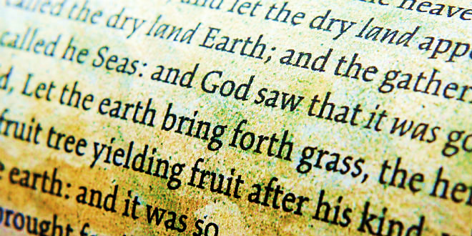
“…not of the letter but of the Spirit; for the letter kills, but the Spirit gives life.” 2 Cor. 3:6
“The Spirit gives life… The words I have spoken to you--they are full of the Spirit and life.” John 6:63
“My message and my preaching were not with wise and persuasive words, but with a demonstration of the Spirit's power.” 1 Cor. 2:4

Slide 37
Blood = Salvation
But Alone = Stunted Growth, No Teachers
Water / Salt = The Word of God
But Alone = Legalism, Joyless Pharisees
Oil = Power, Prayer, Worship, Joy
But Alone = Signs & Wonders Seekers, So-Called “New Revelation,” False Teachers

Slide 38
Balanced Ministry
Christ’s
Cross / Blood
The
Church
Holy
Spirit
Power
Written
Word
Of God

Slide 39
The Blood, The Water and The Oil Agree!!!
“This is the one who came by water and blood—Jesus Christ. He did not come by water only, but by water and blood. And it is the Spirit who testifies, because the Spirit is the truth. For there are three that testify: the Spirit, the water and the blood; and the three are in agreement.” 1 John 5:6-8

Slide 40
Pastor Please…
Sprinkle
Us!

Slide 41
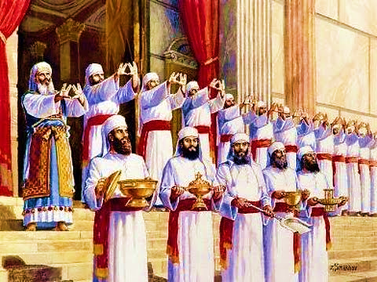
We are all called to sprinkle!
“But you are a chosen people, a royal priesthood, a holy nation…”
1 Pet. 2:9

Slide 42
Is Jesus Speaking
to You?
“They said to each other, ‘Did not our hearts burn within us while he talked to us on the road, while he opened to us the Scriptures?’”
John Wesley Said:
“…the preacher was describing the change which God works in the heart through faith in Christ and I felt my heart strangely warmed.”
That burning in your heart is the still, small voice of Jesus.

Slide 44
What is the Sinner’s Prayer?
This is a prayer we can pray when we are ready to admit we are sinners and need Christ’s forgiveness.
It must be prayed with faith in our hearts and a readiness to have a life-changing encounter with Jesus Christ.

Slide 45
A prayer of faith → Pray this prayer:
If you never have before
If you have in the past, but you think it would mean more today
If you have been walking afar off and you want to come back
If you want to set an example & show others how it’s done
If you just like to give your heart to Jesus again & again
Faith

Slide 46
We Declare Our Faith Publicly Because Jesus Declared His LOVE Publicly
“If you stand before others and are willing to say you believe in me, then I will tell my Father in heaven that you belong to me.” Mat 10:32

Slide 47
Important Questions
Do you want to know Jesus as your Savior right now?
Do you believe He died to save you from your sins & that He rose from the dead?
Do you believe that He is here, waiting to save you right now?

Slide 48
The Prayer of a Sinner Turning to Jesus
Dear Jesus, I know that I have sinned against You and that my sins separate me from You.
I am truly sorry.
Right now, I turn away from my sinful past .
Please forgive me, and help me to keep from sin.
I believe You died for my sins.
I believe You rose from the dead, you are alive, and you hear this prayer from my heart.
I invite You Jesus to be both my Savior and the Lord of my life.
I want You to rule my life from now on.

Slide 49
“But some people did accept him. They believed in him, and he gave them the right to become children of God.”
John 1:12

Slide 51
“If you openly say, ‘Jesus is Lord’ and believe in your heart that God raised him from death, you will be saved.”
Rom. 10:9
What did you learn today?
What have you been thinking about God lately?
What do you want to tell others about Jesus?

Slide 52
“Draw near to God, and He will draw near to you…
Altar Time
…Cleanse your hands, you sinners, and make your hearts pure, you who are half-hearted towards God.” James 4:8 WNT

Slide 53
Let’s Close in Prayer

