Slide 1
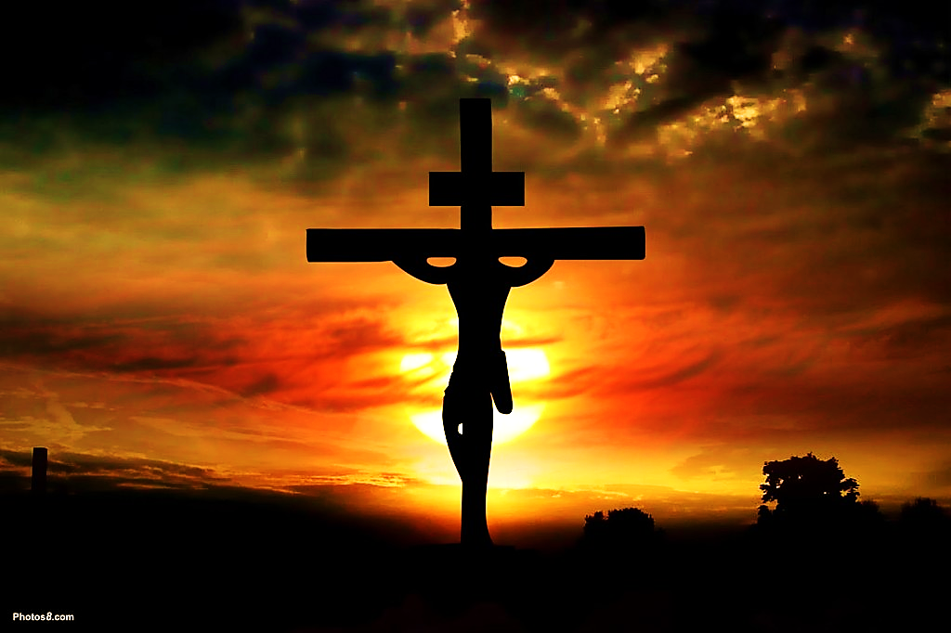
For
the
Cross
For
Auld
Lang
Syne
On forgetting God

Slide 2
Note: Any videos in this presentation will only play online. After you download the slideshow, you will need to also download the videos from YouTube & add them back into your PowerPoint.
We present these messages at Bee Creek Park in College Station, TX. If you would like to watch the video of the service with this message, click here:
http://campaignkerusso.org/?p=12892
We would love to know more about the people who download our lessons & sermons. We invite you to email us & let us know where & how you use them.
info@ckbrazos.org

Slide 3
For
the
Cross
For
Auld
Lang
Syne
On forgetting God

Slide 4
We Forget God’s Provision
“Be careful not to forget the Lord, who rescued you from slavery in the land of Egypt. Deut. 6:12 (NLT)
“They forgot all he had done, even the mighty miracles” Ps. 78:11 (CEV)

Slide 5
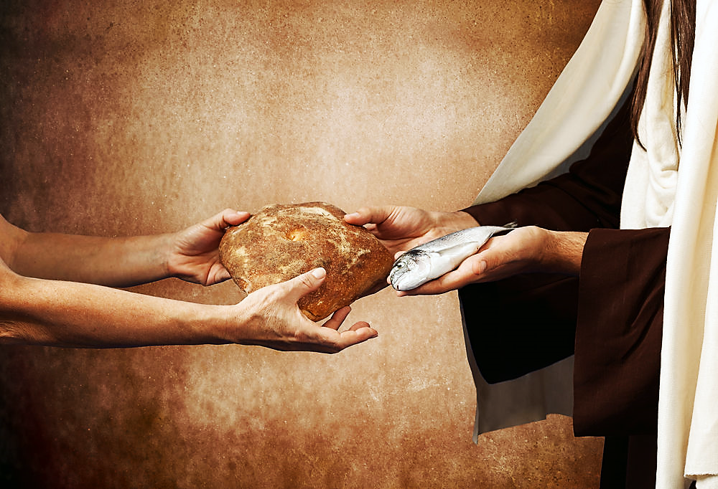
“…Have you forgotten about the five thousand people and all those baskets of leftovers from just five loaves of bread?” Mat. 16:9 (CEV)
“I will praise the Lord. I won’t forget anything he does for me.”
Ps. 103:2 (NIRV)

Slide 6
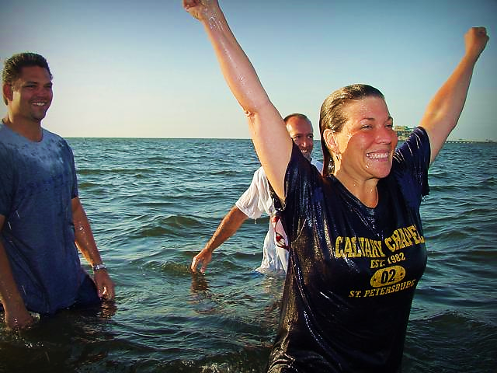
We Forget the Joy of Salvation

Slide 7
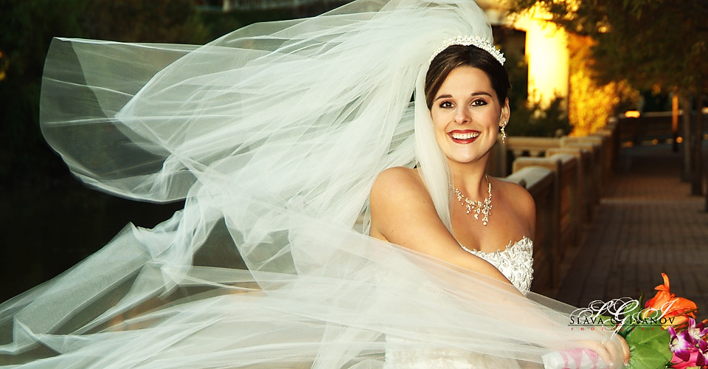
The righteousness
of Jesus Himself
is wrapped around
us as a wedding
garment and the jewels of our salvation.
“…For he has clothed me with garments of salvation and draped about me the robe of righteousness. I am like a bridegroom in his wedding suit or a bride with her jewels.” Isa. 61:10 (TLB)

Slide 8
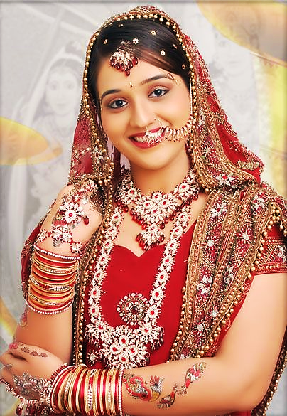
“Does a young woman forget her jewelry or a bride her wedding dress? Yet you have forgotten me days without end!”
Jer. 2:32 (CEB)

Slide 9
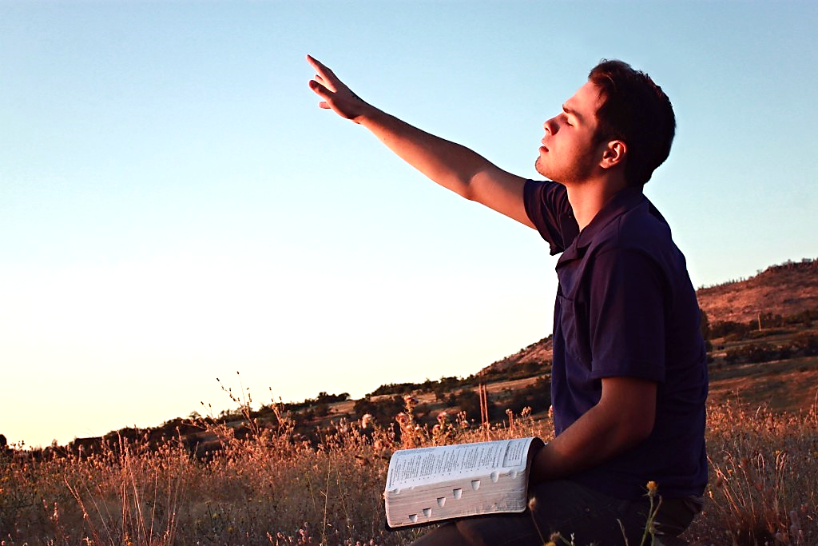
We Forget Communion with Him

Slide 10
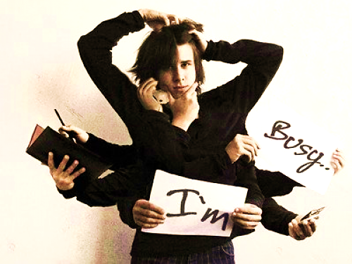
“Of the Rock who became your father, you are unmindful, and have forgotten God who gave you birth.”
Deut. 32:18 (WEB)

Slide 11
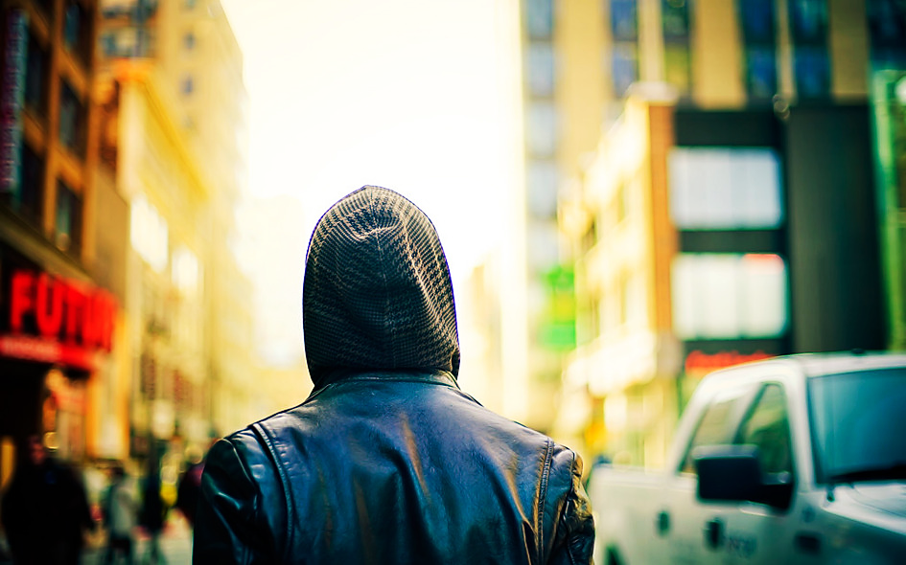
We spurn His Comfort
“The Lord says to his people,
“I comfort you because of who I am. Why are you afraid of mere human beings? They are like grass that dries up. How can you forget me? I made you….” Isa. 51:12,13 (NIRV)

Slide 12
Our Love Grows Cool
“But I have this against you: You have left the love you had
in the beginning”
Rev. 2:4 (ICB)

Slide 13
But Jesus Never Forgets Us

Slide 14
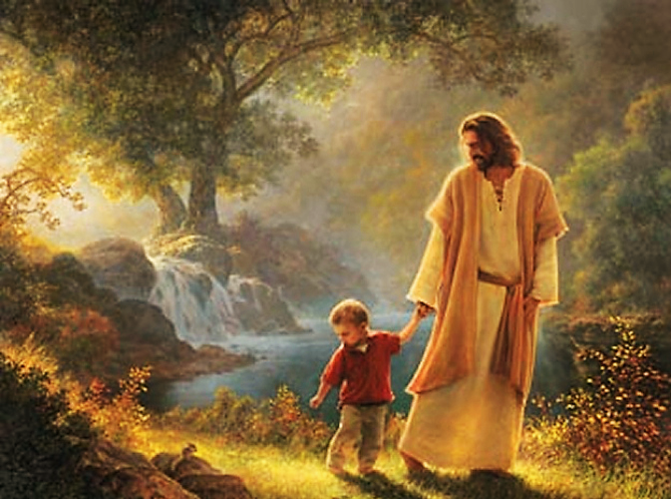
“Remember these things, Jacob, and Israel, for you are My servant; I formed you, you are My servant; Israel, you will never be forgotten by Me.” Isa. 44:21 (HCSB)

Slide 15
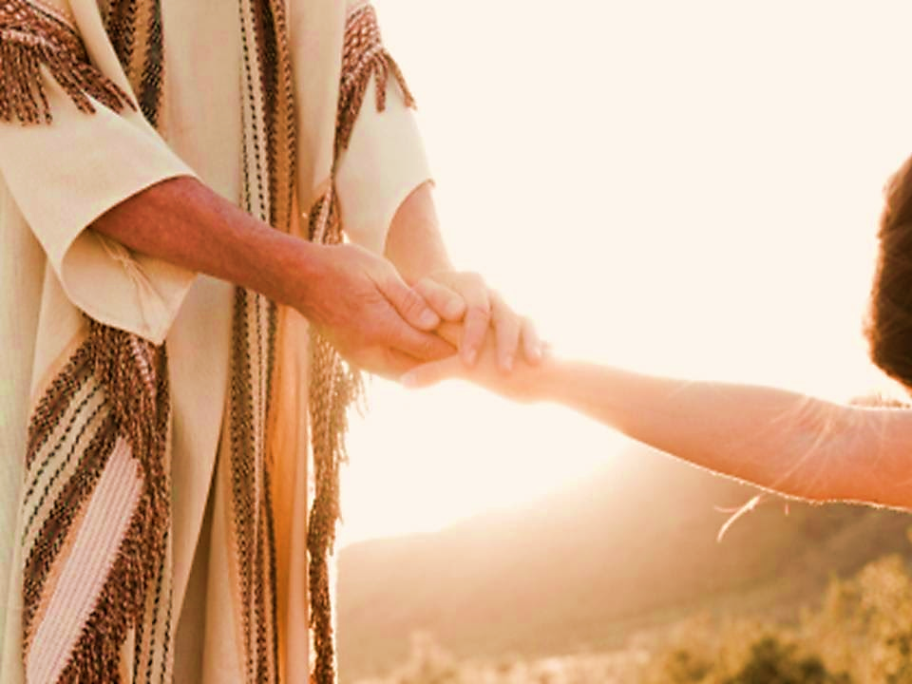
“You know that Israel is my dear son. The child I love. Yes, I often speak against Israel, but I still remember him. I love him very much, and I want to comfort him,’ says the Lord.”
Jer. 31:20 (NCV)

Slide 16
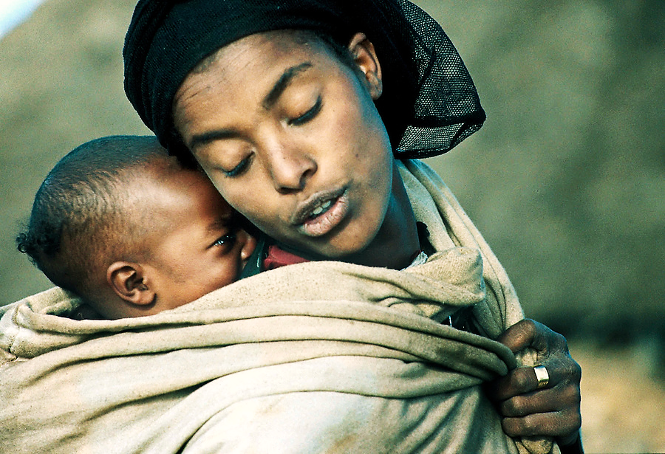
“Can a woman forget her
nursing child?
Will she have
no compassion
on the child
from her
womb? Although
mothers may forget, I will not forget you. I have engraved you on the palms of my hands.” Isa. 49:15-16 (GW)

Slide 17
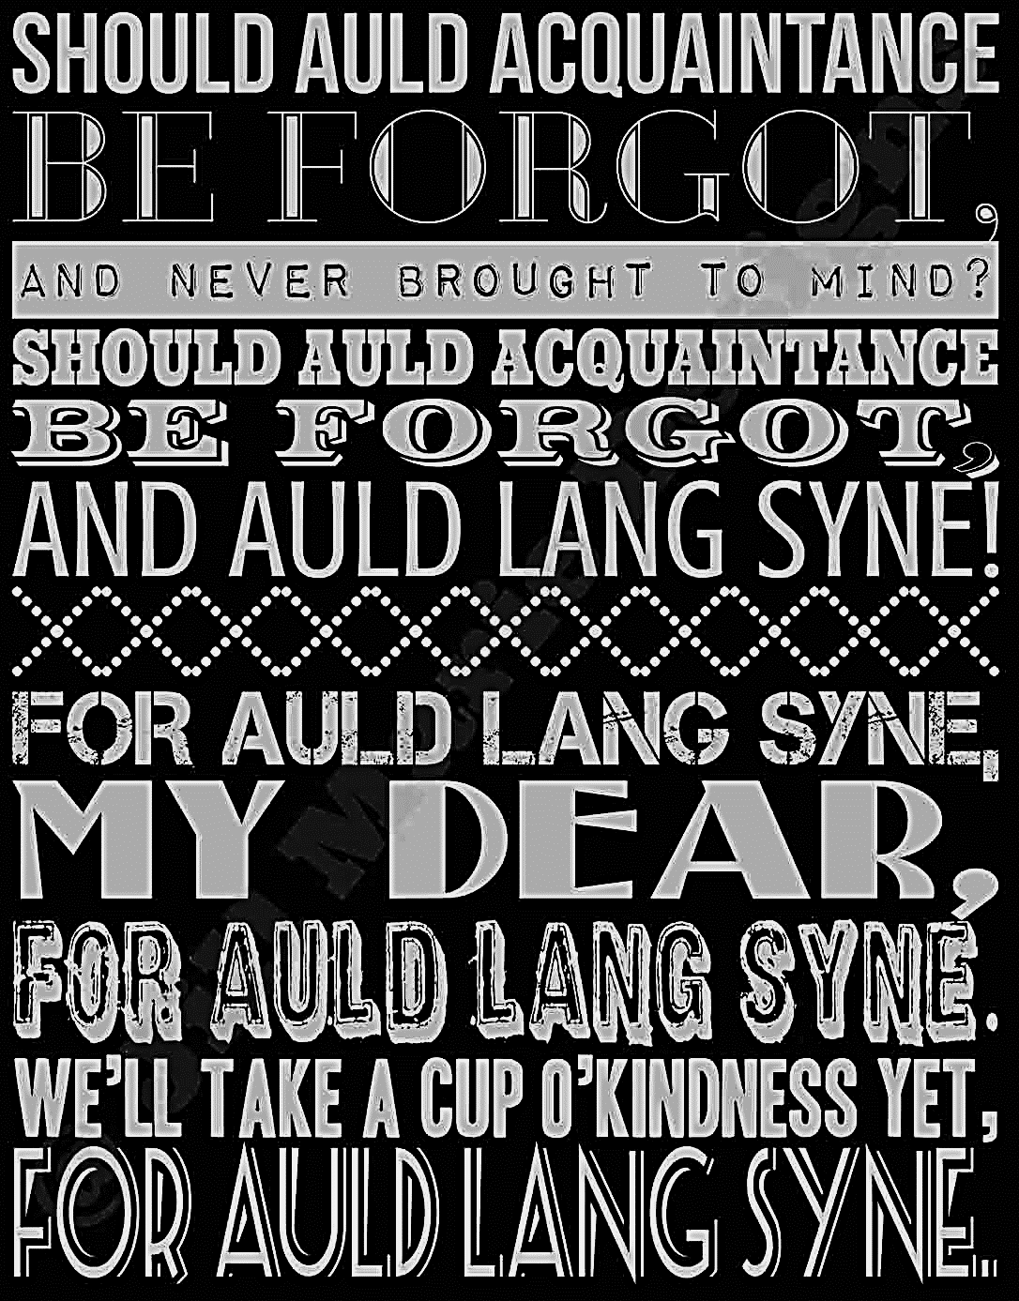
“Auld Lang Syne” is a Scottish poem/song about forgotten friendship…
about growing apart from someone with whom you were once close.

Slide 18
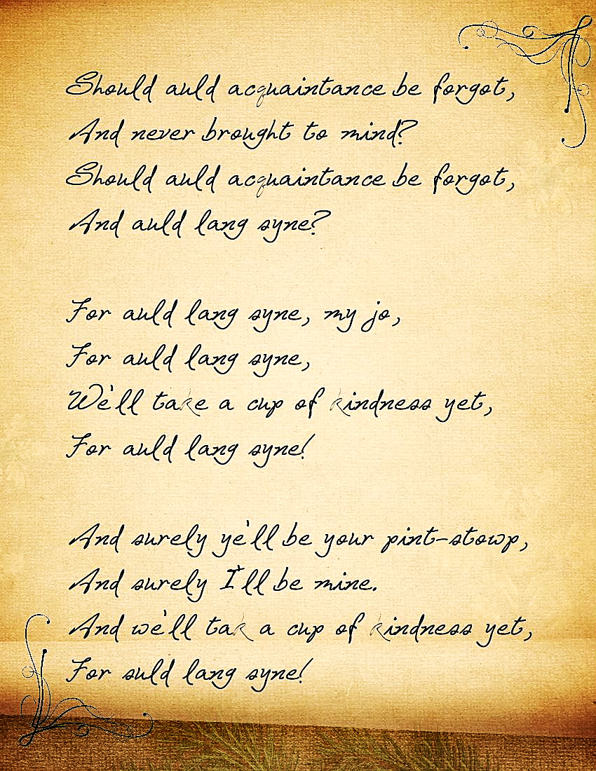
The original Scottish words are a little hard to understand.
Let’s take a moment to translate them.

Slide 19
Auld Lang Syne
Should auld (old) acquaintance be forgot,
and never brought to mind?
Should auld acquaintance be forgot,
and days of auld lang syne? (days long ago)
CHORUS:
For auld lang syne, my jo, (friend)
for auld lang syne,
we’ll tak' a cup o’ kindness yet,
(toast good-will) for auld lang syne.

Slide 20
Verse One & Two
We twa (two) hae run about the braes, (hills) and pou’d (picked) the gowans (daisies) fine;
But we’ve wander’d mony (many) a weary fit, (mile)
sin' (since) auld lang syne.
We twa (two) hae paidl’d (paddled) in the burn (stream)
Frae (from) morning sun till dine; (night).
But seas between us braid hae roar’d (broad have roared)
sin' (since) auld lang syne.

Slide 21
Verse Three & Four
And there’s a (here’s my) hand, my trusty fiere! (friend)
and gie's a hand o’ thine! (give me a hand of yours!)
And we’ll tak' a right gude-willie waught, (share a good-will drink)
for auld lang syne.
And surely ye’ll be your pint-stoup! (buy your pint cup)
and surely I’ll be mine! (buy)
And we’ll tak' a cup o’ kindness yet, (toast good-will)
for auld lang syne.

Slide 22
The Cross is our “Days of Auld Lang Syne” (our long ago)
The cross is the beginning of our relationship with God.
Our Savior has walked
beside us daily and
paddled with us
through life’s storms, yet
we neglect and forget Him.
Should Jesus be forgotten or
should we renew the love we
first felt way back at the cross of old?
Here is our Christianized Version:

Slide 23
Next Slide – Video Song:
For the Cross (To the tune of Auld Lang Syne) Download Here:
https://youtu.be/yv-PGI9yxXs

Slide 24
Is Jesus Speaking to You?
“They said to each other, ‘Did not our hearts burn within us while he talked to us on the road, while he opened to us the Scriptures?’”
John Wesley Said:
“…the preacher was describing the change which God works in the heart through faith in Christ and I felt my heart strangely warmed.”
Jesus makes His presence Known by a small voice!

Slide 26
What is the Sinner‘s Prayer?
This is a prayer we can pray when we are ready to admit we are sinners and need Christ’s forgiveness.
It must be prayed with faith in our hearts and a readiness to have a life-changing encounter with Jesus Christ.

Slide 27
A prayer of faith → Pray this prayer if :
If you never have before
You have in the past, but you think it would mean more today
You have been walking afar off and you want to come back
You want to set an example & show others how it is done
You just like to give your heart to Jesus again & again
Faith

Slide 28
We Declare Our Faith Publicly Because Jesus Declared His LOVE Publicly
“If you stand before others and are willing to say you believe in me, then I will tell my Father in heaven that you belong to me.” Mat 10:32

Slide 29
Important Questions
Do you want to know Jesus as your Savior right now?
Do you believe He died to save you from your sins & that He rose from the dead?
Do you believe that He is here, waiting to save you right now?

Slide 30
The Prayer of a Sinner Turning to Jesus
Dear Jesus, I know that I have sinned against You and that my sins separate me from You.
I am truly sorry.
Right now, I turn away from my sinful past .
Please forgive me, and help me to keep from sin.
I believe You died for my sins.
I Believe You rose from the dead, you are alive, and you hear this prayer from my heart.
I invite You Jesus to be both my Savior and the Lord of my life.
I want You to rule my life from now on.

Slide 31
“But some people did accept him. They believed in him, and he gave them the right to become children of God.”
John 1:12

Slide 33
“If you openly say, ‘Jesus is Lord’ and believe in your heart that God raised him from death, you will be saved.”
Rom. 10:9
What did you learn today?
What have you been thinking about God lately?
What do you want to tell others about Jesus?

Slide 34
“Draw near to God, and He will draw near to you…
Altar Time
…Cleanse your hands, you sinners, and make your hearts pure, you who are half-hearted towards God.” James 4:8 WNT

Slide 35
Close in Prayer

Slide 36
Note: Any videos in this presentation will only play online. After you download the slideshow, you will need to also download the videos from YouTube & add them back into your PowerPoint.
We present these messages at Bee Creek Park in College Station, TX. If you would like to watch the video of the service with this message, click here:
http://campaignkerusso.org/?p=12892
We would love to know more about the people who download our lessons & sermons. We invite you to email us & let us know where & how you use them.
info@ckbrazos.org

Slide 37
Welcome to Aggieland Faith Family Style Worship

Slide 38
Would You Like Prayer or Bible Study at Your House?
Personal Prayer: We can come to your home & pray with you, or you can email us when you need prayer.
Home Bible Study: We will come to your home & hold a bible study for you & your friends.
Bible Party: We will hold a Kid’s Bible Party: You provide the food & kids - we will do the bible fun & stories.

Slide 39
Would You Like Visitation?
We will visit a friend, loved one in the hospital or in prison to pray for them & share Christ with them.
Contact: info@aggielandfaith.org

Slide 40
www.aggielandfaith.org
Go here to see pictures & videos
Go here to subscribe to e-mails about changes & cancellations

Slide 41
Note: Any videos in this presentation will only play online. After you download the slideshow, you will need to also download the videos from YouTube & add them back into your PowerPoint.
We present these messages at Bee Creek Park in College Station, TX. If you would like to watch the video of the service with this message, click here:
http://campaignkerusso.org/?p=12892
We would love to know more about the people who download our lessons & sermons. We invite you to email us & let us know where & how you use them.
info@ckbrazos.org

