Slide 1
The Finger of Prophecy – Pointed to Jesus for thousands of years!

Slide 2
Welcome All

Slide 3
Let’s Begin with Prayer

Slide 4
The Finger of Prophecy – Pointed to Jesus for thousands of years!

Slide 5
Note: Any videos in this presentation will only play online. After you download the slideshow, you will need to also download the videos from YouTube & add them back into your PowerPoint.
We present these messages at Bee Creek Park in College Station, TX. If you would like to watch the video of the service with this message, click here:
http://campaignkerusso.org/?p=11104
We would love to know more about the people who download our lessons & sermons. We invite you to email us & let us know where & how you use them.
info@ckbrazos.org

Slide 6
Next Slide: Video – Can’t Be Chance! Download here: http://youtu.be/uWWoYZARqzA

Slide 7
Meet the Finger of Prophesy:
Thousands of years ago…
The finger of prophesy started pointing to a coming King.
Here are 20 of the
over 350
facts to which this
finger pointed:

Slide 8
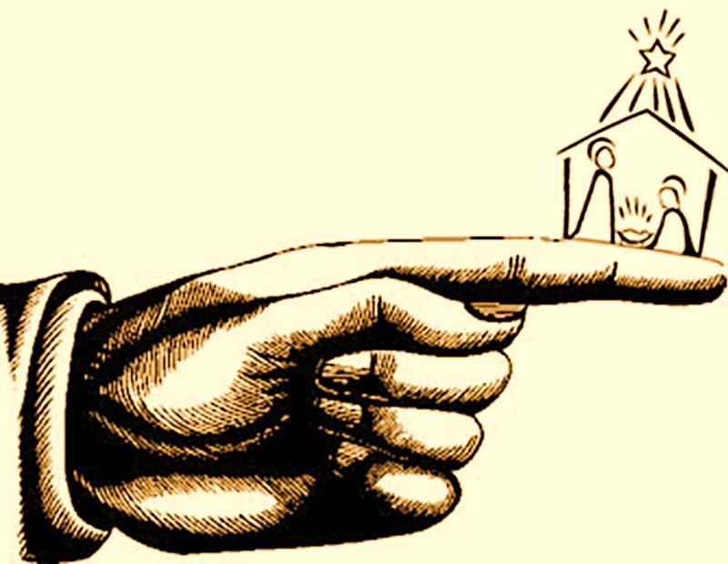
The finger of prophesy pointed to an infant King

Slide 9
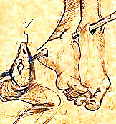
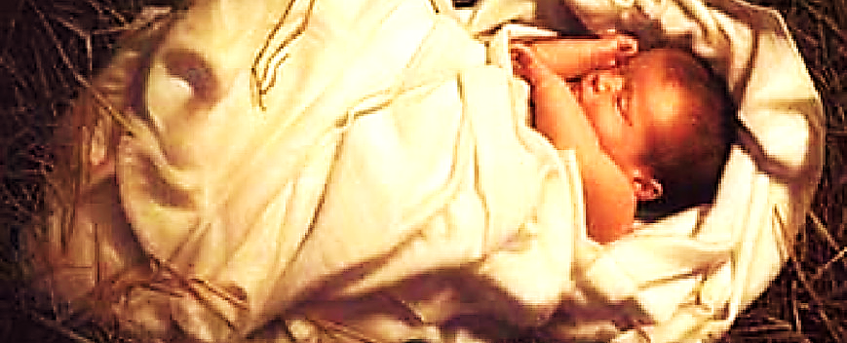
The Finger said…
The King will be born as a human boy who will someday destroy Satan.
“You and this woman will hate each other; your descendants and hers will always be enemies. One of hers will strike you on the head, and you will strike him on the heel.” Gen. 3:15

Slide 10
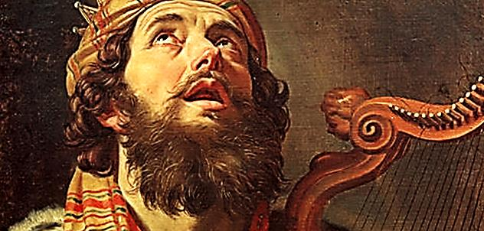
The Finger said…
The King will born to King David’s family.
“Someday I will appoint an honest king from the family of David, a king who will be wise and rule with justice.” Jer. 23:5

Slide 11
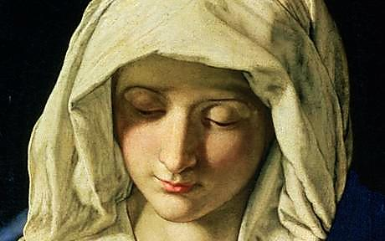
The Finger said…
The King will be born to a young girl who had never laid down with a man.
“A young woman, who has never had a man, will give birth to a son.” Isa. 7:14

Slide 12
The Finger said…
When the King comes, bad men will kill many babies.
“Rachel mourns for her children and refuses to be comforted, because they are dead."
Isa. 7:14

Slide 13
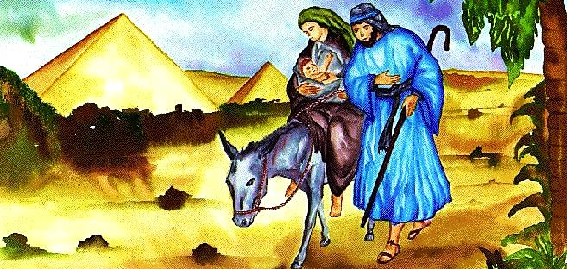
The Finger said…
The King will live in Egypt for a while.
“I called my son out of Egypt.” Hos. 11:1

Slide 14
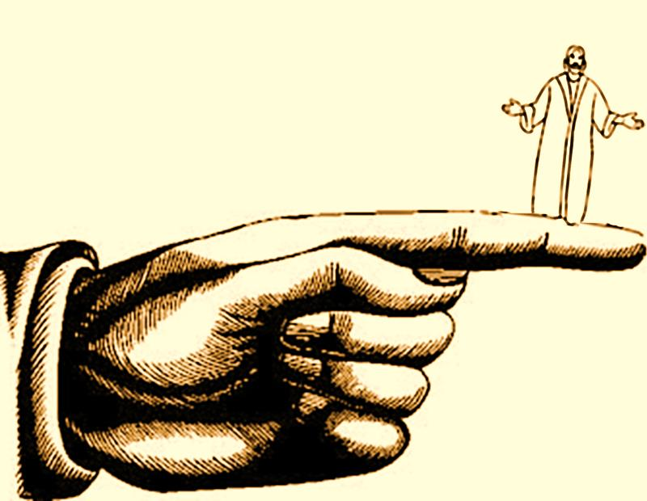
The finger of prophesy pointed to a teaching & healing King

Slide 15
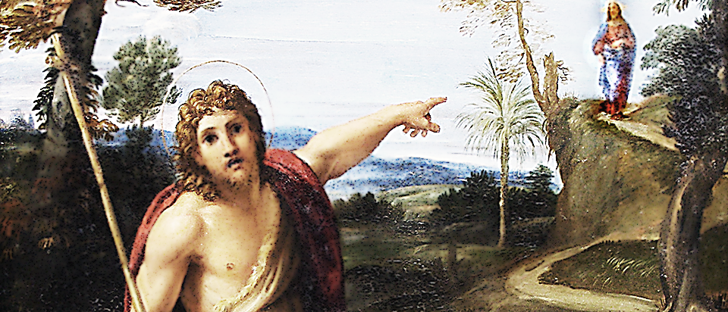
The Finger said…
A messenger will announce the King.
“I will send my messenger, who will prepare the way before me.” Mal. 3:1

Slide 16
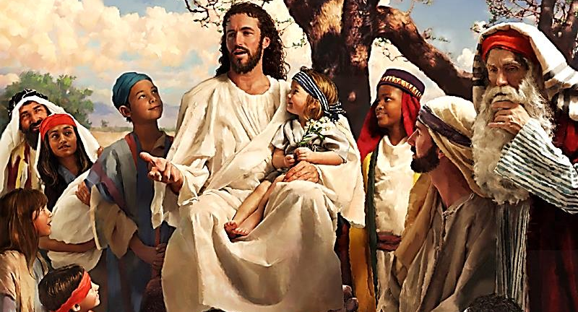
The Finger said…
The King will teach with stories.
“I will speak using stories.” Ps. 78:2

Slide 17
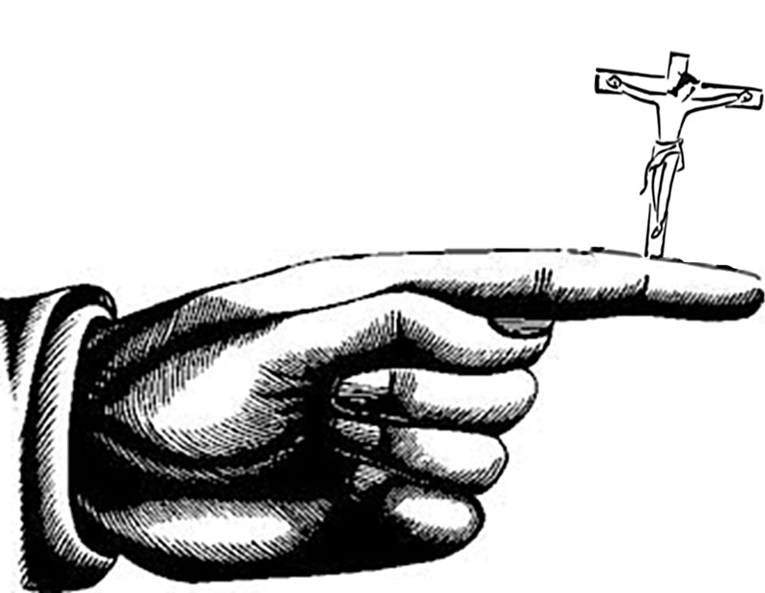
The finger of prophesy pointed to a suffering King

Slide 18
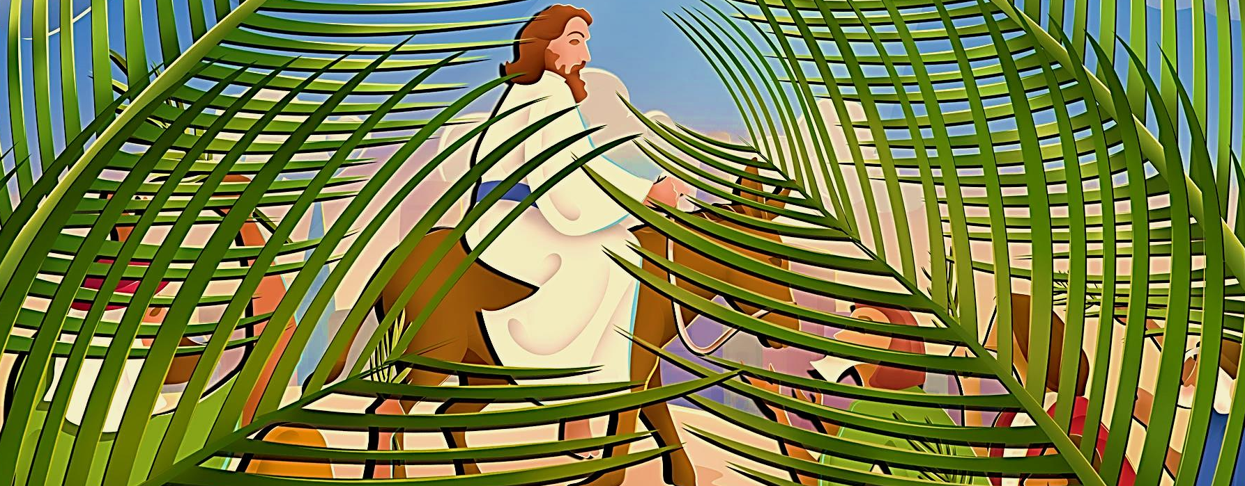
The Finger said…
The King will ride into Jerusalem on a donkey.
“For look—your King is coming! He is the Righteous One, the Victor! Yet he is lowly, riding on a donkey’s colt!” Zech. 9:9

Slide 19
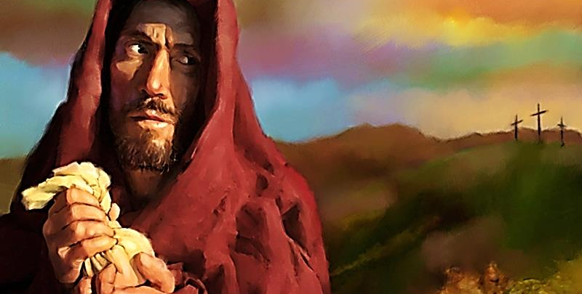
The Finger said…
The King will be betrayed by a close friend.
“Even a friend of mine whom I trusted, who ate my bread, has turned against me.” Ps. 41:9

Slide 20
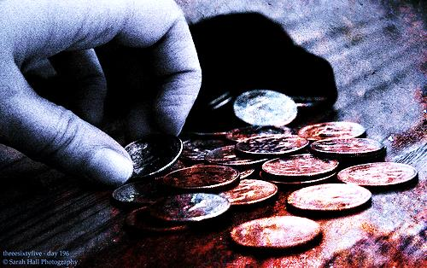
The Finger said…
The King will be sold for 30 pieces of silver.
“So they paid me thirty pieces of silver.”
Zech. 11”12

Slide 21
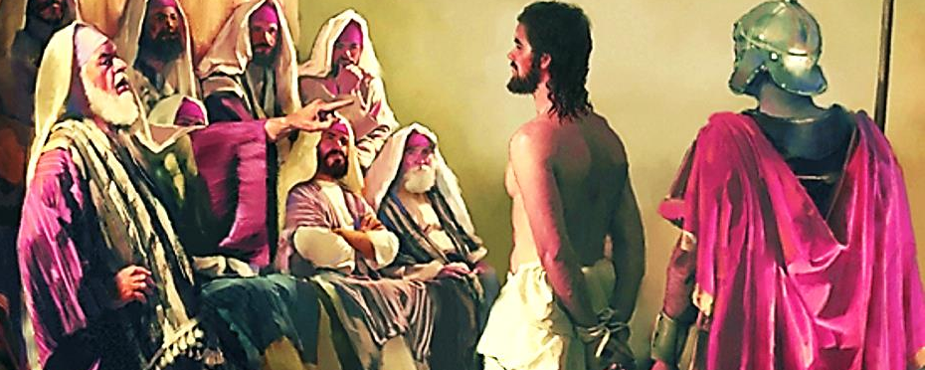
The Finger said…
The King be silent before His accusers.
“He was beaten, he was tortured, but he didn’t say a word. Like a lamb taken to be slaughtered and like a sheep being sheared, he took it all in silence.” Isa. 53:7

Slide 22
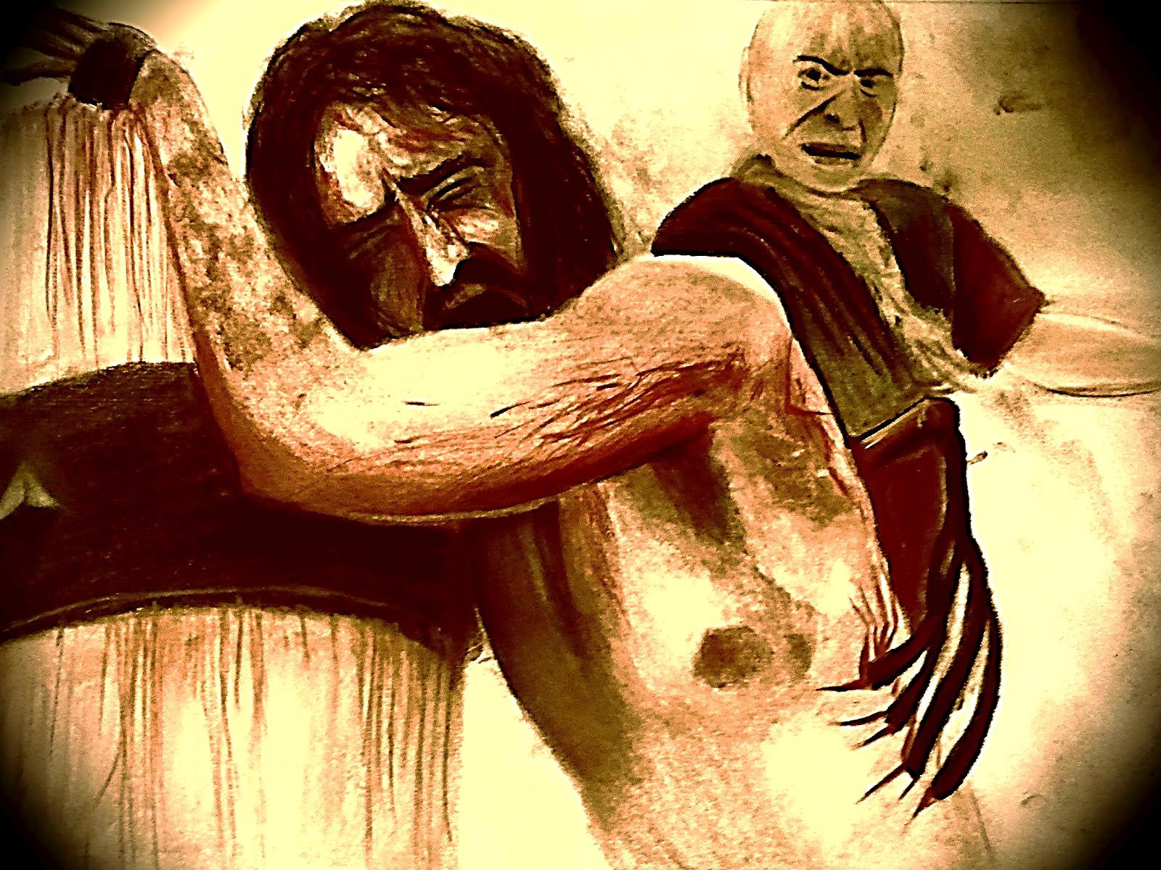
The Finger said…
The King will be whipped.
“But he was wounded and bruised for our sins. He was beaten that we might have peace; he was lashed—and we were healed!” Isa. 53:5

Slide 23
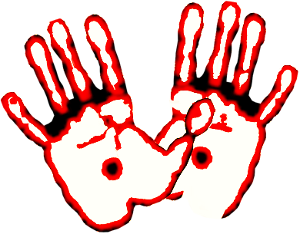
The Finger said…
The King’s hands & feet will be pierced.
“A group of sinful people has closed in on me. They are all around me like a pack of dogs. They have pierced my hands and my feet.” Ps. 22:16

Slide 24
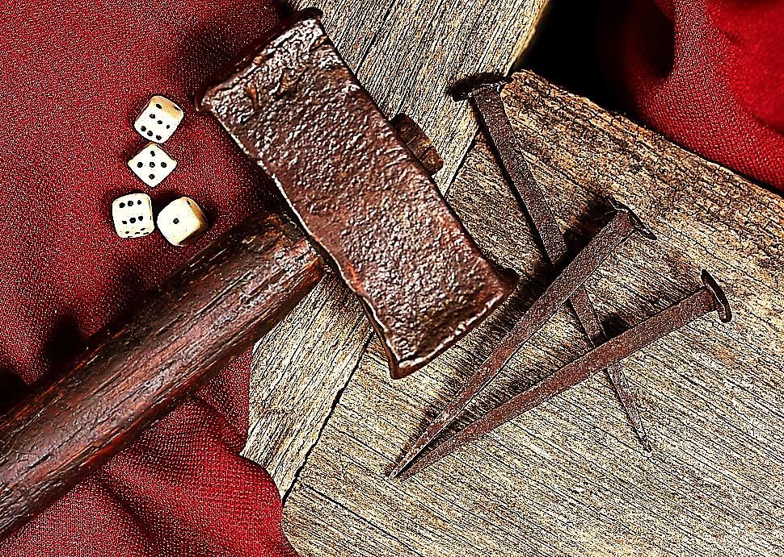
The Finger said…
The soldier’s would gamble for the King’s clothes.
“They took my clothes and gambled for them.” Ps. 22:18

Slide 25
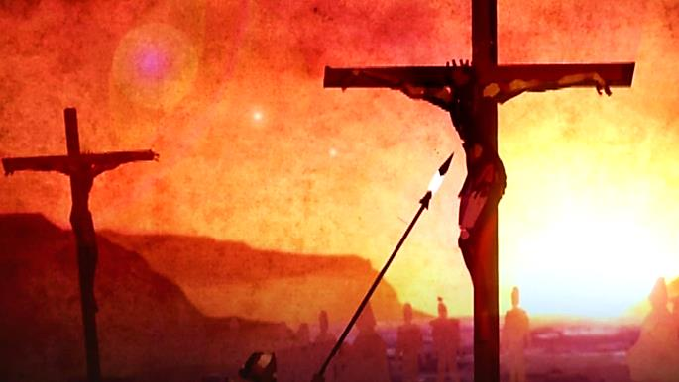
The Finger said…
The King’s body would be pierced.
“They will look on him they pierced, and mourn for him“ Zech. 12:10

Slide 26
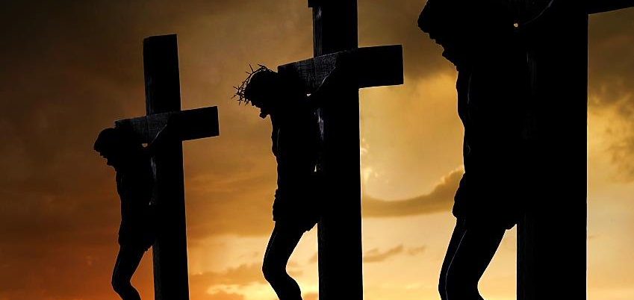
The Finger said…
The King’s death would be a dark day.
"And in that day, says the Lord God, I will cause the sun to go down at noon, and I will darken the earth in the broad daylight.” Am. 8:9

Slide 27
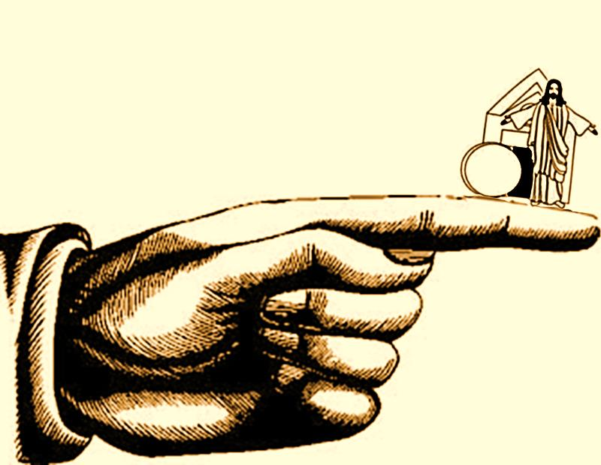
The finger of prophesy pointed to a risen King

Slide 28
The Finger said…
The King would rise from the dead.
“For you will not leave me among the dead; you will not allow your beloved one to rot in the grave.” Ps. 16:10

Slide 29
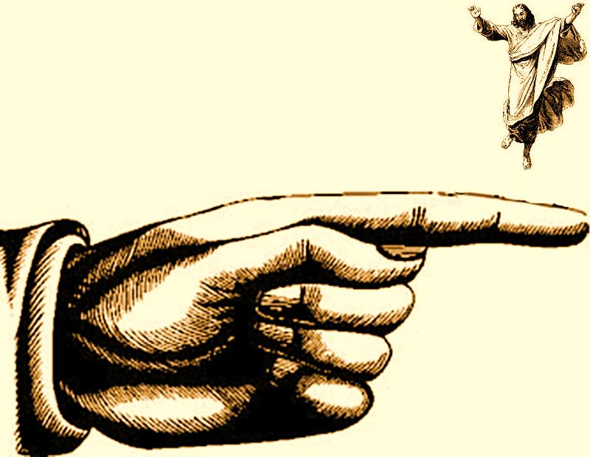
The finger of prophesy pointed to an ascended King

Slide 30
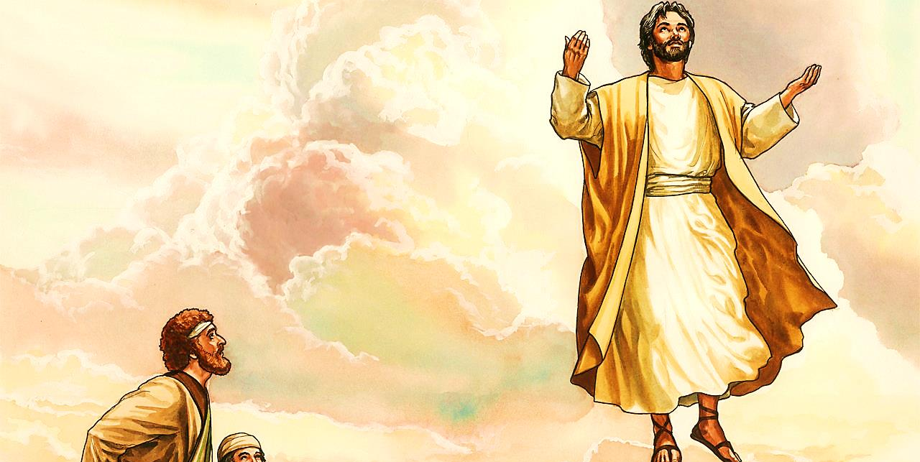
The Finger said…
The King will rise up into Heaven.
“You have gone up on high. You have taken those who were held with You.” Ps. 68:18

Slide 31
How did the Finger of Prophesy know so many facts about the coming King so many thousands of years ago?
Because the finger of prophesy is really the Word of God!!!
Every fact points to
Jesus Christ!
He is the King
of all, but Is He
King of your life?

Slide 32
Next Slide: Song – Lord I Believe in You Download Here: http://youtu.be/W5I_yYbpLKA

Slide 34
Is Jesus Speaking
to You?
“They began telling each other how their hearts had felt strangely warm as he talked with them…”
Lk.24:32 (TLB)
John Wesley Said:
“…the preacher was describing the change which God works in the heart… and I felt my heart strangely warmed.”
Jesus makes His presence Known by a small voice!

Slide 35
What is the Sinner‘s Prayer?
This is a prayer we can pray when we are ready to admit we are sinners and need Christ’s forgiveness.
It must be prayed with faith in our hearts and a readiness to have a life-changing encounter with Jesus Christ.

Slide 36
A prayer of faith → Pray this prayer if :
If you never have before
You have in the past, but you think it would mean more today
You have been walking afar off and you want to come back
You want to set an example & show others how it is done
You just like to give your heart to Jesus again & again
Faith

Slide 37
Important Questions
Do you want to know Jesus as your Savior right now?
Do you believe He died to save you from your sins & that He rose from the dead?
Do you believe that He is here, waiting to save you right now?

Slide 38
We Declare Our Faith Publicly Because Jesus Declared His LOVE Publicly
“If you stand before others and are willing to say you believe in me, then I will tell my Father in heaven that you belong to me.” Mat 10:32

Slide 39
The Prayer of a Sinner Turning to Jesus
Dear Jesus, I know that I have sinned against You and that my sins separate me from You.
I am truly sorry.
Right now, I turn away from my sinful past .
Please forgive me, and help me to keep from sin.
I believe You died for my sins.
I Believe You rose from the dead, you are alive, and you hear this prayer from my heart.
I invite You Jesus to be both my Savior and the Lord of my life.
I want You to rule my life from now on.

Slide 40
“But some people did accept him. They believed in him, and he gave them the right to become children of God.”
John 1:12

Slide 42
“If you openly say, ‘Jesus is Lord’ and believe in your heart that God raised him from death, you will be saved.”
Rom. 10:9
What did you learn today?
What does the finger of prophesy prove about Jesus.
What have you been thinking about God lately?
What do you want to tell the world about Jesus?

Slide 43
Let’s Close in Prayer

Slide 44
Next Slide: Video – 351 Prophecies Fulfilled (Suggested use: Play in the background during altar-service or after-service.) Download Here: http://youtu.be/tDnm7fkAQTE

