Slide 2
Note: After you download the slideshow, you may also need to download some videos from YouTube & add them into this PowerPoint. This tool can help you: Free YouTube Download
We present these messages in outdoor venues using the SonShineTent. Watch the video of our service that goes with this message, click here: https://youtu.be/c6UJ3quHTTE
We would love to know more about the people who download our lessons & sermons. We invite you to email us & let us know where & how you use them.
info@campaignkerusso.org

Slide 3
Welcome All

Slide 4
Let’s Begin with Prayer

Slide 6
God’s Love is Unconditional
He cannot turn it off and on.
“But God proves His own love for us in that while we were still sinners Christ died for us!” John 15:13 CSB

Slide 7
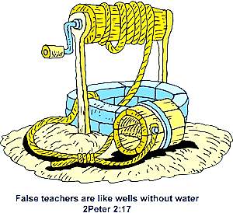
God doesn’t merely have a measure of love for us.
He has an unlimited supply.
“But the eyes of the LORD are on those who fear him, on those whose hope is in his unfailing love”
Ps. 33:18

Slide 9
The Bible Says, “God IS Love”
Love is His very essence, not just some of His thoughts & behaviors.

Slide 10
What does this mean for us?
Is God’s love like a pink cotton cloud?
Nothing so passive.
God’s love is the strongest force in the universe!

Slide 11
We are going to look at three things God’s love is like:
Flood Waters
Sweet Perfume
A Slave Master

Slide 12
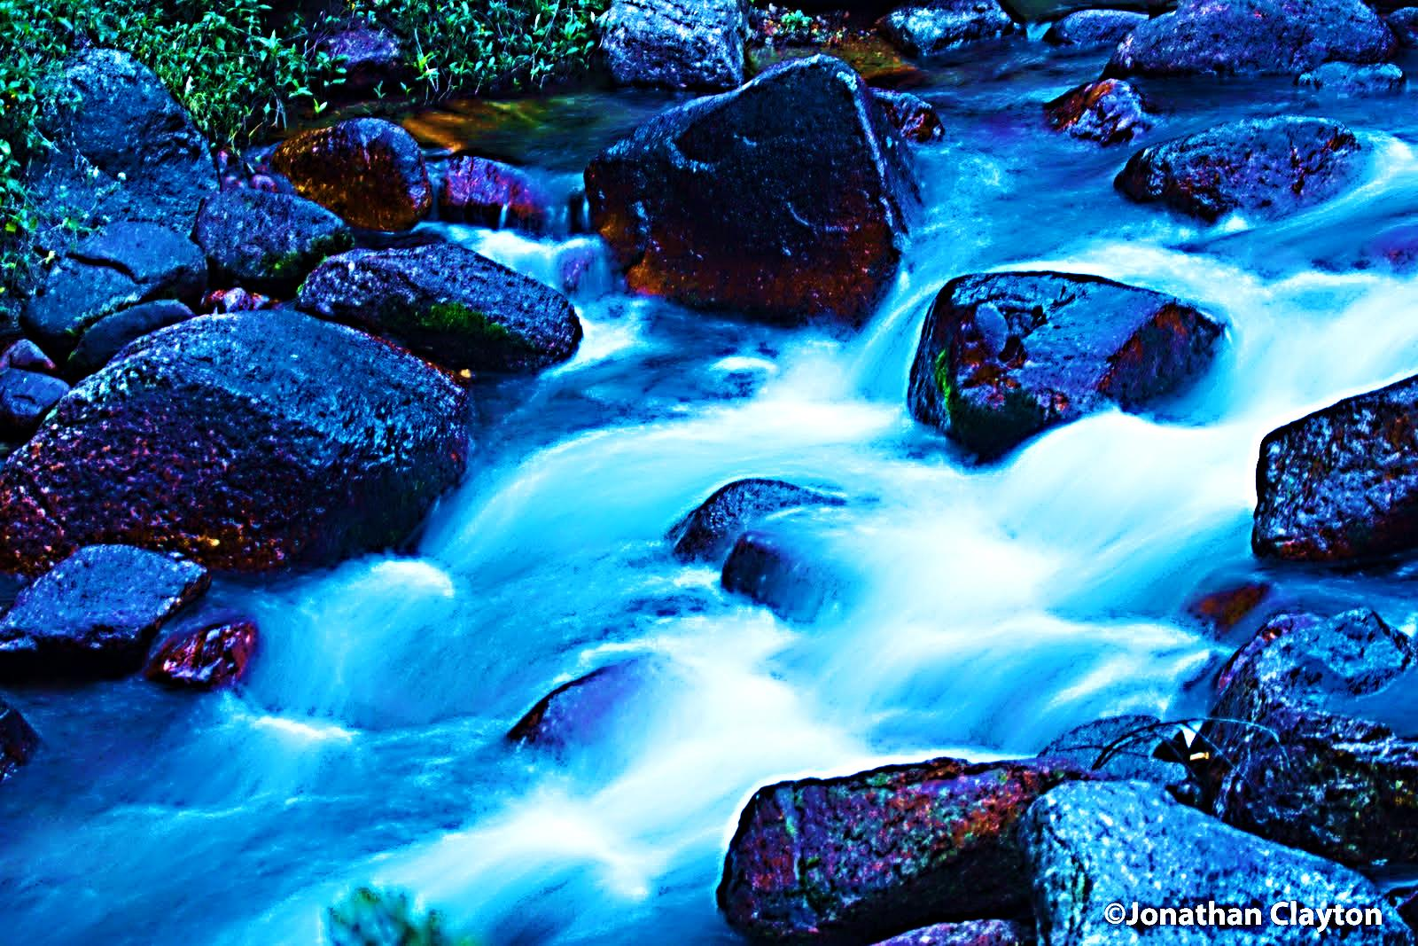
1st God’s Love is Like Raging Flood Waters: He Cannot Withhold His Love for Anything.
“Can anything separate us from Christ's love? No! Can trouble separate us from Christ's love? No! Can problems or persecution separate us from Christ's love? No! If we have no food or clothes, will that separate us from Christ's love? No! Will danger or even death separate us from Christ's love? No!” Rom. 8:35 ERV

Slide 13
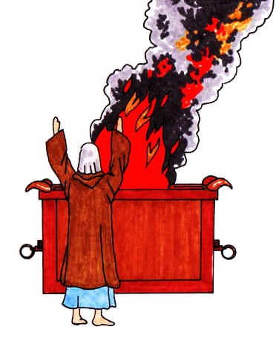
2nd Christ’s Love is Like Sweet Perfume in God’s Nostrils.
“Burn the whole sheep on the altar; it is a burnt offering made by fire to the LORD. Its smell is pleasing to the LORD.”
Ex. 29:18 NCV
This innocent lamb was a foreshadow of Christ as an innocent sacrifice.

Slide 14
It was a sweet perfume in the nostrils of God, because it reminded Him that His Son would one day become the ultimate sacrificial lamb on a Cross. To God, the lamb smelled like sacrificial love.
God smelled the coming Cross in the lamb’s smoke.

Slide 15
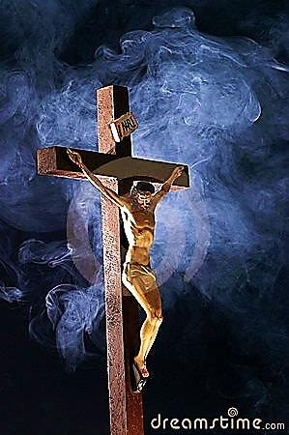
“… He gave Himself for us, a gift on the altar to God which was as a sweet smell to God.”
Eph. 5:2 NLV
There was no smoke this time, only the burning love of Christ sacrificing His life for mankind’s sin.

Slide 16
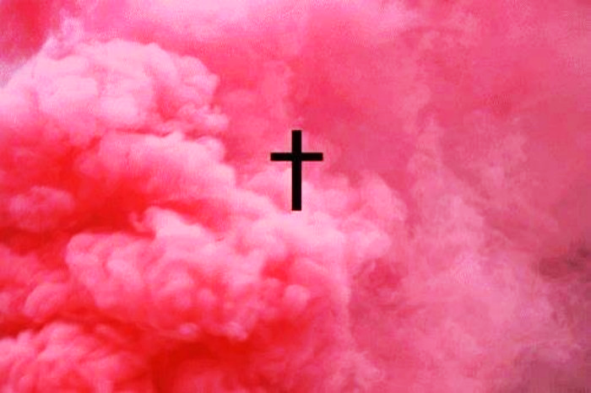
To God, the cross emanated the sweet scent of His Son’s sacrifice..
Believers who reflect Christ’s sacrificial love for the lost also exude this God-pleasing perfume.
“We are a sweet smell of Christ that reaches up to God. It reaches out to those who are being saved from the punishment of sin and to those who are still lost in sin.” 2 Cor. 2:15 NLV

Slide 17
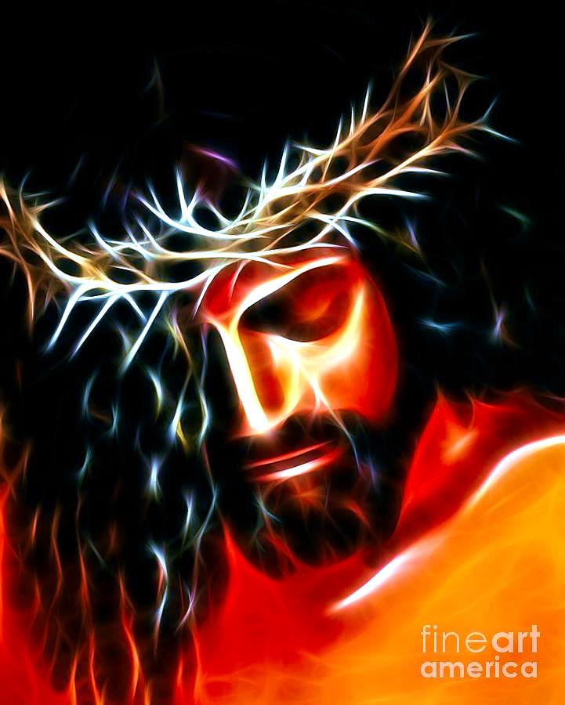
3rd Love is Like a Slave Master : Christ’s LOVE compelled Him to buy our salvation with His own blood!
“No one can have greater love than to GIVE his life for his friends.” John 15:13 NLV

Slide 18
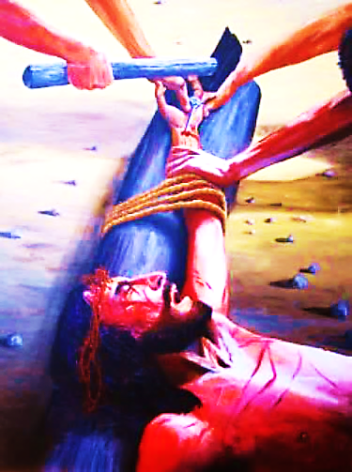
It wasn’t nails, but love that held Him tightly to the cross.
"He saved others; Himself He cannot save." Mat. 27:42 KJV
They meant it as a joke, but it was actually the truth. Love wouldn’t allow Him to save Himself.

Slide 19
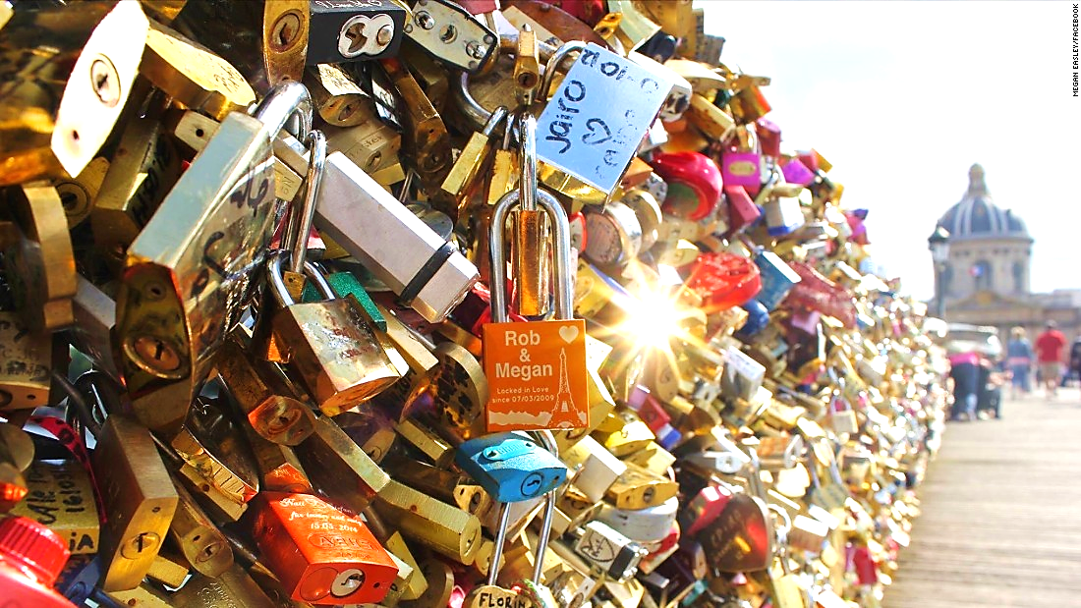
The famous “Love Locks” on the Ponts des Arts Bridge in Paris became a global romantic trend.
The locks are placed by couples to signify their enduring love. The key is then tossed into the River Seine.

Slide 20
Downtown Lufkin, TX has a similar tradition, the “Locked With Love Tree”

Slide 21
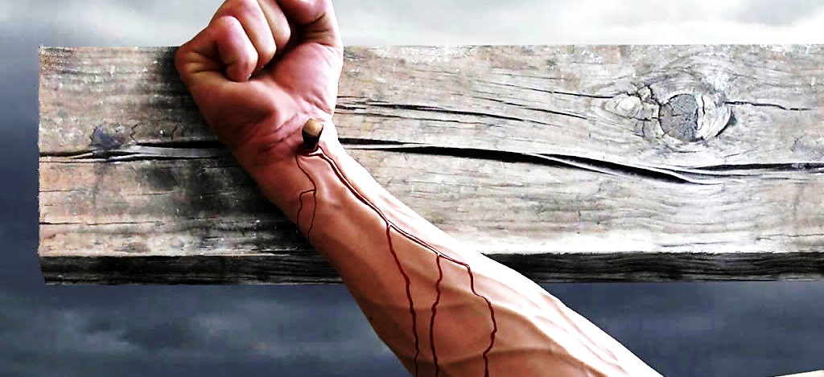
The Cross is God’s “Locked with Love Tree” where He told the world who He loves forever. He loves you and me! Love held Him to the Tree—throw away the key!

Slide 22
This Slide – Song Title: It Was Love Download Here:
https://youtu.be/wfyutFUdUEw

Slide 23
In Review: Three Things God’s Love is Like
Flood Waters
Sweet Perfume
A Slave Master

Slide 24
This Slide – Song Title: My Lord, What Love is This? Download Here:
https://youtu.be/RVgmdzQCl6U

Slide 26
Is Jesus
Speaking to You?
“They said to each other, ‘Did not our hearts burn within us while he talked to us on the road, while he opened to us the Scriptures?’”
John Wesley Said:
“…the preacher was describing the change which God works in the heart through faith in Christ and I felt my heart strangely warmed.”
Jesus makes His presence Known by a small voice!

Slide 27
What is the Sinner‘s Prayer?
This is a prayer we can pray when we are ready to admit we are sinners and need Christ’s forgiveness.
It must be prayed with faith in our hearts and a readiness to have a life-changing encounter with Jesus Christ.

Slide 28
A prayer of faith → Pray this prayer if :
If you never have before
You have in the past, but you think it would mean more today
You have been walking afar off and you want to come back
You want to set an example & show others how it is done
You just like to give your heart to Jesus again & again
Faith

Slide 29
We Declare Our Faith Publicly Because Jesus Declared His LOVE Publicly
“If you stand before others and are willing to say you believe in me, then I will tell my Father in heaven that you belong to me.” Mat 10:32

Slide 30
Three Important Questions
Do you want to know Jesus as your Savior right now?
Do you believe He died to save you from your sins & that He rose from the dead?
Do you believe that He is here, waiting to save you right now?

Slide 31
The Prayer of a Sinner Turning to Jesus
Dear Jesus, I know that I have sinned against You and that my sins separate me from You.
I am truly sorry.
Right now, I turn away from my sinful past .
Please forgive me, and help me to keep from sin.
I believe You died for my sins.
I Believe You rose from the dead, you are alive, and you hear this prayer from my heart.
I invite You Jesus to be both my Savior and the Lord of my life.
I want You to rule my life from now on.

Slide 32
“But some people did accept him. They believed in him, and he gave them the right to become children of God.”
John 1:12

Slide 34
“If you openly say, ‘Jesus is Lord’ and believe in your heart that God raised him from death, you will be saved.”
Rom. 10:9
What did you learn today?
What about God’s love for the lost?
What have you been thinking about God lately?
What do you want to tell others about Jesus?

Slide 35
Let’s Close in Prayer

Slide 36
Note: After you download the slideshow, you may also need to download some videos from YouTube & add them into this PowerPoint. This tool can help you: Free YouTube Download
We present these messages in outdoor venues using the SonShineTent. Watch the video of our service that goes with this message, click here: https://youtu.be/c6UJ3quHTTE
We would love to know more about the people who download our lessons & sermons. We invite you to email us & let us know where & how you use them.
info@campaignkerusso.org

